Slide 2
Merovingio: mislead the malware
Juan Carlos Montes – INTECO-CERT

Slide 3
Index
Malware Analysis
what else?
state of art
why?
Merovingio
Sandboxie
Merovingio Agent
PebHooking
DorianIA
Merovingio Website

Slide 4
Index
Malware Analysis
what else?
state of art
why?
Merovingio
Sandboxie
Merovingio Agent
PebHooking
DorianIA
Merovingio Website

Slide 5
Malware Analysis
What else?
New techniques
Avoid signatures
The market is dozed
A lot of new samples daily
It’s expensive complicated have people focused on malware analysis in a CSIRT

Slide 6
Malware Analysis
State of art
Commercial products are similar
Same VM.
Same drivers.
Same look&feel.
SAME RESULTS.
The commercial products are the same limits
One sample on each VM.
Wait to reboot/reset the VM to start another analysis.
The analysis spend 2-3 minutes all times. This time is not based on the behavior of the sample.
Attached to the company for any grown.
And… the source code is not our.

Slide 7
Malware Analysis
Why?
Need “anything” to detect new samples and behaviors
Avoid the dependencies of the antivirus
Avoid the problems with VM.
One sample on each VM
Samples are out of control on execution
Hasten the analysis
Include some control on the execution
Create a system to simulate behaviors

Slide 8
Index
Malware Analysis
what else?
state of art
why?
Merovingio
Sandboxie
Merovingio Agent
PebHooking
DorianIA
Merovingio Website

Slide 9
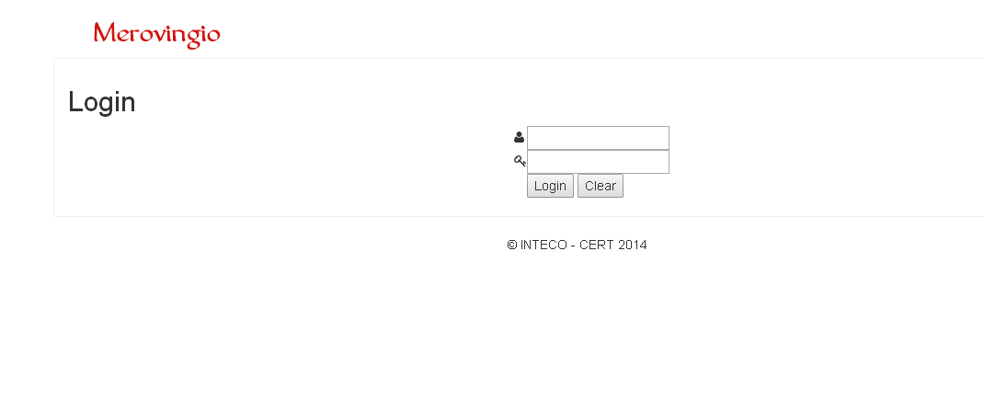
Merovingio
“Virtual Machine”
Sandboxie
Pebhooking
DorianIA
And… his web site ☺

Slide 10
Merovingio
VirtualBox
web site
sample
Dorian IA
SandBoxie
Pebhooking

Slide 11
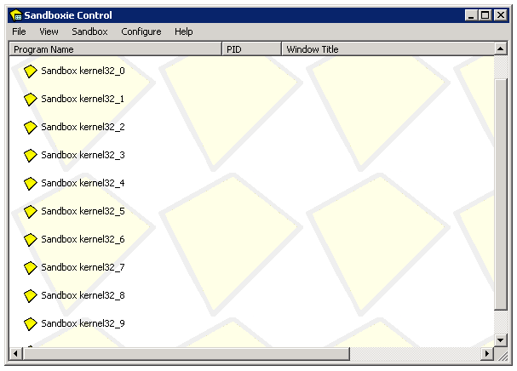
Run programs in a sandbox
Prevent permament changes on system
Help us to load our libraries on each process
Isolate each program execution

Slide 12
Merovingio Agent
Tested in Windows XP and Windows 7
Developed in Python v2.7
Can manage all sandboxie instances as we want
Recover the logs and send us to next step
Multithread
Can receive more that one sample at same time
Decide on which instance must be executed the sample
Free slot
Specific analysis
Monitorized the analysis to detected when the analysis end

Slide 13
Index
Malware Analysis
what else?
state of art
why?
Merovingio
Sandboxie
Merovingio Agent
PebHooking
DorianIA
Merovingio Website

Slide 14
Pebhooking
Published in Phrack #65
Dreg and [Shearer] (me)
Modify the PEB in the process to exchange real libraries for our libraries
All dynamic loaded libraries will be hooked
Only is necessary repair the main IAT

Slide 15
Pebhooking
PEB
LoaderData
InheritedAddressSpace
ReadImageFileExecOptions
BeingDebugged
Spare
Mutant
ImageBaseAddress
LoaderData
Length
Initialized
SsHandle
InLoadOrderModList
InMemoryOrderModList
InInitOrderModList → Flink
…
process
LDR_MODULE
InLoadOrderModList
InMemoryOrderModList
InInitOrderModList
…
BaseDllName “ntdll.dll”
LDR_MODULE
LDR_MODULE
InLoadOrderModList
InMemoryOrderModList
InInitOrderModList
BaseAddress 7C801000
…
BaseDllName “kernel32.dll”
InLoadOrderModList
InMemoryOrderModList
InInitOrderModList
…
BaseDllName “xxxxxx.dll”

Slide 16
Pebhooking
PEB
LoaderData
InheritedAddressSpace
ReadImageFileExecOptions
BeingDebugged
Spare
Mutant
ImageBaseAddress
LoaderData
Length
Initialized
SsHandle
InLoadOrderModList
InMemoryOrderModList
InInitOrderModList → Flink
…
process
LDR_MODULE
InLoadOrderModList
InMemoryOrderModList
InInitOrderModList
…
BaseDllName “ntdll.dll”
LDR_MODULE
LDR_MODULE
InLoadOrderModList
InMemoryOrderModList
InInitOrderModList
BaseAddress XXXXXXXXXX
…
BaseDllName “kernel32.dll”
InLoadOrderModList
InMemoryOrderModList
InInitOrderModList
BaseAddress 7C801000
…
BaseDllName “ph_k32.dll”

Slide 17
Pebhooking
ph_ker32.dll
Export the same functions that kernel32.dll
We must do a specific dll for each service pack
The functions exported have the same ordinal as the original function
We can manage any function we want
Store the return value
Modify params in runtime
Block the execution on any API

Slide 18
Index
Malware Analysis
what else?
state of art
why?
Merovingio
Sandboxie
Merovingio Agent
PebHooking
DorianIA
Merovingio Website

Slide 19
Dorian IA
It is based on the workflows of neural networks
Set the time on each log received
Analyze the log looking for patterns
Create execution blocks
Try to link the different blocks to create behaviors
Show the results in a new log that is send to the website
At this moment can learn new behaviors, our aim is create a real AI

Slide 20
DorianIA
Log from PebHooking
LoadLibraryW|IMM32.DLL
CreateFileW | C:\ikkka.exe|0x178
CreateFileW|COMCTL32.DLL|0x4C
LoadLibraryW|user32.dll
WriteFile | 0x178 | 0x22800 | XXXXXXXXX
CloseHandle | 0x4C
CloseHandle | 0x178
Block
CreateFileW | C:\ikkka.exe | 0x178
WriteFile | 0x178 | 0x22800 | XXXXXXXXXX
CloseHandle | 0x178

Slide 21
DorianIA
Block
Log from PebHooking
CreateFileW | C:\itself.exe|0x77
ReadFile | 0x22800 | XXXXXXXXX
CloseHandle | 0x77
LoadLibraryW|IMM32.DLL
CreateFileW | C:\itself.exe|0x77
ReadFile | 0x22800 | XXXXXXXXX
CloseHandle | 0x77
DeleteFile | C:\autoexec.bat
CreateFileW | C:\ikkka.exe|0x178
CreateFileW|COMCTL32.DLL|0x4C
LoadLibraryW|user32.dll
WriteFile | 0x178 | 0x22800 | XXXXXXXXX
CloseHandle | 0x4C
CloseHandle | 0x178
Block
CreateFileW | C:\ikkka.exe | 0x178
WriteFile | 0x178 | 0x22800 | XXXXXXXXXX
CloseHandle | 0x178
Block
DeleteFile | C:\autoexec.bat
Read itself
Write itself in other file
Similar content: we use ssdeep to compare the information with threshold 95%
The sample was copied itself to another path.

Slide 22
Index
Malware Analysis
what else?
state of art
why?
Merovingio
Sandboxie
Merovingio Agent
PebHooking
DorianIA
Merovingio Website

Slide 23
Website features
User management
Able to upload different samples at same time
Hold the history to recover old reports
Able to looking samples for filename or hash (SHA1)
All the communication with the agent is transparent to user
Easy to get if any sample if malicious or not, directly from the history

Slide 24
Merovingio screenshots
Home page / Send samples

Slide 25
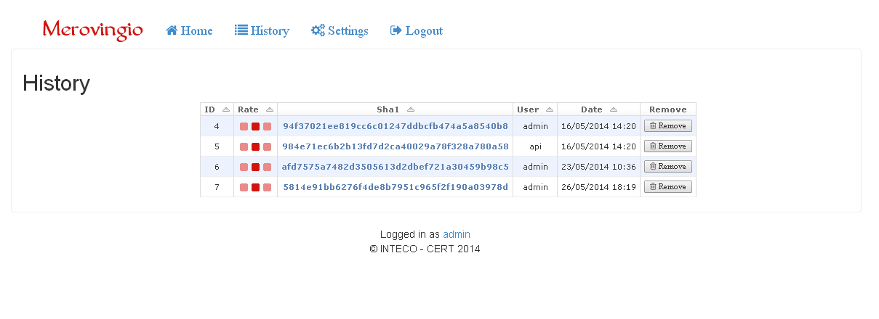
Merovingio screenshots
History

Slide 26
Merovingio screenshots
Raw log

Slide 27
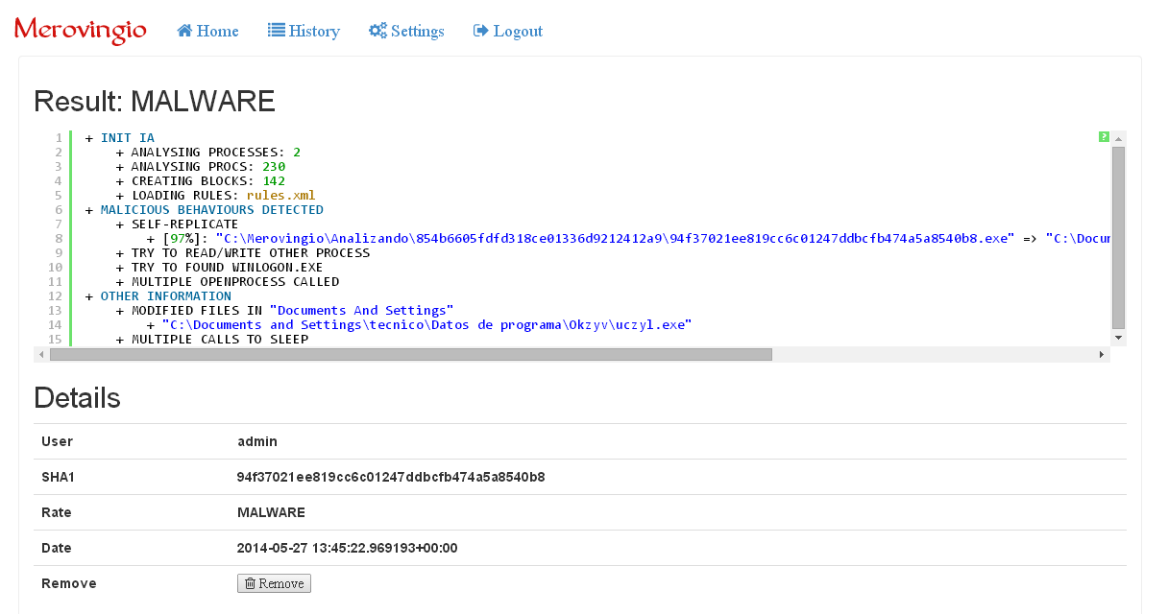
Merovingio screenshots
Analysis

Slide 28
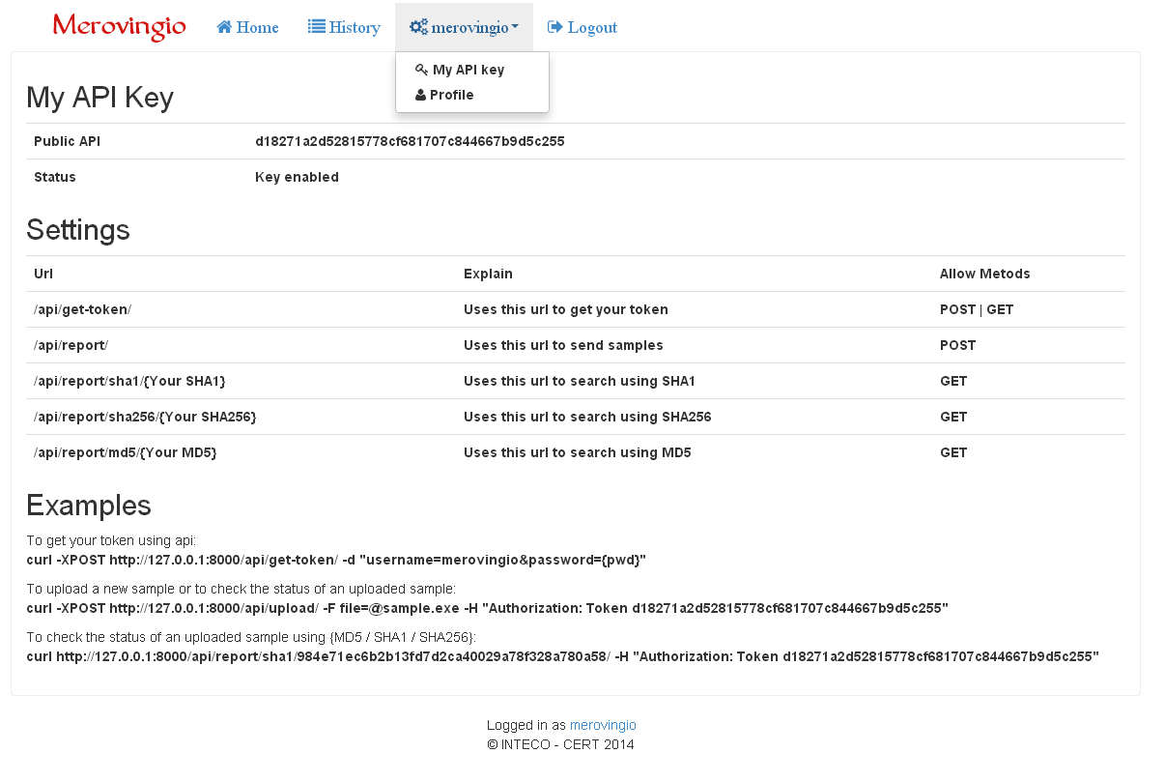
Merovingio screenshots
API

Slide 29
Merovingio Achievements
Max. runtime 2 minutes, but the analysis stop when we don’t detect any new behavior
We can analyze over 20 samples on the same machine (VM or real)
To grown we need add more RAM memory to allocate more process or add a new machine to get 20 slots more.
Very cheap (information for 20 analysis):
Only one machine
4Ghz CPU (4 cores) and 4Gb RAM
We can stop the analysis when the sample finish the execution.

Slide 30
Merovingio numbers
720 samples can be analyzed on each sandbox instance daily
14.400 samples using 20 instances on the sandboxie
Only 1 cheap machine to get this numbers

