Slide 2
Understanding Cyber Security Incident Response Teams (CSIRTs) as Multiteam Systems (MTSs)
Stephen J. Zaccaro, Tiffani R. Chen,
Carolyn J. Winslow, and Amber K. Hargrove

Slide 3




Acknowledgements
Project funded by the U.S. Department of Homeland Security (BAA 11-02)
Additional contributors:
  Lois Tetrick, GMU
  Reeshad Dalal, GMU
  Jennifer Green, GMU
  Aiva Gorab, GMU
  Qikun Niu, GMU
  Daniel Shore, GMU
  Alan Tomassetti, GMU
  Mark D. Troutman, GMU
  John Gudgel, GMU
  William A. Grasmeder, GMU
  Shari L. Pfleeger, Dartmouth College
  William G. Horne, HP
  Sandeep N. Bhatt, HP
  Loai Zomlot, HP

Slide 4
Overall Research Objectives
Conceptualize CSIRTs as MTSs
Increase understanding of factors that foster MTS and CSIRT effectiveness
Provide CSIRT managers and team members with guidance on facilitating effectiveness

Slide 5
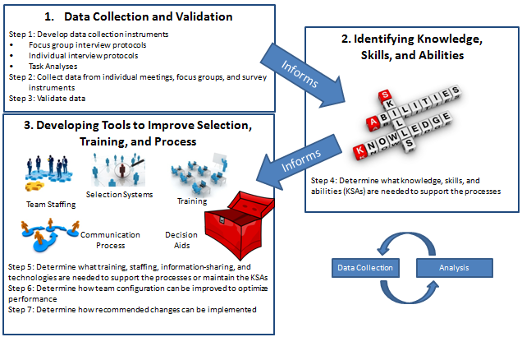
Research Program - Big Picture

Slide 6
Presentation Outline
Nature of teamwork in CSIRTs
Drivers of effective CSIRT performance
CSIR MTSs
  What are MTSs?
  Key elements of MTSs
  Examples of cyber security MTSs
Drivers of effective CSIR MTS performance
Process of collaboration escalation
Prescriptions and future directions

Slide 7
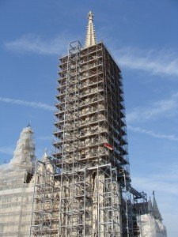

Nature of CSIRT Teamwork
Externalized Cognition
Information Sharing
Knowledge Management
Notes:
Scaffolding image: http://chelshakirby.edublogs.org/2011/12/12/scaffolding-in-the-art-classroom/
Gold people image: http://www.seccdc.org/callforteams.html

Slide 8


Nature of CSIRT Teamwork (Cont’d.)
Collective Problem-Solving
Adaptation and Innovation
Group Learning
Notes:
human image: blink.ucsd.edu
Cartoon image: www.mindwerx.com

Slide 9
Effective CSIRT Performance
CSIRT performance requires Taskwork and Teamwork
  Taskwork:
  triaging incoming incidents
  analyzing incidents
  developing and executing comprehensive solutions
  skills in detecting and responding to incidents
  Teamwork:
  giving, seeking, and receiving task-clarifying feedback
  Collective problem solving
  Monitoring and assessing team performance
  Active listening skills
  Communication skills
  Collaboration skills

Slide 10
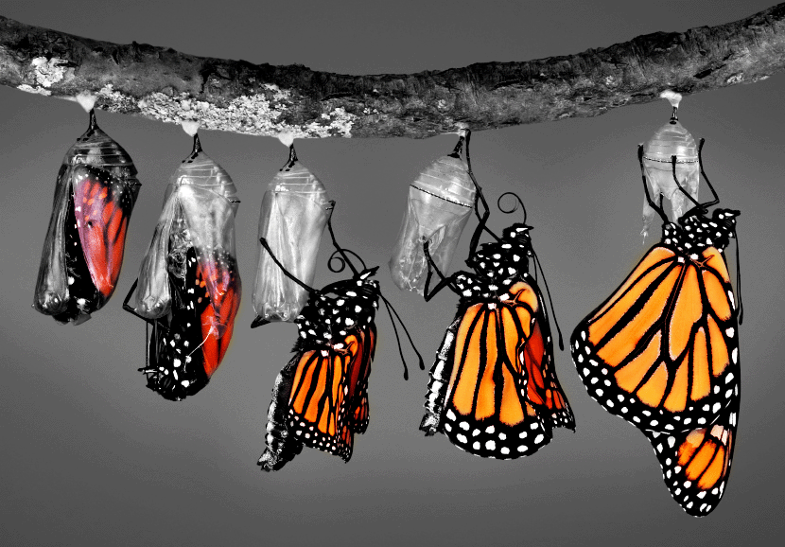
Emergent States
CSIRT performance also requires “facilitating emergent states”: Aspects of team climate that develop over time through group interactions (Marks et al., 2001)
2 Types
  Cognitive
  Emotional

Slide 11
Cognitive Emergent States
Shared mental models
  “…It's more than just staring at a screen all day. It's having a mutual understanding of why what’s going on is important.”
Transactive Memory
  “We know each other, so we know what our strengths and weaknesses are. We know who to go to who and for what.”

Slide 12
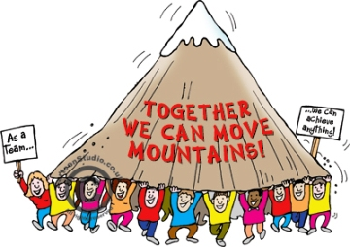
Motivational Emergent States
Cohesion
Trust
Collective Confidence
Notes:
Image: walkyourasoff.com

Slide 13

CSIRTS as Multiteam Systems
...Creating the best CSIRT is not enough: CSIRTS typically operate as part of multiteam systems

Slide 14


Three-level CSIRT Framework
Individual
  Processes, behaviors, and outcomes of a single individual
Within Team (or “component team” level)
  Internal processes, behaviors, and outcomes of a team which require interpersonal dynamics with at least one other person in the team

Slide 15

Three-level CSIRT Framework
Between team (or “multiteam system”) level
  “Two or more teams that interface directly and interdependently in response to environmental contingencies toward the accomplishment of collective goals” (Mathieu, Marks, & Zaccaro, 2001, p. 290)

Slide 16
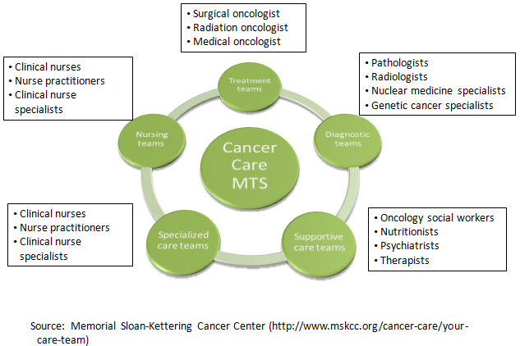
Non-CSIRT MTSs – Example 1

Slide 17
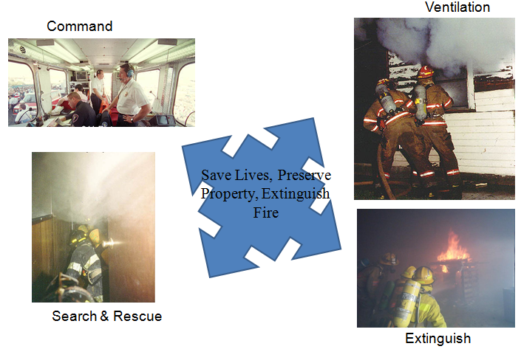
Non-CSIRT MTSs – Example 2
(Fire-Fighting MTS)
(slide images from Leslie DeChurch – used with permission)

Slide 18
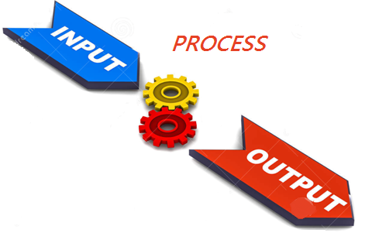
Key Elements of MTSs
  Two or more teams
  Interdependence
      Input
      Output
      Process
Notes:
Input/output image: dreamstime.com

Slide 19

Interdependence
Not a team/task activity
Reciprocal
Pooled/additive
Intensive
Sequential
Source: Arthur, Edwards, Bell, Villado, & Bennett, 2005

Slide 20
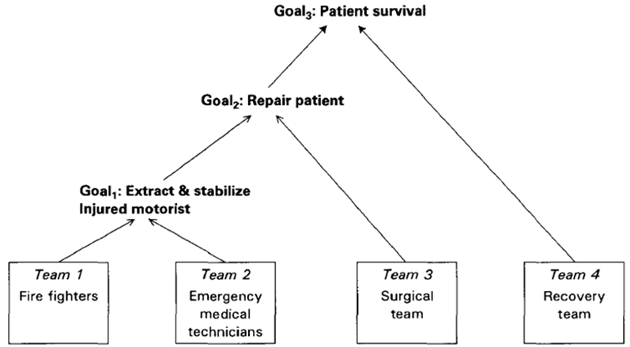
Non-CSIRT MTS Goal Hierarchy

Slide 21
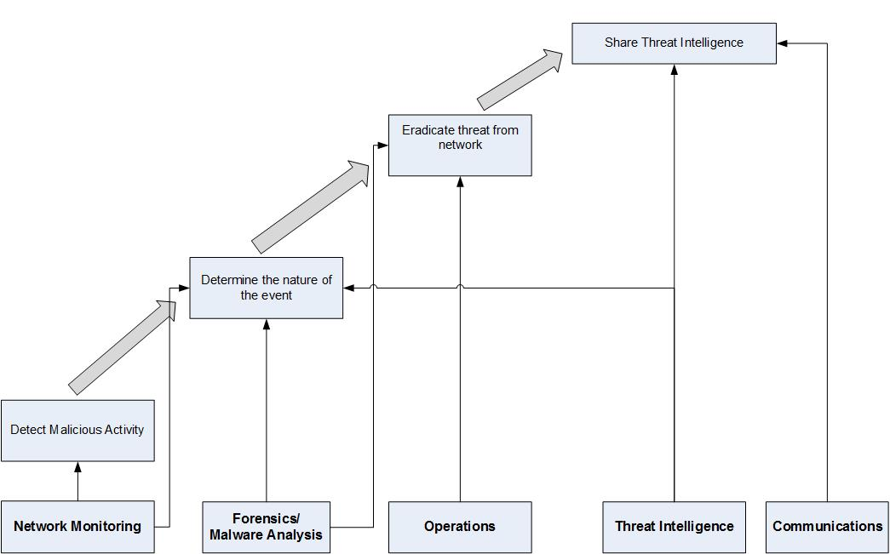
CSIRT MTS Goal Hierarchy

Slide 22
Key Issues in MTS Effectiveness
Between Team Activities
  Externalized Cognition
  Information Sharing
  Knowledge Management
“We connect the dots…We correlate and coordinate. We have many different facets that we've talked about, threat analysis, network analysis, digital, analytics, malware…. We use that capability along with our trusted partnerships with industry, local governments and so forth to correlate information and try and create a common operating picture. And to try and link everything together and connect the dots, so we can paint the actual picture…What is the actual cyber incident?”

Slide 23
Key Issues in
MTS Effectiveness (Cont’d.)
Between Team Activities
  Collective Problem-Solving
  Adaptation and Innovation
  MTS Learning
“We configured it. Another team shipped it, and then the contractors are going to be racking it. Then, a fourth person is going to be using it, and coming back to us if they have problems.”

Slide 24

Drivers of MTS Success & Failure
Between-team emergent states
Leadership and boundary spanning dynamics
Motivational dynamics
Notes:
Image:careersuccess.typepad.com

Slide 25


Countervailing Forces
What helps the team hurts the system
What helps the system hurts the team

Slide 26
Collaboration Escalation
  Description of phenomenon
    Individual makes decision to escalate
    Team makes decision to escalate in MTS
“Our team is designed to be very tactical. If there's something that requires a lot of digging in, then we don't have the resources to handle that in our team so we're going to hand that off to an investigation team or a forensics team to do the kind of digging in that will be required for that. Sometimes we're also going to hand things off to the remediation team, if there's broad segment of the organization that's impacted. “

Slide 27
Collaboration Escalation (Cont’d.)
  What are the drivers of escalation?
    Nature of the problem
    Organizational protocols, policy and politics
    Individual disposition
    Team norms and states
    Between team and MTS norms and states

Slide 28
Suggested Prescriptions for Enhancing CSIR-MTSs
Build and train teams and MTSs to effectively “think together”
Facilitate within and between team dynamics
  Key role for CSIRT and MTS leaders
Select and train team members with high communication and collaboration skills, in addition to technical expertise
Select team members who are predisposed to work well in a highly collaborative environment

Slide 29
Future Research and Practice Requirements
  Understanding CSIR-MTS dynamics
  Deriving best practices
  Developing tools for CSIRT managers to use when hiring and training CSIRT members
  Helping CSIRTs collaborate more effectively within the team and the entire system

