Slide 1
Ransomware Empowerment Training
FIRST Multi-Stakeholder Ransomware SIG

Slide 2
Copyright
Copyright © by Forum of Incident Response and Security Teams, Inc.
FIRST.Org is name under which Forum of Incident Response and Security Teams, Inc. conducts business.
This training material is licensed under Creative Commons Attribution-Non-Commercial-Share-Alike 4.0 (CC BY-NC-SA 4.0)
FIRST.Org makes no representation, express or implied, with regard to the accuracy of the information contained in this material and cannot accept any legal responsibility or liability for any errors or omissions that may be made.
All trademarks are property of their respective owners.
Permissions beyond the scope of this license may be available at first-licensing@first.org

Slide 3
Acknowledgments
A big thank you to all the contributors who made this training possible!
Special thanks to:
Nadia Meichtry (Oneconsult AG), Gregor Wegberg (Oneconsult AG), creators of the training
Éireann Leverett (Concinnity Risks), Serge Droz (Swiss FDFA, FIRST) and Barry Greene (Senki)
All members of the FIRST MSR SIG

Slide 4
Slides
You can download the actual version of the slides under: https://www.first.org/education/trainings

Slide 5
Training Introduction
Photo by Chris Wormhoudt on Unsplash

Slide 6
Agenda
Welcome and introductions
Ransomware Attacks
Preparation for ransomware attacks
Darknet & Ransomware groups
Incident Response Management
Response to a ransomware attack
The recovery phase
A word on negotiation
Q&A

Slide 7
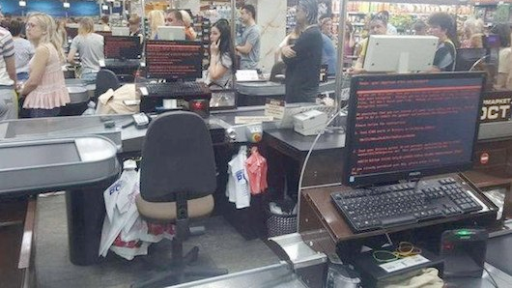
Ransomware Attacks
Mikhail Golub @golub
Introduction into the world of ransomware attacks

Slide 8
What is Ransomware?

Slide 9
Ransomware (Attacks)
Ransomware = Ransom + ware
It makes data inaccessible until a ransom is paid….
Or it makes data universally available unless a ransom is paid
It is a malicious software, i.e., malware.
Ransomware Attack
An incident that usually employs a Ransomware.
The focus begins to shift from holding data hostage until the ransom is paid to extortion by threatening to publish stolen data. Ransomware not necessarily involved.
Notes:
Definition sources for “Ransomware”:
https://www.ic3.gov/Media/PDF/AnnualReport/2023_IC3Report.pdf: “Ransomware: A type of malicious software designed to block access to a computer system until money is paid.”
https://www.enisa.europa.eu/topics/incident-response/glossary/ransomware: “Ransomware depicts a type of malware (like Viruses, Trojans, etc.) that infect the computer systems of users and manipulates the infected system in a way, that the victim can not (partially or fully) use it and the data stored on it. The victim usually shortly after receives a blackmail note by pop-up, pressing the victim to pay a ransom (hence the name) to regain full access to system and files.”

Slide 10
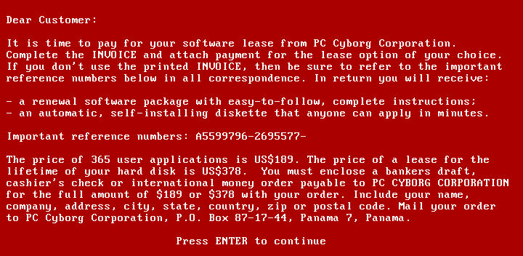
A brief history of Ransomware
Ransomware is not a new phenomena
1989 there was the
●Aids virus, a wiper
●Aids trojan, a ransomware
~ 2010 PC Ransomware
~ 2015 Big game hunting → Go for orgs
Ransomware took off with the emergence of cryptocurrencies
By Joseph L. Popp, AIDS Information Trojan author
Notes:
The first such software was found 1989, and distributed by Floppy disks. These malwares were not particularly sophisticated by today’s standards. The Aids Trojan demanded $189 to be sent to a Panama address. The author was arrested in the UK, and was a microbiologist consulting a.o. For the WHO.
The business did not really take of until the emergence of cryptocurrencies, which solved tha payment issue.
In started in the 2010’s with some. E.g. the rather successful banking Trojan gameover Zeus began delivering ransomware, presumably because it was much more profitable. A few years later actors started to encrypt entire organisations, dubbed Big game hunting, presumably because the AV industry could protect reasonably well against PC Ransomware and there was much more money to be made from a single entity ( 100’000’s vs 1’000 USD).
https://digitalcommons.kennesaw.edu/cgi/viewcontent.cgi?article=5312&context=facpubs

Slide 11
Ransomware Attack
Compromise target
Theft of sensitive data
Encrypt data (1st extortion)
Threaten to publish data (2nd extortion)
Optional: Public naming and shaming
Optional: Threat of distributed denial of service (3rd extortion)
Optional: Threaten customers, users, employees, etc.
Optional: Use stolen data for business email compromise (BEC), phishing, etc.
Optional: Publish stolen data

Slide 12
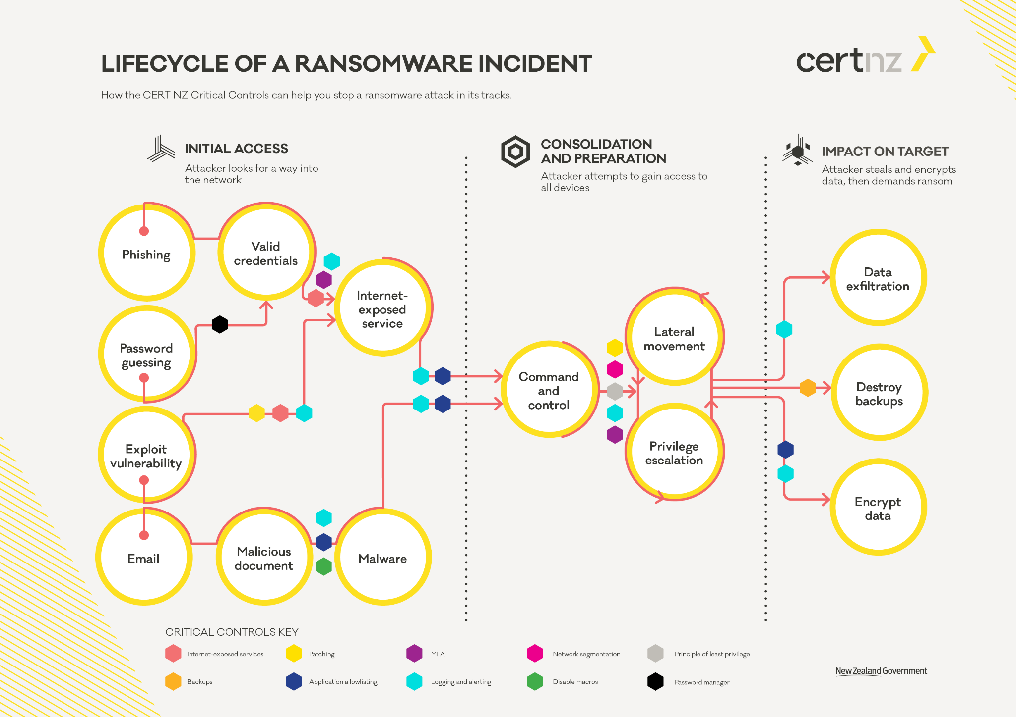
Notes:
Source: https://www.cert.govt.nz/it-specialists/guides/how-ransomware-happens-and-how-to-stop-it/

Slide 13
Adversary Tactics & Techniques
MITRE ATT&CK (https://attack.mitre.org/)
Source for ideas on which artefacts to analyze
Ideas what the attackers might have done before / after (starting from the event)!
Examples:
Valid accounts: https://attack.mitre.org/techniques/T1078/
Data encrypted for impact: https://attack.mitre.org/techniques/T1486/
MITRE D3FEND (https://d3fend.mitre.org/)
Source for ideas on how to defend oneself

Slide 14
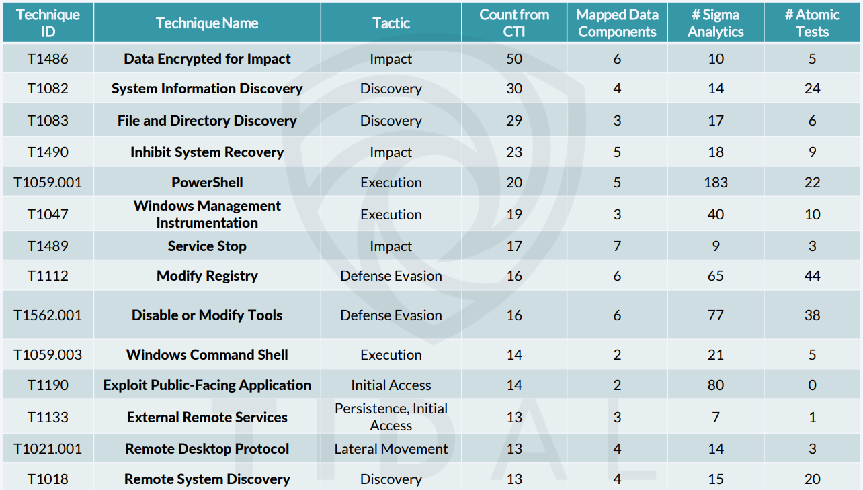
MITRE ATT&CK
Notes:
https://www.first.org/resources/papers/conf2023/FIRSTCON23-TLP-CLEAR-Leverett-and-Small-Ransomware-Zugzwang-Final.pdf

Slide 15
How bad is it?

Slide 16
Ransomware - Your Experience ~10Min
Who experienced ransomware attacks directly in the past?
Who works for an organization where a partner/supplier got hit by ransomware?
Who’s hosting organization / management is aware of ransomware and takes the threat seriously?

Slide 17
How is victimisation distributed by country?
Detections: ransomware over time by geolocation
Source: FIRST22: Ransomware as a Science
Jul.21 |  | Aug.21 |  | Sep.21 |  | Oct.21 |  | Nov.21 |  | Dec.21
United States | 25.5% | United States | 20.2% | United States | 19.5% | United States | 23.4% | United States | 21.1% | United States | 22.2%
China | 10.7% | France | 7.2% | Hong Kong | 9.9% | France | 7.5% | France | 6.3% | France | 7.3%
India | 6.1% | India | 6.5% | Germany | 7.9% | Italy | 5.0% | Belgium | 4.4% | Hong Kong | 7.0%
Germany | 4.8% | Hong Kong | 5.8% | France | 4.6% | Belgium | 4.5% | Italy | 4.4% | Italy | 5.7%
Brazil | 4.8% | Germany | 4.6% | Turkey | 4.2% | Brazil | 3.8% | Hong Kong | 4.3% | India | 5.3%

Slide 18
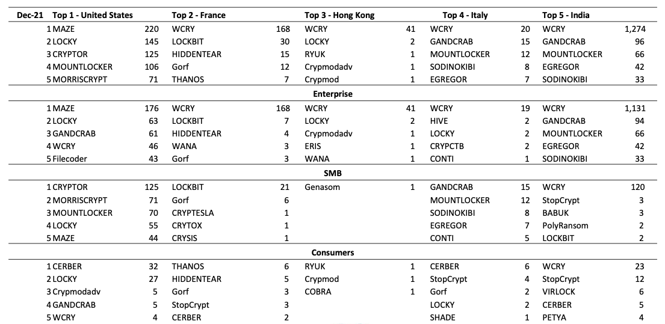
How big is the problem
Detection by business size
Source: FIRST22: Ransomware as a Science

Slide 19
How big is the problem
Detection by business size
US IC3 Extortion reports 2023: 49k
Global data leaks by ransomware gangs: 21K
Both are underreported, but probably not more than 100k events globally.
We know number of events correlates to GDP: https://ccb.belgium.be/en/news/richer-country-more-ransomware-victims-it-has

Slide 20
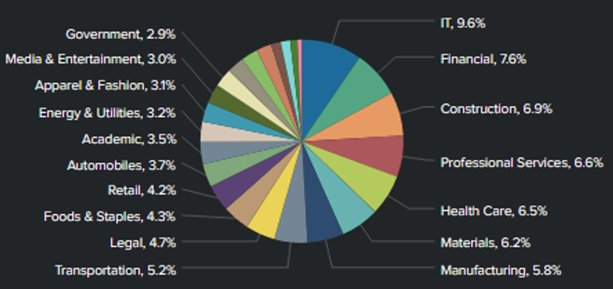
Victim Landscape
Leaks: Targeted sector
Source: FIRST22: Ransomware as a Science

Slide 21
Victim Landscape
Leaks: Targeted region over time
Source: FIRST22: Ransomware as a Science

Slide 22
Victim Landscape
“The threat landscape report on ransomware attacks published today by the European Union Agency for Cybersecurity (ENISA) uncovers the shortcomings of the current reporting mechanisms across the EU.”
https://www.enisa.europa.eu/news/ransomware-publicly-reported-incidents-are-only-the-tip-of-the-iceberg

Slide 23
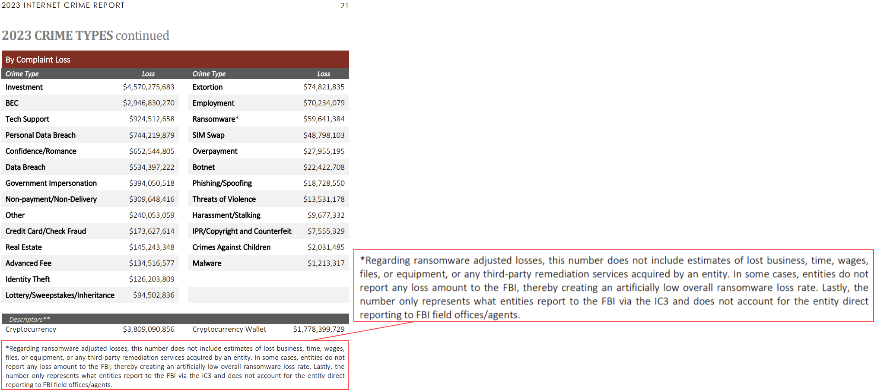
Loss Comparison (USA)
Notes:
Source: IC3 Annual Report 2023: https://www.ic3.gov/ => https://www.ic3.gov/Media/PDF/AnnualReport/2023_IC3Report.pdf

Slide 24
What do current attacks look like?

Slide 25
Ransomware as a Service (RaaS)
Industrialisation of ransomware attacks through division of labour:
RaaS Operator
RaaS Affiliate
Initial Access Broker
Notes:
Source material:
https://www.microsoft.com/en-us/security/blog/2022/05/09/ransomware-as-a-service-understanding-the-cybercrime-gig-economy-and-how-to-protect-yourself/

Slide 26
Ransomware as a Service (RaaS)
RaaS Operator
Develops necessary tooling, e.g. a ransomware builder
Maintains the leak site
Processes payments: Distributes payments to parties involved
Negotiates with victims
Provides guidance, recommendations and standards
Maintains and develops its branding
Notes:
Source material:
https://www.microsoft.com/en-us/security/blog/2022/05/09/ransomware-as-a-service-understanding-the-cybercrime-gig-economy-and-how-to-protect-yourself/

Slide 27
Ransomware as a Service (RaaS)
RaaS Affiliate
Purchases or gains access to a victim's environment
Uses services provided by the RaaS Operators
Executes the majority of the attack: Moves laterally, persists on systems, exfiltrates data, and executes ransomware
Notes:
Source material:
https://www.microsoft.com/en-us/security/blog/2022/05/09/ransomware-as-a-service-understanding-the-cybercrime-gig-economy-and-how-to-protect-yourself/

Slide 28
Ransomware as a Service (RaaS)
Initial Access Broker
Focus is on gaining unauthorised access to an organisation's system(s)
They often conduct automated reconnaissance to gain insight into the compromised organisation. They then use this information to find buyers.
Notes:
Source material:
https://www.microsoft.com/en-us/security/blog/2022/05/09/ransomware-as-a-service-understanding-the-cybercrime-gig-economy-and-how-to-protect-yourself/

Slide 29
Commodity / Automated Attacks
Low-effort, high-volume ransomware attacks
Threat actor doesn't care who or what is affected
Often starting with mass exploitation of easily exploitable vulnerabilities or scalable social engineering attacks (e.g. malspam, credential phishing)
Common to target/affect individual systems or environments
Highly automated
Hint: Public clouds have well-documented and common APIs, making it much easier to automate attacks across a large number of organisations.

Slide 30
Human Operated Ransomware
Ransomware attacks driven by a human at a keyboard
Usually affects entire organisation, not just some systems
Attackers adapt to the environment
Target recovery systems, e.g. destroy backups
Encrypts infrastructure services, e.g. hypervisors rather than virtual servers running on them
More difficult to kick off your networks
Threat actor adapts to target organisation
Develops in-depth understanding of the organisation
Ransom/extortion amount based on accounting data
Could still be a RaaS Affiliate
Notes:
Sources:
https://learn.microsoft.com/en-us/security/ransomware/human-operated-ransomware

Slide 31
Ransomware Attacks
Operations stops
Human operated ransomware
Commodity ransomware
Extortion only (data theft)
Limited operational impact
Single devices affected
Whole organisation affected
Based on https://learn.microsoft.com/en-us/security/ransomware/media/human-operated-ransomware/ransomware-extortion-based-attack.png
Notes:
Source: https://learn.microsoft.com/en-us/security/ransomware/media/human-operated-ransomware/ransomware-extortion-based-attack.png

Slide 32
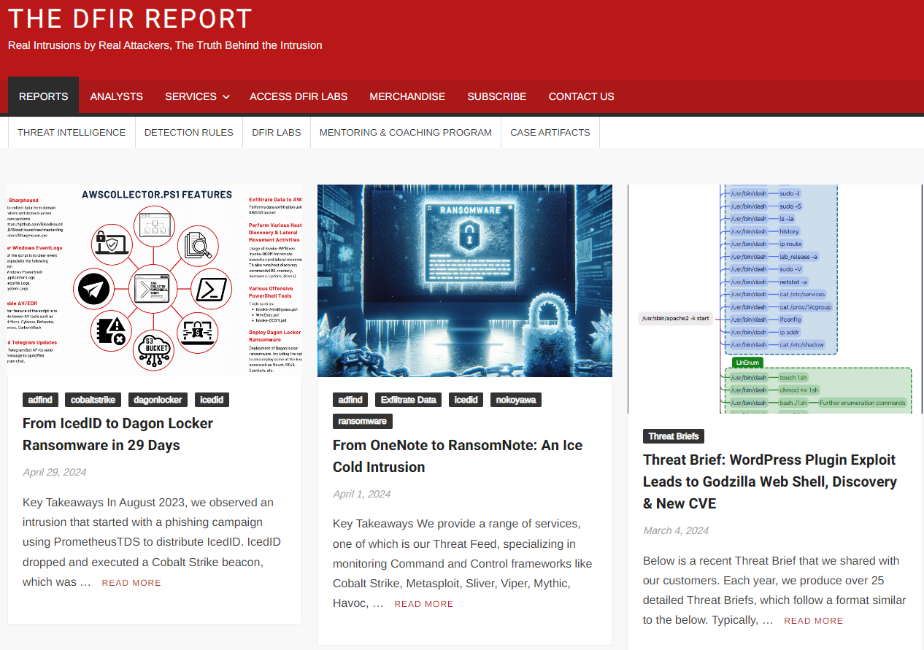
The DFIR Report

Slide 33
Example of a large logistics company

Slide 34
Example Case 1: large logistics company
What happened?
Attackers attempt to gain access to a partner company’s systems with a phishing attack
Perpetrators search for an entry point
Lateral movement into the targeted company using administrator privileges
Start encrypting the systems in the target organization
August 2020
Sept. - Dec. 2020
Jan. - Feb. 2021
March 2021
June 2020
Created a backdoor on multiple systems.
Waiting to take over an administrator account
Communication with the perpetrators’ servers to download the data theft (data breach) “toolbox” and deploy ransomware
Detection of the incident
Notes:
Attack was detected 9 months after initial access on a Friday evening
On Monday most systems were encrypted.
Management in shock, nobody knows what to do

Slide 35
Example Case 1: large logistics company
During Incident Response
Ransom: several million euros
Chaos phase ended after 3 weeks
Incident management ended after 8 months
Return to normal operation after more than 1 year

Slide 36
Example Case 1: large logistics company
After the Incident
1 burnout
5 people left the company because of the stress
Stress on family, private life, constant adrenaline level
Other consequences?

Slide 37
Example Case 1: large logistics company
Lessons Learned - Things that did not go well
Who has the lead and who decides?
Incident Management
Incident Response
Keep overview over all ongoing tasks
Legal Aspects (GDPR)
Technical Aspects
Restore and Return to Normal
Protect the organization

Slide 38
Example Case 1: large logistics company
Lessons Learned - Things that did not go well
Communication with stakeholders
Board of Directors
Media
Employees and Partners
Communication with perpetrators
Do the right tasks at the right time

Slide 39
Example Case 1: large logistics company
Lessons Learned
Are all the necessary people present from the beginning?
Lawyers: data protection, reporting requirements, etc.
Data protection officer
Management: to be able to make decisions quickly
Board of directors: decisions and strategic issues
Marketing/Communication: Internally and externally
Who are you going to call? IT service provider?
If you think you will pay, see already how difficult it is to get larger amounts in BTC

Slide 40
Example of a small company

Slide 41
Example Case 2: small company
Timeline: The Start
Day X, Monday in the morning:
Ransomware attack detected / realized
External SOC calls in CSIRT for support
Incident management by external SOC
CSIRT to perform digital forensics and provide additional expertise
Initial investigation with existing Microsoft Defender deployment
Velociraptor deployed to ease the investigation

Slide 42
Example Case 2: small company
Timeline: Investigation
Day X+1: 19 VM snapshots received for forensic analysis
Day X+2: Meeting with law enforcement
Day X till X+9: Investigation, analysis, documentation

Slide 43
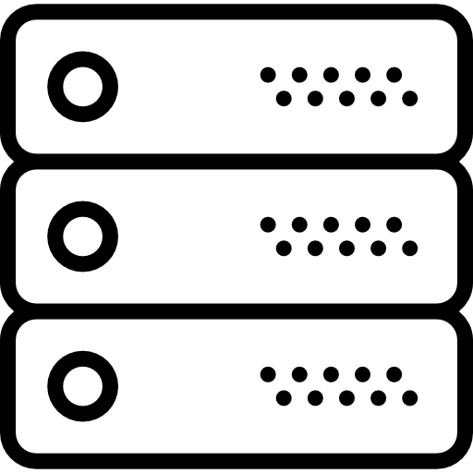
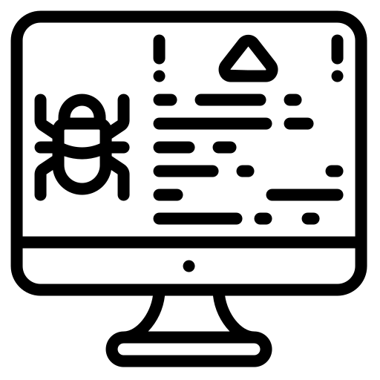
Example Case 2: small company
Attacker’s steps
4
5
C2
Server with valuable session
5
3
7
Supplier
account
1
Management
server
6
2
Domain Controller
Icons created by Smashicons from Flaticon
Notes:
Steps:
1.Citrix Login (without MFA) on Management Server with supplier account
2.AD Enumeration with Bloodhound: supplier account had admin rights on the management server
3.Lateral Movement via RDP to other servers, where the supplier user had local admin rights
4.LSASS Process Dump - there was an active session from an admin user on the DC that thus got compromised -> turns out, they had no password policy and the passwords were very bad
5.Installation of C2 Beacon on two servers
6.Lateral Movement to Domain Controller with Domain Admin thanks to the compromised user
7.Persistence over Scheduled Tasks + Deployment of the ransomware over GPO ; the scheduled task also deleted Volume Shadow Copies

Slide 44
Example Case 2: small company
Lessons Learned
MFA for everyone
Improve AD password policy
Deploy EDR on every system, enable it and regularly check the alerts
Improve logging (default logs and some completely disabled)
Harden AD & GPOs (lots of PingCastle findings)
To discuss: Geoblock non-essential web services, e.g. remote access?

Slide 45
Ransomware Impact - Exercise Part 1
Form a group of 3
Each person shares with the group (~10 min):
Describe what your organisation or constituency does / what its purpose is.
Tell each other what a successful ransomware attack would mean for your organisation and your constituents: What would be the impact? Why?

Slide 46
Operational/Business Impact
Everything in the organisation comes to a standstill
By encrypting critical/all systems
Loss of trust in your own environment
Incident costs
Regulatory notice periods
Regulatory and compliance fees/penalties
How would you:
Ensure resilience in the aftermath of an incident

Slide 47
Operational/Business Impact
Damage to reputation, brand, and trust
Leaked customer / employee data
Trust in your services and products
Regulatory and contractual consequences
Effort to check and comply with legal or contractual obligations
Possible penalties
The impact on victims has an impact on the economy.

Slide 48
Societal Impact
The erosion of trust and confidence in and within the sector
What does it mean when hospitals are under constant and successful attack?
What effect does it have on me and our community if I keep reading about successful attacks on electricity and water suppliers?
Contributes to mistrust of authorities/government
Are we just at the mercy of the attackers?
Why is nothing being done? Are they so powerless?

Slide 49
Human Impact
“An IT employee has a three-month-old daughter at home. He hasn't seen her for four days, he says.” – from an article about a ransomware attack on a newspaper publisher
Source (German): https://web.archive.org/web/20240217115416/https%3A%2F%2Fwww.nzz.ch%2Ftechnologie%2Fkriminelle-hacker-greifen-die-nzz-an-und-erpressen-sie-cyberangriff-ransomware-ld.1778725%3Fmktcid%3Dsmsh%26mktcval%3DE-mail

Slide 50
Human Impact
Incidents take a toll on people!
Employees can see and feel that something is not right, and this unsettles them
What does this mean for my job security?
What happens next? ⇒ Uncertainty
Incident responders and their support will be working long hours (10-14 hours) for weeks

Slide 51
Human Impact
This is really hard for everyone involved: Assume 50% of staff operates at 50% of normal capacity.
How do you handle this?
What does this mean for employees and management?
How to counter risks on human wellbeing?

Slide 52
Technical Impact
What is compromised? What not?
How to communicate securely?
Can we trust our own documentation (stored in digital form)?
Can we even access it?

Slide 53
Technical Impact
When will you be able to trust your systems again?
Were the (immediate) measures sufficient?
Are the backups infected?
Is a recovered/rebuilt system now secure? Secure enough?
Will the threat actor be able to do it again?

Slide 54
Ransomware Impact - Exercise Part 2
Discuss with your previous group (~10 min):
What additional impacts on your organisation and constituents have come up in the last few slides?
Which are the top 2? Why?

Slide 55
What are the risks to keep an eye on?

Slide 56
“Risk to whom?” - Dan Geer
Risks Before Incident
Technical stuff
CPE, CVE, CVSS, EPSS, Credential Stuffing, APIs, Phishing, Malware, Botnets, exposed services etc, etc, etc,
Revenue
Brand
Country
Sector
Risks During Incident
To the incident responders - burnout, bad decisions, communications, working shifts
To the CERT team - reputational, liability
To the victim executive team
To the victim Security Team
To the victim IT team
To the ransomware affiliate
To the negotiator
To the ransomware group

Slide 57
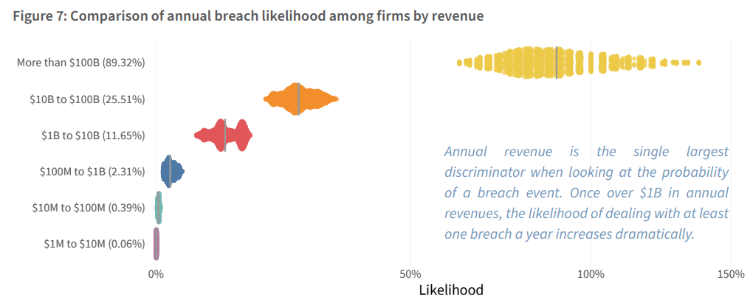
For an enterprise
Most groups start their demands at 1-10% of a company's annual recurring revenue (ARR)
Can be negotiated down 50% if you're lucky
⇒ ?% likelihood x 5% of ARR is a good idea of just the financial impact of the ransom

Slide 58
For an enterprise
Add the lost revenue from being offline for 2 weeks
Add 2 weeks of 12 work hour days multiplied by the number of people needed to rebuild your critical systems (~2x-4x your own IT staff)
The Gordon-Loeb model suggests that you should spend about a third of the impact to prevent it
⇒ 1/3 x ?% likelihood x 5% ARR + lost revenue + employee/support costs = rough budget goal for ransomware prevention for any business.

Slide 59
For a CSIRT/PSIRT/SOC
Frequency depends on your constituency
Severity depends on your constituency
It is possible to predict roughly
Check your history of events and project and/or contact the MSR-SIG to estimate it

Slide 60
Cyber insurance
Ransomware is currently (2024) the largest loss driver in the insurance world
Insurance can save a victim from going bankrupt
Insurers increasingly demand proof of good cyber-hygiene
Insures increasingly reluctant to pay ransoms
Insurance companies have a lever to promote better cyber security

Slide 61
#1 Targeting “analysis”
Imagine 100 victims of ransomware
79 are under 100M in revenue
21 are above 100M in revenue
Clearly small business (<100M) are targeted right?

Slide 62
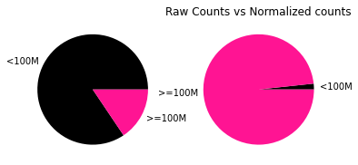
#1 mistake of targeting “analysis”
Imagine 100 victims of ransomware.
79 are under 100M in revenue / 15 Million Companies
21 are above 100M in revenue / 5000 companies

Slide 63
Who should be involved

Slide 64
Who is responsible?
Who/which team in your organisation is responsible for handling ransomware incidents?
Who else would be involved in such an incident?

Slide 65
Stakeholders Outside Your Team
When faced with a ransomware attack, it is important to get the following stakeholders involved in the response:
Communication / Marketing / Public Relations for proactive communication
The attack could quickly become public knowledge, e.g. publication on the leak site
Legal department for review and compliance with reporting requirements
Senior management / C-level
Needed to decide which immediate actions can be taken (usually these have a significant operational impact), as well as to prioritise the recovery work according to what the business needs.
Without the support of these groups, technical staff will be overwhelmed and won't act in their and the organization's best interests!

Slide 66
Contacting Stakeholders
During a ransomware attack, your usual communication channels may be unavailable. What's more, key stakeholders are often unavailable, especially during an emergency or it happens after hours.
Prepare for it:
Each role has at least one alternate, preferably two.
For each key role, multiple ways to contact are specified, including not only work but also private phone numbers.

Slide 67
Challenge for the Entire Organization
During a ransomware attack
IT/OT works on this
Technology (IT & OT) | Incident Operations / Crisis Team | Legal | Communication
Understand the situation Scope of attack Objective of attack Root cause Everyone wants and needs more information. Rebuild with more security controls. | Set up emergency operation Enable limited operation Establish crisis team Find a way back to normal Take the business perspective Stay focused Negotiations | Reporting obligations Data protection laws Contractual obligations Stock exchange law Support negotiations Check for sanctions Support activities Public statements Engage law enforcement | Map the stakeholders Employees Public Customers Partners Shareholders Prepare and publish statements. Interact with the media. Monitor the conversation Rebuild trust.
Careful, this requires the involvement of the whole organization!

Slide 68
Resources: Measures
https://www.cisa.gov/stopransomware/general-information
https://www.cert.govt.nz/it-specialists/guides/how-ransomware-happens-and-how-to-stop-it/
https://www.cert.govt.nz/business/guides/communicating-a-cyber-security-incident/public-communications-for-cyber-security-incidents-a-framework-for-organisations/

Slide 69
International Activities
International Counter Ransomware Initiative
Initiated by the White House
Country membership, nearly 50
FIRST Multi-Stakeholder Ransomware SIG
Open to all!
Ransomware Task Force
Mostly US private sector
Initiated by the Institute for Security and Technology

Slide 70
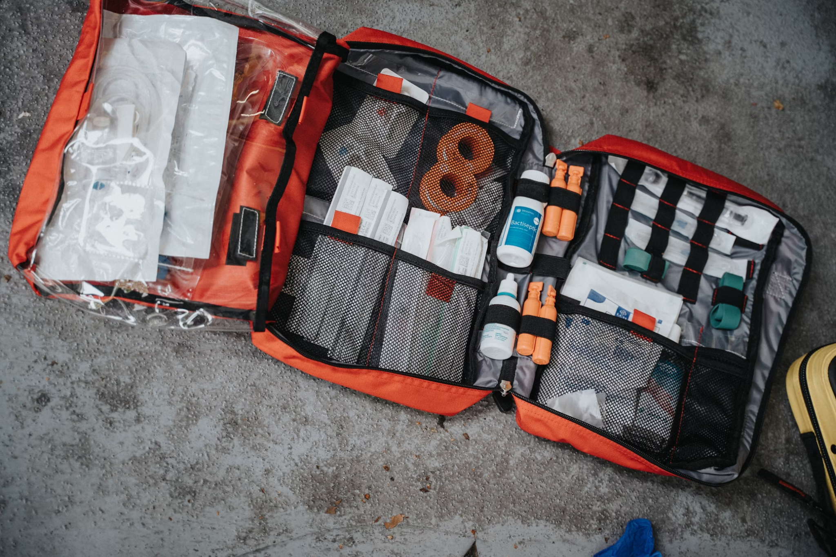
Preparation for Ransomware Attacks
Photo by Mathurin NAPOLY / matnapo on Unsplash

Slide 71
Challenge for the Entire Organization
Prepare for a ransomware attack
IT/OT works on this
Technology (IT & OT) | Incident Operations / Crisis Team | Legal | Communication
Practice incident scenarios Plan, implement, and test security controls Plan and test recovery Run through possible scenarios with other business units (to increase awareness) | Prepare and practice crisis management Define recovery priorities Prepare checklists Define when and if the payment of the extortion/ransom is considered | Clarify legal framework in advance Prepare checklist for reporting obligations Prepare reporting templates Define reporting timelines | Define who communicates with whom Define communication timeline Prepare statements for common scenarios

Slide 72
About recommending backups
We recommend backups:
But forget to say what to backup…
Network configuration
Identity management
Payroll
Credentials
Safety Data*
ERP
They also need to be tested/used/offline
If you look at leak data in bulk, most of it has backups in it. So we have to be mindful backups are also targets and a useful signafier of ‘sensitive data’ to a threat actor
Signed backups are ideal as they can demonstrate no corruption.
Multiple media is good too, in case one method fails.
How long does it take to restore
The number one cost to companies DURING the incident is downtime. So knowing your backups will take X long to restore is part of your key incident response plan.
Especially in situations where this is compared to the restoration time of the decryptor.

Slide 73
Ransomware Resistant Backup System
Threat actors may prevent effective recovery by compromising the integrity of your backups.
Prevent any (short-term) deletion or modification of backups once they have been created. Possible approaches (may need to be combined):
Write Once Read Many (WORM) Backups
Offline backups, e.g. tape cartridges outside of a tape drive
Immutable cloud backups with unchangeable retention policy
Delayed deletion or alteration of backups without a digital bypass path

Slide 74
Ransomware Resistant Backup System
Threat actors may deny access to backups, preventing effective recovery by compromising the availability of your backups.
Make sure you can always access your own backups:
Prepare an emergency access account / break glass account
Prepare for offline, i.e. physical, access to your backups

Slide 75
Ransomware Resistant Backup System
Threat actors may force the storage of corrupted or infected backup data. This could make both integer and clean backups unavailable.
Backups should be stored for a retention period appropriate to the organisation's risk appetite, and the integrity of backups should be monitored and tested regularly.
Backups should be kept for a fixed period of time rather than a number of backups.
Retain multiple backups of a system or of data, i.e. keep a version history.

Slide 76
Ransomware Resistant Backup System
It may be easier for a threat actor to attack a backup system than the actual systems or data.
If backups are encrypted, make sure the key cannot be deleted or changed.
Backups must meet the same security requirements as the systems or data they store.
Monitor your backups and trigger alerts in case of significant events:
Significant changes, e.g. non-automatic deletion or modification
Execution of privileged operations

Slide 77
Ransomware Resistant Backup System
Scenarios to think through to identify problems in your current backup approach:
Could a threat actor compromise the integrity of your backups by taking over an IT administrator's endpoint?
What if the threat actor gains domain admin rights or root access?
How do you access your backups when all of your organisation's existing IT systems and assets are unavailable?
How would we do a rebuild of our core & critical infrastructure from a backup?
How much time will it take?
Who has the necessary knowledge?

Slide 78
Resources: Ransomware Resistant Backups
https://www.ncsc.gov.uk/guidance/principles-for-ransomware-resistant-cloud-backups
https://www.nccoe.nist.gov/data-integrity-identifying-and-protecting-assets-against-ransomware-and-other-destructive-events

Slide 79
(Opinionated) Measure Overview
Write Once Read Many (WORM) or offline backups
Create, maintain, and regularly exercise a (basic) incident response plan
Use phishing-resistant multi-factor authentication
Protect your endpoints / networks with current detection & response products
Make sure to monitor them!
Reduce your cyber attack surface
Internet facing systems / services
Harden end user systems and key services (e.g. IAM)
Vulnerability & patch management
Observe current ransomware trends and apply lessons learned

Slide 80
Resources: Measures Against Ransomware Attacks
https://www.cisa.gov/stopransomware/general-information
https://www.cert.govt.nz/it-specialists/guides/how-ransomware-happens-and-how-to-stop-it/

Slide 81
Detection, detection, detection
Canary Tokens
Honeypots
Detection Engineering:
Yara: https://github.com/Yara-Rules/rules
SIGMA: https://github.com/SigmaHQ/sigma
IDS
XDR
Log Files
Emails
*Note to IR; Sometimes the data is still in detection systems and the victim doesn’t know it. Ask them about their detection systems.

Slide 82
Remember This Slide?
Notes:
https://www.first.org/resources/papers/conf2023/FIRSTCON23-TLP-CLEAR-Leverett-and-Small-Ransomware-Zugzwang-Final.pdf

Slide 83
Don’t just think about encrypted impacts
Impacts
Data
Executives
Availability
Leak
Destroy
Threaten
Legal
DDoS
Lock

Slide 84
Darknet & Ransomware Groups
Photo by benjamin lehman on Unsplash

Slide 85
Surface, Deep & Dark
Surface Web
Web content that is readily available and searchable with standard web search-engines
Surface web (World Wide Web) runs on the “clearnet”
Deep Web
Part of the World Wide Web that is not indexed by standard web search-engines
Hidden behind access controls, only accessible with specific URL/IP addresses, etc.

Slide 86
Surface, Deep & Dark
Dark web
World Wide Web content that exists on “darknets”
Darknets are usually overlay networks that use the clearnet (Internet)
Best known darknet: Tor (The Onion Router)

Slide 87
Tor
Tor is free and open-source software, mostly financed by the CIA that enables anonymous communication
Using Tor as a user protects your privacy by hiding your location, and protects you from network surveillance and traffic analysis.
So called “Onion services” provide the same anonymity to services, e.g. websites.
Be careful, just using Tor you or your service are not necessarily anonymous. See: https://support.torproject.org/faq/staying-anonymous/

Slide 88
Stay Safe & Secure
Even with Tor you leave traces behind
Server knows which URLs were visited
Be careful with URLs that contain secrets or are not well known
Software (browser) may be vulnerable or misconfigured, allowing some degree of deanonymization
If you really want to be anonymous, take the time and make the effort to stay hidden!
Use at least a virtual machine with a current and AV-equipped operating system and the official Tor browser.

Slide 89
Darkweb & Ransomware Groups
Most leaksides are Tor hidden services
To interact with the threat actor you need to visit their site in the Tor network

Slide 90
Darknet - Exercise
Browse the darknet with TOR (~10 min)
Can you find data leak blogs?

Slide 91
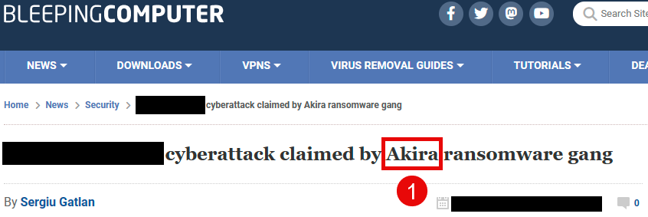
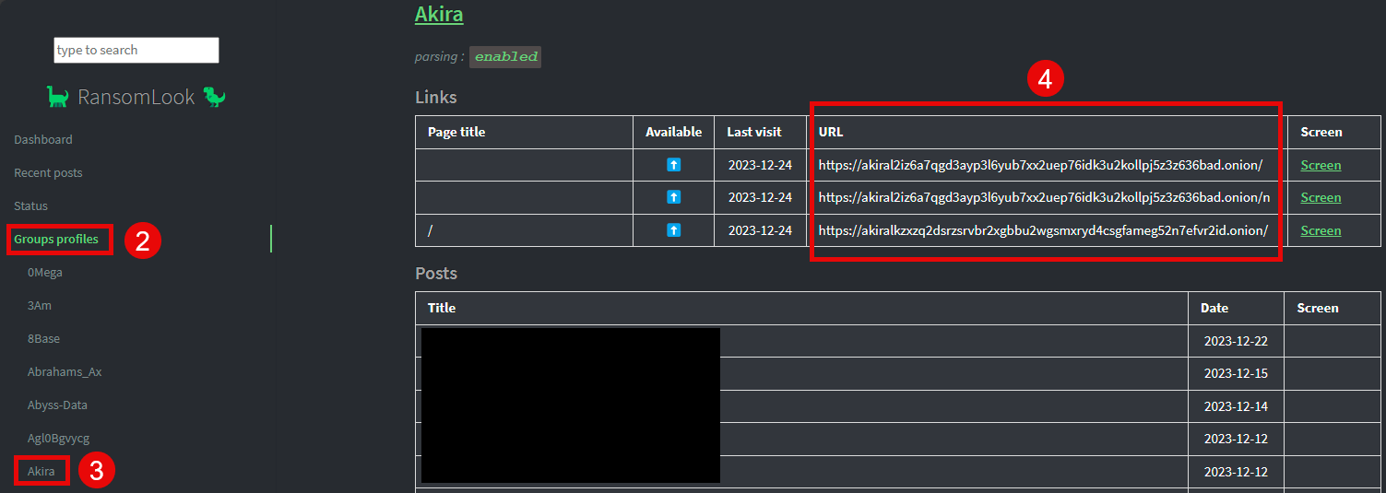
Visiting a Site on the Darkweb
Step 1: Get the Onion Address
Get the .onion address
From the ransomware note
Search for their address in the clearweb, e.g. https://www.ransomlook.io/

Slide 92
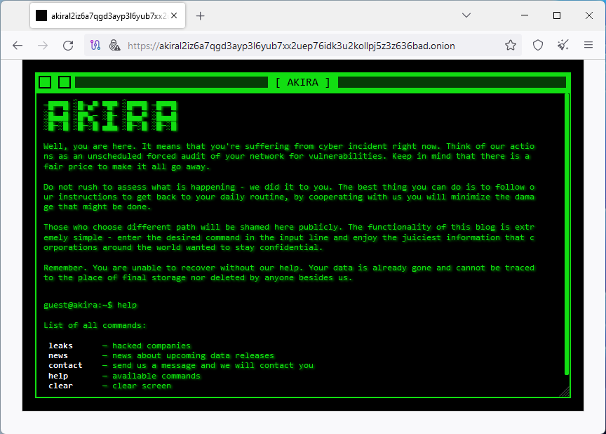
Visiting a Site on the Darkweb
Step 2: Visit the site with Tor Browser

Slide 93
Incident Response Management
Ransomware Specific Lessons

Slide 94
General Guidance
ISO/IEC 27035 is a highly recommended source of reference.
Running through an attack in your head, or around a table with your colleagues, will help you identify what is missing in your organisation and incident response management so that you are prepared for an incident.
Reach out and talk to your peers!

Slide 95
Stakeholders Outside Your Team
When faced with a ransomware attack, it is important to get the following stakeholders involved in the response:
Communication / Marketing / Public Relations for proactive communication
The attack could quickly become public knowledge, e.g. publication on the leak site
Legal department for review and compliance with reporting requirements
Senior management / C-level
Needed to decide which immediate actions can be taken (usually these have a significant operational impact), as well as to prioritise the recovery work according to what the business needs.
Without the support of these groups, technical staff will be overwhelmed and won't act in their and the organization's best interests!

Slide 96
Contacting Stakeholders
During a ransomware attack, your usual communication channels may be unavailable. What's more, key stakeholders are often unavailable, especially during an emergency or it happens after hours.
Prepare for it:
Each role has at least one alternate, preferably two.
For each key role, multiple ways to contact are specified, including not only work but also private phone numbers.

Slide 97
Keep it ready
Don't forget that during a ransomware attack, your entire technical infrastructure is likely to be unavailable!
Keep your incident response plan and other supporting documentation physical or offline
Print it regularly or store it offline on removable media
Make sure more than one person has a copy in case some of you are away
Train on a regular basis based on your incident response plan

Slide 98
Be First to Report & Don’t Forget It
A growing number of organisations are required to report incidents. Make sure that the obligation to report is checked as early as possible and that it is carried out on time.
Make it part of your incident response process and get the right people involved at an early stage.
Threat actors may report you to the authorities to increase pressure or embarrass you.
If you do have a cyber insurance policy, early notification may be necessary for your coverage and could lead to valuable third party support.

Slide 99
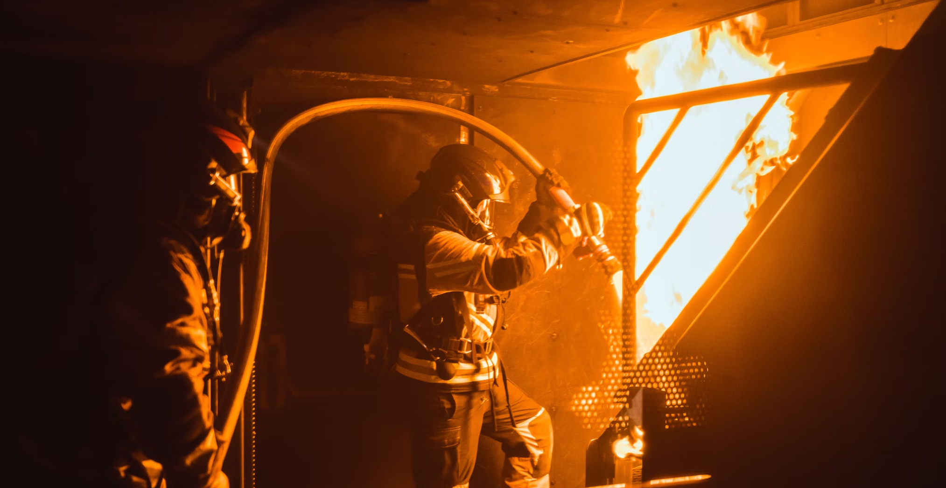
Response to a
Ransomware Attack
Photo by Sandro Gautier on Unsplash
Notes:
/

Slide 100
Incident Response Process

Slide 101
Incident Response Processes
There are several incident response processes. Overall they are very similar. Use the one that meets your needs or fits well with your other processes and policies.
FIRST Incident Response Process
SANS Incident Response Process
NIST Incident Response Life Cycle (see NIST SP 800-61)
ISO/IEC 27035

Slide 102
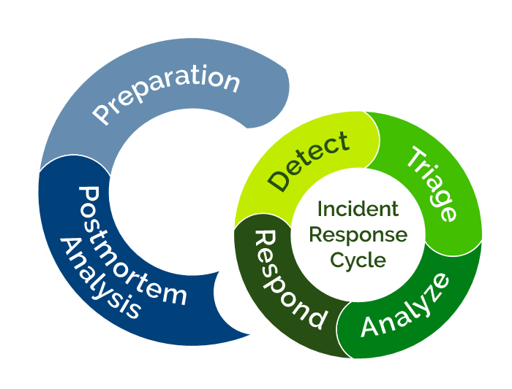
FIRST

Slide 103
Preparation
Prepare/maintain technical and organizational framework
Establish guidelines, principles, rules, etc.
Define process and procedure for incident management
Communication plan: internal, external, partners etc.
Define Computer Incident Response Team (CIRT)
Provide necessary tools
Train

Slide 104
Detect
Identify information security incidents
How can we be informed about a potential attack?
Affected employees
AV / EDR solution
SOC / CDC / MDR
What are the needed sources of information?
Logs, but which logs?
Firewall, Proxy, DNS
Endpoint Logs
Application Logs (e.g., email)
Cloud

Slide 105
Detect
Make sure this is the case:
Employees know how and to whom to report unexpected behaviour
Often the service desk. Does the service desk know how to identify an incident?
AV/EDR alerts are processed
Especially with human-operated ransomware, it's common to see multiple alerts where the AV/EDR successfully blocked an activity. Think about why it stopped! Maybe the threat actor found a malware or variant that is no longer detected?
You are responsive to your SOC / CDC / MDR, especially if it is a managed service.

Slide 106
Analyse
To analyse, first make sure you have the necessary visibility!
There is no investigation without data
Do we have visibility across all environments and system types?
What happens on the servers?
What happens on the clients?
What happens on the network / perimeter?
What happens in the cloud?

Slide 107
Respond - Containment
Preventing the threat from spreading across the network ("stop the bleeding") and stopping communication with command and control.
Immediate measures
Measures based on analysis
Preservation of evidence

Slide 108
Respond - Immediate Measures
Identify and isolate/disconnect affected devices
Disable/lock users and invalidate their sessions and tokens
Interrupt threat actor’s command & control channel
Protect/isolate backups
Reduce the likelihood of the threat actor regaining access
Deactivate external access (VPN, Citrix, etc.)
Secure evidence, if necessary

Slide 109
Respond - Eradication
Elimination of the threat and its remains
Clean up systems
Checking the backups
Vulnerability analysis

Slide 110
Respond - Eradication
Typically includes:
Change (admin) credentials, invalidate Kerberos ticket (twice)
Establish a clean environment for recovery
Validate the backups (if available)
Restore strategy (see later in this course)
Identify and fix vulnerabilities
Patch and harden systems

Slide 111
Respond - Recovery
Restoration of the normal state with as little negative impact as possible
Restore from backup or rebuild systems
What is the right strategy?
In which network do we restore or rebuild the system?
Reintegration into a interconnected environment
To which network do we connect (likely) clean devices?
Observe (Detect)

Slide 112
Postmortem Analysis - Learn Lessons
Learn from the incident
Have a Learn Lessons Meeting
Debrief what went well and what not so well
Improve your security controls longterm
Improve incident response

Slide 113
Incident Response Process
in Practice

Slide 114
Step 1: Assembling your IRT
Assemble the incident response team (IRT) to deal with the incident, using internal and external resources as necessary
Initial meeting: discuss what happened, set goals and priorities, share contact details etc.
Provide them with at least one physical space in which to work
Decide on a digital space to work in and a way to communicate digitally

Slide 115
Step 2: Immediate action
Take immediate action to reduce impact
Isolate affected systems/networks
Stop Command & Control communication
Disable affected accounts and revoke their sessions
Protect/isolate backups and other key systems
Preserve at least some evidence
Snapshot virtual systems
Put some of the affected systems aside and don't touch them

Slide 116
Step 2: Immediate action
The simplest approach for on-premises environments: Disconnect from the Internet.
See if this is possible, at least for the first few hours.
This will give you time to think, plan and act.
Assumption: It's a cyber attack, i.e. the threat actor is using the internet to launch the attack.

Slide 117
Step 3: Set organisational goals
Ensure from the outset that the response to an incident is in line with the organisation's objectives
In most cases, the primary objective is for the organisation to be able to pursue its purpose again!
Careful, it should be able to do this in the long term without another incident.
Prioritise based on the primary objective. Do nothing else.
Understand the non-technical implications as early as possible. Make sure the right people are managing them.

Slide 118
Step 4: Collect evidence?
Decide how much digital evidence you want/need to collect, e.g. for legal action.
Very dependent on the organisation
It is common, especially in the private sector, not to collect evidence that can be used in court.
Gathering evidence takes a lot of time in many jurisdictions ⇒ Handling the incident will take much more time and cost more

Slide 119
Step 5: Gain visibility
Gain visibility with standard security tools
Run AV-Scans, YARA-Scans
Deploy EDR/NDR
Deploy digital forensics / incident response tooling, e.g. Velociraptor or GRR

Slide 120
Step 6: What happened?
Understand what has happened so that gaps in security can be identified and closed
How did it get in?
How did it spread?
How did it persist?
Be careful not to spend too many resources/time on your investigations.
Keep the overall goal in mind. Focus on analysis that can add significant value to the response.

Slide 121
Day 2
Management
Decide whether to negotiate/pay the ransom
Preparation for mandatory reporting begins and first reports go out
Establish an escalation process if the attack worsens
Have a plan B in case the current approach fails

Slide 122
Day 2
DFIR Analysis
The objective is to identify IOCs & TTPs for containment & eradication
Understand the scope of the attack and its impact, particularly in relation to sensitive data
Find initial entrypoint

Slide 123
First week
Management
Decide on the priority order for restoration
Plan recovery
Analysis
Make sure you have documented everything so far and continue to document
Focus on identifying IOCs & TTPs → block/eliminate them (Containment & Eradication) → repeat ↻
Notes:
21.03.

Slide 124
End of first week
Eradication & Recovery
Prepare clean and isolated environment for restore
Plan and implement additional security controls
Plan and begin monitoring the new environment for signs of compromise or similar.
Finalize company-wide reset of secrets
Start restoring/rebuilding critical systems

Slide 125
Incident Response Steps - Deep Dive

Slide 126
Analysis steps
Ransomware identification
Look for decryptors
Identify affected systems
Triage: focus on high priority impacted systems
Identify root cause/entry point
Goal: identify attacker activity and actions on objective

Slide 127
Analysis - Artefacts
Goal | Artefact
Identify the ransomware | Read-me file: text, domain/url, name mentioned within the file, wallet address Encrypted file extension
Determine the features and capabilities of the ransomware | Exe-file of the ransomware (if already found) Derive from identified ransomware and public information on it
Provide clues to infection time and origin, entry vector, lateral movement, possible data leakage, and potentially infected systems | Image/log files of infected systems Perimeter logs (firewall, proxy, DNS, etc.)

Slide 128
Analysis - Ransomware identification
Use Read-me file and encrypted file extensions, AV/EDR detection, or exe file of the ransomware if already found
https://www.nomoreransom.org/
https://id-ransomware.malwarehunterteam.com
https://malpedia.caad.fkie.fraunhofer.de/
https://www.ransomlook.io/
https://www.bitcoinabuse.com/
https://www.virustotal.com/

Slide 129
Analysis - Decryptors
Publicly available decryptors:
https://www.nomoreransom.org/
https://id-ransomware.malwarehunterteam.com
https://www.emsisoft.com/ransomware-decryption-tools/

Slide 130
Analysis
Identify high priority impacted systems:
Focus the investigation on high priority impacted systems and crown-jewels, e.g. Domain Controller, Microsoft Exchange, public cloud environment, and similar systems used by nearly everyone and everything
First focus on the time around the encryption (e.g. creation time of the Read-Me and encrypted files) and AV/EDR detections to find IOCs.
Use them to pivot and discover further IOCs.
Useful tools: Velociraptor, GRR, KAPE

Slide 131
Analysis - Affected systems and users
Identify affected systems and user accounts:
Check owner of ReadMe files to find out affected user accounts and thus affected systems
Find out affected systems by looking for IOCs with:
AV/EDR scans
Thor (Lite)
Chainsaw
Hayabusa
By hand

Slide 132
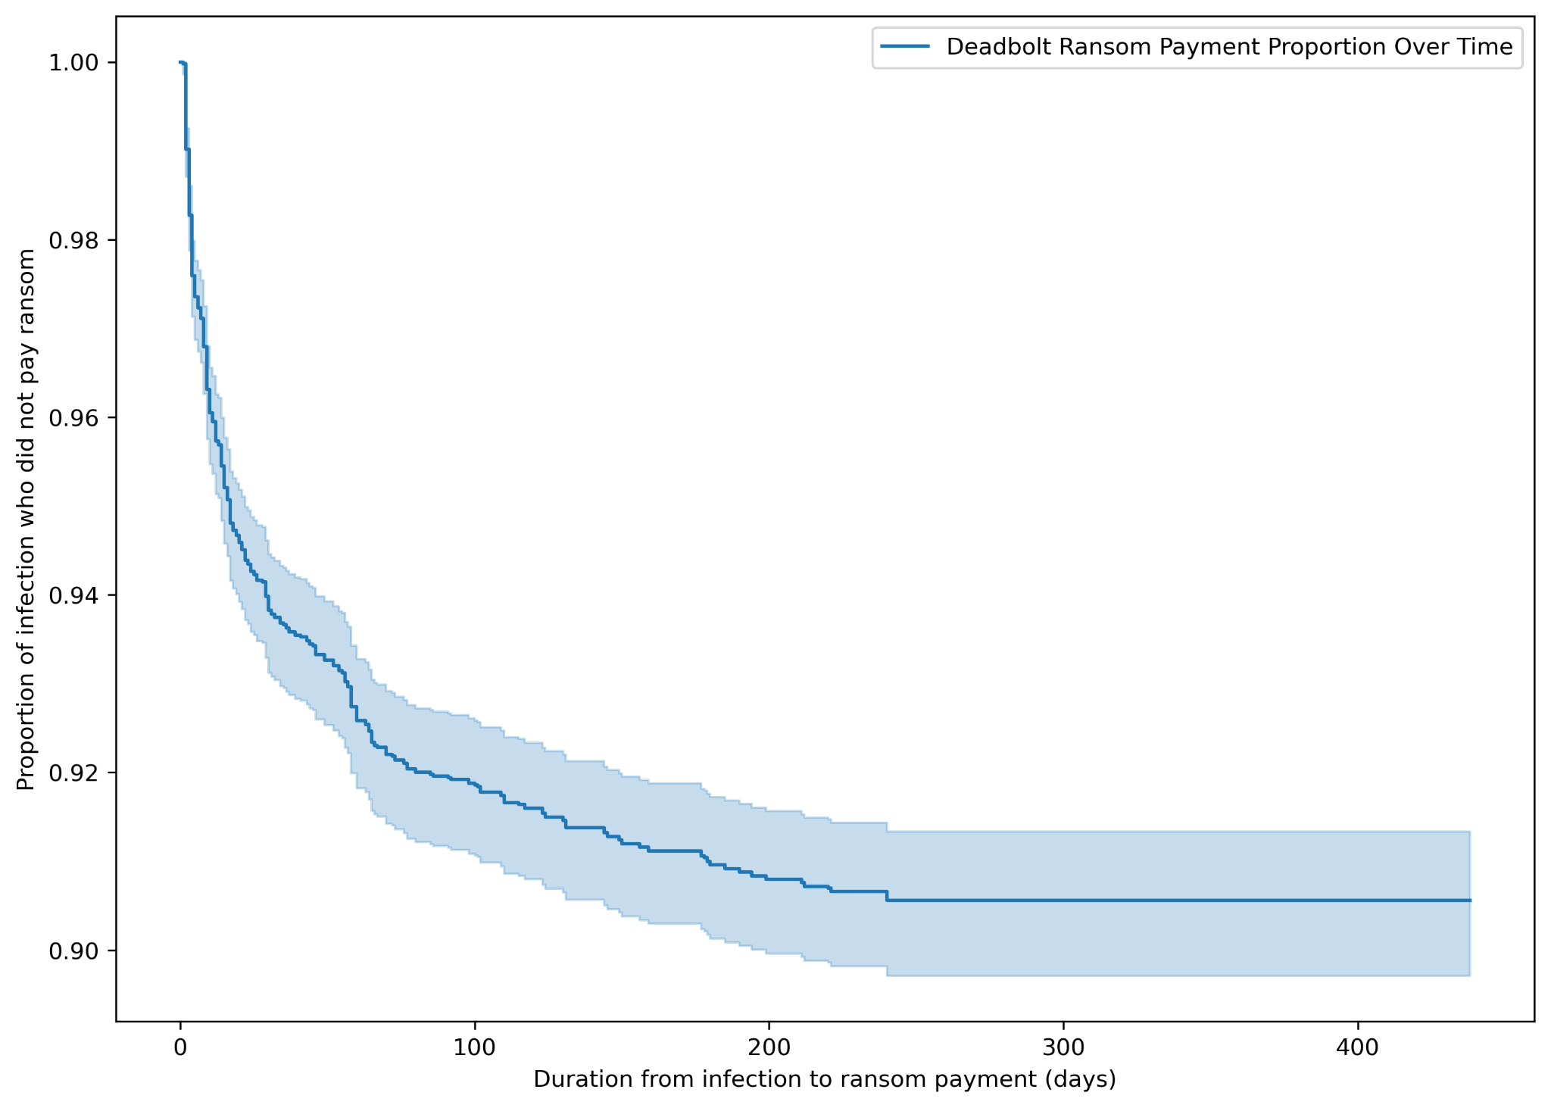
Deadbolt - Exercise (1 hour)
3 Malware File
? BTC addresses

Slide 133
Analysis - Disclaimer
In this training, we focus on Windows’ artefacts as it’s the most common OS used.
Of course, ransomware also targets Unix, ESXi, OT/ICS, Cloud, etc.

Slide 134
Analysis - Artefacts of high value
Account activity
Program execution
Persistence
Lateral movement
Network communication
See the SANS Hunt Evil (the blue poster) and SANS Windows Forensic Analysis poster (the red poster).

Slide 135
Analysis - Network Communication
The aim is to find command and control communication and lateral movement. Some hints:
Suspicious ports
Unusual port numbers on the listening side?
Protocol and targeted port mismatch
Suspicious or unexpected connections
Connections to known bad IP addresses
Tor or Tor2Web requests
DNS requests for unusual domain names
Unexpected workstation to workstation communication
From/to regions outside the business radius
Communication outside usual working hours

Slide 136
Analysis - Network Analysis
Full-packet capture (pcap)
NetFlow
Contains 5-Tuple information (source IP, destination IP, source port, destination port, protocol used) + bytes transferred
Useful tools:
Tcpdump
Wireshark/tshark
Zeek
Snort
Suricata

Slide 137
The Recovery Phase
The easy part, right?
Photo by Shivendu Shukla on Unsplash

Slide 138
Be aware why we perform recovery!
Overall objective: return to normal with as little negative impact as possible
Careful, do the recovery from your business point of view! It is important for the organisation to be able to pursue its purpose again.

Slide 139
Typical recovery goals
We want to get back to business!
Restore a clean IT infrastructure
Get back to normal as quickly as possible
in BCM think of the Recovery Time Objective, RTO
Prevent any business data loss
in BCM think of the Recovery Point Objective, RPO
RPO
INCIDENT
RTO
Lost Data
Outage

Slide 140
Be aware of the challenges
Our infrastructure was successfully compromised
Is our backup infrastructure even available?
What if we re-enable or reconnect the backup infrastructure and it is destroyed by the threat actor?
If we just restore everything to the way it was, what stops another compromise?
What if the backup systems were also compromised?
Can we trust the backup systems itself?
Can we trust the backups and the data within them?

Slide 141
Be aware of the challenges
We are quickly talking about terabytes of data
Where is the data located?
How can we transfer the data?
How fast is your network?
Do we even have network connectivity?
Data drive shipping could be faster and more reliable
This will take some time…

Slide 142
Be aware of the challenges
How do we properly restore a particular system?
What other systems does it depend on? They must be recovered first
Do we remember how we configured this system? It was built a long time ago…
Do we have software, drivers, licence keys?
How do we find out if a recovery was successful?
Who can test and confirm it for us?

Slide 143
The number of affected systems matters!

Slide 144
Scenario 1: Systems affected can be counted on one hand
Example case: Individual end-user systems must be considered compromised because their users fell for a phishing attack.
Typical approach for recovery:
Disconnect affected device from any network
Transfer necessary data from the infected device to an external storage medium
Set up a fresh device
Run antimalware scan on the data
If nothing is found, transfer data to the new system
Destroy old system (logically), e.g. completely format built-in storage
Done

Slide 145
Scenario 2: Significant number of devices affected
Example case: An entire network with its devices has been compromised, for example by a ransomware attack.
Contains the same elements as scenario 1 but is much more complex and requires a well-thought-out strategy!
From here on, we will assume this scenario and thus automatically also talk about scenario 1 and how to address the simpler case.

Slide 146
Prepare the recovery environment
Step 1

Slide 147
The existing environment
The compromised environment already exists
It got compromised
All our (potentially) affected devices are in this environment
All our (potentially) affected logical objects (e.g. user accounts) are in this environment
Important:
We do not trust this environment
Everything that it touches might be/get compromised
We assume the threat is still in this environment

Slide 148
The new environment
This environment will replace the compromised environment
Must stay clean
Objects are only connected/added if they have been classified as clean and secured
Must be more secure than the compromised environment
Important:
We must keep an eye on the environment and detect if something unexpected happens
Visibility, detection and protection is key

Slide 149
The environment in between
Think of it as a DMZ between the infected and clean environment
Here we check devices, data and other object for indicators of compromise before they may move into the clean environment
Here we prepare backups to be restored in the clean environment
Here we cleanup devices, if there is no other way
Important:
Internet access only as far as necessary to perform the tasks
No network connectivity between the three environments
No network connectivity between devices within the network

Slide 150
The three environments for recovery
Internet
Compromised
Environment
Test, Cleanup & Restore
Environment
Clean
Environment
Icons created by Smashicons from Flaticon

Slide 151
Decide on a recovery approach
Step 2 for every device

Slide 152
Option 1: Complete Restore from Backup
You have a full backup of a system
Operating system, business software, configuration and all the business data
Common for virtual machines and appliances
Great! Restore is (theoretically) easy
Prepare the hardware and/or virtual environment
Restore the backup and start the restored system

Slide 153
Option 1: Complete Restore from Backup
However, some open questions remain
Is the restored system secure and clean?
Which restoration point (backup) to use?
How much time will it take and what dependencies need to be taken care of first?

Slide 154
Option 1: Complete Restore from Backup
Make sure you do protect your backup first (we will discuss it later)
Restore the system in the Test Environment
Improve the system’s security
Make sure the system has no indicators of a compromise
Move the system into the clean environment

Slide 155
Option 2: Partial Restore from Backup
You have a partial backup of an affected system or it’s data
Common for complex systems where, for example, the data is backed up but not the entire environment with all its components
Also, valuable when we have a full backup
We do not trust the whole backup, just parts of it (usually business data)
We want to restore just part of the backup, the one that is likely safe
Same questions remain as with a full backup

Slide 156
Option 2: Partial Restore from Backup
Make sure you do protect your backup first (we will discuss it later)
Prepare data within the Test Environment
Restore the system in the Test Environment
Extract the necessary data to another system (often an external storage medium)
Make sure the selected data has no indicators of malicious data
Rebuild the system in the Clean Environment
Improve the system’s security
Move the data from the Test Environment to the new system in the Clean Environment

Slide 157
Option 3: No Backup Available, Greenfield Recovery
You have no backup of a system
Recommended approach: Build it from scratch
Recovery Approach
Rebuild the system in the Clean Environment
Improve the system’s security

Slide 158
Option 4: Cleanup a system
You have no backup and building from scratch is not realistic
Must check for any indicator of infection or malicious content
If an indicator of compromise is identified on the system: please, rebuild from scratch
If no indicators identified: Dangerous approach, can introduce malware into the Clean environment
Be aware:
It is mostly done to save time
Poses a realistic threat to recovery efforts
Should be considered only at the beginning for particularly critical systems

Slide 159
Option 4: Cleanup a system
Remove any known malware and indicators of compromise from system while it is still in the Compromised Environment
Move system into the Test Environment
Check system again for any indicators of malicious data and remove them
Improve the system’s security
If possible, do a final check for malicious data on system
Move system into the Clean Environment

Slide 160
Options - From a Security Perspective
Rebuild from scratch
Partial restore from backup
Restore from backup
Security / Confidence of Cleanliness
Cleanup
Amount of effort necessary

Slide 161
Option 5: Decrypt System
Create a backup copy of all data and store it separately from the network to have a second chance in case of complications during decryption.
For e.g. VMs, a snapshot can simply be created and copied away.
Optional: After receiving the decryptor (publicly available or after ransom payment), scan it and verify its functionality.
The check is ideally done in a sandbox, while the functionality can be verified in a VM with a separate network by decrypting some files.
Notes:
Mention: Universal decryptor

Slide 162
Option 5: Decrypt System
Decryption can then take place directly on the affected systems or in a VM.
In the first case, the decryptor is executed directly on the systems.
In the second case, the encrypted data to be restored is first copied away and then only the data and not the entire system is decrypted.
The procedure here depends to a certain extent on the strategy chosen with regard to returning to normal operation.
You have the option of
completely rebuilding all systems (recommended) or
decrypting and disinfecting.

Slide 163
Option 5a: Decrypt System + Rebuilding
If complete rebuild of all systems:
Either decrypt affected systems or data only.
Extract data and scan for malware with AV/EDR solution.
Migrate data to the new environment

Slide 164
Option 5b: Decrypt System + Disinfecting
Decrypt affected systems (ideally separate from the network).
Perform a full scan of all systems in the entire IT environment with the AV/EDR solution.
Scan systems with e.g. Microsoft Safety Scanner and Thor-Lite for remnants of the ransomware infection. Clean up findings. The scan results can provide information about the entry vector and possible vulnerabilities in the system.
Update and harden systems and take basic measures to prevent reinfection.
Change all passwords (enforce organisation-wide, service, user, domain admin passwords, Kerberos ticket, etc.).
Enforce multi-factor authentication (2FA) at least on all interfaces to the outside world.
The CIS benchmarks can be consulted as an aid to system hardening.
A security scan/port scan can be performed internally and externally to identify vulnerable and accessible services.
PingCastle can be used to check the health of the Active Directory.
Return to normal operation, reconnect systems to the network, etc.

Slide 165
Open Questions on Backups
Do we have backups?
Full or partial?
Is the restored system secure and clean?
Which restoration point (backup) to use?
How much time will it take and what dependencies need to be taken care of first?

Slide 166
Keep an eye on the Clean Environment
Step 3

Slide 167
How to protect the Clean Environment?
Use Endpoint & Network Detection
Every endpoint is protected by an EDR
Network Intrusion Detection System is in place
In the environment, block and monitor for known Indicators of Compromise (IOCs), which could indicate an infected system
Regularly check for any alerts in all of the deployed security products!

Slide 168
How to protect the Clean Environment?
Use additional security products for detection, visibility, and protection
DNS based security products (e.g. Quad9, Cisco Umbrella)
Start building up a Security Operation Center with Information Security Event Management services
Deploy multi-factor authentication (MFA)

Slide 169
How to protect the Clean Environment?
Reduce your attack surface
Limit accessibility to services from the internet
Assess the security of your Active Directory configuration and improve it
Perform vulnerability scans and mitigate critical vulnerabilities
Patch systems
If necessary, perform regular Threat Hunts based on known threat actor and malware activity.
Generally speaking: Ensure basic protection that was probably forgotten in the past.

Slide 170
Finalize the recovery
Step 4

Slide 171
The last steps
Shut down and remove environments and systems that are no longer needed
Shut down the Compromised Environment
Shut down the Test Environment
Ensure that all potentially malicious or compromised devices/objects are completely removed and cannot be accidentally reconnected to the Clean Environment
Make security a habit: Any additional security measures for the Clean Environment should be operationalized.

Slide 172
What about all the other compromised objects?
User and service accounts
Secrets: passwords in configuration files, private keys, tickets, tokens, …
Photo by Hal Gatewood on Unsplash

Slide 173
It really depends on the object
Accounts and any kind of secret
Reset it again (should have already been done during containment)
Use the chance to improve its security
Use current security functions & algorithms
Make them harder to guess
Check if there is a more secure way to keep/use them
Invalidate any open session
For everything else it depends on the particular object and event

Slide 174
Details that we have not yet clarified

Slide 175
Protect your backup
If a working backup exists, protect it!
Very first step, before you use it for recovery
Make a copy of the backups and keep it stored offline or in a cloud environment with a retention policy
Alternatively, implement security measures to protect the backup from compromise and destruction

Slide 176
Checking in test environments
Goal: Make sure that the system is probably trustworthy, and data does not contain anything malicious
Usually a four-step approach:
Install an Endpoint Detection & Response (EDR) product on the system to check or the system used to check the data
Check for known Indicators of Compromise (IOCs)
Perform a full scan with an antivirus software (ideally with the installed EDR product)
Perform a YARA-scan and check the results for true positives

Slide 177
Do the restored systems work at all?
Identify individuals outside of IT who can test systems for functionality and verify that all data is likely to be present. This frees up time for IT.

Slide 178
What can we prepare today?
Ideally start with Business Continuity Management (BCM)
Otherwise, it helps to prepare the following:
Know the most critical systems for your business
Know their dependencies
Create priority list for recovery
Prepare recovery plans and playbooks (follow your priority list)
Plan and exercise how the additional networks for the Test and Clean Environments are created
Generally: Do a tabletop exercise, identify weaknesses and improve on them.

Slide 179
Ransom Negotiations
Photo by Headway on Unsplash

Slide 180
Their goal is to get paid
Ransomware operators have an economic interest
They have already invested resources and want to recover their costs and make a profit
Time spent to perform the attack
Costs for the storage to store the stolen data, malware, access, operation of the darknet site, etc.
Making the attack and stolen data public has little economic value
They want to negotiate with you because of that!

Slide 181
Ways they will try to achieve their goal
Exerting pressure is their most powerful weapon
Threat of publication
Threat of contacting customers, partners, etc.
Time pressure (countdowns, limit time for reply)
Inconsistent communication style
Threat of further attacks (e.g., DDoS)
Threat of leaving incriminating data on your devices
Prepare for and expect these situations, and try to remain calm in the midst of them.

Slide 182
Be the first to report
If reporting is necessary, ensure that the incident has already been reported
Make sure that the threat actor cannot pressure you with it
Even if you are not required to report it, it may still be beneficial to make some information on the attack public in order to alleviate pressure.

Slide 183
You might be lucky
Sometimes you can use the ransomware group's own rules against them!
Read their own rules and check if they claim not to target your sector, e.g. medical facilities, schools, etc.
Pointing out that they are hitting someone they claim not to be hitting could lead to a quick release of the decryptor without payment.

Slide 184
Our recommendation
Do NOT pay!

Slide 185
Do NOT pay
We do not want to encourage and support the attackers
No guarantee to recover the data
No guarantee that the leaked data will be deleted
There could be legal consequences
This does not remove the attack vectors! A new attack could occur via a backdoor

Slide 186
The End
You have been empowered!

