Slide 2
“He didn’t sleep for four nights! Four whole nights.” And if that trip had been his idea of a vacation, where, the psychologist wanted to know, did he work?

Slide 3

Detecting Malicious Infrastructure and Calculating Risk Scores Using Contextual Information From Open and Dark Web Sources
Staffan Truvé, PhD
CTO and co-founder

Slide 4
The Challenge
We all need speedy and accurate assessment of the maliciousness of technical indicators (IP addresses, hashes, file names, etc.) and threat level of vulnerabilities
Traditional threat lists are valuable,
but based on history
They also provide little or no context
Analyst reports provide good context but are always outdated
Can we combine traditional threat list information with open source intelligence?
Can we even predict malicious indicators like IP addresses before they occur on threat lists?

Slide 5
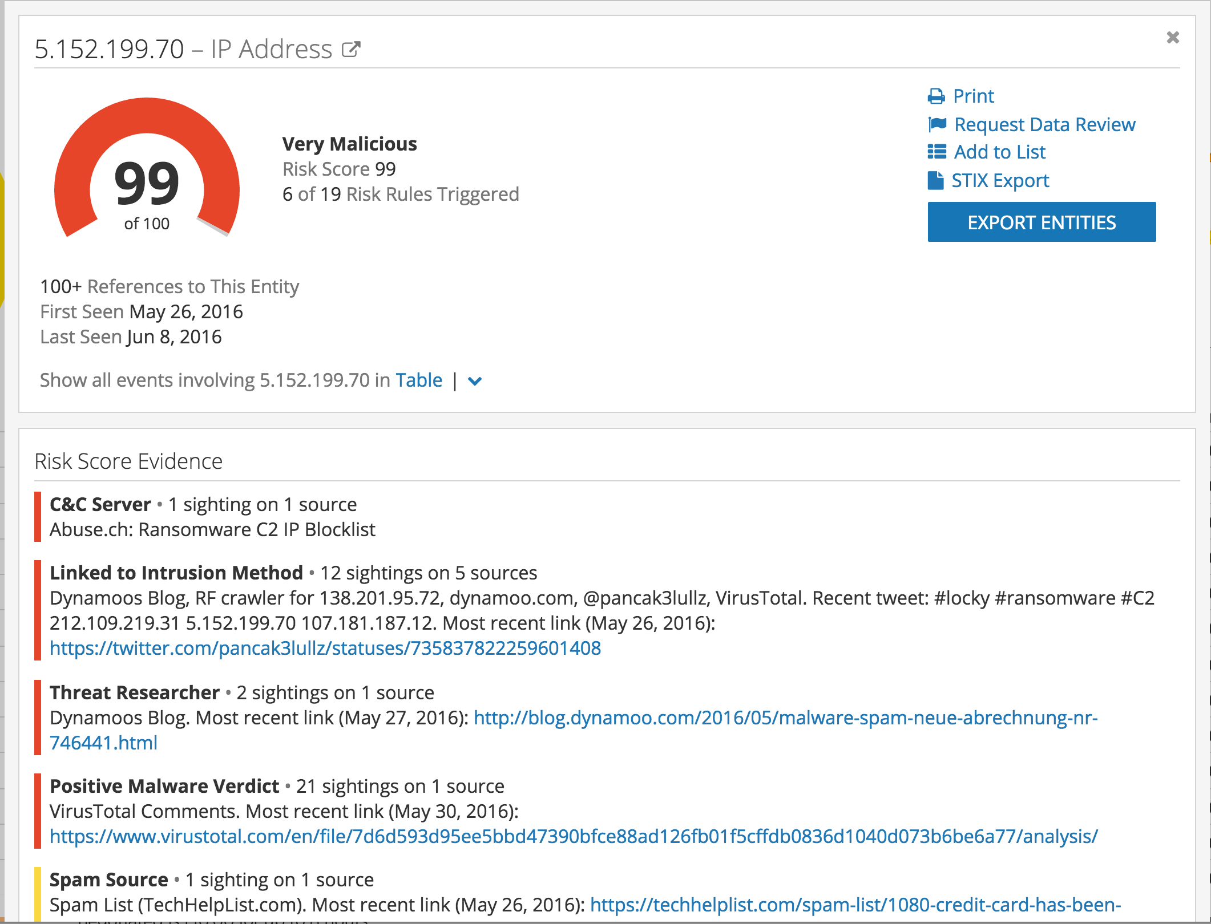

IP Risk Scores:
Swipe Left or Right,
or Investigate Further?
A malicious IP address is visible in your system.
5.152.199.70

Slide 6
Our overall goal
Organize the web for analysis,
not only for search –
entities, ontologies, events, time
Help analysts find trends, anomalies, asses threats,
generate predictions.
Create “analyst centaurs” –
man-machine collaboration.

Slide 7
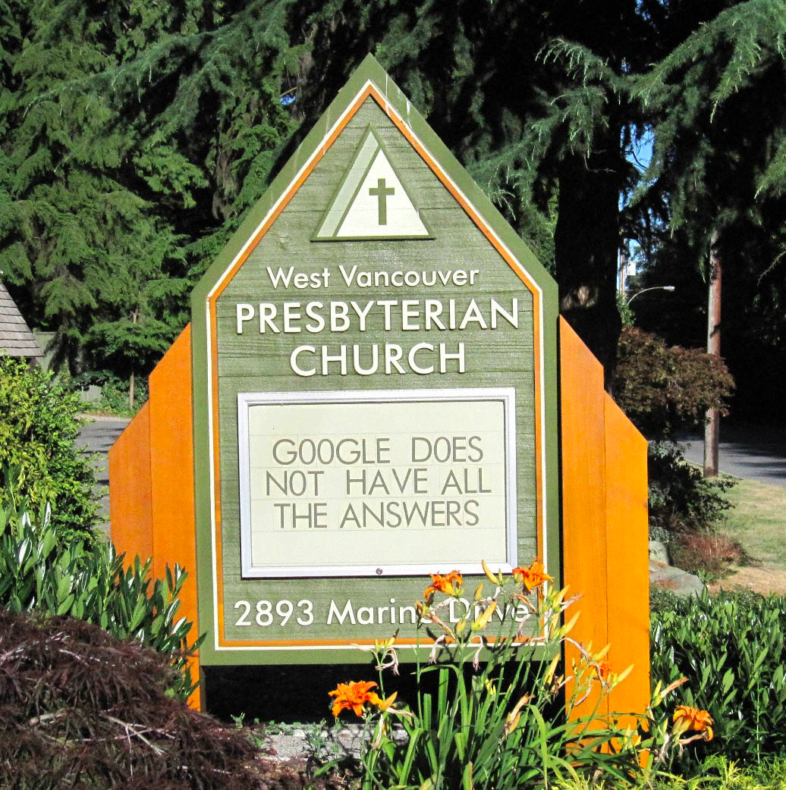
Empowering
Analysts
Way too much to read
Too many languages
Hard to prioritize what threats to focus on
Need to shift from organizing the web for search to organizing for analysis

Slide 8
Man & Machine
We use AI/NLP/ML in two major ways:
  Convert unstructured text into a language independent, structured data representation
  Find patterns / trends / anomalies to alert analysts on where to focus their attention
  Aid in decision-making

Slide 9
Man & Machine
Way too much to read
Too many languages
We use AI/NLP/ML in two major ways:
  Convert unstructured text into a language independent, structured data representation
  Find patterns / trends / anomalies to alert analysts on where to focus their attention
  Aid in decision-making
Hard to prioritize what threats to focus on and what decision to make

Slide 10
Risk Scoring of IPs
External threat lists
Recorded Future
Web Intelligence
  Malicious mentions
  Bad neighborhoods
  Suspicious company

Slide 11
External Threat Lists
Frequently based on honeypots and IDS data
Predictive – we’ve shown
88% predictability within threat lists
(i.e. only ~12% changes per day)

Slide 12
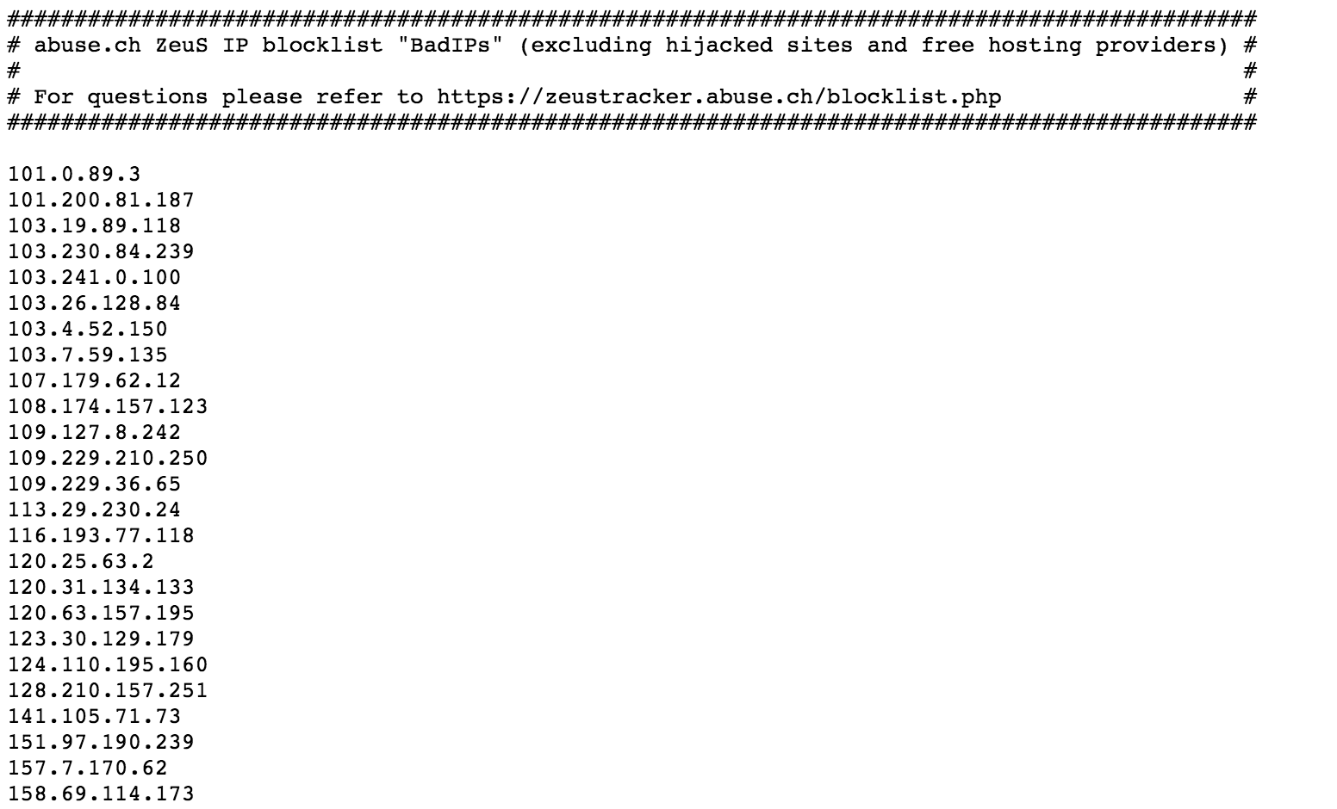
Threat Lists

Slide 13


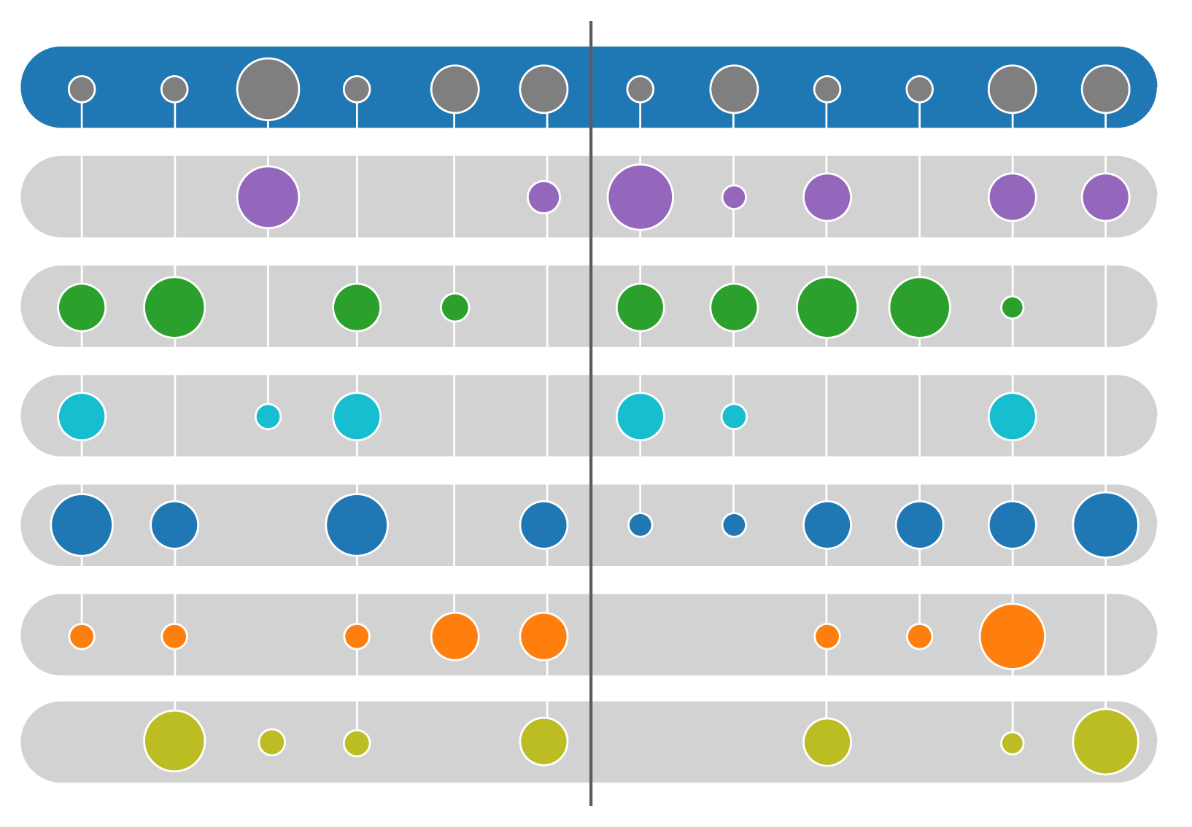

Web Intelligence
The Web
Organized for Analysis
Yield New Insights
Web
Intelligence
EngineTM
Entities
Events
Time
Past
Present
Future

Slide 14
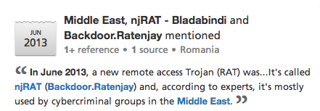
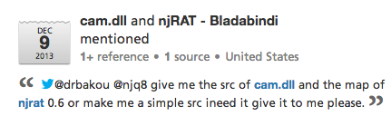
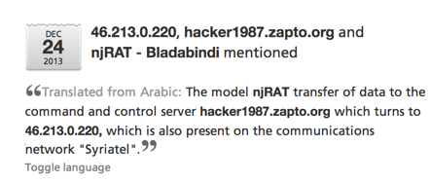
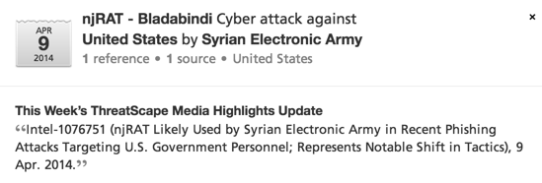
Recorded Future Web Intelligence Platform
REAL TIME
TEMPORAL ANALYTICS
7 languages
700k+ sources
10M+ docs/day
16B+ facts
300M+ entities
hacker1987.zapto.org
domain
Middle East
Region
46.213.0.22
IP
Backdoor.Ratenjay
njRAT
Remote Access Trojan
@drbakou
Twitter
Syriatel
Company
cam.dll
File Name
@njq8
Twitter
Syrian Electronic Army
Group

Slide 15
Recorded Future Web Intelligence Engine
Collecting
Organizing
Analyzing
Indexing
API
RSS feeds
Social media
Forums
Paste sites
IRC
TOR/Onion
Threat lists
Natural Language Processing
Structured Source Analysis
Signals
Risk Scoring
Events
Entities
Ontologies
Core API
Cyber API
Analytics API
Alerts
Cyber Daily
Browser Plugins
Only minutes from publishing to interactive analysis / alerts / …
750k+ sources,
7 languages
10-20M docs/day
20-40 million facts per day
16+ billion facts
1s response time

Slide 16
Ontologies: facts + hierarchies
Geography
World politics
Business leaders
Industries
Technology
Cyber

Slide 17
Malware Ontology

Slide 18
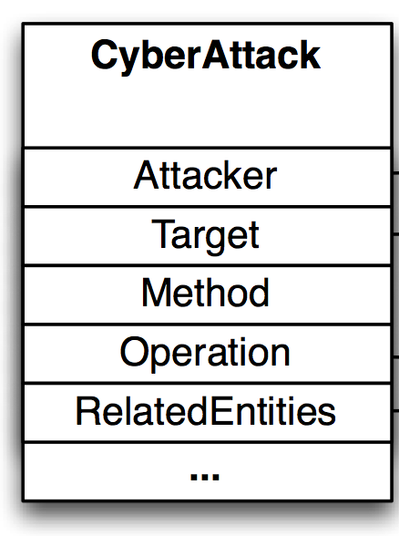
Events: Cyber Attacks

Slide 19
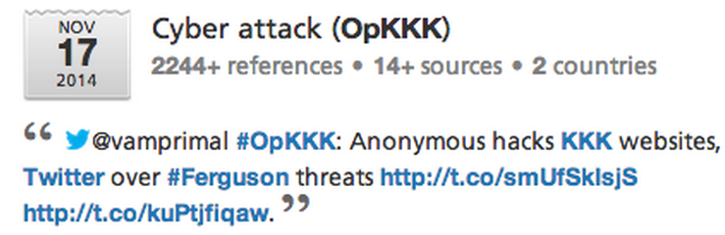
Extracting Cyber Attack Events

Slide 20
Extracting Cyber Attack Events

Slide 21
Events: Cyber Exploits

Slide 22
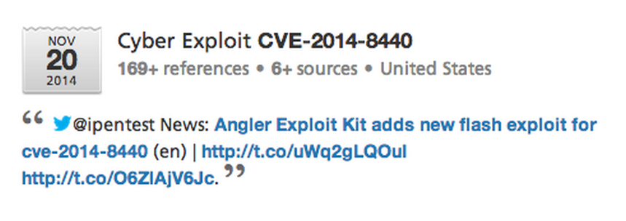

Slide 23
Using Recorded Future data for Risk Scoring
Our Web Intelligence Engine harvests millions of documents per day from all over the web, and extract entities, events, and time
This information can be though of as defining a “threat graph” that connects entities based on relationships defined by events and co-occurrence
Information in this threat graph can be used to compute risk metrics in multiple ways

Slide 24
Bad Company
“Two Shady Men Walk Into a Bar”

Slide 25
“Two Shady Men Walk Into a Bar”
Look at contexts where an IP occurs –
e.g. being mentioned together with Malware and known threat actors
Number of co-occurrences and severity of related entities indicates if an IP address is malicious

Slide 26
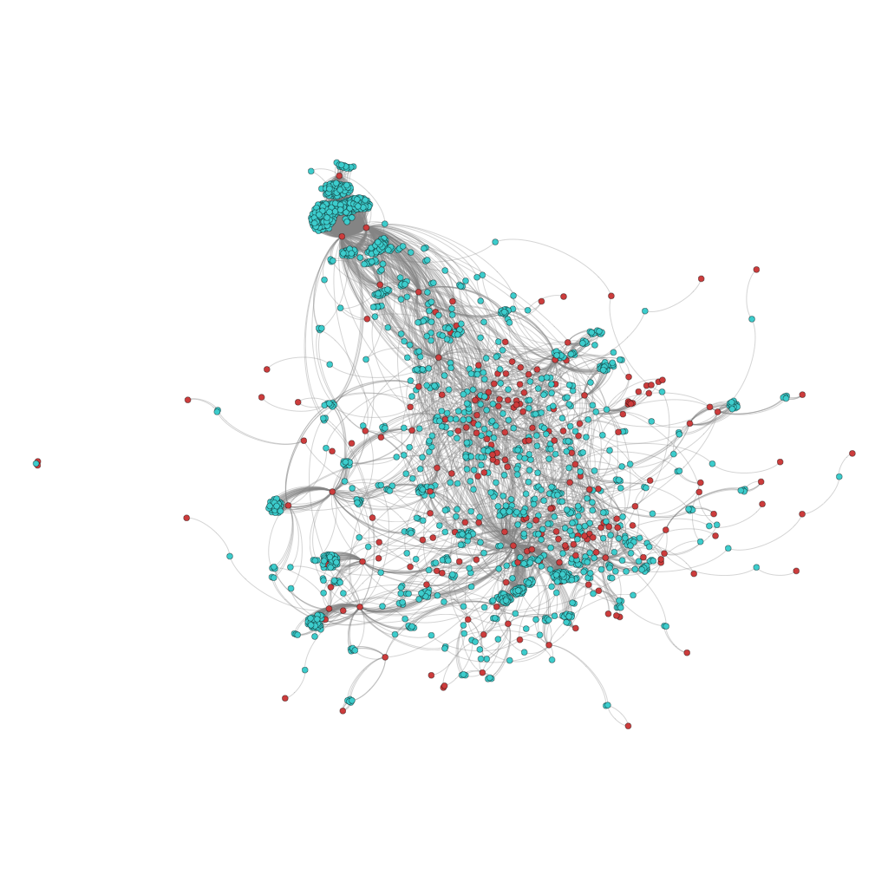
Network graph of 1,521 IP addresses (blue) and 198 Malware (red) shows some major clusters and several smaller structures.

Slide 27
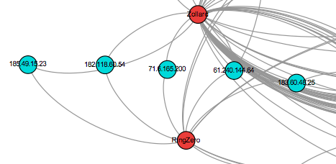
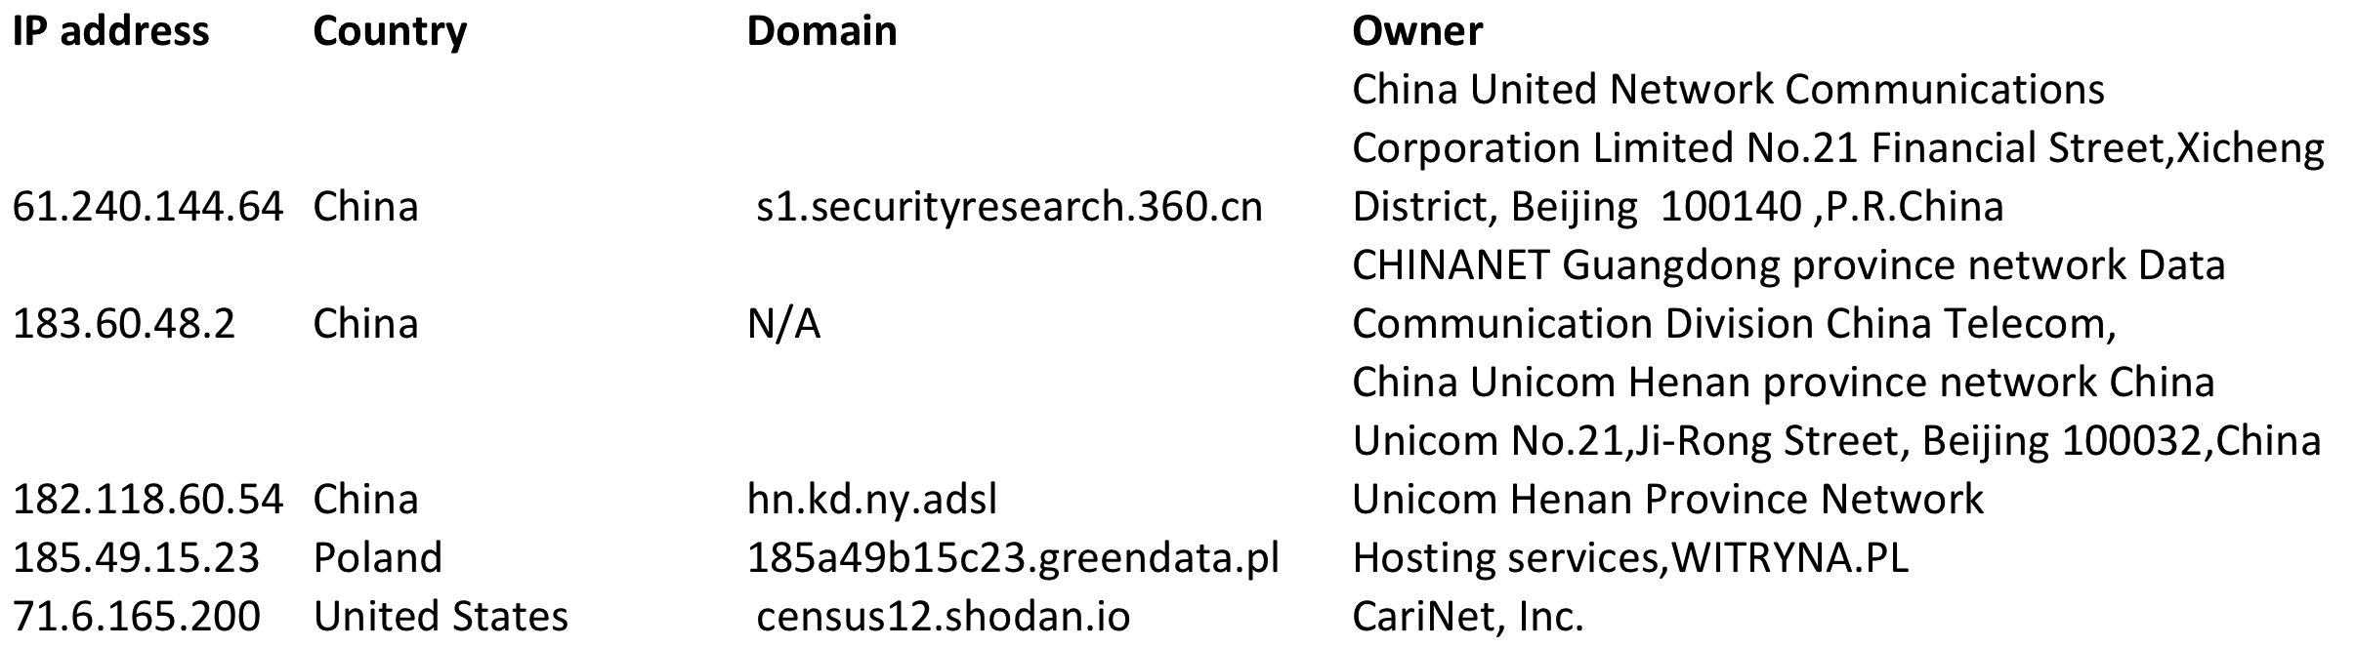

Slide 28
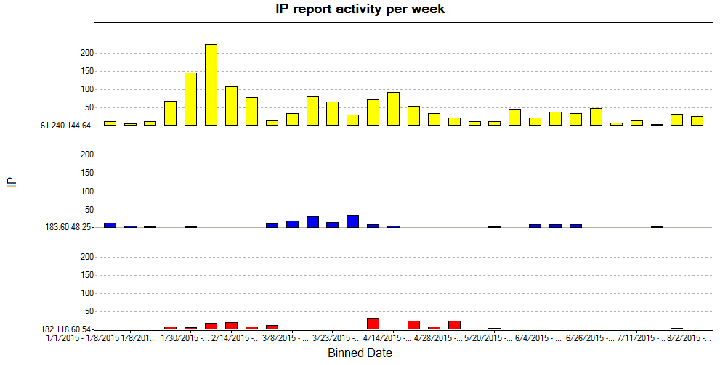

Slide 29
Bad Neighborhoods

Slide 30


Slide 34
Risk Scoring
We have created an aggregated Recorded Future Risk Score based on a set of maliciousness / suspiciousness criteria:
  Mentions by honeypot bots,
  Co-occurrence with Malware entities
  etc. etc.
Applied to IP Addresses and Hash values
Same machinery also used to asses criticality of vulnerabilities

Slide 35
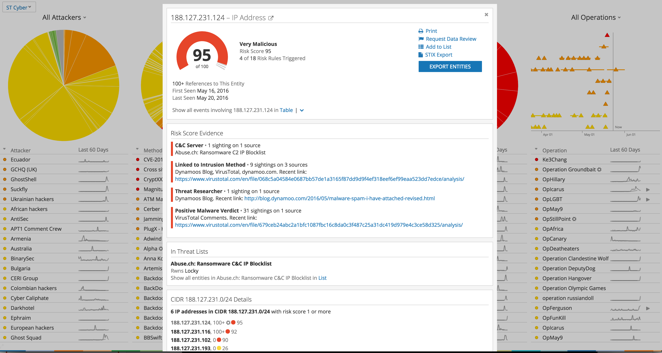

Slide 36
Details on Risk Score Calculation
  The overall Risk Score is a number between 0 and 99, determined by which rules are currently triggered. Each risk rule has a severity level, which corresponds to a band of risk scores.
    Very Malicious: 90-99
    Malicious: 65-89
    Suspicious: 25-64
    Unusual: 5-24
    No current evidence of risk: 0
  The highest severity level associated with an entity determine the base score as follows:
    Very Malicious: 90
    Malicious: 65
    Suspicious: 25
    Unusual: 5
  Additional risk evidence will increases the Risk Score within that band. However, this additional evidence never moves the score to a higher band. For example, no amount of suspicious risk evidence will cause the score to become Malicious.

Slide 37
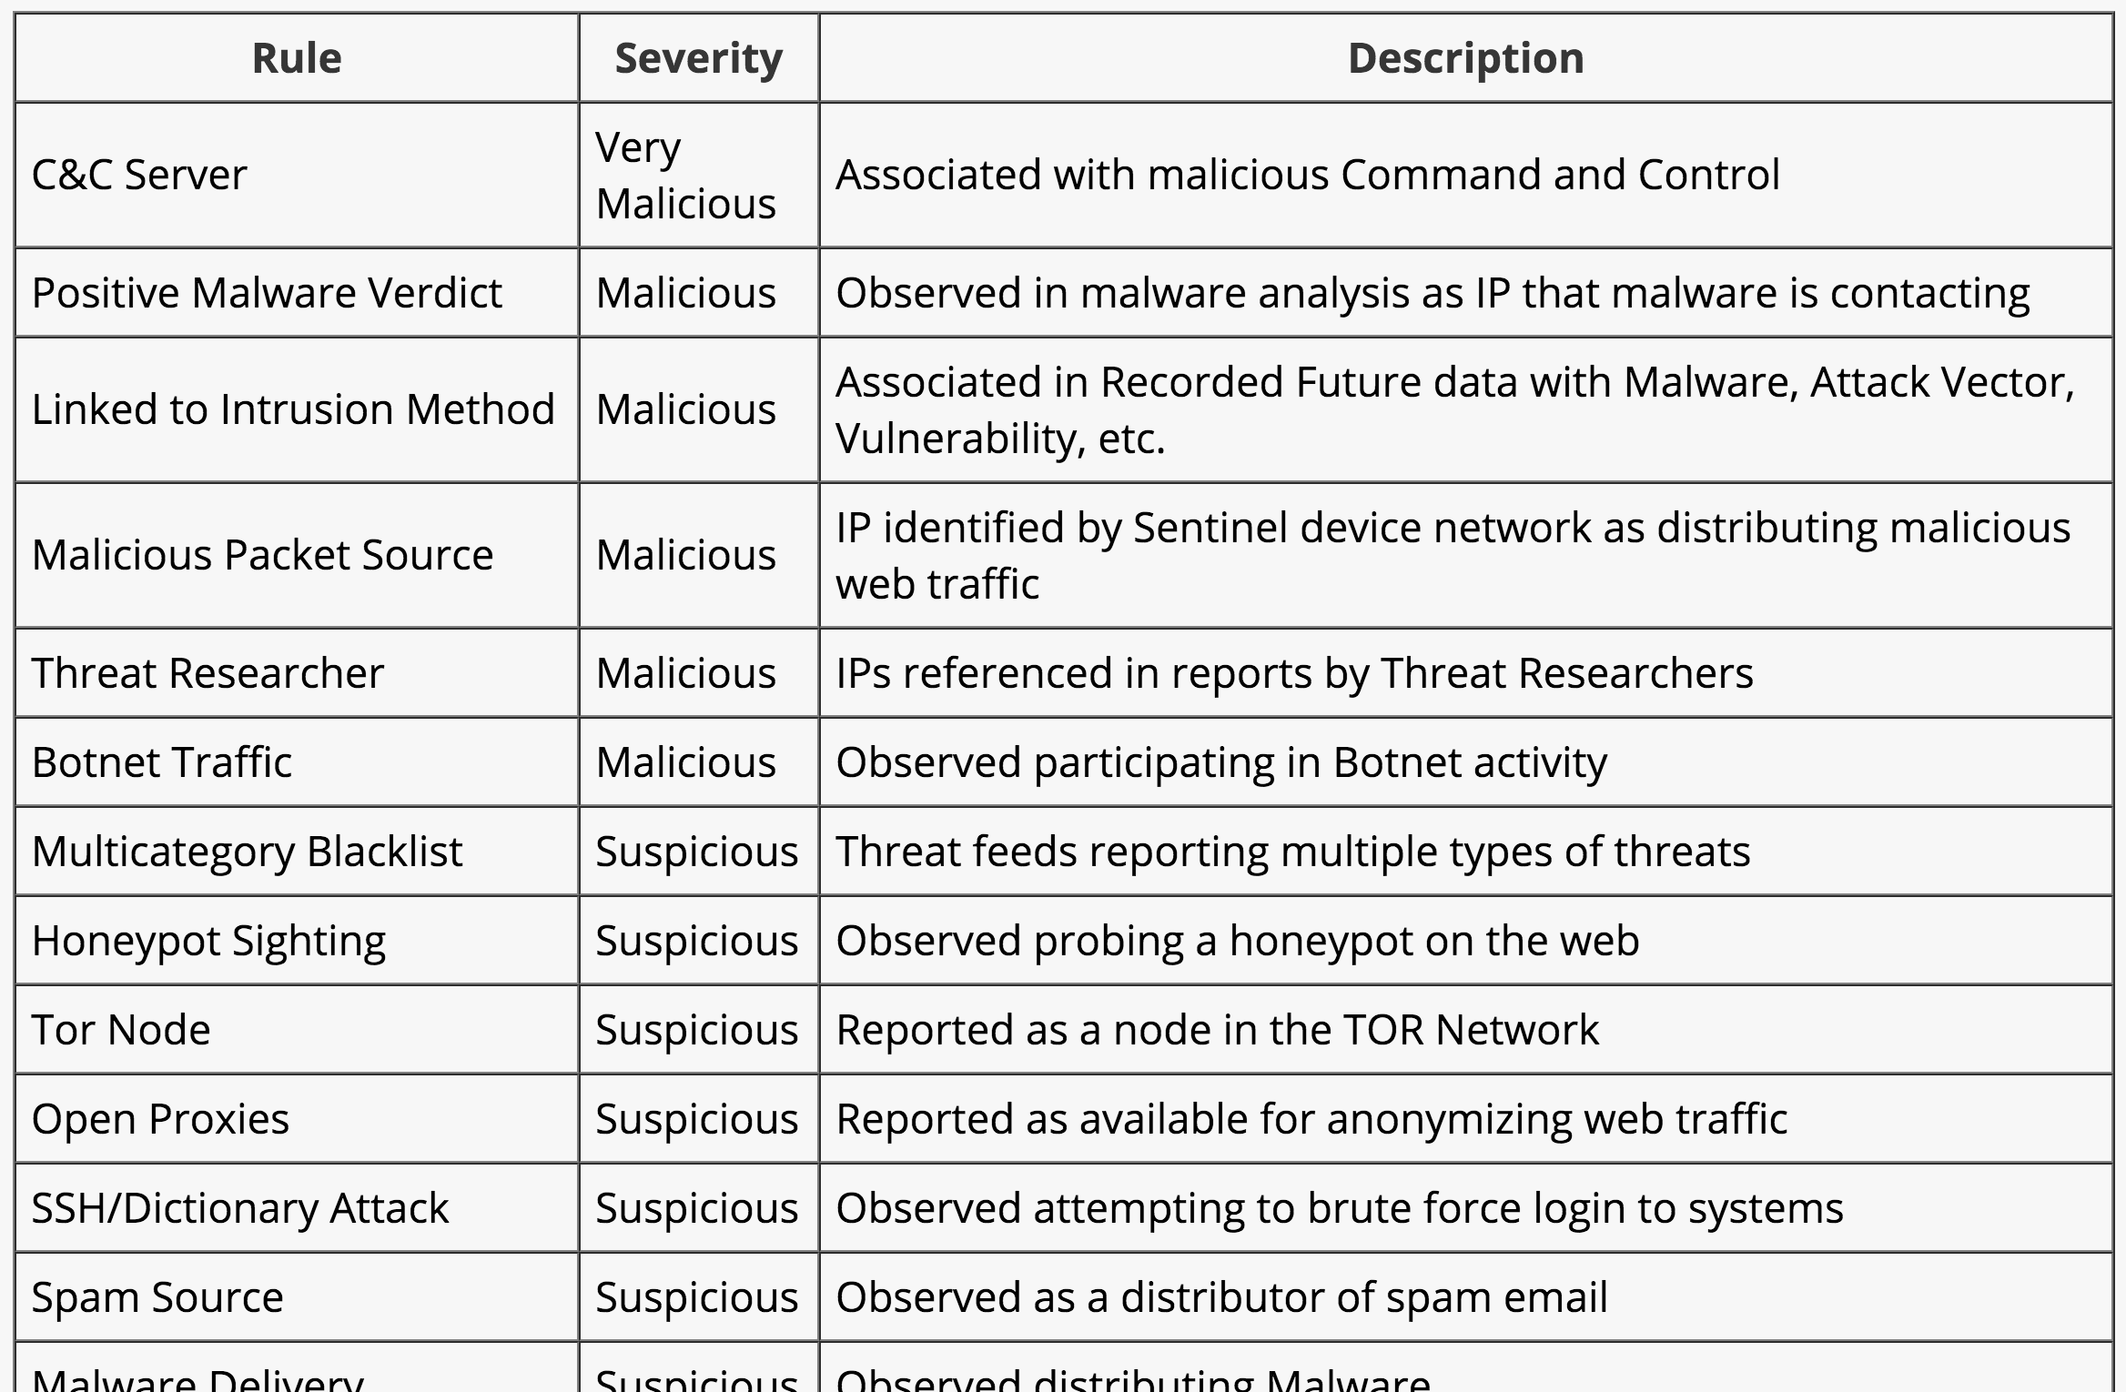
Risk Score Rules

Slide 38
Value of Risk Scores Based on
Threat Lists + Open Source Intelligence
Open Source Intelligence adds ~120% more
IP addresses with risk score on any given day
40k IPs from threat lists →
88k IPs from threat lists + open source

Slide 39
Next Step: Predictive IP Risk Scoring
45% of this week’s threat list addresses
remain on next week’s lists
Our extended threat lists based on contextual information identify 66% of next week’s threat listed IPs (the 45% above is true subset of these)
An SVM (support vector machine) trained on historical data from both threat lists and open source intelligence yields 75% of next week’s threat listed IPs at
>99% precision on a balanced test set
Combination of two types of intelligence (threat lists and open source intelligence) is critical to achieve good precision at substantial recall level

Slide 40
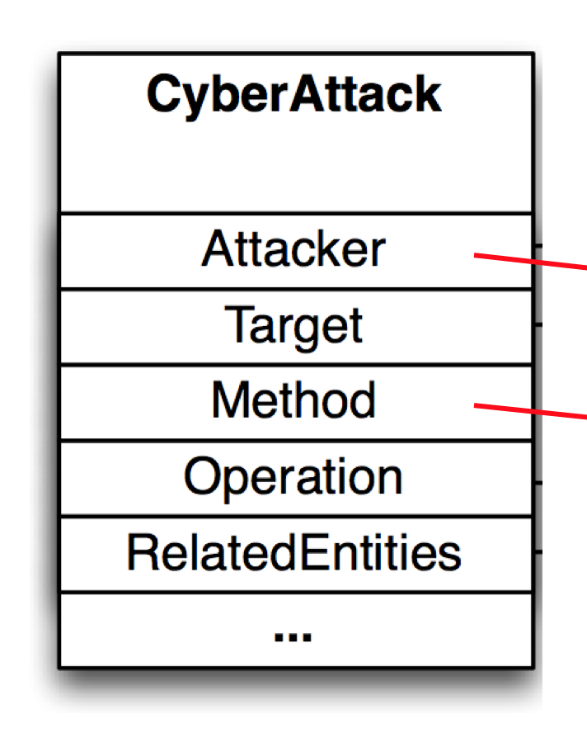
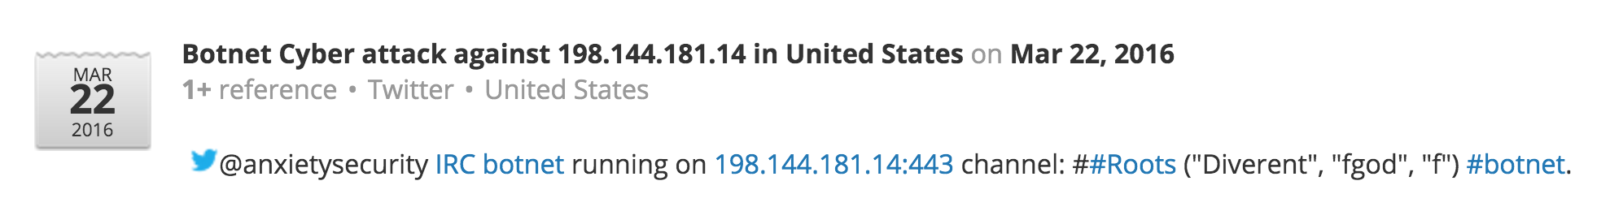
Data Used in Machine Learning Modelling
Threat Lists
  Harvesting directly implicated IP addresses from a collection of public threat lists
  Compare MLSec’s Combine project –
  github.com/mlsecproject/
  combine
  High value, but not necessarily up to date – many resources are not real-time
  Provides little or no context useful for validation
Open Source Intelligence
  Real time open source resources (750k+ sources – open, deep, dark web)
  Natural Language Processing (NLP) to bring structure to unstructured text

Slide 41
Predictive Model at a High Level
Historic Threat
List Data
Training + Validation ML Pipeline
(Run Daily)
NLP’ed Contextual Data
Feature Map
Predictive Model
Maps an IP into the numeric vector of densities around historic data of IP lists
Maps a feature vector into a risk score between 0 and 100 (probability of maliciousness)

Slide 42
Predictive Risk Scoring - Results
We trained a model on historic data on the morning of 3/8, and applied it to the entire IPv4 address space
  327,549 IPs occurred on any future threat lists
  in the following week (3/9 to 3/15; 7 days in total)
185,209 of these did not appear on any lists in the past three weeks
(2/17 to 3/8 inclusive; 21 days total)
Our model predicted 242,206 (74%) of future listed IPs while maintaining >99% precision on a balanced test set
38,922 of these future additions wouldn't have been detected any other way

Slide 43
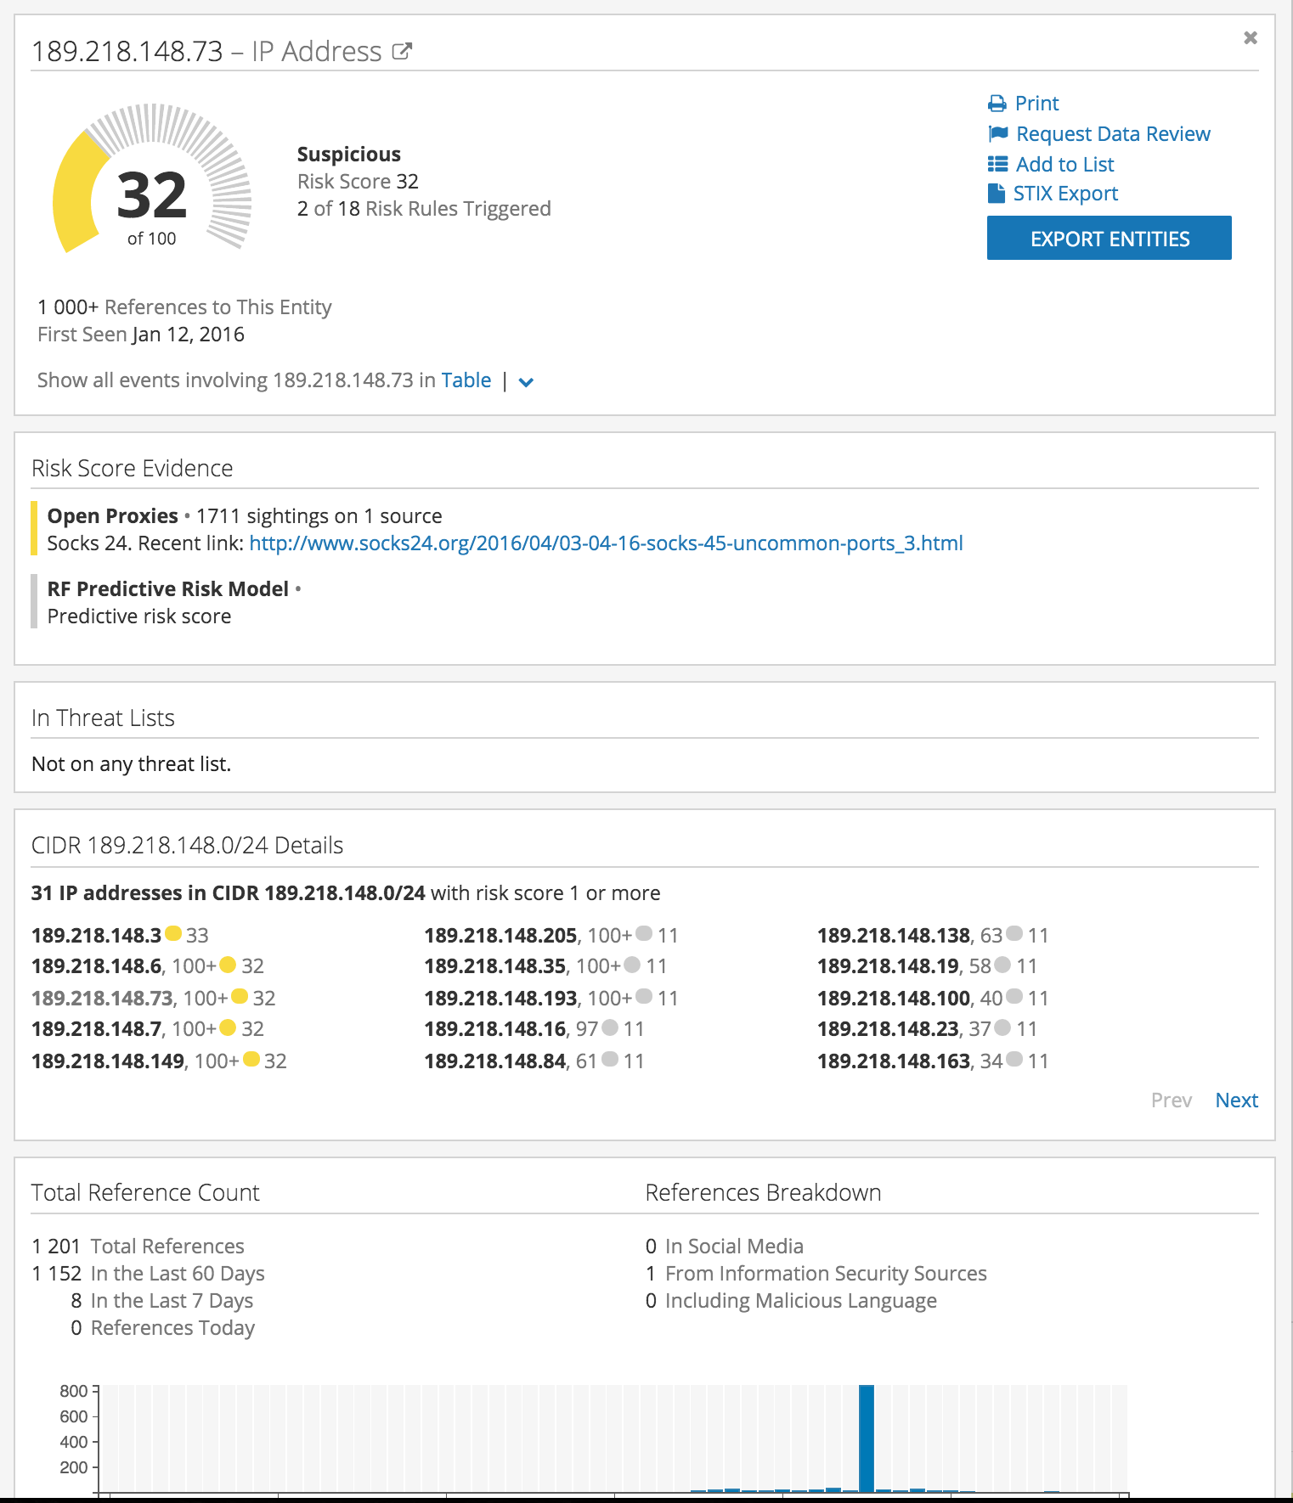
189.218.148.73
Predictive risk score 0.75
on 2016-03-08
First sighting on threat lists (Socks24) on
2016-03-11
and on open source intelligence (PasteBin) on 2016-03-16

Slide 44
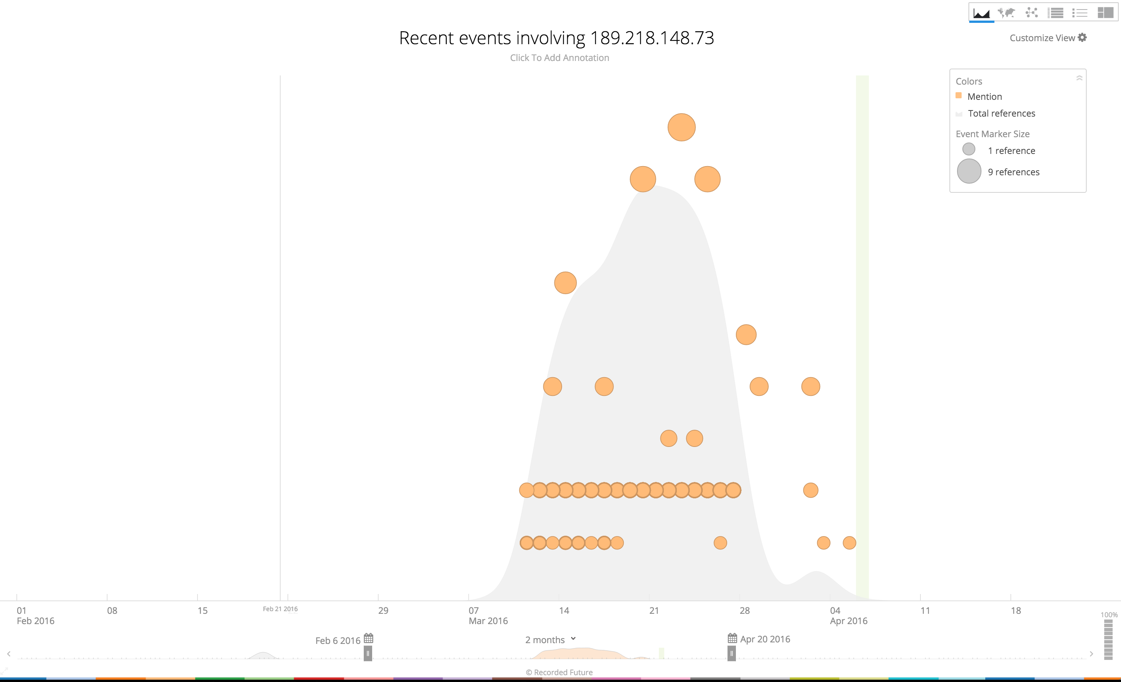
Risk Score 0.75

Slide 45
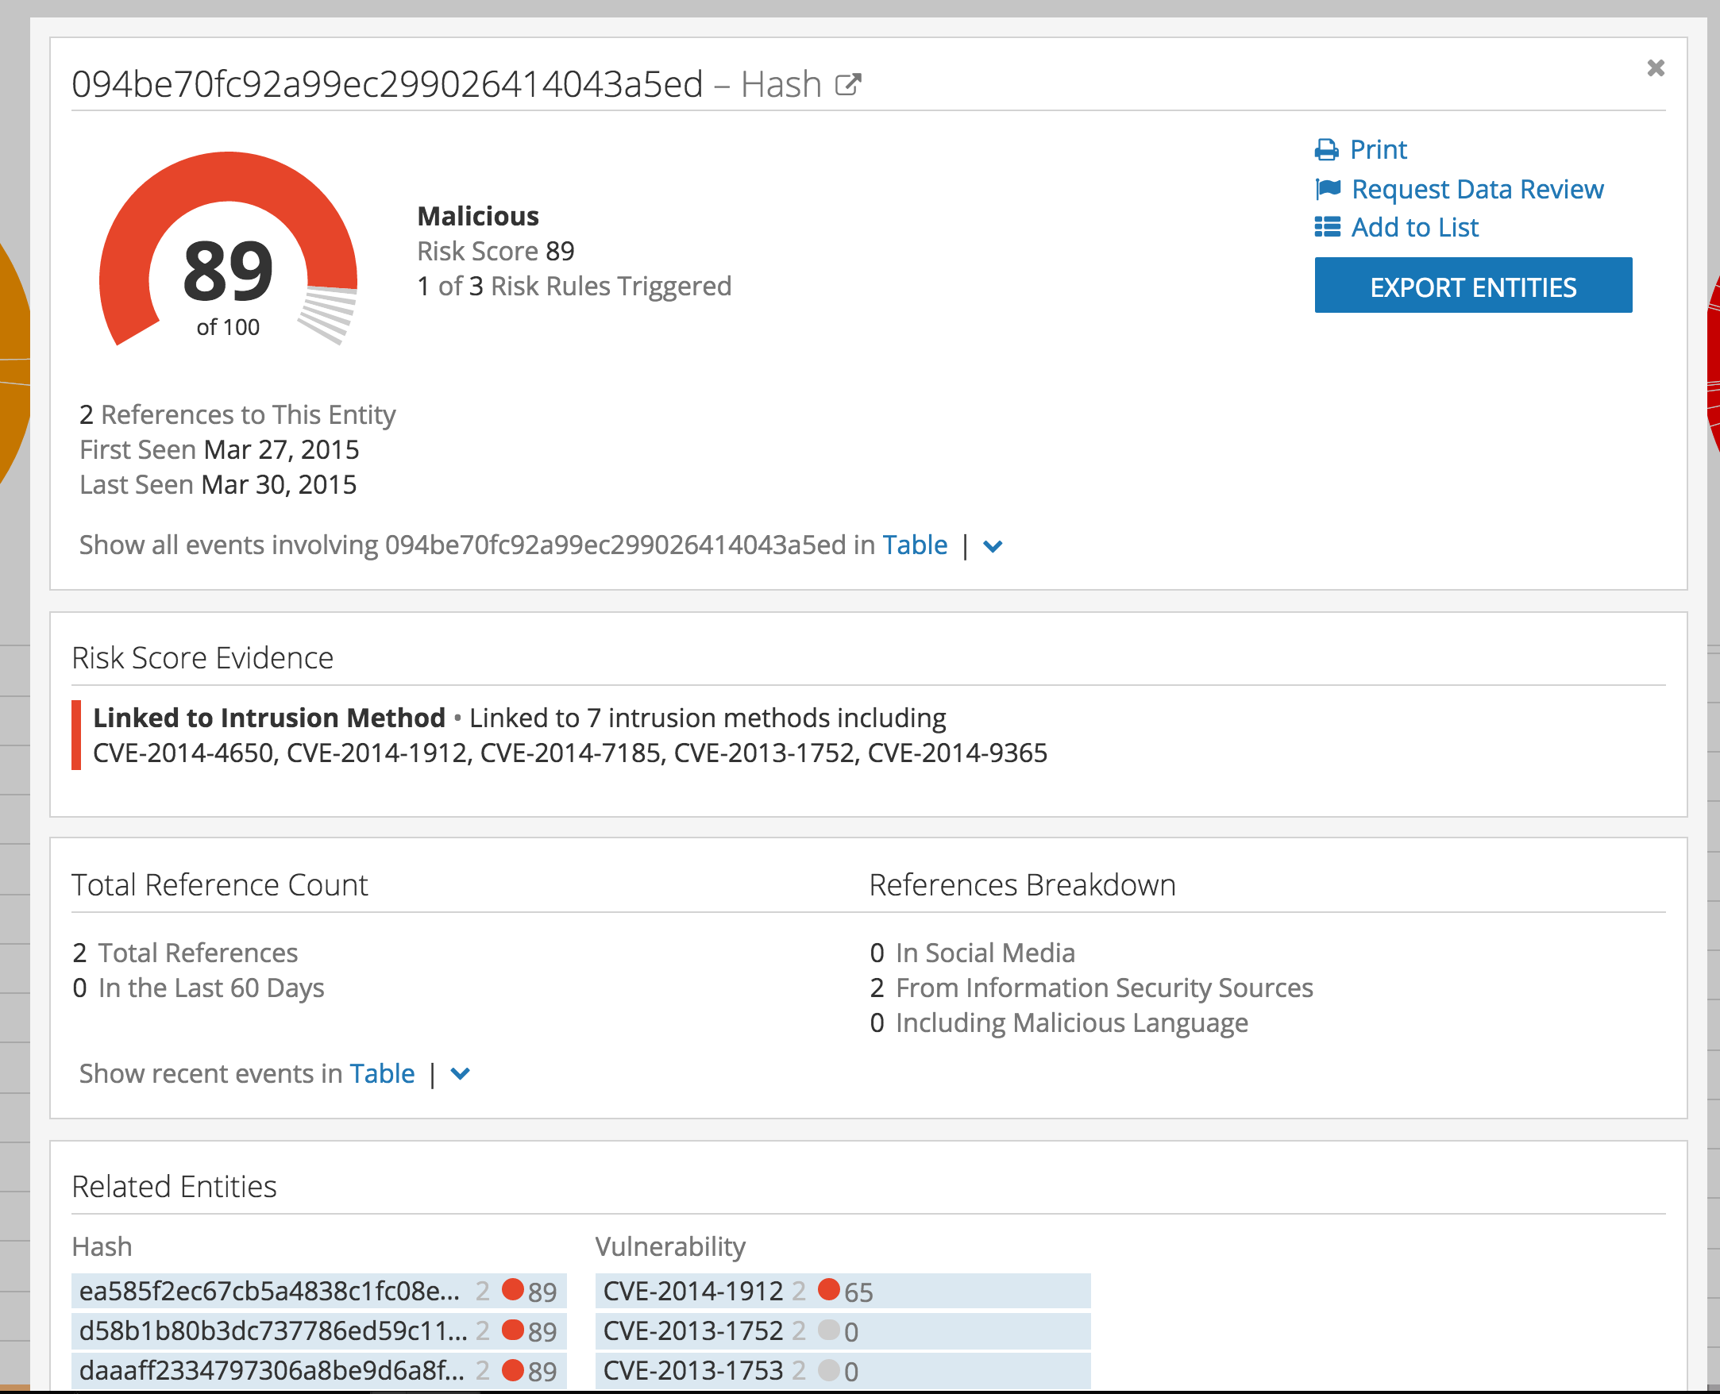
Hash Risk Scoring

Slide 46
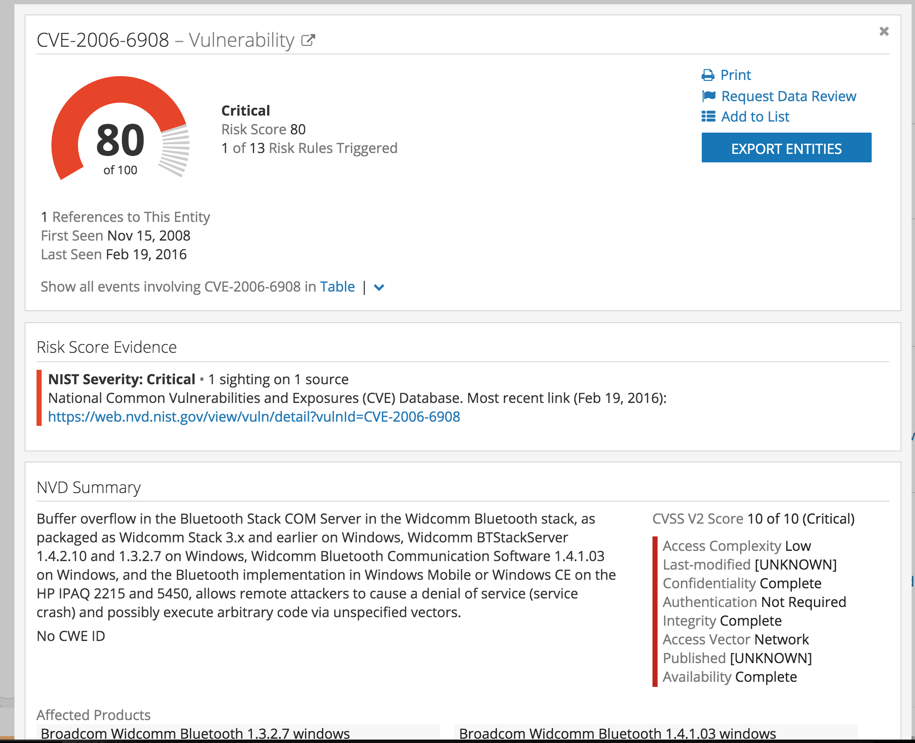
Vulnerability Risk Scoring

Slide 47
Conclusions
Adding open source intelligence to traditional threat lists yields 120% more malicious IPs
Predictive Risk Scoring gives analysts and operators ability to handle future malicious IP addresses – identifies 75% of all IPs on next week’s threat lists
Risk scores so far calculated for IPs, hashes, and vulnerabilities
Risk Score + Context allows for speedy, informed decision making

Slide 48
Thanks for listening – get in touch!
Staffan Truvé truve@recordedfuture.com
@truve
DON’T MISS OUR WORKSHOP ON WEDNESDAY, 10:30-12:30
“Qualification in the Web – Using NLP for Adversary Identification & Prioritization”
Notes:
The best way to finish your presentation is to place call to action text or contacts. Try to initiate feedback and further communication.
Please mind the size of text areas.

