Slide 2
From Cyber Incident Response to Cyber Resilience
Dr. JR Reagan

Slide 3
Incident Response
Changing landscape
Impact
Low likelihood / High Severity
Critical Risk
Crisis
Corporate Crisis with reputational damage to the brand
Requires an executive level response and plans with pre-considered actions
Cyber attack
High
Major technology failure
Key supplier failure
Health pandemic
Terrorist attack
Non-routine incident
Indicative
Require the business to step in and coordinate the response
Needs a defined structure to manage and resolve
Staff discontent
Medium
Severe weather
Low-level risk
High Likelihood / Low Severity
Routine incident
Minor fraud
Site utility failure
Low
Addressed through Standard Operating Procedures
Minor technology failure
Fire alarm
Low
Medium
High
Likelihood

Slide 4
Incident Response
Typical response plan types
Crisis
Crisis/Incident Management Plan
Scenario specific response plans
High impact
How we transition from Business-as-usual to major incident
Required protocols and structures
Provides the overall ‘command and control’ structure to execute recovery plans in a controlled and coordinated manner
Used to make sure the right people are involved to make decisions
Plans for specific risks of a much larger scale, with a greater impact than scenarios detailed in the business continuity plans
Non-routine / major incident
Business Continuity Plans
Technical response plans
Plans for recovering business processes in the event of disruption caused by general unavailability scenarios
Plans for recovering key systems / operations in line with recovery objectives (e.g. IT DR)
Routine incident
Standard Operating Procedures
Low impact
Well used response actions in place to deal with BAU disruptions (e.g. fire alarms, site utility failure)

Slide 5
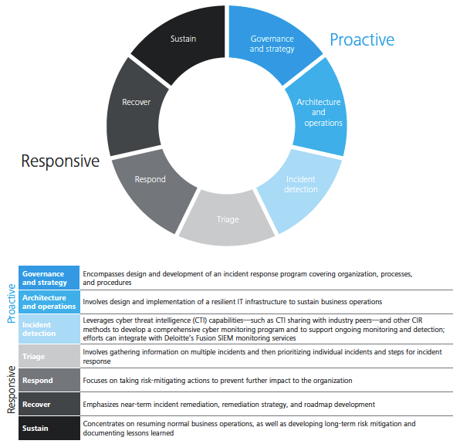
Incident Response Lifecycle
Continuous action

Slide 6
Cyber Incident Response Lifecycle
Capabilities and stakeholder confidence
CRISIS
INTERMEDIATE
Weeks – Months
LONG-TERM
Months – Years
MONITORING
Ongoing
SHORT-TERM
Hours – Days - Weeks
At the most strategic level, recovering from a cyber incident involves an important balance between recovering or enhancing capabilities and restoring confidence among a broad spectrum of stakeholders.
Capabilities
Business and operational capabilities need to be restored in the case of disruptive or destructive attacks, which usually takes hours or days, but can extend for weeks or even months in severe cases.
Cyber risk capabilities need to be enhanced to secure the environment, provide better visibility into ongoing threats, and reduce the impact of future attacks. Important progress can be made in the short term, but significant improvement usually takes months or years to achieve.
Confidence
Customers are most immediately concerned with direct personal damage from loss of data, but may develop longer-term brand aversion
Employees can be overwhelmed by negative publicity and increased chaos in both their work and personal lives
Business partners are concerned about the immediate threat of cross contamination and the longer-term integrity of business transactions
Regulators are concerned about consumer protection, existential threats to the business, and the broader soundness of the industry
Capital markets and shareholders are highly attuned to potential impacts to revenue and earnings in the near term and the viability of the brand over a longer time horizon. They pay a lot of attention to the attitudes of other stakeholders, especially customers and regulators.

Slide 7
Cyber Incident Response Lifecycle
What to expect in the short-term
CRISIS
INTERMEDIATE
Weeks – Months
LONG-TERM
Months – Years
MONITORING
Ongoing
SHORT-TERM
Hours – Days - Weeks
Example Response and Capability Enhancing Activities
Examples of Confidence Influencing Events / Realities
Deploy Crisis Response Team
Anticipate strategic, operational and tactical impacts; establish battle rhythm, communication and decision making process
Execute initial technical containment strategy
Establish internal and external communications plan to pre-empt or respond to reputational threats and manage stakeholder outreach
Determine need to engage law enforcement and regulators
Determine need to ramp-up external forensics, analytics, legal, and other assistance
Establish specific metrics to communicate on containment and response efforts
Communicate updates with executive team and board of directors
Monitor social media for customer sentiment and integrate in decision making
Identify and implement “customer confidence” enhancement schemes
Identify and mobilize to determine compliance impact and response
Prepare for increased call volume and other required customer management measures
Implement fraud controls
Press reports on breach → negatively impacting consumer, regulatory, and internal confidence
Directors being targeted in lawsuits
Damaged careers at executive and director levels
Fumbled communications opportunities can have a disproportionate impact on public and regulatory response to breach
Intellectual property compromised → negatively impacts confidence and increases legal and business operating costs over short and long term
Customer personal data released → heightens emotional response to breach and could incite feelings of mistrust and betrayal.
Stock price (market cap) reaction to the breach is difficult to predict, a negative market reaction could hinder company investment and growth

Slide 8
Cyber Incident Response Lifecycle
What to expect in the intermediate-term
CRISIS
INTERMEDIATE
Weeks – Months
LONG-TERM
Months – Years
MONITORING
Ongoing
SHORT-TERM
Hours – Days - Weeks
Example Response and Capability Enhancing Activities
Examples of Confidence Influencing Events / Realities
Execute notification procedures for data breach, if applicable
Set up briefing sessions with appropriate officials and / or major clients and third-party stakeholders
Execute technical remediation and mitigation strategy
  Establish incidence response command center
  Investigate breach while preserving evidence
  Install monitoring and threat containment software
  Update software or configuration settings
Assess need for declaring operational risk event
Execute approved crisis communications plan, monitoring traditional and social media for customer sentiment
Coordinate support for business process workarounds/interim processes, as appropriate
Conduct criminal investigation and file criminal complaint or civil pleading, if applicable
Determine and immediately operationalize steps needed to re-establish trust with client base
Determine 8K filing requirement
Regulatory investigation by Office of Civil Rights within HHS, States’ Attorney Generals begin to field complaints and investigate → Negatively impacting confidence levels
Regulatory investigation by National Association of Insurance Commissioners → Increased scrutiny by State insurance regulators
Class action lawsuit / litigation wheels begin to turn → negatively impacting confidence levels
Initial notification of clients and potentially affected persons → negative impact initially, however, if managed properly could turn into a positive impact on confidence levels
Congressional hearings or inquiries → negative impact initially, these will increase visibility of the breach, however an effective response could positively impact confidence levels and stakeholder relationships
Industry response will likely be influenced by the ongoing dialogue with congress on the regulatory environment→ this dialogue played out in the media could have unpredictable confidence ramifications; a qualified government relations team could neutralize this threat.

Slide 9
Cyber Incident Response Lifecycle
What to expect in the long-term
CRISIS
INTERMEDIATE
Weeks – Months
LONG-TERM
Months – Years
MONITORING
Ongoing
SHORT-TERM
Hours – Days - Weeks
Example Response and Capability Enhancing Activities
Examples of Confidence Influencing Events / Realities
Conduct broad post-crisis assessment to document lessons learned and adjust response plans
Prioritize, budget, coordinate and execute remediation of operational gaps across enterprise
Re-assess current and desired/target maturity levels across security domains
Re-assess security organizational model and enterprise cyber strategy
Build data justification/analysis for insurance claim submission
Execute technical recovery and sustainment strategy:
  Implement controls to prevent similar incidents
  Deploy containment measures to otherwise unaffected but potentially vulnerable environments
  Plan and execute remediation; possibly including re-training of personnel and updating software
  Define program metrics and measure success
Transition from incident response to business resumption/resilience → transitioning to upgraded daily operations
Conduct simulation and wargaming to stress test new plans
Customer “short term memory” – as customers are ‘locked in’ to a plan for a year, there is opportunity to eradicate, remediate, and message about the breach and decisive steps to strengthen relationships and improve confidence levels
Investigation identifies the source of the incident → potentially a positive impact if properly and efficiently communicated
Eradication and resolution - probable positive impact regarding confidence levels if well handled
Other news / March of Time → probable positive impact as the public, employees, and regulators focus their attention on the crises of tomorrow instead of our current cyber incident
Investing in cyber leadership for industry – become leading advocate for improved protections for sensitive data and PII → probable positive impact as the public, employees, and regulators view us as “carrying the flag” for cybersecurity
Sustain communications strategy to communicate revised strategy and priorities and maximize the relationship re-building process post recovery (board, regulators, third parties, vendors and clients)

Slide 10
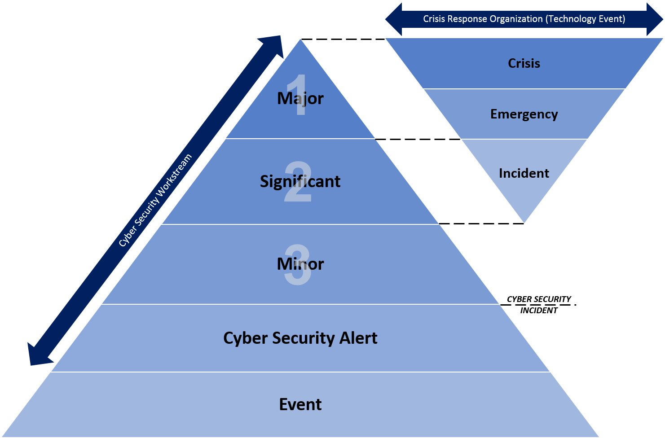
Cyber Security Incident Response (CSIR) Framework (example)
CYBER SECURITY INCIDENT LEVELS
MAJOR (L1) | Impacting or high likelihood of impacting significant volume of sensitive/critical information, users, and/or electronic services. Can potentially disrupt critical services across enterprise and recovery may not be possible. Requires coordinated response several various functional teams across the enterprise.
SIGNIFICANT (L2) | Impacting or potentially impacting sensitive/critical information, users, and/or electronic services. Can potentially disrupt services across departments or business units within the enterprise, and recovery time is moderately unpredictable with additional resources required. Requires coordinated response several various functional teams across the enterprise.
MINOR (L3) | Minimal or no impact to sensitive/critical information, users, and/or electronic services. Does not promptly lead to disruption of critical services, but has potential to cause loss in efficiency or worsen over time. Predictable recovery time and recovery may require additional resources. Typically requires response efforts from the incident response team in conjunction with relevant subject matter experts.
CSIR FRAMEWORK DEFINITIONS
Event | An observable occurrence in a system or network. Events include a user connecting to a file share, a server receiving a request for a web page, a user sending email, and a firewall blocking a connection attempt.
Cyber Security Alert | An event that is, or has the potential to be, a cyber security incident. Cyber security alerts should be investigated to confirm whether they are a cyber security incident (true positive). Once confirmed, the incident severity, along with other criteria, should be defined in order to enact the proper cyber security handling protocol.
Cyber Security Incident | An occurrence that actually or potentially jeopardizes the confidentiality, integrity, or availability of an information system or the information the system processes, stores, or transmits. A Cyber Security Incident is an incident in which there has been, or there is the imminent potential for, a violation of security policies, acceptable use policies, or standard security practices.

Slide 11







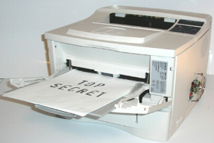
Cyber Incident Scenarios
  Real world examples
Scenario #1
A significant volume of customer PII and sensitive company data is stolen by a criminal hacker group and then ransomed.
Scenario #5
The company’s primary customer-facing website / user portal is systematically compromised until it is fully disabled.
Scenario #2
A disgruntled company insider facilitates outsider access to critical company business applications and data.
Scenario #6
Weaknesses in the company’s mobile application are exploited – diverting a large number of payments to offshore bank accounts
Scenario #3
A cyber-attack on a third-party vendor results in the exposure of sensitive company data and customer information.
Scenario #7
Hackers capitalize on publicly disclosed vulnerabilities in company systems to steal and then sell customer PHI.
Scenario #4
Aggressive malware deployed within the corporate computing environment destroys key technology infrastructure and end-user computing assets.
Scenario #8
Hardware vulnerabilities in technology assets are used to create uncontrolled access points into the company network – supporting the entrenchment of an advanced persistent threat.
All these cyber incident examples must be highly coordinated if an incident is to be contained or, if an incident does escalate to crisis levels, managed.

Slide 12
Incident response and executive leadership
Cross functional team
To manage the challenges associated with incident response, and to appropriately balance rebuilding and enhancing confidence and capabilities, organizations should embrace an enterprise incident response approach. At the helm, a cross-functional executive level incident response team should drive decisions and lead the prioritization of restoration and enhancements.
Governance
Incident Response cross-functional coordination, documentation,
and stakeholder communication
Strategy
Organizational
strategy in dealing with cyber incidents, including executive, board, and customer communication.
Technology
Technical Incident Response, forensics, malware analysis, log analysis, and IT operations support.
Business Operations
Operational resilience during cyber incidents through integrated business continuity and disaster recovery processes and proactive communications.
Risk & Compliance
Risk and compliance management, including interfacing with regulators, legal counsel, and law enforcement.
Remediation
Remediation of incident root cause and associated business processes.

Slide 13


Governance
Once a response strategy is developed, organizations need appropriate governance processes to facilitate cross-functional coordination, develop actionable documentation, and drive stakeholder communication.
Leverage lessons learned to confirm current staff and their skillsets are sufficient.
Incorporate executive training and awareness in the plan.
Evaluate if dedicated team and proper coverage are available.
Do I have the right team in place to handle a cyber incident?
Develop and agree upon metrics to periodically report.
Identify existing reporting channels for executive sponsors.
Who and what am I reporting to and how often?
Develop formal cyber war gaming initiatives that include the cross functional team.
Perform cyber war gaming periodically to measure effectiveness of appropriate security controls in the organization.
Develop formal and informal training program for process dissemination.
Are we periodically testing our plan and training our staff?
Conduct post-breach and war gaming sessions to document gaps that impacted response efforts.
Update plan and training materials accordingly.
How am I incorporating lessons learned?

Slide 14
Strategy
Organizations should develop and implement an Incident Response strategy that aligns with expectations, responsibilities, and values of an organization’s stakeholders, leadership, and markets.
C-Suite needs to understand
what decisions need to be made,
timing involved, and other related considerations.
Identify individuals responsible for communicating and informing
the C-Suite.
When do I inform the C-Suite?
Design key risk and performance indicators based on organizational strategy.
Align notification thresholds to risk appetite as defined by the board.
When do I inform the board?
Assemble a cross-functional team.
Implement a broad coordination plan driven by executives: tone and leadership “set from the top”.
Have a qualified firm on retainer to assist before an incident occurs.
Does my strategy address internal and external coordination?
Tailored response for customers, suppliers and business partners.
Train and engage public affairs and external communications team appropriately.
How will we take care of those affected?
Prioritize effective communication channels based on size
and severity of incident.
Identify multiple communication channels to affected parties.
What is the most effective communication channel?

Slide 15
Technology
Technical forensic and investigative capabilities are vital to Incident Response and remediation processes. Organizations should also implement proactive and responsive technologies to mitigate cyber incidents.
What incident mitigation techniques are we employing?
Deploy monitoring and response tools and techniques for identified threat vectors.
Develop and update response protocols for most relevant threats.
Conduct periodic assessments of technical capabilities against industry leading practices.
Develop strategy and roadmap for implementing controls to mitigate identified gaps.
What technical capabilities does my team have and what are we missing?
Contractual mechanisms in place ahead of time for external forensic resources as needed, as well as briefing them on the environment before an incident occurs.
Train internal security team to accelerate root cause analysis.
Do I have access to forensic resources?
Obtain periodic external feeds to enhance monitoring capabilities.
Have formal processes in place to digest external data and enable identification and mitigation of new threats.
Establish external intelligence partnerships to enable quicker response to cyber threats.
How am I incorporating threat intelligence?

Slide 16
Risk & Compliance
Organizations must understand their obligations and incident implications in post-incident situations. This understanding will help shape the Incident Response program, and will be useful when managing regulator and customer communications.
Identify and coordinate with local and federal law enforcement officials.
Periodically communicate to understand incident reporting channels where law enforcement involvement is required.
When and how do I inform law enforcement?
Identify U.S. and international footprint for employees and customers.
Develop rationalized requirements for breach notification and update periodically.
What are my breach notification requirements?
Develop master list outlining requirements that need to be met during and post incident.
Coordinate with contracts to understand business obligations.
What are my regulatory and third-party obligations?
Based on regulatory analysis, determine remediation steps and timeline required to achieve compliance, if required.
Coordinate internally to determine if independent assessor is needed to achieve compliance.
Could this incident impact my compliance posture?

Slide 17
Business Operations
Once the Incident Response process has been initiated, organizations should focus on resuming critical business operations as soon as possible to decrease financial, reputational, regulatory, and customer impacts.
Focus recovery on most critical processes & applications.
Execute recovery based on impact of disruption.
What business processes & applications are most critical to operations?
Define key network “terrain” and core business processes to protect.
Design highly redundant critical infrastructure components.
Initiate recovery within ecosystems least impacted by incident.
Adapt plans and processes as the incident evolves.
What infrastructure is most protected?
Identify physical or virtual command center.
Implement redundant channels for regular communications. during and following incidents.
Document recovery plans & test execution.
Strict emphasis on testing functionality & security of recovered elements.
How will I recover?
Train & redeploy staff to support response & recovery operations.
Execute supplier contingency plans.
Engage partner networks to deploy required expertise.
Implement a crisis communication plan to provide frequent & meaningful updates to stakeholders.
Confirm existing mechanisms in place to initiate alternative business processes, if required.
How will staff, suppliers, and partners support recovery?

Slide 18
Remediation
When critical business operations resume, organizations should focus on building a remediation plan that addresses short- and long-term initiatives to close identified gaps. This step will help organizations verify attack vectors are eradicated, and also help organizations detect and prevent similar attacks in the future.
Define a timeframe in which
systems will be restored and recovered for various business purposes.
Assign a business functional
lead who can coordinate and communicate the remediation activities with their function and
other functional leads.
Have the technical/business process root causes been identified?
Define a process to return impacted systems back to a secure baseline image.
Perform vulnerability assessments to verify system vulnerabilities are identified and patched to prevent similar events.
Has a remediation strategy been developed?
Evaluate and deploy a network monitoring solution to detect and/or prevent similar attacks.
Create a process for security personnel to continuously monitor alerts.
Build use cases into existing technology to look for indicators of compromise.
Have the root causes been closed?
Create a process to regularly check for repeat events.
Develop a strategy to exit the remediation phase if signs of repeat event are not observed.
Incorporate lessons learned into applicable business processes.
Are there signs of repeat events?

Slide 19



Cyber Incident Response: Lessons Learned
Educate executives on crisis communication plans and their associated responsibilities. Setting tone at the top of organizational hierarchies has cascading impacts.
Determining legal, regulatory, and compliance issues in the midst of a crisis is a bad place to be. Prepare ahead and incorporate these considerations into the CIR plan.
Executive Crisis Management
Legal, Risk, & Compliance
Simple, flexible and distributed plans provide guidance to responsible parties throughout the organization. Understand where external help is needed and have contracts and capabilities in place beforehand.
Carefully select CIR team members and confirm they have the requisite skills and experience to perform responsibilities outlined in the plan.
CIR Response Team
The Plan
Cyber Incident Response (CIR)
Prevent your plans from becoming “shelf ware” by training your CIR team periodically.
Cyber
Education
Supported by Technology
Organizations should embrace technologies that enable operational resiliency and proactive detection and response capabilities.
Operations
Simulate the Event
Simulate realistic incidents regularly. By exercising the plan, organizations can build “muscle memory” and respond more effectively and consistently.
Involve business operations in cyber Incident Response planning so that mission critical processes and systems are available when crises occur.

Slide 20


Summary
Organizations should perform activities within each of the six Incident Response disciplines to enable rapid adjustments during Cyber Incident Response situations that involve dynamic internal and external changes.
Sets tone-at-the-top Aligns strategy with organizational goals Provides mechanism for cross-functional communication
Avoids “tunnel vision” when planning response and recovery strategies Reduces adverse impact to business operations and revenue streams during incidents Aligns IR efforts with Security Management and IT engineering initiatives
Create technology architecture that can rapidly adapt to and recover from cyber incidents Improve situational awareness Confirm applications are highly resistant to standard attack vectors
Demonstrate alignment with obligations Embrace a risk-based approach that puts focus on high impact areas Strengthen organizational readiness for addressing regulator and law enforcement inquiries
Protect revenue, IT, physical, and personal assets Respond to unplanned events with minimal disruption Plan for and recover from disruptions quickly, regardless of specific incident characteristics
Develop a remediation plan that incorporates short and long term goals Close identified technical and business process gaps Monitor technology infrastructure for repeat events
Governance
Strategy
Technology
Risk & Compliance
Business Operations
Remediation

