Slide 1

Three circles to improve health care cyber security
TLP:WHITE
This is how we do it in Finland
Perttu Halonen, NCSC-FI
#FIRSTCON19

Slide 2
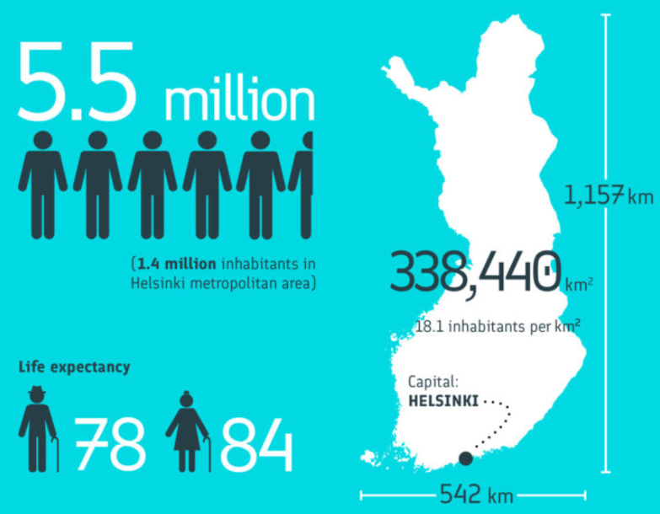
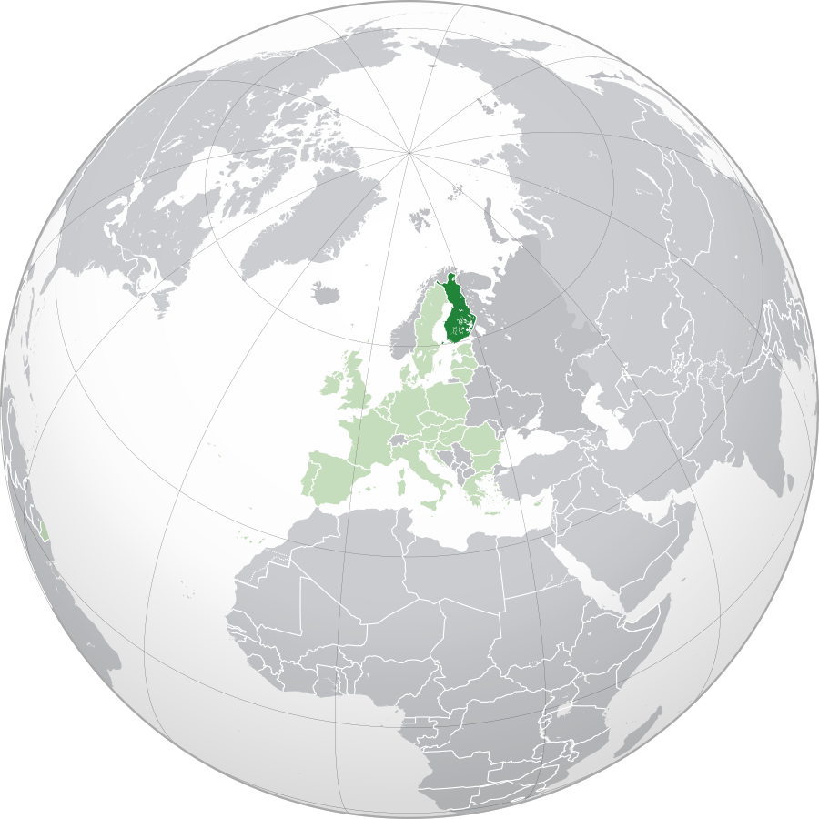
Some facts about Finland
By Rob984 - Derived from File:Germany on the globe (Germany centered).svg, CC BY-SA 4.0, https://commons.wikimedia.org/w/index.php?curid=70142692
By ThisisFINLAND.fi
Notes:
Also: Finland has the world's highest per capita consumption of coffee: 12 kg per year. It also has the highest per capita consumption of milk, at about 1 litre per day, even though 17% of the Finns are lactose intolerant. Source: Wikipedia

Slide 3
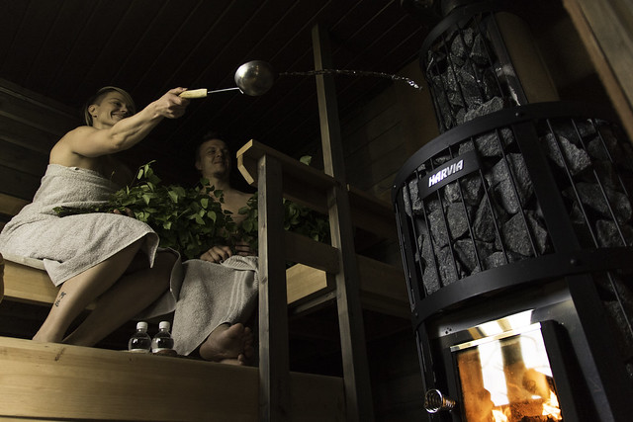
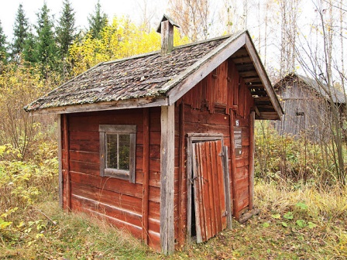

Sauna
By Tiia Monto
By skysauna.fi
By Visit Lakeland
Notes:
One more thing to remember about Finland: Sauna. There are approximately 3 million saunas in Finland. There's a sauna even in ferris wheel at Helsinki market square.

Slide 4



Three circles of health care cyber security
Trusted circle of experts
Circle of common guidelines
Circle of devoted organisations

Slide 5
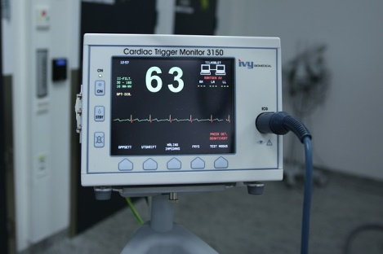

Some fundamental cyber security challenges on health care sector
S.O.S.
Notes:
Large number of health care employees:
How to efficiently keep employees' cyber security competence on adequate level and up-to-date?
Lots of opportunities for social engineering
Cyber environment deeply influences people's life, health and wellbeing:
But patching software in medical devices is slow
What is the price of your health? See Douglas W. Hubbard and Richard Seiersen: How to measure anything in cybersecurity risk.
Generally low cyber security maturity:
Skills of cyber security experts are not efficiently used. Organisations are hierarchical and turfs are rigidly defined.
Medical experts making care decisions often don't understand cyber security needs.
Sensitive personally identifiable information handled on a daily basis:
In emergency cases, access should be provided to any health care professional
How to detect unauthorised access?

Slide 6
Cooperation needed on many levels
Strategic cooperation of authorities on national level
Operational and tactical cooperation of organisations on national and regional levels
Technical cooperation of cyber security experts

Slide 7
NCSC-FI's relation to health care sector
Ministry of Economic Affairs and Employment
Ministry of Transport and Communications
Ministry of Social Affairs and Health
Health Care Cyber Range
€
NESA
€
Cyber- Health project
Hospital district
Hospital district
€
NCSC-FI
Health ISAC
ICT service provider
Health CERTs
Notes:
The National Emergency Supply Agency NESA is a Finnish peculiarity. It funds a wide range of activities and projects that improve and maintain the emergency preparedness of Finnish businesses and the Finnish society at large. A large part of NCSC-FI's funding comes from the NESA.
NCSC-FI is located in Finnish Transport and Communications Agency Traficom and is directed by the respective ministry. Historical reasons: telecommunication services regulation. An agreement with NESA prioritises NCSC-FI's services to supply critical organisations such as hospital districts. With that emphasis, the NCSC-FI has established ISACs on all supply critical sectors.
Cyber-Health and Health Care Cyber Range are examples of coordinated cyber security development projects that get significant funding from the NESA and where the NCSC-FI provides expert knowledge and serves as a contact hub.
The NCSC-FI has assigned three persons to liaison with health sector, but they have other duties too. In practice it amounts to about half a person's work time dedicated to health sector alone.
I will explain the relationships in more detail during this presentation.

Slide 8
Health sector information sharing and analysis centre
Trusted circle of experts
Circle of common guidelines
Circle of devoted organisations

Slide 9


Finnish Health ISAC
10
organisations
Autonomous
Voluntary-based
Rules:
Membership
TLP, CHR
Some discussed topics:
Incidents (permanent topic)
Facsimiles
O365
SOC, SIEM
@
Sec@
7
Collab
Notes:
Actually: Social welfare and health care ISAC. Established in 2017
Member organisations: NCSC-FI, selected hospital districts, selected ICT service providers and selected national authorities
Autonomous and voluntary based
Rules for membership, representation and information sharing. TLP and Chatham House Rule respected.
Mailing list, secure e-mail channel, secure web based collaboration platform, regular meetings, rotating chairperson role
Some of the topics discussed during previous 12 months:
Replacement of facsimiles as a "secure" patient data transfer tool
Establishing a SOC, utilising SIEM
Office 365 themed phishing and intrusions
ISAC maturity and two-year action plan

Slide 10
On establishing an ISAC
Find one or a few champions and prepare facts about value of information sharing
Recruit a small number of trusted individuals for practical preparations
Agree upon ISAC's mission and rules and have them signed-off by senior management
Appoint operating members and organise regular meetings
See for example
  ENISA: Network Security Information Exchanges - Good Practice Guide
  NIST SP 800-150 Guide to Cyber Threat Information Sharing
Notes:
Find one or a few champions and prepare facts about value of information sharing
Preferably someone from the field who knows more key persons on the field.
Recruit a small number of trusted individuals for practical preparations
Agree upon ISAC's mission and rules and have them signed-off by senior management
What should an ISAC do (at the minimum)?
Trusted circle of cyber security experts: meet peers, share pain points, network
Share analysis efforts: emerging threats, post-incident analysis
Share threat intelligence: give some, get some
Share best practices: gain goodwill by sharing to the public
Appoint operating members and organise regular meetings

Slide 11
On relations of people and organisations
Definition | Networking | Coordinating | Cooperating | Collaborating
Characteristics | Exchanging information for mutual benefit. Initial level of trust. Limited time availability. | Networking + altering activities for mutual benefit and to achieve common purpose. | Coordinating + sharing resources. High level of trust. Substantial investment of time. | Cooperating + enhancing the capacity of another. Shared risks, responsibilities and rewards. Very high trust.
Resources | No need or willingness for sharing resources. | Little need for sharing resources. | Significant sharing of resources. | Full sharing of resources.
After Arthur T. Himmelman: Collaboration for a change

Slide 12
On growing the maturity of an ISAC
Level | Fundaments | Information sharing | Analysis and situation awareness | Projects | Operation and value
3 | Autonomous, broad international cooperation. | Fully automated. | Information provided by the ISAC essential in improvement of society's cyber security. | Dedicated resources for large cross-sectoral development projects. | Society relies much upon the ISAC.
2 | Dedicated budget, action plan spans over 5 years, possibly international cooperation. | Continuous, based on automated processes. | Proactive. Information provided by the ISAC important feed to national cyber situation awareness. | Significant impact on society's cyber security. Promotes and executes cross-sectoral projects. | Significant value to society and sector. ISAC's expertise is widely recognised.
1 | 3-5 year action plan, active participation, strong mandate from senior management. | Active and open information sharing also between meetings, common sharing methods. | Solution centric analysis of incidents, common validation of reports prior publication. | Promotes projects important for society's cyber security. Common cyber security exercises. | Value recognised outside the ISAC. Annual report shared to sector organisations.
0 | Initial terms of reference and action plan. Chairperson nominated from sector. | Mutual trust, ad hoc information sharing between meetings. | Incidents experienced by the members are discussed within the ISAC. | Ad hoc commitment to projects. | Value for members, reactive operations, annual report shared to members.
Notes:
Ooph, a rush-hour slide! I'm sorry for that. This is our generic maturity model for our ISACs. Let's have a closer look on its level 1 because that's approximately where the Health ISAC currently aims at.

Slide 13
Current maturity target of the Health ISAC
Level | Fundaments | Information sharing | Analysis and situation awareness | Projects | Operation and value
1 | 3-5 year action plan, active participation, strong mandate from senior management. | Active and open information sharing also between meetings, common sharing methods. | Solution centric analysis of incidents, common validation of reports prior publication. | Promotes projects important for society's cyber security. Common cyber security exercises. | Value recognised outside the ISAC. Annual report shared to sector organisations.

Slide 14
Coordinated cyber security projects
Trusted circle of experts
Circle of common guidelines
Circle of devoted organisations

Slide 15
Cyber-Health project
Cyber security competence development for health care professionals
Cyber security requirements for suppliers
Tools and practices for health care SOCs
System criticality classification
NESA funded
Runs 2018–2019
About the same members as in Health ISAC
Notes:
NESA funded:
Part time project management covered
Members responsible of their own costs
Cyber security requirements for suppliers:
Requirements analysis
Categorised list of requirements
Cyber security education for procurement specialists

Slide 16
Health Care Cyber Range — project topics
EU funded
Runs 2019–2021
Builds on top of Realistic Global Cyber Environment platform
Wide range of partners
Development of exercise activity in hospitals
Need-based development of skills and processes
Cooperation networks
Implementation of HCCR
Notes:
Wide range of partners: health care providers, ICT service providers, public authorities, Jyväskylä University of Applied Sciences, which also manages the project. NCSC-FI is an invited expert partner.
Implementation of the HCCR includes also applied research on health care digital environment.

Slide 17
On joint cyber security development projects
Circle of devoted organisations
Agree on scope, background, foreground
Spread the word about the project
Degree of collaboration | Project characteristics | Funding
Low | Small project | Everyone bears their own costs
Medium | Needs a manager | Public funding helps a lot
High | Intertwined with business | Public funding often not applicable
Notes:
Circle of devoted organisations
Collect project ideas through open discussions with your stakeholders and collaboration networks. Discuss challenges and solutions already tried
The initial set of organisations often is a good composition for a project steering group
Agree on scope, background, foreground
Agree upon a small set of topics where every partner can give and get
Agree upon sharing background information and project results
Spread the word about the project
You might get new valuable members for your current project or future projects.

Slide 18
National cyber preparedness guidelines
Trusted circle of experts
Circle of common guidelines
Circle of devoted organisations

Slide 19
National social welfare and health care preparedness guidelines
Ministry of Social Affairs and Health official guidelines for care providers and authorities, updated in 2018
For the first time, a cyber security specific section was included
  Cooperative effort by national level stakeholders
Review comments by Health ISAC members and Cyber-Health project partners improved the quality
Notes:
Participants in authoring of the cyber security section: the Ministry of Social Affairs and Health, some of its agencies, Association of Local and Regional Authorities (representing local basic health care), Ministry of Finance, Population Register Centre, NCSC-FI, representatives of hospital districts and central ICT service providers.

Slide 20
Main topics of the guidelines
Everyday preparedness
Binding cyber risk management to generic risk management
Resilience of organisation to disturbances in cyber environment
A model for incident response and escalation
References for best cyber security practices

Slide 21
Recommendations of Safety Investigation Authority
Investigation report Y2018-02: Information system disruptions of the Hospital District of Helsinki and Uusimaa on 7 and 8 November 2017
  Root cause: failures in chassis switch of patient information system
  No treatment injuries reported, but prolonged unavailability of patient information system was a major risk for patient safety
Four recommendations:
  Identification of information systems and their components critical to patient safety, and reinforcing the resilience of such systems
  Health care providers to have maintenance, update and replacement programmes in place for information systems
  Wards with particular patient safety risks to have continuity plans in place, including information system related continuity
  National system for collecting and analysing of all sorts of incidents causing serious risks to patient safety; based on analysis results, improvement of safety of whole sector
Notes:
The Safety Investigation Authority is an independent organisation with mission to learn from past major accidents and near miss incidents and to make recommendations for prevention. This was the first time the authority investigated an ICT incident. The NCSC-FI supported the authority by providing insights into cyber incident response.

Slide 22

What's next?

Slide 23
Trusted circle of experts
Circle of common guidelines
Circle of devoted organisations
Grow, deepen
Share results
Innovate
Reinforce connections
Reiterate
New best practice guidelines
Notes:
Trusted circle of individuals
Gradually invite new members to Health ISAC
Increase the maturity of Health ISAC
Circle of devoted organisations
Share results from current projects
Innovate new cross-sectoral projects
Reinforce the connection between Finnish Health ISAC and international Health CERTs community
Common guidelines
Improve official preparedness guidelines based on, e.g., excellent Danish strategy
Prepare coordinated best practice guidelines with health care organisations

Slide 24
Summary
- Mutual trust creates continuity
- Maturity model of ISACs
- Devoted organisations as champions
- Start with tangible project goals
- Guidelines improved by feedback from the field

Slide 25
Thank You!
perttu.halonen@ncsc.fi

