Slide 1
VEXed by vulnerabilities that don’t affect your product? Try this!
Allan Friedman (CISA, USA)
Thomas Schmidt (BSI, Germany)

Slide 2
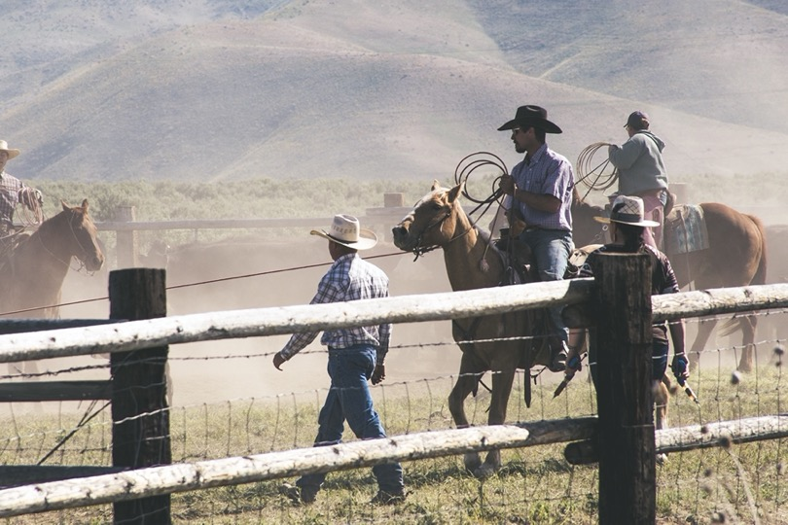
Who are we? Just a couple of nerd-wranglers
Allan Friedman
aka Doc SBOM
Not really an “expert,” just talks a lot
@allanfriedman on twitter
Primary nerd wrangler for SBOM & VEX
Thomas Schmidt
aka The ICS Cowboy
OT and automation expert
Actively avoids social media
Primary nerd wrangler for CSAF
Notes:
Photo b`y Brett Sayles: https://www.pexels.com/photo/people-riding-on-there-perspective-horse-in-farm-1069731/

Slide 3
Caveat: Still cooking this up
Notes:
Julia Child in her kitchen as photographed ©Lynn Gilbert, 1978
allan

Slide 4
But there’s plenty to sample today
Notes:
allan

Slide 5
https://github.com/lunasec-io/lunasec/blob/998c69decc0894a214efa035854b48b1af18eb6e/docs/static/img/log4shell-logo.png
Notes:
Thomas

Slide 6
What do we need to know?
Which (of my) products are at risk?
What are mitigation measures?
Notes:
Thomas

Slide 7
Potential ways to find products at risk
Security Advisories
Ask the vendor
Own investigation
SBOM
Notes:
Thomas

Slide 8
How many vendors do you have?
https://iot-analytics.com/wp/wp-content/uploads/2019/01/I4.0-Vendor-Landscape-v4.5.jpg

Slide 9
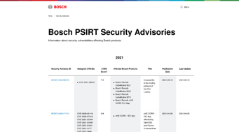
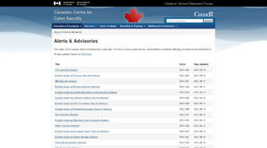
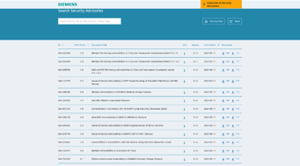
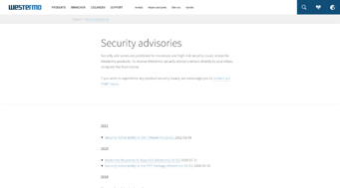
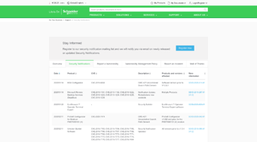
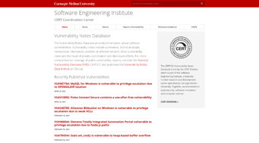
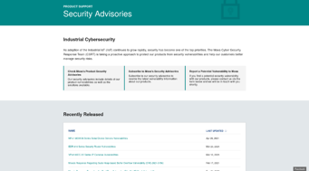
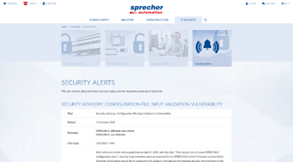
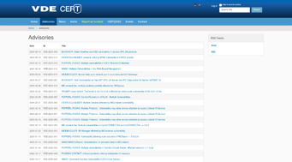
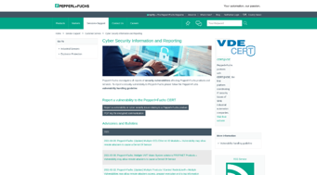
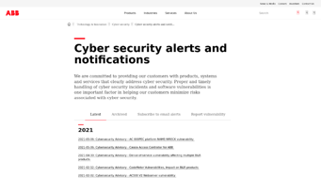
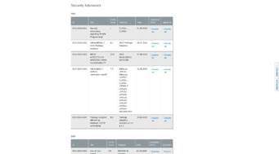
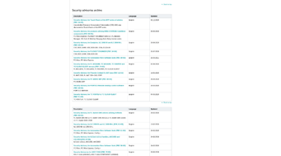
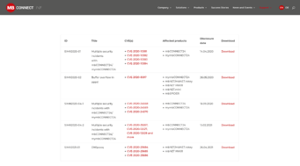
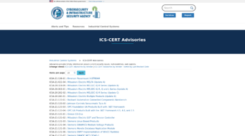
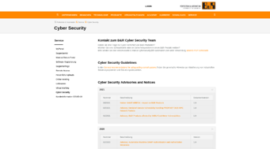
Find

Slide 10
Potential ways to find products at risk
Security Advisories
Ask the vendor
Own investigation
SBOM
Vendor hasn‘t issued one
Just got a support ticket
Time consuming
Where to start?
Do you have it?
Does it have enough details?
Product is not mentioned in it
Notes:
Thomas

Slide 11
Number of vulnerabilities
Notes:
THomas

Slide 12
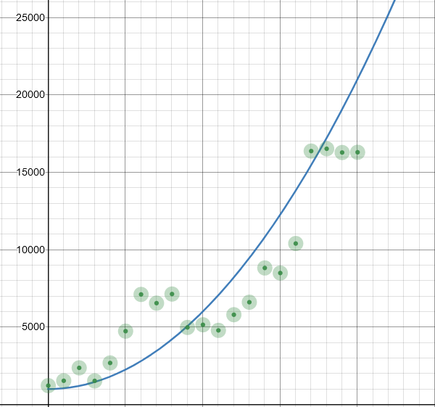
Number of vulnerabilities CVEs
https://opensourcesecurity.io/2021/03/30/its-time-to-fix-cve/
Notes:
Thomas

Slide 13
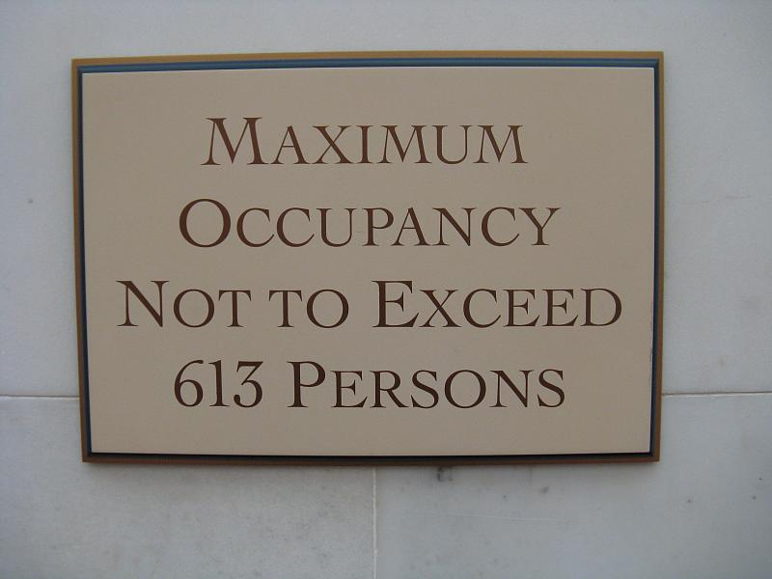
We will know about more potential
vulnerabilities with SBOM
Vulnerabilities
https://www.flickr.com/photos/sadsnaps/2983577932
Notes:
Allan

Slide 14
What do asset owners and product managers want today?
Notes:
Allan
Photo by Mikael Blomkvist: https://www.pexels.com/photo/woman-wearing-helmet-and-safety-vest-8960933/

Slide 15
Problems to solve
Number of security advisories is rising
SBOM adds to overload
Not every vulnerability can be exploited
Scalability
Exploitability
Notes:
THomas
If I use Log4j 2 in a vulnerable version and pass just hard-coded strings => no issue.
Let‘s deal with exploitability first.

Slide 16
What are we actually trying to do?
Optimize time to handle “real” vulnerabilities
Minimize list of products with an unknown status
Document analysis result
Notes:
Allan
Photo by Kelly Sikkema on Unsplash

Slide 17
“exploitable”?
Notes:
Allan
Actions are recommended to remediate or address this vulnerability.
This could include for instance learning more about the vulnerability and context, and/or making a risk-based decision to patch or apply defense-in-depth measures

Slide 18
“affected”
Do I need to do anything?
Notes:
Actions are recommended to remediate or address this vulnerability.
This could include for instance learning more about the vulnerability and context, and/or making a risk-based decision to patch or apply defense-in-depth measures

Slide 19
“affected”
Actions are recommended to remediate or address this vulnerability.
This could include: learning more about the vulnerability and context, and/or making a risk-based decision to patch or apply defense-in-depth measures
Notes:
Actions are recommended to remediate or address this vulnerability.
This could include for instance learning more about the vulnerability and context, and/or making a risk-based decision to patch or apply defense-in-depth measures

Slide 20
“Not Affected”
You’re good.
Notes:
No remediation is required regarding this vulnerability.
This could for instance be because the code referenced in the vulnerability is not present, not exposed, compensating controls exist, or other factors.

Slide 21
“Not Affected”
No remediation is required regarding this vulnerability.
This could be because the code referenced in the vulnerability is not present, not exposed, compensating controls exist, or other factors.
Notes:
No remediation is required regarding this vulnerability.
This could for instance be because the code referenced in the vulnerability is not present, not exposed, compensating controls exist, or other factors.

Slide 22
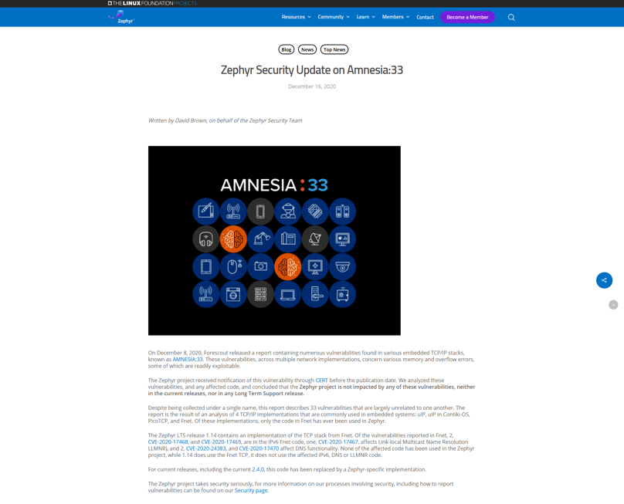
Communicate “not exploitable affected”
Notes:
Obvioulsly not as a press release.

Slide 23
Let’s call it VEX!
Vulnerability Exploitability eXchange
Communicate product status explicit
Machine-readable to address scalability
Notes:
Allan

Slide 24
Use cases
(Media-)hyped vulnerabilities
False-positives in security scanners
In depth security analysis of products
Notes:
Thomas
Photo by Marvin Meyer on Unsplash

Slide 25
“Modality” of VEX – Use Cases
Product
Product
Product
Product
Product
vuln
vuln
vuln
vuln
vuln
status
status
status
status
status
Notes:
Allan

Slide 26
Benefits
Save money!
Reduce human workload!
Spread the word about the good work your PSIRT does!
Notes:
Thomas
But how do we implement that?

Slide 27
Too good to be true?
No one could ever build a spec that could do all this, right?
Notes:
Allan
Actions are recommended to remediate or address this vulnerability.
This could include for instance learning more about the vulnerability and context, and/or making a risk-based decision to patch or apply defense-in-depth measures

Slide 28
Common Security Advisory Framework
Machine-readable format for security advisories (JSON)
Standardized way of distribution security advisories
Build with automation in mind
Standardized tool set
Guidance to actionable information
Successor of CSAF CVRF 1.2
OASIS Open Standard
Ready to use!
Notes:
Thomas

Slide 29
VEX and CSAF
VEX is a profile in CSAF
Specific, mandatory fields
Uses same infrastructure and systems
VEX is parallel to SBOM (not necessarily in the SBOM)
Notes:
THomas
by mohamed abdelghaffar: https://www.pexels.com/photo/man-in-black-jacket-771742/

Slide 30
Needed fields for VEX
Status
Vulnerability
Product
Notes:
Allan

Slide 31
Required fields for a VEX
Metadata
(author, id, timestamp)
Product id
Product id
Vulnerability ID
Vuln details
Product Status
Action statement / Impact statement
Vulnerability ID
Vuln details
Product Status
Action statement / Impact statement
Notes:
Allan
Metadata (author, id, dates)
Products
Vulnerabilities
ID
Details
Product status
Action statement (remediations) or impact statement (why not affected)

Slide 32
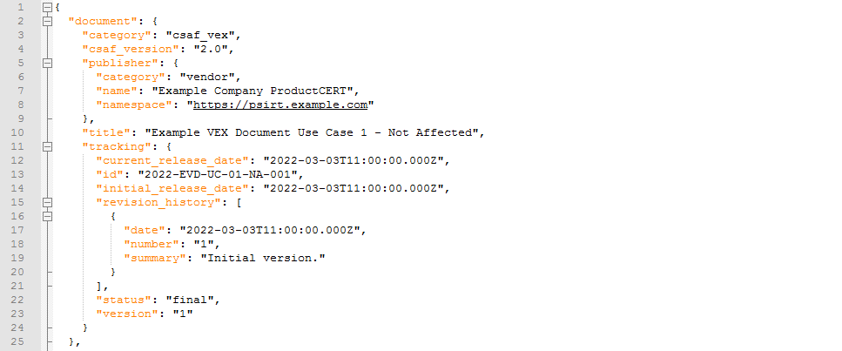
Required fields – VEX metadata
VEX format identifier
Author and role
Identifier String of VEX
Timestamp

Slide 33
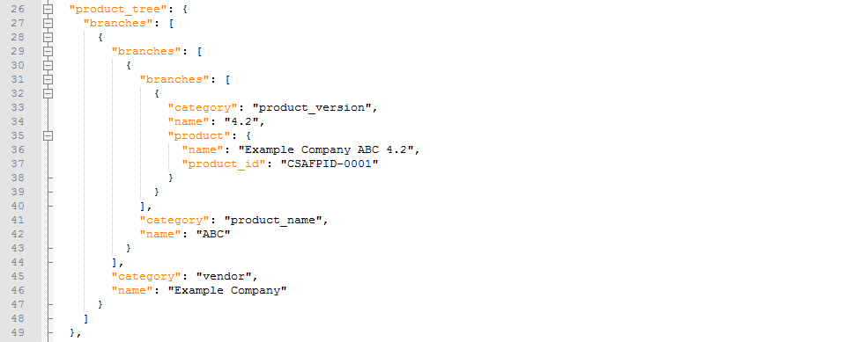
Required fields – Product details
Product identifier
Human-readable product name
Product Identifier for reference within document
Notes:
Thomas
Acknowledge that it’simplemented in ”product families” which can be a bit confusing at first, but we have very good reasons.

Slide 34
Product statuses
Not Affected → impact statement
Affected → action statement
Fixed
Under Investigation
Notes:
Thomas

Slide 35
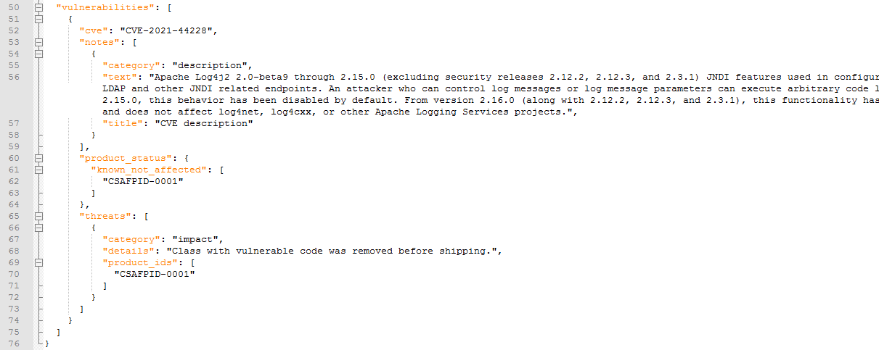
Required fields – Vulnerability and Product status
Identifier of vulnerability
Vulnerability description
Product status
Impact statement

Slide 36
How to link to an SBOM?
Product identification helpers:
Retrievable SBOM
Notes:
THomas

Slide 37
How to link to an SBOM component?
CycloneDX
SPDX
Notes:
Thomas

Slide 38
Status Justifications
Component_not_present
Vulnerable_code_of_component_not_present
Vulnerable_code_cannot_be_controlled_by_adversary
Vulnerable_code_not_in_execute_path
Inline_mitigations_already_exist
Notes:
Allan

Slide 39
Problems solved?
Vendor vulnerability management
Security Advisory
Customer vulnerability management
Notes:
Scalable format, easy distribution

Slide 40
Problems solved?
Vendor vulnerability management
VEX
Customer vulnerability management
CSAF format and distribution / retrieval
Notes:
Scalable format, easy distribution

Slide 41
Tools assist
Vendor vulnerability management
VEX
Customer vulnerability management
CSAF content management system
CSAF format and distribution / retrieval
Notes:
Scalable format, easy distribution

Slide 42
Tools assist
Vendor vulnerability management
VEX
Customer vulnerability management
CSAF content management system
CSAF format and distribution / retrieval
CSAF asset matching system
Notes:
Scalable format, easy distribution

Slide 43
Tools assist
Vendor vulnerability management
VEX
Customer vulnerability management
CSAF SBOM matching system
CSAF content management system
CSAF format and distribution / retrieval
CSAF asset matching system
Notes:
Scalable format, easy distribution
Tools assit – but not the end of automation

Slide 44
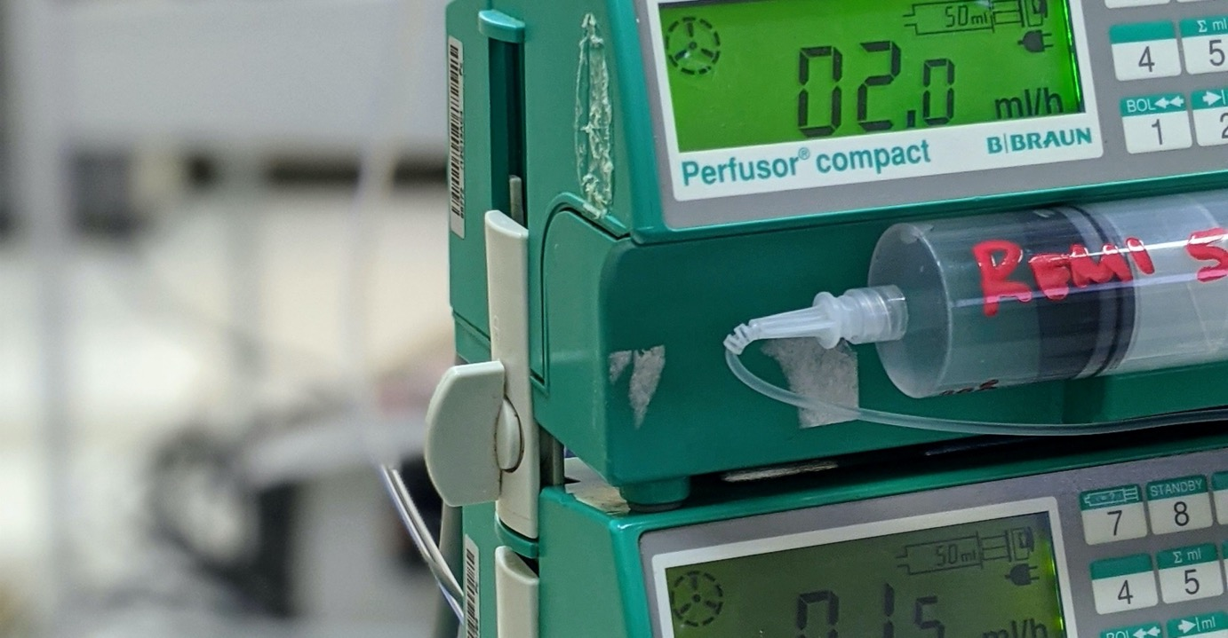
Starting to implement this today
Photo by Matías Ramos on Unsplash
Notes:
Allan

Slide 45
Executive Order 14028 (May 12, 2021) “Improving the Nation’s Cybersecurity”
"The trust we place in our digital infrastructure should be proportional to how trustworthy and transparent that infrastructure is...”
The EO defines SBOM and identifies the value proposition in 10(j)
Section 4: Enhancing Software Supply Chain Security.
4(f) – NTIA defines the “minimum elements” of SBOM
4(e)(vii) –USG defines guidance on “providing a purchaser a Software Bill of Materials (SBOM) for each product”
Notes:
Allan

Slide 46
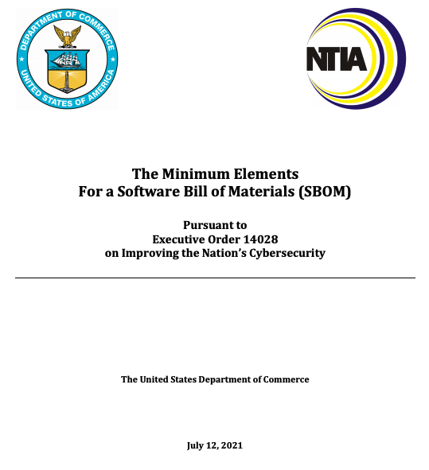
Executive Order 14028 (May 12, 2021) “Improving the Nation’s Cybersecurity”
"The trust we place in our digital infrastructure should be proportional to how trustworthy and transparent that infrastructure is...”
The EO defines SBOM and identifies the value proposition in 10(j)
Section 4: Enhancing Software Supply Chain Security.
4(f) – NTIA defines the “minimum elements” of SBOM
4(e)(vii) –USG defines guidance on “providing a purchaser a Software Bill of Materials (SBOM) for each product”

Slide 47
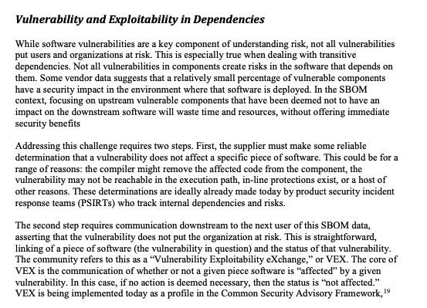
Executive Order 14028 (May 12, 2021) “Improving the Nation’s Cybersecurity”
"The trust we place in our digital infrastructure should be proportional to how trustworthy and transparent that infrastructure is...”
The EO defines SBOM and identifies the value proposition in 10(j)
Section 4: Enhancing Software Supply Chain Security.
4(f) – NTIA defines the “minimum elements” of SBOM
4(e)(vii) –USG defines guidance on “providing a purchaser a Software Bill of Materials (SBOM) for each product”

Slide 48
Next steps: Automation Opportunities & Challenges
Distribution & retrieval of VEX
Push vs Pull
Aggregation?
Integration of VEX with existing tools
Trust judgements vs. policies
Linking VEX data
SBOMs ✓
SBOM components ✓
Software identifiers 😬
Notes:
Thomas: distribution
Allan: integration, linking
Photo by Andrea De Santis on Unsplash

Slide 49
Next steps – Hard work!
Convince companies to use VEX broadly
Facilitate a shift in culture: from vulnerability compliance to vulnerability risk
Tools to assist with VEX generation and consumption
Solve unique product identifiers!
Notes:
Thomas
Culture shift from vulnerability compliance to vulnerability risk

Slide 50
Summary & Action items
Number of vulnerabilities discovered rising
SBOM is going to come
Not all vulnerabilities are exploitable
Ask your vendors to provide VEX
Clean up your SBOM / asset inventory
Spread the word! #VEX #oCSAF
Minimize & Prioritize!
VEX and other resources: cisa.gov/SBOM
CSAF information: csaf.io
Join SBOM work: SBOM@cisa.dhs.gov
Notes:
@Allan: You could

Slide 51
Presentation Best Practices & Suggestions
Introduce yourself to your audience with an intro slide. Include your Twitter handle at the start so that your attendees can live tweet (if you approve).
Repeat your contact details at the end of your presentation.
Keep your slides clean and easy to read.
Don’t throw too much text into one slide – be courteous to those that may be in the back of the room ☺
Include images when it makes sense for visual interest.

