Slide 1
Incident Response Investigations in the Age of the Cloud

Slide 2
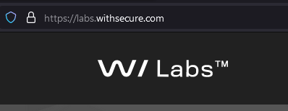
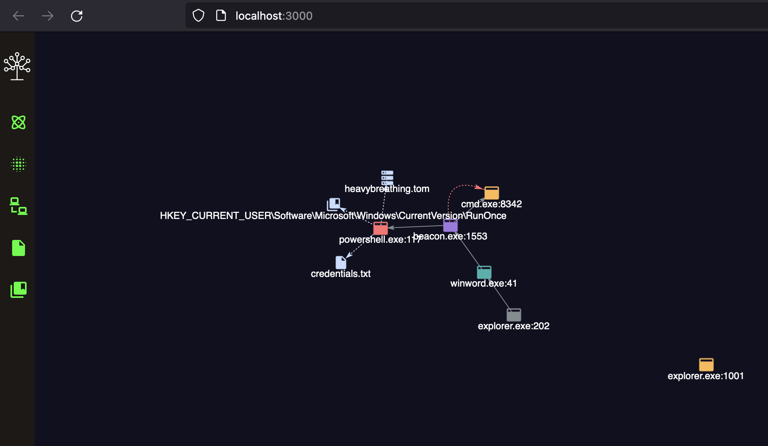
Who the hell are you?
Principal Incident Response Consultant at WithSecure
Response & Readiness
Tooling
Service Engineering
LabsMentor
Business
Consumer
Linux CatScale https://github.com/FSecureLABS/LinuxCatScale
https://github.com/countercept/detectree
https://github.com/countercept/chainsaw

Slide 3
1
Nuclear Orange - Case Study
2
Cloud Incident Response Challenges vs Opportunities
3
Cloud Incident Readiness Strategies

Slide 4
Nuclear Orange Case Study
Centralize your logging
Develop Trust Issues

Slide 5
Client profile
Who
Tech Start Up, Developing IoT Firmware
Security
Limited logging and monitoring
Overly-permissive IAM policies
No MFA
SaaS services managed by third-party vendor
Technology
AWS
Windows AD
AWS EKS - K8s
BitBucket and Jenkins

Slide 6
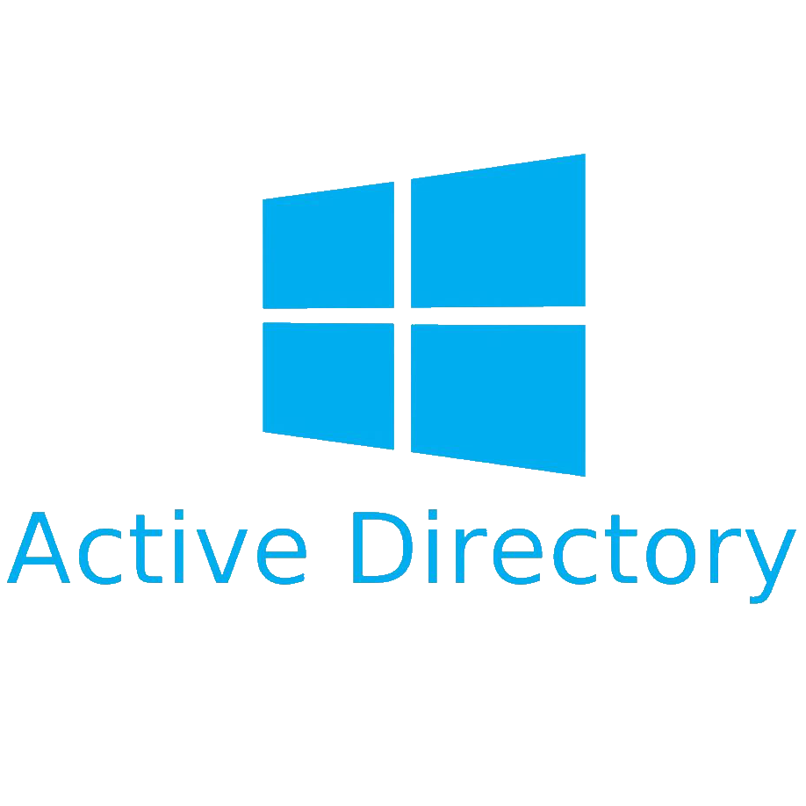
CLIENT AWS
MANAGED BY 3rd Party
AWS: Staging VPC
Client Code Repositories
CLIENT AD
Client-website.com
AWS: Production VPC
Single-Sign On (SSO)
Jenkins.staging
Jenkins.prod
AWS EKS Containers
Public Jenkins Web Portals
Fortinet VPN
AWS: Vendor Managed
Client Staff
External Vendor
Notes:
Why did they do this? Probably an opportunistic attacker
The point is, it could have been a lot worse for them if the attacker decided to resort to extortion
We still don’t know what the attacker did with the data, maybe they sold it?

Slide 7
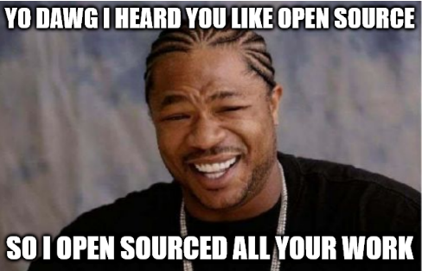
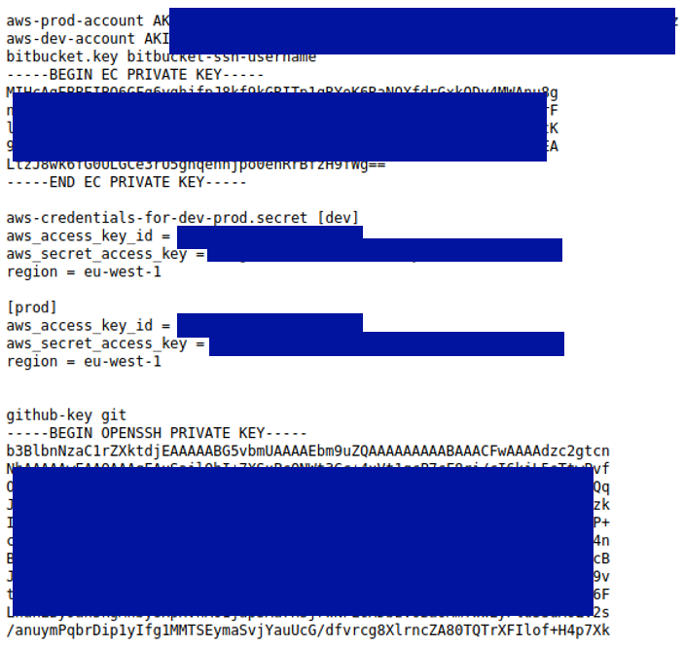
Everything Public
Notes:
Strange file in victim S3
index.html file
All private Git repositories
All pilfered creds (AWS, Bitbucket, SSH Keys etc.)

Slide 8
The Classic What we asked for vs What we got
CloudTrail Logs
CloudTrail Logs
VPN Logs
7 Random Snapshots relating to AWS EKS
VPN Logs
Snapshots of the AWS EKS Jenkins Instances
Jenkins Application Logs
Jenkins Application Logs
Random Bitbucket Logs
Fully managed by 3rd Party
Bitbucket Logs
Fully managed by 3rd Party
VPC Logs
VPC Logs
S3 Logs
S3 Logs
 | Available
 | Partial
 | Not Available

Slide 9
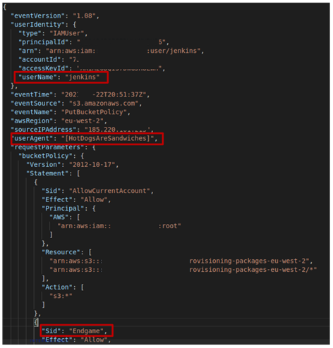
CloudTrail Logs
The Threat Actor
https://endgame.readthedocs.io/en/latest/

Slide 10
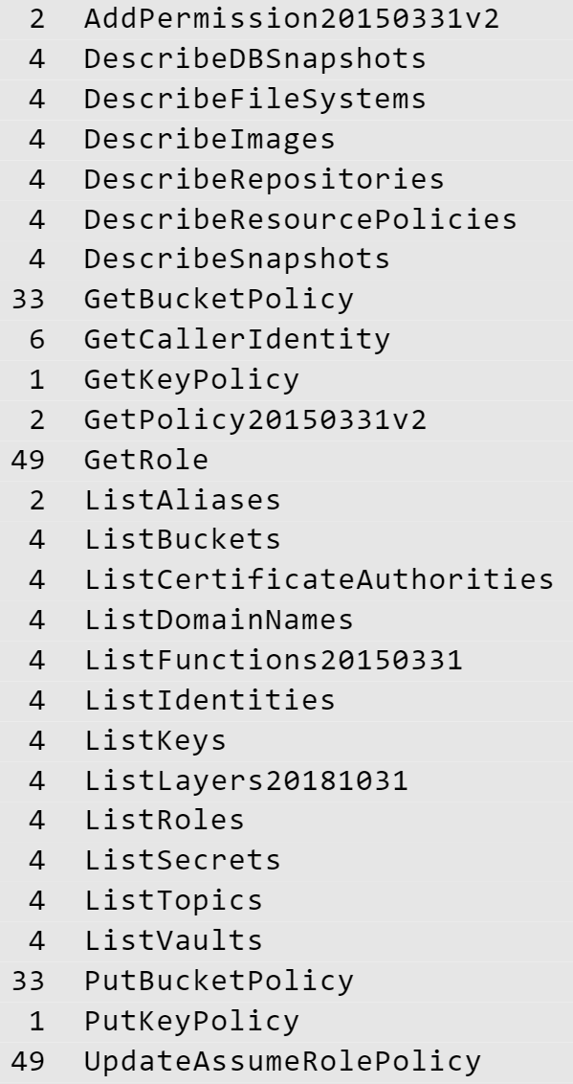
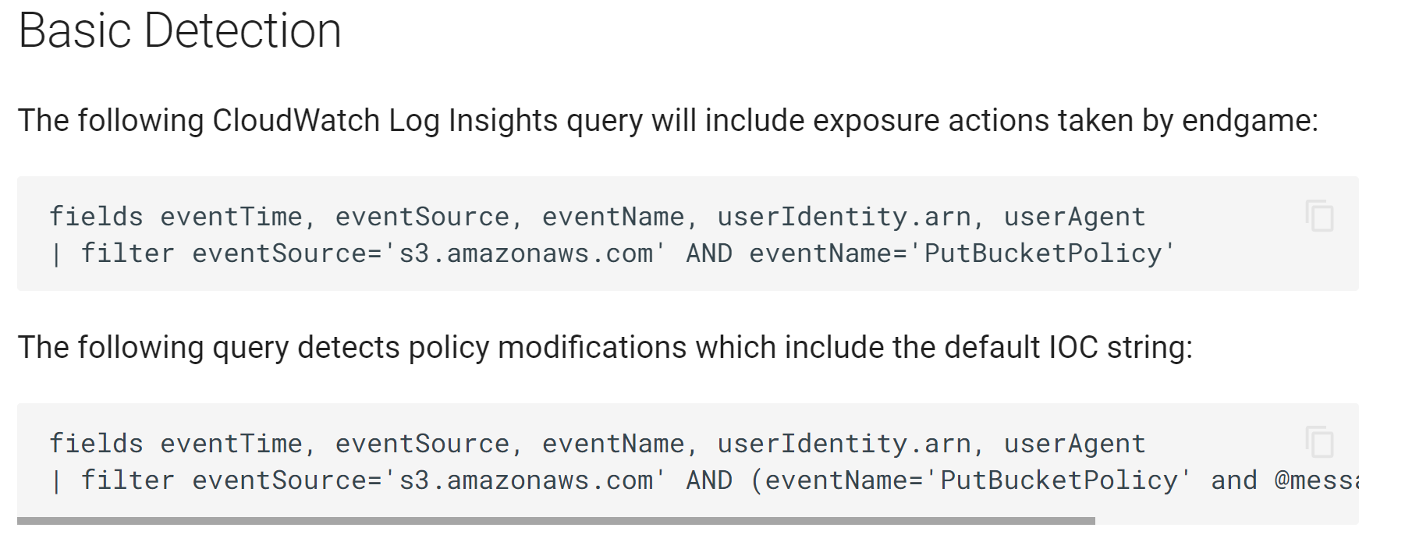
CloudTrail Logs Threat Actor API Request
Grants permissions
Apply S3 bucket policy
Attach a key policy to KMS key
Grants IAM entity permission to assume a role
Notes:
API Calls we were concerned about:
AddPermission: grants an AWS service or another account permission to use a function
PutBucketPolicy: grants permission to add or replace a bucket policy on a bucket
PutKeyPolicy: attaches a key policy to the specified customer master key(CMK)
UpdateAssumeRolePolicy: updates the policy that grants an IAM entity permission to assume a role

Slide 11
Random AWS EKS Snapshots
Hyper Visor Data Disk Partitions
One random Windows partition
Jenkins Containers
Evidence in the Snapshots
Snap 1
Snap 5
Snap 6
Snap 2
Snap 7
Snap 3
Snap 4
Notes:
FINDINGS:
No relevant artifacts on hypervisors – container logging not on by default
No relevant container artifacts – WHY? The attacker compromised the web app, not the OS
No Jenkins application logs anywhere. Client couldn’t answer where these are. We believe these were stored on a separate volume not persevered.

Slide 12
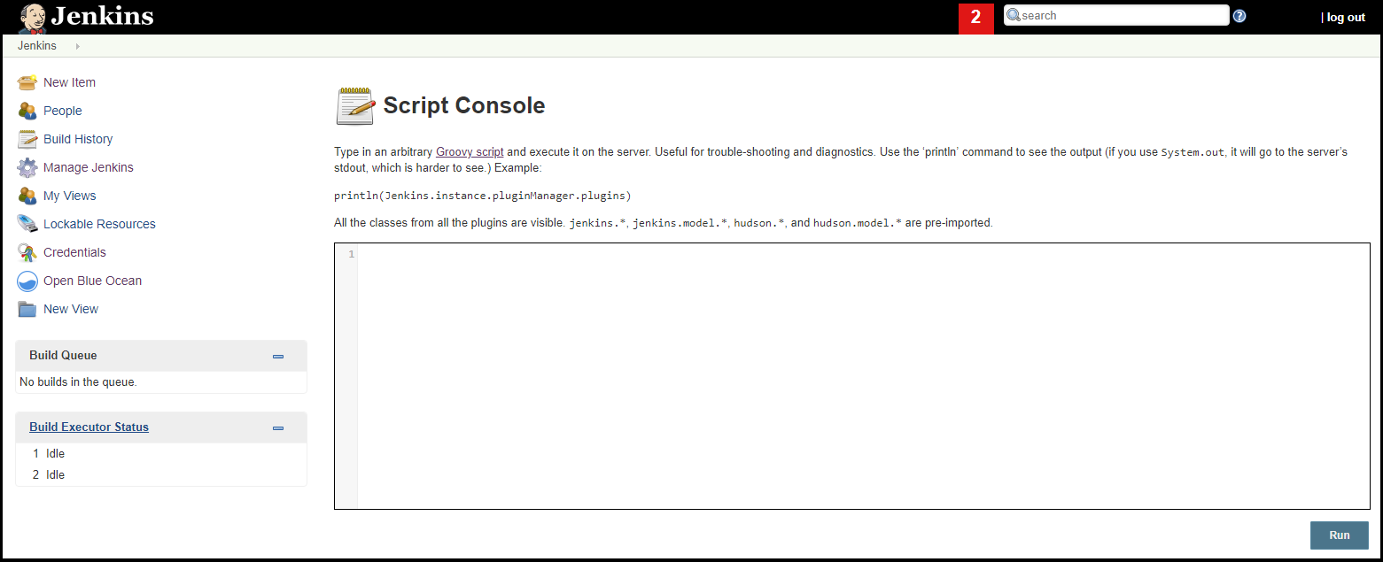
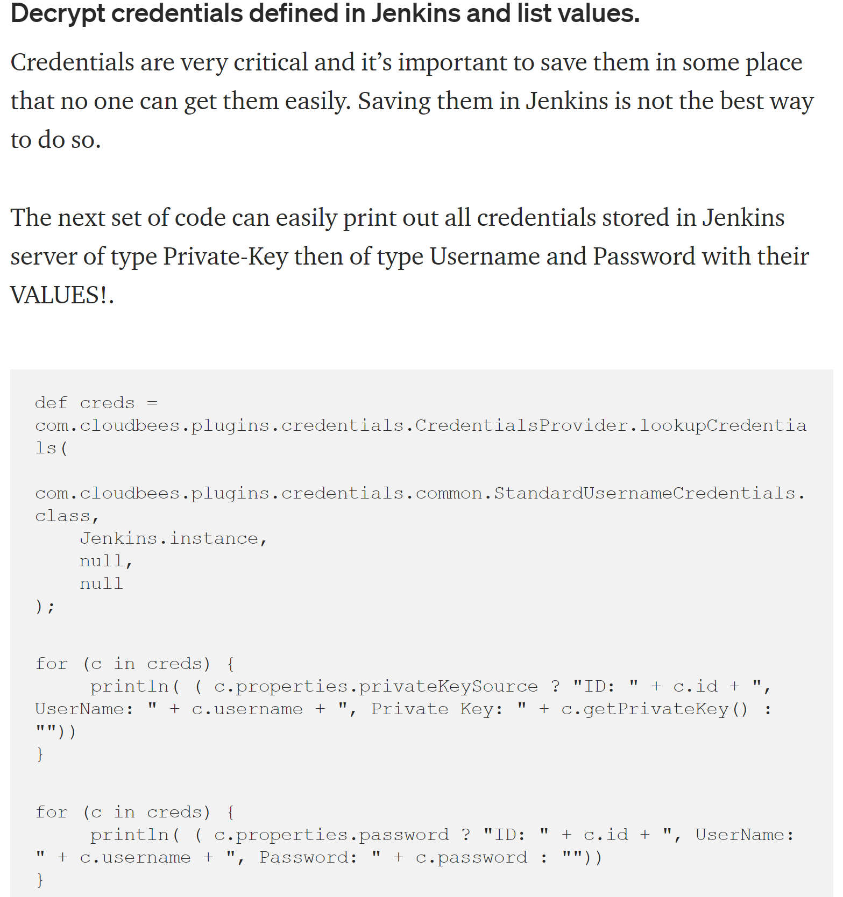
How to Root Cause Hack it like they did
It’s in the CLOUD!
Deploy the Jenkins in an isolated environment
Single-Sign On (SSO)
ANY BITBUCKET ACCOUNT CAN LOG IN!
https://medium.com/@eng.mohamed.m.saeed/show-all-credentials-value-in-jenkins-using-script-console-83784e95b857
Notes:
Logging in to Jenkins portal redirects you to Bitbucket SSO
From Jenkins portal, script console was enabled -> could access all creds on the server
Tried logging in with a Bitbucket account that I set up using a personal email address
Could log in and had the exact same access as organizational Bitbucket account
External Vendor admitted they made changes to the config files resulting in:
Jenkins web portal being open to the internet
ANY Bitbucket account could authenticate

Slide 13
Available
Partial
Not Available
CLIENT AWS
MANAGED BY 3rd Party
AWS: Staging VPC
Client Code Repositories
Random Snippets of logs
CLIENT AD
Public S3 Bucket
Client-website.com
CloudTrail Logs
No S3 Logs
AWS: Production VPC
Credentials.xml
Single-Sign On (SSO)
Jenkins.staging
Jenkins.prod
AWS EKS Containers
Public Jenkins Web Portals
Fortinet VPN
AWS: Vendor Managed
No Application Logs
VPN logs
Client Staff
External Vendor
Threat Actor
Notes:
Why did they do this? Probably an opportunistic attacker
The point is, it could have been a lot worse for them if the attacker decided to resort to extortion
We still don’t know what the attacker did with the data, maybe they sold it?

Slide 14
Cloud IR Challenges vs Opportunities

Slide 15
Cloud IR Challenges vs Opportunities
SaaS
Access to logs not instant
On demand access is not forensically sound ☹ ☹ ☹
Log extraction maybe throttled ☹ ☹
Default Logs Retentions
Logs can be easily piped to solutions
Scale up, down -> Evidence Destroyed
Logging not enabled by default
Not enough IR documentation
Automating Snapshots
Enabling logging never been so easy
Cloud Native log collection Agents
Default logging none
Network logging default off or sampled(?!)
Cloud Native log collection agents
Automated Network log capture
Containers (IaaS/PaaS)
IaaS
Notes:
10 mins on this slide
SAAS:
-Access to important data is going to be delayed (Long wait for vendors to provide the correct logs –Example Github and the Codecov breach)
You cannot ensure that the data is forensically sound
Extracting logs without premium services = throttling
Logs may roll over / evidence may not be available at all
CONTAINERISATION TECHNOLOGY:
Designed for rapid spinning up and taking down, not for forensic investigations
Forensic analysis of containers is not very well documented – Example Azure Virtual Desktops
IAAS on any platform
Data is expensive, to be lean - often logging is not on by default
Network logging is almost never available or sampled (?)
Access to resources in regions is complex

Slide 16
Cloud Readiness Strategies

Slide 17
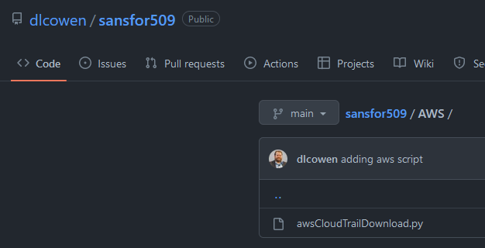
Cloud Readiness Strategies: Responders
01
Establish a Incident Response Cloud Account
For each vendor supported
AWS and Azure prevalent
02
Build Cloud IR Analysis Environment
Consider IaaS, PaaS first
Build Templates or Utilise Code as Infrastructure
Artefact parsing vs JSON ingestion into SIEM
03
Build tooling for Active Monitoring
Scripts that download logs every X minutes
Learn how to redirect logs on different cloud vendors
Push logs into a platform i.e. SOF-ELK.

Slide 18
Cloud Readiness Strategies: Business
01
Centralise Logging
04
Establish Responder Accounts
Cloud provider log dashboards are not built for Security Investigation!
Accounts that can extract logs or query the AWS environment
Consider Indirect vs Direct
02
Default Logging is not Enough
03
Tag/Map Assets
S3, System Logs, Applications Logs, Container API logs, NetFlow
Don’t reverse engineer your deployment as well as the attack
Notes:
To ensure that your cloud environment is resilient in an incident, there are definitely a number of steps that can be taken in preparation
Firstly,
Map out your environment and understand what is there, as well as what the opportunities are to prepare the environment for an incident.
Pre-creating Responder Accounts & Keys: This will save a lot of time during an investigation
- Have DFIR accounts prepared that are separate from normal every day use accounts (clear what activity is part of an investigation)
- Enable MFA for these accounts as well as Read only permissions (Just Enough Privileges)for DFIR account
Network Isolation: this can usually be achieved by
- "Security Groups" - pre-prepare your isolation groups before an incident so easy to isolate with a click of a button
Detection:
Consider what technology you can implement to enable detection and real time monitoring, as well as what level of automation you can apply to the detection process
For example in Azure you can enable Microsoft Monitoring agent or even full Windows Defender ATP. For Azure MMA -> “The Microsoft Monitoring agent scans for various security-related configurations and can then raise event log events for these which can be used in a detection stack“
Playbooks make it easier to stay organized during an incident so these are important and shouldn’t only be a governance thing. They can also be very useful during table top simulations for your teams to practice and get familiar with what is needed during an incident. Also consider how these can be automated
Logging and centralization, a very important step
Often times logs aren’t centrally available so we cant answer key questions for clients
We also see clients keeping logs, but the logs are stored where the workload is running, in the account that created them so this causes a bit of a run around when an investigation kicks off
So an important question to ask is how would your team access these logs for this asset during an incident?
Ideally these should be centrally exported to a read only account,
and that way an attacker can’t tamper with or destroy the logs if they compromised the area where the logs are locally stored
----
----

Slide 20
Cloud IR readiness for enterprises
Centralize Logging!!
01
CREATE RESPONDER ACCOUNTS & KEYS
DRAFT
02
PREPARE FOR RAPID NETWORK ISOLATION
03
INCREASE OPPORTUNITES FOR DETECTION
04
PLAYBOOKS
05
SECURITY LOGGING AND CENTRALISATION
06
Notes:
To ensure that your cloud environment is resilient in an incident, there are definitely a number of steps that can be taken in preparation
Firstly,
Map out your environment and understand what is there, as well as what the opportunities are to prepare the environment for an incident.
Pre-creating Responder Accounts & Keys: This will save a lot of time during an investigation
- Have DFIR accounts prepared that are separate from normal every day use accounts (clear what activity is part of an investigation)
- Enable MFA for these accounts as well as Read only permissions (Just Enough Privileges)for DFIR account
Network Isolation: this can usually be achieved by
- "Security Groups" - pre-prepare your isolation groups before an incident so easy to isolate with a click of a button
Detection:
Consider what technology you can implement to enable detection and real time monitoring, as well as what level of automation you can apply to the detection process
For example in Azure you can enable Microsoft Monitoring agent or even full Windows Defender ATP. For Azure MMA -> “The Microsoft Monitoring agent scans for various security-related configurations and can then raise event log events for these which can be used in a detection stack“
Playbooks make it easier to stay organized during an incident so these are important and shouldn’t only be a governance thing. They can also be very useful during table top simulations for your teams to practice and get familiar with what is needed during an incident. Also consider how these can be automated
Logging and centralization, a very important step
Often times logs aren’t centrally available so we cant answer key questions for clients
We also see clients keeping logs, but the logs are stored where the workload is running, in the account that created them so this causes a bit of a run around when an investigation kicks off
So an important question to ask is how would your team access these logs for this asset during an incident?
Ideally these should be centrally exported to a read only account,
and that way an attacker can’t tamper with or destroy the logs if they compromised the area where the logs are locally stored
----
----

Slide 21
Quick Introduction to Containers
Controller Manager
Cloud
Controller Manager
Cloud Provider API
Kubelet
Kubelet
etcd
API
K-Proxy
K-Proxy
Scheduler
Pods
Pods
Pod 1
Pod 2

Slide 22
Other log findings
VPN Logs: No logons on the date of interest
BitBucket HTTP Logs: All repos accessed using Jenkins bitbucket credentials from multiple IPs
BitBucket AUTH Logs: Shows anomalous user authenticating to BitBucket before repos are accessed
ISSUES:
No VPC logs so can only see Gateway IP in Bitbucket Auth logs
No Jenkins Application Logs or endpoint artifacts
Couldn’t answer the question conclusively: “how did this happen?”

Slide 23
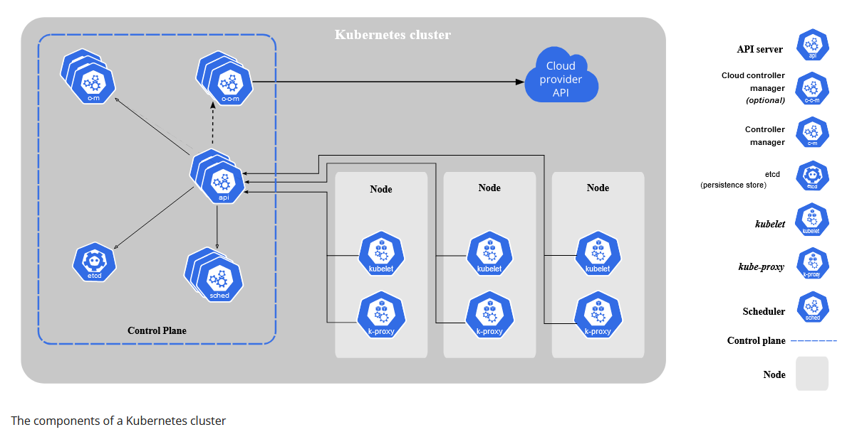
Focusing On Containers

