Slide 1
Busy Bees The Transformation of BumbleBee
Patrick Staubmann (VMRay GmbH, DE)

Slide 2
BumbleBee, is it you?

Slide 3
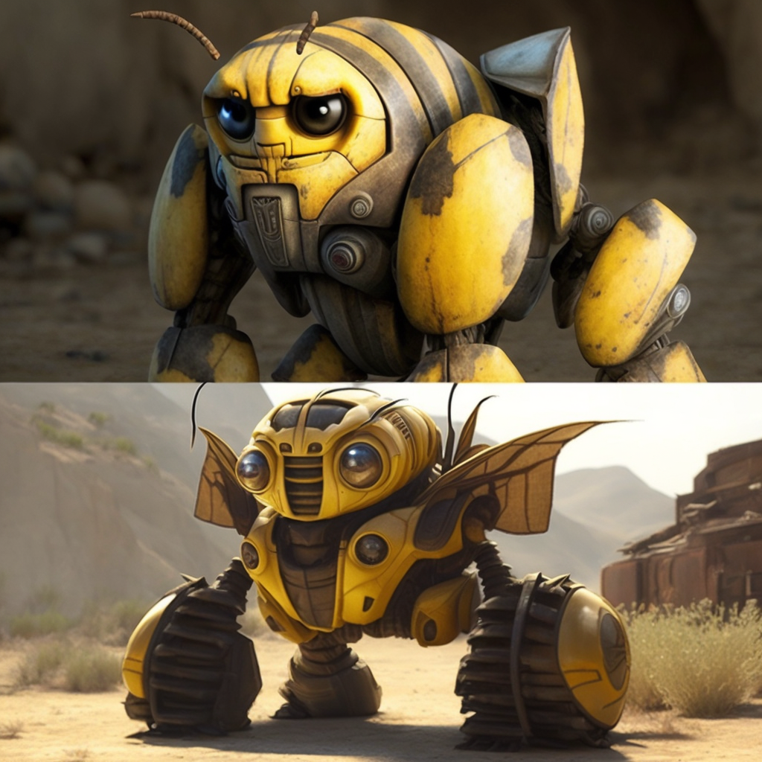
BumbleBee
Active since 03/2022
Successor to BazarLoader
Acts as a loader (bot) for other malware
Unique and customized packer
Novel hooking method
Numerous evasion techniques
Created by Midjourney

Slide 4
BumbleBee’s Loading Activities
Meterpreter Shellcode
Cobalt Strike
Sliver
Conti Ransomware
Icons taken from https://www.flaticon.com

Slide 5
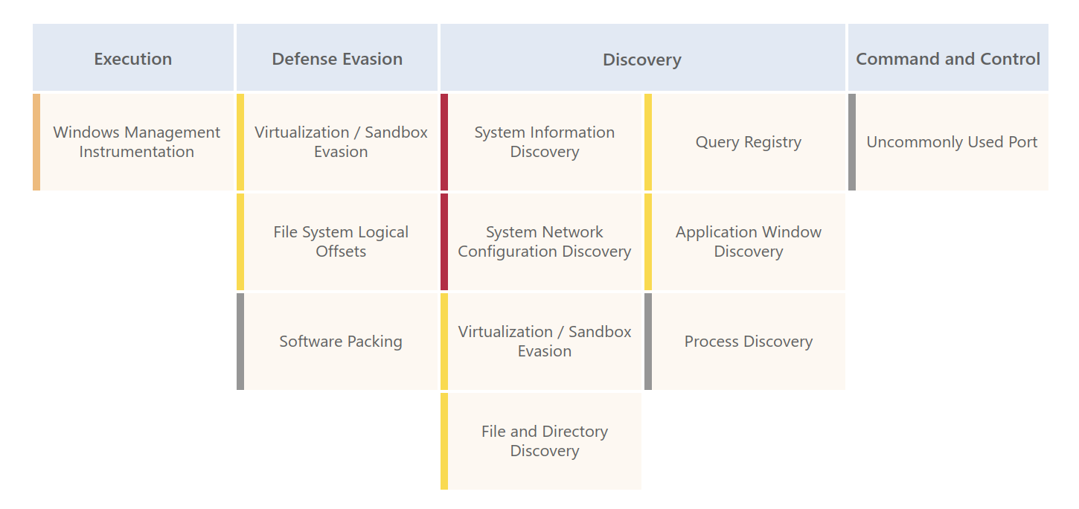
MITRE ATT&CK Overview

Slide 6
BumbleBee’s Delivery and Execution

Slide 7
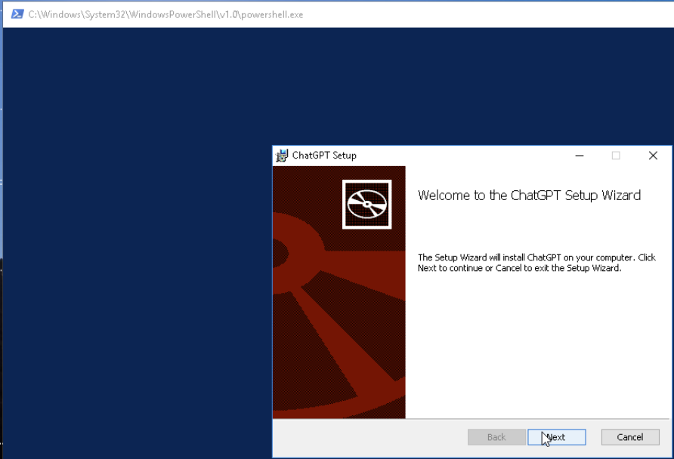
BumbleBee’s Delivery
Icons taken from
https://www.flaticon.com
https://commons.wikimedia.org

Slide 8
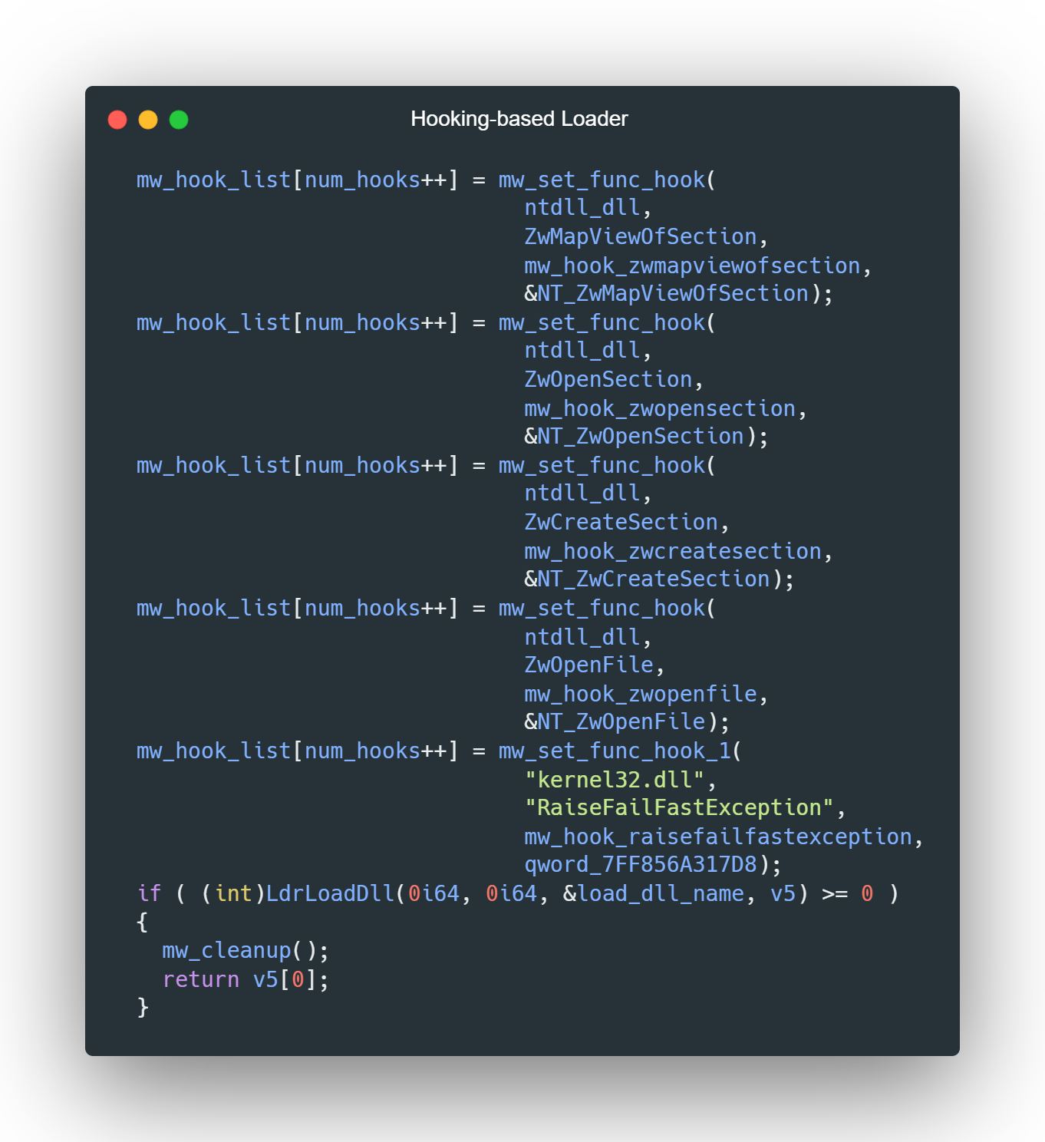
Hooking-based Loader
“Fake-” loads DLL via LdrLoadDll
Tries to find not loaded DLLs
dimsroam.dll
sbe.dll
wups.dll
Loads malicious DLL in the context of a trusted Windows DLL

Slide 9
BumbleBee’s Evasion Techniques

Slide 10
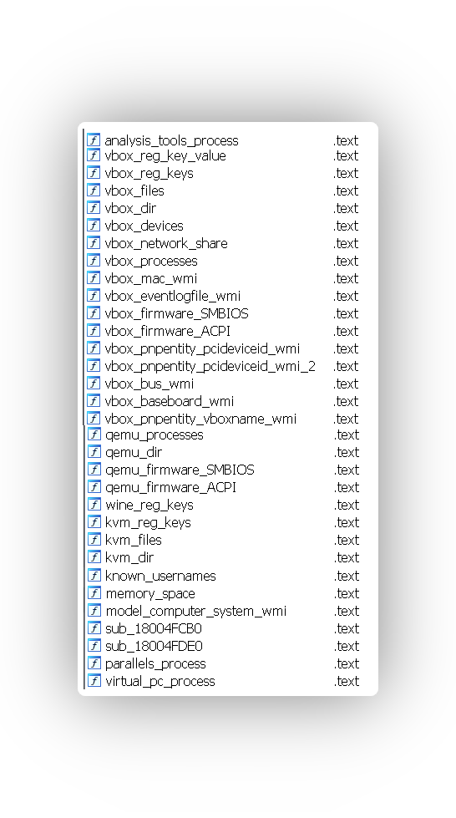
Evasion Techniques Overview
~50 evasion techniques
Mostly related to detect virtual machines
VirtualBox
VMware
Parallels
…
Memory, mouse movement, etc.
Mainly from Al-Khaser
Icons taken from
https://www.cleanpng.com
https://commons.wikimedia.org

Slide 11
Evasion Techniques Evolution
3/2022
5/2022
> 35 evasion techniques
11/2022
1/2023
> 50 evasion techniques

Slide 12
Evasion Techniques Difference
Mid 2022
Virtual Box
Parallels
QEMU
KVM
Windows version
Registry keys
MAC address
Early 2023
VMware related artefacts
Mouse movement
File name
Disk size
Services
CPU fan

Slide 13
BumbleBee’s C2 Communication

Slide 14
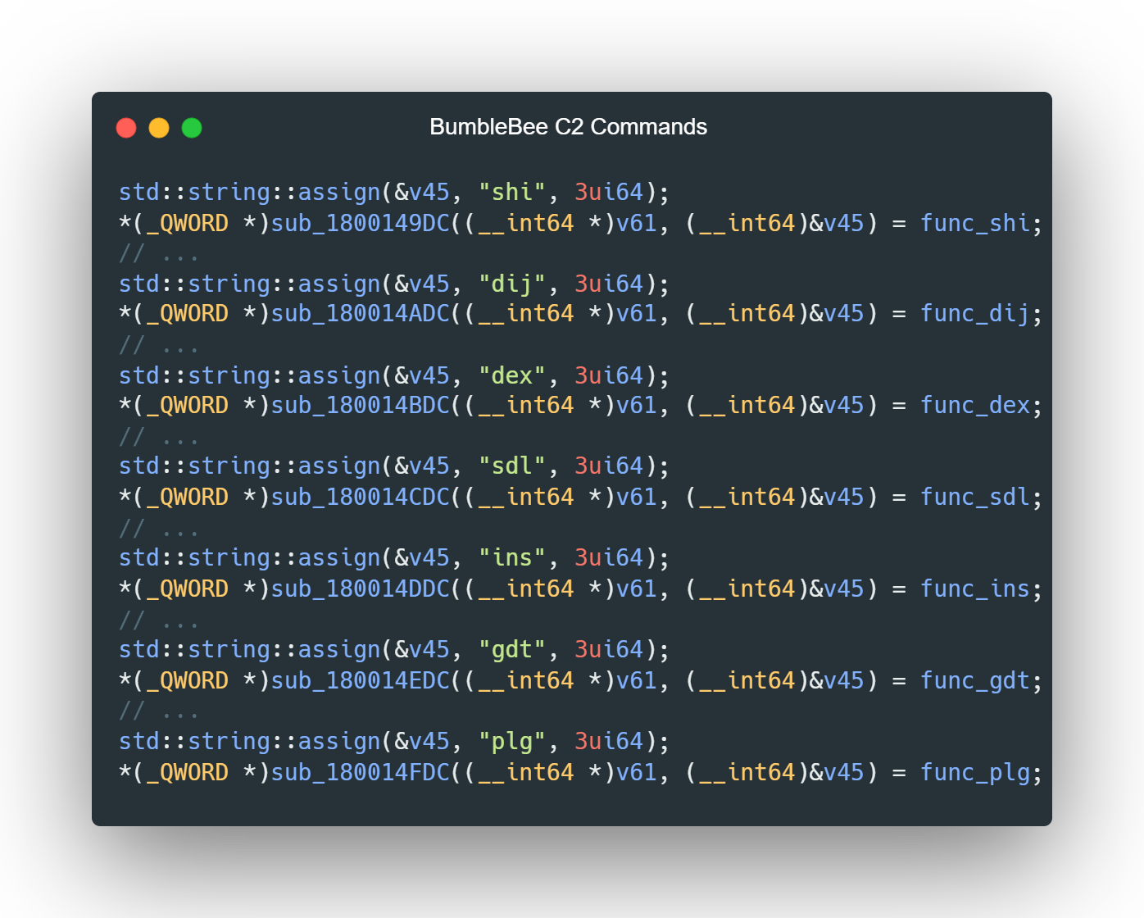
Supported C2 Commands
Shellcode Injection
DLL Injection
Download & Execute
Uninstall
Persistence
Execute Shell Commands
Load Plugins

Slide 15
C2 Commands Evolution
03/2022
Shellcode injection DLL injection Download & Execute Uninstall Persistence
05/2022
NEW: Shell Command Execution
08/2022
NEW: Load Plugin

Slide 16
Malware Configuration Extraction

Slide 17
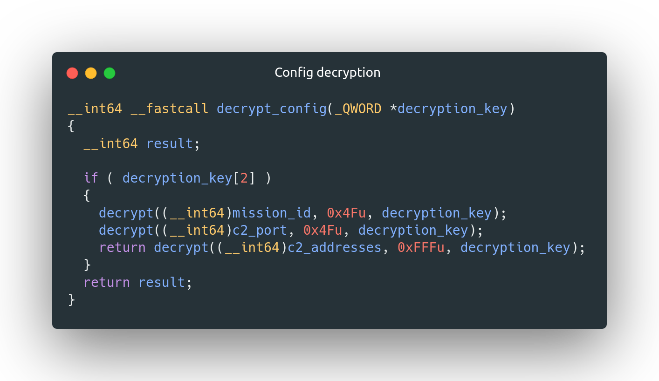
BumbleBee’s Configuration Overview
RC4 encryption
Encryption Key
Config data
Identifier
Mission ID
C2 address(es)

Slide 18
Configuration Decryption

Slide 19
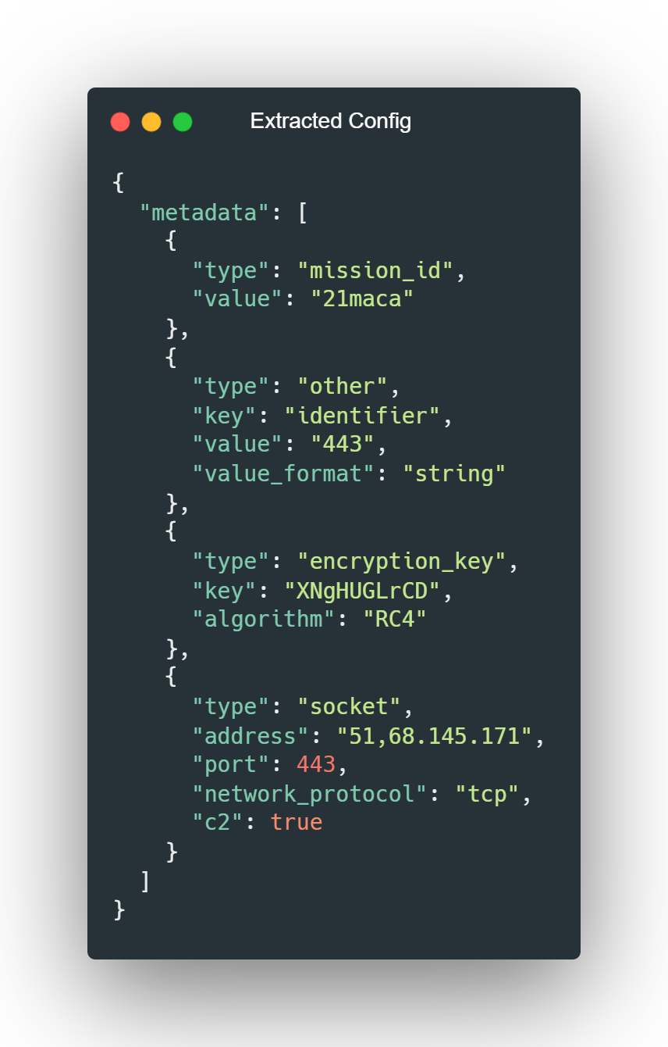
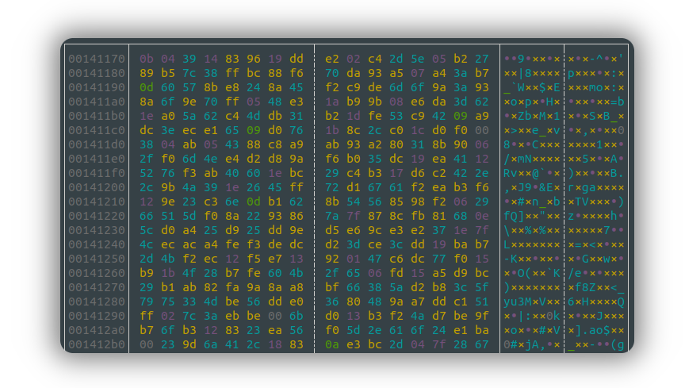
Extracting the Configuration

Slide 20
Conclusion

Slide 21
Conclusion
Gradual code changes over the last year
Still in active development
Potential to become more popular

Slide 22
Thank you!
pstaubmann@vmray.com

Slide 23
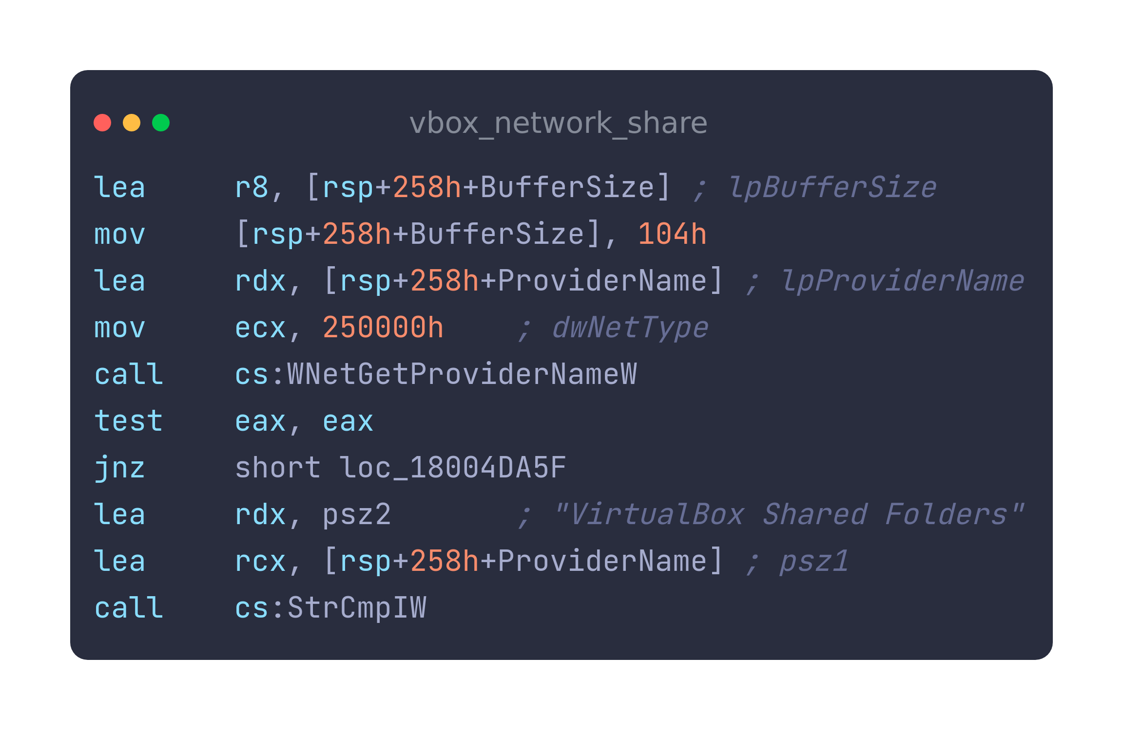
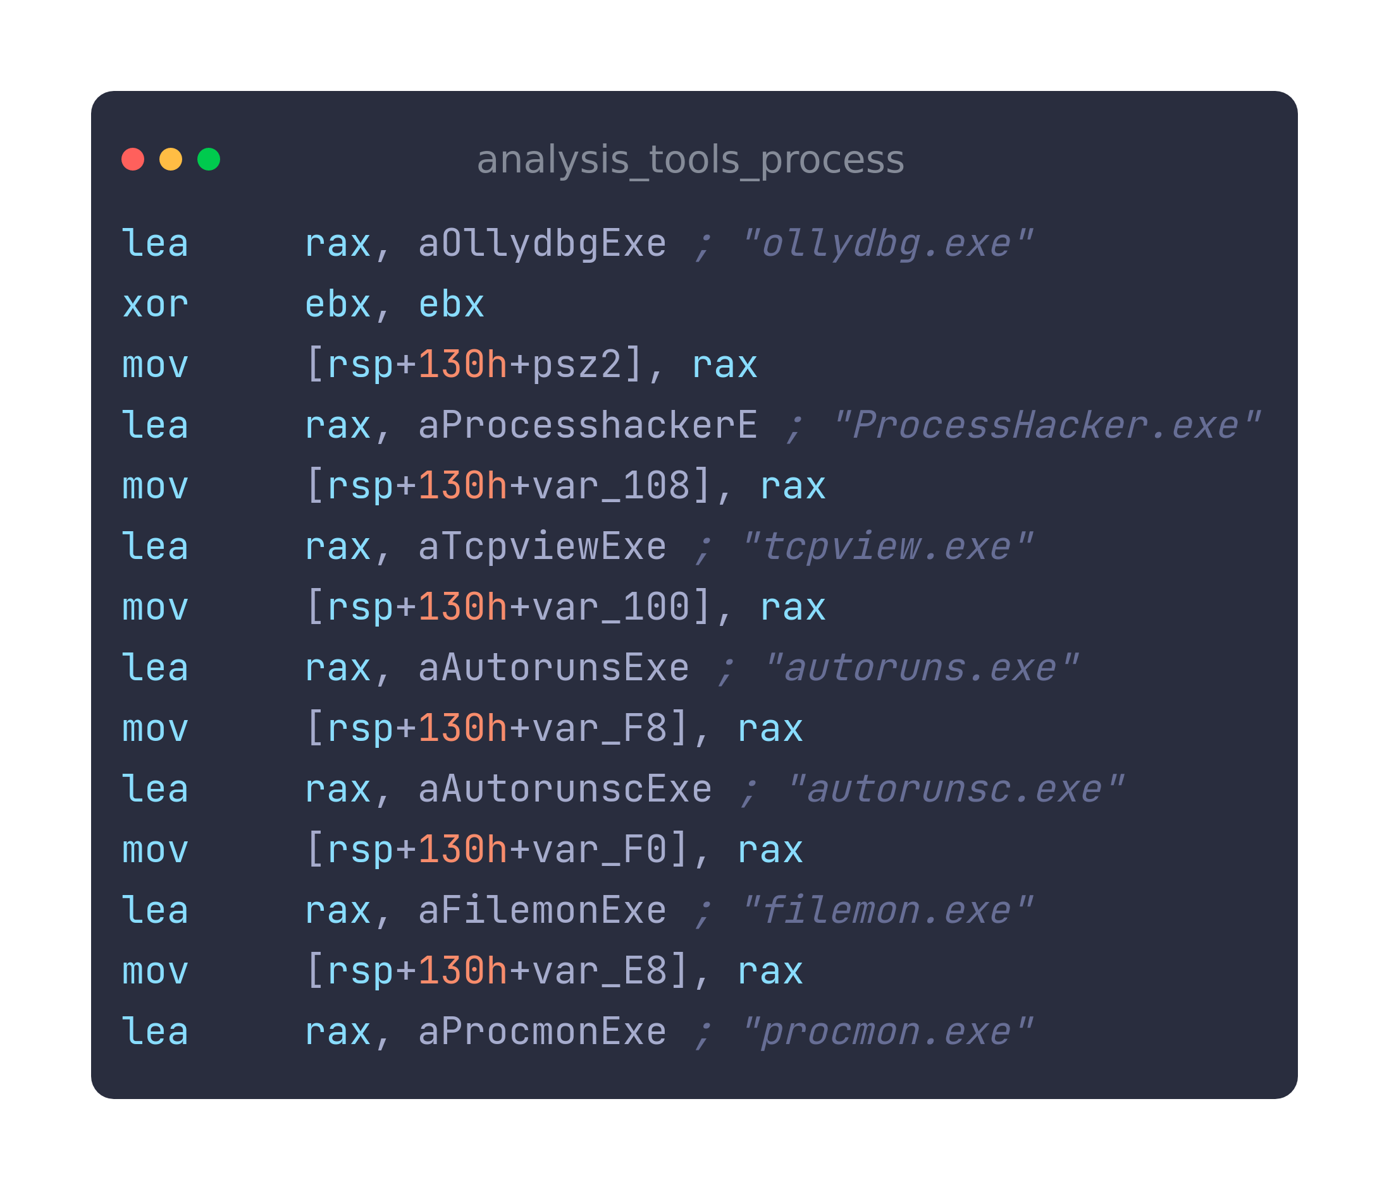
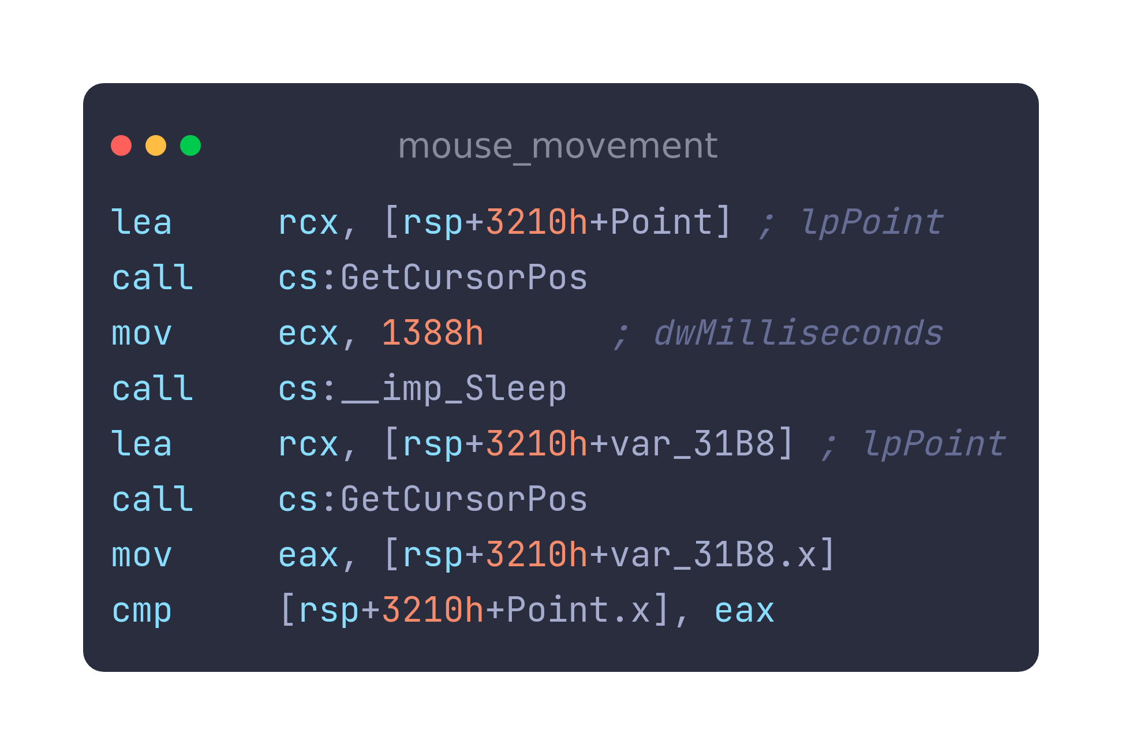
Evasion Techniques

Slide 24
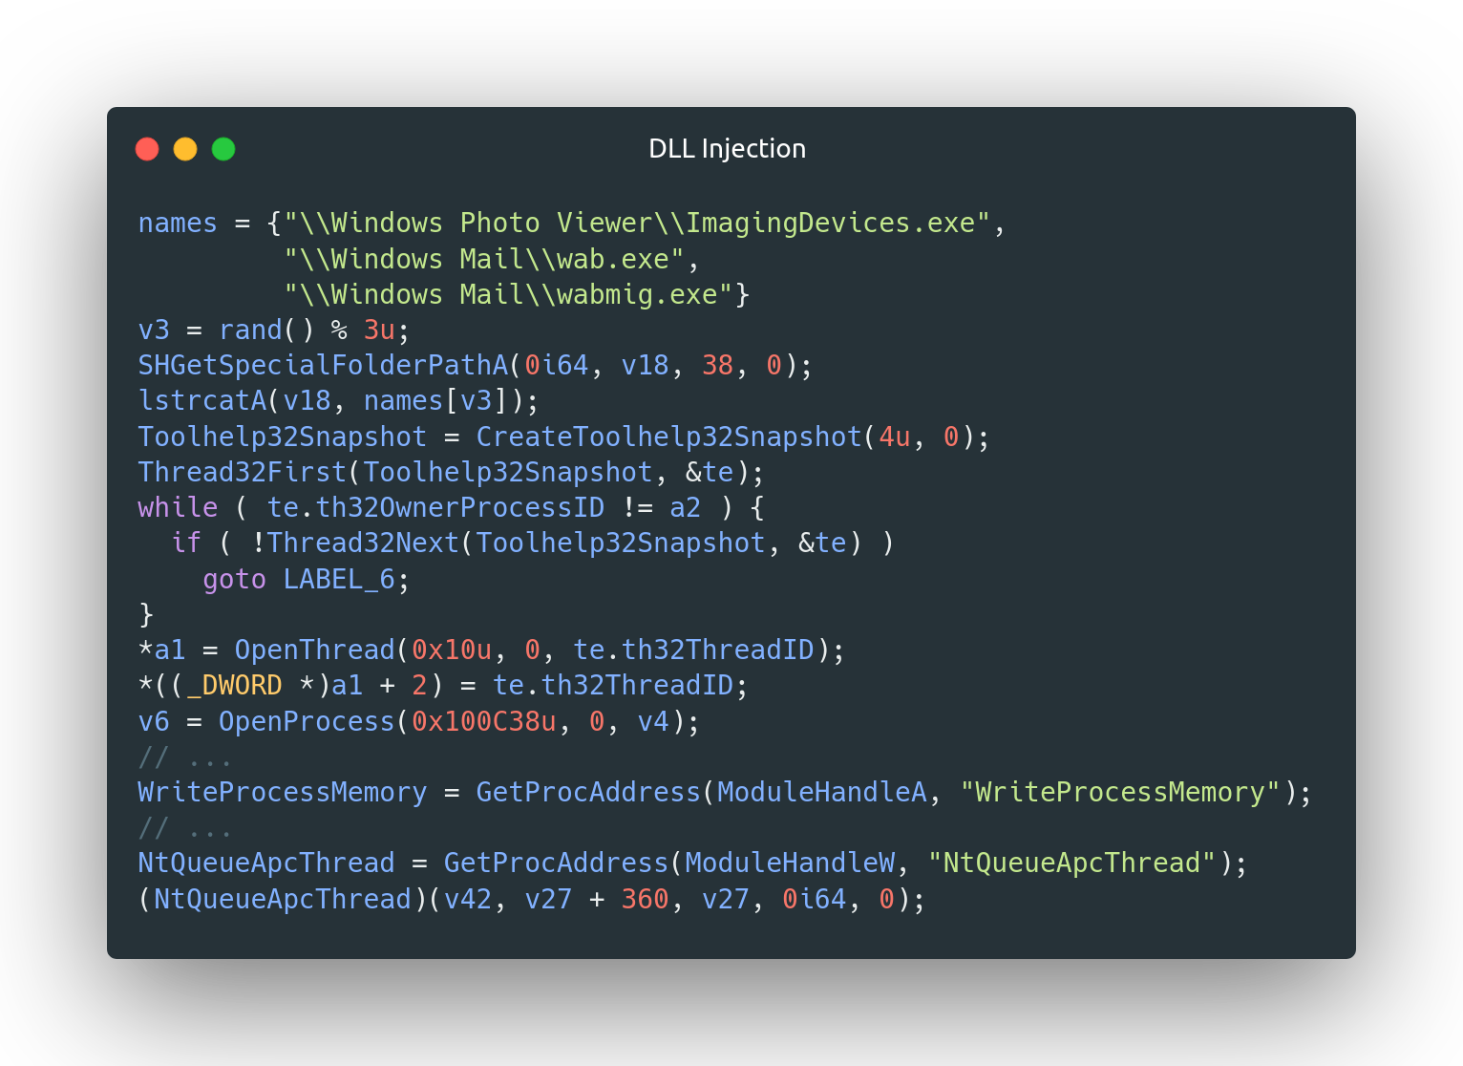
Command Examples

Slide 25
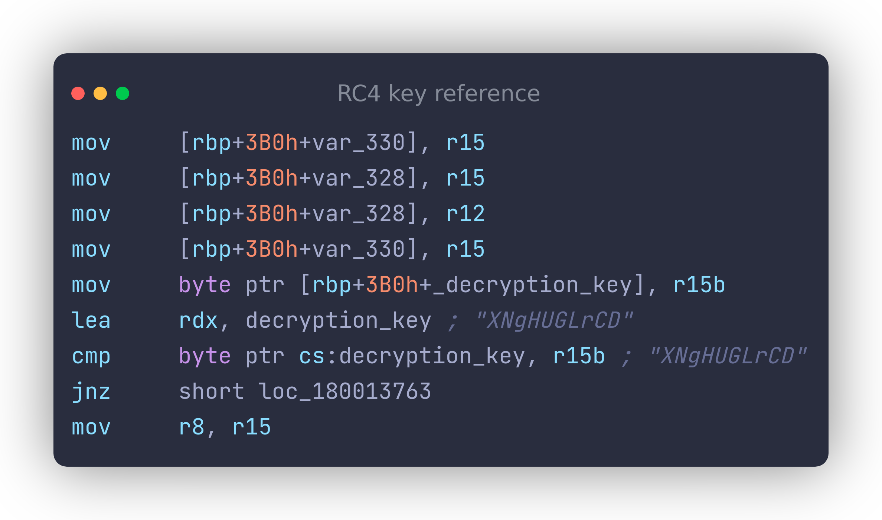
Extracting the Key

Slide 26
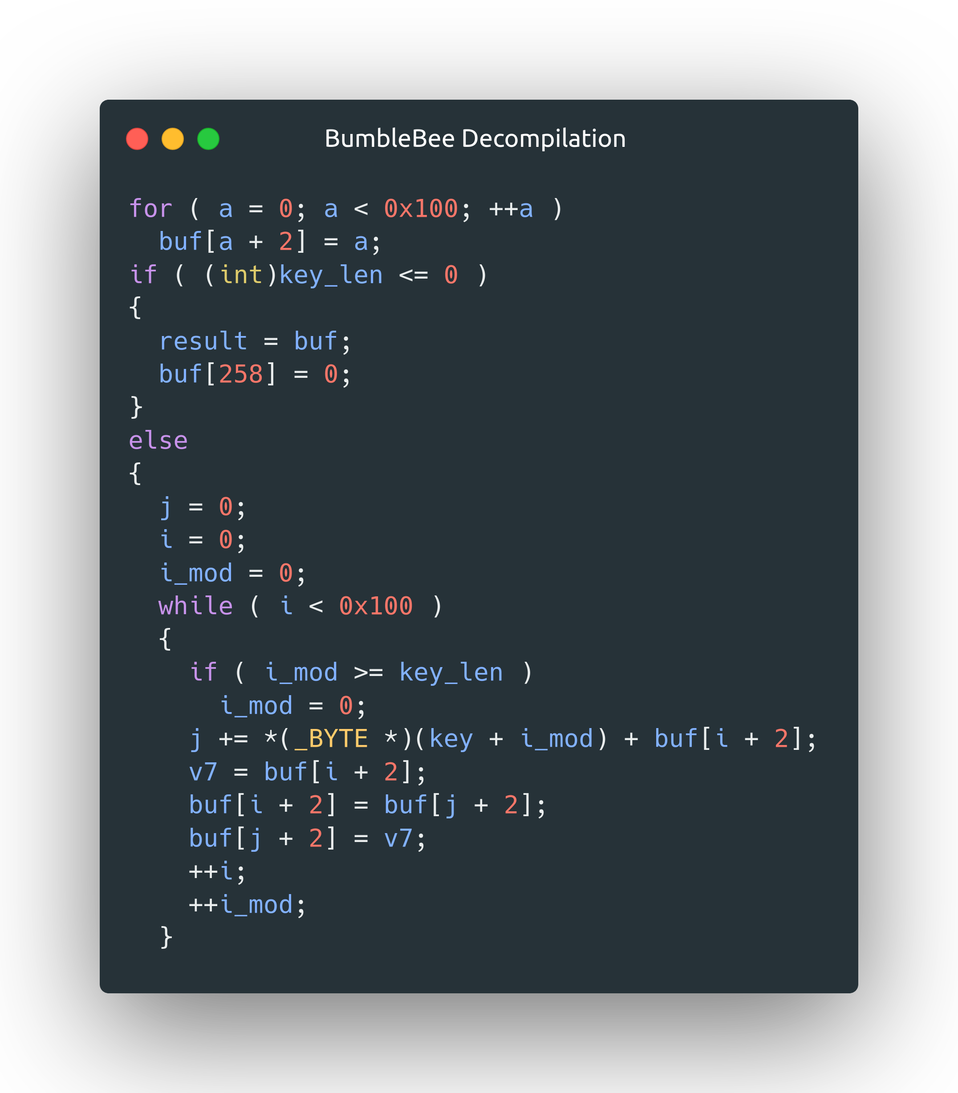
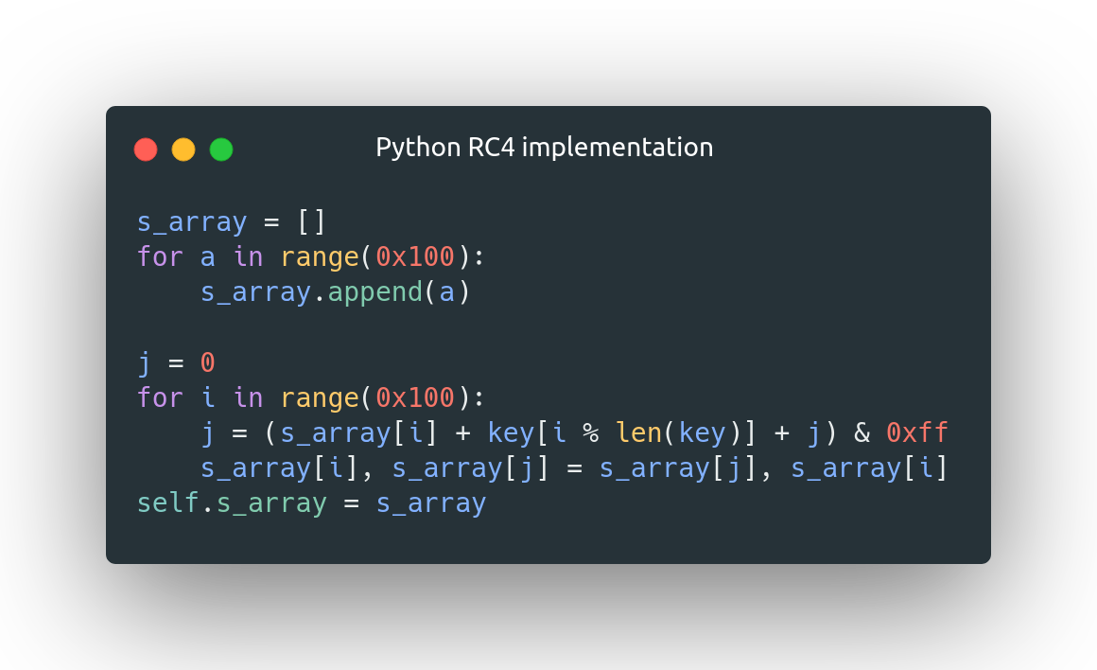
RC4 Decryption Identification

