Slide 1
Improving ICS/OT Threat Hunt & Incident Response Capabilities Through Adversary Emulation
Shaun Long
CISA, Deputy Chief – Industrial Control Systems Section

Slide 2
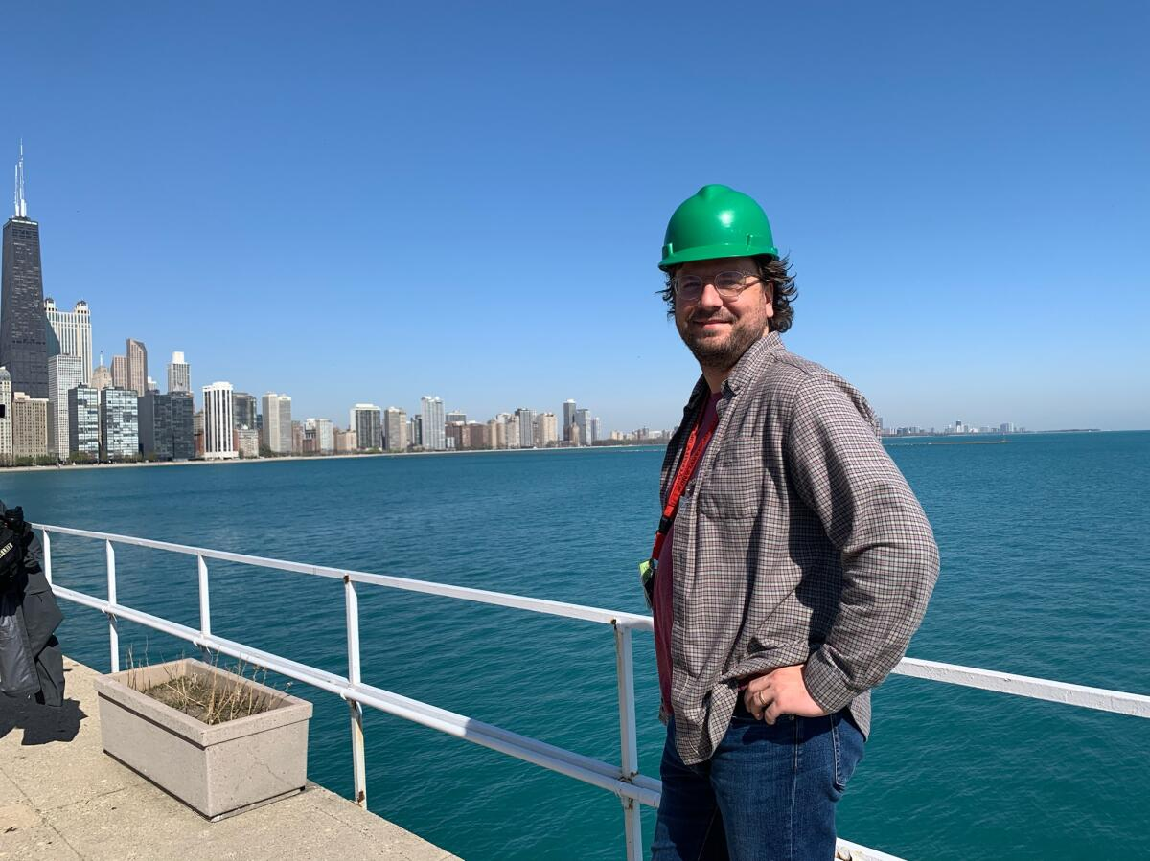
Introduction
Shaun Long – Deputy Chief for CISA’s Industrial Control Systems Section
Spent the last three years at CISA – previously worked for eight years at Booz Allen Hamilton focused on security & resilience for platform/mission systems and industrial control systems
Current team focused on CISA’s OT test range (CELR), adversary emulation for ICS, a variety of open-source projects for ICS/OT, and general efforts to prioritize risk reduction for at-risk critical infrastructure in the US and collaborating partners abroad

Slide 3

ICS IR Problem Set – 10+ Years Ago
Limited number of tools designed for constraints present in ICS environment (timing, availability, etc)
Personnel expertise exists – ad-hoc and dependent on practical experience/deep understanding of environments
IT & OT integration exists in industry – but is limited based on available commercial applications and network constraints
Limited availability of ICS/OT CTI

Slide 4



ICS IR Problem Set – Present Day
The problem set has completely shifted – we now have a robust market of tools and capabilities to address network visibility and host activity
The industry has a significant shortfall of experienced analysts relative to the rapidly expanding market of OT-cyber-aware owner/operators
Private sector has capacity challenges – private & public sector are competing for the same talent pool
Industry 4.0 IT/OT inter-connectivity have created target rich/high impact environments
More robust cyber threat intelligence – private sector & public sector partnership CTI sharing

Slide 5
How do we close the gap?
Robust Training & Exercise Environment
Engineering Focus
Train like you fight, fight like you train!
Intelligence driven – curated exercises
Design environments to mirror operational environments (water treatment, power transmission, etc)
Analysts may need to hear, see, and feel the kinetic effects of ICS to understand how they work
ICS environments each have unique challenges
Focus on operator interactions – analysts must gain trust to succeed
Analysts must understand operator priorities – Safety is #1 and operations = $$ or critical services
Train with the latest discovery & analysis tools
Gain repetitions in realistic operational environment
Expose analysts to ICS protocols & traffic, network designs, and sector relevant hw/sw
Expose analysts to relevant threat actor TTP’s
ICS environments provide fertile ground for LoTL
Focus on “high likelihood” TTP’s – tunneling through IT to OT and leveraging normal operations to hide

Slide 6
CISA Solution - CELR
The Control Environment Laboratory Resource (CELR) is a collection of representative operational technology (OT) environments comprised of actual control system hardware and software used for research, training, capability testing, and supporting operational elements of CSD
These environments include purpose-built processes, kinetic effects, full integrated IT/OT network architecture, and specific technologies found in US Critical Infrastructure (CI)
CELR Service Offerings:
  Critical Infrastructure Cyber Attack Demonstrations
  Simulated Threat Hunting Engagements
  OT Test Range to support Research & Product Development
  ICS Technology and Protocol Training
  OT Solutions Assessment

Slide 7




Using CELR to build the next OT IR workforce
Robust Training & Exercise Environment
Engineering Focus
Train like you fight, fight like you train!
Intelligence driven – curated exercises
CELR services scale up and down to meet the participant in their OT-cyber journey. The flexibility to adjust attack scenarios and exercise content enable CELR to reach a broader audience, while still producing consumable content and products for the greater community.
Hypotheses Driven TH/IR
Advanced OT Det. Engineering
Caldera copyright MITRE
OT Protocol Advanced
Basic OT Detection Engineering
Impact Driven TH/IR
Malcolm (Open-Source) Training
OT Protocol Basics
Netflow Analysis
Sensor Deployment

Slide 8


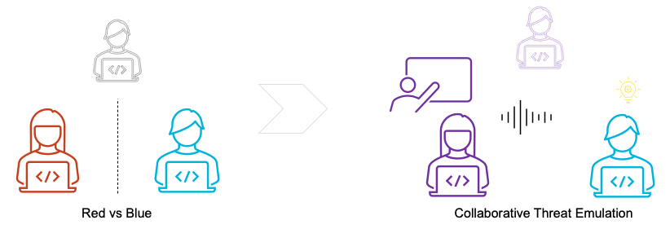
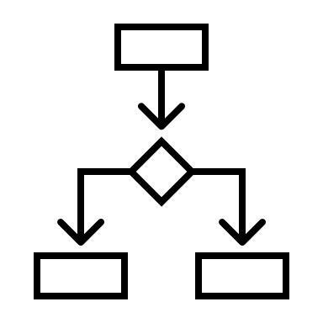
Executing a Purple Team Engagement
Defense is viewed as a shared responsibility
TTPs are executed with intent to enhance knowledge of both red and blue stakeholders – and build consumable products (Caldera OT)
1.
Training Objective Focus
2.
Collaboration
3.
Pace of engagement

Slide 9
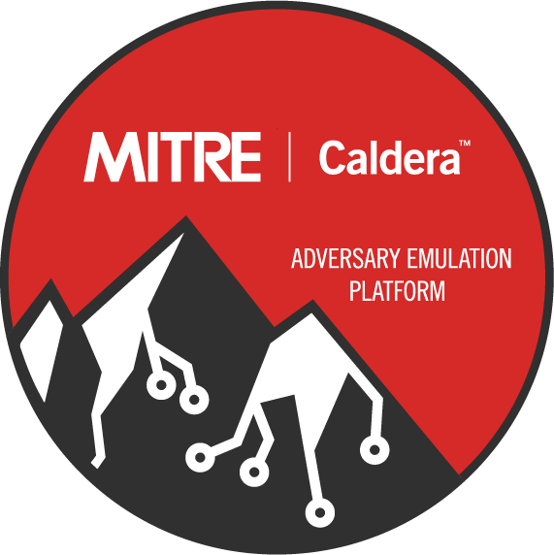

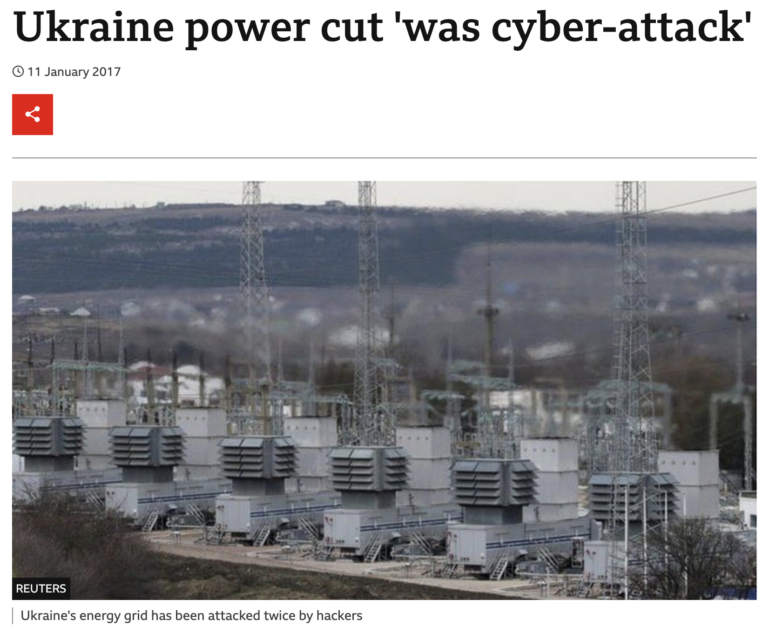



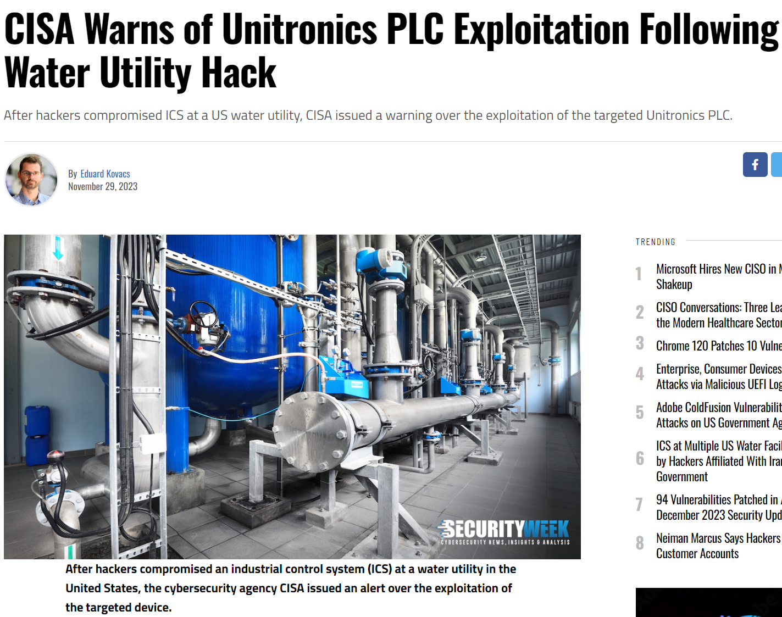







MITRE Caldera™ for OT
A cybersecurity framework that empowers practitioners to save time, money, and energy through automated security assessments.
Need
Solution
Impact
WHO
HOW
openDNP3 C++
Civil & Military
Training + Education
Test + Evaluation
Research + Development
Caldera for OT
BACnet stack C
libIEC61850 C
Owner-Operators
International
pnio_dcp Python
pymodbus Python
https://github.com/mitre/caldera-ot
.

Slide 10
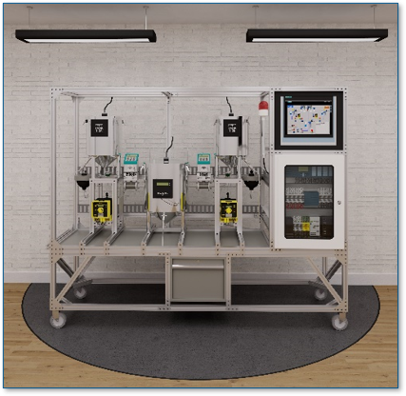
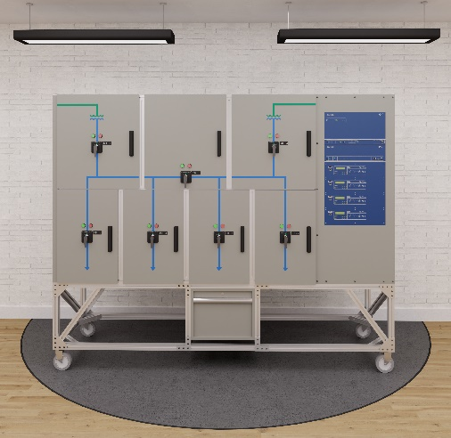
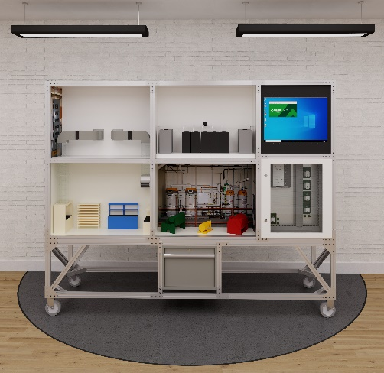
Real-World Adversary Emulation
LoTL Campaigns
Sandworm - Industroyer
US HVAC Ransomware

Slide 11
Case Study – Owner/Operator
Participant Background
Multi-utility operator – water, waste-water, energy
Limited IR experience
Maturing cyber security program – incident response & threat intelligence capability
Learning Objectives
Identify threat actor TTPs
Gain familiarity w/ vendor software/protocols – characteristics on the wire
Live off the land to detect adversary behavior
Work collaboratively in safe space – IT & OT
Exercise detections
Exposure to new Hunt/IR tools
Outcomes
IT/OT dept. collaboration through purple team
Realization OT IR requires new toolsets
Identified TTP’s for adversaries abusing legit programs/protocols
Practice identify high impact red flags
“As incident responders, we almost never see the immediate effects of threat actor activity in real time. Use of the water skid and corresponding logs really helped paint a picture of how ICS environments & communication work.” – CELR Simulated Eng. Participant

Slide 12


Owner/Operator – Key Takeaways
IT/OT Collab
Collaboration between IT & OT staff to map key terrain, identify critical assets & processes, and baseline normal behavior & communications flows between IT & OT
Early introduction to LoTL TTP’s for critical operator
37 unique TTP’s – 15 of those emulated VT
Exercise included the owner/operator’s priority sector
Artifacts included:
  OT network telemetry – modbus & HAP traffic
  Host logs – EWS, Historian, powershell command history, scheduled tasks, PLC logs, etc
Performed Exercise re-run to provide owner/operator dataset to continue practice at home on their own tools
Reps in Realistic Environment
The owner/operator did not have a test range to practice & sharpen their skills – they were able to evaluate the need during this exercise
Tool Exposure
During the exercise – the team was exposed to new open-source tools & solutions to address real-world gaps in their network coverage
Operational Resilience
Took the TTP’s run during the simulated exercise and performed a gap analysis of their security tools & procedures to validate if they had the ability to detect

Slide 13
Efforts to Scale & Share CELR
We’re actively working to share and create resources to reach front-line organizations to help improve their cybersecurity posture & increase their operational resilience
Creating open-source/freely available packet captures from exercises & pairing with attack playbooks/scenarios to exercise
Developing open-source CTF’s focused on OT campaign & kinetic effects
Blueprints for creating OT testbed environment – reducing the costs for engineering design & organizations can prioritize purchasing
Open-sourcing attack playbooks to complement blueprint testbeds – enabling partners to run their own simulated threat hunt & incident response exercises

Slide 14
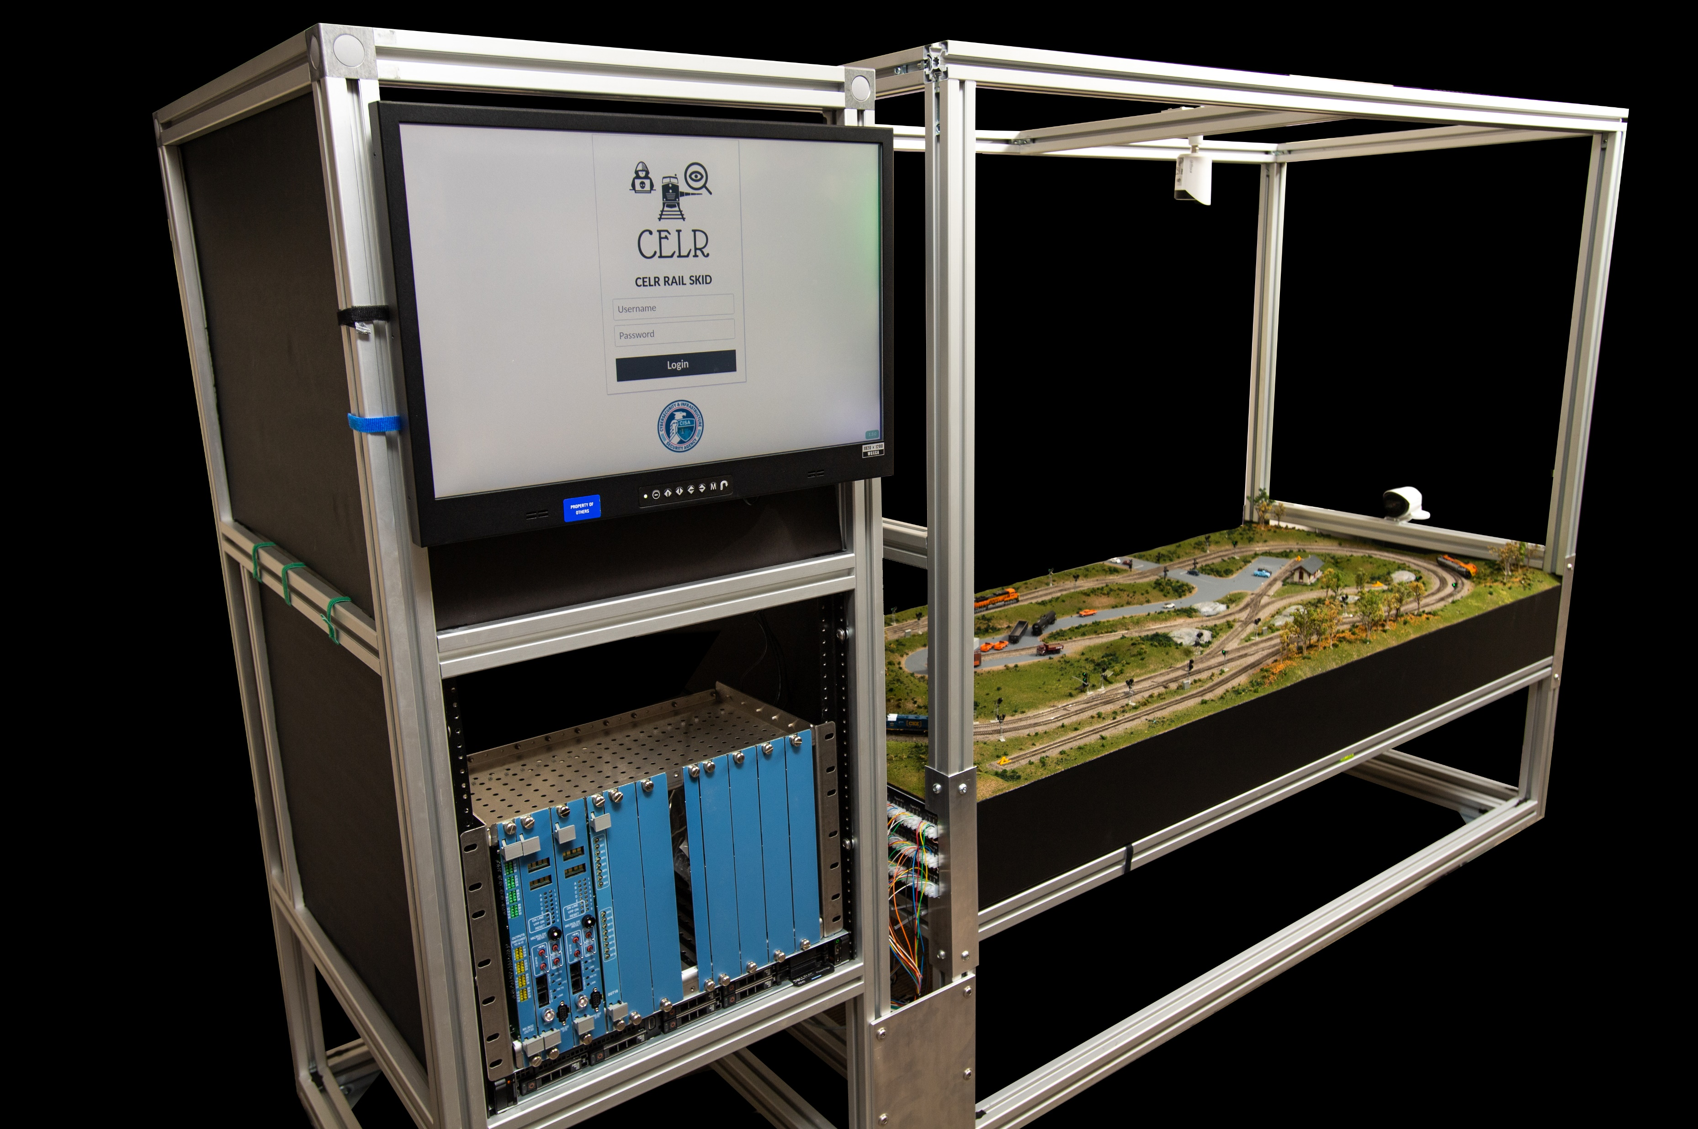



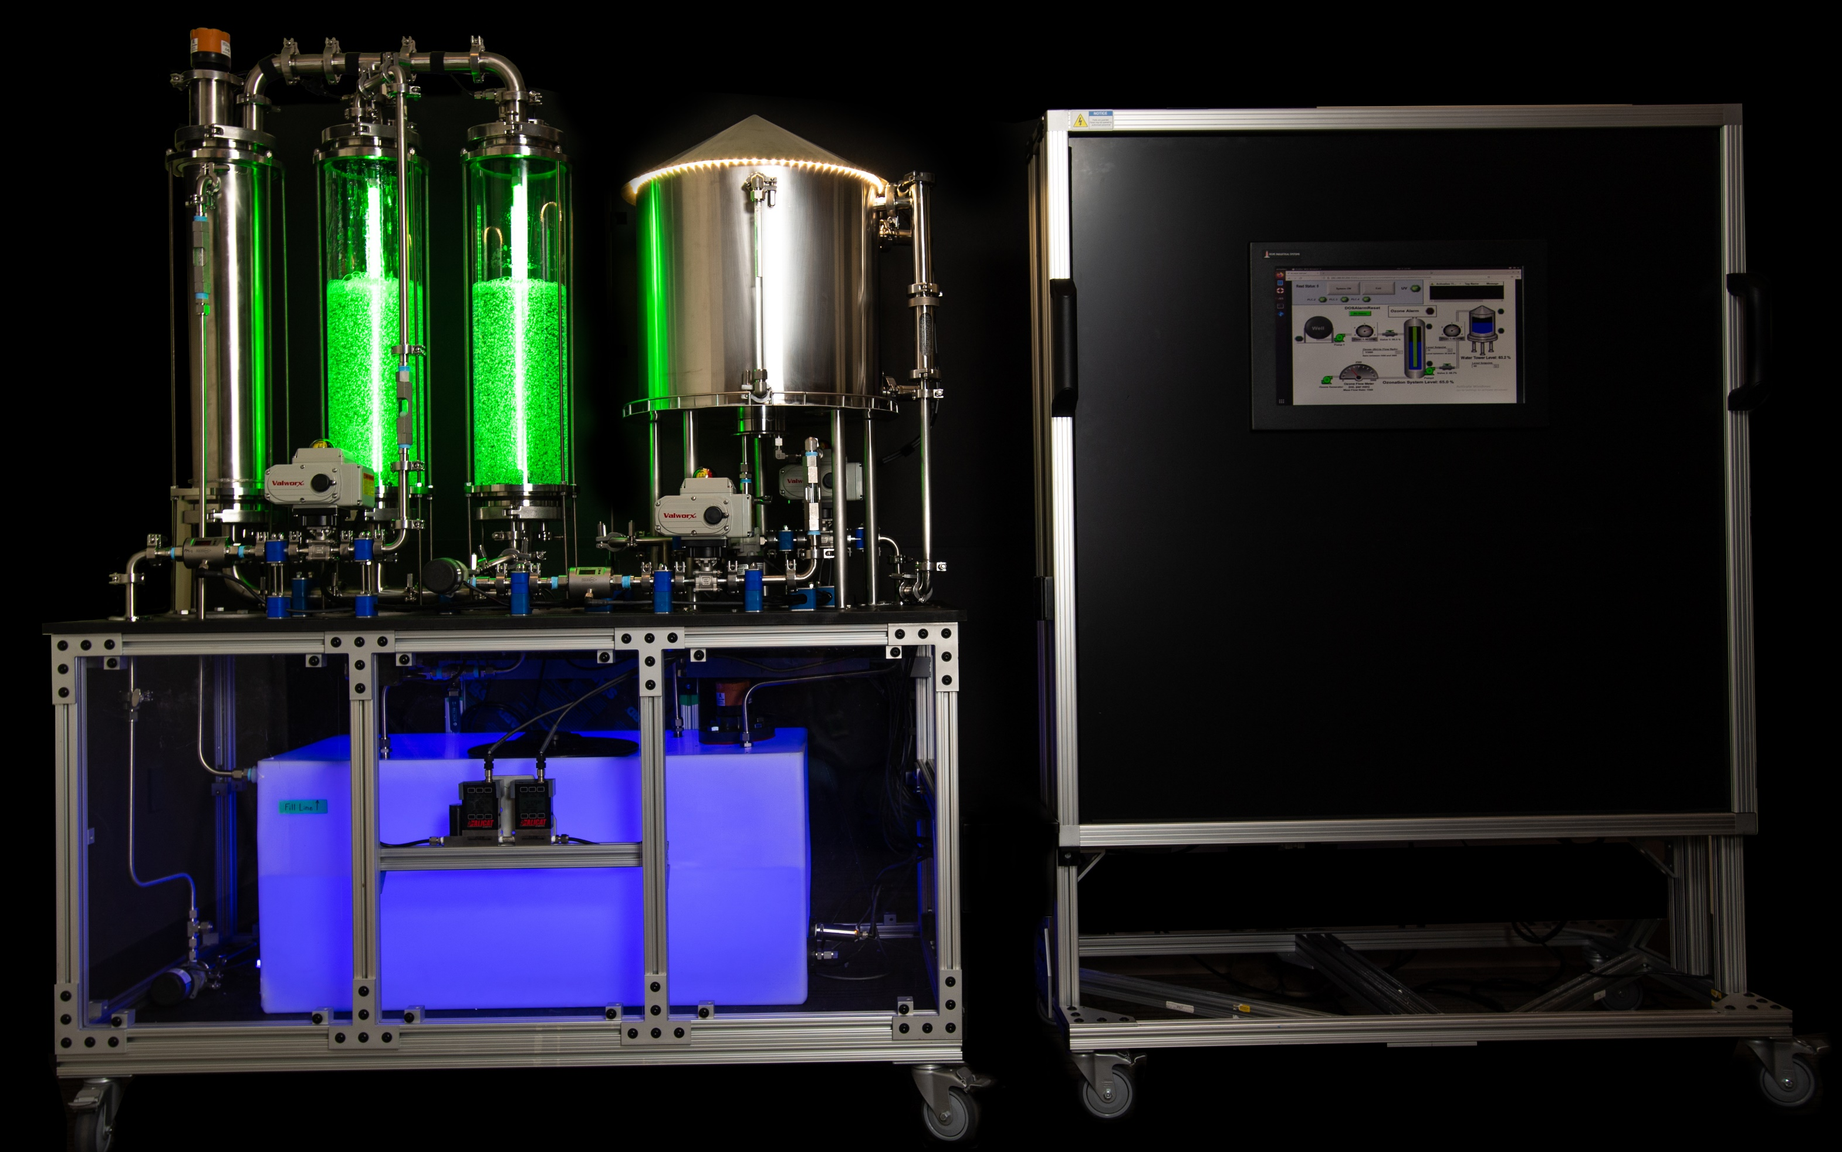
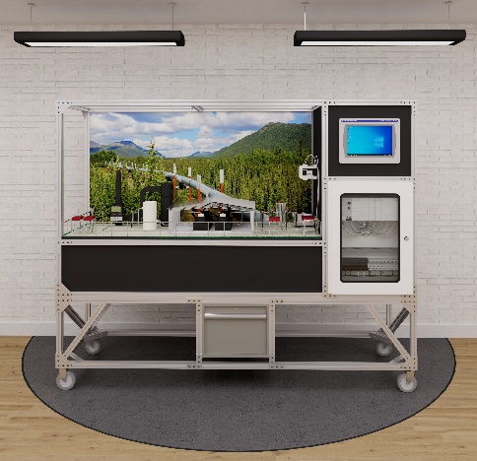

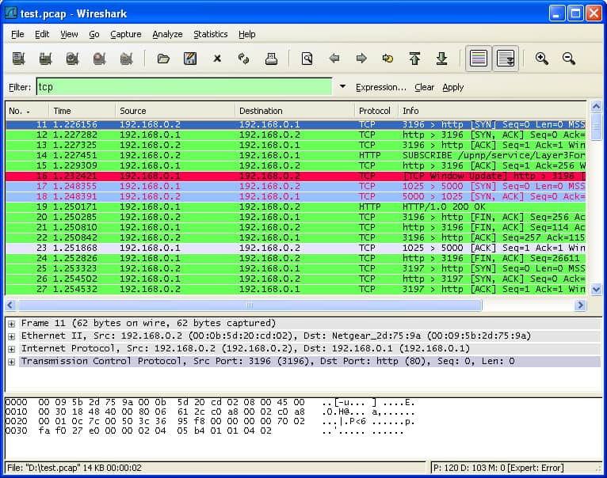

CELR Product Pipeline
CELR SKIDS
Tool Test & Evaluation
ICS Network Protocol Parsers
Commercial Vendor Tools
Parsnip
TOOLS & PRODUCTS
ICS PCAP
MITRE Caldera OT

Slide 15
🚀 CISA Open-Source Public Releases! 🚀
Parsnip – CISA & Idaho National Laboratory (INL)
https://github.com/cisagov/parsnip
Parsnip is a program developed to assist in the parsing of protocols using the open-source network security monitoring tool Zeek. Parsnip is specifically designed to be applied towards developing Industrial Control Systems (ICS) protocol parsers but can be applied to any protocol. Lookout for a presentation at Zeek Week & upcoming ICS SIG meetings ☺
ACID – CISA & MITRE
ATT&CK-based Control-system Indicator Detection for Zeek
https://github.com/cisagov/ACID
ACID is an open-source collection of OT protocol indicators developed to detect specific ATT&CK behaviors for ICS within Zeek. It integrates non-intrusively with Zeek and is easily extendable, allowing users to add their own protocol indicators. The framework includes Incident Summaries for correlating events across sessions and offers customizable options to fine-tune reporting.

Slide 16
For more information:
www.cisa.gov
Questions?
Email: celr_cisa@dhs.cisa.gov

