Slide 1
Krassimir Tzvetanov (Hydrolix, Purdue University, USA) Hendrik Adrian (LAC, Japan)
Cyber Threat Intelligence (CTI) SIG

Slide 2
Cyber Threat Intelligence SIG
Established: February 2018
Members: 161 (around 30+ fairly active)
Meets bi-weekly on Wednesday
The present SIG goals are:
Standardize terminology across the CTI industry
Create educational and training material to support CTI analyst training
Prepare and train new CTI analysts
Provide contemporary information about CTI tradecraft and emerging topics
Support new teams in the establishment or improvement of CTI programs

Slide 3
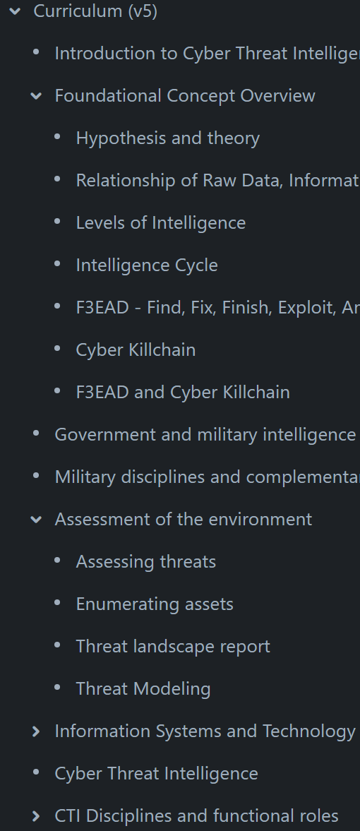
CTI SIG Output
Main principle: Quality over Quantity!
CTI Curriculum - v5 is going to be published after the conference
Standalone whitepapers
Continuous education webinars
Supporting materials for new teams
Slide decks
Training material references
Training videos

Slide 4
Should you join?
If you are interested in creating content or learning – we want you!
This is not an operational group to exchange observables/IoCs.

