Slide 1
Cornelia Puhze (Switch-Cert, Switzerland)
FIRST SIG Human Factors in Security

Slide 2
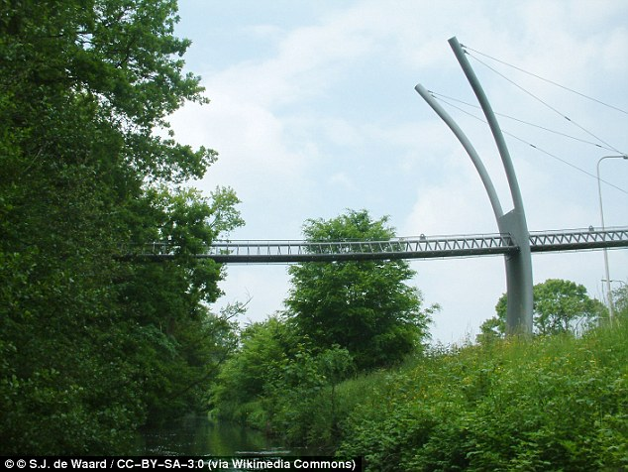
Our mission: building the right kind of bridges
Chairs:
Bjørn Hellesøy, KraftCERT
Cornelia Puhze, Switch CERT
Katja Dörlemann, Switch CERT
Notes:
The £120,000 bridge was built in 2012, to give squirrels a safe passage over a highway near the Hague, however, in the following years, only five have used it

Slide 3
Human-Centered Security (HCS)?
An interdisciplinary growing research field:
People as security assets
Practical, user-friendly measures
Behavioral & cultural awareness
Empowerment over blame
Usability + security = synergy
Notes:
Human-Computer Interaction (HCI) / Interaction Design / Human-Centered Design
Cybersecurity / Information Security
Behavioral Psychology / Behavioral Economics
Organizational Psychology / Sociology / Cultural Studies / Anthropology
Learning Sciences / Cognitive Science
Communication Studies

Slide 4
Topics monthly meetings 2024 / 2025
Learning from Safety Culture
Security needs human-centered design
Security Advocacy and Framing
Designing Behaviour Change Interventions
Next meeting 2nd July, 4:00PM CET
Laura Maguire: Cognitive Systems & Resilience Engineering
Notes:
Laura targeted applied research projects that focus on understanding what makes safety, risk, and resilient performance challenging in a given work setting.
She designs solutions aimed at giving a strong ROI and are practical to integrate into operations.

Slide 5
Thank you and join us!
https://www.first.org/global/sigs/hfs/

