Slide 1
The funny story of Active Directory backdooring 💀
TLP:CLEAR

Slide 2
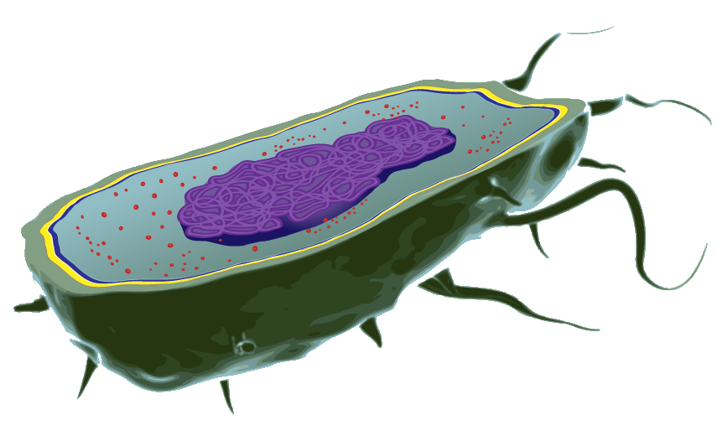
TLP:CLEAR
>whoami
Sylvain Cortes
VP - Strategy Hackuity
scortes@hackuity.io
sylvaincortes@hotmail.com
Freelance: Identity & Cyber (18 years)
Expertises: Directories Security, Active Directory Hardening, Kerberos, Vulnerability Management, VOC strategy
Co-organizer of www.identitydays.com
VP Strategy at www.hackuity.io
https://www.linkedin.com/in/sylvaincortes/
Hackuity = VOC Enabler

Slide 3
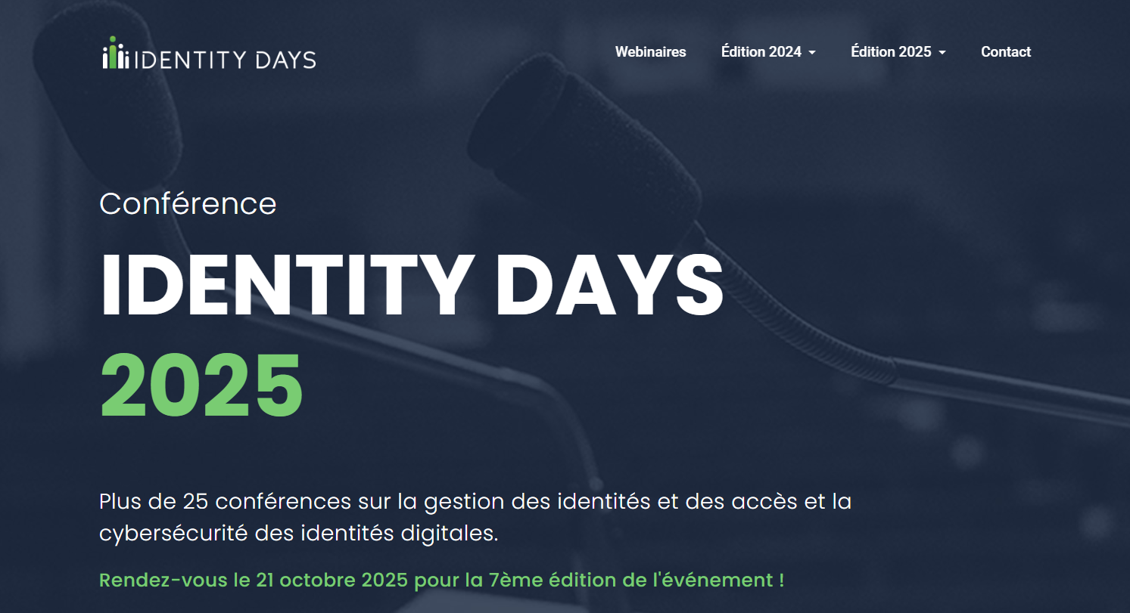
www.identitydays.com
TLP:CLEAR

Slide 4
Agenda
TLP:CLEAR
Introduction
How do Active Directory attacks occur in real life?
What is an AD backdoor?
AD backdooring techniques
Q&A

Slide 5
TLP:CLEAR
How do Active Directory attacks occur in real life?

Slide 6
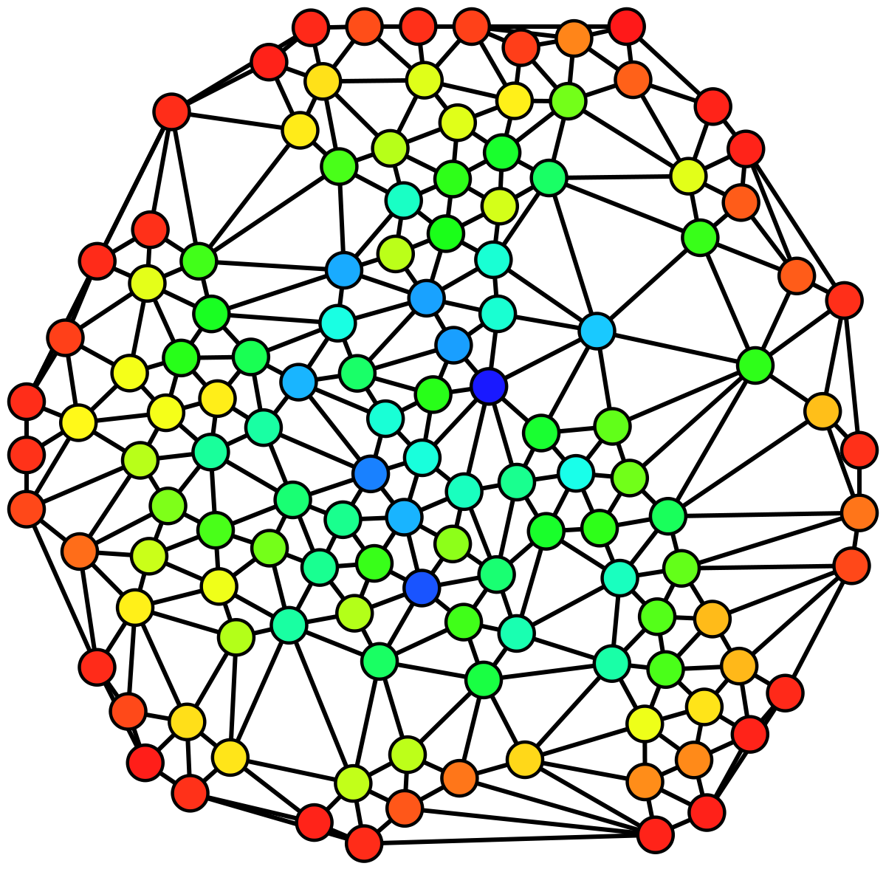
How a ransomware attack occurs
TLP:CLEAR
Ransomware’s classic sequence
1
2
Infected web page
3
1
1
2
AD
Infected USB key
1
Infected software
First malicious code infects one computer
Disable the local AV/EDR and create fake AV/EDR services and fake logs
Download the second malicious code
Locally steal login, password, password hash
Perform Active Directory (AD) reconnaissance
Look for attack paths using CVEs or AD misconfigurations
Use lateral movement & Privilege escalation to gain AD Domain Dominance
Third malicious code is downloaded
Backups are destroyed
Backdoors are created
The encryption payload is deployed on all the machines
1
Access Gateway / RDP
1

Slide 7
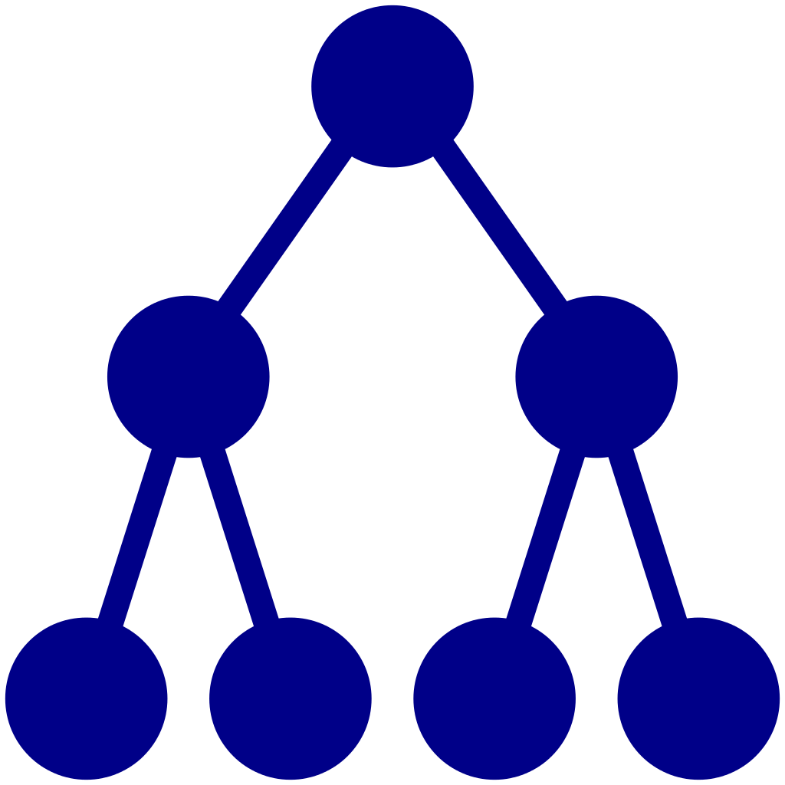
How Active Directory attacks occur in real life
TLP:CLEAR
Attack path example using CVEs & AD misconfigurations
Root objects permissions allowing DCSync attack
CVE-2021-22986 F5 BIG-IP
Windows running an obsolete OS
Privileged account running Kerberos services
Dangerous SID History attribute on account
Domain Controllers managed by illegitimate users
CVE-2020-1472
Windows DC with ZeroLogon
MS17-010
(SMB exploit)
Windows
CVE-2016-1525
Windows server with Netgear Pro NMS 300
💀
Primo-infection
Lateral movement & privilege escalation
Domain dominance +
AD Backdooring

Slide 8
TLP:CLEAR
What is an AD backdoor?

Slide 9
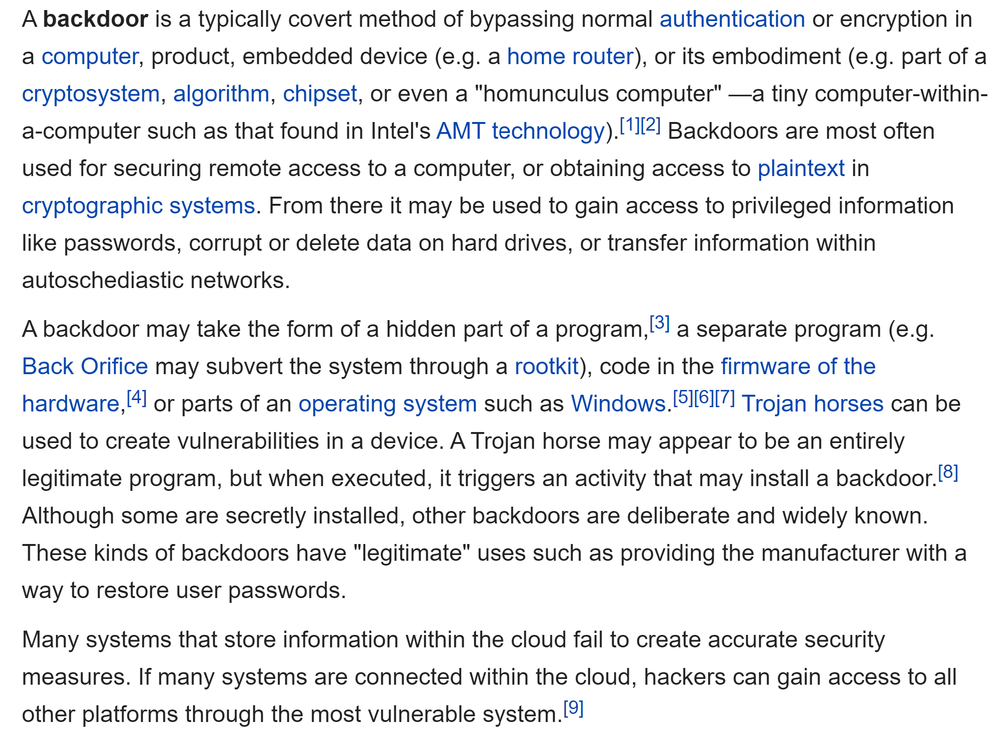
What is an AD backdoor?
TLP:CLEAR
Definition
My definition in the Active Directory context:
“After a Domain Dominance status, a way to come back later…”
Source: https://en.wikipedia.org/wiki/Backdoor_(computing)

Slide 10
AD is down. Ok, but what’s next?
TLP:CLEAR
The red pill vs. blue pill question
"You take the red pill... you stay in Wonderland, and I show you how deep the rabbit hole goes“
> Active Directory reinstallation
"You take the blue pill... the story ends, you wake up in your bed and believe whatever you want to believe“
> Try to hunt for
AD backdoors

Slide 11
TLP:CLEAR
AD backdooring techniques

Slide 12
TLP:CLEAR
AD backdooring techniques
SIDhistory attribute manipulation

Slide 13
AD backdooring techniques
TLP:CLEAR
Understand the concept
SIDhistory attribute manipulation
Domain A
Domain B
ACE / S-1-5-21-971854990-4143533025-234257201-2078
User object migration
userPrincipalName | userx@domainA.priv
SID | S-1-5-21-971854990-4143533025-234257201-2078
SIDhistory
userPrincipalName | userx@domainB.priv
SID | S-1-5-22-238747360-3847846620-347463388-1761
SIDhistory | S-1-5-21-971854990-4143533025-234257201-2078
SIDhistory attribute can host multiple values

Slide 14
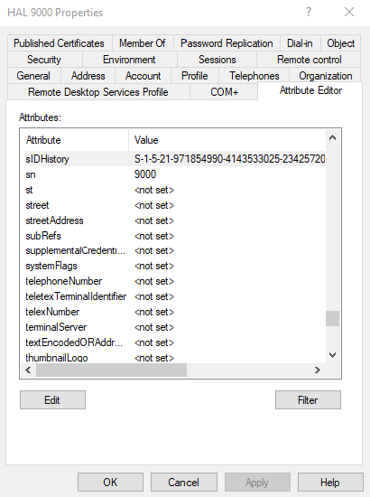
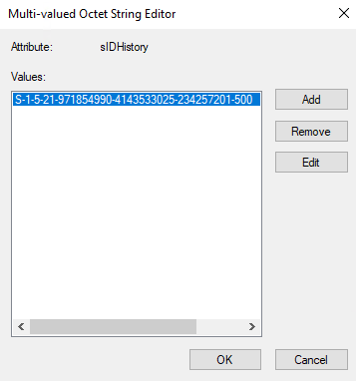
AD backdooring techniques
TLP:CLEAR
Understand the concept
SIDhistory attribute manipulation
How to modify?
SidHist VB.NET module
ADMT
All migration tools
SIDCloner - https://github.com/GreyCorbel/SIDCloner
DCShadow
Etc.

Slide 15
AD backdooring techniques
TLP:CLEAR
Understand the concept
SIDhistory attribute manipulation
Why this is dangerous?
Not limited to external SIDs!
Not limited to User SIDs!
Fact… not limited at all!
Domain Admins SID
« local » User SID

Slide 16
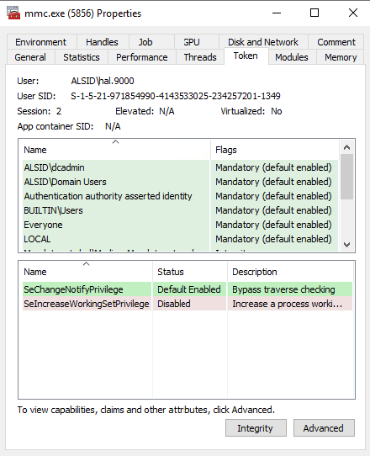
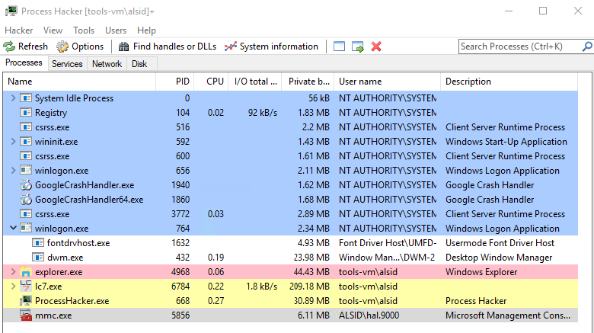
AD backdooring techniques
TLP:CLEAR
Process example with DCadmin
SIDhistory attribute manipulation
hal.9000 user
You can be domain admin without being a member of the ‘Domain Admins’ group
User hal.9000 hosts a SID value from a Domain Admin account (aka dcadmin) in SIDhistory attribute

Slide 17
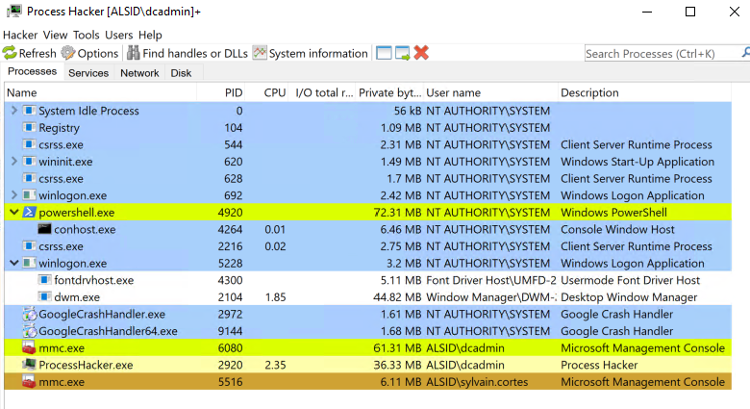
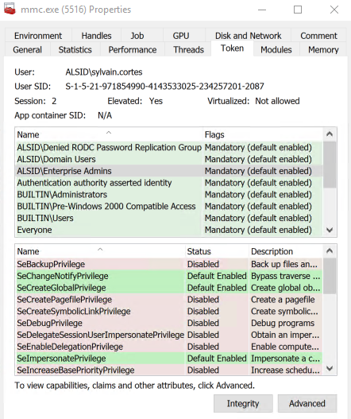
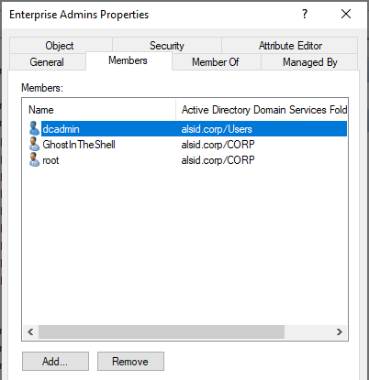
AD backdooring techniques
TLP:CLEAR
Process example with Enterprise Admins
SIDhistory attribute manipulation
sylvain.cortes user
User Sylvain.Cortes with value S-1-5-21-971854990-4143533025-234257201-519 (Enterprise Admins group) in SIDhistory attribute
But… Sylvain.Cortes is not in the Enterprise Admins group!

Slide 18
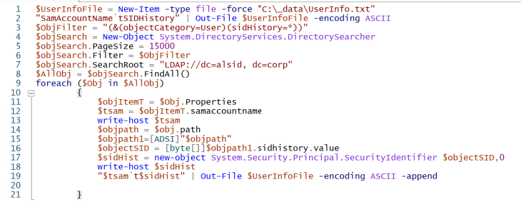
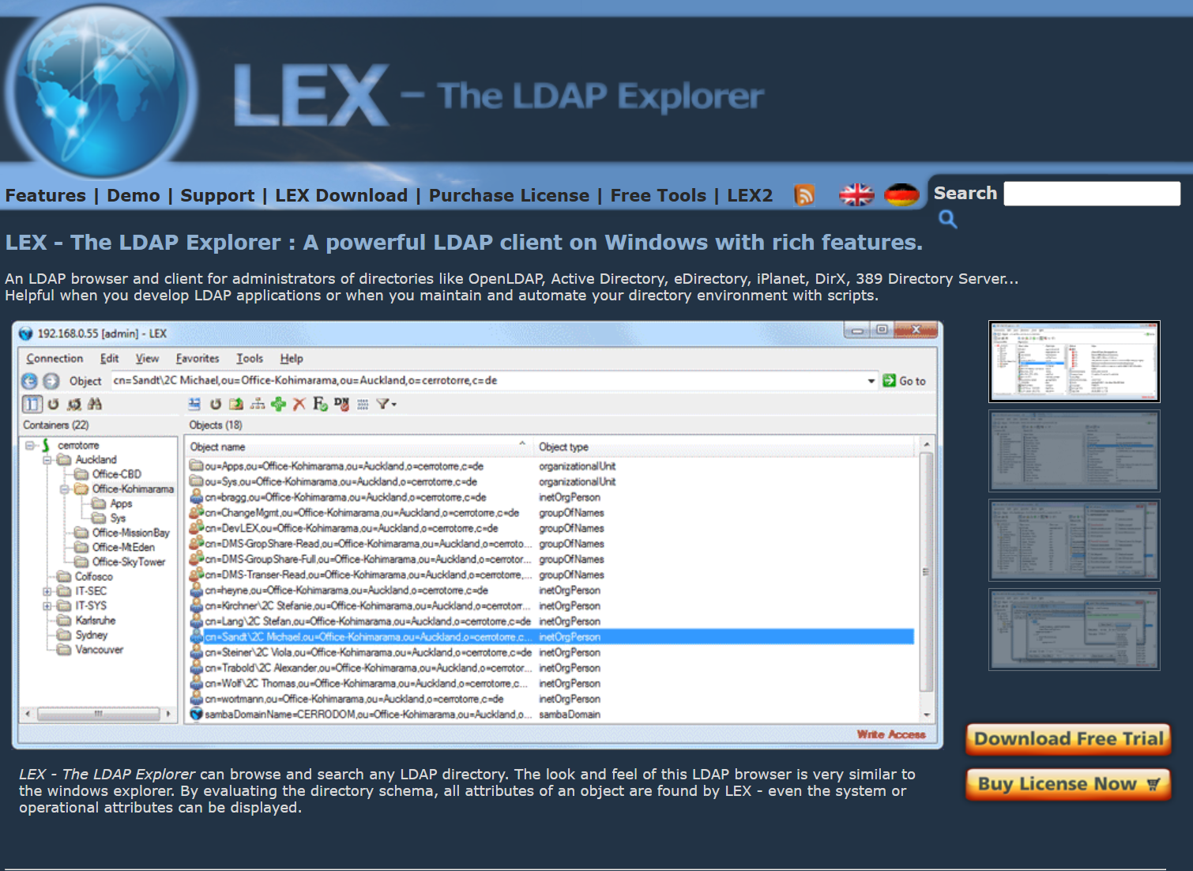
AD backdooring techniques
TLP:CLEAR
How to check
SIDhistory attribute manipulation
How to check
Search_SIDHistory PS script by Santhosh Sivarajan – https://santhoshsivarajan.wordpress.com/2010/12/12/powershell-script-search-active-directory-and-generate-sidhistory-report/
LDAP query (LEX is the best!)
AD security tools
Etc.
http://www.sivarajan.com/scripts/Search_SidHistory.txt
https://www.ldapexplorer.com/index.htm

Slide 19
TLP:CLEAR
AD backdooring techniques
‘Managed by’ attribute manipulation

Slide 20
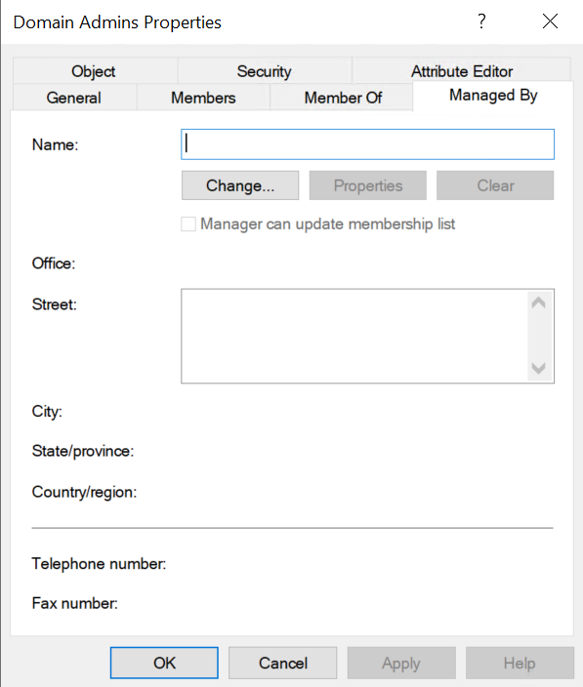
AD backdooring techniques
TLP:CLEAR
Understand the concept
‘Managed by” attribute manipulation
‘Managed By’ is a “specific” attribute designed to facilitate delegation.
On a group type object, this attribute has some “advanced” options – some of these “advanced” options are inherited from the first version of Exchange Server, which was (reminder) the first real directory in Microsoft products history

Slide 21
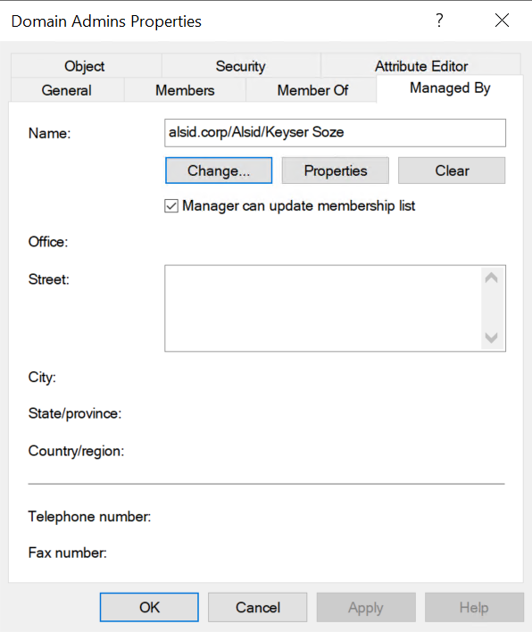
AD backdooring techniques
TLP:CLEAR
Step-by-step example
‘Managed by” attribute manipulation
First option: set a user account (here Keyser Soze) and check the “Manager can update membership list”
1
keyser.soze
user

Slide 22
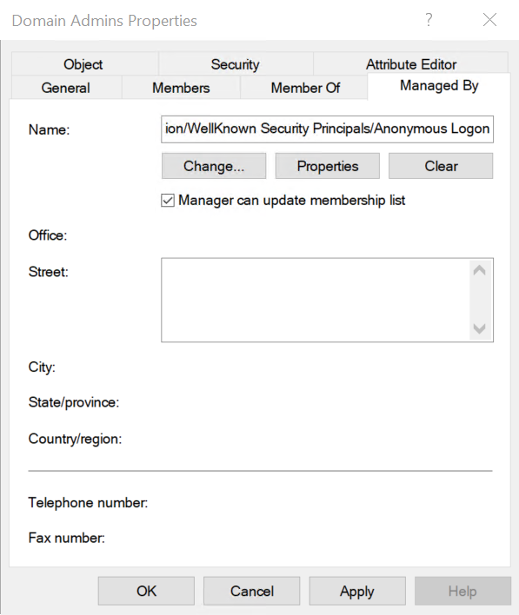
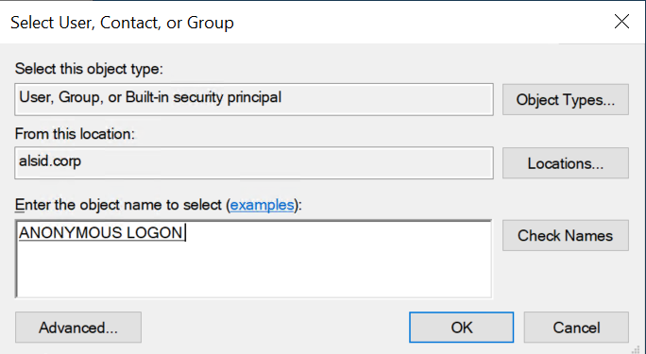
AD backdooring techniques
TLP:CLEAR
Step-by-step example
‘Managed by” attribute manipulation
Second option: set the user account ‘Anonymous Logon’ (domain.priv/Configuration/WellKnown Security Principals/Anonymous Logon)
and check the “Manager can update membership list”
Reminder: Anonymous Logon in Active Directory refers to a user or computer accessing resources without providing authentication credentials
2

Slide 23
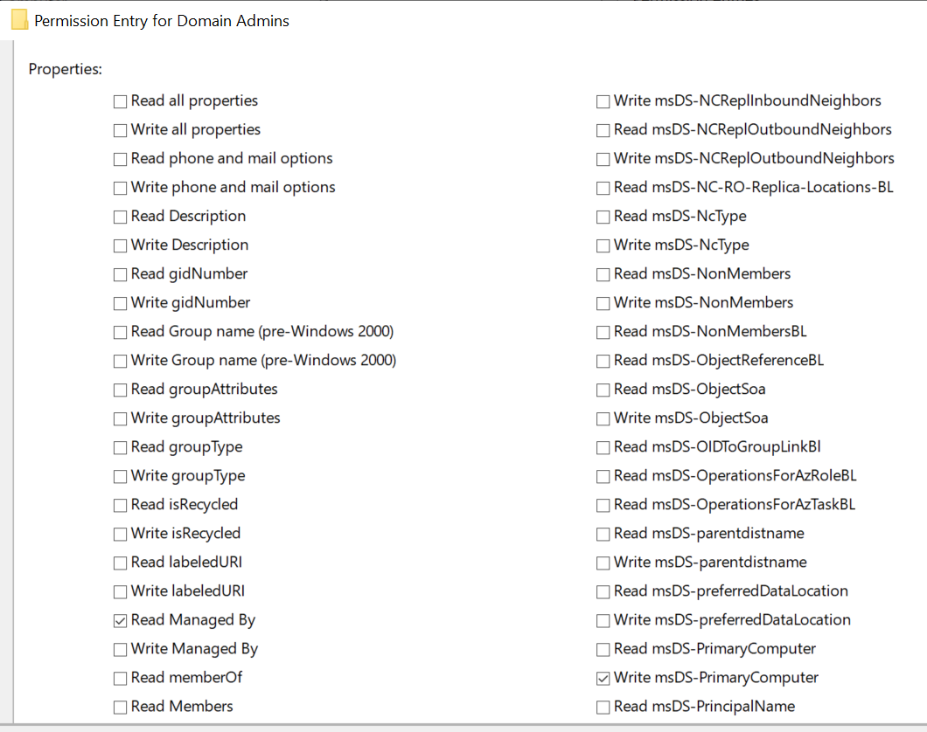
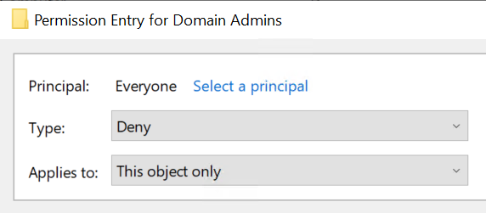
AD backdooring techniques
TLP:CLEAR
Step-by-step example
‘Managed by” attribute manipulation
Deny read access for ‘Managed by” attribute for Everyone

Slide 24
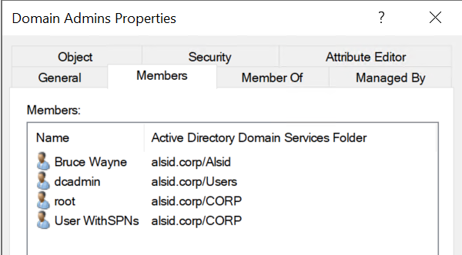
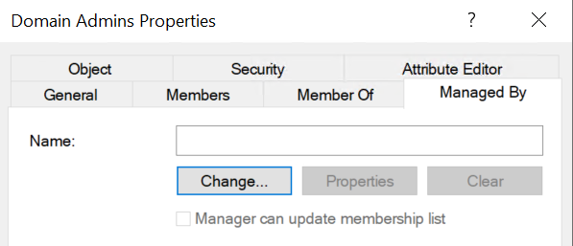
AD backdooring techniques
TLP:CLEAR
Step-by-step example
‘Managed by” attribute manipulation
keyser.soze
user
Then remove the ‘Keyser Soze” account from the ‘Domain Admins’ group members to hide the domain dominance position
Now, because we had set ‘Deny Read’ access on ‘Managed by’ attribute for ‘Everyone’, sysadmins or even Domain admins can’t read the attribute ‘Managed by’ anymore and can’t check the value
‘Keyser Soze’ account is still able to change the ‘Domain Admins’ members list

Slide 25
AD backdooring techniques
TLP:CLEAR
How to check
‘Managed by” attribute manipulation
How to check
‘Deny’ ACE hunting is the way

Slide 26
TLP:CLEAR
AD backdooring techniques
gPLink attribute to perform Domain Controllers future dominance

Slide 27
AD backdooring techniques
TLP:CLEAR
Understand the concept
gPLink attribute to perform Domain Controllers future dominance
NEW DOMAIN

Slide 28
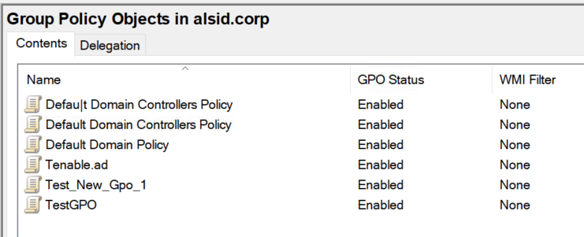
AD backdooring techniques
TLP:CLEAR
Step-by-step example
gPLink attribute to perform Domain Controllers future dominance
PASTE
COPY
Copy/Paste the “Default Domain Controllers Policy” and rename the new GPO: “Defau|t Domain Controllers Policy” so change the “l” by a “|”

Slide 29
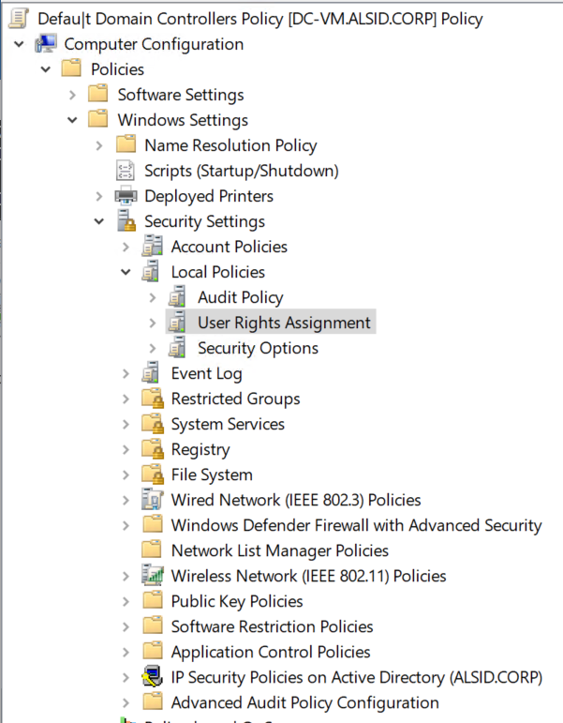
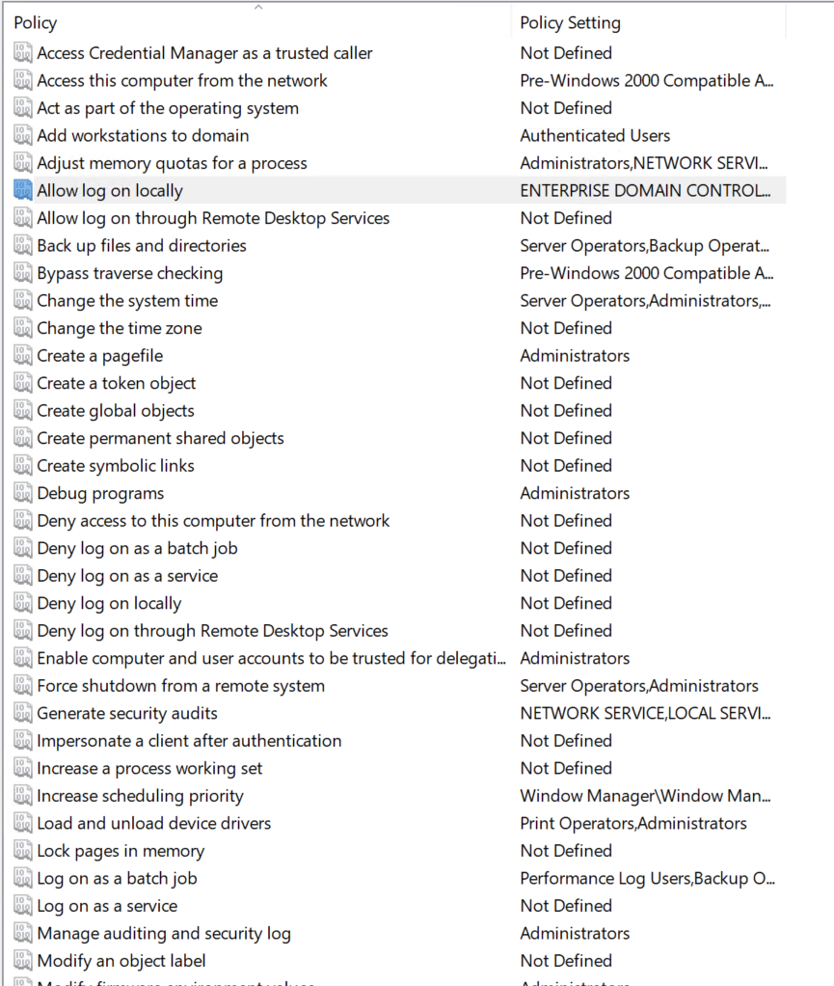
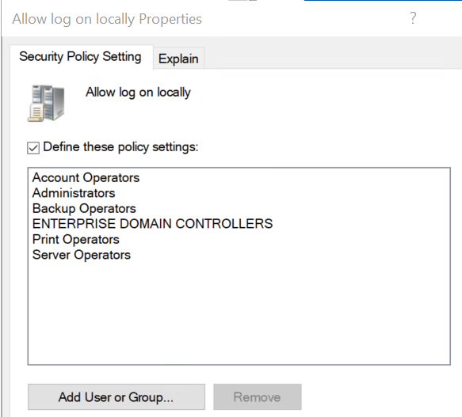
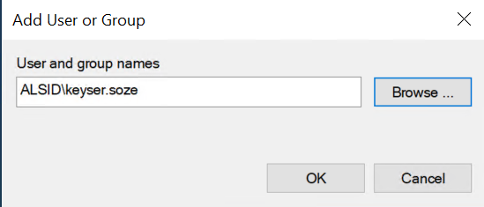
AD backdooring techniques
TLP:CLEAR
Step-by-step example
gPLink attribute to perform Domain Controllers future dominance
Change the User Rights Assignment policy for keyser.soze:
Allow log on locally
Allow log on through Remote Desktop Services
Debug programs
Log on as a batch job
Log on as a service
keyser.soze
user

Slide 30
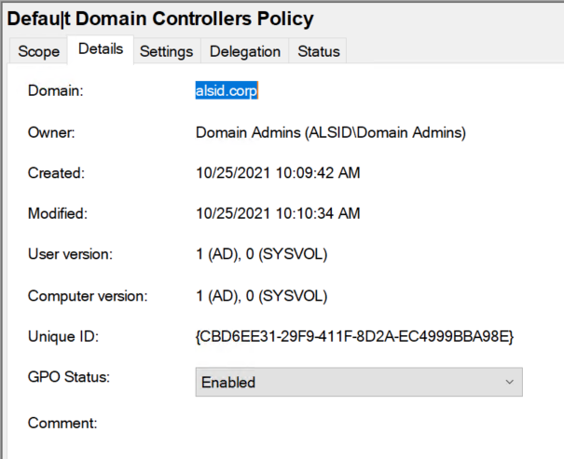
AD backdooring techniques
TLP:CLEAR
Step-by-step example
gPLink attribute to perform Domain Controllers future dominance
Check and copy/paste the Unique ID of the “Defau|t Domain Controllers Policy”
Here:
Keep this value somewhere

Slide 31
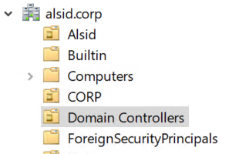
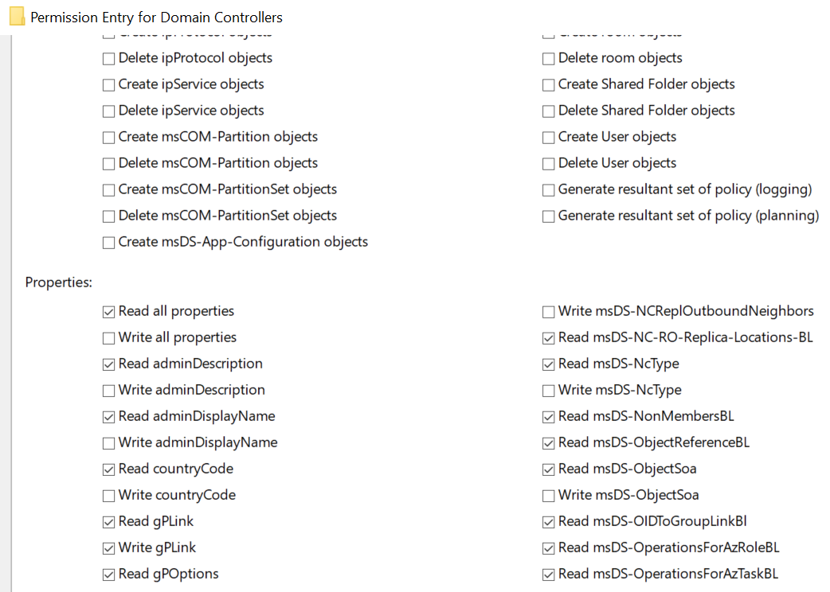
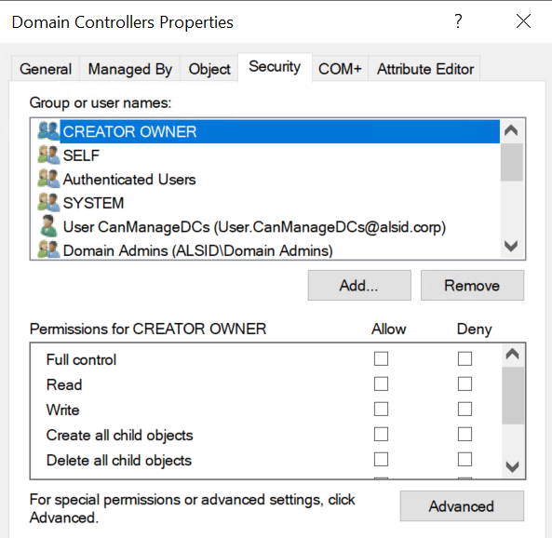
AD backdooring techniques
TLP:CLEAR
Step-by-step example
gPLink attribute to perform Domain Controllers future dominance
Modify the Domain Controllers ACL and add “Write gPLink” permission to your attacker user account (keyser.soze or another)
?
{ Or grant permission to a group and use the ‘managed by’ technique to make it impossible to detect! }

Slide 32
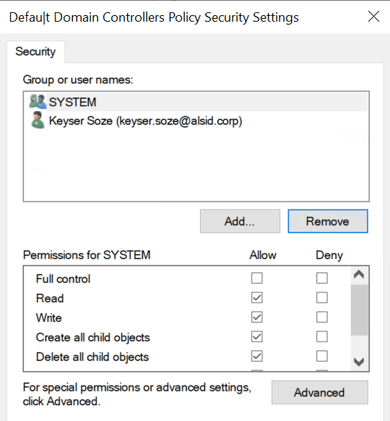
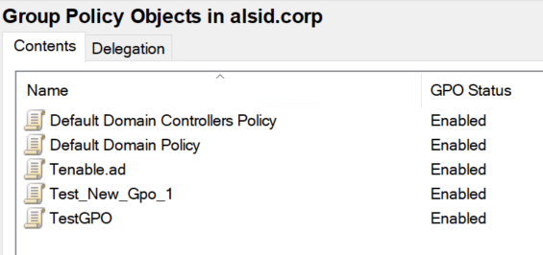
AD backdooring techniques
TLP:CLEAR
Step-by-step example
gPLink attribute to perform Domain Controllers future dominance
Mask the new GPO: Modify security on the “Defau|t Domain Controllers Policy” and remove any access except for SYSTEM and your hacker user account
Now the GPO is not listed anymore in the GUI, even for Domain Admins!
?
keyser.soze
user

Slide 33
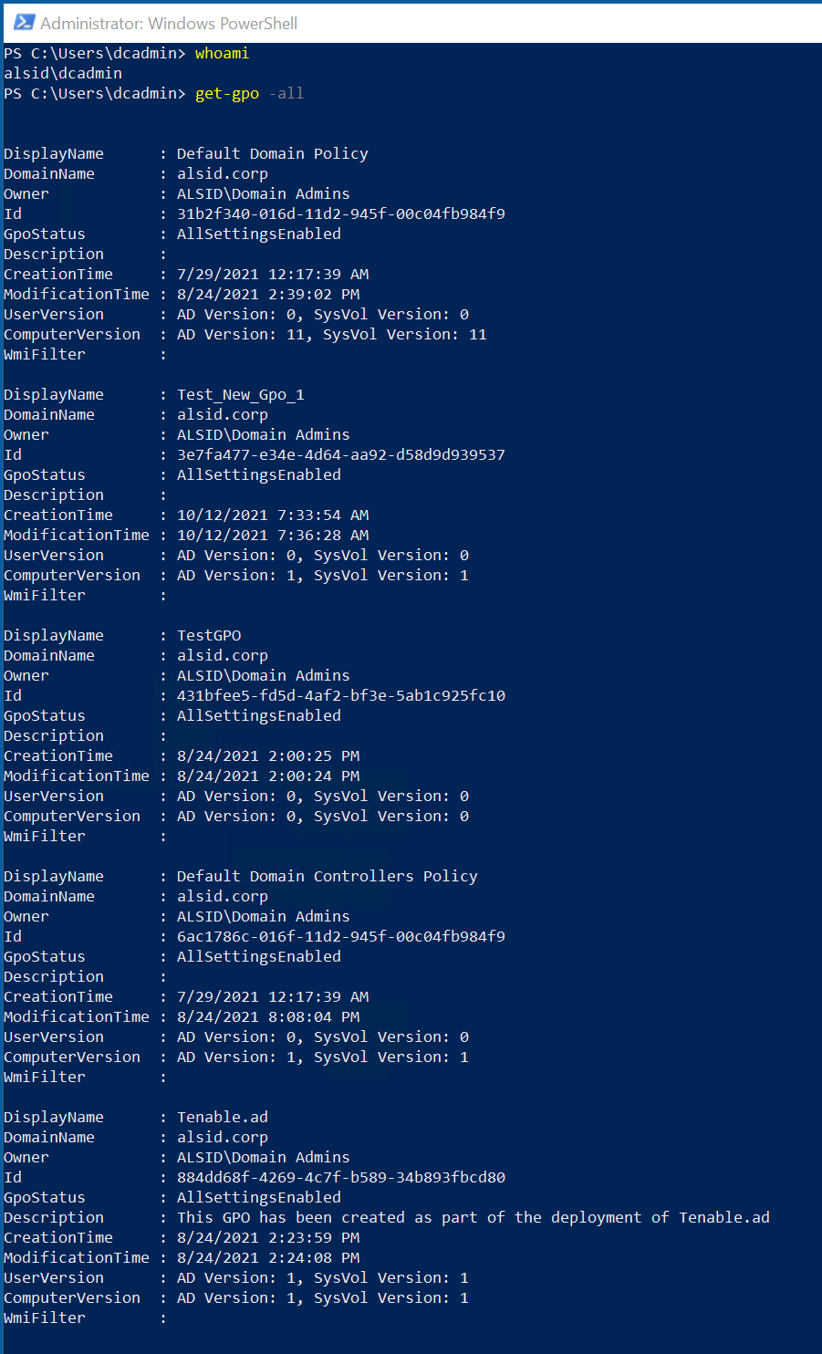
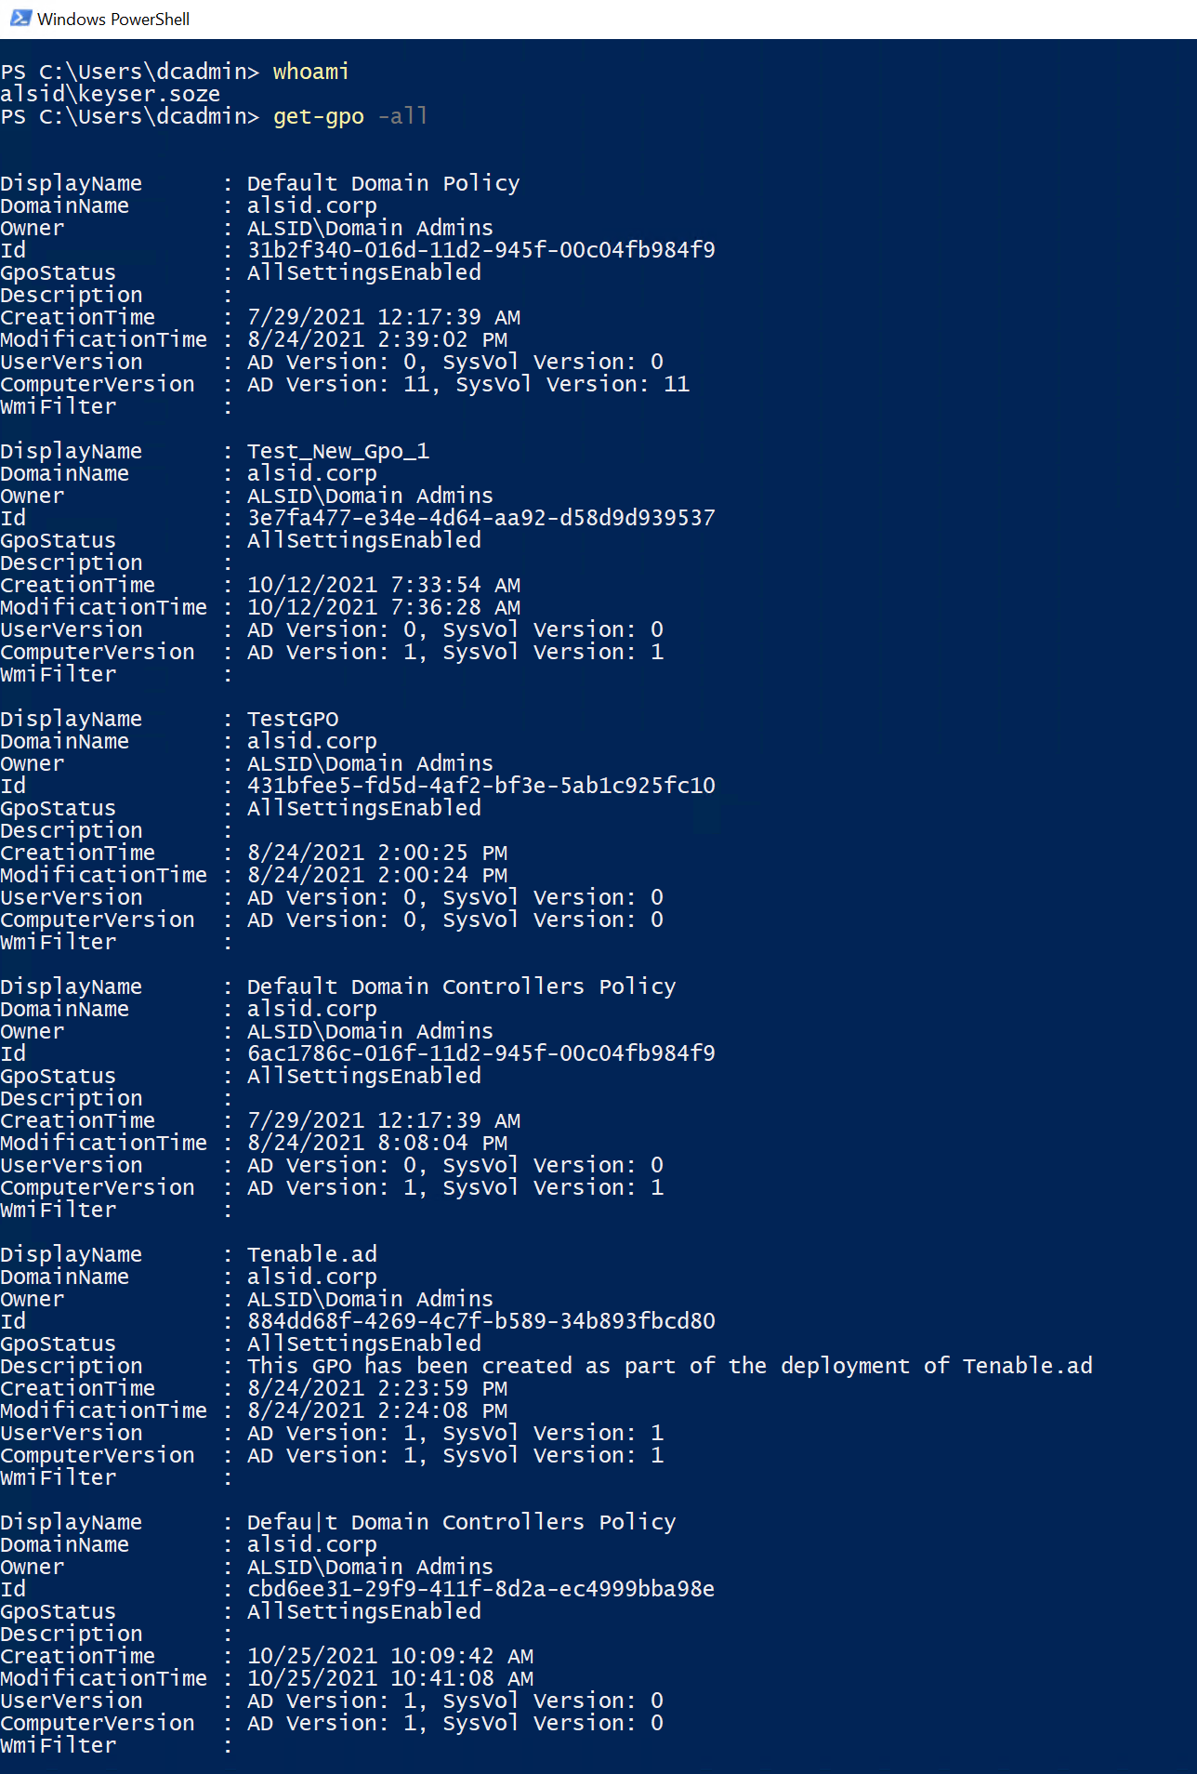
AD backdooring techniques
TLP:CLEAR
Step-by-step example
gPLink attribute to perform Domain Controllers future dominance
Domain admin
user
keyser.soze
user

Slide 34
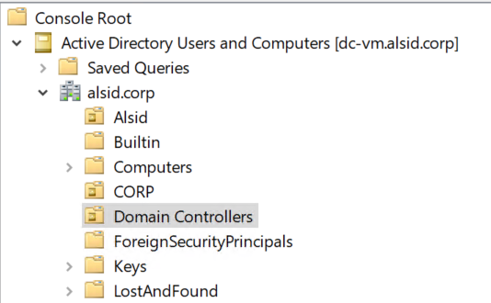
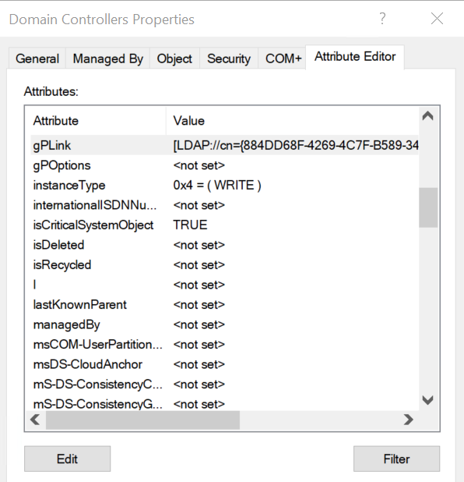
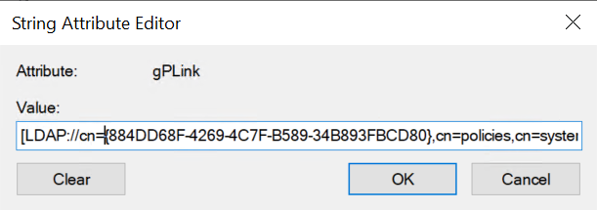
AD backdooring techniques
TLP:CLEAR
Step-by-step example
gPLink attribute to perform Domain Controllers future dominance
When attacker wants to activate the backdoor, replace the ‘6AC1786C-016F-11D2-945F-00C04fB984F9’ value (original Default Domain Controllers Policy) with the value ‘cbd6ee31-29f9-411f-8d2a-ec4999bba98e’ (Defau|t Domain Controllers Policy)
Then mask (ACL modification) the original ‘6AC1786C-016F-11D2-945F-00C04fB984F9’ GPO from the domain

Slide 35
AD backdooring techniques
TLP:CLEAR
How to check
gPLink attribute to perform Domain Controllers future dominance
How to check
Check the “well-known” Group Policies values
?

Slide 36
AD backdooring techniques
TLP:CLEAR
How to check
gPLink attribute to perform Domain Controllers future dominance
How to check
Check the “well-known” Group Policies values
?
{6AC1786C-016F-11D2-945F-00C04FB984F9}
{31B2F340-016D-11D2-945F-00C04FB984F9}

Slide 37
AD backdooring techniques
TLP:CLEAR
Summary
gPLink attribute to perform Domain Controllers future dominance
managed
Read & Write gPLink
Default Domain Controllers Policy
GROUP A
keyser.soze
THE PIPE GPO
Grants keyser.soze:
Allow log on locally
Allow log on through Remote Desktop Services
Debug programs
Log on as a batch job
Log on as a service
GROUP A
1️⃣ keyser.soze changes the GROUPA membership & add herself
2️⃣ GROUPA can change the gPLink attribute at the OU level – keyser.soze replaces the « default domain controllers policy » ID by the « PIPE GPO » ID
3️⃣ « THE PIPE GPO » grants keyser.soze global access to all Domain Controllers
4️⃣ keyser.soze masks the original « default domain controllers policy »
5️⃣ keyser.soze can do everything on DCs but is not member of the Domain admins or Enterprise admins groups

Slide 38
Take aways
TLP:CLEAR
AD Backdoors hunting is fun!
🤩
Remember the blue pill and the red pill
Fact, you can’t rely on your backups
Quick tip: monitor the new Deny ACEs entries in your directory — it’s very often a bad signal...

Slide 39
TLP:CLEAR

