Slide 1
Crypted Hearts
Exposing the HeartCrypt Operation
Daniel Bunce/Jerome Tujague

Slide 2
Who Are We?
Jerome Tujague
Malware Reverse Engineer @ Palo Alto Networks, Unit 42
Mainly focus on APT and commodity malware, specifically configuration extraction and automation
Daniel Bunce
Malware Reverse Engineer @ Palo Alto Networks, Unit 42
Focus on e-crime and APT malware, looking at botnet tracking and malware emulation for tracking purposes

Slide 3
HeartCrypt

Slide 4
Overview
Packer-as-a-Service
Also referred to as a “crypter”
Extra layer of defense for malware
Customers range from e-crime malware to ransomware affiliates
Simple in nature
A lot of obfuscation effort, but with some tricks we can pull out key data.
Data analysis over time
Steady usage rates, with occasional peaks
Discovery of new versions, v2.0 and v2.5
Identification of active campaigns
LummaStealer Captcha and fake software ad campaigns
Blind Eagle - targeted South American orgs

Slide 5
First Contact
First one case… then another… and another.
Cicada3301, Inc. Ransomware, and BlackSuit
Tool used by a ransomware group to terminate EDR
Use of a custom packer to deliver the samples
STONESTOP: an EDR termination tool
Kernel driver (POORTRY) is loaded, and awaits commands
Accepts custom IOCTLs for Process Control
Removes EDR/AV related files from disk
Disables kernel callbacks for certain functions
POORTRY stores a list of targeted EDR/AV processes and drivers
(Update) March 2025: Elastic Security noted Medusa ransomware using HeartCrypt to deliver STONESTOP

Slide 6
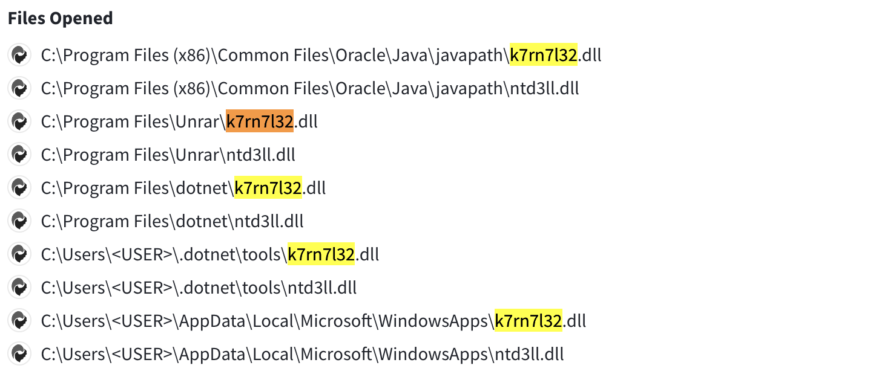
Hunting - VirusTotal
Hunting in VirusTotal
Unusual strings identified via detonation
k3rn3l32.dll and ntd3ll.dll
I

Slide 7
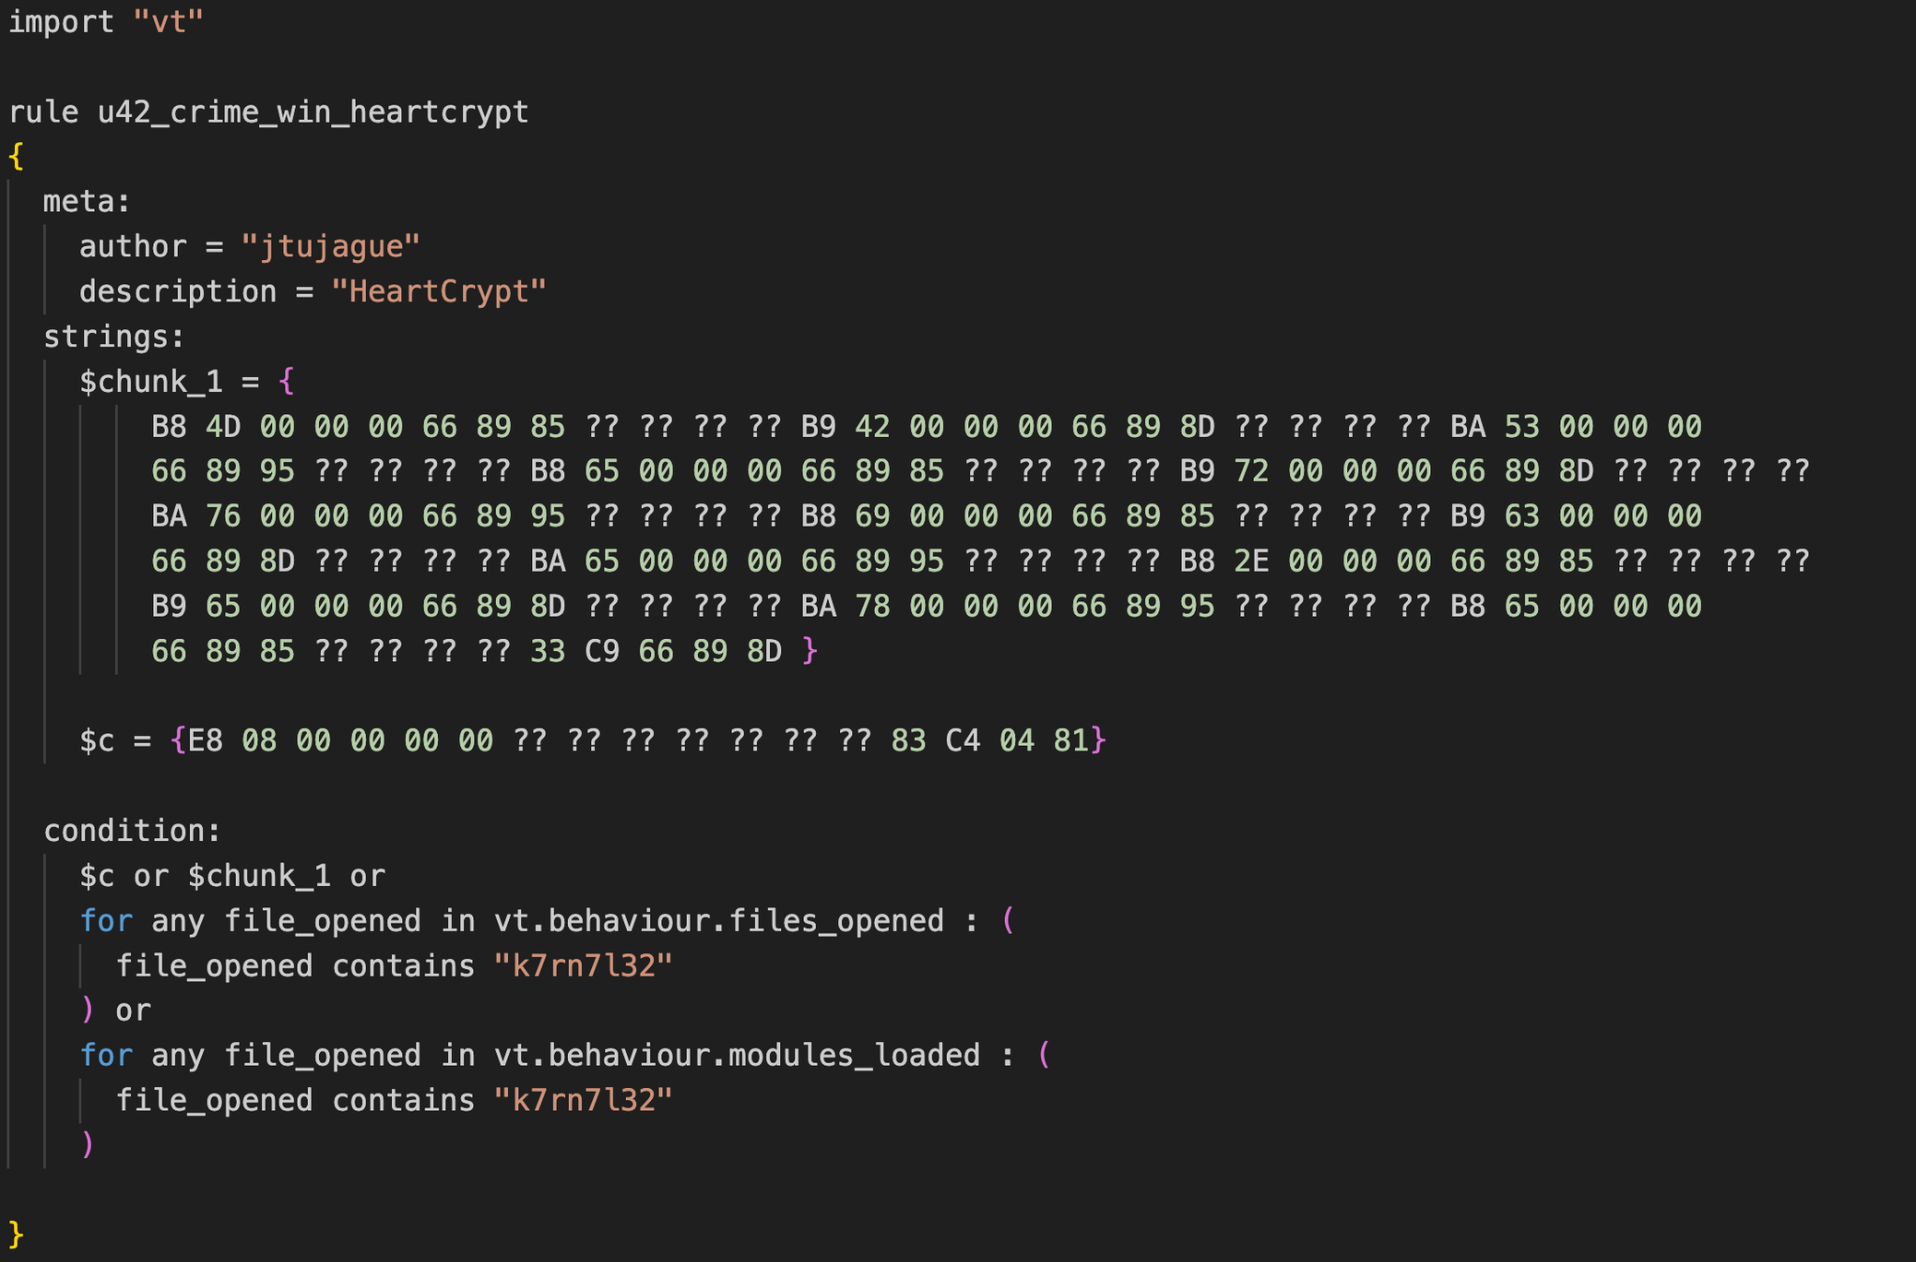
Hunting Retroactively

Slide 8
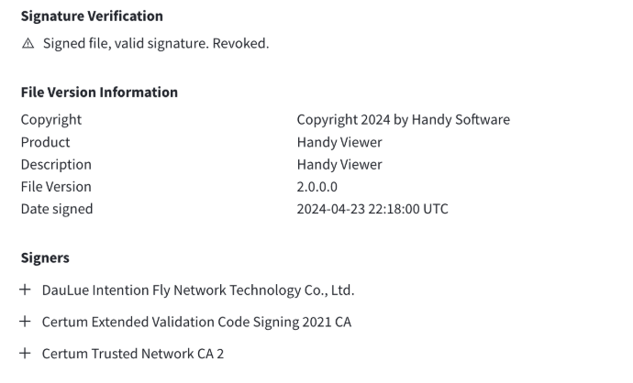
Hunting - Legitimate Software Bindings
Identified commonalities between identified samples
All bound to legitimate software
Using fake or revoked certificates

Slide 9
Observed Commonalities
Inserted into legitimate software
Large number of irrelevant functions
PIC (Position Independent Code)
Commonly referred to as shellcode
Modified entry functions
Malicious code executes before WinMain
Code obfuscation
Flow obfuscation through multiple JMPs
Unnecessary arithmetic
Stack strings
Several unusual resources within payload
Stored as bitmap (BMP) files

Slide 10
Observed Commonalities
Inserted into legitimate software
Large number of irrelevant functions
PIC (Position Independent Code)
Commonly referred to as shellcode
Modified entry functions
Malicious code executes before WinMain
Code obfuscation
Flow obfuscation through multiple JMPs
Unnecessary arithmetic
Stack strings
Several unusual resources within payload
Stored as bitmap (BMP) files

Slide 11
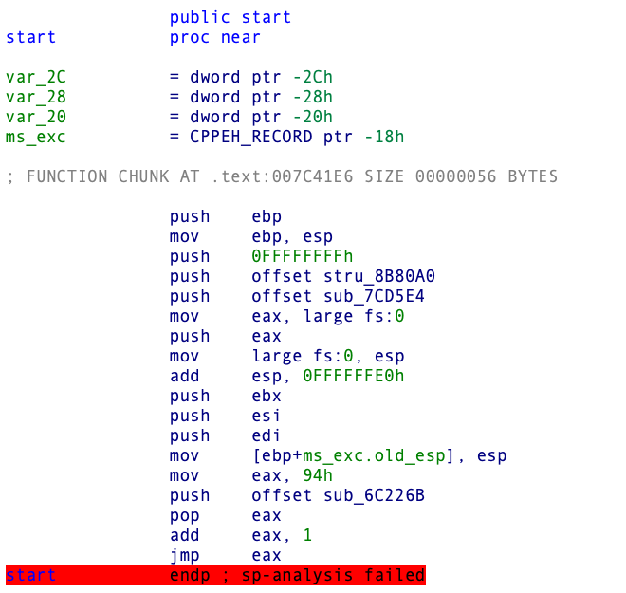
HeartCrypt - Entry Point
Entry point modified to execute malicious code
Different methods of modification
TLS Callbacks
Modifying C Runtime functions
Overwriting start()

Slide 12
Observed Commonalities
Inserted into legitimate software
Large number of irrelevant functions
PIC (Position Independent Code)
Commonly referred to as shellcode
Modified entry functions
Malicious code executes before WinMain
Code obfuscation
Flow obfuscation through multiple JMPs
Unnecessary arithmetic
Stack strings
Several unusual resources within payload
Stored as bitmap (BMP) files

Slide 13
Observed Commonalities
Inserted into legitimate software
Large number of irrelevant functions
PIC (Position Independent Code)
Commonly referred to as shellcode
Modified entry functions
Malicious code executes before WinMain
Code obfuscation
Flow obfuscation through multiple JMPs
Unnecessary arithmetic
Stack strings
Several unusual resources within payload
Stored as bitmap (BMP) files

Slide 14
Unusual Resources - Bitmap
Repeating Bytes
Bitmap Header
Similar Pattern

Slide 15
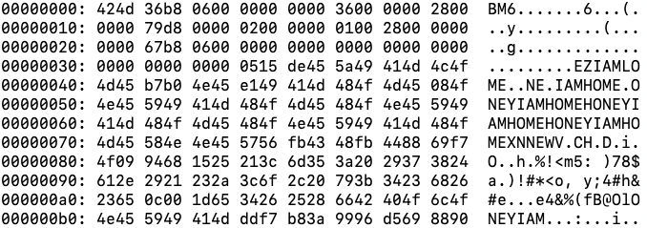
Unusual Resources - Bitmap

Slide 16
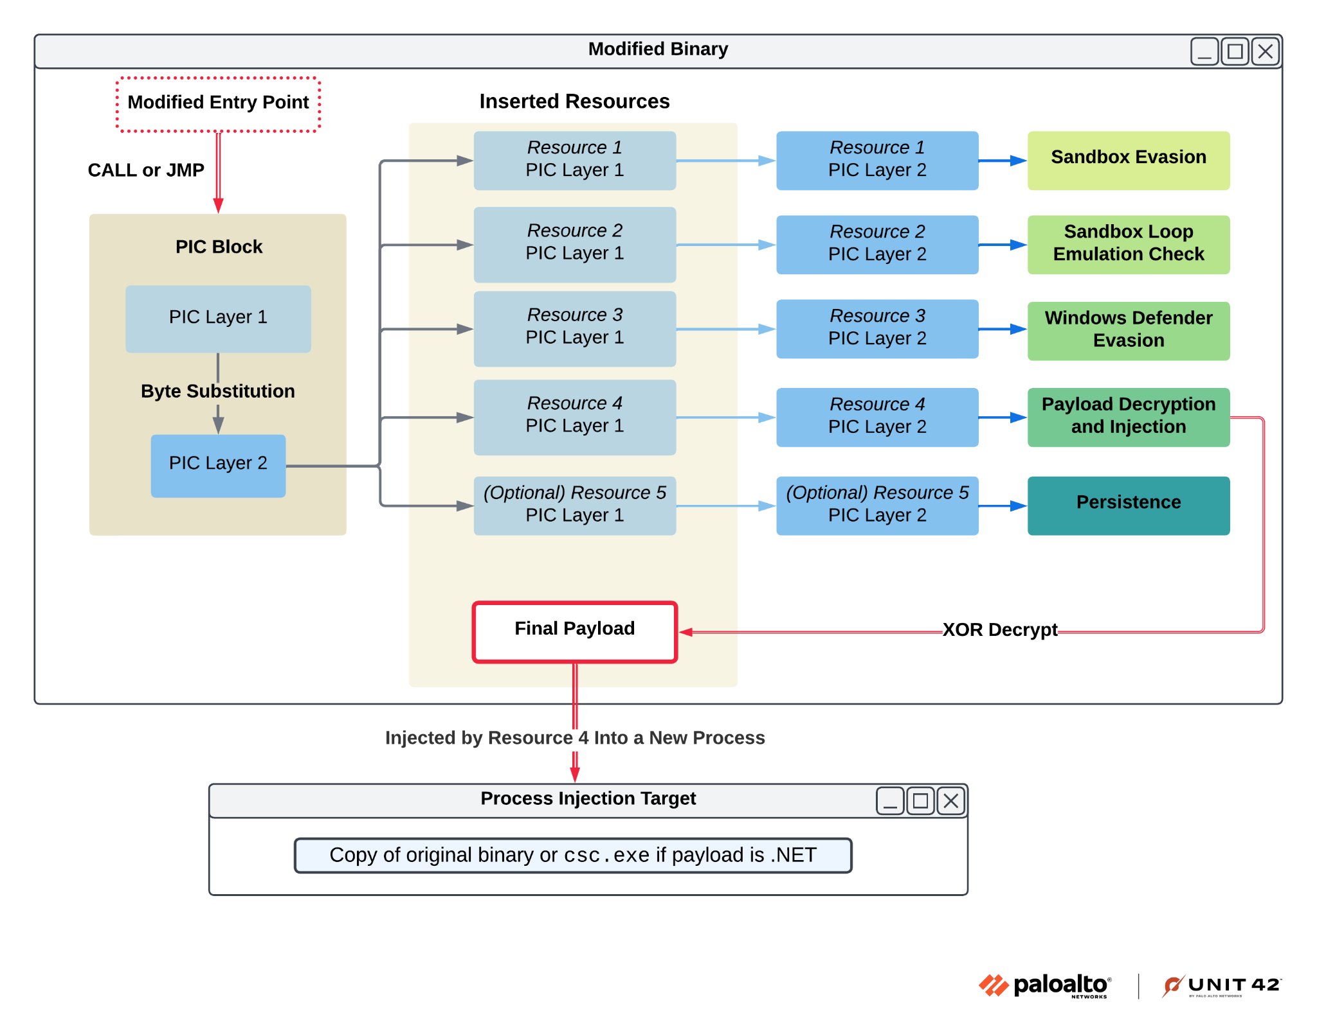
HeartCrypt - Architecture

Slide 17
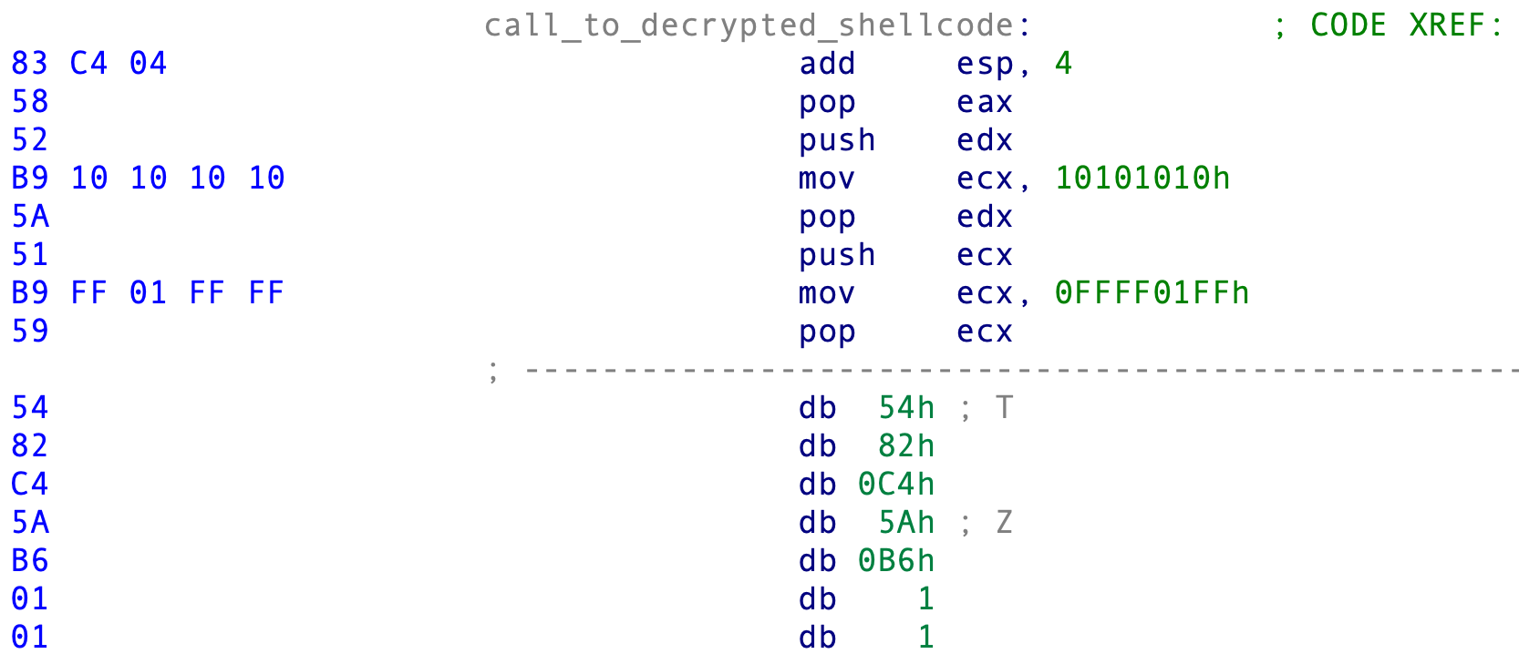
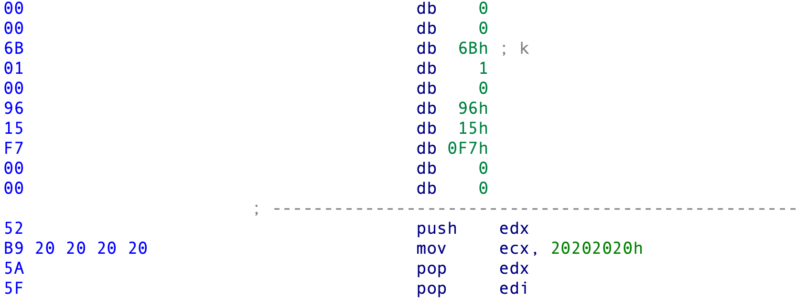
HeartCrypt - Layer Decoding
Egg Start
Encoded Layer 2
Egg End

Slide 18
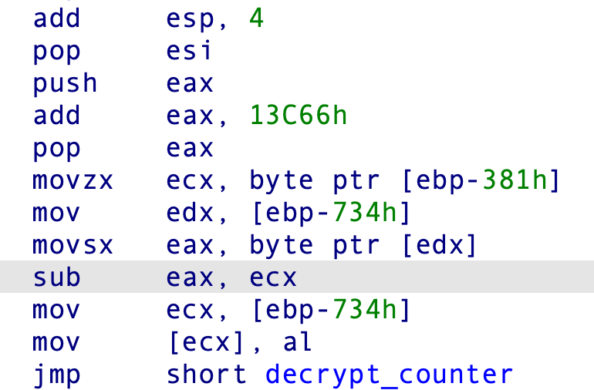
HeartCrypt - Layer Decoding
Layer 2 is decoded with a dynamically resolved key
The decoding algorithm?
A single subtraction loop…

Slide 19
HeartCrypt - Layer Decoding
We can identify where the subtraction key is resolved in a few ways
We could iterate through all possible keys from 0x00 to 0xFF
Check for stack strings as validation
Or… we can try something a bit different

Slide 20
HeartCrypt - Layer Decoding
Can you guess one of the more common bytes within executables and position independent code?
ls binary
grep binary
HeartCrypt binary

Slide 21
HeartCrypt - Layer Decoding

Slide 22
HeartCrypt - Resource PIC Functionality

Slide 23
HeartCrypt - Resource PIC Functionality

Slide 24
HeartCrypt - Sandbox Evasion
Dependency emulation
Attempts to load non-existent DLLs: k7rn7l32.dll and ntd3ll.dll (was A.DLL, now random non-ascii chars)
Rudimentary and unreliable
Modern sandboxes handle this
MessageBox with “CheckLibraryEmulated”

Slide 25
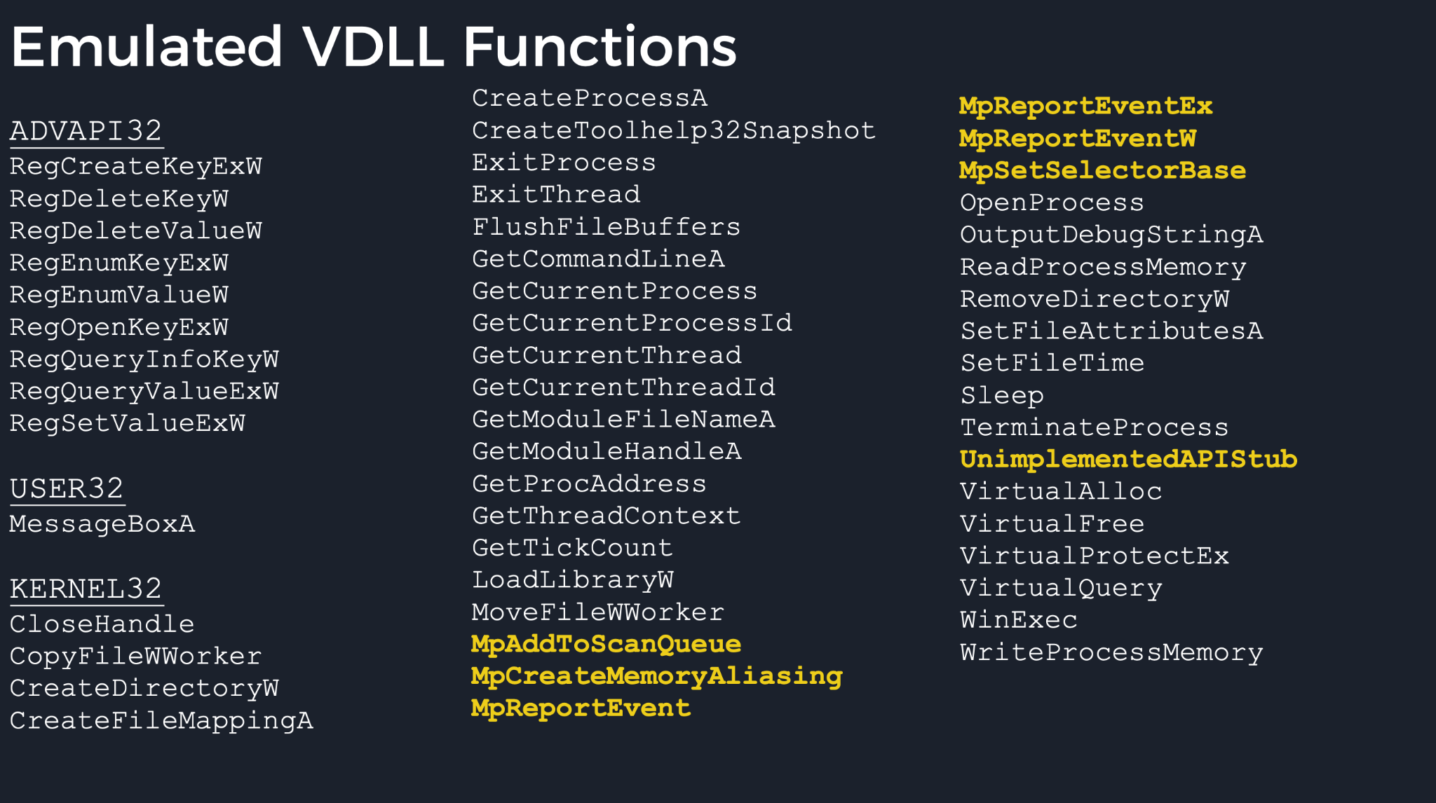
HeartCrypt - Defender Evasion
Windows Offender Reverse Engineering Windows Defender's Antivirus Emulator Alexei Bulazel, BlackHat 2018

Slide 26
HeartCrypt - Defender Evasion
Attempts to call GetProcAddress to find:
MpVmp32Entry
MpSehHandler
MpSwitchToNextThread
MpReportEventEx
MpStartProcess
If GetProcAddress is successful:
ExitProcess

Slide 27
HeartCrypt - Resource PIC Functionality

Slide 28
HeartCrypt - Decrypt & Execute
Simple XOR used to protect the final payload

Slide 29
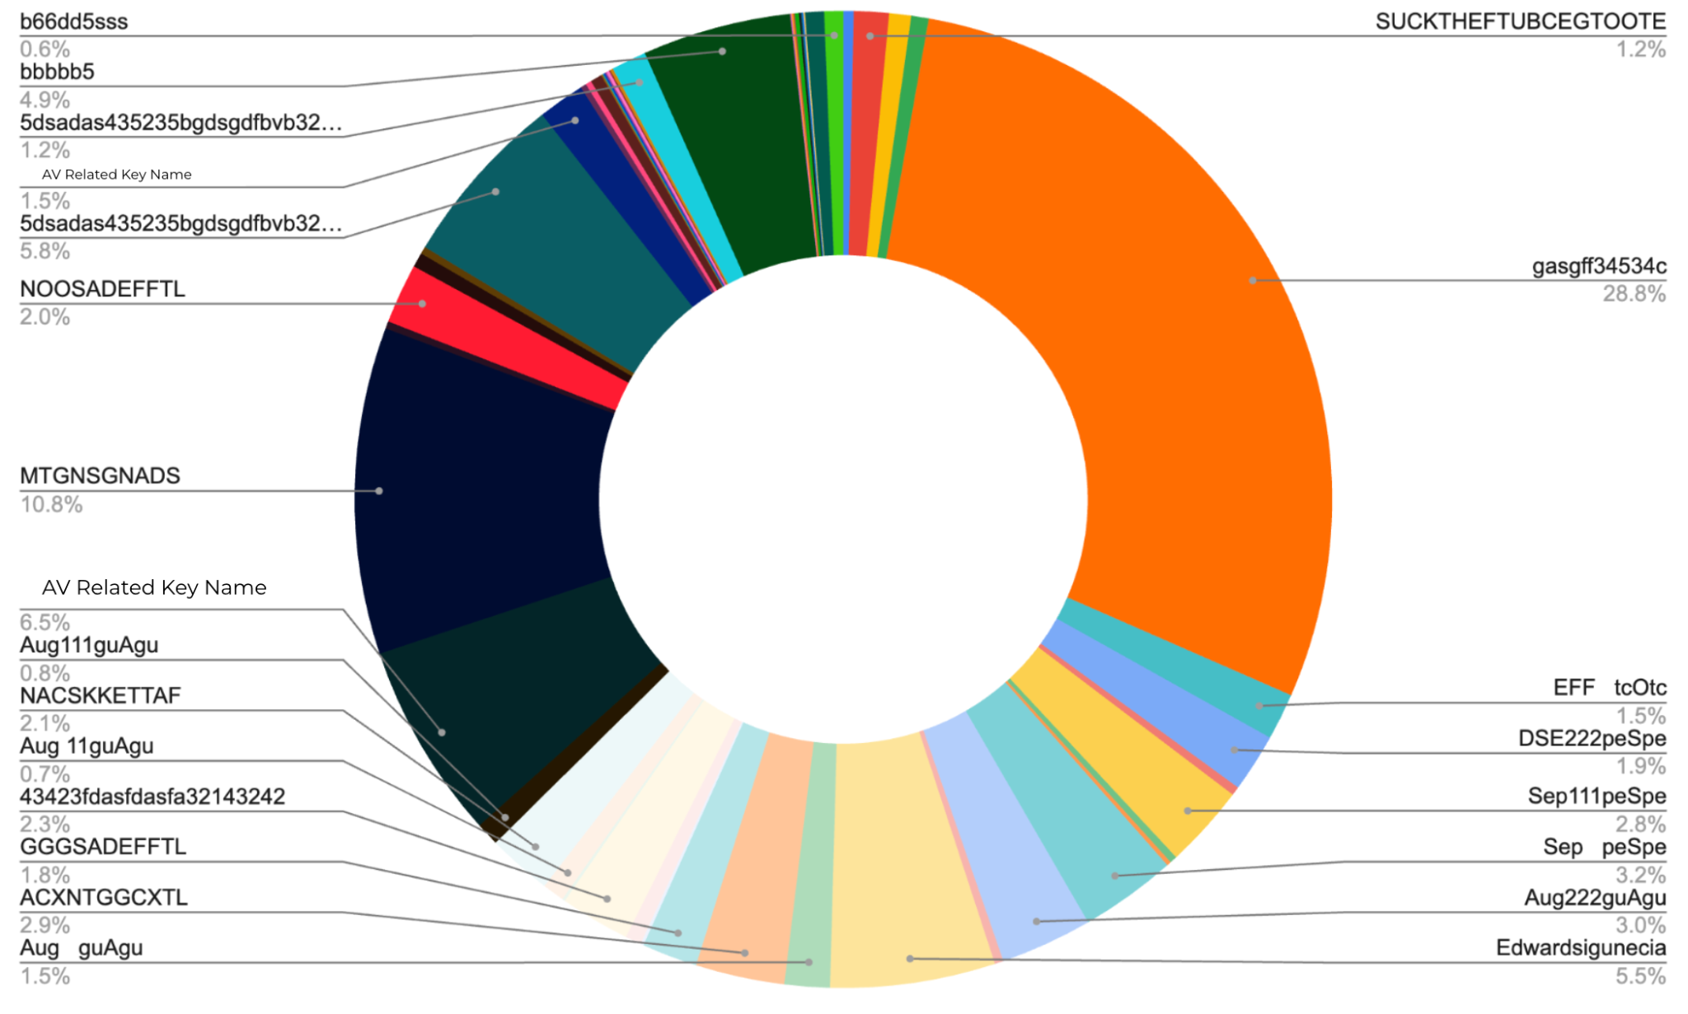
HeartCrypt - Identified Keys

Slide 30
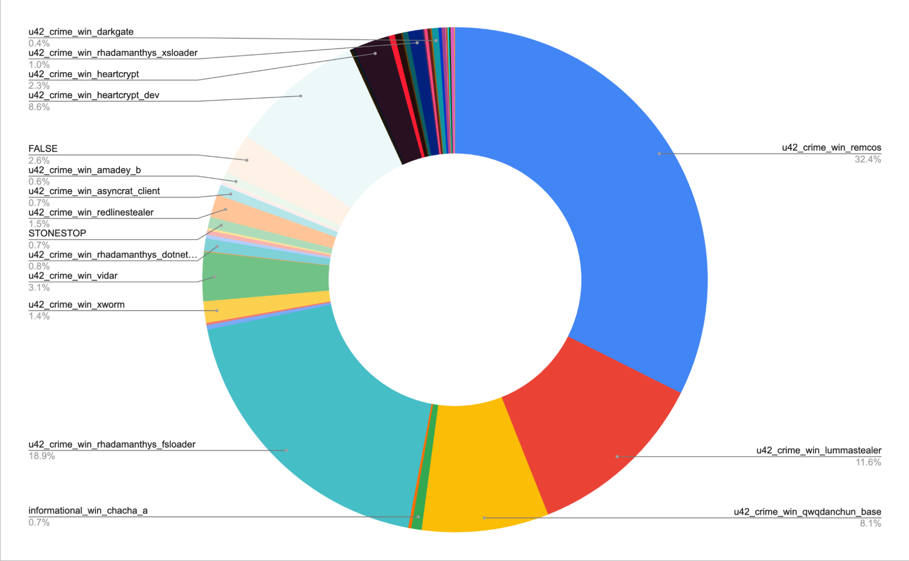
HeartCrypt - Identified Families
U42_crime_win_heartcrypt_dev - 8.6%

Slide 31
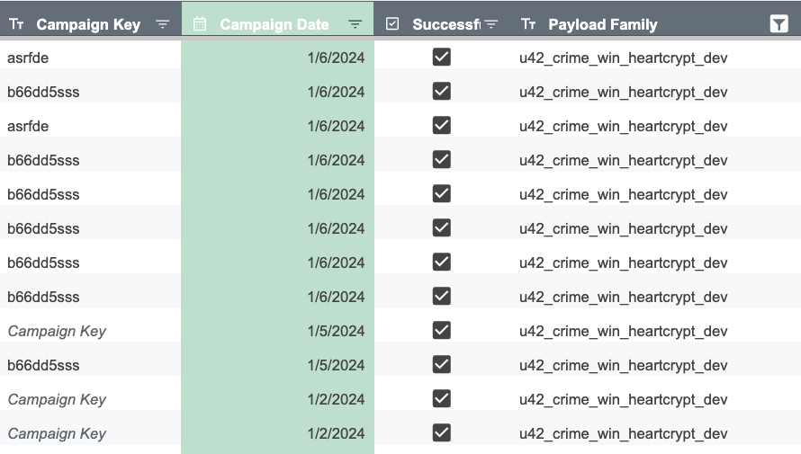
Hunting HeartCrypt - Dev Stages

Slide 32
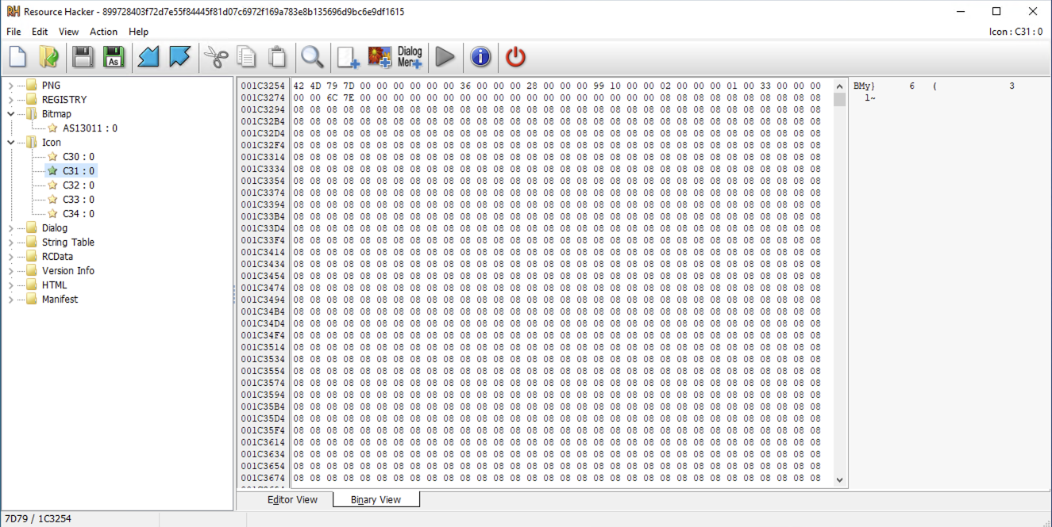
Hunting HeartCrypt - Identification

Slide 33
Hunting HeartCrypt - The Developer

Slide 34
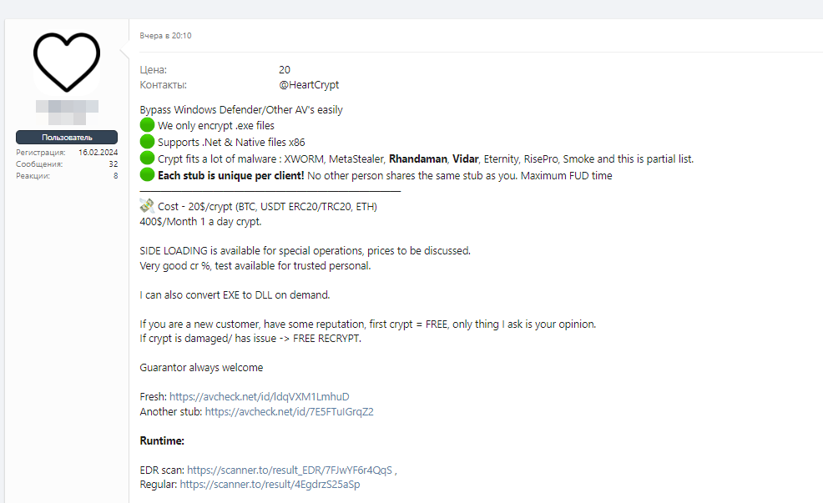
Hunting HeartCrypt - The Developer

Slide 35
Hunting HeartCrypt - The Developer

Slide 36
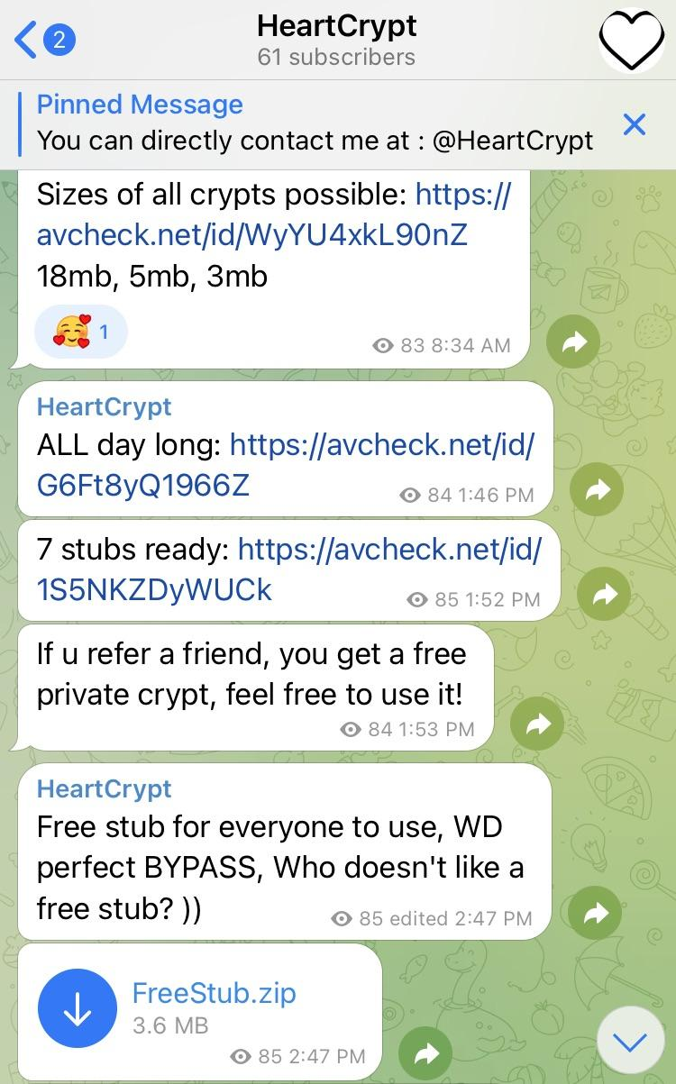
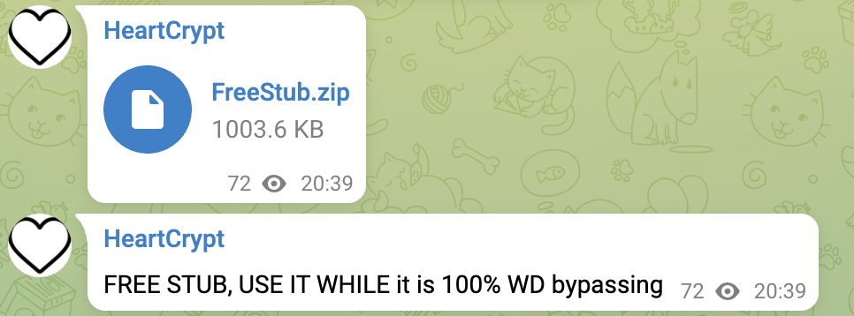
Hunting HeartCrypt - The Developer

Slide 37
Hunting HeartCrypt - The Developer
Packer-as-a-Service
Advertised across several forums including XSS and BlackHatForums
Predominantly sold through Telegram
Service likely setup as a Telegram bot
Often has low detection rates
VirusTotal, Scanned.to, AvCheck.net
$20 per packed file or $400 per month

Slide 38
Hunting HeartCrypt - Timeline
July 2023: First samples observed using HeartCrypt obfuscator
No payloads, these were very early test versions
January 1st, 2024: HeartCrypt test payloads
February 17th, 2024: First malicious payload

Slide 39
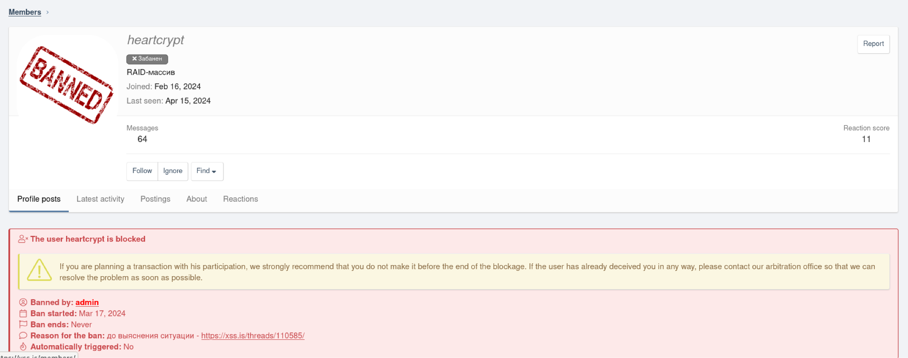
Hunting HeartCrypt - The Developer

Slide 40
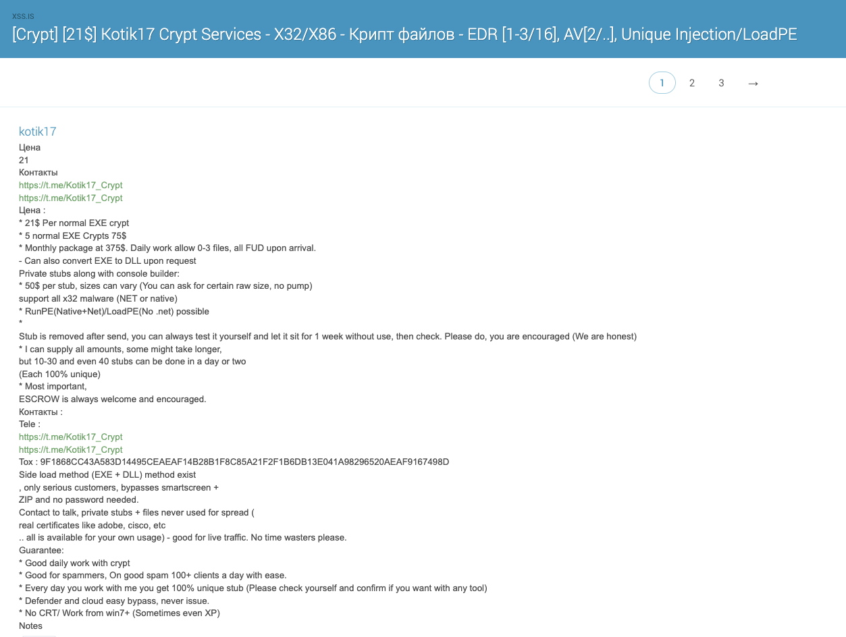
Hunting HeartCrypt - The Developer
Kotik17
July 19 - Sept 21st

Slide 41
December Developments (version 2)
Blog published Dec 13th
Removed PIC from resources
All functionality is now in PIC layer 1
Final payload is stored in two XOR encoded resources
XOR keys no longer A-Z strings

Slide 42
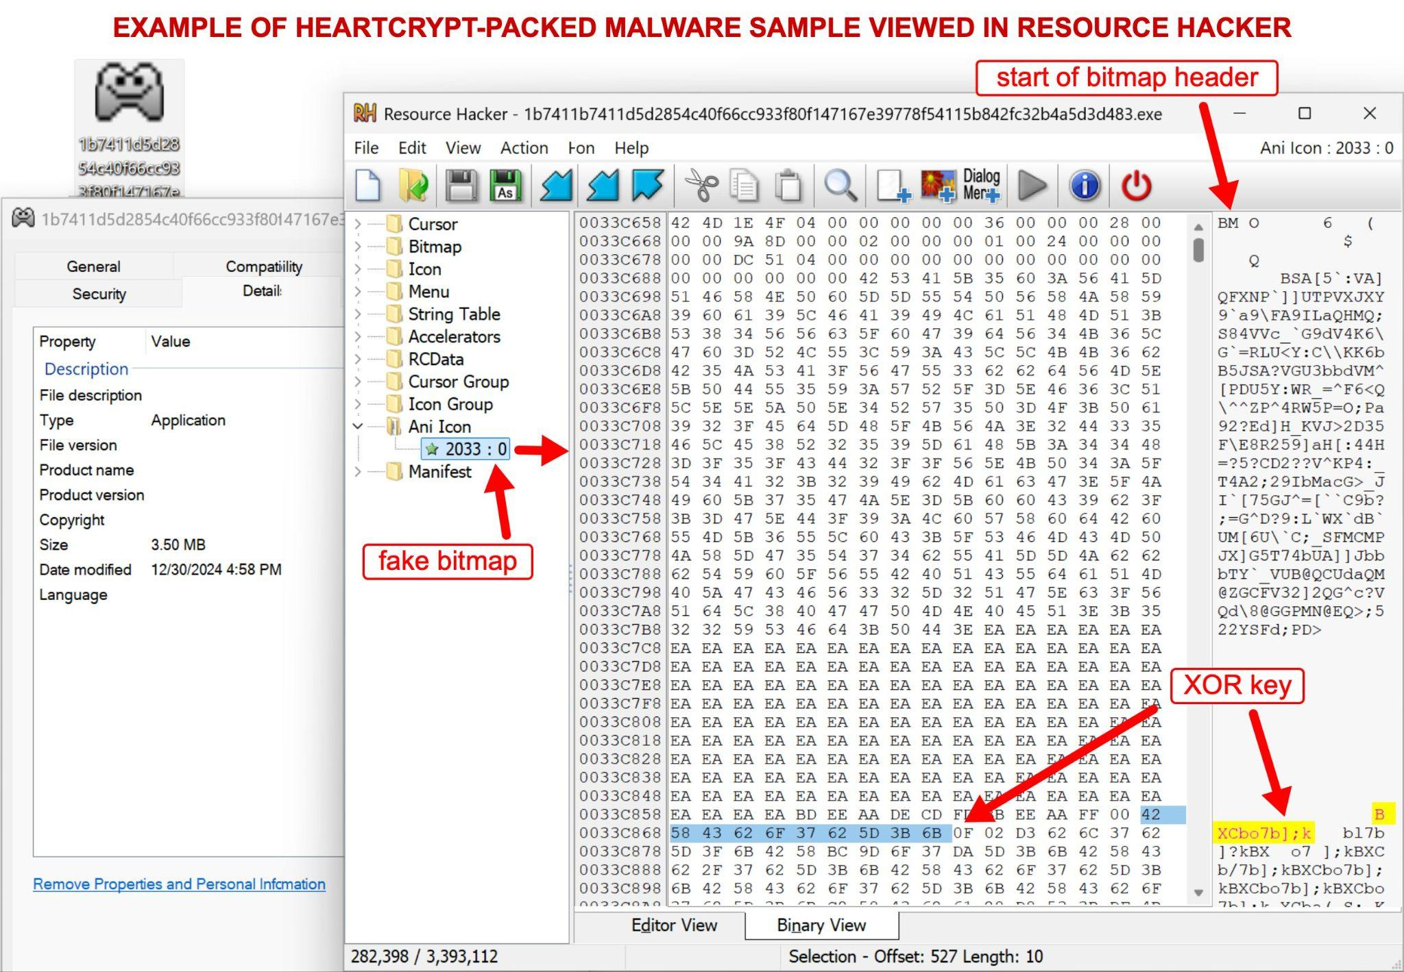
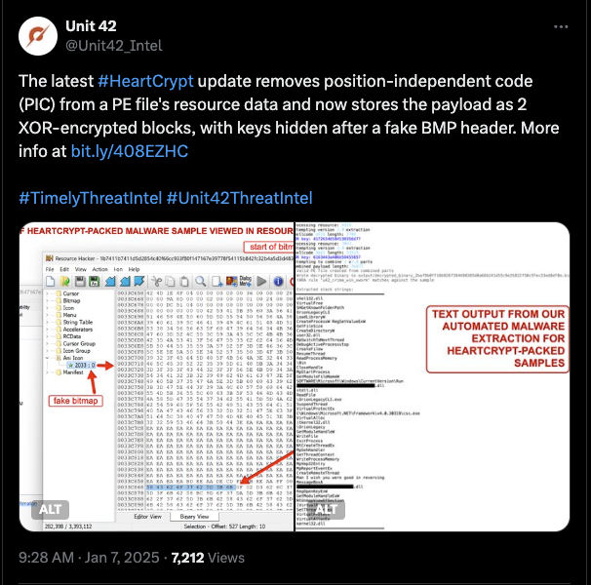
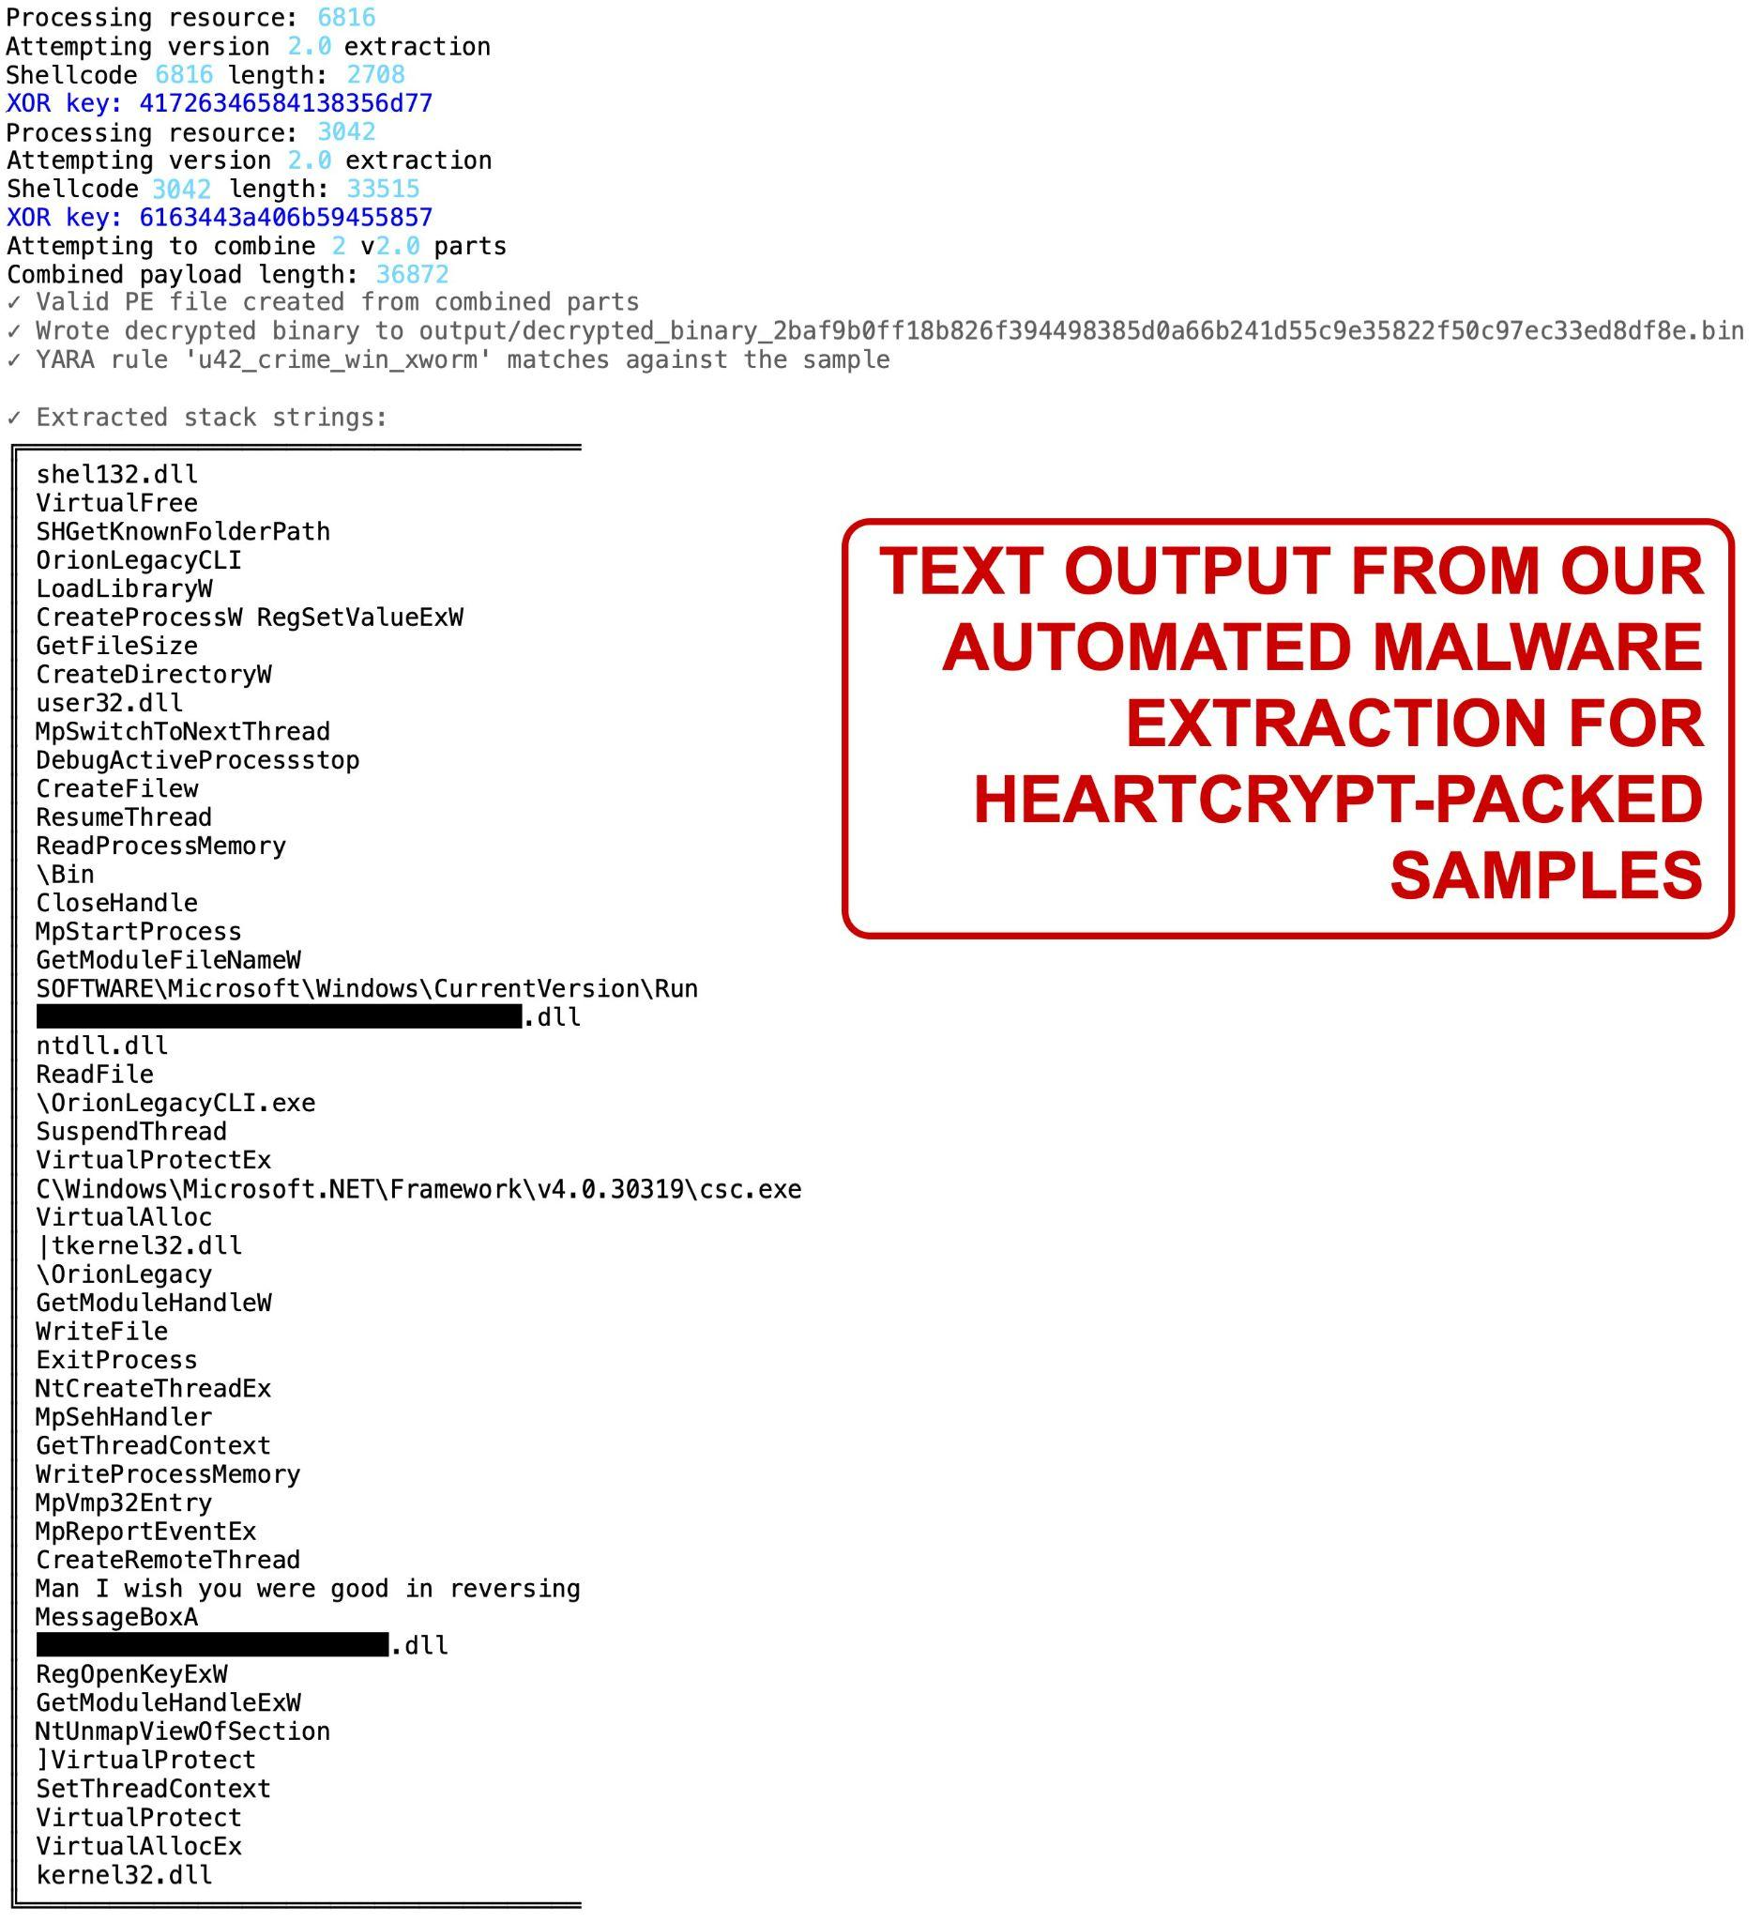
December Developments (version 2)

Slide 43
January Developments (version 2.5)
Completely removed XOR encoding for payloads
Replaced with a custom ChaCha8 stream cipher
Using only “A.DLL” to test for dependency emulation

Slide 44
Thank You

