Slide 1
Why is Finnish healthcare doing so well against ransomware?
TLP:CLEAR
Perttu Halonen
2025-06-25
TLP:CLEAR
Photo by US Centers for Disease Control and Prevention, on Unsplash
Notes:
30-minute presentation plus 5 minutes for questions from the audience.
Nota bene: In this presentation,
I use ENISA's definition for the term ransomware. It covers both attacks that encrypt victim's data, and demands ransom for decrypting it; and attacks where the thret actor steals victim's data, and demands ransom for not publishing it.
I use Finnish notation of numbers, where a comma is the decimal separator and a space is thousands separator.

Slide 2
Who am I
Senior specialist at the National Cyber Security Centre Finland (NCSC-FI)
Healthcare, social services and rescue services sectors' cyber specialist
Food sector cyber specialist
Secondary cyber specialist for finance sector
Also a husband, father and volunteer firefighter

Slide 3
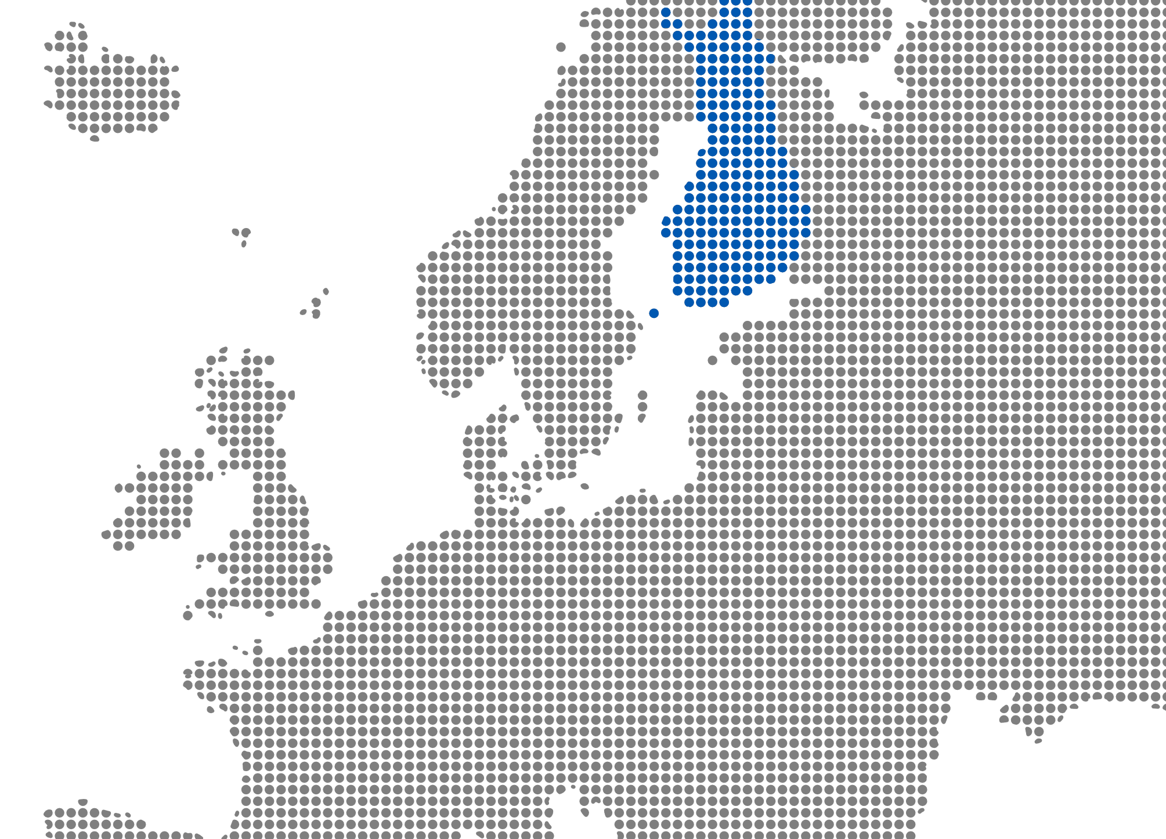
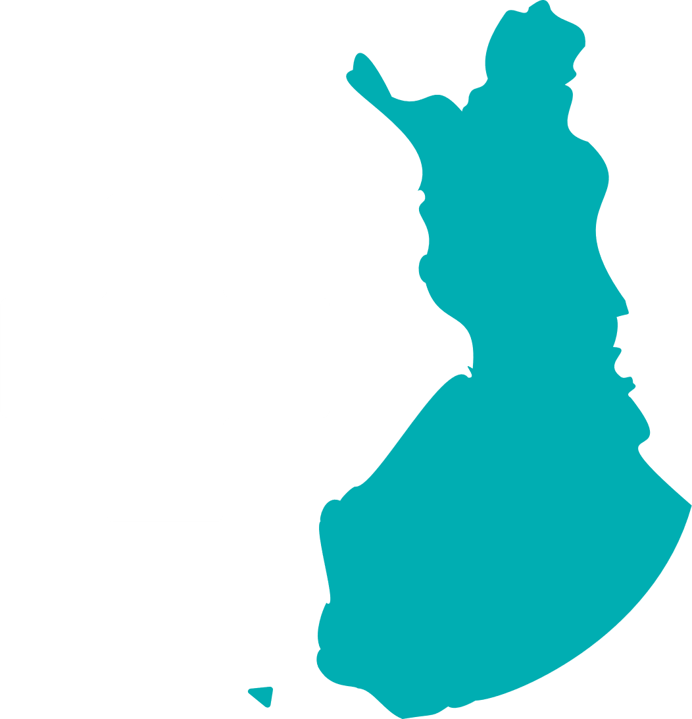
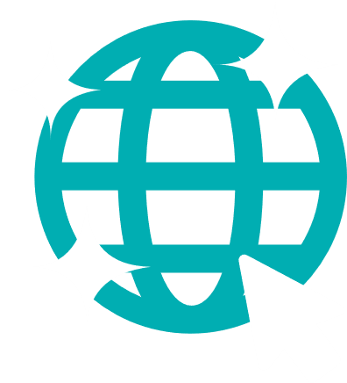
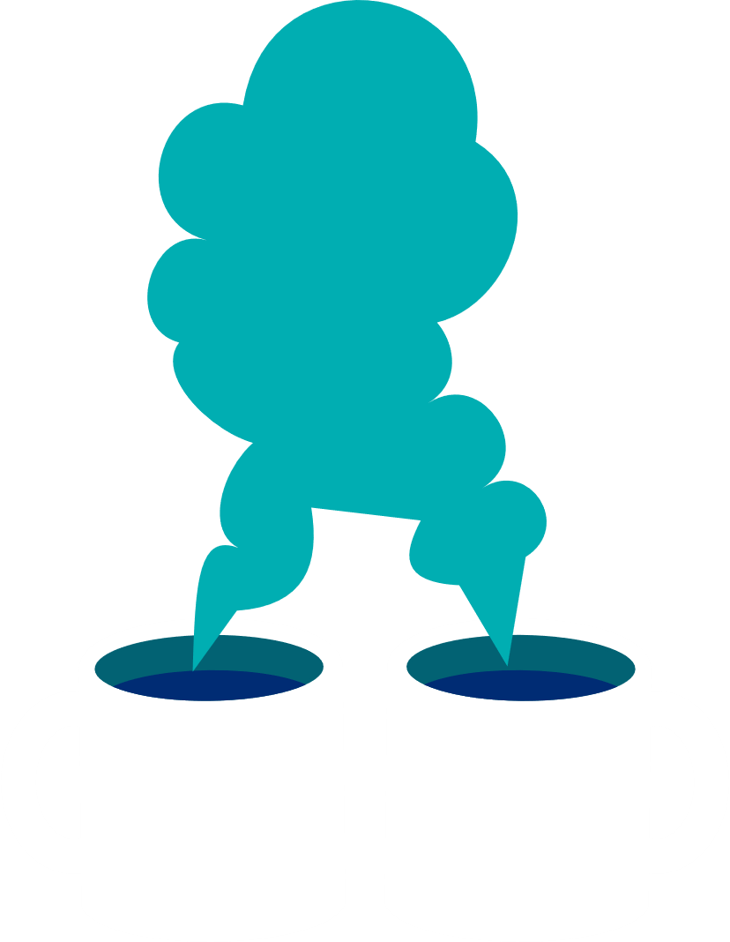
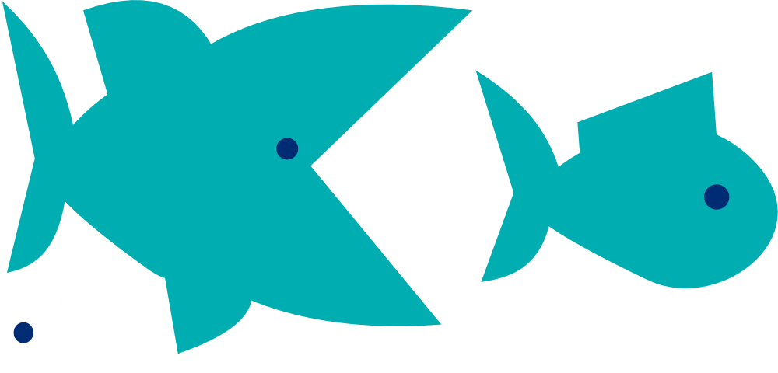
Why is Finnish healthcare system doing so well against ransomware?
Mainly public healthcare system
Personal liability of individual decisionmakers guides cybersecurity investments
Special support from NCSC-FI
In general, cleanest internet in the world, and the internet-facing attack surface is small
No healthcare organisation has made a ransom payment
Criminals focus their efforts on targets they expect to pay
Small country, low hierarchies
Peer-to-peer information sharing enhances preparedness
Small Economy
"Big game hunters" find lots of bigger targets elsewhere

Slide 4
Key assumptions
Ransomware attacks are mainly done by financially motivated criminals
Cyber crime is inherently international
Ransomware criminals rationally choose targets from which they expect to get biggest benefit with smallest effort
Ransomware victims report most of the incidents to national authorities
Ransomware incidents get publicity more likely than other types of cyber crime, and therefore public statistics of ransomware incidents probably are comparable
Wishful thinking?
Notes:
Ransomware attacks are mainly done by financially motivated criminals: assumption is likely supported. One might argue whether a data wiping attack should be classified as ransomware if the attacker presents a ransom note, but that is a corner case.
Cyber crime is inherently international: assumption is likely supported particularly in the case of ransomware.
Ransomware criminals rationally choose targets from which they expect to get biggest benefit with smallest effort: very much supported assumption. See, for example Tom Meurs's doctor's thesis from 2025, "Double-extortion ransomware. A study of cybercriminal profit, effort, and risk".
Ransomware victims report most of the incidents to national authorities: likely supported assumption among large organisations, but less among small and middle-sized organisations. See Meurs's thesis. But:
So many ways to count incidents.
With a good luck you might find something comparable.

Slide 5
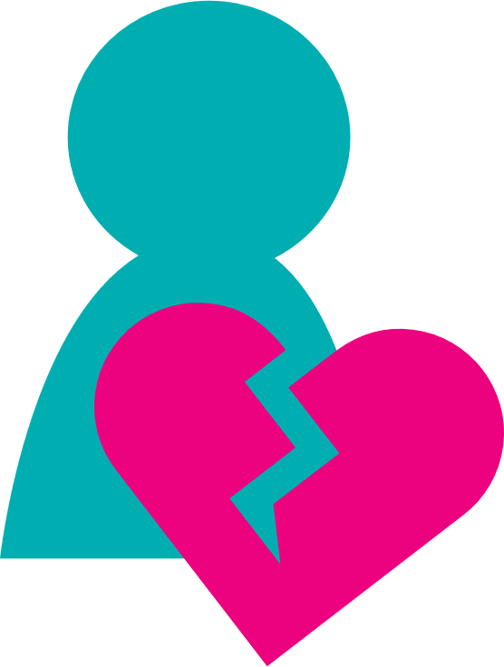
Ransomware Impact on Healthcare, Globally, 2024
5-8 %
of ransomware attacks target Healthcare Sector SOURCES Cyberint, Enisa
67 %
healthcare organisations fell victim to ransomware SOURCE Sophos, based on a survey (N=402)
Ransomware incidents have visible impacts on patient health
SOURCE Dameff C, Tully J, Chan TC, et al. Ransomware Attack Associated With Disruptions at Adjacent Emergency Departments in the US. JAMA Netw Open. 2023;6(5). doi:10.1001/jamanetworkopen.2023.12270
Notes:
Impact on patient health: the number of ischemic strokes and other similar stroke cases significantly increased in emergency departments in the USA that neighbour such emergency departments that suffered a ransomware incident.
All these figures are from surveys and statistics from year 2024.
Cyberint: https://cyberint.com/blog/research/ransomware-annual-report-2024/#Targeted%20Sectors
ENISA Threat Landscape 2023 estimated that in 13 % of ransomware cases globally, the victim is a healthcare sector organisation. ETL 2024 estimated the percentage to be 8: https://www.enisa.europa.eu/publications/enisa-threat-landscape-2024.
The number of respondents to Sophos' survey (https://news.sophos.com/en-us/2024/07/30/the-state-of-ransomware-in-healthcare-2024/) is rather small on a global scale, and sampling might be biased, but it is pretty clear that ransomware is a major threat for healthcare.

Slide 6
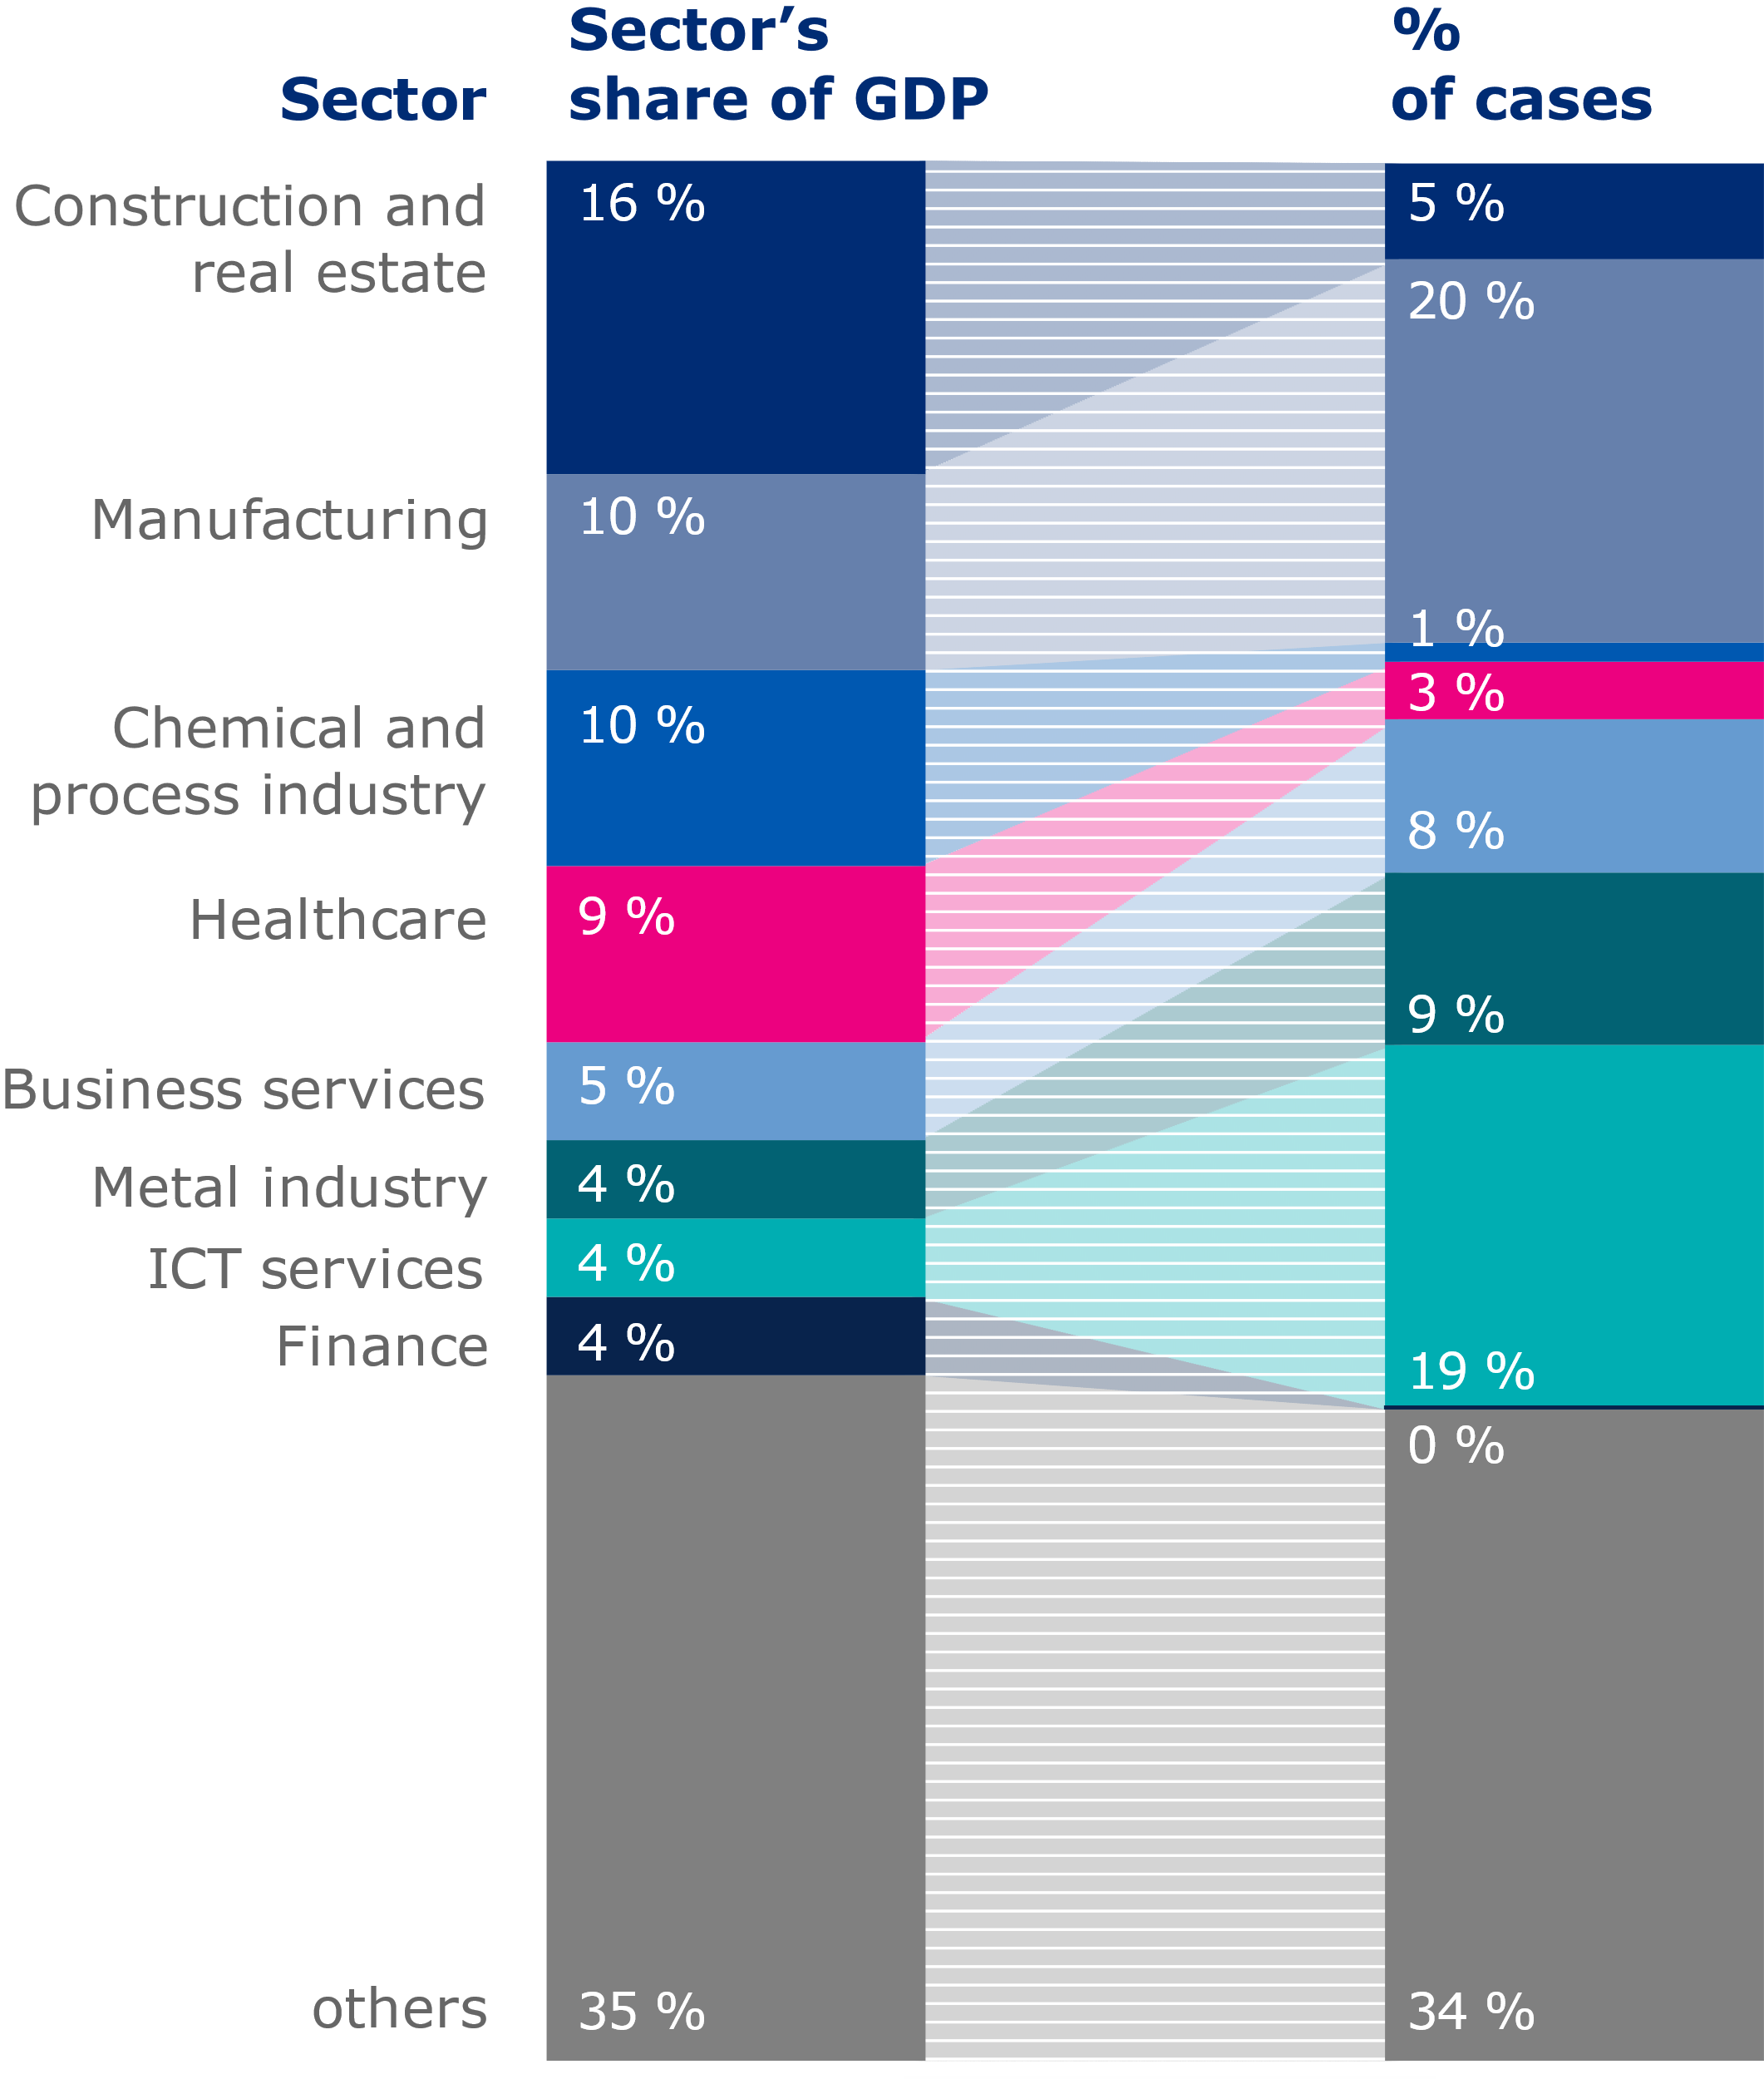
Ransomware cases in Finland in 2022–2024
SOURCE NCSC-FI
Cyber Maturity of some business sectors (2022)
SOURCE National Emergency Supply Organisation
74 cases
Notes:
The number of cases is the number of those distinct ransomware incidents reported to the NCSC-FI, where the attacker presented a ransom note to the victim and encrypted or stole victim's data. Why an observation period of three years? Because the yearly variation in victim sectors is significant in a relatively small country like Finland.
I assume that threat actors performing ransomware attacks are purely interested in money, and therefore comparing the number of cases to the sector's share of Gross Domestic Product (GDP) makes sense. It is certainly not a flawless estimator, but good enough for this purpose. The GDP figures are estimated from Statistics Finland's statistic 123h, year 2023.
Small number of ransomware cases compared to the sector's size: construction and real estate, chemical and process industry, healthcare, and finance.
Large number of ransomware cases compared to the sector's size: manufacturing, metal industry and ICT services.
The category "others" summarises the following sectors and other smaller sectors: logistics and transport, food, retail, water and waste, media, energy, public administration, and education. Some of these sectors, such as food sector, are rather large. I omitted them from the table because the percentage of ransomware cases and percentage of GDP are in line with each other.
Globally, business services is the most targeted sector. In Finland, it is slightly more targeted than what the GDP share would suggest, but still far less than the global average.
The maturity was assessed against selected cyber security targets defined in NCSC-FI Cyber Meter tool. The Cyber Meter is based on NIST Cybersecurity Framework (CSF) and the U.S. Department of Energy Cybersecurity Capability Maturity Model (C2M2).
In this survey, chemical and process industry was included in manufacturing sector. Therefore, the manufacturing sector has here both a plus and a minus for susceptibility to ransomware.
Why is ICT and software sector so susceptible to ransomware attacks? Doesn't high maturity entail better preparedness and prevention capabilities? Maturity doesn't equal to technical prevention capability, but a mature organisation is likely to organise their cyber security more consistently and have better resilience to attacks. Part of the sector's situation can be explained by how ransomware incidents are tallied: if an incident impacts many companies, it is easiest to evaluate that as an ICT sector incident. It is also reasonable for ransomware actors to target ICT service providers because they have a lot of attack surface and their business is quickly halted after an attack, which increases the likelihood of ransom payment (Routine Activity Theory; see, for example Tom Meurs's doctor's thesis, page 13).

Slide 7
Impact to Finnish society has been rather low
Overview of the Finnish healthcare ransomware cases 2022-2024
2022 a municipality
Impacted primary healthcare appointment reservation system
Quite a local impact. Full recovery lasted over 1 month.
2023 an elderly care company
middle-sized
Impacted an administrative file server. No impact for care delivery.
2024 no victims
Notes:
We cannot give more details about these cases to the public.

Slide 8
Finnish Healthcare System
Public Healthcare And Social Welfare Services
A fundamental reform in the beginning of 2023
21 welfare counties, city of Helsinki, HUS Group, and Åland islands healthcare district
78 % of national healthcare spending, funding from the state
Lots of subcontracting from private healthcare and social care providers
Five key ICT providers. A large variety of supporting ones.
Private Healthcare And Social Welfare Services
Five big providers, hundreds of middle sized, thousands of small ones. A large variety of ICT providers.
Pharmaceuticals
One large pharmacy company, hundreds of SMEs, a couple of key ICT providers
One large pharmaceuticals manufacturer, tens of smaller ones. Two key pharmaceuticals wholesalers.
National Social Insurance Institute Kela
National electronic health record and prescription database Kanta
Almost all ICT services produced in-house

Slide 9
Cooperation and networking
Annual healthcare ICT fairs in Finland since 1970's
Comprehensive peer-to-peer networking and support
USA: since 2010
Health ISACs
Finland: since 2017
Notes:
In Finland, healthcare ICT fairs have networked people since 1970's -> strong peer-to-peer support in cyber security topics.
Comparison:
Small Finnish healthcare ISAC since 2017. Nowadays about 30 members. The number of members has intentionally been kept low in order to foster deep mutual trust.
In the USA, Health-ISAC has operated since 2010. Nowadays, thousands of members around the globe.

Slide 10
Information, communication, and medical technologies
Vulnerability scanning
NCSC-FI promotes especially for healthcare sector
Small public attack surface in Finnish healthcare
Outdated systems
Certainly found both in Finland and in the USA
Healthcare sector not much different from other sectors
Complexity
Technological legacy both in Finland and in the USA
Notes:
NCSC-FI appears to have better succeeded in promoting our vulnerability scanning service to healthcare sector compared to CISA. As a result, internet-facing attack surface of Finnish healthcare appears to be smaller than that of American healthcare.
There certainly are outdated systems in use both in Finnish and American healthcare.
There's also high level of technological complexity in both Finnish and American healthcare providers' systems. Finnish wellbeing counties inherited lots of technology from their predecesors in the reform of 2023. In the USA, hospital mergers have increased the technological legacy.

Slide 11
Money
Finland is a small economy
Largest Finnish organisations are globally small
Criminals easily find more lucrative targets elsewhere
Notes:
In absolute terms, Finland is a small economy. Even the biggest Finnish organisations are small in a global scale. Cyber criminals easily find more lucrative targets elsewhere.

Slide 12
Politics
Vastaamo incident in 2020
Government resolution on information security and privacy on critical sectors
Notes:
Psychotherapy clinic Vastaamo incident in 2020 raised cyber resilience to the top of political agenda in Finland.
Government resolution on information security and privacy on society's critical sectors in 2021.
In the USA, there have been many significant ransomware incidents in healthcare, but none of them has had the same political impact as the Vastaamo incident had in Finland.

Slide 13
Law and other norms
Public healthcare
Personal liability of public servants
GDPR
Finns are quite strict about following the rules
Comprehensive long-term investments in cybersecurity
Boosts also cybersecurity
Notes:
Majority of healthcare in Finland is provided or funded by public authorities (public healthcare) (78 % of Finnish healthcare spending).
Public servants are personally liable also for cyber security. That has guided comprehensive long-term investments in cybersecurity, and has influenced also private healthcare providers' investments.
Finns are quite strict about following rules. EU general data privacy regulation (GDPR) has improved also cybersecurity in Finnish organisations.

Slide 14
Reputation and relations
Ransom payments
53 % of American healthcare organisations pay
None of the Finnish ones have paid
ICT is special
Pivotal role of ICT service providers makes them lucrative targets
Increased reporting
Notes:
In the USA, many ransomware victims have paid the ransom, which increases the criminal's targeting.
In Finland, some victims have paid the ransom, but none on the healthcare sector.
ICT service providers are pivotal in enabling other organisations' business, which makes them lucrative targets for ransomware threat actors. In Finland, ICT service providers are more likely to report their incidents to the NCSC-FI than organisations on other sectors, which increases the ICT sector's share of reported ransomware incidents.

Slide 15
Why is Finnish healthcare system doing so well against ransomware?
Mainly public healthcare system
Personal liability of individual decisionmakers guides cybersecurity investments
Special support from NCSC-FI
In general, cleanest internet in the world, and the internet-facing attack surface is small
No healthcare organisation has made a ransom payment
Criminals focus their efforts on targets they expect to pay
Small country, low hierarchies
Peer-to-peer information sharing enhances preparedness
Small Economy
"Big game hunters" find lots of bigger targets elsewhere

Slide 16
Thank you for listening! Let's discuss.
Contact me at perttu.halonen@ncsc.fi

Slide 17
Definitions
Healthcare: "This sector includes the companies related to the manufacturing of medical devices (e.g., implantable medical devices), the pharmaceutical industry, as well as the healthcare settings, including hospital and private clinics. It also comprises the activities regarding the monitoring of chronic diseases and elderly people based on the integration of new technologies in the healthcare ecosystem (e.g. smart health)." See https://publications.jrc.ec.europa.eu/repository/handle/JRC118089
Ransomware: "Ransomware is a type of attack where threat actors take control of a target’s assets and demand a ransom in exchange for the return of the asset’s availability and confidentiality." See https://www.enisa.europa.eu/publications/enisa-threat-landscape-for-ransomware-attacks

Slide 18
Healthcare spending and ransomware cases in the USA, the EU, and Finland
Country | Healthcare spending in 2022, Million USD | Healthcare spending, % of GDP | Ransomware cases in 2023 | Healthcare spending per ransomware case, Million USD
Finland | 34 218 | 10,04 | 1 | 34 218
EU | 2 678 439 | 10,40 | 63 | 42 515
USA | 4 325 986 | 16,63 | 460 | 9 404
Notes:
The numbers of ransomware cases have been obtained as follows:
- Finland: incidents reported by victims or their partners to the NCSC-FI
- EU: Deducted from ENISA Threat Landscape 2023
- USA: statistics compiled by the US Department of Health and Human Services: "Ransomware & Healthcare", January 18, 2024, ID# 202401181300
Spending figures are from OECD statistics.
Additionally, Finland spends a lot in social protection: 31,7 % of GDP in year 2023. That is close to the EU average. 43 % of social protection expenditure is various services and 57 % is various income compensations.
In the USA, the federal government spent USD 1,35 trillion on Social Security in fiscal year 2023. This accounted for 22% of the total federal budget. 85 % of the spending went to retirement benefits.

Slide 19
Contexts of ransomware victims – the STEMPLES+ framework
Social
Technological
Economical
Military
Political
Legal
Environmental
Security
PLUS: Psychological | Reputational | Other
© Pherson

Slide 20
Finnish society in general
Social
Small country; population about 5,5 million
Technological
Thoroughly digitalised
But not every resident is equally tech-savvy
Economical
GDP 61 685 USD/capita
Relatively small diversity in personal incomes
Political
Legal
Environmental
Security
PLUS
Multi-party parliamentary democracy
Very low corruption
Scandinavian civil law system
Cyber crime is well covered in the criminal code
Cold and dark
Capable police forces, internationally connected
CERT-FI established in 2002
Military
Obligatory military service for men → social networks
Happiest country in the world
Low birth rate
High trust in public authorities
Notes:
Economical: Finnish Gross Domestic Product per capita just above the Organisation for Economic Co-operation and Development (OECD) average.

Slide 21
Social aspects
Finnish healthcare
Other Finnish sectors
American healthcare
SOTE-ISAC, the Finnish healthcare ISAC established in 2017. About 30 members
Annual "Sote-ATK-päivät" ICT fair: cooperation and information sharing since 1970's
National ISACs on many but not all sectors; manufacturing and metal sectors lack one
Weird language has offered some degree of protection from social engineering by international crime gangs
Health-ISAC established in 2010. Thousands of members around the globe.
Notes:
SOTE-ISAC: the number of members has intentionally been kept low in order to foster deep trust among the members.

Slide 22
Technological aspects
Finnish healthcare
Other Finnish sectors
American healthcare
NCSC-FI promotes free vulnerability scanning service particularly for healthcare → moderate attack surface
Some outdated systems in use, but seldom exposed to the Internet
Public healthcare has a huge technological legacy due to wellbeing county reform
NCSC-FI promotes free vulnerability scans for some but not all sector
ICT sector has a large attack surface
Large attack surface (see Microsoft's report). CISA offers free vulnerability scanning on request.
Outdated systems (see Microsoft's report)
Technological complexity due to high rate of hospital mergers (see Microsoft's report)

Slide 23
Economical aspects
Finnish healthcare
Other Finnish sectors
American healthcare
A rather large business sector within Finland
Largely provided as public service and mainly funded through taxes
Lack of resources in public healthcare
Globally, Finland is a small economy
A large share of world's biggest economy
Provided through private companies and mainly funded through private insurances
Lack of resources; thin profit margins (see Microsoft's report)

Slide 24
Political aspects
Finnish healthcare
Other Finnish sectors
American healthcare
Psychotherapy clinic Vastaamo incident in 2020 raised cyber resilience to the top of political agenda.
Government resolution on information security and privacy on society's critical sectors in 2021
Cyber resilience of other critical sectors got public attention as a side effect of the Vastaamo incident.
Over the years, an increasing public concern of healthcare cybersecurity
Change Healthcare incident in 2024 significantly increased public concern

Slide 25
Legal aspects
Finnish healthcare
Other Finnish sectors
American healthcare
Majority of healthcare personnel are public servants, and thus have personal liability for cybersecurity
Mandatory auditing of EHR products.
Mandatory requirement for an information security plan
But many small providers see it only as a compliance exercise
European Medical Device Regulation mainly covers only pre-market cybersecurity
GDPR boosts also cybersecurity
ISPs are mandated to disconnect malware infected systems from the Internet → Finnish internet is one of the cleanest in the world
Before NIS2 directive, only telecom, health, finance and energy sectors and public administration had mandatory cybersecurity requirements.
HIPAA security rule since 1998
Requires, e.g., defined and documented cybersecurity policies
But has led to prioritising confidentiality (see Microsoft's report)
Advanced pre-market and post-market cybersecurity requirements for medical devices

Slide 26
Other (PLUS) aspects
Finnish healthcare
Other Finnish sectors
American healthcare
Healthcare organizations prioritize patient care at all costs → likely willing to pay ransom
But, to our knowledge, none has paid
Lesser ethical impact from disturbances in operations; merely a financial issue
ICT providers are pivotal in enabling other actors' business; possibly high effort, but certainly high reward targets for criminals
ICT companies are most likely to report their ransomware incidents to the NCSC-FI
Track record of paying ransom: 53% of victims have paid (see Microsoft's report)

