Slide 1
Eric Akumiah (FIRST, Ghana)
Enhancing Trust within Africa CSIRT Communities Using the “Carrot and Stick” Principle

Slide 2
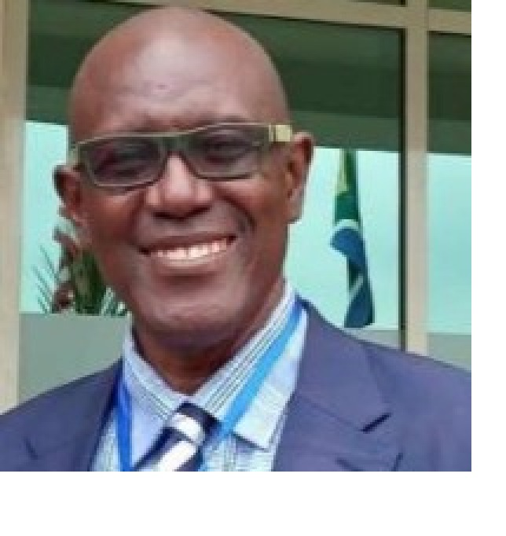
FIRST Africa regional Liaison, Ghana
Former Director of Operations & Support, National IT Agency, GH
Former Cyber Lead, MoC, Ghana
Founding Manager, CERT-GH
Lead, Multistakeholder Adhoc Technical Committee responsible drafting Ghana’s first Cyber Policy & Strategy
Founding Manager, Africa Top level Organization (AfTLD)
FACILTATOR INTRODUCTION
Eric Akumiah

Slide 3
FIRST Africa Regional Liaison Initiative
Supporting the priorities and ambitions of the Africa incident response community
Three-year initiative started in November 2024 under the Africa Cyber Program of the UK Government;
Focused on providing ongoing, in-region support for incident response community and capacity building;
Operationally focused
Community driven
Ecosystem approach
Foundation of trust
Notes:
Focused on fostering trust
Being responsive to the needs, priorities, and ambitions of local partners
Leveraging local, regional, and global peer-to-peer information and good practice sharing and capacity building
Developing ecosystem of capable, trusted partners

Slide 4
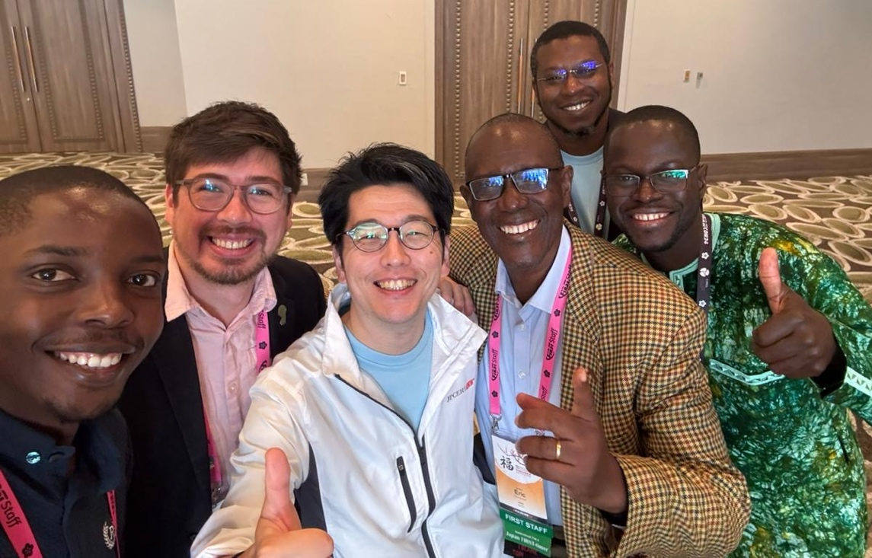
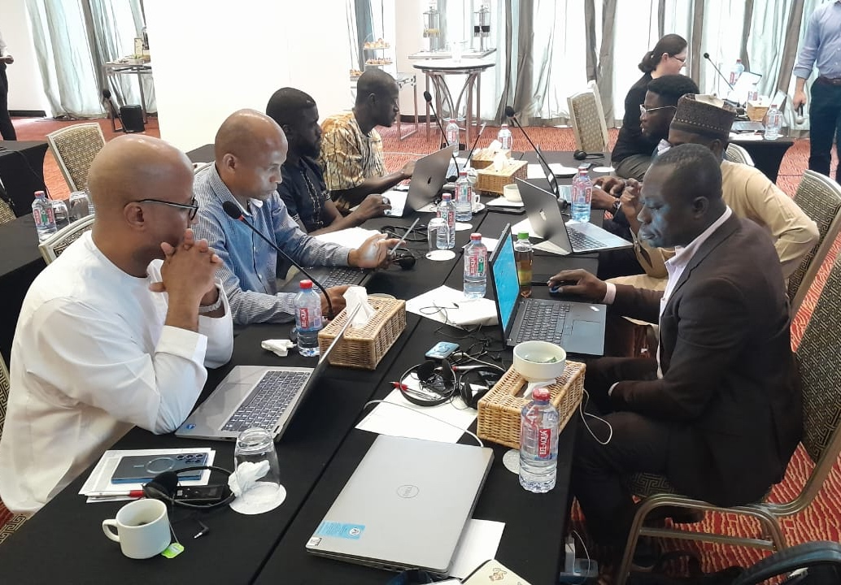
High Level Goals
Enable Community building through formal and informal networks
01
Build Incident management & Technical Capacity of CSIRTs in the region.
02
Facilitate Advisory & Mentorship
03
Develop Trust relations with Partners & Stakeholders
04

Slide 5
Focus Areas
natCSIRT Level
National Ecosystem
Regional
Provide direct mentorship and advisory support
Facilitate sharing of lessons learned and good practice
Support capacity building priorities and ambitions
Connect with practitioners across local stakeholder groups
Deliver tailored training
Support development of incident response ecosystem
Foster local communities of practice
Support formal and informal regional trust groups for:
information sharing
good practice sharing
activity coordination
capacity building delivery

Slide 6
Emerging cyber landscape wrt CNII, Sector CSIRTs
Few economies already have legal instruments for CNII
CNII Directives
Cybersecurity Law
Sector CSIRT policy and legal instruments
Many more economies working on and finalizing CNII instruments
Some economies are yet to start work on CNII
Some medium to large Economies are considering establishment of sector CSIRTs

Slide 7
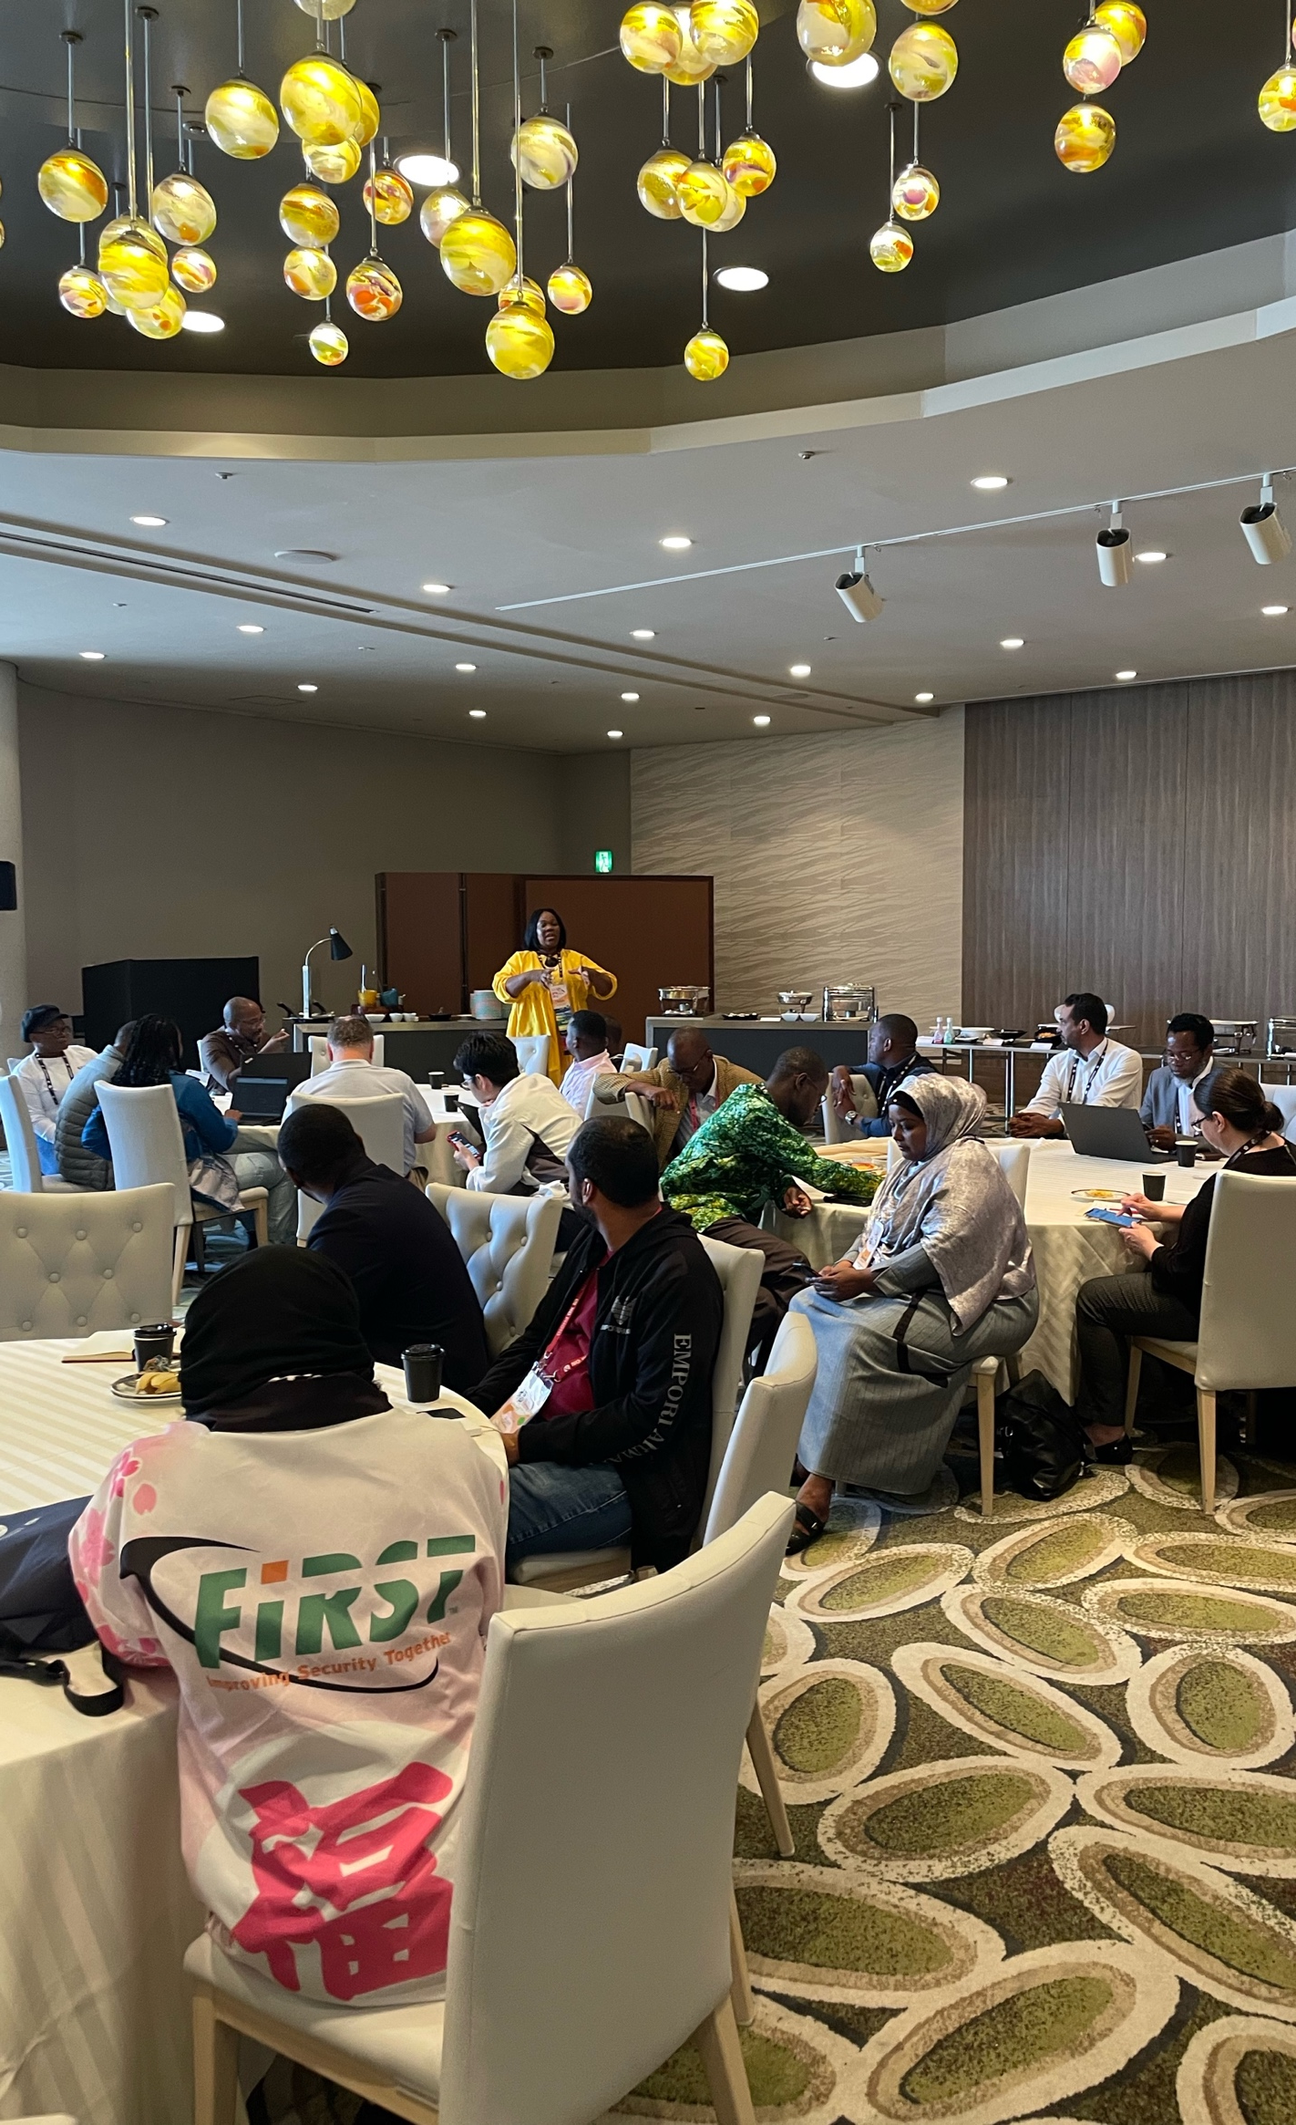
Lessons Learned
There is a need for a more contextualized content and local trainers (T3 Program for Africa Regional Liaison Initiative)
There is an overly prioritization of indicators of incident response over operationalization
Need to Building a robust CSIRT ecosystem through creating trust between nCSIRT and constituencies
Minimize Duplication of capacity building initiatives
Notes:
Indicators of IR = tools, equipment, theoretical training, and policies w/o operaitonalisation

Slide 8
How do we improve trust between CSIRTs & Community?
What are challenges in building and maintaining trust?
Proactively
Pre- policy, legal instrument development
Reactively
Developing trust after policy, legal instruments, and implementation

Slide 9
Core Principles of Trust-Building
Transparency and Open Communication
Competence and Reliability
Confidentiality and Privacy
Collaboration and Inclusiveness

Slide 10
Presentation inspired by work done by Don Stikor FIRST in Mozambique

Slide 11
The Carrot Approach—Positive Reinforcements
1. Transparency & Communication
Recognize proactive information sharing
Publicly acknowledge contributors
2. Proactive Engagement
Offer certifications, training, and incentives for participation
3. Demonstrating Performance
Use awards and recognition for improvements
4. Fostering Collaboration
Host joint workshops; reward teamwork

Slide 12
The Stick Approach—Accountability & Enforcement
1. Confidentiality & Privacy
Enforce penalties for data breaches
2. Consistency & Reliability
Clear accountability mechanisms
3. Institutional Support
Use authoritative mandates to ensure compliance
4. Monitoring & Audits
Conduct regular assessments; enforce corrective actions

Slide 13
Practical Strategies for Implementation
Combine
Combine incentives with enforcement
Tailor
Tailor activities to constituent needs
Communicate
Communicate benefits and obligations clearly
Foster
Foster a culture of trust and accountability

Slide 14
Conclusion
Trust is essential for effective CSIRT operation
The carrot and stick approach helps motivate cooperation and adherence to best practice

Slide 15
Eric@first.org
+233-243380612

