Slide 1


Slide 2

Sharing eCrime Data Across National Borders
Patrick Cain
Resident Research Fellow

Slide 3
Agenda
  Overview of Event Collection
  Event Collection Evolution
  Old Solutions, New Problems
  A Plan
  Current Status

Slide 4
A Look Backwards
Many years ago, we started a block list of phishing ‘site’ URLs
  We ignored spam, malware, etc., sites
  But phishing is now smushed with everything else – one lure gets you a phish, malware, and other prizes
  Having the URL is nice, but is no longer complete
    It didn’t help us find the ‘bad guy’

Slide 5
So we expanded the dataset
We convinced people to send in more than the URL
  Spam source, collector DNS data, etc.
Crafted a common format. ;)
  Lets us send/receive data with others with little additional work
Initial pain
  The tools got more complex
  New data ‘types’ appeared –
    cyber bullying, extortion,…

Slide 6
It’s time to play nice with others
The data collectors are exchanging datasets
  Data from phishing lure sources that also do other things
  Data correlation has lead down new paths
Others were using our datasets to generate interesting correlations
We needed to start thinking bigger, or at least more complex, about our datasets

Slide 7
Our definition of ‘data’ changed
CRIME?
INCIDENT
(Correlation)
EVENT
EVENT
EVENT
(Context)
Phishing URL, spam source, etc.
(Context)
Phishing URL, spam source, etc.
EVENT
CONTEXT
Phishing URL, spam source, etc.
(Context)
Phishing URL, spam source, etc.
ARTIFACT
ARTIFACT
IP Address + Timestamp
ARTIFACT
ARTIFACT
IP Address + Timestamp
ARTIFACT
ARTIFACT
IP Address + Timestamp
IP Address + Timestamp
IP Address + Timestamp
IP Address + Timestamp

Slide 8
Our definition of ‘data’ changed
Artifacts:
  IP Address, Timestamp
Events
  Artifacts with context
  IP address + phish + collector data + metadata
Incident
  Events with large-area correlation
  E.g., 5680 events from same server ->> 2 banks
Crime?

Slide 9
New challenges
We know how to combine artifacts into an event
We know how to relate events into an incident
Could we correlate events into a ‘crime’?
Where ‘crime’ is:
  Enough data to identify the actor(s) behind the activity
  Support ‘Group Forensics’^{sm}
  Solid data to help/direct the police/polita/cop/bob/etc.
    Private industry still does the brunt of the discovery work
    How do we talk/share with the cops (intel vs. evidence)

Slide 10
New problems; Old solutions
What is ‘crime’?
  No good universal definitions for fraud, etc.
  What specific data is required to completely describe
How does a ‘crime report’ move around?
  Are there new integrity constraints?
  The standard barriers to trust get invoked
What is an acceptable format?
  XML must be the answer. ☺
Do the current privacy and security models still work?

Slide 11
The racetrack for success
Every time we talk about sharing data electronically we run the same obstacle course:
  What are we trying to share
    Are there required data items
    Are there sensitive data items
  Is there already a format to share the data
  Has someone or group already defined these things
    If not, where is the expertise to figure it out
    If so, what can we do to help get it operational or useful

Slide 12
Our partners’ efforts
We thought judiciary types would be all over this
  We’re kind of right
  Most treaty organizations have an effort underway
    EUROPOL announced a new analysis center recently
    UN, ENISA, OSCE, OECD, G8, etc., all have on-going efforts
  Many are not making headway or are stuck on the challenges slide
We’re wondering if there is a ‘problem’ to ‘solve’
  And, if so, what is it?

Slide 13
The challenges
Cops don’t speak geek & geeks don’t speak cop
  Discovering a common language is hard!
  Currently a techie is always the interface
Identifying eCrime that would benefit from aggregation
  Botz? Spam? attacks?
Defining the data elements to put into a ‘report’
  Required and optional and descriptive

Slide 14
Our (optimistic) Work Plan
Get everyone to speak the same language
  Gather common definitions (IPC)
  Propose a taxonomy (IPC + Research dept)
Identify impediments for common data sharing
  IEEE/APWG Stop-eCrime WG is tackling
‘Collect’ some of the crime data
  Like the global phishing report does
  Leverage the unofficial data to move sharing ahead

Slide 15
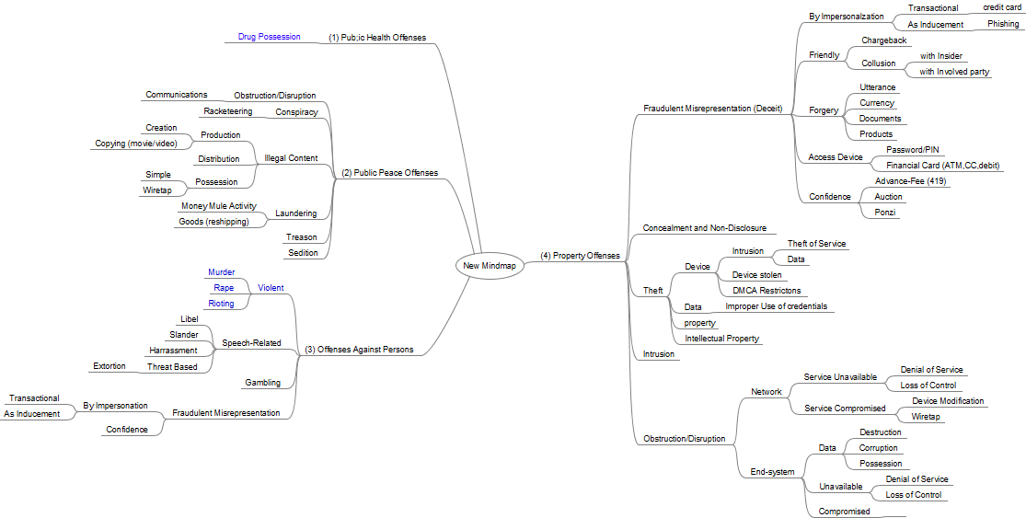
Taxonomy

Slide 16
Status of our efforts
The APWG has been doing some of the ‘thinking’
  Trying to develop a CONOPS (flow diagrams) on how this would work
  Developing some acceptable crime definitions
  Exploring inter-organization impediments
Using our partners efforts to see if we’re going down the right path
  Most of those efforts are awaiting funding or direction
Thinking about a test case (longer-term thought)
  Maybe using our bot reporting system

Slide 17
How *you* can help
i.e.: FIRST-24 theme “crime is not an island”
We’d love to talk to you if:
  you have thought about correlating incidents into crimes,
    Particularly if you’ve written down your thoughts
  you are aware of an existing group effort to do this work
    especially people who are *doing*, not talking

Slide 18
Info: global phishing report 2H11
http://apwg.org/reports/APWG_GlobalPhishingSurvey_2H2011.pdf

Slide 19



Thank you
Pat Cain (pcain@apwg.org)
Resident Research Fellow
APWG

