Slide 1
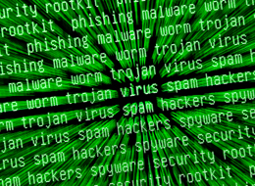
Insight into Russian Black Market

Slide 3
sh-3.2# whoami
Alan Kakareka, CISSP, GSNA, GSEC, CEH, MCP, MCDST, Net+, Sec+
Masters degree in science from Florida International University
CTO and founder of Demyo, Inc.
Based in Miami, Florida, USA.
Demyo, Inc.

Slide 4
And I enjoy green letters on black background
Demyo, Inc.

Slide 5
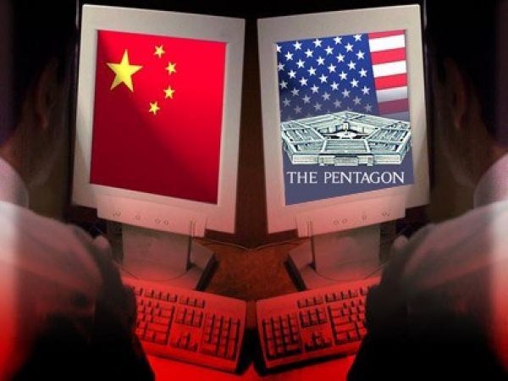
What are the most dangerous countries?
Demyo, Inc.

Slide 6
What are the most dangerous countries?
Demyo, Inc.

Slide 7
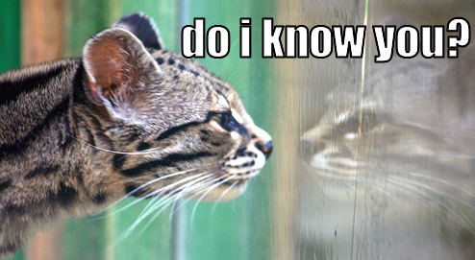
Where all the goodies are?
Unknown – Unknown:
Forums, various websites
Known – Known:
IM, typically ICQ
Demyo, Inc.

Slide 8
Lets take a look at 2 underground forums
https://exploit.in/forum/ - pretty small
https://forum.antichat.ru/- one of the bigger ones
Demyo, Inc.

Slide 9
Small vs big
Example: rdot.org
Demyo, Inc.

Slide 10
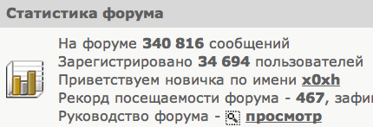
https://exploit.in/forum
341k messages, 35k users.
Demyo, Inc.

Slide 11
How many of all messages are sale / buy / trade?
Roughly 10-15% of all messages are related to
sell / buy / trade
Another 90% is how to program this, how to hack this, how to solve this kind of issue, etc.
Demyo, Inc.

Slide 12
Lets see what can we buy?
Demyo, Inc.

Slide 13
How about root access to mysql.com
Demyo, Inc.

Slide 14
Anybody wants to guess the price?
Demyo, Inc.

Slide 15
Later on in the news….
Demyo, Inc.

Slide 16
Auction system for serving malware - “vDele”
Demyo, Inc.

Slide 17
Software to build your own botnet – “andromeda botnet”
Demyo, Inc.

Slide 18
Also available
Credit card numbers
Paypal accounts
Online banking accounts
Email spamming services
Cell phone spamming services (by text messages) and / or calls
0-day exploits (rarely)
Custom malware, spyware, tools
Plain hacking services
DDOS
Full identity (CC + SSN + DOB + address + email with password + online banking credentials + mothers maiden name + dogs name + etc.)
Demyo, Inc.

Slide 19
0-day exploits (rarely)
If a black hat has 0-day it is much more profitable do something with it than selling it
If you are white hat hacker, sell it to company’s who are buying bugs like ZDI
Demyo, Inc.

Slide 21
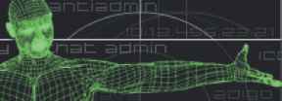
https://forum.antichat.ru/
2 million messages, 104k users
Demyo, Inc.

Slide 22
How many messages are related to buy / sell / trade
Almost 10% of all messages are related to trading
Demyo, Inc.

Slide 23
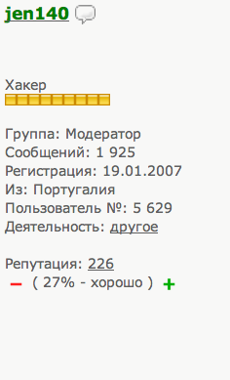
How do they trust each other?
VS
Demyo, Inc.

Slide 24
Another way is by endorsing from the forum owner
Demyo, Inc.

Slide 25
Means of payment
No paypal….. WHY????
Webmoney
Liberty Reserve
Yandex Money
BitCoin – not so much
F2F – almost never
Most popular is WEBMONEY
Demyo, Inc.

Slide 26
Closed sections
Typically there are 3 access levels
1st level – make some useful posts
2nd level – get to know somebody and post some sensitive data
3rd level – be well known in community, post some real goodies
Demyo, Inc.

Slide 27
Limiting access only to higher profile people
Demyo, Inc.

Slide 28
Prices…
How much is this, how much is that?
Depends what language you speak
If you ask in Russian – 100 bucks
If you ask in English – 200 bucks
Demyo, Inc.

Slide 29
Actual pricing
Private virustotal.com service – 40 USD / month, unlimited amount of files
Why do you need a private virustotal.com service? When virustotal.com is free???
1 million SPAM emails in inbox – 200 USD
DDOS – 100 to 400 USD a day, depending on traffic amount.
DDOS sales/discussions are getting forbidden in many public Russian forums, why???
CC – 0.1 USD to 5 USD depending on amount and/or quality
Demyo, Inc.

Slide 30
Actual pricing
Paypal – 1% to 10% of the balance, also depending on account type and other factors
Online Banking – 1% to 10% percent of the balance, depending on the bank, account type and other factors
Email:pass combo – FREE, unless it is sorted, verified for validity, and is bundled with other accounts
Full identity (CC + SSN + DOB + address + email with password + online banking credentials + mothers maiden name + dogs name + etc.) – about 100 USD
Many, many, many other types of services and goods – agreed price
Demyo, Inc.

Slide 31
OTHER FACTORS
Paypal and Online Banking – 1% to 10% of the balance depending on account type and other factors.
User logs in into his account once every 6 months
Password to users email is available as well
This particular bank DOES allow online transfers
User logs in into his account daily
Password to users email is not available ☹
This particular bank DOES NOT allow online transfers
Demyo, Inc.

Slide 32
How many Russian resources are there?
A LOT OF THEM
http://forum.xakep.ru/default.aspx 1,5 million messages
http://hackzona.ru/
https://forum.k0d.cc/index1.php
http://www.hack-info.ru/index.php
https://forum.xeksec.com/
http://aferizm.ru/
http://grabberz.com/forum.php
http://forum.kriminala.net/index.php
http://www.xaker.name/forvb/index.php
And so on….
Demyo, Inc.

Slide 33
How to find Russian resources
Russian search engines
http://www.rambler.ru/
http://www.yandex.ru/
Classic Google dork
‘Site:ru hacking’
Or…..
Demyo, Inc.

Slide 34
How to find Russian resources
http://hacksearch.madnet.name/

Slide 35
Wrapping up
Yeah we are wrapping up ☹

Slide 36
questions? And Contact info
Email: almaz@demyo.com
Phone: +1 201 665 6666
LinkedIn: Almantas Kakareka
Twitter: @DemyoSec
www.demyo.com

