Slide 1


Slide 2
A Systemic Perspective of Internet Infrastructure Threats
Danny McPherson
Verisign, Inc.

Slide 3
Objective
Discuss Internet threat landscape, particularly as it relates to systemic and Internet infrastructure considerations
Discussion includes:
  Internet Protocol Architecture
  Routing System
  DNS
  DDoS
  X.509, TLS/SSL ,and DANE

Slide 4
The Internet Architecture
Ubiquitous data communications platform; no single authority
  Global collection of loosely interconnected networks
  Datagram / packet-based connectionless network service
  Ultimate goal of resilient end-end any-any connectivity
Primary Internet infrastructure elements
  _{Name: What we seek (DNS)}
  _{Address: Where it is (IP)}
  _{Route: How to get there (BGP)}
_{Security primitives enable:}
  Systemic and wide-scale OR topologically localized attacks
  _{Asymmetric Threats}
  _{Complexity in attribution}

Slide 5

The IP Model
host A
host B
browser
Application
Application
web server
Transport
Transport
router
router
Network
Network
Network
Network
IP
Data Link
Data Link
Data Link
Data Link
Physical Sub Layer
WiFi
Copper, fiber,
wireless, etc.
Ethernet
End to end, any to any
  Smart end systems, dumb intermediate nodes
  Challenged by middleboxen, OTT applications, etc..
  Threat largely circumvent firewalls, etc..

Slide 6
IPv6 and Transitional Coexistence
IPv4 -> IPv6 transition plan was ‘dual stack’
  Both operate at Network layer, are not ‘bits on the wire’ compatible
  Transition plan best when plentiful quantities of IPv4 and IPv6 exist
  IPv4 depletion will impair dual stack transition plan, introducing expense and potential disruption to Internet as service platform
  Following depletion dual stack transition problems progressively worse
Dual Stack
Interoperability and Coexistence
  Y2K had flag day, find all 2-digit ‘year’ data - change to 4
  Everything in the IP stack has to handle either – or both
    IPv4 devices may never be upgraded to IPv6
    IPv6-only devices may need to communicate with IPv4 devices
  Greenfield now with Large-scale/Carrier-grade NATS
Application
Transport
IPv4
IPv6
Data Link
Physical
Notes:
Ahh, the crux of the issue is this.. IPv4 and IPv6 are NOT bits on the wire compatible. The transition plan from IPv4 to IPv6 is what’s was referred to as dual stack, where each system and network device ran both, and then when they all were IPv6-enabled, IPv4 could simply be turned off. This in practice is far more difficult to realized than it was theorized. Any dual stack transition model requires sufficient quantities of both resources (IPv4 and IPv6 addresses) to work, and for all the devices to be enabled and reachable on the new stack before the old stack is disabled. Because IPv4 depletion is upon us, post depletion dual stack transition models become problematic and will only worsen with time.
With Y2K you both had a flag day and didn’t require co-existence. That is, you simply had to locate all the two-digit year data and replace it with four-digit data. With IP and dual-stack, everything must handle IPv6, or IPv4, or both, for the foreseeable future. IPv4 devices may never be upgraded, for example because of hardware limitations. OTOH, IPv6-only devices may need to communicate with an IPv4 device. Because there’s no ‘bits on the wire’ compatibility, network layer protocol translation devices will be required if you don’t have both IPv4 and IPv6 everywhere during this co-existence period. These translation devices compromise end-to-end, but are also much more complex than basic like-protocol NATs, (as with traditional IPv4) as they need to map variable sized values (i.e., IPv4 and IPv6 address) between different layers that utilize this information. They also need to interact with DNS and an array of other applications that contain IP addresses as objects, and must keep state in the network that, as discussed, compromises end-to-end and presents an myriad of issues.

Slide 7

Internet Routing == ‘Routing by Rumor’…
Regional Internet Registries (RIR)
AfriNIC, APNIC, ARIN, LACNIC, RIPE NCC
IANA
ISP/LIR/NIR
ISP
Border Gateway Protocol (BGP) used to advertise destination reachability (routes) to peers
  Peers autonomously choose to reject, accept, and/or propagate routes
  No functional tie-in from resource allocation to routing system; no central arbiter
  ~50 IRRs; may or may not be used
  Little or no route filtering between ISPs today
  Number resource certification efforts underway (RPKI, SIDR, etc..)
Allocate
Allocate
Allocate
Legacy
Assign
Assign
Assign
End Site
Internal DB
Internet Routing Registry (IRR)
ARIN, CW, LEVEL(3), NTT, RIPE, RADB, …
ISP 1
AS5
ISP 2
AS6
AS2
ISP 4
ISP 6
AS3
AS4
ISP 3
AS7
ISP 5
AS8

Slide 8

What’s DNS?
Domain Name System - Maps {key,type} tuples to set of unordered values
  E.g., human-readable names (e.g., www.example.com) to machine-usable numbers (i.e., IP addresses; 192.168.100.1)
‘Under the covers’ and simplicity of use leads most folks to underestimate the complexity of the DNS
  until broken or employed for malice
2. www.example.com?
root (.)
3
User-desired transaction
1. www.example.com?
4. www.example.com?
client
resolver
5
tld (.com)
9
8
6. www.example.com?
7
www.example.com
auth server (example.com)

Slide 9












DNS Attack Surface
Tools, Policy, Government, Law Enforcement, Application, CERT/ISRT, etc..
Consumer
Registrants
authoritative DNS
Registrars/resellers
IP
Recursive Name Servers
authoritative DNS
gTLDs
ccTLDs
authoritative DNS
Smart Grid & Internet of Things
registries
root
Notes:
9

Slide 10




DNS: Inherently Hierarchical Yet Distributed
“ “
Inherent Hierarchy
com
net
.ee
.gov
Natural clusters: Economies of scale
High Value Domains
Web hosting
& Registrar DNS
authority services; driven
by web hosting and
domain name purchase
market dynamic
mof
mod
state
HVDs
(e2000), frequent
targets
www
mail
Application/Stub/Recursive
(consumer v. enterprise
RNS
RNS
Stub Resolver (SR) on end system
SR
SR
SR
SR
SR
SR
SR
SR
Necessary hierarchy to avoid namespace collisions, global uniqueness
Naturally emerging SLD authority clusters
Democratization of recursion/resolution; not strategic control point

Slide 11
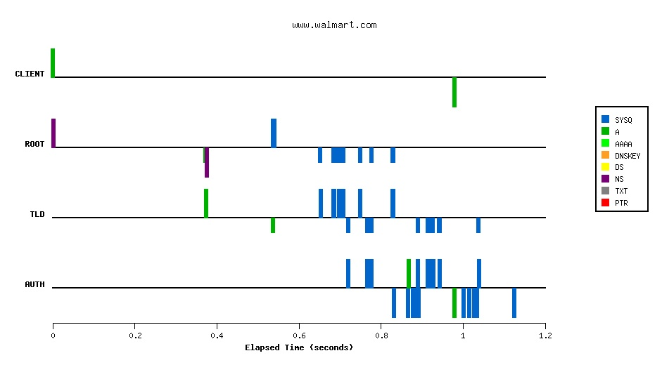
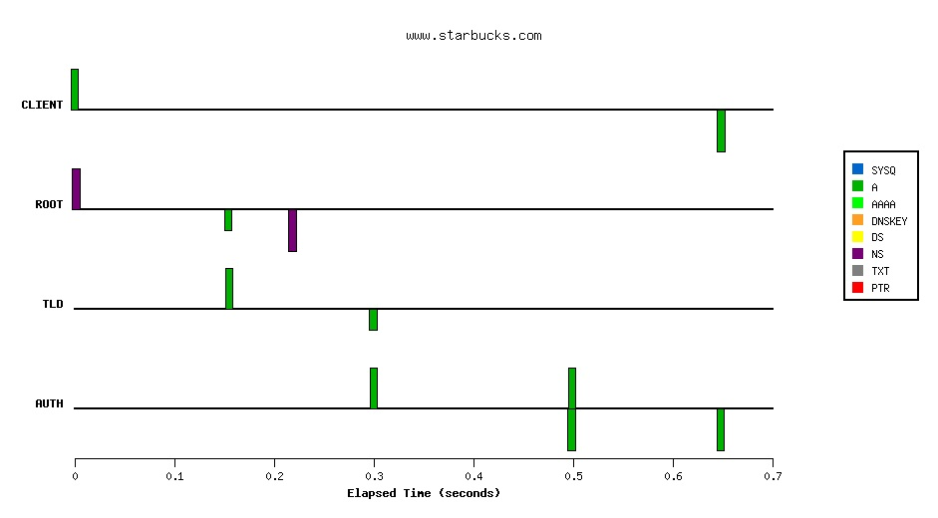
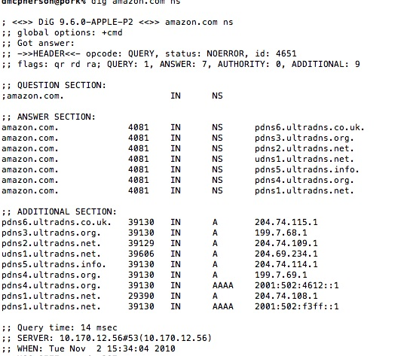
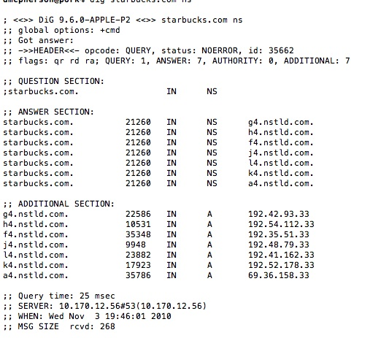
Delegation Graphs and Trustworthy Glue
Each tick on the graphs represent a query or response
BIND recursive from ‘cold cache’ for two domains
Each tick represents attack surface element
walmart.com authority servers aren’t siblings for zone
  not within TLD, can’t trust glue

Slide 12
Transitive Trust and Delegation
First.org delegation graph (JUN ‘12)
  >= ~79 IP hosts
DNSSEC object-level integrity reduces poisoning attack surface from 79 to 3 nodes (zone masters)
Plot your own:
  http://trans-trust.verisignlabs.com

Slide 13
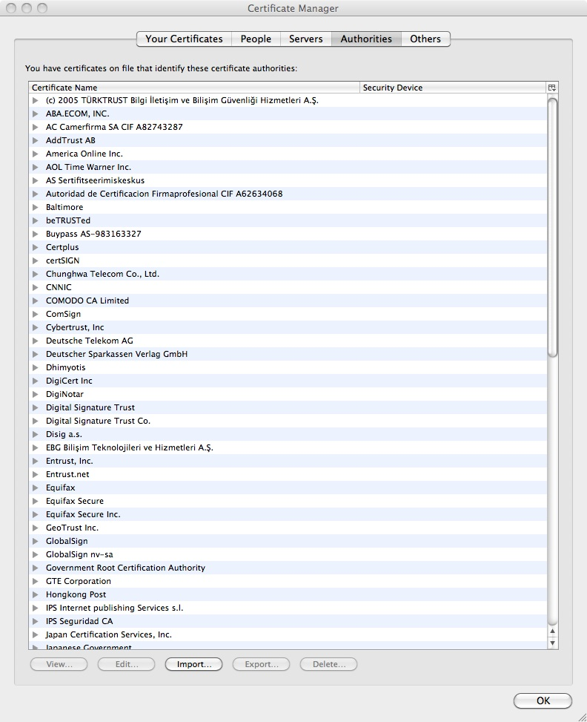

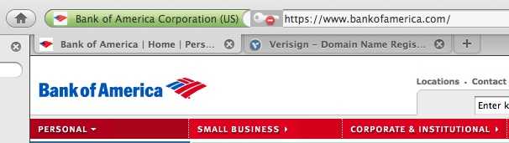
“Challenged” Internet TLS/CA Architecture
All CAs trusted essentially equally, artifact of markets client application vendors wish to enter. Entire system only as secure as least trustworthy CA
You’re only ever as secure as least secure CA contained in client application (most browsers have 150+ CAs!)

Slide 14
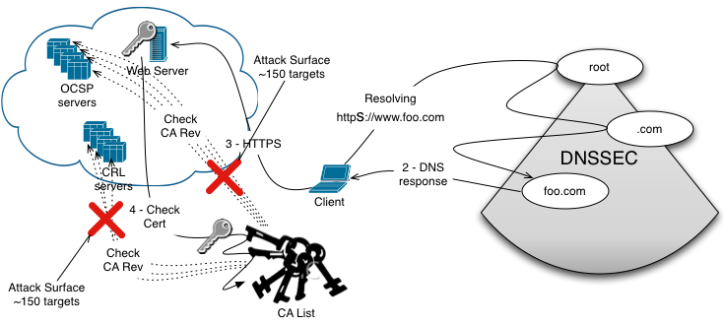
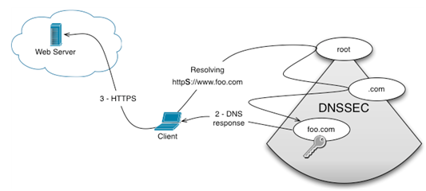
DANE Reduces TLS/CA Attack Surface
Currently the TLS/CA deployment exposes a large attack surface from its many certificates, many OCSP services, and many CRL servers.
Since transactions are already captive to DNS[SEC], relying on DNS Authenticated Named Entities (DANE) reduces, without adding to, the attack surface.
Notes:
Need more talking points for Burt
Would like to add conference name if accepted
Format the contact info and the line on the bottom box

Slide 15
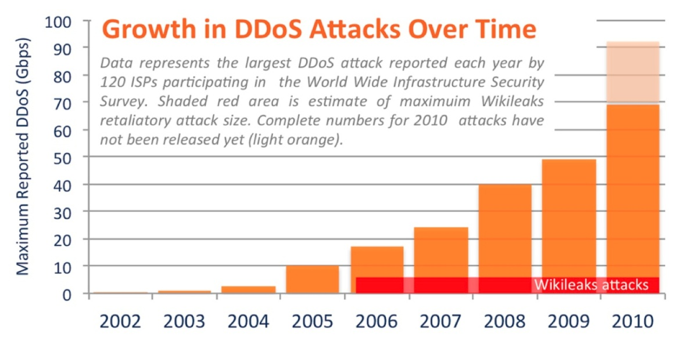
DDoS Attack Evolution
Scale
  69 Gbps attack in 2010, larger since
Increased Frequency & Duration
  Volumetric and application layer
Higher Sophistication
  Expressly exploit middleboxes (e.g., load-balancer, firewall, NAT)
  Target transport, server, and backend state exhaustion
IP networks are inherently multi-tenant, as are most end systems
  Collateral damage from even moderate attacks is common occurrence
Source: Arbor Networks
Fastest discrete IP backbone links today are typically 10 Gbps – large attacks MUST be absorbed / mitigated “in the cloud”

Slide 16
Where IP Robustness Breaks Down
IP network primitives – inherently multi-tenant
  Statistically multiplexed packet networks
  Control and User traffic share datapath
Transaction-enabling services challenge resiliency
  Name resolution
  Certificate Status (OSCP, CRL)
  AAA, etc..
Physical diversity does not yield logical diversity
  Tough enough with transmission path DLRs given DACS and shared fiber with transmission routes, regrooming, etc..
IP-based pseudo-wires, connectionless IP, OTT applications, and enabling transaction systems pose veiled risks, more and more prominent

Slide 17
Transaction Enabling Systemic Dependencies
User-desired transaction
www.example.com
root
in-addr.arpa
RNS
CA
SLD
Authority
TLD
Enumerating underlying AND overlay
enabling infrastructure non-trivial; most folk stop at the former

Slide 18
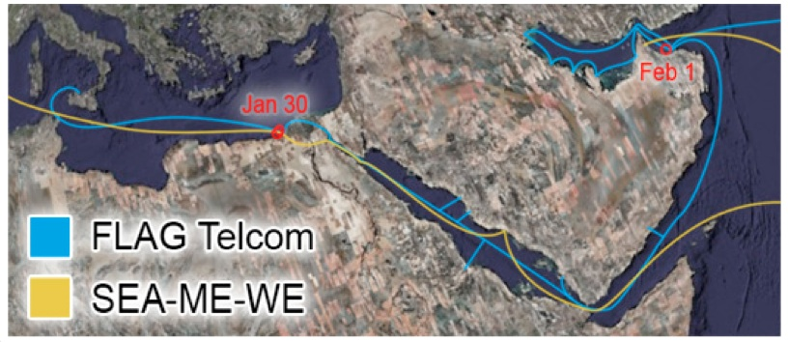
The Case for Service-Level Resilience
Luzon Straight (2006)
Estonia (2007)
Georgia, South Ossetia (2008)
FALCON & SEA-ME-WE 3/4 (2008)
Bahrain King Fahd Causeway & FOG Cable System (2009)

Slide 19
Summary
Employ multi-disciplinary approach to analyze dependencies that enable your internal or Internet-facing transactions
Don’t assume all problems are simple matter of deduction
Consider what controls you should put in place to protect those assets…

Slide 20
Questions?

