Slide 2
Where Automation Ends and People Begin One CSIRT's Journey Replacing a SIEM with Logging
Gavin Reid
Dave Schwartzburg
Cisco Systems, Inc

Slide 3
Notes:
Hi everyone,
I am Gavin Reid – I lead Cisco Systems Computer Security Incident Response team - I will provide you today a perspective gleaned from spending the last decade on one of the fronts of the cyber problem we are discussing today. Day-in, Day-out I spend my time working on issues when all of the best laid plans of mice & men end up not working as planned
Faced with fast moving hard-to-understand problems humans have a tendency to some no-so-smart thinking. Panic, overthinking, seeking for magic solutions - gullibility in belief in them
The whole cyber problem of today was predictable and natural. We had countries (areas) of large concentration of wealth, and others with less.
My company helped connect them through one of the most permeable membranes ever made the internet

Slide 4
Notes:
it's time to have a serious discussion about our expectations for computer security
we want push button security
we try to replace IT head count with technology
"set it and forget it”
http://www.istockphoto.com/stock-photo-2900430-computer-security.php

Slide 5
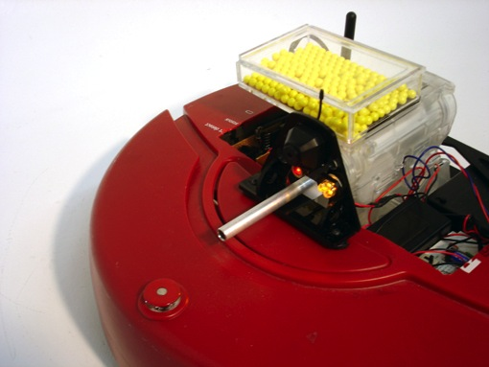
Notes:
vendors, such as myself, have been all to happy to sell magic robots that can come in, sit on autopilot and kill all of the bad stuff without human intervention, just like this airsoft roomba
some of these technologies are very effective particularly anti-spam, web security, anti-virus
they can, in fact, chug along and do their thing independently - very good at improving weak security postures
they target the same problem that everybody has – and are able to do so by virtue of the fact that everybody has the same basic security problems
same spam gets blasted at everybody same ad servers are tricked into serving malware to whomever comes across it
We have become over-reliant on our technology when it comes to managing security and interpreting threats
The security technologies that we deploy are very effective at common problems but they don't do well in finding human lead multi-partate attacks
http://www.isopoddesign.com/7.html

Slide 6
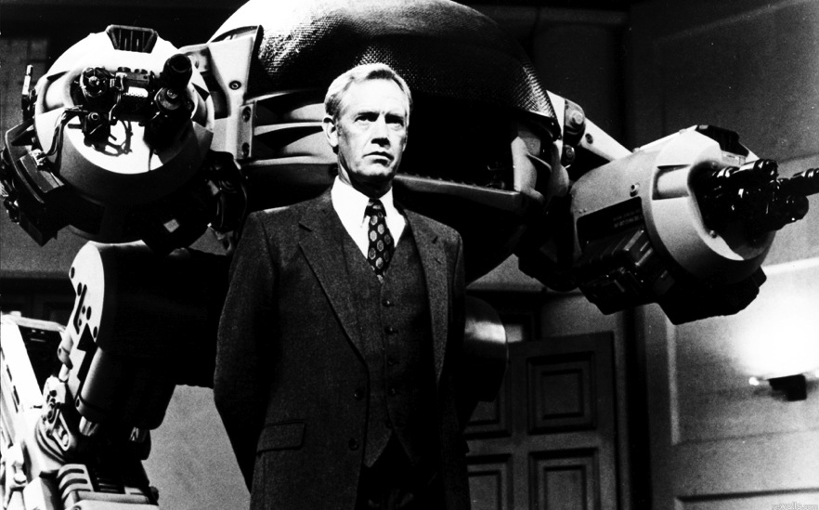
Image © 1990 Orion Pictures Corporation
Image © 1990 Orion Pictures Corporation
Image © 1990 Orion Pictures Corporation
Notes:
let's go back to 1987 and remember the movie, Robocop - Omni Consumer Products buys out the Detroit police department and replaces the police officers with ED-209
it's this huge robot with machine guns on its arms that is supposed to replace a police officer
The famous scene in the board room where they demo their new robot
the bad guy in the movie, Dick Jones, gives a gun to Mr. Kenney and tells him to point it at ED-209
our robotic cop springs to life and orders Mr. Kenney to put down his weapon or be fired on
he throws away the gun, but ED-209 keeps counting down
everybody in the room panics
engineers are frantically tearing apart the control panel, then ED-209 and shoots him anyway
what went wrong was that Dick Jones treated ED-209 as a replacement for a human instead of a tool used by a human
it is difficult to make a machine that can correctly do the reasoning needed to handle a complex situation
I'm going to say that push-button security solutions often fail the same way as ED-209 did
we set them on autopilot with factory settings and expect them to handle our problems

Slide 7
Image © 1990 Orion Pictures Corporation
Image © 1990 Orion Pictures Corporation
Image © 1990 Orion Pictures Corporation
Notes:
What automation can do is act as a force multiplier for your security team.
It is very well suited for gathering data about what is happening on your network.
It is also very well suited for executing repetitive tasks that your security team needs to do.
Automation can be used to create an iterative security process.
Out of the box, these tools will get most of the common, known threats.
Automation is great when it EXTENDS your human reach – not replaces it
http://www.istockphoto.com/stock-photo-7512684-intelligent-robotic-arm-at-work.php?st=b8f70b2

Slide 8
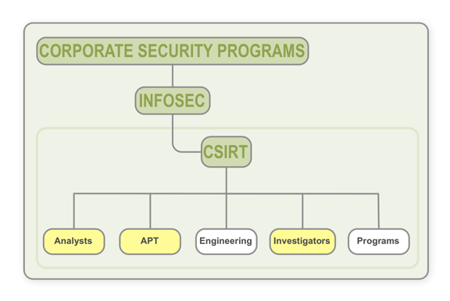
Cisco CSIRT
Teams consuming event data
Critical for:
Malware
Incident response
Sensitive issues
Notes:
We have over 50 users that require access to many different types of security event and user attribution data. Our CSIRT is composed of a number of different sub-teams, specifically:
Analysts
APT
Investigators
Access to data is critical for:
Malware detection, reporting, and mitigation
Incident response and investigations
Forensics and high sensitivity issues

Slide 9
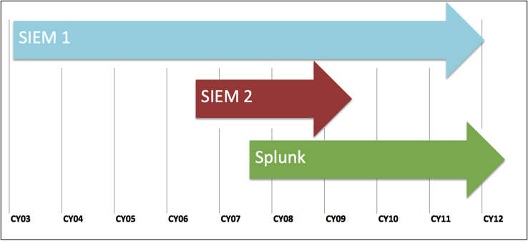
SIEM/Logging History
SIEM:
Two SIEMs previously used in production
Logging:
Syslog collection
Trialed Splunk
Notes:
Varying degrees of success with the two SIEMs that we have used in the past
Logging:
Various incarnations of syslog collection run over the years both by our group and IT
Our Splunk deployment began small:
10GB/day in 2007
+10GB/day in 2010 (for WSA)

Slide 10
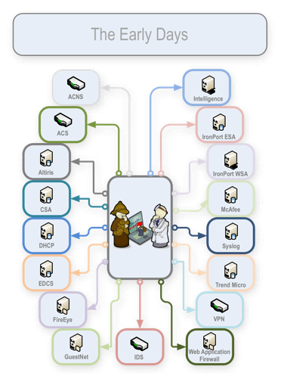
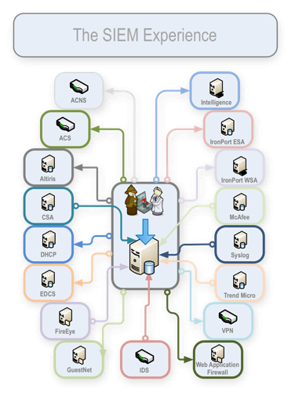
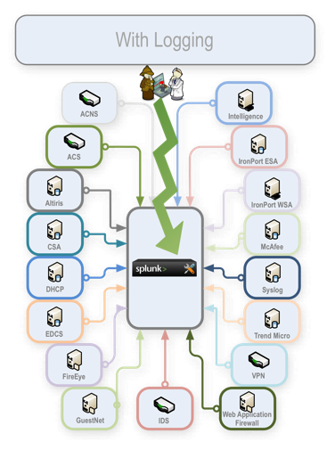
Our Phases of Data Collection
Pre-SIEM:
Manual
Low fidelity
Inefficient
With SIEM:
Quasi-centralized
Slow performance
Rigid
With Logging:
Centralized search
Responsive and intuitive
Flexible
Notes:
Pre-SIEM:
Team manually querying sources
Low fidelity availability
Inefficient search & correlation
Many different tools
Time correlation across all the different sources
With SIEM:
Some centralization
Slow performance / Rigid
With Logging:
Centralized portal for search
Responsive and intuitive
Flexible

Slide 11
Past Problems
Only key data sources
Customization expensive / infeasible
Method of access
DB only or no alternative access
Slow query & reporting
Notes:
Some logging and SIEM solutions we have used or evaluated required considerable effort to process custom formats (custom parsers, etc.)
In our experience with SIEM 1 we found it to be rigid, inflexible, and difficult to customize
Modifying how
We like the ability to throw data of virtually any format/structure at our logging system
No API/CLI
Fat java-based clients
Only direct database access or worse, no alternative access
Making scripting and automation more challenging
In the past, it wasn’t uncommon for regular reports and ad-hoc queries run against the SIEMs to take hours to complete

Slide 12
Challenges & Requirements
Large volume of contextual network data
Numerous custom event sources and types
Wide range of skill level
Hosts on the network
Notes:
Here are some examples of the scale of contextual data that we work with:
50K network devices, 130K Windows hosts, and 90K unix/linux
285 IDS variables with a total of 10K IPs/CIDR ranges
Many products we evaluated and trialed didn’t offer an automated way via API/scripting to easily/regularly update contextual data
The rigidity of other solutions Is challenging making it expensive or impossible for us to load them
We like the ability to throw data of virtually any format and structure at our logging system
Being able to put anything in, free-form is key
Field extractions at search time are great, can be updated anytime without re-parsing/indexing data
Primary CSIRT selection criteria:
scalability,
fast query
free-form
google-like and regex query
IPV6 compliance,
powerful/flexible reporting capabilities
ability to deploy fault-tolerant
Lower licensing / deployment cost
flexible ways of extracting data (api, cli, etc)
ability to add context to events

Slide 13
Event Collection Re-evaluation
Began mid-2010, completed early 2011
Evaluated, trialed, Ran PoCs:
Splunk and three other loggers
SIEM 1 and six other SIEMs
Strategy moving forward:
Retire current SIEM
Undertake global logging
Estimated: 25% of SIEM cost
Notes:
CSIRT undertook reevaluation of logging/SIEM project in mid-2010 running a number of trials and proof of concepts, wrapping up in early 2011
In CY12Q1 we retired the SIEM that had been in use since CY03
Extensive migration project to replicate all existing playbook reports from SIEM in Splunk logging has been successful.
Moved over 400 regularly scheduled reports from our SIEM into the new logging solution.
Global logging solution deployed by end of CY11
Based on sheer cost of deployment, we estimate that investment for a global logging solution was roughly 25% of what deploying a full SIEM would have cost us

Slide 14
What about Correlation?
Large volumes of traffic
Better Correlation
index="wsa" x_wbrs_threat_type="" (NOT (cs_referer="")) [search
index="csa" "attempted to initiate a connection as a client on TCP port 80 "allowed" |
rex "on TCP port 80 to (?<csa_dst_ip>\d+\.\d+\.\d+\.\d+) using" |
dedup csa_dst_ip |
rename csa_dst_ip AS s_ip |
fields s_ip]
Searches CSA for outgoing tcp/80 connections and uses those IPs to find corresponding WSA logs
Notes:
With the large volumes of events we are dealing with it is prohibitively expensive to deploy SIEM that is capable of realtime correlation against that data.
We are arguable doing better correlation via our logging tool because:
There are more of our key data sources in the logging tool then there were in the SIEM
Our emphasis is on our staff making necessary correlation versus depending on pre-built correlation rules
Better correlation due to faster search and increased number of data sources

Slide 15
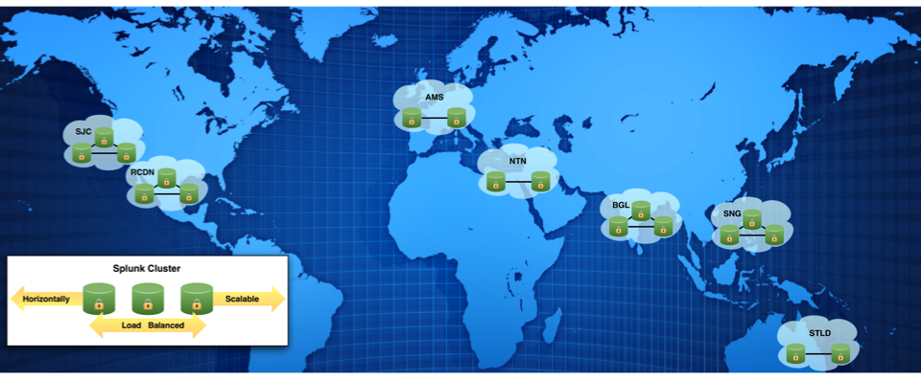
CSIRT Logging Deployment
25 indexers / 7 clusters
HA, load balanced, & scalable
Index up to 1TB/day
150TB storage
Notes:
Potential for data loss is mitigated through a round robin backup between systems, within each cluster
All data is load balanced out, allowing at least one system within the cluster to be unavailable without interruption of data collection
Can easily add more indexing capacity by adding more systems.
Retention can be increased by:
Adding systems
Addition storage
Rolling data out of the system to an archive
Current retention target: 1-3 years depending on source
Auth sources (3 years)
Large sources (1 year)

Slide 16
Results
Number of Queries by User
Notes:
Over 90% 0f the team is using the tool (where as before we primarily had analysts running reports)
It is a great fit for the brand new analyst all the way up to the most seasoned investigators
Much higher percentage than SIEM 1 (which required logging in via a fat client or using direct DB access)
With our revamped event collection deployment we are:
Indexing over 35x the volume of data we were previously
Querying on average 20x faster
Long Queries:
With SIEM 1: 2% over 1 hour
With Splunk: <0.5% over 1 hour

Slide 17
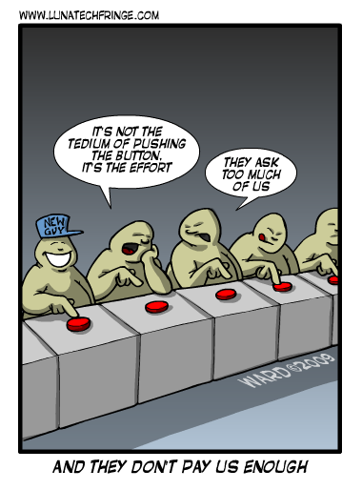
Highly trained staff
They are the difference
Empower them with data
Notes:
We’ve found that having an intuitive logging solution with highly trained, intelligent staff is more valuable than having staff relying on a SIEM spitting out alerts
We currently rely on a very large playbook of reports, and it is a constantly evolving process, where we add/remove reports for the latest zero-day, malware, and other threats
We have empowered our analyst, APT, and investigator teams
Put the data at their command and available via web UI, API, and CLI

Slide 18
Mac Flashback Example
Variant 1:
index=wsa Windows NT 6.1 WOW64 rv\:9.0.1 Gecko\/20100101 |
regex cs_useragent="id:([A-Za-z0-9]){8}\-([A-Za-z0-9]){4}\-([A-Za-z0-9]){4}\-([A-Za-z0-9]){4}\-([A-Za-z0-9]){12}”
Variant 2 & 3:
index=wsa (auupdate OR scheck OR owncheck) AND (cs_url="*/scheck/*" OR cs_url="*/auupdate/*" OR cs_url="*/owncheck/*") |
regex cs_useragent="(^[MN][Djz][BFJNRVZdhl][8][a][T][M][4][N][n])|(^[MNOQR][0DETUjkz][ABEFIJMNQRUVYZcdghkl][012345BCDEFGwxyz][MNOQR][0DETUjkz][ABEFIJMNQRUVYZcdghkl][012345BCDEFGwxyz][MNOQR][0DETUjkz][AEIMQUYcgk][t][MNOQR][0DETUjkz][ABEFIJMNQRUVYZcdghkl][012345BCDEFGwxyz][MNOQR][CSiy][01][012345BCDEFGwxyz][MNOQR][0DETUjkz][ABEFIJMNQRUVYZcdghkl][012345BCDEFGwxyz][L][TU][ABEFIJMNQRUVYZcdghkl][012345BCDEFGwxyz][MNOQR][0DETUjkz][AEIMQUYcgk][t][MNOQR][0DETUjkz][ABEFIJMNQRUVYZcdghkl][012345BCDEFGwxyz][MNOQR][0DETUjkz][ABEFIJMNQRUVYZcdghkl][012345BCDEFGwxyz][MNOQR][0DETUjkz][ABEFIJMNQRUVYZcdghkl][012345BCDEFGwxyz][MNOQR][0DETUjkz][ABEFIJMNQRUVYZcdghkl][012345BCDEFGwxyz])"
18
Notes:
There is a baseline benefit we get from having the tool deployed.
Real benefit comes from harvesting the logs doing reporting and analysis
We initially found 112 infected systems in WSA logs using custom regex
Then proactively blocked traffic in the web proxy based on the characteristics discovered during investigation

Slide 19
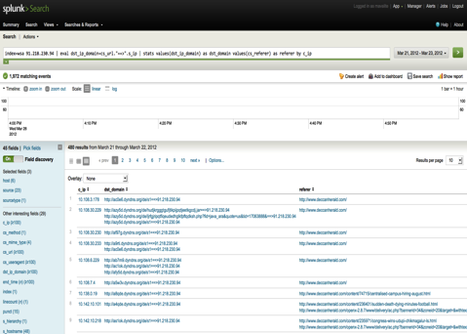
Deccan Herald Hosts Malicious Ad
Redirect to 91.218.230.94
Site serves malicious .jar file
Notes:
Manual investigation into FireEye event logs showed source hosts which downloaded Zeus all at one point visited Deccan Herald.
Deccanherald linkd to 91.218.230.94 which delivered a malicious .jar exploiting a java vulnerability
Jar file not detected by Cisco AV vendor as malicious
Just using the tool we would have been alerted to the 68 potentially infected hosts.
But it was the initiative and efforts of the team that resulted in:
Examining packet captures
Performing malware analysis
Blackholing the related hosts serving the malware
Feeding intelligence back into custom IDS signatures
Notifying the Newspaper, and them resolving the issue.
Days after CSIRT completed this effort news stories were released on this style of attack

Slide 20
Image © 1990 Orion Pictures Corporation
Image © 1990 Orion Pictures Corporation
Image © 1990 Orion Pictures Corporation
Notes:
An idea / revelation - . Automated security tools won't ask the right questions for you.
The cyber problem isn’t really all that complex
Rigorously protect your important stuff – ensure for the important stuff you have good attribution
Have people (not magic boxes) checking the efficacy of all that

Slide 21
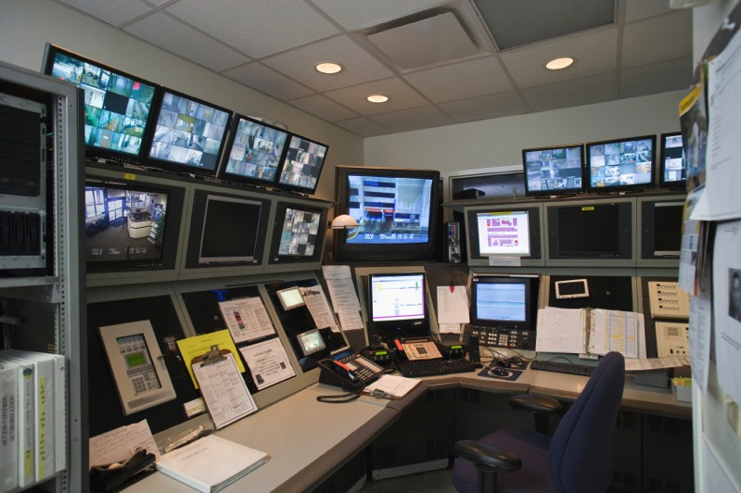
Image © 1990 Orion Pictures Corporation
Image © 1990 Orion Pictures Corporation
Image © 1990 Orion Pictures Corporation
Notes:
Don't get me wrong. A network that has been protected only by automated security products is a lot better off than it would be with nothing at all.
Left to their own devices, most automated security tools will find many of the basic attacks.
The problem is that these are simple attacks that no smart hacker would ever use.
Recap
Problem isn’t really that complex (verizon just released that 97% of the reported cyber-attacks could have been thwarted with easy controls)
Understand where automation ends and people begin – look for tools that extend your teams reach – not to replace them!
Use automation to fight automatic attacks – use people to protect against attacks from sentient human beings
Look into rugged software – use defendable architecture & software for important to protect things
Thank you
http://www.istockphoto.com/stock-photo-18233765-empty-security-control-room-with-monitors.php?st=609cd7d

Slide 22
Feedback from our Analysts
“[It] does not crash when we run big reports”
“The speed of [our logging] … has speed up our procedures … allowing us to spend more time on analysis”
“[It] is faster, we don’t need to wait 2 or 3 hours for a report”
“All data sources in a single box. That makes data correlation very easy”

