Slide 1
Combatting APT with NetFlow
Christopher Smithee
Lancope

Slide 2

2011: The Year of Escalation
Verizon dataset 2004-2009: 904 breaches
Verizon dataset 2011: 800 breaches

Slide 3



APT – The Culmination of the New Arms Race
Welcome to the Cyberspace Arms Race

Slide 4
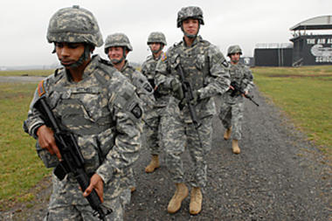
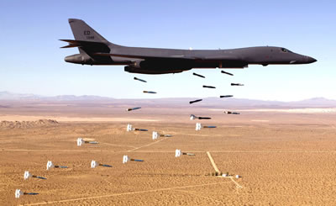
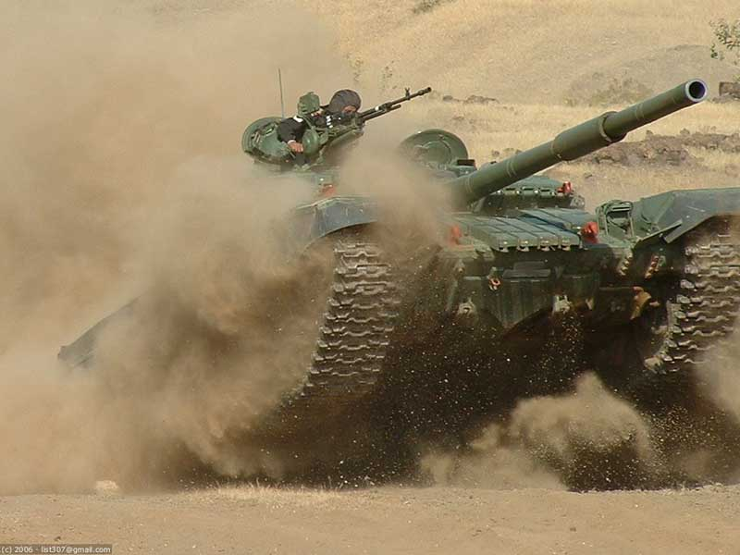
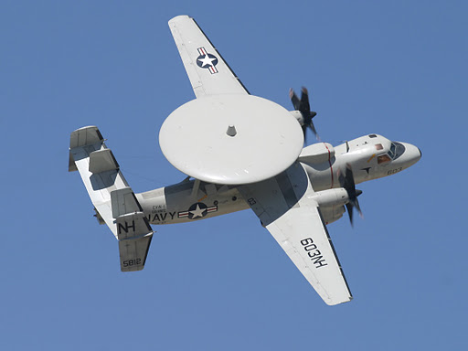
Advanced Persistent Threat is Modern Warfare
These aren’t the countermeasures you are looking for…

Slide 5
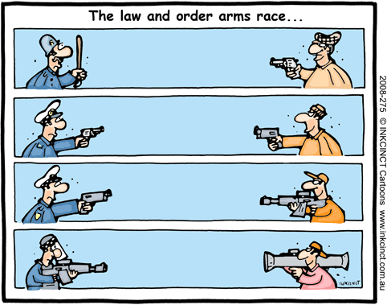
What Happens in a Conventional Arms Race?

Slide 6
Attack Evolution
Viruses (1990s)
Anti-Virus, Firewalls
Worms (2000s)
Intrusion Detection & Prevention
Botnets (late 2000s to current)
DLP, Application-aware Firewalls, SIM
Directed Attacks (APT)
?????

Slide 7
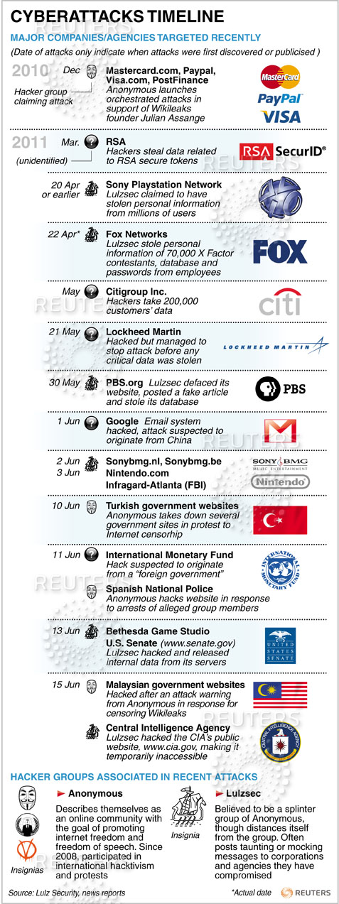
A Small Portion of the Attacks
2012

Slide 8

Art of War
"If ignorant both of your enemy and yourself, you are certain to be in peril.” – Sun Tzu

Slide 9
Motivations and Movements
Governments and State Entities (Stuxnet, Operation Aurora)
Political, Religious, and Patriotism (Hacker collectives such as Anonymous, LulzSec)
Anti-sec Movement (RSA, Stratfor, Symantec, HB Gary Federal)
Organized Crime (monetary) (record setting in holiday season of 2011)
Notoriety Hounds (copy cat attacks, Generation Y)

Slide 10
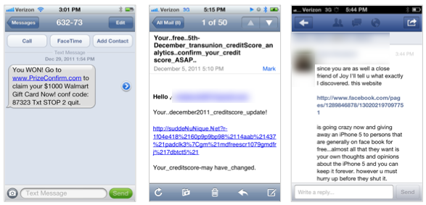
Users – Multiple Attack vectors

Slide 11
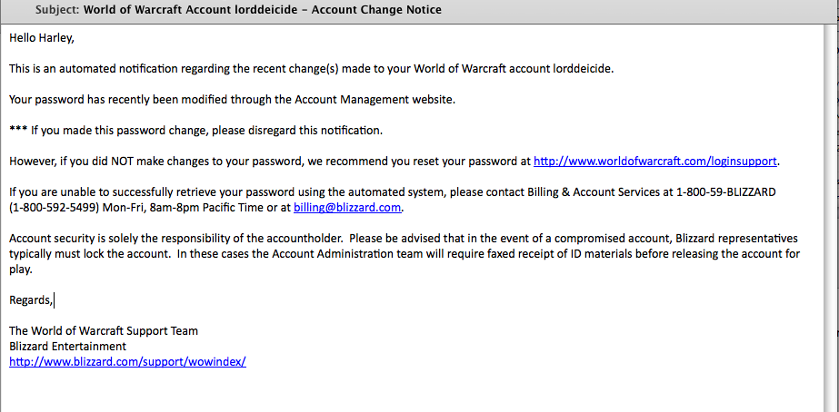
Well crafted

Slide 12
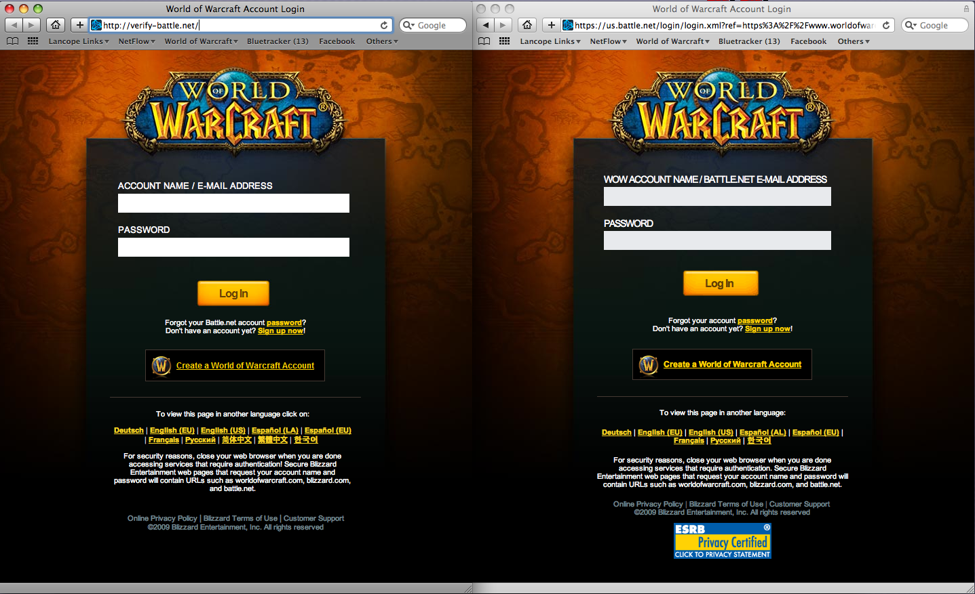

Slide 13




The Environment - Once upon a time
Internet
VPN
DMZ
Internal Network

Slide 14


The Mobile Computing Era
Internet
VPN
DMZ
Internal Network

Slide 15



And now BYOD or IT Consumerization
Internet
VPN
DMZ
3G Internet
Internal Network
4G Internet
3G Internet

Slide 16
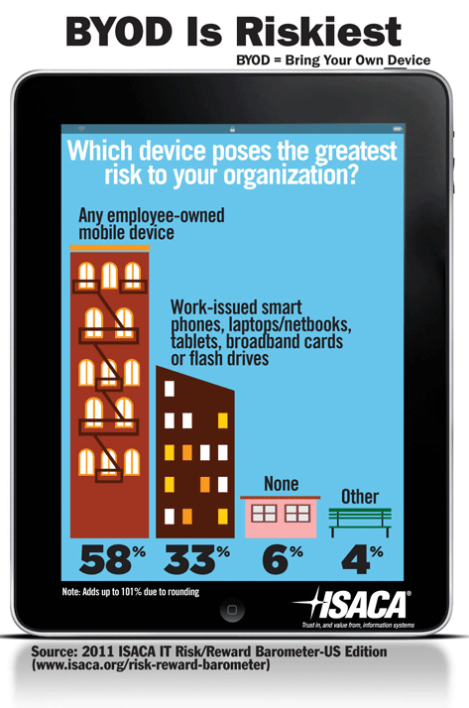
BYOD is Riskiest
Difficult to find common AV or host based IDS spanning platforms
Reliant on employees to install them
Cisco says 70 percent of young workers ignore IT rules.
http://newsroom.cisco.com/press-release-content?type=webcontent&articleId=586267
Over half of all IT leaders in the U.S. say that employee-owned mobile devices pose a greater risk to the enterprise than mobile devices supplied by the company.

Slide 17
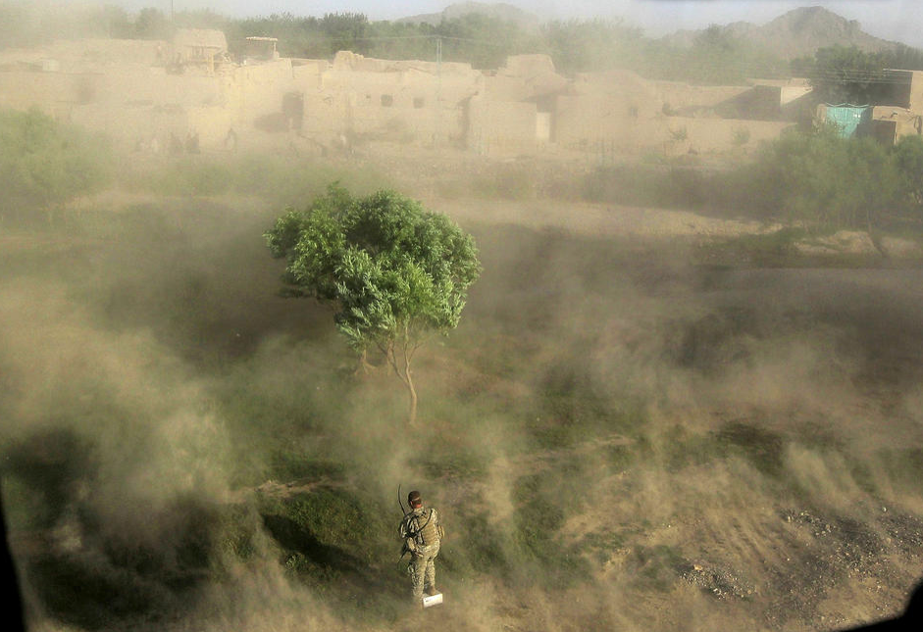
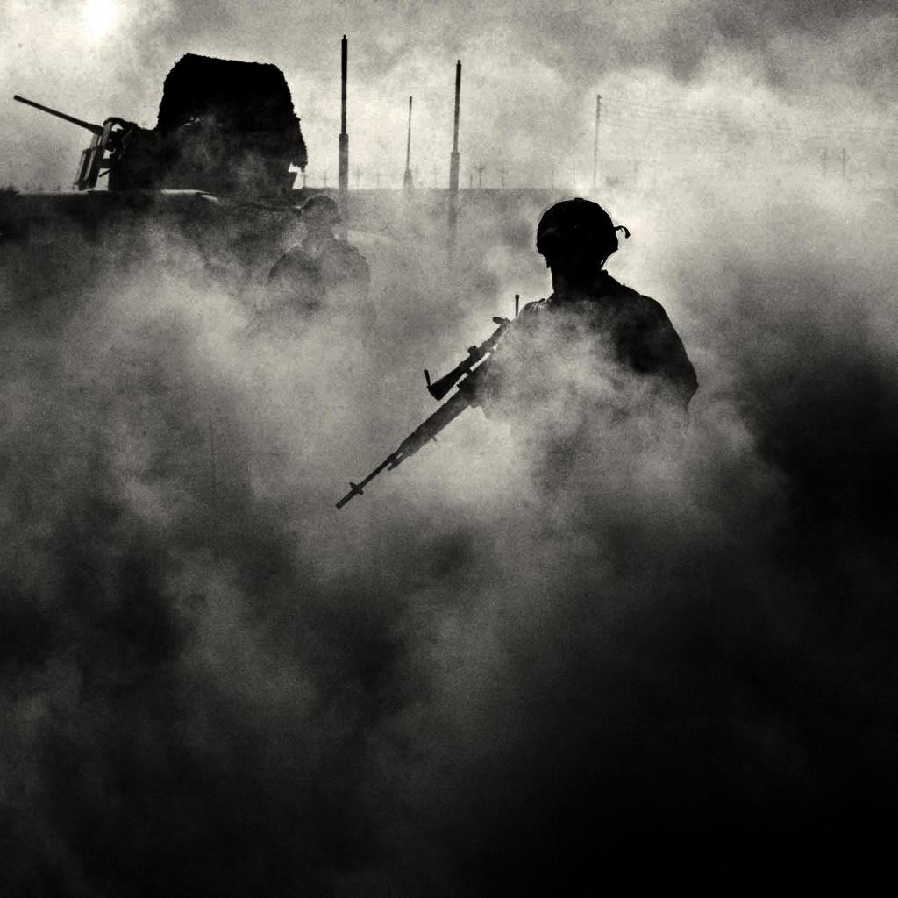
The Fog of War
uncertainty in situational awareness experienced by participants in military operations

Slide 18
Inability to adapt is dangerous
"The opportunity to secure ourselves against defeat lies in our own hands, but the opportunity of defeating the enemy is provided by the enemy himself.” – Sun Tzu

Slide 19
APT Survey by Ponemon Institute, June 2010
“Prevention and detection of advanced threats is difficult. Organizations risk a costly data breach because detection of an advanced threat takes too long. 80 percent of respondents say it takes a day or longer to detect an advanced threat and 46 percent say it takes 30 days or longer. This leaves a huge window of opportunity to steal confidential or sensitive information. In addition, 79 percent believe that advanced threats are very difficult to prevent, detect and resolve.”
“The most effective technologies have yet to be deployed. 92 percent of respondents believe network and traffic intelligence solutions are essential, very important or important. Yet, only 8 percent say these technologies are their first choice to detect or prevent an advanced threat. 69 percent of respondents say that AV and 61 percent of respondents say that IDS are typically used to detect or discover advanced threats. Yet, 90 percent report that exploits or malware have either evaded their IDS systems or they are unsure. 91 percent say that exploits and malware have evaded their AV systems or they are unsure. The same percentage (91 percent) believes exploits bypassing their IDS and AV systems to be advanced threats.”

Slide 20
APT Survey by Ponemon Institute, June 2010 (cont.)
80 percent of respondents say it takes a day or longer to detect an advanced threat and 46 percent say it takes 30 days or longer.
The most effective technologies have yet to be deployed.
69 percent of respondents say that AV and 61 percent of respondents say that IDS are typically used to detect or discover advanced threats.
90 percent report that exploits or malware have either evaded their IDS systems or they are unsure.
91 percent say that exploits and malware have evaded their AV systems or they are unsure.
The same percentage (91 percent) believe[s] exploits bypassing their IDS and AV systems to be advanced threats.”
92 percent of respondents believe network and traffic intelligence solutions are essential, very important or important.
Only 8 percent say these technologies are their first choice to detect or prevent an advanced threat.

Slide 21
NetFlow Analysis
Low cost monitoring solution
Uses outputs from existing infrastrucute
Singe or small number of regional collectors support an infrastructure
No agents
Easy to configure
Enabled on the devices
No hardware to insert
Present throughout the network
Routers
Switches
Firewalls
etc…
Accounting data stores well
Fractions of a percentage of storage needed for Packet Capture
Common format means its easy to write to tables for analysis

Slide 22



Internal Visibility Through NetFlow
NetFlow Packets
src and dst ip
src and dst port
start time
end time
mac address
byte count
- more -
Internet
VPN
NetFlow
NetFlow
NetFlow
DMZ
NetFlow
3G Internet
Internal Network
NetFlow
NetFlow Collector
3G Internet

Slide 23
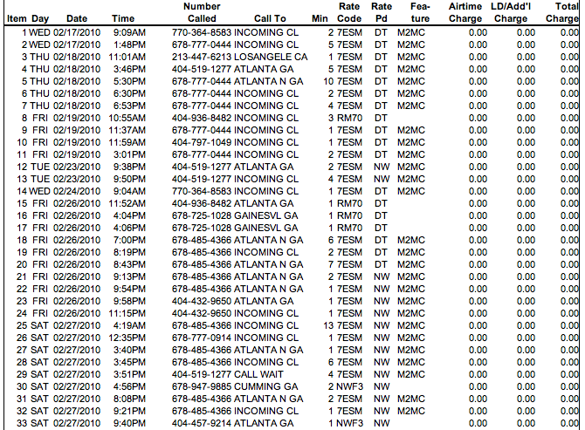
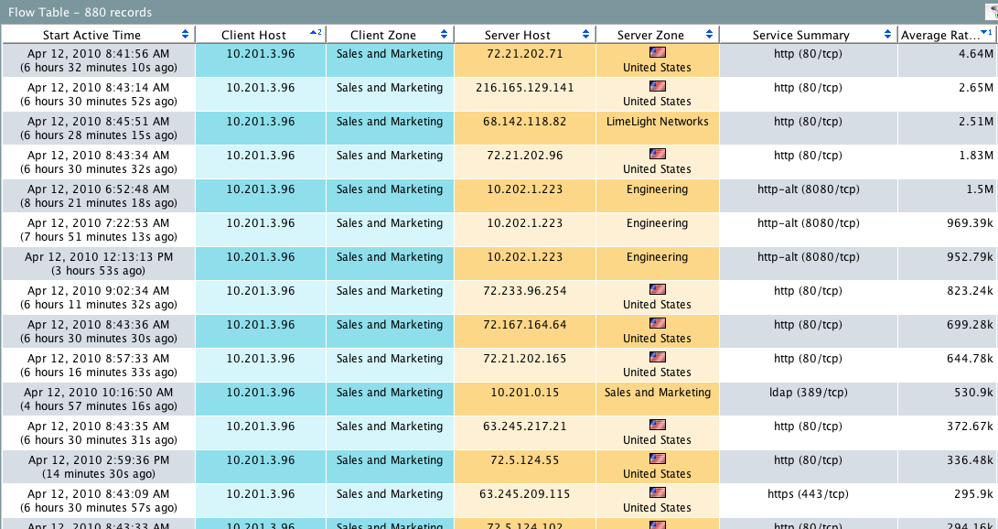
Transactional Audits of ALL activities

Slide 24
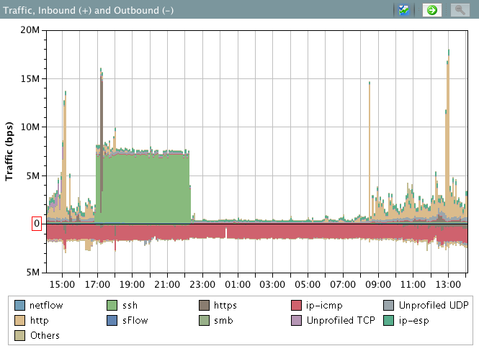
Incident Investigation Using Flows
5 hour 6 Mbps ssh connection?

Slide 25
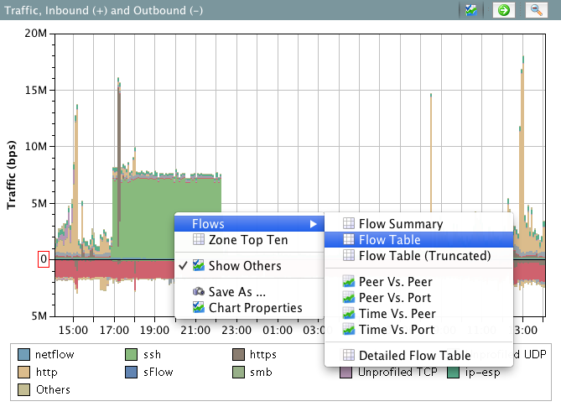
Incident Investigation Using Flows
?

Slide 26
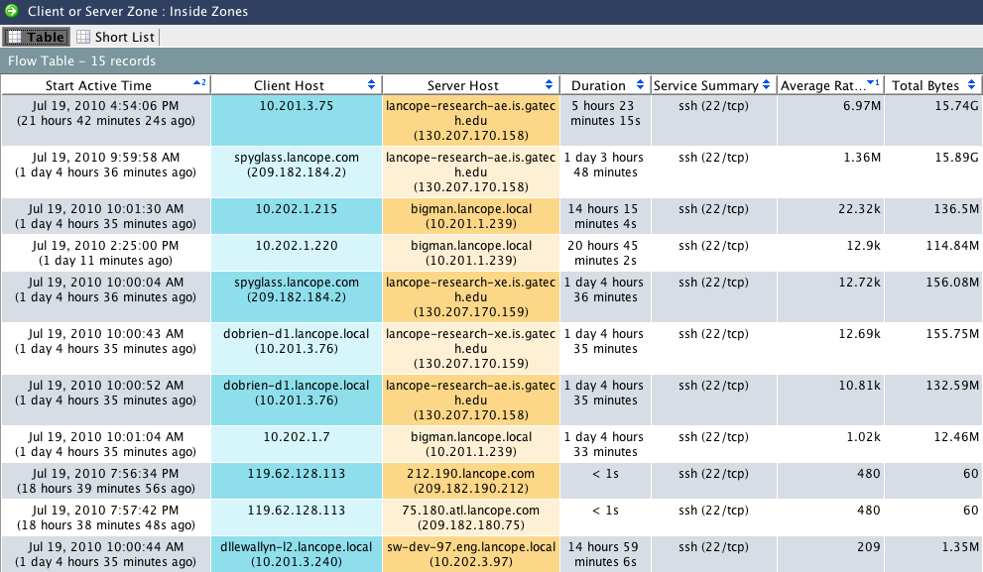
Incident Investigation Using Flows

Slide 27
APT characteristics for the investigator
An APT will generally involve:
Information gathering via social media and Google search. It is via this that the targets for the social engineering phase are identified.
Exploit of common vulnerabilities in support of the above.
Targeted social engineering attacks against identified users.
Compromise of one or more internal machines and installation of remote control software of some kind.
Data mining from the inside.
Exfiltration of data.
Network-based APT detection boils down to discovering the command-and-control connections, the data mining/data reconnaissance, and the exfiltration activity. As with all attacks, success is measured by the time lapsed between attack and discovery.

Slide 28
Command and Control
Remote Control:
Are My Hosts Controlled by External Systems?

Slide 29
Command and Control - Host Becomes Infected
Internal host connects to a malware infected website
Downloads data infecting the system
Method of detection
Host Lock to known bad list

Slide 30
Communication to CNC
Host communicates with Command and Control network for instructions
Periodic phone home
Method of detection
Host Lock to known bad list
Suspect Long Flow and Beaconing Host alarms

Slide 31
Controlled Host Begins Network Activities
Compromised host performs malicious activities
Attempts to compromise internal resources (probing)
Becomes a member of DDoS
Data exfiltration to Internet
Method of detection
Scanning detection (CI)
DoS Monitoring
Suspect Data Loss

Slide 32
Reconnaissance Detection
Reconnaissance/Scan Detection:
Are Hosts Trying to Find Resources to Compromise?

Slide 33
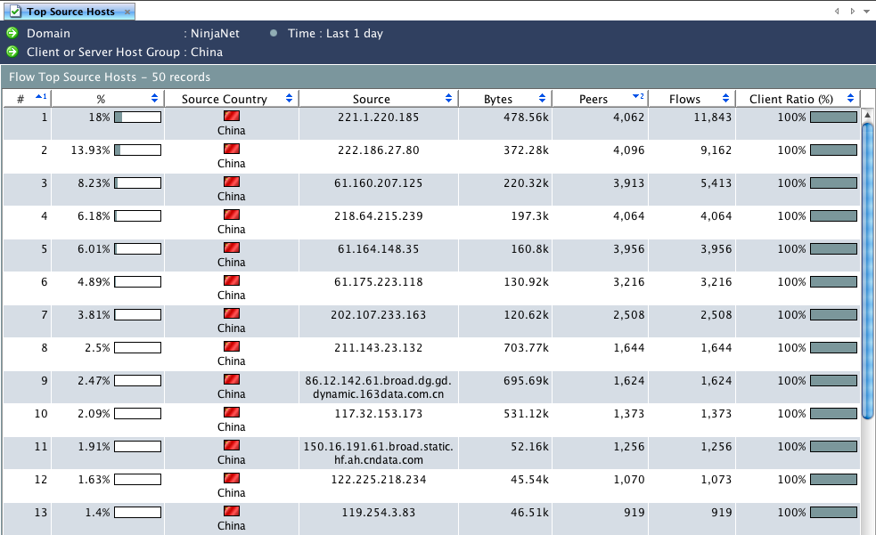
Traffic Analysis and Network Visibility
Top N reports showing any time period across any Host Group

Slide 34
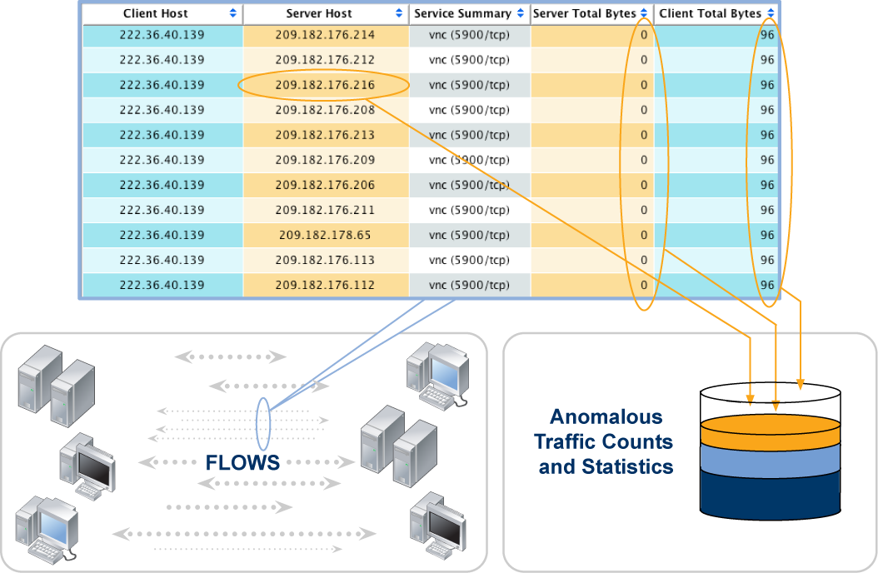
Flow-based Anomaly Detection

Slide 35
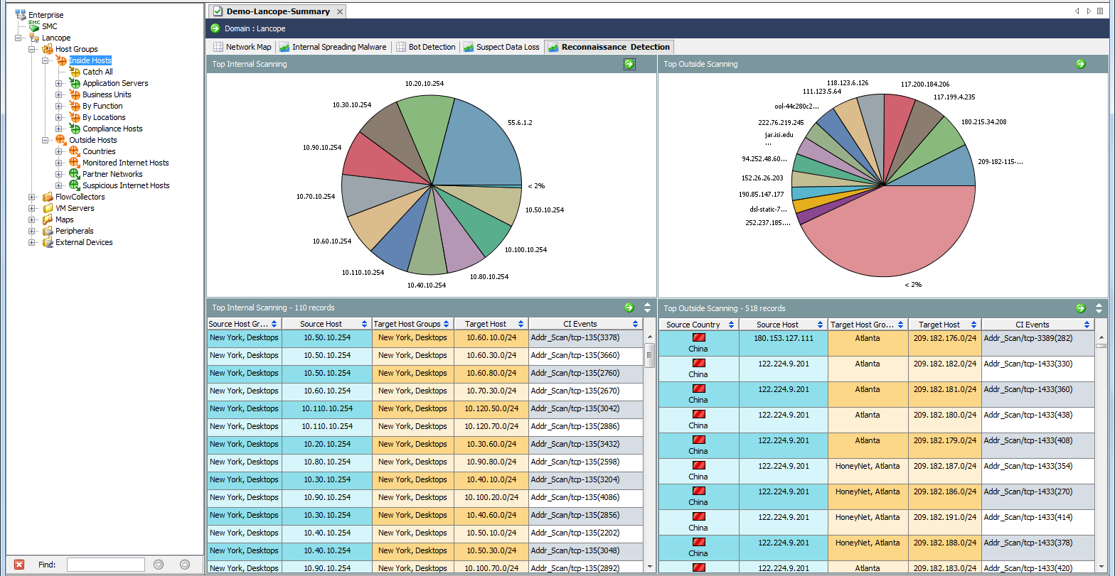
Scan Detection Visualized

Slide 36
Data Loss
Suspicious Data Loss Detection:
Is the Organization Losing Sensitive Information?

Slide 37
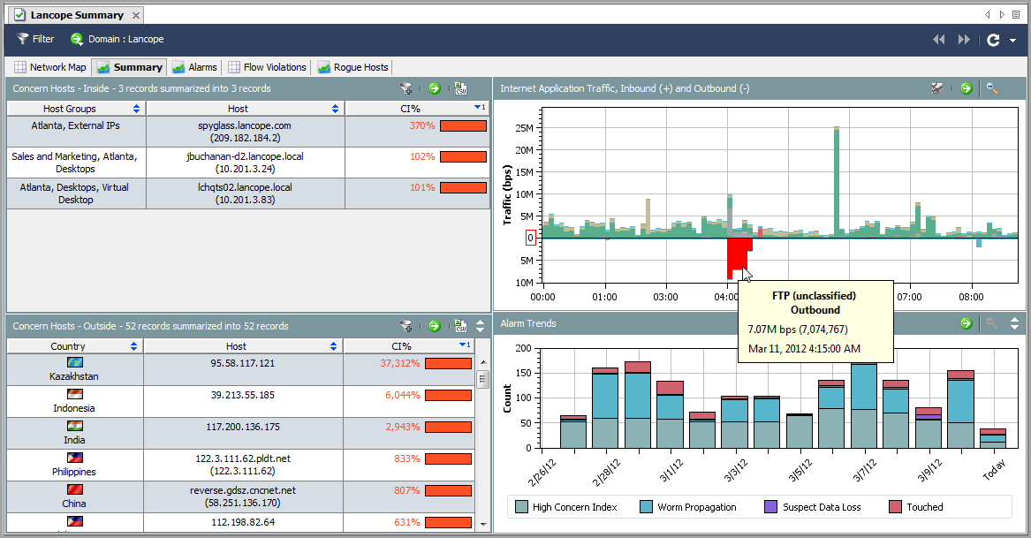
Manual Data Loss Detection

Slide 38
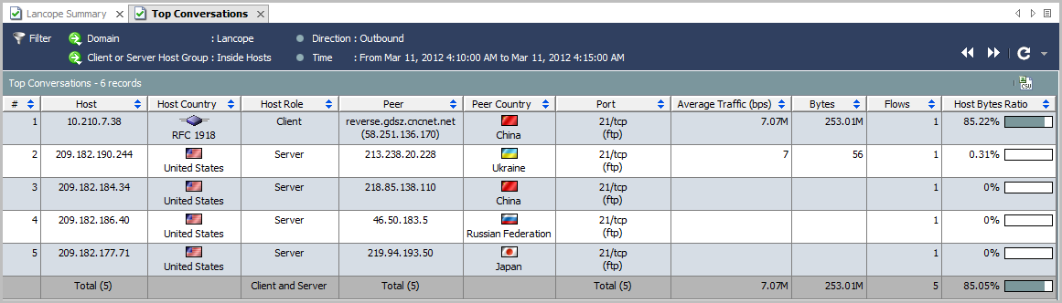
Manual Data Loss Detection - Drill Down
Notes:
This will bring up Top Conversations for the time of the traffic spike. Reference the suspect internal host, when the Internet system received the data, what port was used, and how much data was sent.

Slide 39
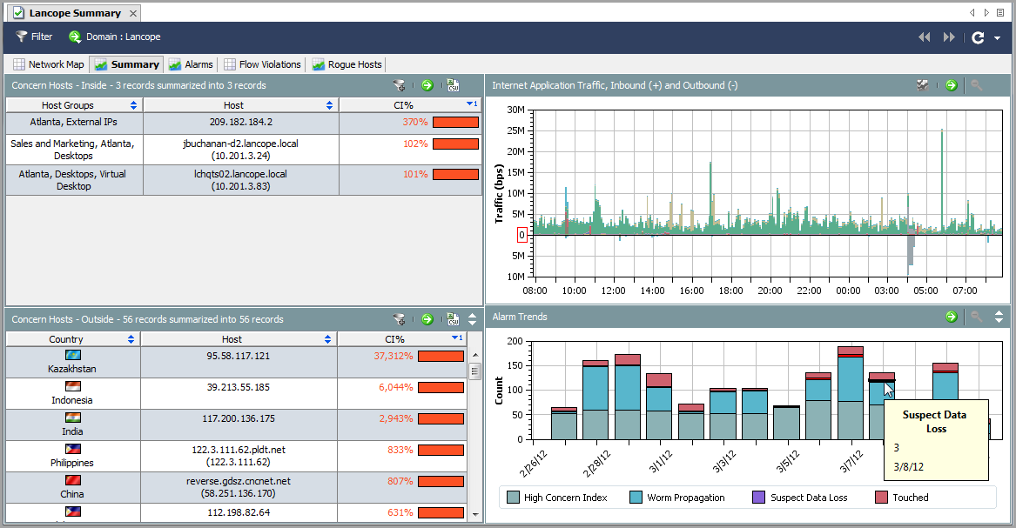
Automated Data Loss Detection

Slide 40
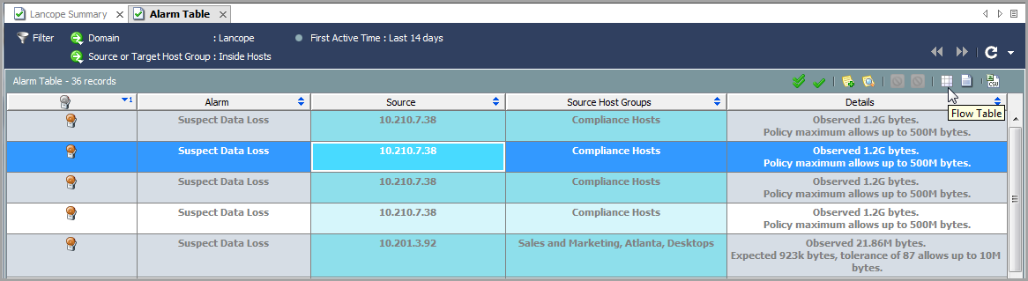
Automated Data Loss Detection (cont.)
Notes:
The associated Alarm Table for the Suspect Data Loss alarms will illustrate when the alarms triggered, which host was uploading data, what group the host was a member of (Compliance Hosts above), and how much data was uploaded.
Simply click the associated flows button to view details of where the traffic went.

Slide 41
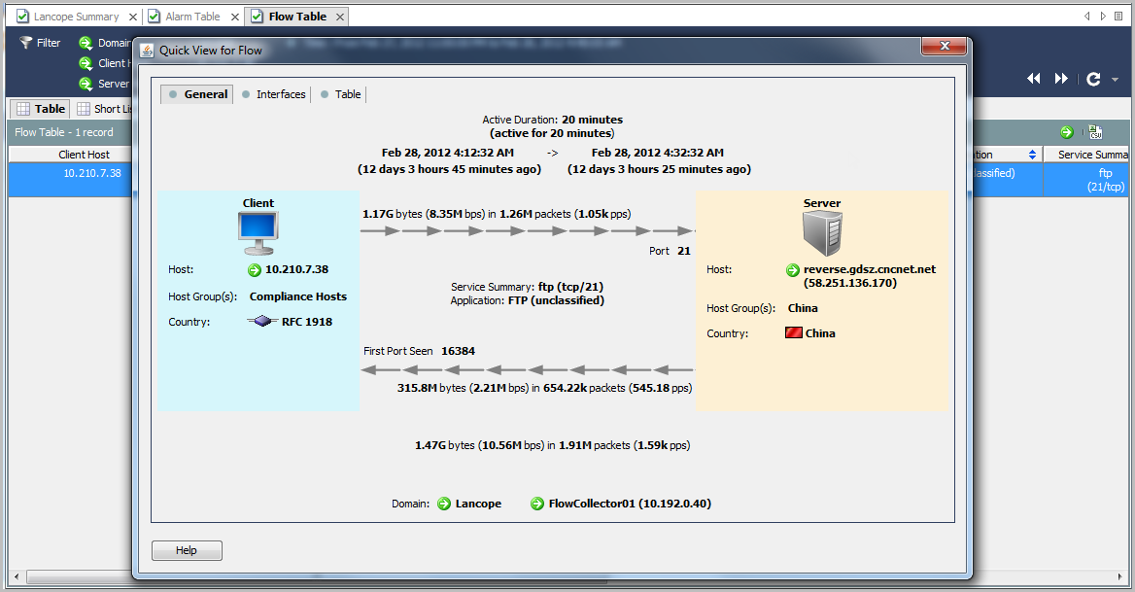
Automated Data Loss Detection - Drill Downs
Notes:
Viewing the Quick View for the associated flows illustrates all details on where the traffic went, how much was transferred, and what path was taken through the network.

Slide 42
The Power of Flow
Flow based Analytics provide new ways to look for:
Covert Channels and Remote Controlled Hosts
Data Reconnaissance
Data Exfiltration
Flow data provides a full accounting for all network traffic
Device agnostic – Understanding device types can help flow tools provide better context, but the data works for any system that uses IP to communicate
No agents to be installed to understand host behavior or posture assessment

Slide 43

How can we make Flow Analysis Even Better?
Cross correlating this data with Directory stores and/or NAC solutions increases value by providing context
While many times the users won’t be aware their machines are used to enact the compromise, IRTs need to be able to quickly correlate this data to mitigate risks.
Accomplished through portals, SIEM integrations or directly in the flow analysis tools themselves.
Click throughs to reduce workflow are optimal

Slide 44
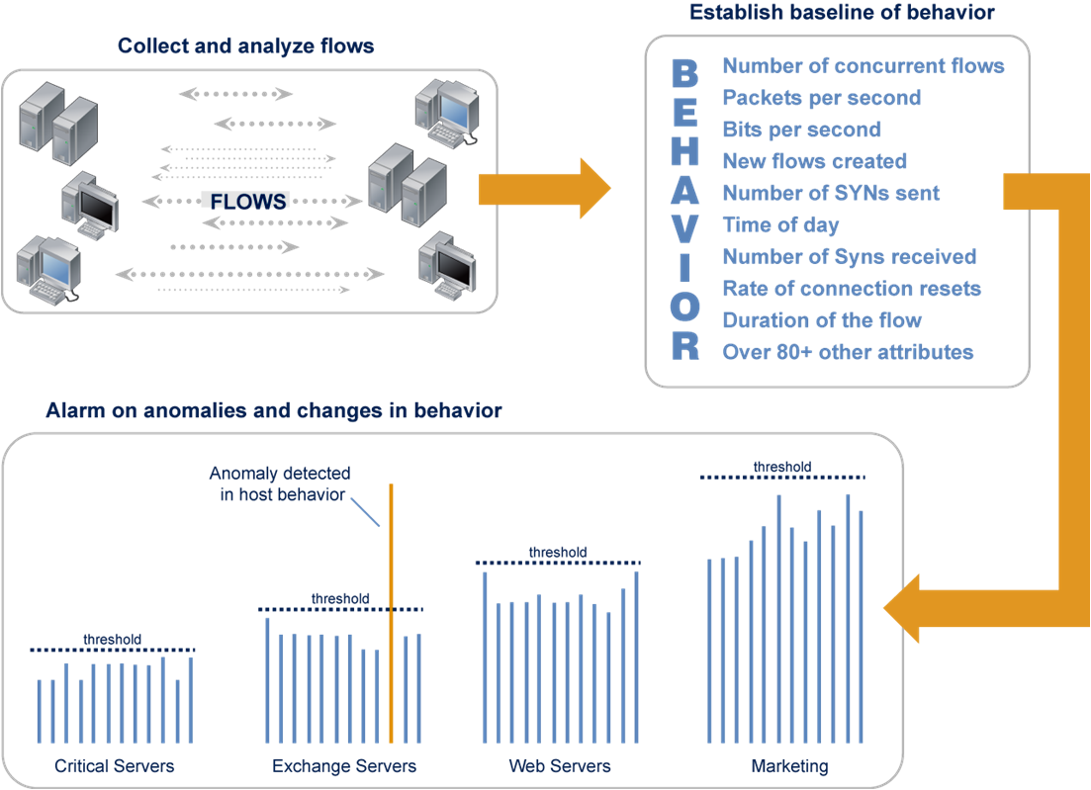
Behavioral Analysis and Host Profiling
Host and host group baselining

