Slide 1
Security Ops, Engineering, and Intelligence Integration through the power of Graph(DB)!
Christopher Clark - Director, Cyber Security Intelligence
cclark@verisign.com

Slide 2
Talk Overview
*WARNING: This talk will use Neo4j for simplicity
Introduction to Graph Databases
Normalization of Inputs ((NODES) and -[RELATIONSHIPS]->)
Deducing Maliciousness from -[RELATIONSHIPS]->
And Then, And Then, And … (Forever Extensible!)
Let’s Ask Questions! (of the Graph..A/K/A: Use Cases!)
Tools of The Trade

Slide 3
Introduction to Graph Databases
“Graph Databases are a way of storing data in the form of nodes, edges and relationships which provide index-free adjacency. “
DATA = NODES
(NODES) are Fully Featured JSON Objects, Indexable to ensure uniqueness
These are the population of your Graph Nation
If it is an immutable thing, if you can anthropomorphize it, it should be a (NODE)(Computer, Email, Hash, Service Ticket, IDS Rule, Domain, Threat Actor)
JOINS = EDGES
Every (NODE) must connect to at least one more… as must we all, else why exist?
Individual –EDGES-> are directional: (Chris)-->(You) or (You)-->(Chris)
EDGES + CONTEXT = RELATIONSHIPS
-[:RELATIONSHIPS]-> are Fully Featured JSON Objects!
-[:RELATIONSHIPS]-> give context to the connections between (NODES)
If it is an action or you can’t imagine holding it, it should be a -[:RELATIONSHIP]->
(Chris) -[:TALKS]->(You) , but are (You)-[:LISTEN]->(Chris) ?
RELATIONSHIPS + NODES = INFORMATION!
Notes:
Graph databases find their usage when data to be stored is associative, meaning when the relationship between two data blocks matters a lot. Relational databases (tabular form) are not that good when a relationship exists between two data blocks, especially if it's the relationship that's more important than the actual data blocks. Graph databases are a very intuitive and expressive way to describe any form of data – as if we're writing something on whiteboards. They let you represent related data as it is – as a set of objects connected by a set of relationships each with its own set of descriptive properties.

Slide 4
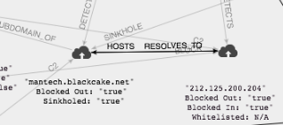
Normalization of Inputs
Security data is the perfect application of a graph database, as we must construct a digital world which properly resembles our schemaless physical one. –[:RELATIONSHIPS]-> are as important as (NODES) in Cyber space.
mantech.blackcake.net {Blocked out: “true”, Sinkholed: “true Whitelisted: “false”}
-[:RESOLVES]-> {time:20131010}
<-[:HOSTS]- {time:20131010}
212.215.200.204 {Blocked out: “true”, Blocked in: “true Whitelisted: “false”}

Slide 5
Deducing Maliciousness Through -[:RELATIONSHIPS]->
To effectively leverage the graph, let it paint the threat picture for you. One (NODE) at a time.
A domain is just a domain, only by its -[:RELATIONSHIPS]-> can it be deemed malicious
Mantech.blac…{Blocked out: “true”,…
-[:RESOLVES]-> {time:20131010}
<-[:HOSTS]- {time:20131010}
212.125…{Blocked out: “true”, …
03557...f18 {"filename":"dropped.exe”…
-[:C2]-> {port:443}

Slide 6
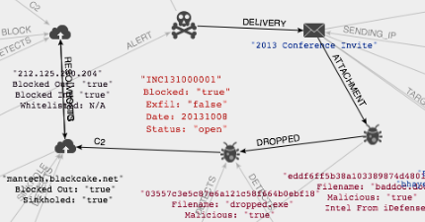
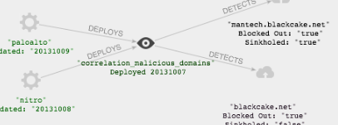
And Then, And Then… (Forever Extensible!)
As a Graph lacks a formal schema and closely maps to the real world,
we can extend our model nearly infinitely.
Add in (Incidents) and (Threat Intelligence Products):
Track (Signatures) and (Security Tools)

Slide 7
And Then, And Then, And Then… (Forever Extensible!)
Let’s add in (Users) , (Machines) , (Organizations) , and (Offices):
And of course we need to reach out to external resources like the iDefense (intelGraph)

Slide 8
Let’s ask questions?! (Of the Graph)
How do we talk to the graph? “Graph-centric databases emphasize navigation.”
Forget SQL and the need to know where everything lives (or data replication) Graph is queried by matching patterns, and then traversing to the destination.
Forget MongoDB & Maltego Application layer joins Graph is not a temporal construct, the data is consistently arranged logically
Simply tell the Graph what you want to find, not where it is Even unknown distance recursive searches are near instantaneous.
Profit! Lets identify the victims of a Phishing attack.
MATCH (a)-[:TARGET]->(b)
RETURN a.subject, b.email

Slide 9
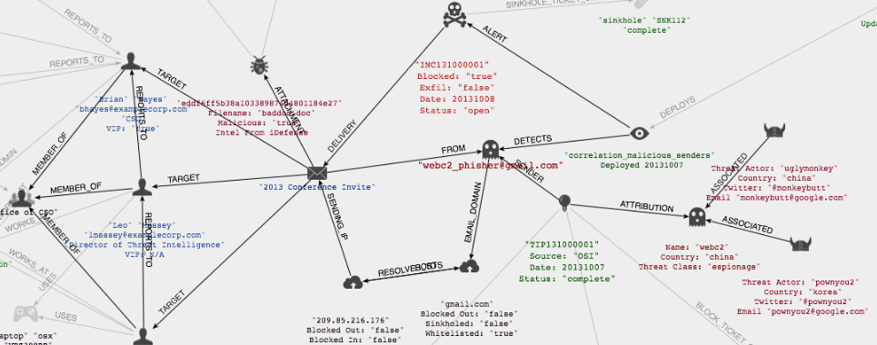
Let’s ask more questions?! (Of the Graph)
Now we will do a variable length path recursive search (*scary!*) to see which of our (Users) a (Threat_Group) has been targeted, their titles, and (Department)
MATCH (a)-[:ATTRIBUTION]-()-[*1..4]->()-[:TARGET]->(b)-[:MEMBER_OF]->(c)
RETURN a.threat_group, b.first_name, b.title, c.department
We just traversed ALL of this! Just by asking a simple question!

Slide 10
Let’s ask even more questions?! (Of the Graph)
If you already know where you wish to start, it’s even easier. Let’s find out what our (correlation_malicious_ips) IDS rule alerts for and when it was last updated.
MATCH (a)-[:DETECTS]->(b)
WHERE a.signature="correlation_malicious_ips"
RETURN a.date, b.ip, b.asn, b.blocked_out
BONUS: Tell me what this little modification will do?
MATCH (a)-[:DETECTS]->(b)<-[*1..5]-()-[:ATTRIBUTION]->(c)
WHERE a.signature="correlation_malicious_ips"
RETURN c.threat_group, a.date, b.ip, b.asn
SWEET, SWEET, CONTEXT AND ORGANIC ATTRIBUTION!

Slide 11
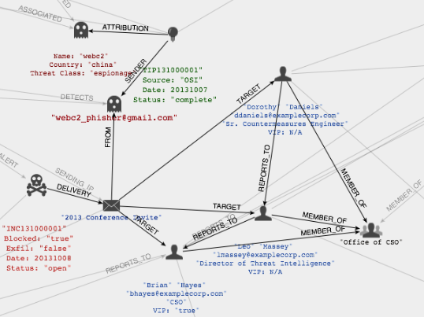
Use Case: Unknown Distance Queries!
Has WebC2 targeted the CSOs office lately? LETS ASK!
Start with (WebC2)
Scan All Paths out from (WebC2) for -[:TARGET{date:2013*}]->
Then tell us if the recipient is a -[:MEMBER_OF]-> (Office of CSO)
Return the COUNT of attacks, date, and names of recipients for each.
WebC2 has Targeted the OCSO once in 2013 Attack Date: 10-08-2013
Targets:
Brian Hayes (VIP) Leo Massey Dorothy Daniels

Slide 12
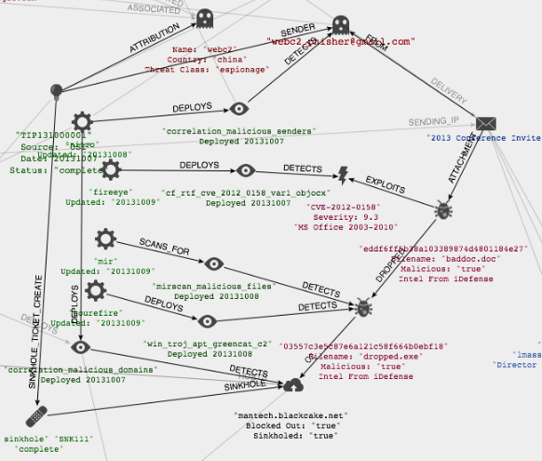
Use Case: Targeted Countermeasures
Do we have Countermeasures in place for this Campaign? LETS ASK!
Start with our previous results and query.
Find each related (IOC) <-[:DETECTS]- (Countermeasure)
Find undetected (IOC)
Return a list of each: (IOC) (Countermeasure) it’s {deploy_date} (Toolset)

Slide 13
Use Case: Targeted Countermeasures Cont.
Countermeasure Gap Analysis for WebC2 Campaign Targeting OCSO
Indicator Type | Countermeasure | Deploy Date | Toolset
Phish Sender | correlation_malicious_senders | 10-07-2013 | Nitro SIEM
Phish Subject
Attachment File | cf_rtf_cve_2012_0158_var1_objocx | 10-07-2013 | FireEye
Attachment Hash
Exploit | cf_rtf_cve_2012_0158_var1_objocx | 10-07-2013 | FireEye
Dropped Hash | mirscan_malicious_files | 10-08-2013 | MIR
Dropped File | win_troj_apt_greencat_c2 | 10-08-2013 | SourceFire
C2 IP | correlation_malicious_ips | 10-07-2013 | Nitro SIEM
C2 Domain | correlation_malicious_domains | 10-07-2013 | Nitro SIEM
C2 SubDomain | APT DNS Sinkhole (Ticket SNK111) | 10-08-2013 | Sinkhole
C2 SubDomain | correlation_malicious_domains | 10-08-2013 | Nitro SIEM

Slide 14
Resources
http://www.slideshare.net/jexp/intro-to-graphs-and-neo4j
http://www.neo4j.org/learn/cypher
http://docs.neo4j.org/refcard/2.0/
http://docs.neo4j.org/chunked/milestone/cypher-query-lang.html
http://thinkaurelius.github.io/titan/
http://www.odbms.org/blog/2013/04/graphs-vs-sql-interview-with-michael-blaha/
Security Graph DB Test Code (Neo4j / Py2Neo): http://github.com/Xen0ph0n/Security_Graph_Demo

