Slide 1
Network security analytics today
Aubrey Merchant-dest
Director, Security Strategies – OCTO
aubrey.merchant@bluecoat.com
June, 2014

Slide 2
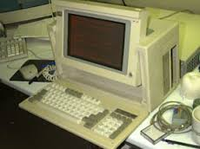
Brief history of network ‘analysis’
In the beginning…
  Sniffers
    Troubleshooting network issues
        Protocol specific decoding
    Mostly used by service providers
  SNMP
    Capacity Planning
    Ensuring business continuity
    QOS for service level support
    Little traffic characterization
    No granular understanding of network bandwidth
This is how we did troubleshooting back in the day…
Limited analysis capabilities
  Frame or packet-level decode

Slide 3
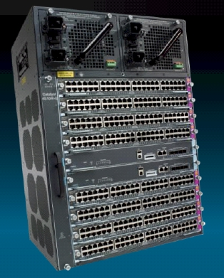
netflow
NetFlow v4 & v5
  Developed by Cisco
    ASIC based
    Catalyst Operating System
  Answered useful questions
    What, when, where and how much (flows)
  Became primary network ‘accounting’ and anomaly-detection tool
Addressed the following:
  Network utilization
  QOS/COS Validation
  Host communications
  Traffic anomaly detection via threshold triggering
‘Statistical’ reporting on packets
  Small flows problematic
Not extensible
  Layer 3 and 4 only (+ interface, tos, AS, etc.)

Slide 4
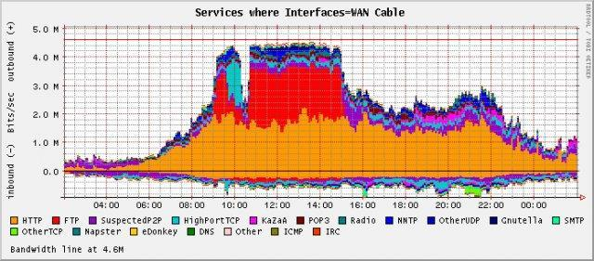
Representative netflow interface
(mrtg)
Note: Based on ‘well-known’ ports
5 minute granularity reporting

Slide 5
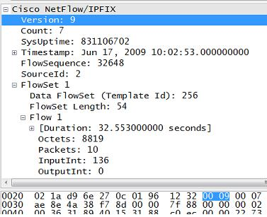
Netflow v9 & ipfix
NetFlow v9
  Added support for IPv6
  Added ‘templates’ concept
    Self-describing
    Self-contained
  Primarily for bandwidth monitoring
IETF standardizes IPFIX (flow information export) as standard
  Almost Identical to Netflow v9
    Supports variable length fields
    Vendor can specify own ID
        Export anything
        Decode later
  Better application visibility
  More context

Slide 6
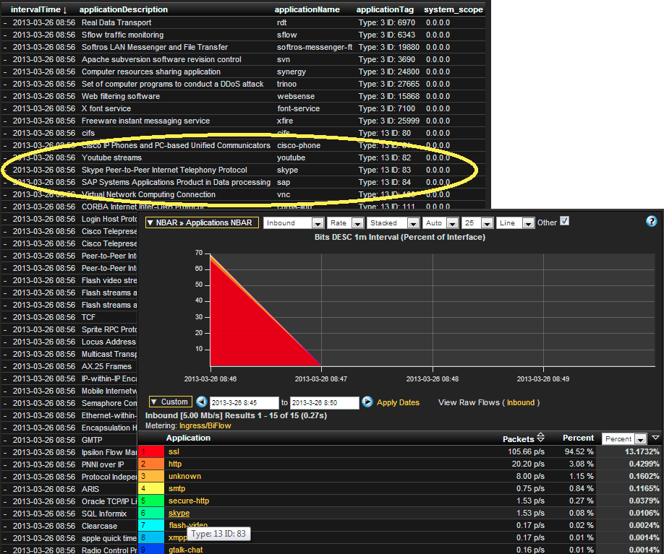
IPFIX Network flow reporting
Cisco NBAR
(Network Based Application Recognition)

Slide 7
Network flow reporting
NetFlow & IPFIX provide visibility
  A sensor in every L2/L3 switch
    Also useful for ‘east-west’ monitoring
  A good source of analytics
    Comparative reporting
  Lightweight storage
    Longer historical view
Especially useful for…
  Monitoring ‘flat’ network architectures
  Visibility for insider activity monitoring
But essentially the equivalent of a phone bill
  A conversation took place…
Context still needed at higher layers…

Slide 8
Why the primer on flow data?
Targeted Attacks
Todays Typical Enterprise…
  Is under attack from multiple sources, varying motivations
  Either has or is budgeting for current technology
  Managing GRC
  Focused on passing audits and protecting assets
  Insufficient number of individuals focused on security
  Supporting multiple OSes and compute surfaces
We need more context to stay in this fight!!!
Nation States
Advanced Malware
Data Theft
DDOS
APTs
Zero Day Threats
IPs
SIEM
Next Gen Firewall
Visibility
Web Gateway
Context
Ransom and Fraud
Adv. Threat Protection
Today’s Security Gap
Hacktivists
URL Filtering
Email Security
Inside Threats
Integrity
Availability
DLP
Host Firewall
Confidentiality
Encryption
Anti
Spam
VPN
NAC
Cybercriminals

Slide 9
Time and the Window
of Opportunity
Initial Attack to Compromise
Initial Compromise
to Discovery
Compromised in
Days or Less
90%
Discovered in
Days or Less
25%
“…bad guys seldom need days to get their job done, while the good guys rarely manage to get the theirs done in a month of Sundays.”
Verizon 2014 Breach Investigation Report
Notes:
Why is a modern approach so important? Well, here’s an interesting perspective from the latest Verizon Data Breach Investigation Report on the time of the initial attack, relative to the discovery of the attack. On one hand, 90 percent of the attacks took days or less to successfully compromise their targets. They're very fast. They are successful. They are penetrating your network and you are compromised before you know it.
On the other side of it, only 25% of the attacks were discovered in days or less. It could take much longer…weeks, months…or as we’ve seen in some prominent attacks, even longer before they are uncovered. And so, we see a lot of breaches in the news today that have gone undetected for some time. The response we see is often… "Well, we're not sure we were breached. We think we were. We don’t have the details, we are looking into it, but can’t tell you any more at this time."
That's kind of code for, ”It’s bad…we've definitely been breached, but we don’t know how bad, and we don’t know what to do." And oftentimes you hear things like, "Well, the threat and the attackers were in the network for four months, six months, a year.” This is definitely an issue. We need to be able to see these attacks early, there’s no reason that today we can’t have full visibility into an attack.
“ It smacks us with the fact that the bad guys seldom need days to get their job done, while the good guys rarely manage to get the theirs done in a month of Sundays.”

Slide 10
Post-prevention security gap
NGFW
IDS / IPS
Host AV
Web Gateway
SIEM
Email Gateway
DLP
Web Application Firewall
Advanced Threat Protection
Content
Detection
Analytics
Context
Visibility
Analysis
Intelligence
Threat
Actors
Traditional
Threats
Advanced
Threats
Known Threats
Known Malware
Known Files
Known IPs/URLs
Nation States
Cybercriminals
Hactivists
Insider-Threats
Novel Malware
Zero-Day Threats
Targeted Attacks
Modern Tactics & Techniques
Signature-based Defense-in-Depth Tools
SSL
Notes:
So, we’ve talked about the threat actors and some of the advanced threats they pose and the attack methods they use. For years we have been trying to stop those threats with the “next new” technologies. We use next generation firewalls, hosted AV, SIEM, email gateways and many other point solutions to detect and block these threats. They can be effective in what they are designed to do, but unfortunately, they can only prevent what they know to stop and many threats today do get by and even using encryption to evade detection. What we need today is an Advanced Threat Protection solution that gives us the context, content, visibility, detection, analysis and real-time, evolving intelligence we need to have a fighting chance against today’s threats.

Slide 11
Post-prevention security gap
60%
Percentage of Enterprise IT Security Budgets Allocated to Rapid Response Approaches
by 2020.
— Gartner 2014
Notes:
A recent report from Gartner indicated that 60% of Enterprise IT security budgets will be devoted to rapid response approaches. It’s clear that protecting the organization’s critical digital assets will come by way of swift incident response, not merely blocking what we can already identify.

Slide 12

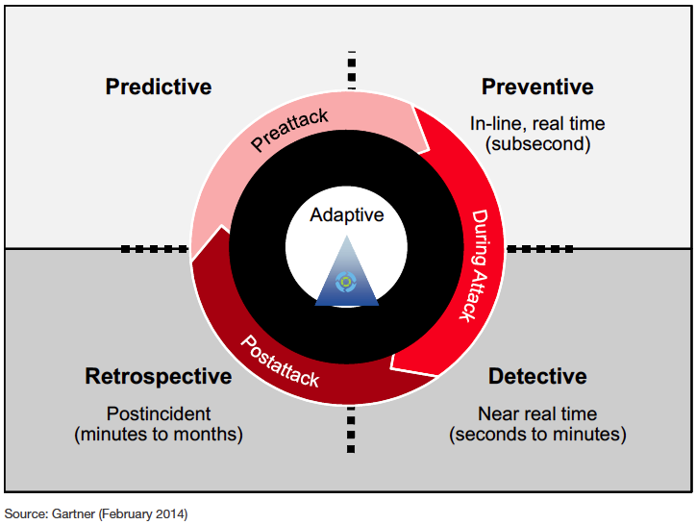
Gartner: adaptive security architecture
Source: Gartner (February 2014)
Notes:
Gartner proposes that Advanced Threat Protection is achieved through an adaptive security architecture. One where the end goal is that different capabilities integrate and share information to build a security protection system can adjust to threats and and is more intelligent overall. It addresses the entire lifecycle of a threat.

Slide 13
DPI and protocol parsing
Deep Packet Inspection
  Generally available in two flavors
    Shallow packet inspection
        Limited flow inspection (i.e., ‘GET’)
    Magic
        Byte value @ offset
  Provides improved classification
    May or may not use port numbers for some classification
Deep Flow/Session Inspection (DPI+++)
  Interrogates network-based conversations
  No usage of port numbers for classification
  State-transitioned classification
  Treats applications as protocols! (wire-view)
  Implements parsing mechanism
  Performs reconstruction (post-process or real-time)
  Allows extraction of artifacts (files, images, etc.)

Slide 14
Benefits of advanced parsers
Re-entrant
  Protocols in protocols
State-transitioning
  Efficient decoding
  Decode metadata only where it should be
Conversation-based classification
  Interrogate request and response
Extraction
  Real-time or post-process artifact reconstruction
  Policy-based rules
Layer 2
MAC, VLAN, MPLS, LTE, DNP3, and others
Layer 3
IPv4, IPv6, MODBUS, BGP, OSPF, GRE, L2TP, IP/IP, and others
Database, Social Networking, Web, hundreds others
Customizable
Extraction/Reconstruction
Policy-based extraction and reconstruction
Application
Reputation & Intelligence

Slide 15
Correlation of sessions over time (all protocol layers
L2 Metadata
MIME Metadata
Files Metadata
L3 Metadata
User Agent Metadata
Geo-location Metadata
Classification Metadata
Reconstructed Artifacts
HTTP Metadata
Hash Metadata
Any to Any
Relationship
(From any one to
any/every other)

Slide 16
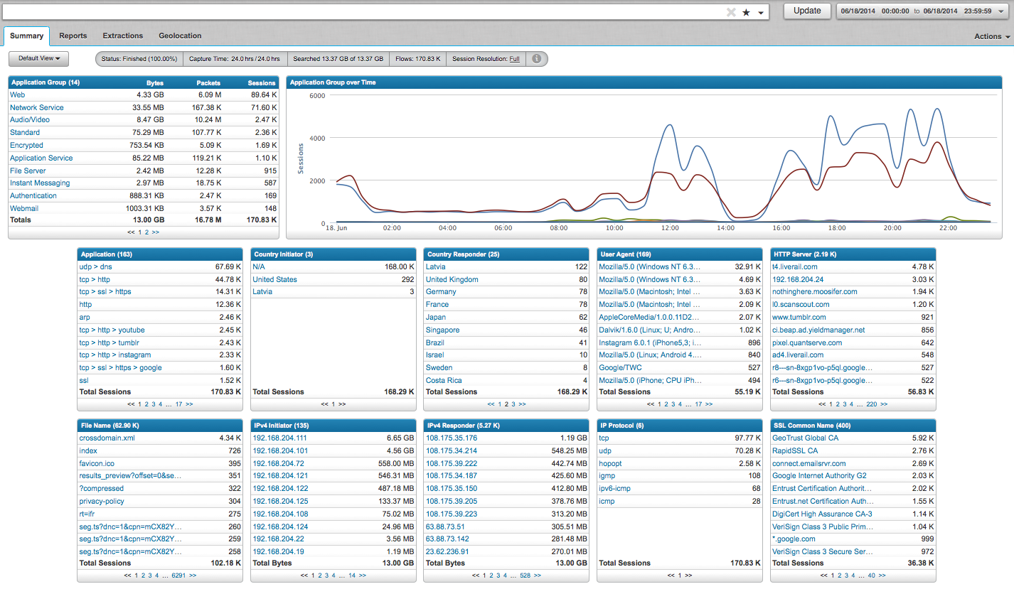
Deep Context via extracted metadata
What we have at our disposal
  Precise application classification
    Classified or Unknown
        Unknown is interesting, too!
  Metadata
    Flow-based
    Inter-relational

Slide 17
Drill interesting Context
What we have at our disposal
  Precise application classification
    Classified or Unknown
        Unknown is interesting, too!
  Metadata
    Flow-based
    Inter-relational

Slide 18
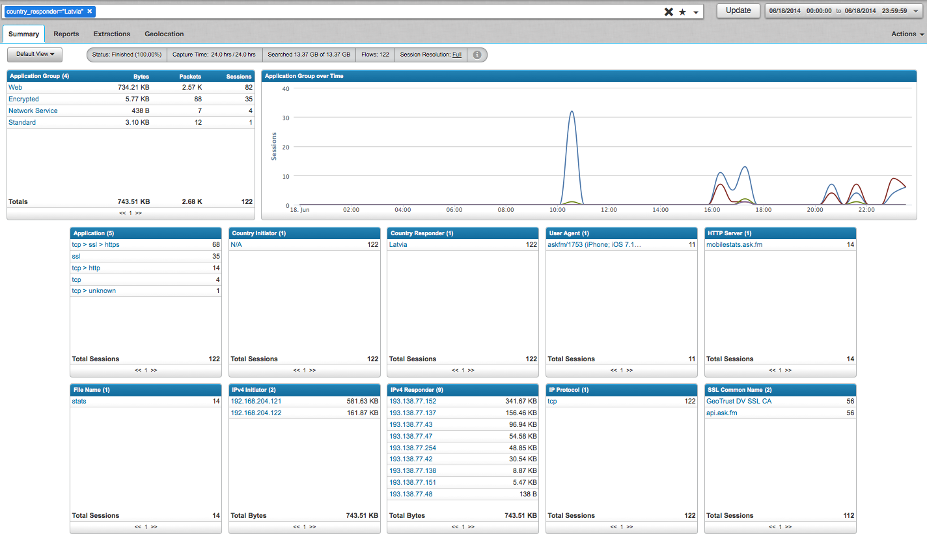
Correlated Context
What we have at our disposal
  Precise application classification
    Classified or Unknown
        Unknown is interesting, too!
  Metadata
    Flow-based
    Inter-relational

Slide 19
Example flow record
timestamp=Jun 02 2014 21:40:23PM, dns=gpnouarwexr.www.qianyaso.net, , application_id=udp , application_id_2=dns , connection_flags=unknown , first_slot_id=23063 , flow_id=20495454 , initiator_country=Azerbaijan , src_ip=149.255.151.9 , src_port=46614 , interface=eth3 , ip_bad_csums=0 , ip_fragments=0 , network_layer=ipv4 , transport_layer=udp , packet_count=2 , protocol_family=Network Service , responder_country=N/A , dst_ip=10.50.165.3 , dst_port=53 , start_time=1401766596:327447386 , stop_time=1401766611:597447252 , total_bytes=176
  Many other session-flow attributes are available!

Slide 20
DPI parsers offer improved analytics
Real-time and Post Process Reconstruction Benefits
  Hashes
    SSDeep
    MD5
    SHA
  Automated reputation
    VirusTotal
    Other details
        Domain age
        WHOIS
        SORBS
        SANS
        3rd Party plugins
  Automated delivery
    Policy-based reconstruction and delivery
        Centralized/distributed sandboxes
        Additional ‘processing’ w/ other tools

Slide 21
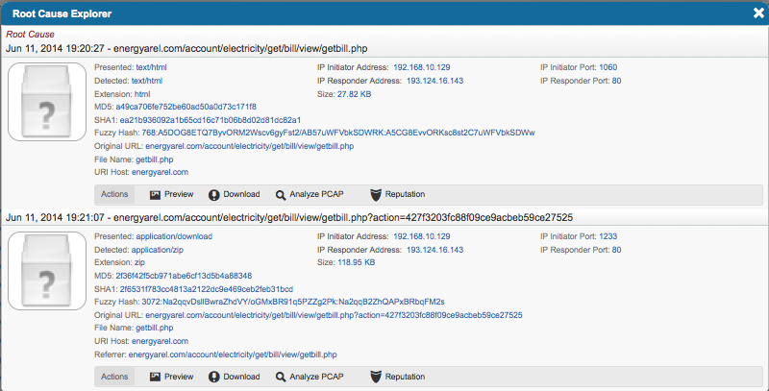
investigation
Malicious ZIP file is detected (via Threat Intel, SIEM, etc.)
Pivot to Security Analytics (pass tuples and temporal vars via REST API)
Use Security Analytics flow records to link HTTP source (root)

Slide 22
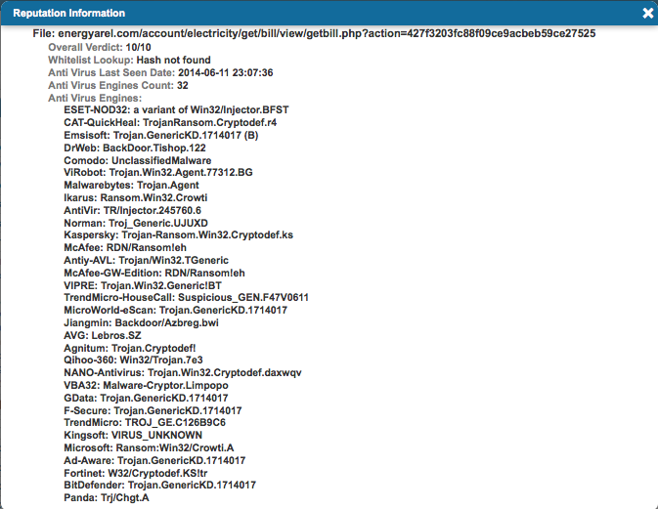
investigation
Hashes compared against reputation service sources
Looks like ransom-ware

Slide 23
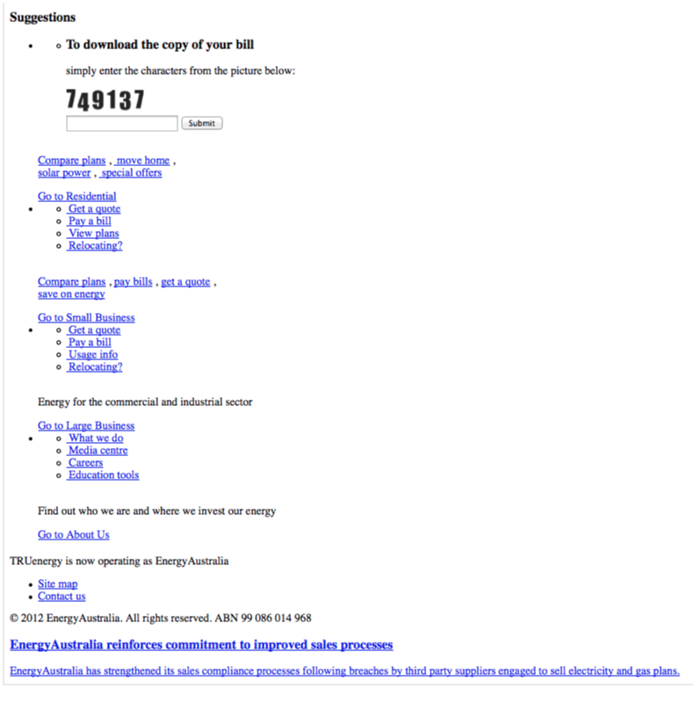
Investigation
Source of exploit determined
  Energy Australia web page (reconstructed)
  Requests ‘captcha’ for copy of bill
  Interestingly, entering the wrong ‘captcha’ values reloads page
  Correct entry starts exploit

Slide 24
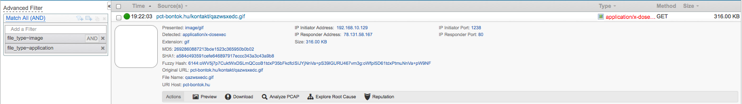
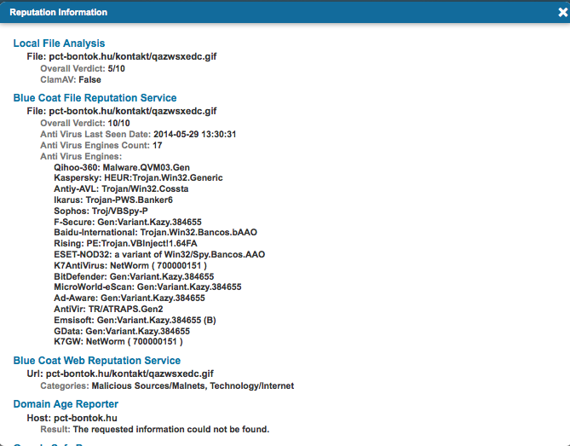
investigation
Other malware delivered
  Presented on the wire as ‘.gif’
  Decoded by DPI parser as ‘x-dosexec’
  17 reputation sources know this as malicious
  First seen in 5/29/14

Slide 25
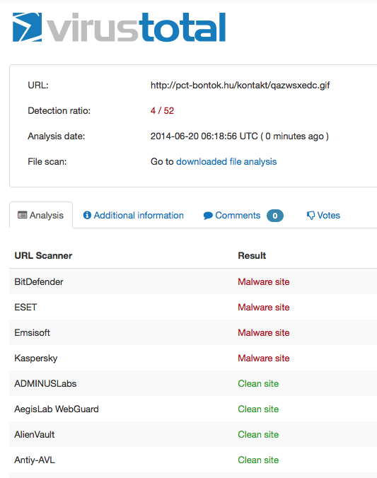
investigation
VirusTotal reports that 4 AV engines reporting site as malicious…
Take relevant action
  Re-image WKS
  Perimeter rules
  …

Slide 26
But so far we’ve talked about analysis…
Analytics vs. analysis
  Analytics is a multi-dimensional discipline. There is extensive use of mathematics and statistics, the use of descriptive techniques and predictive models to gain valuable knowledge from data - data analysis. The insights from data are used to recommend action or to guide decision making rooted in business context. Thus, analytics is not so much concerned with individual analyses or analysis steps, but with the entire methodology. There is a pronounced tendency to use the term analytics in business settings e.g. text analytics vs. the more generic text mining to emphasize this broader perspective. There is an increasing use of the term advanced analytics, typically used to describe the technical aspects of analytics, especially predictive modeling, machine learning techniques, and neural networks.
Short definition
  Multi-dimensional analysis to uncover relationships not visible discretely, yielding insight.

Slide 27
Multi-dimensional analysis
Application
Application Group
Email Recipient
Email Sender
Email Subject
SSL Common Name
File Name
Fuzzy Hash
MD5 Hash
MIME Type
SHA1 Hash
VLAN ID
VoIP ID
Country Initiator
Country Responder
DNS Query
Ethernet Destination
Ethernet Destination Vendors
Ethernet Protocol
Ethernet Source
Ethernet Source Vendors
Interface
IP Bad Checksums
IP Fragments
IP Protocol
IPv4 Conversation
IPv4 Responder
IPv4 Initiator
IPv4 Port Conversation
IPv6 Conversation
IPv6 Initiator
IPv6 Responder
IPv6 Port Conversation
Packet Length
Port Initiator
Port Responder
Size in Bytes
Size in Packets
TCP Initiator
TCP Responder
Tunnel Initiator
Tunnel Responder
UDP Initiator
UDP Responder
Password
Social Persona
User Name
File Analysis
Malware Analysis
URL Analysis
URL Categories
Database Query
HTTP Code
HTTP Content Disposition
HTTP Forward Address
HTTP Method
HTTP Server
HTTP URI
Referrer
SSL Cert Number
User Agent
Web Query
Web Server
*1000s of additional attributes available based on protocol

Slide 28
Multi-dimensional analysis
Application
Application Group
Email Recipient
Email Sender
Email Subject
SSL Common Name
File Name
Fuzzy Hash
MD5 Hash
MIME Type
SHA1 Hash
VLAN ID
VoIP ID
Country Initiator
Country Responder
DNS Query
Ethernet Destination
Ethernet Destination Vendors
Ethernet Protocol
Ethernet Source
Ethernet Source Vendors
Interface
IP Bad Checksums
IP Fragments
IP Protocol
IPv4 Conversation
IPv4 Responder
IPv4 Initiator
IPv4 Port Conversation
IPv6 Conversation
IPv6 Initiator
IPv6 Responder
IPv6 Port Conversation
Packet Length
Port Initiator
Port Responder
Size in Bytes
Size in Packets
TCP Initiator
TCP Responder
Tunnel Initiator
Tunnel Responder
UDP Initiator
UDP Responder
Password
Social Persona
User Name
File Analysis
Malware Analysis
URL Analysis
URL Categories
Database Query
HTTP Code
HTTP Content Disposition
HTTP Forward Address
HTTP Method
HTTP Server
HTTP URI
Referrer
SSL Cert Number
User Agent
Web Query
Web Server
Any to any/many
*1000s of additional attributes available based on protocol

Slide 29
Multi-dimensional analysis
Application
Application Group
Email Recipient
Email Sender
Email Subject
SSL Common Name
File Name
Fuzzy Hash
MD5 Hash
MIME Type
SHA1 Hash
VLAN ID
VoIP ID
Country Initiator
Country Responder
DNS Query
Ethernet Destination
Ethernet Destination Vendors
Ethernet Protocol
Ethernet Source
Ethernet Source Vendors
Interface
IP Bad Checksums
IP Fragments
IP Protocol
IPv4 Conversation
IPv4 Responder
IPv4 Initiator
IPv4 Port Conversation
IPv6 Conversation
IPv6 Initiator
IPv6 Responder
IPv6 Port Conversation
Packet Length
Port Initiator
Port Responder
Size in Bytes
Size in Packets
TCP Initiator
TCP Responder
Tunnel Initiator
Tunnel Responder
UDP Initiator
UDP Responder
Password
Social Persona
User Name
File Analysis
Malware Analysis
URL Analysis
URL Categories
Database Query
HTTP Code
HTTP Content Disposition
HTTP Forward Address
HTTP Method
HTTP Server
HTTP URI
Referrer
SSL Cert Number
User Agent
Web Query
Web Server
Any to any/many
Session-based
*1000s of additional attributes available based on protocol

Slide 30
Multi-dimensional analysis
Application
Application Group
Email Recipient
Email Sender
Email Subject
SSL Common Name
File Name
Fuzzy Hash
MD5 Hash
MIME Type
SHA1 Hash
VLAN ID
VoIP ID
Country Initiator
Country Responder
DNS Query
Ethernet Destination
Ethernet Destination Vendors
Ethernet Protocol
Ethernet Source
Ethernet Source Vendors
Interface
IP Bad Checksums
IP Fragments
IP Protocol
IPv4 Conversation
IPv4 Responder
IPv4 Initiator
IPv4 Port Conversation
IPv6 Conversation
IPv6 Initiator
IPv6 Responder
IPv6 Port Conversation
Packet Length
Port Initiator
Port Responder
Size in Bytes
Size in Packets
TCP Initiator
TCP Responder
Tunnel Initiator
Tunnel Responder
UDP Initiator
UDP Responder
Password
Social Persona
User Name
File Analysis
Malware Analysis
URL Analysis
URL Categories
Database Query
HTTP Code
HTTP Content Disposition
HTTP Forward Address
HTTP Method
HTTP Server
HTTP URI
Referrer
SSL Cert Number
User Agent
Web Query
Web Server
Any to any/many
Session-based
Temporal
*1000s of additional attributes available based on protocol

Slide 31
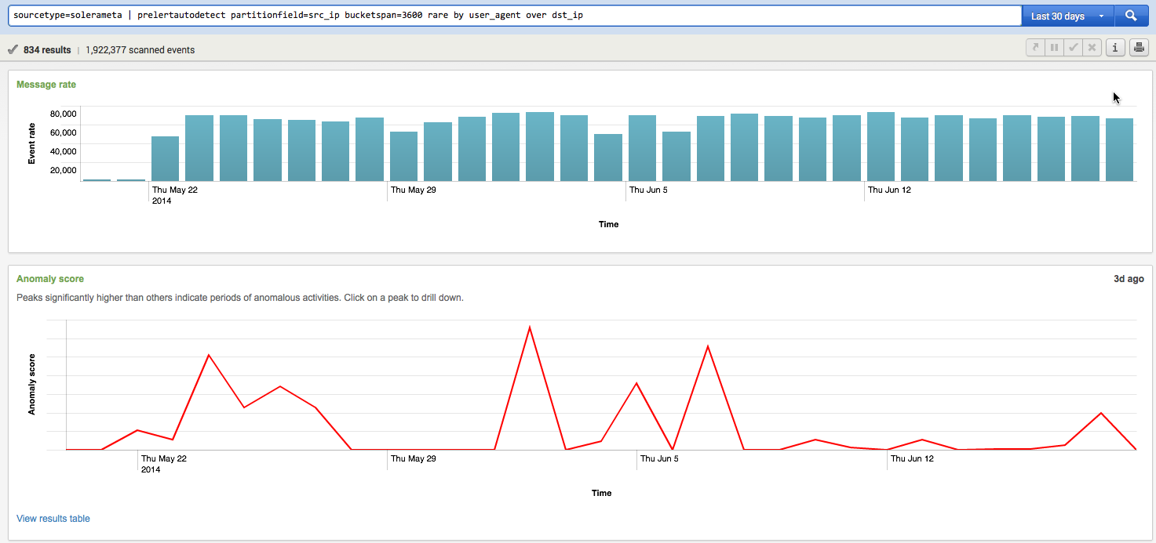
Sample analytics
Example: user_agent over dst_ip (30 days)

Slide 32
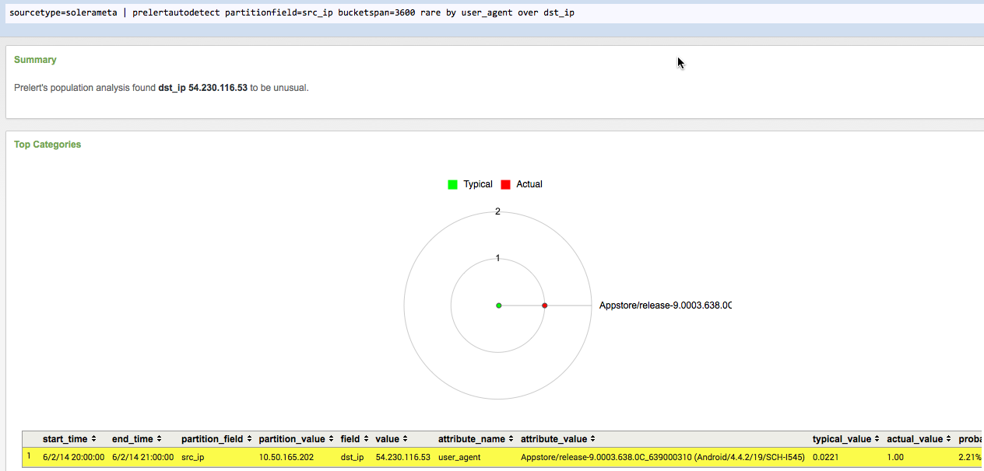
Sample analytics

Slide 33
Sample analytics

Slide 34
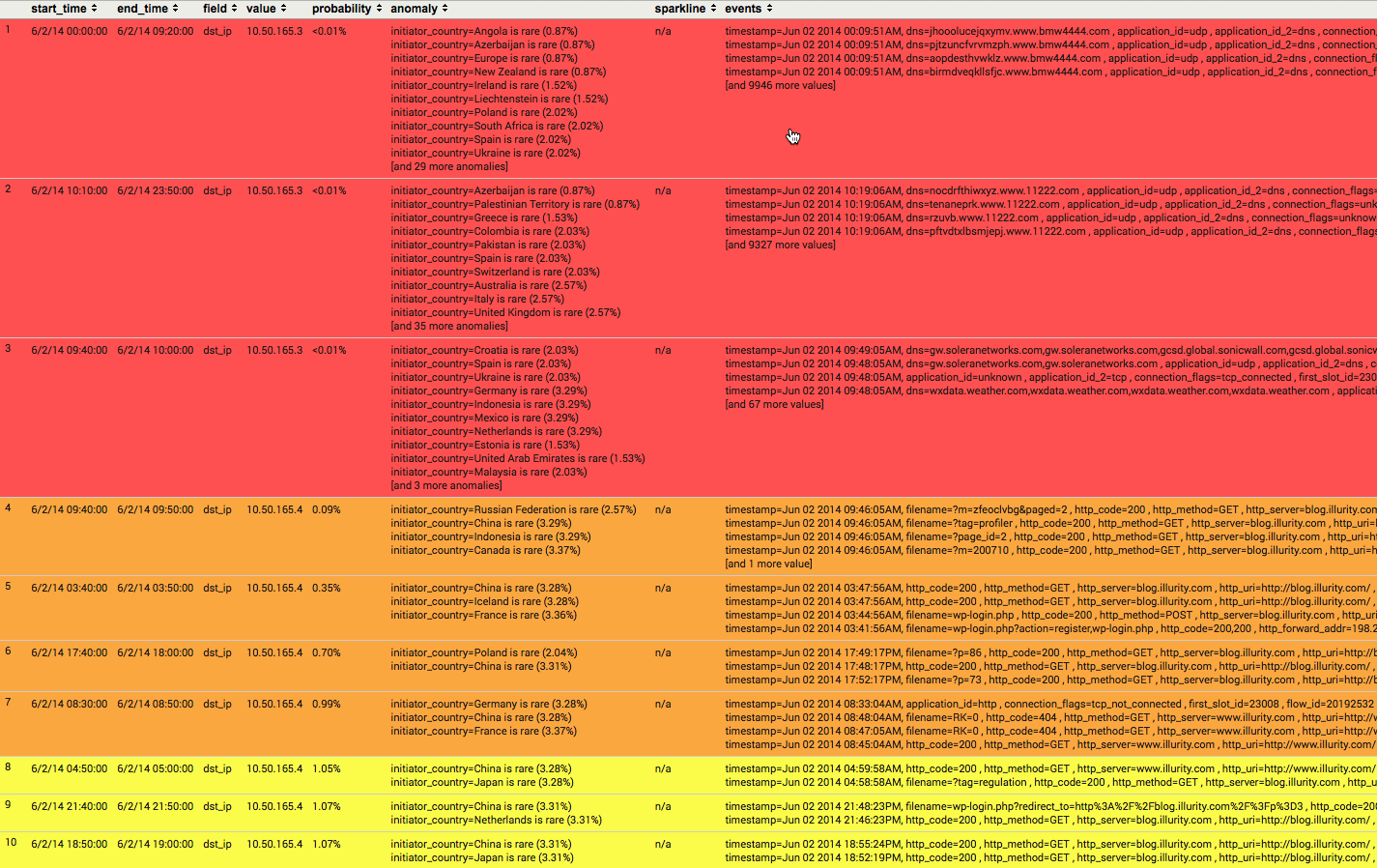
Sample analytics

Slide 35
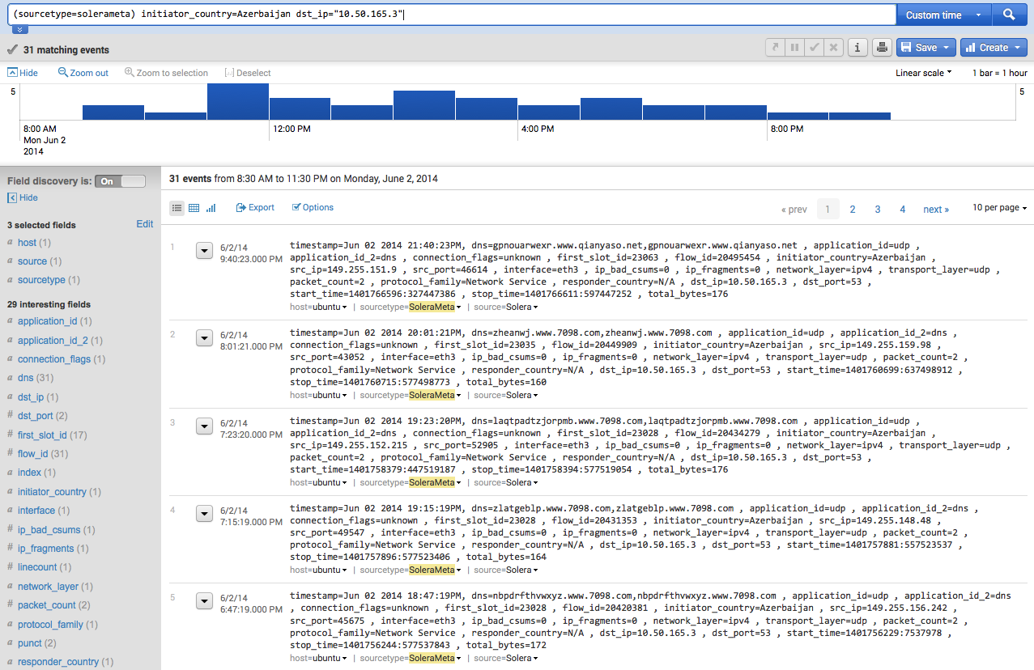
Sample analytics

Slide 36
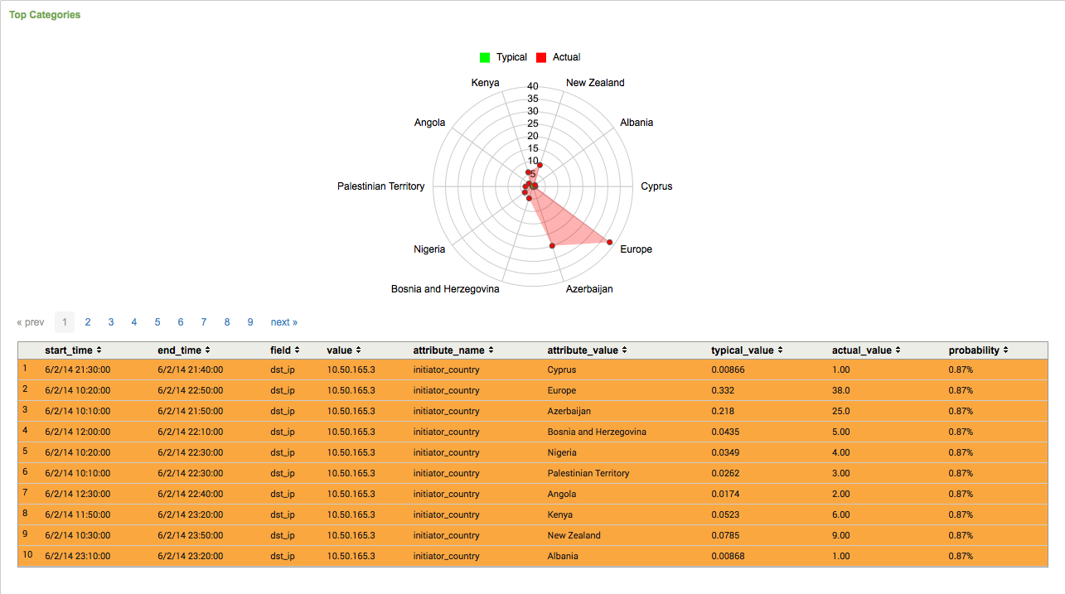
Sample analytics

Slide 37
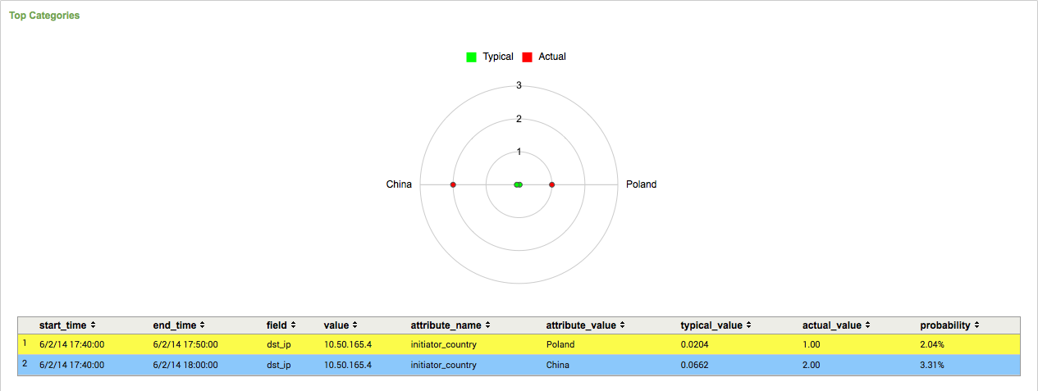
Sample analytics

Slide 38
Key take-aways
NetFlow & IPFIX
  Understand the who and what of your network
  You ‘likely’ have access to this information
Security Analytics
  Stateful protocol parsing
  Correlated session metadata
  Artifact reconstruction
  Integrates with existing tools via REST
    Make your tools better
  Efficient workflow for IR and investigation
  Ties in with Cyber Threat feeds
  RAW Packets
Flow records are much smaller than packets
  Provides historic look-back (you can keep them longer)
RAW packets always useful, still needed

Slide 39







What blue coat is doing today
3
Fortify &
Operationalize
1
SSL Visibility Appliance
Incident
Resolution
Investigate &
Remediate Breach
Threat Profiling
& Eradication
Unknown
Event Escalation
Ongoing
Operations
Detect & Protect
Block All
Known Threats
Security Analytics Platform
Retrospective
Escalation
ProxySG
Global
Intelligence
Network
Content Analysis System
2
Incident Containment
Analyze & Mitigate
Novel Threat
Interpretation
Security Analytics Platform with ThreatBLADES
Malware Analysis Appliance

Slide 40
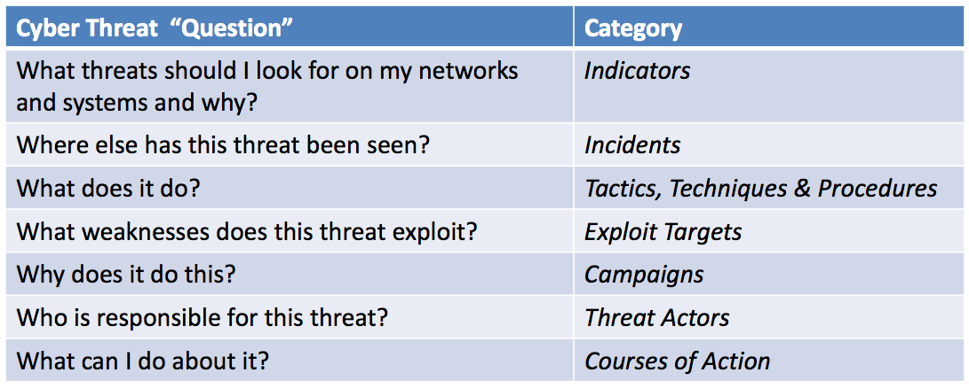
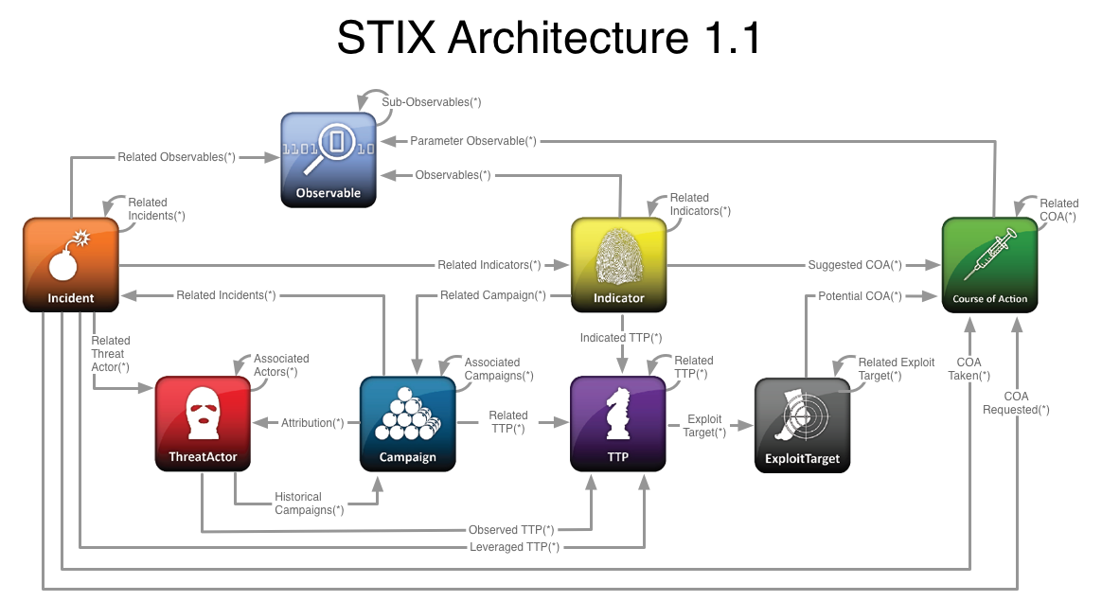
Where can we go from here?

Slide 41
Q&A

