Slide 2
Cyber Security for Board of Directors and Senior Management
Peter O’Dell
Author: Cyber 24-7: Risks, Leadership, Sharing

Slide 3
Introduction – Pete O’Dell
Author: Cyber 24-7: Risks, Leadership and Sharing , Sound advice for Boards, the C-Suite, and non-technical executives
Background: Technology and manufacturing, CIO, COO, CEO, board member, entrepreneur, consultant
www.swanisland.net – TIES Azure based situational awareness/cyber-intelligence capability, Microsoft CityNext
Fellow: National Cybersecurity Institute

Slide 4
Today’s Cyber Situation
Victims of our own success
Opportunity expands the attack surface:
  Clouds linked to legacy systems
  Internet of Things (IOT) means more entry points
  Bring Your Own Devices (BYOD)
We’re not doing all we can:
  Boards and C-Suite largely delegating/ignoring
  Poor info sharing even at basic levels, not real-time
  Eliminating/upgrading legacy systems
  “Tone at the Top” by the board and C-Suite
  Government – no legislation since 2002, poor grades

Slide 5
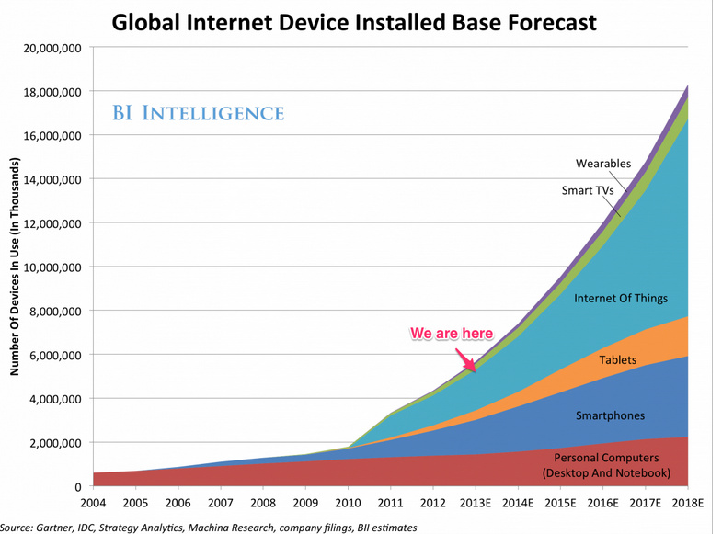

Slide 6
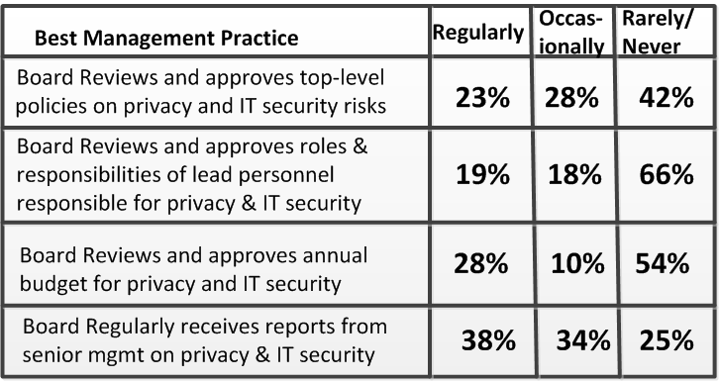
Carnegie Mellon CYLAB Research 2012

Slide 7
Cyber is not a Normal Risk!
Cyber defies conventional metrics
  Non-quantifiable
  Non-predictable
  Global, not local
  Can put the entire organization at complete risk
Examples of normal risks:
  Weather - business interruption
  Employee and customer lawsuits
  Theft of a trailer full of cell phones

Slide 8
Simple Risk Metaphors
Medieval Fire:
  Concentrated building w/legacy materials
  No automated controls, manual watch/warning
  Interconnections allowed rapid spread
  Malicious or inadvertent spark had same impact
Wolves, Elk, and Buffalo – Yellowstone:
  Buffalo communicate threat info and circle herd
  Elk scatter – every elk for themselves
  Who would you eat if you were a wolf?
Titanic & Costa Concordia:
  Huge, valuable assets
  Known threat and risk picture
  Total preventable loss

Slide 9
Cyber Pressure at all levels
Board, management:
  Are we safe?
  Are we prepared?
  Can we count on our people?
  Can we afford it?
  What is our strategy?
  I don’t understand!
  I don’t want liability!
  We can’t stop!
  We don’t like bad news!
CIO, CISO, IT team:
  Rogue IT projects
  SAAS w/credit card
  BYOD
  USB sticks
  Data everywhere
  Budget constraints
  Legacy systems
  New demands - cloud and IOT
  Nobody likes to deliver bad news

Slide 10
Cyber Dialogue - Techspeak
“The APT slipped through the DMZ and the IDS missed it”
“CERT, part of DHS NCCIC released some IOCs using STIX and TAXII”
“Stuxnet was targeted by USB into an ICS utilizing Siemens PLCs”
Is your management going to understand this? Understandable dialogue critical.

Slide 11
Board & C-Suite Preparation/Proactive Efforts
Set the “Tone at the Top”
Set the organizational priorities
Consider a technical board member/committee creation and outside expertise
Hire and validate right people and partners
Detailed risk, resilience and plan review
Exercise full response plan across the enterprise
Work with all levels of the organization

Slide 12
People – Critical at all Levels
Industry shortage means marginal employees, turnover, and rapid obsolescence
Validate through outside expertise
Finding, training, retaining and motivating
Standing guard 24/7 difficult and boring
Trusted can turn malicious for outside reasons
360 degree communications for team success
Entire organization – this is not just an IT issue

Slide 13
What can IT pros do to work with board and C-suite?
Communicate in clear, concise terms (non-tech)
Write it down!
Analyze impact on entire organization
Suggest proactive measures
Identify threat reduction areas – e.g. elimination of legacy technology
Involve and train the entire organization on defense
Design cross-organizational incident response

Slide 14
Planning and Prevention
1735 : “An ounce or prevention is worth a pound of cure” - common sense applies
Cyber hygiene - attending to the basics
SANS Top 20 Controls - excellent
“Defense in Depth” & “Kill Chain” efforts
Prioritized approach – Tower of London
Outside validation – avoid myopic view
Strategic budgeting - pay not, pay later
Continual reassessment /examination
Push the attackers to someone else

Slide 15
Partners – Who will stand with you?
Proactive effort: Worst time to engage is in the middle of a crisis
Reality: You can’t staff to an unknown level or timeframe – outside services vital
Great partners will help on the prevention and preparation plus incident response
Broad set of offerings – choose carefully
Exercise and integrate ahead of time
Set service level agreements/expectations

Slide 16
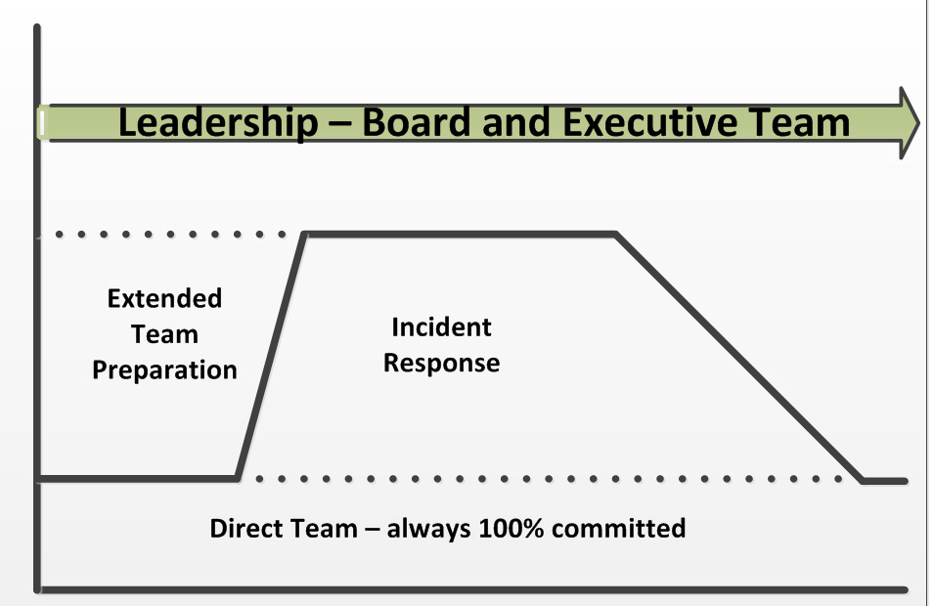
Enterprise ready to respond?

Slide 17
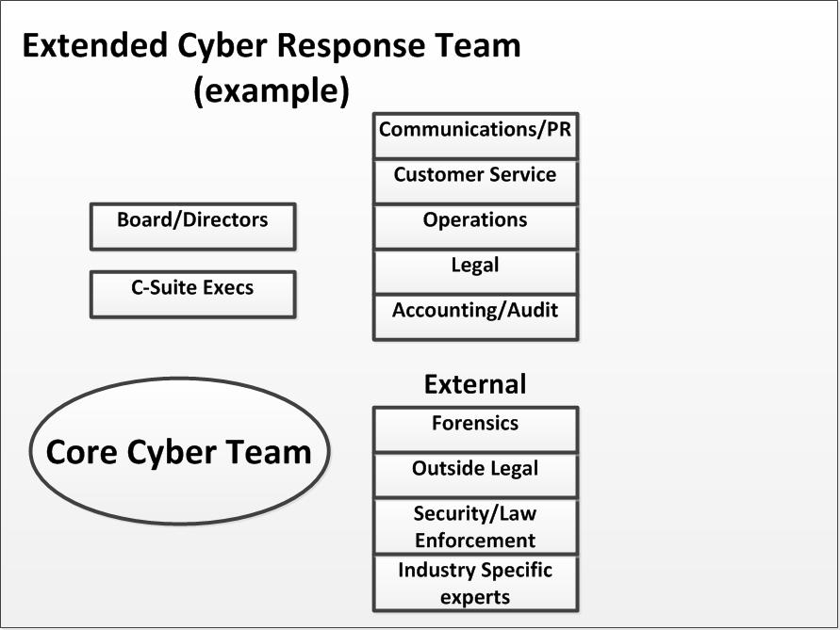

Slide 18
Breached – now what?
Preparation will reflect response
Immediate actions
Mobilizing outside partners
Ramping incident response
Cross organizational involvement
Documenting throughout
Disclosures and insurance claims
Reset to normal operations
Post incident analysis

Slide 19
Sharing – underutilized defense
US-CERT and other governments trying
Classified programs unknown quality but worth pursuing for large organizations
ISACs – Information Sharing and Analysis Centers – sector specific
Fusion Centers – some are trying cyber
GRN – Global Risk Network – NYU hosted
Worth the effort – share the risk

Slide 20
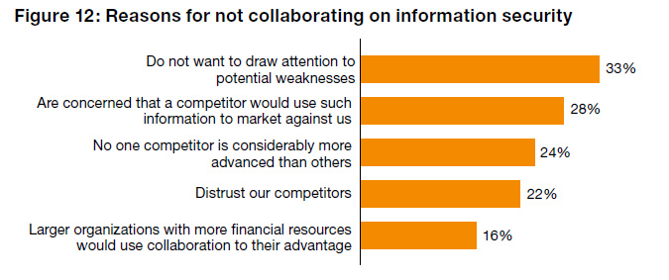
Scared of Sharing?

Slide 21
Sharing - Standards
DHS: TAXII and STIX
RSA/IETF: MILE and IODEF
Mandiant (FireEye): OpenIOC
Issues:
  Maturity model
  Volume use important
  Real time
  Machine to Machine (M2M)
  Market adoption/incorporation

Slide 22
Highly Leveraged Areas
Authentication
BYOD – Bring your own devices
Encryption
Cloud
ICS – Industrial Control Systems
Payment collection systems

Slide 23
Promising efforts
European format credit cards (chip vs stripe)
M2M sharing of threat indicators - OpenIOC
Serious global sharing initiative – likely private sector based
Better software creation and testing
International law enforcement improvements
Cloud – good security implications
IOT – devices will help detect attacks

Slide 24
Conclusions for the C-Suite
Board responsibility to lead continuously
Growing threats, no easy fixes or panaceas
Shortage of talented defenders – choose wisely
People, partners, planning, prevention critical
Continual learning and adapting required
Far bigger than just the IT organization
Recommended: National Association of Corporate Directors (www.nacdonline.com)

Slide 25
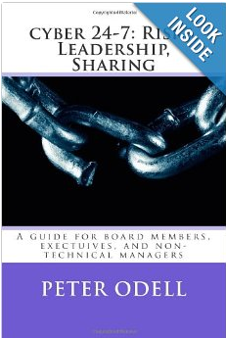
Book – Available Now!
Cyber 24/7: Risks, Leadership and Sharing: Sound advice for board members, the C-Suite and non-technical executives
Kindle and softcover
Easy to read
Comprehensive look at issues

Slide 26
Questions?
Pete O’Dell
peterlodell@gmail.com

Slide 28
Thoughts
How many people keep all their money at home? How many of your organizations keep all your data on site?
How many or

Slide 29
Audience Polling
Know of major breach?
Thinks they are secure?
Discussions w/board?
Sharing today?
Utilizing ISACs?
CERT alerts?
Software all up to date?
Background checks?
Outside validation?
Full exercises?
Strong plan?

