Slide 1
The study of Knowledge-sharing in CSIRTs using Anthropology
Raj Rajagopalan Xinming Ou
Honeywell Kansas State U
FIRST 2014
(DRAFT)

Slide 2
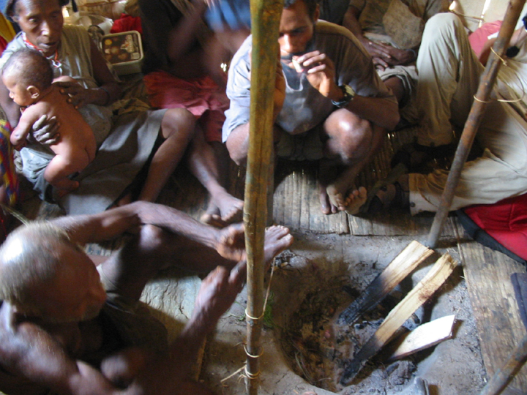
The Team
Kansas State: Sathya Chandran,
Mike Wesch, Xinming Ou
Honeywell: Raj Rajagopalan
RedJack: John McHugh

Slide 3

SOCs and CSIRTs are our first line of defense and yet
… we don’t know much about how they actually function

Slide 4
For example, we don’t know how to make incident handling more automated how to train new analysts quickly how to share information effectively across teams

Slide 5
To do this we have to know a SOC/CSIRT really works
But don’t we know that already?
But first a little story…

Slide 6
Back in 2006 a group of intrepid security researchers were on a mission to find out how to build an effective IDS
So they went to the nearest SOC/CSIRT which happened to be the one on campus
What did they learn?

Slide 7
What we saw
Some of us (Ou and graduate students) watched the SOC handle a malware incident affecting campus servers.
What they discovered was not what they expected

Slide 8
What we saw
1. SOC analysts don’t use high tech tools!
2. Most of the work is grubby manual work
3. Most of the analysis is hit-and-miss
What we learned
Academic security research is well-separated from the practice of research.

Slide 9
What we did
Embedded ourselves in the SOC to observe it in action
How did that work
Not well.
What was wrong?

Slide 10
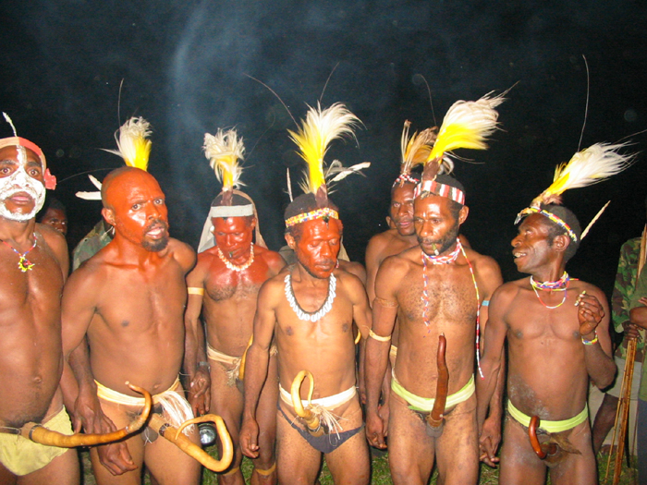
Who we set out to observe

Slide 11
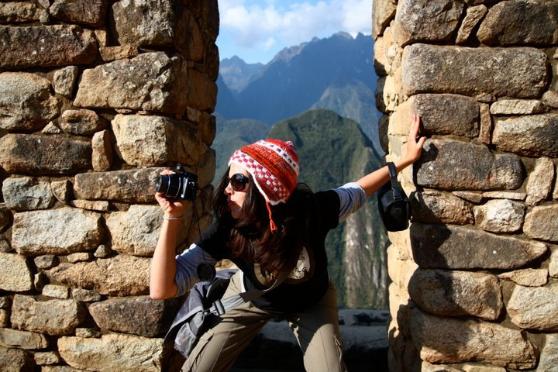
What we were actually doing

Slide 12
Time for Reflection what was happening?
Embedded researchers could not get time of day from the SOC staff
SOC personnel were too busy and too suspicious
SOC jobs are learned primarily via a master-apprentice model
We were on the outside looking in!

Slide 13
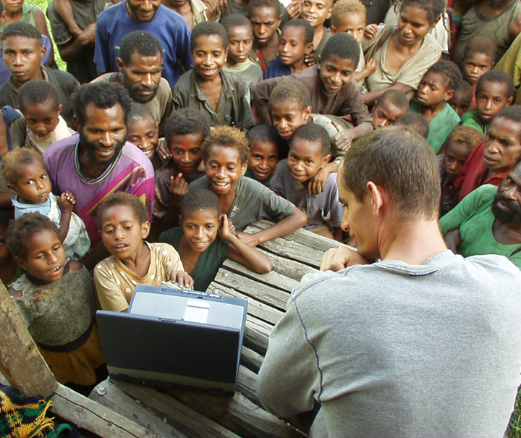
The Professional Observer
Dr. Mike Wesch, Socio-cultural Anthropologist
to the rescue!

Slide 14
Introduction to Anthropology the study of all people in all times in all places
See the big picture and the small picture at the same time.

Slide 15
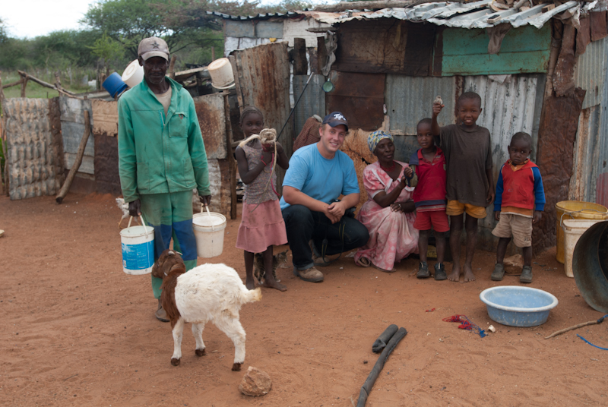
What we think Anthropologists do!

Slide 16
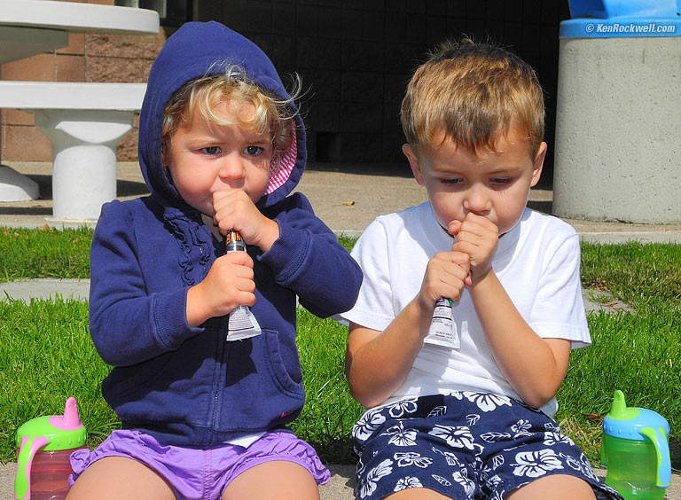
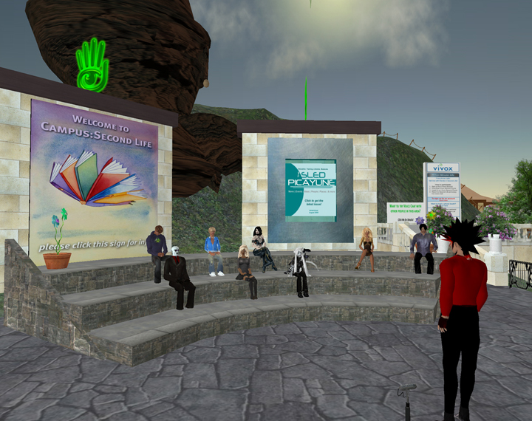


Other things Anthropologists do!

Slide 17
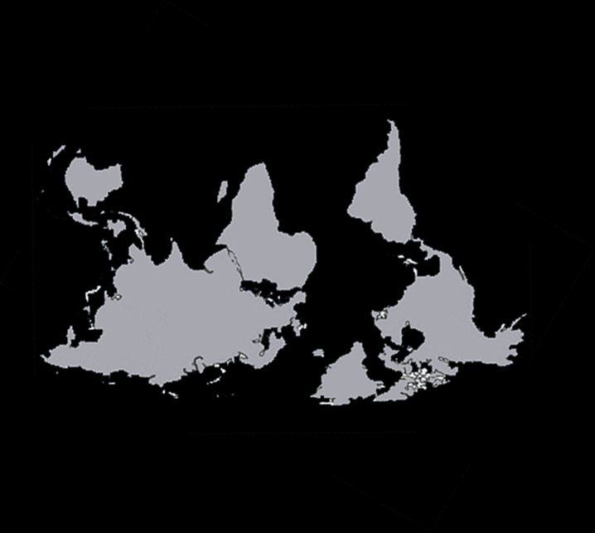
What Anthropology teaches us
Get rid of your familiar biases!

Slide 18
What does Anthropology tell us about studying the SOC?
People know more than they can tell
Knowledge is held in the community
Converting tacit knowledge to explicit knowledge requires patient study.

Slide 19
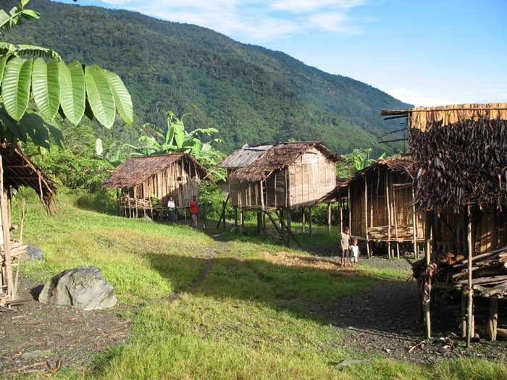
What Anthropology teaches us
It is not enough to live there
You have be one of them

Slide 20
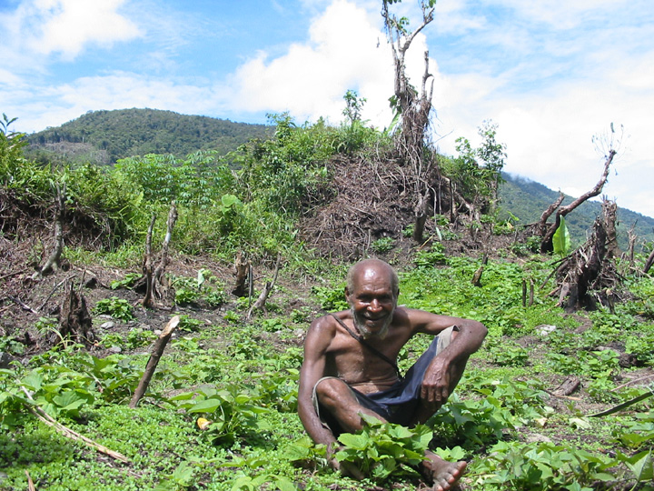
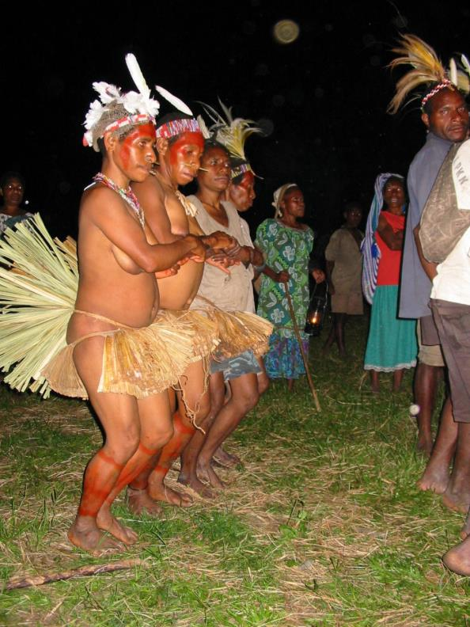
Knowledge comes when the observer achieves the perspective of the observed

Slide 21
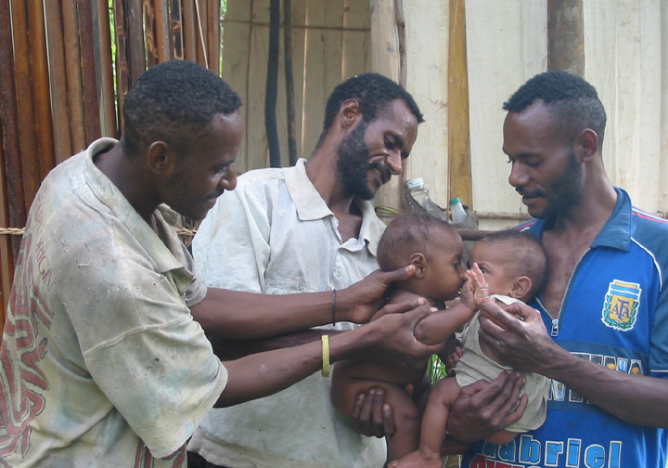
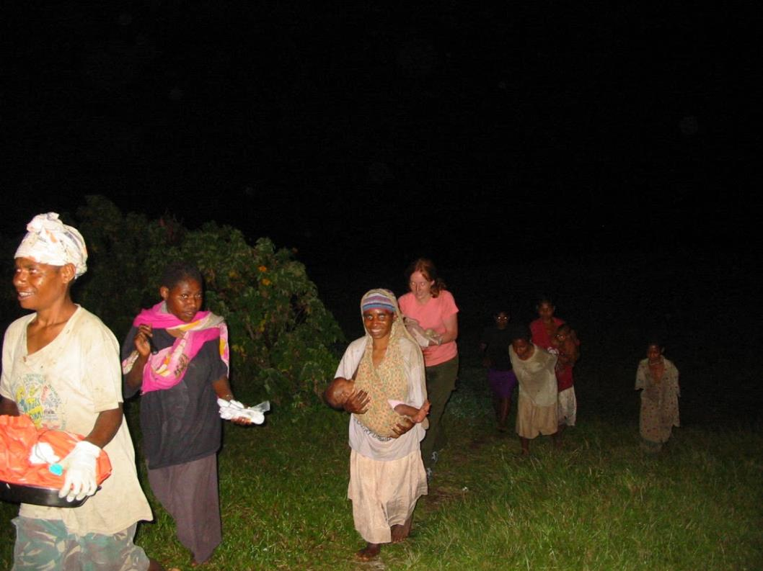
Knowledge comes when the observer achieves the perspective of the observed

Slide 22
How did we put Anthropology into the SOC?
Our Embeds
1. Worked patiently on the sidelines
2. Built tools for the SOC analysts
3. Gained the trust of SOC analysts
4. Co-created tools with the SOC analysts over the course of 18 months!

Slide 23
How to observe what is being said
S-P-E-A-K-I-N-G
Setting and Scene
Participants
Ends
Act Sequence
Key (tone, manner, or spirit of the event)
Instrumentalities (forms and styles used)
Norms (social rules governing the action)
Genre
not what’s being said …
it’s what what’s being said says

Slide 24
What we learned when we applied Anthropological techniques
1. SOC analysts’ knowledge is very tacit
2. Analysts are not always aware of their own knowledge.
3. It is necessary but possible to become a SOC “insider”
4. SOCs need to empower and incentivize knowledge sharing among analysts
5. Tool co-creation is the best way to transfer technology into a SOC

Slide 25
How did Anthropology help?
1. The SOC is a unique socio-cultural environment.
2. SOC culture is closed and suspicious by necessity.
3. A few hours or interviews of SOC staff is not likely to reveal much.
4. We have a methodology to extract knowledge.

Slide 26
Further work
This work was limited to one SOC in a university environment.
We have now expanded the study to include two corporate SOCs.
We need to conduct the study at more SOCs.
We would like to invite participation from the FIRST community in our study.
Study participation can benefit both the SOC and the community.

Slide 27
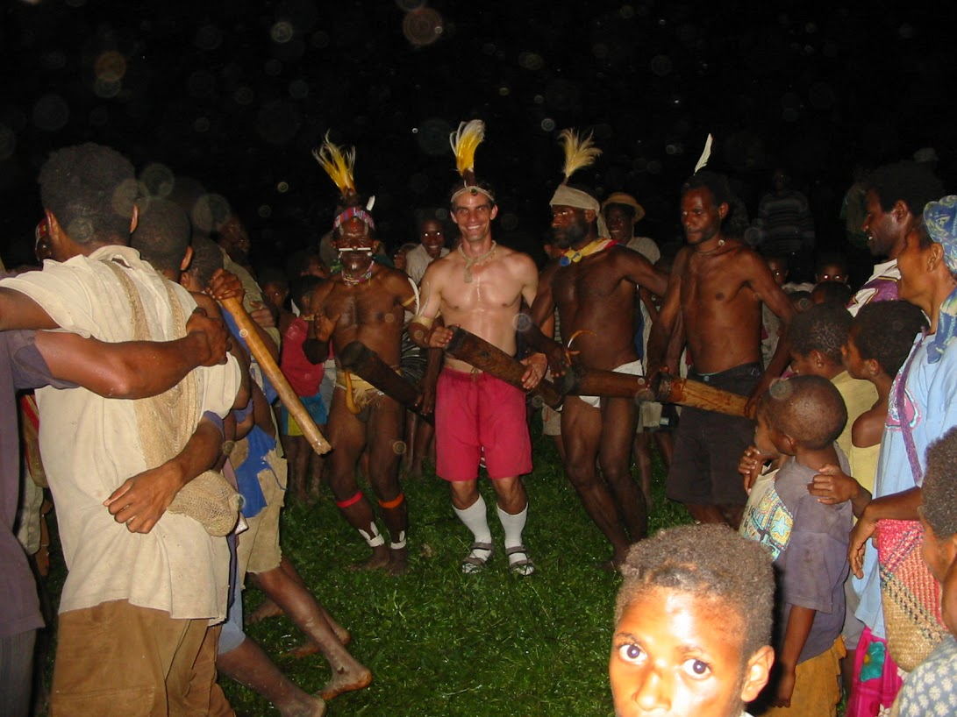
What we hope to achieve in the long run
Deeper understanding of how security analysis works by converting tacit knowledge into explicit
Learn to make our SOC/CIRT more effective
Learn to train our analysts better
Create a SOC/CIRT community that learns to observe itself and share better

Slide 28
How and when we share information
is not that different after all

