Slide 1
Two-tiered, Multi-team Assessment of CSIRTs
Robin Ruefle
CERT Division
Software Engineering Institute
Carnegie Mellon University
26th Annual FIRST Conference
Boston, MA
June 2014
Notes:
Again, our modeling helps us understand and characterize the contextual factors that surround and influence events.
Technical question: “What are the observable technical and behavioral precursors and indications of insider theft of IP?”

Slide 2
Copyright 2014 Carnegie Mellon University
This material is based upon work funded and supported under Contract No. FA8721-05-C-0003 with Carnegie Mellon University for the operation of the Software Engineering Institute, a federally funded research and development center sponsored by the United States Department of Defense.
Any opinions, findings and conclusions or recommendations expressed in this material are those of the author(s) and do not necessarily reflect the views of the United States Department of Defense.
NO WARRANTY. THIS CARNEGIE MELLON UNIVERSITY AND SOFTWARE ENGINEERING INSTITUTE MATERIAL IS FURNISHED ON AN “AS-IS” BASIS. CARNEGIE MELLON UNIVERSITY MAKES NO WARRANTIES OF ANY KIND, EITHER EXPRESSED OR IMPLIED, AS TO ANY MATTER INCLUDING, BUT NOT LIMITED TO, WARRANTY OF FITNESS FOR PURPOSE OR MERCHANTABILITY, EXCLUSIVITY, OR RESULTS OBTAINED FROM USE OF THE MATERIAL. CARNEGIE MELLON UNIVERSITY DOES NOT MAKE ANY WARRANTY OF ANY KIND WITH RESPECT TO FREEDOM FROM PATENT, TRADEMARK, OR COPYRIGHT INFRINGEMENT.
This material has been approved for public release and unlimited distribution.
This material may be reproduced in its entirety, without modification, and freely distributed in written or electronic form without requesting formal permission. Permission is required for any other use. Requests for permission should be directed to the Software Engineering Institute at permission@sei.cmu.edu.
Carnegie Mellon® and CERT Coordination Center® are registered marks of Carnegie Mellon University.
DM-0001434

Slide 3
How Is My CSIRT Doing?
A key struggle for CSIRT organizations today is determining how successful they are in meeting their mission of managing cybersecurity incidents.
As teams become more mature in terms of operational longevity, they are looking for ways to evaluate their operations.
Key outcomes are to identify strengths and weaknesses in processes, technologies, and methods and use this to plan for improvement.
Teams are also interested in being able to benchmark themselves against similar external teams but also against their own internal incident management groups.

Slide 4
Available Instruments from CERT
Mission Risk Diagnostic for Incident Management Capabilities (MRD-IMC)
  New version just published: http://resources.sei.cmu.edu/library/asset-view.cfm?assetid=91452
  Replaces the Incident Management Mission Diagnostic.
Incident Management Capability Assessment (IMCA)
  Version 2 planned for development and publication
  Will replace the Incident Management Capability Metrics: http://resources.sei.cmu.edu/library/asset-view.cfm?assetid=8379

Slide 5
MRD-IMC
Purpose:
  Determine the extent to which an IM function is in position to achieve its mission and objective(s)
Overview:
  Evaluates a set of systemic risk factors (called drivers) to aggregate decision-making data and provide decision makers with a benchmark of an IM function's current state.
Provides a high-level assessment of an IM function
  First-pass screening (i.e., “health check”)
  High-level diagnosis of conditions
  Complements detailed, deep-dive evaluations of IM functions
Delivery Method:
  Expert-led assessment
  Self-assessment

Slide 6
Driver Question: Example

Slide 7
Incident Management Drivers: Detect and Respond
1. Incident Management Objectives
2. Stakeholder Requirements
3. Incident Management Plan
4. Organizational Environment
5. People
6. Roles and Responsibilities
7. Information Management
8. Tools and Technologies
9. Facilities
10. Information Collection
11. Detection
12. Analysis
13. Response
14. Information Dissemination
15. Coordination
16. Resilience

Slide 8
Incident Management Capability Assessment
Purpose:
  Determine how many IM capabilities are being adequately performed by an IM function
Overview:
  Measures an organization’s incident management functions against the CERT incident management capabilities which define a benchmark of good practice
Provides a more detailed assessment of an IM function
  Evaluates a set of indicators for each capability
  There are three types of indicators: required, recommended best practices, and institutionalization
  Compliments detailed, deep-dive evaluations of IM functions
Delivery Method:
  Expert-led assessment
  Could be used as a self-assessment, but process still needs to be followed
  Could also be used as guidance for creating incident management framework

Slide 9
Capability Example
1.1 Establish IM Function
1.1.2 An incident management function or CSIRT has been officially designated by the organization head or CIO through an official appointment order. | Priority II
Scoring Criteria | Yes | No | Evidence
Required
1.1.2.1 Prerequisite: The constituency supported by the incident management function has been defined.
1.1.2.2 Control: Executives in the organization support the incident management mission.
1.1.2.3 Activity: A CSIRT, SOC, or other group has been established as the officially designated authority for incident management functions within the organization.
1.1.2.4 Activity: An entity or specific person has been designated as the incident management “lead.”
Recommended Best Practices
1.1.2.5 Activity: A policy or other official designation is documented and distributed throughout the organization or otherwise made available.

Slide 10
Incident Management Capability Categories
Prepare | Protect | Detect | Respond | Sustain
Establish IM Function Core Processes and Tools | Risk Assessment Prevention Operational Exercises for CND Training and Guidance Vulnerability Management | Network and Systems Security Monitoring Threat and Situational Awareness | Incident Reporting Incident Analysis Incident Reporting | MOUs and Contracts Project/Program Management IM Technology Development, Evaluation and Implementation Personnel Security Administration IM Information Systems

Slide 11
Use of Assessment Instruments
Each instrument can be used alone to perform the prerequisite assessment.
The MRD-IMC can be useful for small teams who do not have a lot of time or funding to perform a multi-week assessment activity.
The instruments can also be used in combination to drill down into problem areas and areas for improvement.

Slide 12
Two-Tiered Multi-Team Assessment Approach

Slide 13
Who Should Use This Combined Assessment?
This approach is best for large organizations with distributed CSIRTs or incident management components.
Examples:
  Global company with incident management capabilities in different countries
  Government agencies with incident management capabilities in different ministries
  Academic organizations with incident management capabilities at different campuses
  Large enterprise with incident management capabilities in different divisions or components of the organization

Slide 14
Approach Perspective – Tier One
Tier One uses the MRD-IMC to do a high-level check of the components or teams.
The assessment can be completed by
  The team lead
  All members of a team as a survey
  Stakeholders and constituents who use the services of the team
Analysis looks for
  Common problem areas across teams
  Specific problem areas for a team, e.g., where score and rationale do not match
The Tier One assessment can also be used to establish an initial baseline of performance for yearly comparisons.

Slide 15
Approach Perspective – Tier Two
Tier Two then uses the results of the MRD-IMC to do a more focused evaluation.
The focused evaluation can concentrate on
  Capabilities which were scored poorly or identified weakness that were prevalent across the distributed components or teams.
  Specific teams that performed well or that performed poorly.
Tier Two uses the IMCA to do a deeper dive assessment by
  Performing a complete IMCA on a team
  Scoping the evaluation, as needed, to specific capabilities

Slide 16
Benefits of Two-tiered Approach
Allows for trends and baselines across components to be captured.
Assessment time and resources is not as extensive as performing an IMCA on each component.
Allows for focusing on most critical weaknesses or gaps.

Slide 17
Challenges and Issues
Most challenges and issues were not related to the two-tiered approach, but were related to how the MRD-IMC drivers and the IMCA indicators were interpreted.
Clarification of focus and perspective of the assessment needs to be made.
  For example if a team lead is completing the instrument are they answering what they think or what they believe their team thinks?
Very clear definitions for terms in the assessments should be provided if a self-assessment is performed.
Also, as self-assessments tend to be biased, scoring should be based on the analysis of the rationale given by the organization for their score rather than just the score.

Slide 18
Additional Activities That Can Be Done
As a benchmark for identifying potential bias, the expert team can complete an MRD-IMC on the same group on which they performed an IMCA and compare their results to the group’s original self-applied MRD-IMC.
Create a consolidated report of all the organizations MRD-IMC self-assessments to see how the organization performed across its components for all drivers.

Slide 19
MRD-IMC in More Detail

Slide 20
Driver
A factor that has a strong influence on the eventual outcome or result
  Direct connection to the mission and objectives
  Small number of drivers (10-25) provides insight into mission and objectives
Examples:
  Stakeholder Requirements:
    Are stakeholder requirements for the incident management function well understood?
  Incident Management Plan:
    Does the incident management plan enable achievement of objectives?
  Analysis:
    Does the incident management function analyze events and incidents sufficiently to enable an appropriate course of action for response?

Slide 21
Drivers: Success and Failure States
A driver can guide the outcome toward key objectives (success state) or away from them (failure state).

Slide 22
Identifying Drivers: Basic Approach
Approach:
  Gather information from experts
    Experts need to be familiar with the mission and objective(s)
    Mission and objective(s) help focus discussions with experts
Questions answered by experts:
  What circumstances, conditions, and activities prevent an IM function from achieving each objective?
  What circumstances, conditions, and activities enable an IM function to achieve each objective?

Slide 23
Analyzing Drivers: Rationale and Supporting Evidence
Rationale and supporting evidence recorded for each driver question
Evidence can come from:
  Interview data
  Documentation
  Reports
  Observations
  Demonstrations
  Measurement data
The publication includes a workbook.
In a self-assessment, you need to balance your time and resource limitations against the need for objective (and sufficient) evidence.

Slide 24
Example: Rationale and Evidence
2. Are stakeholder requirements for the incident management function well understood?
Response: Equally likely
Rationale:
Our overall response is “equally likely” due to equally compelling, conflicting data. The data do not favor a “yes” or “no” answer at this time.
Supporting Data
+ The CSIRT has a good sense of its requirements and responsibilities. (anecdotal evidence from a few quick queries of IM personnel)
+ Technical objectives sufficiently consider constituency needs. (anecdotal evidence from a conversation with a group of constituents)
- The current set of objectives for the standard services to be provided to constituents is not documented or well-communicated to the two contractors. (based on team knowledge)
- Plans for improving the IM function’s services are documented to some extent but the schedule is out of date. (based on quick team review of IM plans)

Slide 25
Driver Profile
Provides an indication of risk to the mission (i.e., mission risk)
Dashboard for decision makers

Slide 26
IMCA in More Detail

Slide 27
Incident Management Capability Assessment Objectives
The assessment measures an organization’s incident management functions against the CERT incident management capabilities which define a benchmark of good practice.
The capabilities within the assessment are used to determine if an organization has all the necessary components, processes, and controls in place to perform the full range of incident management functions and services.
The assessment can also be scoped to focus only on particular sets of capabilities based on the organization’s structure and operations.

Slide 28
Categories and Priorities for Incident Management Capabilities
Five major service categories:
  Prepare
  Protect
  Detect
  Respond
  Sustain
Three priorities:
  Priority I capabilities: critical services that an incident management function must provide
  Priority II capabilities: important services that should be provided
  Priority III capabilities: best practices that enhance operational effectiveness and quality

Slide 29
IMC Assessment Process
Collect and Analyze Documentation
Present
Overview Briefing
Present Participants Briefing
Conduct Interviews
Observe Activities
Analyze Data
Deliver Final Results

Slide 30
  Types of Documents Reviewed
Documents reviewed include but are not limited to
  Incident management capability organization chart and
  CONOPs or charter
  incident response/management plan
  communications plan
  incident management workflow processes
  incident management policies and procedures
  incident reporting forms and guidance
  incident management service descriptions
  job descriptions and training requirements for incident management staff

Slide 31
Types of Staff Interviewed
  executive management such as chief information officers (CIOs), chief security officers (CSOs), and chief risk officers (CROs)
  managers of incident management operations such as SOC managers or CSIRT manager or lead
  SOC or CSIRT staff such as help desk or hotline staff, incident analysts, vulnerability analysts, and malware analysts
  specialists such as law enforcement liaisons, digital media analysts, system and network administrators, firewall management, network monitoring, vulnerability scanning, threat assessment, patch management, and risk assessment
  other parts of the organization as required including representatives from human resources, legal counsel, training, budgeting, and contracting

Slide 32
Types of Observations or Demonstrations
Observation or demonstrations of procedures, processes, mechanisms, tools, or systems may include but are not limited to
  IDS or other network monitoring activities
  vulnerability and threat assessment
  distributing and installing patches
  storing and analyzing incident and event data
  configuration and change management operations
  operational cyber exercises
  research and monitoring for situational awareness
  reacting to changes in threat levels
  establishing or working with trusted experts
  information dissemination and communication, including alerts
  and warnings
  secure communication and alternate communication paths
  sensitive and classified information handling

Slide 33
Capability Indicators
Each capability contains a set of indicators
  prerequisites that are needed
  controls that are available or exist
  activities that are performed
  qualities that establish effective, quality service provision
The indicators are evaluated to
  determine the performance of the activity
  validate the ability of the CSIRT to meet the requirements for that capability
The assessment team uses the indicators to make a qualified judgment as to whether or not the capability has successfully been satisfied.

Slide 34
Analysis of Results
Capabilities are scored based on information collected from the
  documentation reviewed
  interviews
  observations or demonstrations
We document the rationale for the score given to each capability.

Slide 35
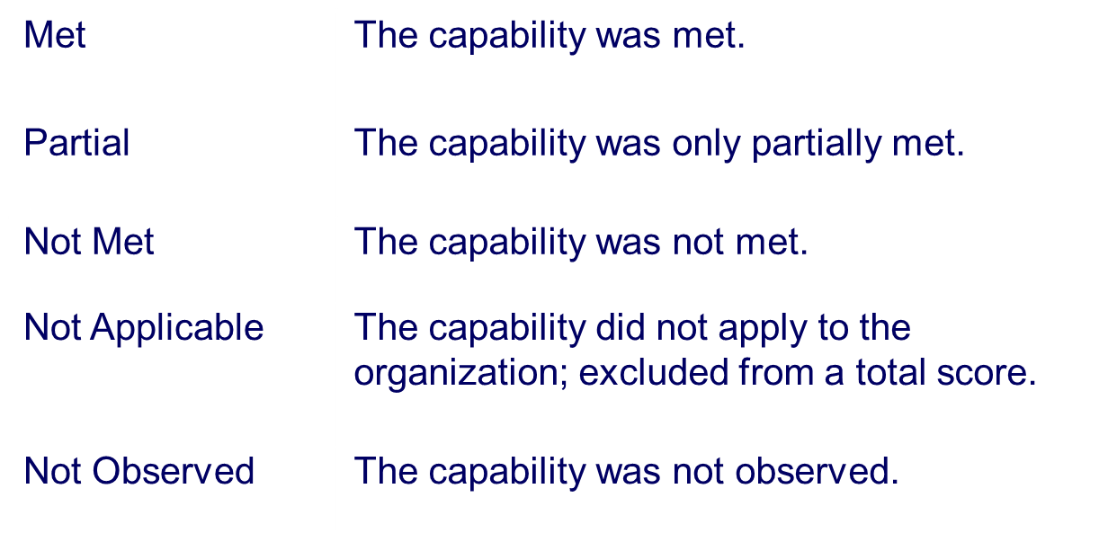
Scoring the Capabilities

Slide 36
Final Results
The organization receives a report which reviews the score of each capability and a rationale for the score.
Capabilities are analyzed to identify which priorities were met or where there are weaknesses in specific types or categories of capabilities.

Slide 37
Questions or Comments?

