Slide 2
Malware\Host Analysis for Level 1 Analysts “Decrease exposure time from detection to eradication”
Garrett Schubert – EMC Corporation
Critical Incident Response Center
Incident Response\Content Lead
Notes:
Introduction:
Back to the root of IR – - Many presentation here at the FIRST conference have been talking about information sharing so this morning I would like to discuss what happens after that information\intelligence comes in. What can your team do to decrease the exposure time of the alert\detection to containment? Imagine if the first analyst could respond to an alert, assess the threat and not have to pass it to any other team.

Slide 3
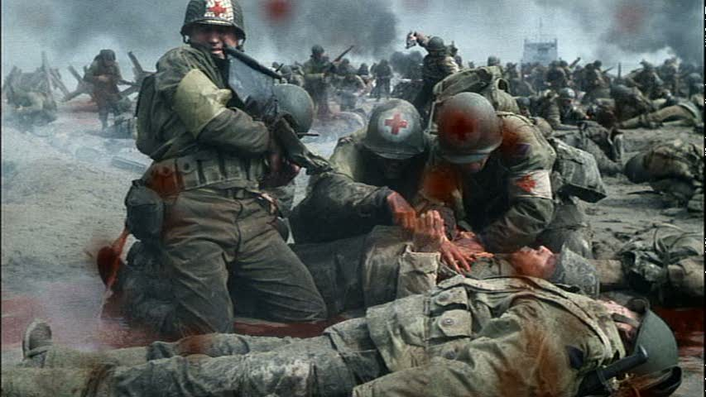
Surgery on the front lines
Notes:
IR teams often have to triage events during an active firefight.
-This limits the success and accuracy of the analysis on the frontlines

Slide 4
Notes:
-Our goal is to move from the battlefield to surgery as soon as possible.
Here is how EMC CIRC is attempting to do that.

Slide 5
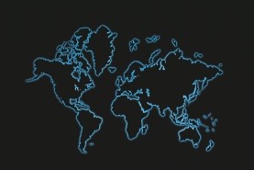
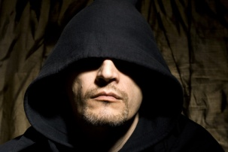
The Adversary
NATION STATE ACTORS
Nation states
Government, defense contractors, IP rich organizations, waterholes
Organized crime
CRIMINALS
Petty criminals
Organized, sophisticated supply chains (PII, PCI, financial services, retail)
Unsophisticated, but noisy
Insiders
Cyber-terrorists / Hacktivists
NON-STATE ACTORS
Various reasons, including collaboration with the enemy
Political targets of opportunity, mass disruption, mercenary
Notes:
-Known define threats within InfoSec

Slide 6
Attack Lifecycle (Kill Chain)
Research & Mapping the Target
Create the Malware
Compromise Host
Install Backdoor
Control the Device
Send to target
Exfiltrate Data
Reconnaissance
Weaponize
Delivery
Exploitation
Installation
C2
Action
Incident Response Team Maturity
*http://www.lockheedmartin.com/content/dam/lockheed/data/corporate/documents/LM-White-Paper-Intel-Driven-Defense.pdf
Notes:
The EMC CIRC is working to mature not just to wait for the bad thing to happen but to detect it and deny the attack at the earliest possible stage.
-Depending on when a campaign is detective a time sensitive response is critical. Between delivery (email comes in) and exploitation.

Slide 7
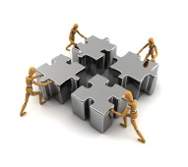
An Evolution
CIRC 2009
Today
Cyber Threat Intelligence
L1
L2
L3
CIRT
Advanced Tool & Tactics
Eyes on Glass
Analysis
Forensic
Coordination
Remediation
Rule/Report Creation
Workflow Development
Content Analytics
- Specific functions
- Reduces “Scope Creep”
- Focused workflow
Notes:
For the EMC CIRC to appropriately response to the concept of the kill chain we had to change our tactics and structure.

Slide 8
Incident Monitoring & Response
Eyes-On-Glass
End User Intake
Event Triage-Incident Command
Incident Containment
24x7 Coverage
Threat Indicator Portal (IOC’s)
Source Actor Attribution
Attack Sensing & Warning
Social Media
High Value Target (HVT)
Cyber Threat Intelligence
CIRT
Advanced Tool & Tactics
Content Analytics
Reverse Malware Engineering
Host & Network Forensic
Hunters
Cause & Origin Determination
Scripting & Integration
Content Development
Integration
Scripting
Workflow
Rules/Reports
Notes:
Each team has defined roles helping in limiting exposure time and responding to the threat.
CTI –
CATs –
CIRT –
ATTA -
Adv Tools & Tactics – leveraging "SA"/"warehouse" to hunt for "anomalous" activity. This is the testing ground for conditions that can be structured into rules which will be escalated into the CIRT queue.
Such searches include using proxy logs to see users going to Uncategorized sites with no User Agent String or referrer sting within a standard deviation. This indicates that there isn't a user behind the keyboard and a process is potentially attempting to communicate to a C2 or 2nd stage delivery site.
They also have a list of malicious user agent strings that they look at to see if there is unusual traffic associated with them. They will then build the "Investigation" in the workflow to keep track of the threat and ensure it gets visibility by the Incident Handler in the CIRT.
CATs has developed over 100 custom parsers to provide more detailed view of the traffic coming in and out of the network. These lead to rules that allow us to trigger on specific events (RAT's, executable code in image file) as traffic passes through the sensor.
This also provides our CIRC with greater "robustness" of the workflow, in the event the primary incident workflow is down we are still able to quickly see the same "alerts" in the custom view within the investigations view.

Slide 9
Notes:
When it comes to responding to alerts or that “call” you get into the CIRT, I tell my team to “Tell me the story”
I don’t want the response, I think this happened. I call this the 8bit version. As much as I like old video games that is not the kind of response I am looking for.
I want the full High quality version of the story.

Slide 10
Low Quality - Black and White
Notes:
What is this image?
-OK lets “zoom” in!

Slide 11
Low Quality - Black and White
Notes:
Any ideas?

Slide 12
Where’s Waldo now?
Notes:
This is the kind of stories we want our analysts to give. The challenge is just like finding Waldo the first one wins.
The analysts need to know all the details going on with an incident to make the appropriate assessment.
The key is presenting the right data to the analyst at the shortest time possible. The question is what do IR teams needs to shorten exposure time. The People, the process and the technology.

Slide 13
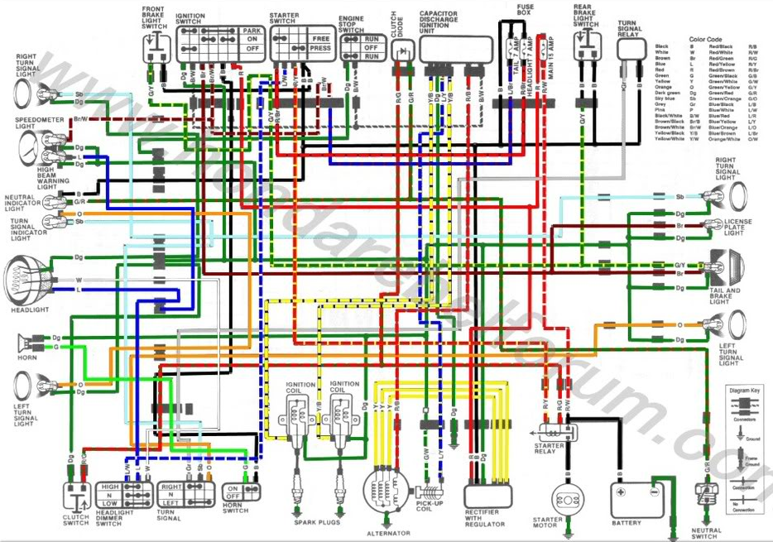
The People
Notes:
What is this image? What parts of this schematic do you recognize?
-Many of us have electrical backgrounds but not all of our frontline analysts know what they are looking at when it comes to an incident, we need the ability to break down the problem into it’s parts.

Slide 14
The Process
HR
Legal
Eng.
Log and Packet data
Identity
Division
Geo Info
IPS
Data
Incident Workflow
AV
Auth
EP
Data Enhancement
WAF
DLP
Incidents
Threats
GRC
FW
URL
WLAN
AD
Location
Regulation
Department
Asset Value
CIRC
IT
Notes:
The data (packets and logs) needs to be presented to the analyst so that they can make the assessment of the threat and identify the impact.
Knowing that a host is in Data Center is very different than knowing it is a sales person’s laptop when it comes to assessing the threat

Slide 15
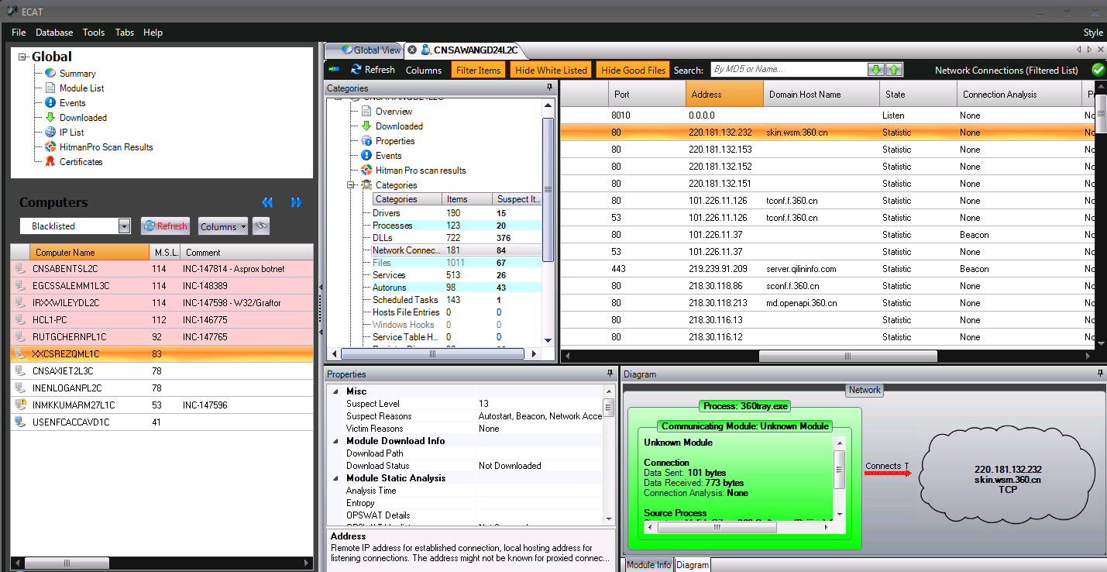
The Tech

Slide 16
PlugX (Sogu) Use case
EMC CIRC received intelligence about a command and control server.
The C2 server was identified as the call back station for a PlugX RAT.
MISSION: Identify impact to EMC and defend against all found threats

Slide 17
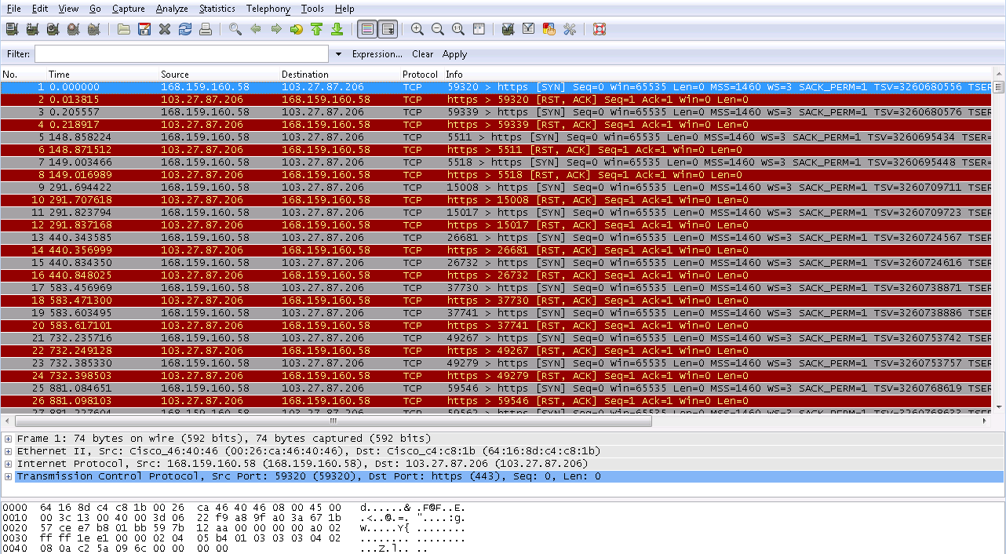
Network traffic

Slide 18
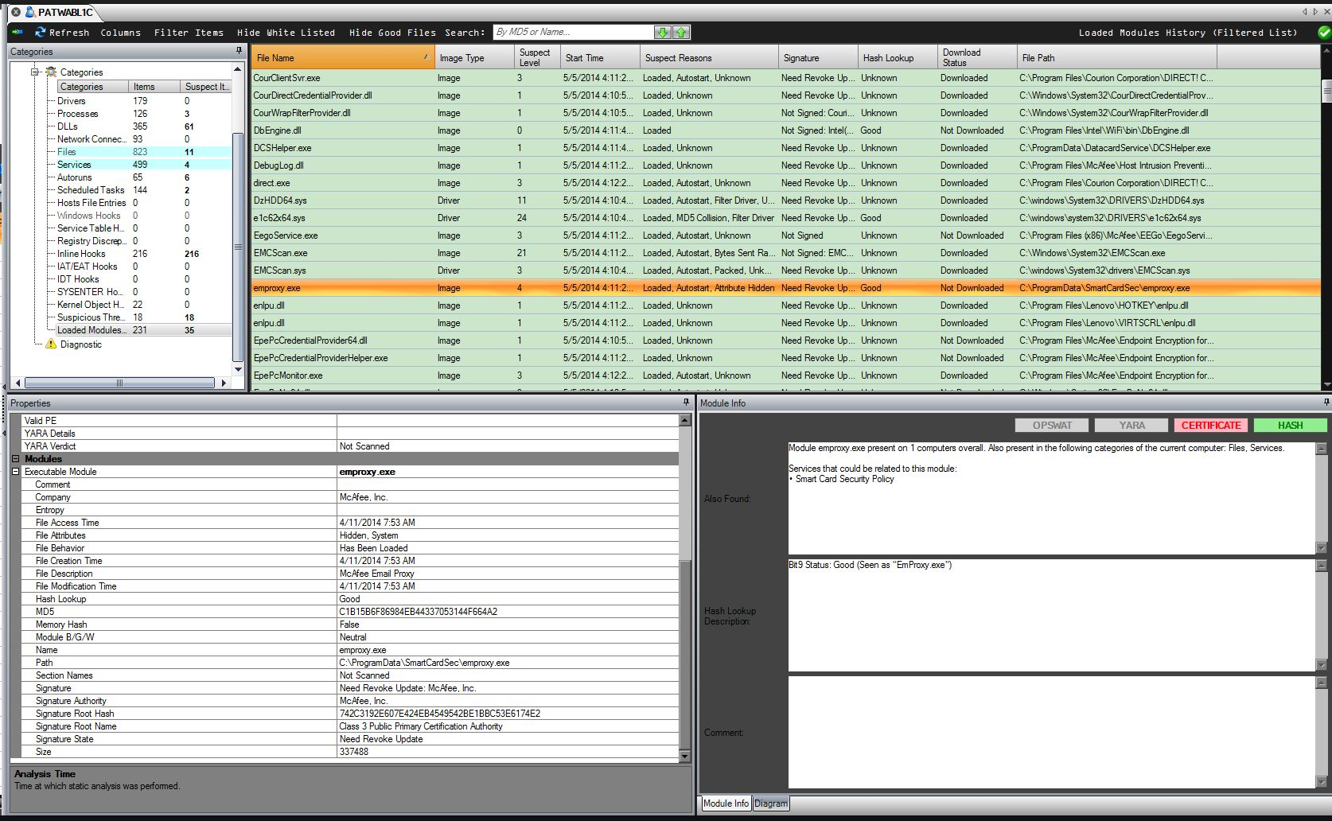
Find the malware from C2
Notes:
Where can you identify network traffic to process\file? What locations within the OS is that data stored?
Can a network connection ever occur without using memory?

Slide 19
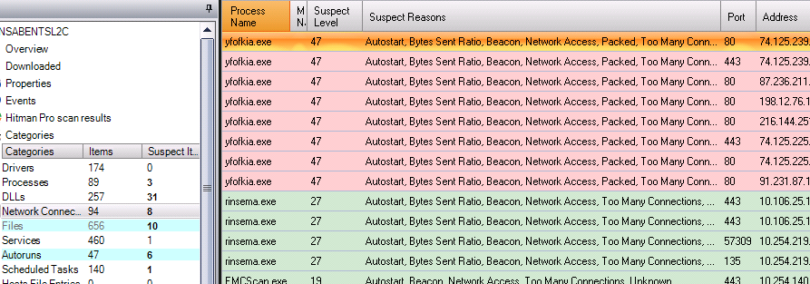
Network Connection to Process

Slide 20
Scoping threat within Organization

Slide 21
Origination of malware – Root cause
Notes:
Watering hole site

Slide 22
Recommendations
Cyber Threat Intelligence
Prioritize your intel!
Not all IoCs have the same threat
Content Analytics
Get business\organizational context at alert
Don’t make the analyst query for data you know they need
“Frontline” IR Analysts - CIRT
Level 1 analysts need the right tools
Stop training run books – THINK out of the box
Malware Team - ATTA
Share\document TTP and pivot points of specific campaigns

Slide 23
Questions?

Slide 24
The art of war teaches us to rely not on the likelihood of the enemy's not coming, but on our own readiness to receive him.
- Sun Tzu, The Art of War

