Slide 1

Managing Your Managed Security Service Provider
Stephen Seljan, General Dynamics Fidelis
Improving Your Security Posture
June 24, 2014

Slide 2
Overview
Introduction
SOC Analyst Expectations
Event Analysis
Event Tuning
Device Logging
Negative vs. Positive Filters
Conclusion & Questions

Slide 3

Critical Questions
Does your MSSP know your critical infrastructure?
Does your MSSP know what alerts are important to you?
Does your MSSP know what
you are vulnerable to?
Do you work with your MSSP
to tune alerts on a daily/weekly basis?
Do you ensure all security devices and logs are reporting as they should be?
Do you perform frequent review of old alerts

Slide 4
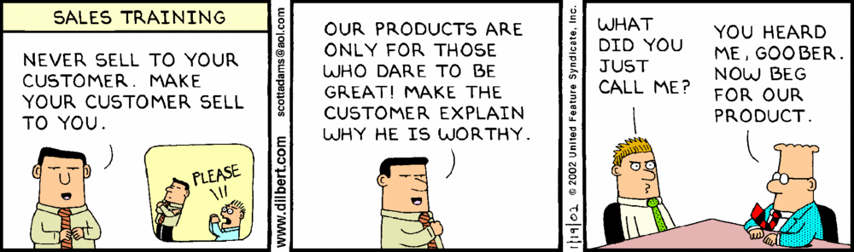
SOC Analyst Expectations
SOC Analyst Expectations

Slide 5

Event Analysis (or the lack of)

Slide 6
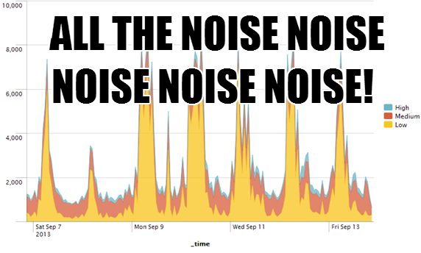
Event Tuning

Slide 7
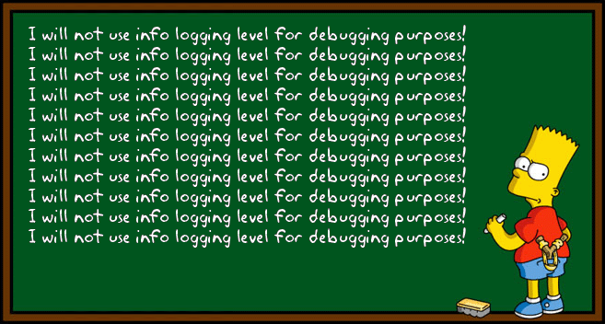
Device Logging

Slide 8

Device Trending

Slide 9

Positive
vs.
Negative Filters

Slide 10
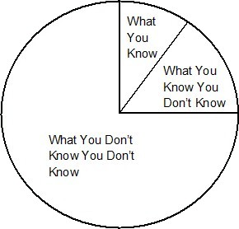
Event Review
Why an Event Review? Because you don’t know what you don’t know until you know it
Takes an average of 225 days to detect APTs
Days, weeks, even months for AV to detect new
Malware
New indicators of compromise released everyday
New rules pushed daily to IDS/IPS systems
Poorly written filters

Slide 11
Conclusion & Questions

