Slide 1


U.S. DEPARTMENT OF ENERGY
Flexible Transform
Semantic Translation for Cyber Threat Indicators

Slide 2
Who We Are
Andrew Hoying
National Renewable Energy Laboratory
andrew.hoying@nrel.gov
Chris Strasburg
Ames National Laboratory
cstras@ameslab.gov
Dan Harkness
Argonne National Laboratory
dharkness@anl.gov
Scott Pinkerton
Argonne National Laboratory
pinkerton@anl.gov
Notes:
Team contact e-mail: federated-admins@anl.gov

Slide 3

Agenda
Motivation
Background
Flexible Transform (FT) Approach
Extended Example
Conclusions

Slide 4

Motivation
Why transformation? It is needed to:
Facilitate migration to a common language (STIX) …
without having to wait on entire customer base to adopt
the language natively
Adapt data to multiple tool chains
dynamically within a single site
Why must it be flexible?
Point–point translation is not scalable, O(n²)
A semantic representation minimizes data loss
Deals with inherent ambiguities in legacy data
  Shared Internet Protocol (IP) address – source or target (or resource or pivot point or …)?
Notes:
Split – Avoid least common denominator sharing
– Newer languages (e.g. STIX) are able to represent new threat characteristics, however clients using older languages can only consume a subset
-- We want to avoid holding back those organizations with larger resource pools from migrating to new representations because they must wait on all of their community

Slide 5
Motivating Example
Notes:
When mappings are codified in the translation program directly, the syntax -> semantic elements are tightly coupled, requiring changes to code when new variations of the same syntax are introduced.
Flexible transform provides a mechanism to capture the semantics of a language. It can be used to facilitate:
Mapping from one syntax to another
Mapping between two schemas, same syntax (e.g. XML -> XML)

Slide 6
Translation Scalability
New Syntax
/ Schema
/ Semantics
O(N²)
CSV = comma-separated value; XML = extensible markup language.
Notes:
Additionally, scalability of ‘fixed’ translators between pairs of formats grows quadratically; when manual effort is involved in developing each translator, this quickly becomes unmanageable.

Slide 7

Background
Sharing data is hard when everyone does not speak a common language
Methods exist for parsing data from systems you do not control
  Dynamic or static mapping
  of field names and types
  Post-ingestion data recognition
  Predefined parsers
We want a richer ontology
so that data are not lost
in translation.
Notes:
Perfect world -> everyone speaks a Common Language, for example STIX. However, there is always a transition period, and the threat space is continually evolving – not everyone can adapt at the same rate

Slide 8
U.S. Department of Energy Cyber Fed Model (CFM) – GUWYG Background
[2004–2010] – Single Input Format Supported
[2010–2013] – Give Us What You’ve Got (GUWYG) v1
[2013–Present] – GUWYG v2
  Added XML and Key/Value formats for input
  CFM supports multiple input/output formats and functions as a bridge between Enhanced Shared Situational Awareness (ESSA) initiative and thousands of Energy Sector utilities
Notes:
The CFM project has wrestled with this issue from its inception. From dictating a single format, CFM evolved to support dynamic translation of pre-defined upload formats to a single output format, and is now pursuing multiple input / multiple output translation.
Historical translation efforts – experience moving a community from a legacy sharing language to an updated one; communities are slow to migrate.

Slide 9
Ontology
Notes:
Ontology concept hierarchy example.

Slide 10
Ontology
Notes:
Ontology relations example.

Slide 11
Flexible Transform Approach
Notes:
By mapping directly to semantic concepts, rather than schema elements of the target language, we have a machine-consumable common notion of threat indicator data.

Slide 12
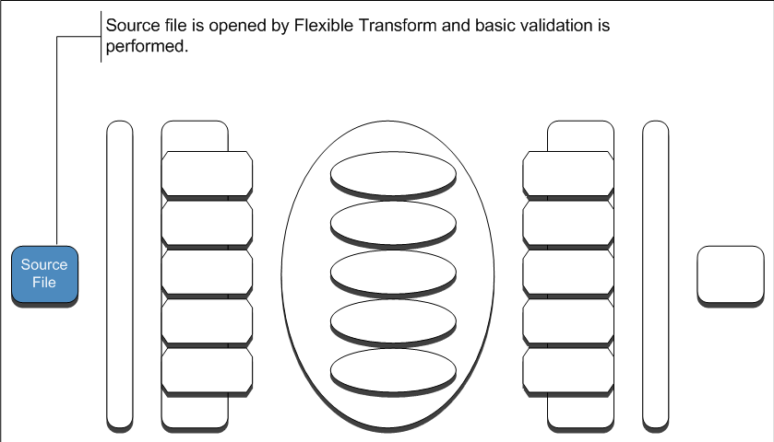

Approach/Design – Process Detail

Slide 13
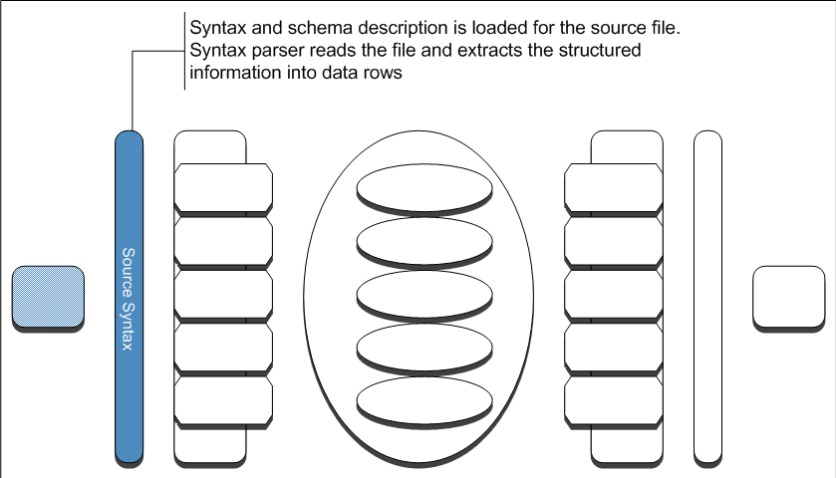
Approach/Design – Process Detail (cont.)

Slide 14
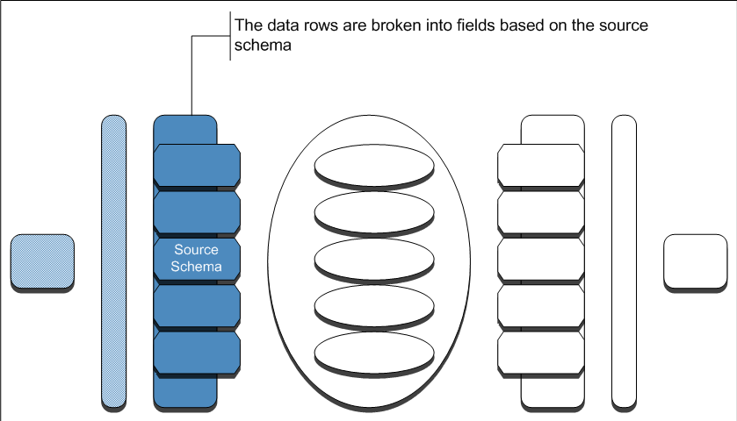
Approach/Design – Process Detail (cont.)

Slide 15
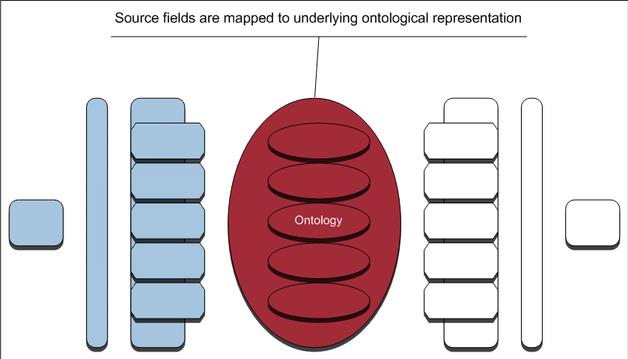
Approach/Design – Process Detail (cont.)

Slide 16
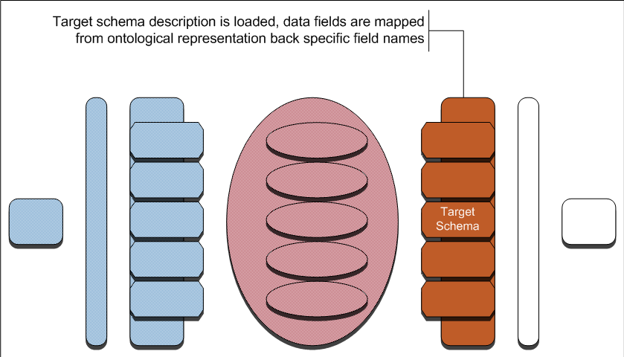

Approach/Design – Process Detail (cont.)

Slide 17
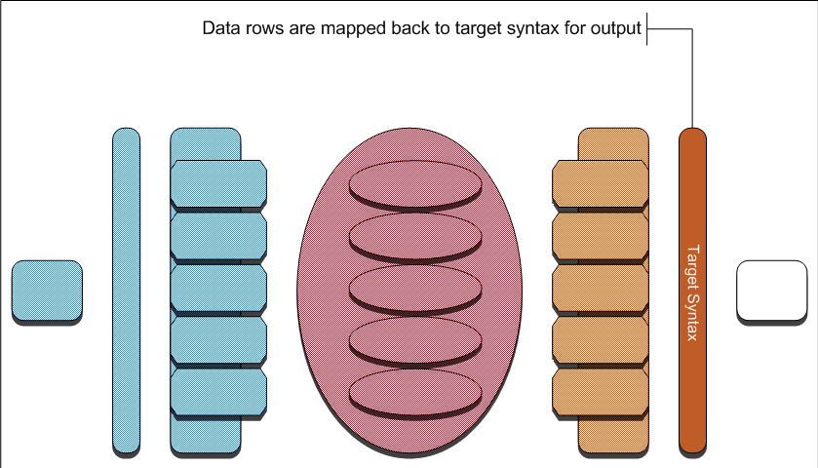
Approach/Design – Process Detail (cont.)

Slide 18
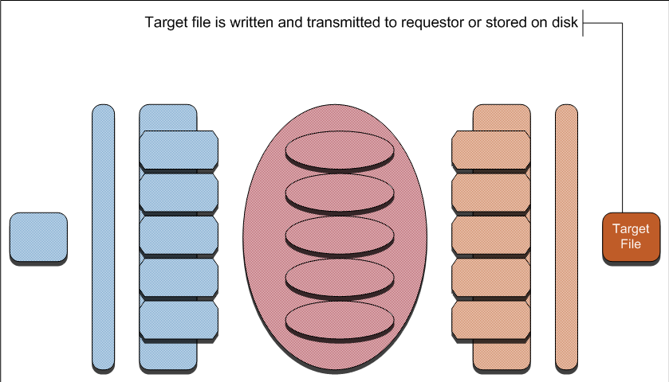
Approach/Design – Process Detail (cont.)

Slide 19
Flexible Transform Scalability
O(N)
Notes:
Our quadratic problem is now linear.

Slide 20
Approach/Design – Semantic Structure
Notes:
Example high-level ontology structure. Document structure concepts are shown on the left, while threat related concepts are shown on the right.

Slide 21
Extended Example – Perfect Semantic Match
Notes:
No semantic loss.

Slide 22
Extended Example – Generalization Mismatch
Notes:
Semantic loss – recipient does not receive the full context around the observed activity. In these cases, out of band communication is used to alert the sender and recipient that formats are not entirely semantically compatible.

Slide 23
Extended Example – Specialization Mismatch
Notes:
Semantic loss – recipient information is potentially overspecified.

Slide 24
Extended Example – Missing Data 1
Notes:
Some contextual information in the source file cannot be represented at all in the target and is lost.

Slide 25
Extended Example – Missing Data 2
Notes:
The recipient relies upon semantic information which is not supplied by the sender at all.

Slide 26

Conclusions/Limitations
Using flexible transform, we act as an automated translator, enabling communities to share data regardless of the native tools/languages
FT carries a performance impact – additional processing
‘on-the-fly’
Current definition of new syntaxes, schemas is manual – we are working on an RDF language to automate this function
It requires fully structured data – we are examining the feasibility of parsing semi-
structured data
Reduces, but does not eliminate,
the problems of sharing
ambiguous data
Notes:
Until full adoption of a universal language, a-la STIX, translation will continue to be needed.

Slide 27
Preparing for Tomorrow’s Cyber Threat
Cyber threats are global – sharing is key:
  Are you ready to consume?
  Are you ready to produce?
Examine your data / workflow:
  Let us know what schemas/ languages are in use
  Provide/ask for schema specifications when needed
Add structure to your data!

Slide 28
Future Needs
A cross platform, or web-based, graphical user interface (GUI) for building indicators, other data types, and relationships using known semantic values
  Visualize large data sets
  List known semantics; provide user with a list of target formats
  Built-in definitions of field types help analysts choose the appropriate field for the indicator or relationship
Syntax parser and dynamic schema for semi-structured data
Notes:
GUI Example – Mandiant IOC Editor
PDF Example
Extract probable fields from raw text, maintain logical groupings, provide analyst with simple to use tool to map the data to indicators.
Reduce chance of typos when report is translated to sharable indicators

Slide 29

Questions?
Questions Now?
  Ask away!
Questions Later?
  federated-admins@anl.gov
Notes:
Announcements and a project website / distribution list will be made available soon!

