Slide 2
Open Source Software Environment Security Issues
Yoshiki Sugiura, NTT-CERT
Keisuke Kamata, Freelance
Tomoyuki Kuroda, OSS Forum Japan
Ikuya Hayashi, NTT-CERT

Slide 3
Agenda
Roles of CSIRT
OSS Security Tools
Issues on OSS

Slide 4
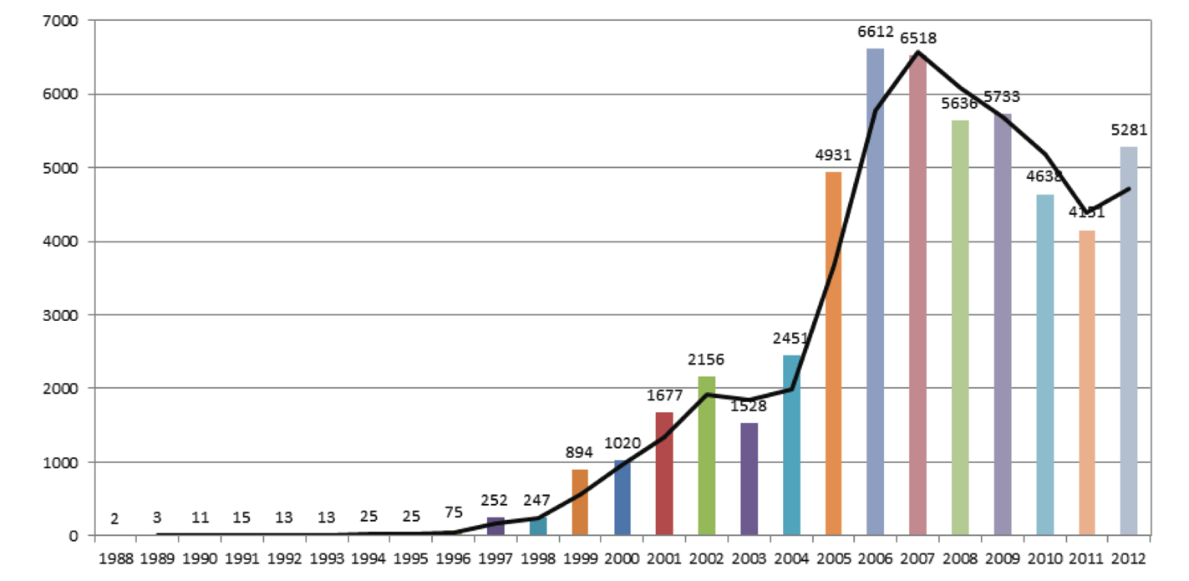
Vulnerability
Root problems of most cyber security incidents
Source: 25 Years of Vulnerabilities: 1988-2012 by sourcefire

Slide 5
Vulnerability Quiz
How many apache related vulnerability problems were published in 2012 and 2013?
http://www.osvdb.org/search?search[vuln_title]=apache&search[text_type]=alltext
2014: (@May 12th )
2013:
2012:
45
133
120

Slide 6
A lot of Security Issues on OSS
http://en.wikipedia.org/wiki/Swiss_cheese_model
Awareness test

Slide 7
CVE-2013-1966 http://struts.apache.org/development/2.x/docs/s2-013.html
Apache Struts 2 before 2.3.14.1 allows remote attackers to execute arbitrary OGNL code via a crafted request that is not properly handled when using the includeParams attribute in the (1) URL or (2) A tag.
A very serious vulnerability in Japan
A lot of Japanese websites might have been defaced as drive by download sites.
needed to apply security patch quickly after releasing vulnerability information.
A lot of vulnerable sites still.

Slide 8
Apache Struts
Open source web application Framework
Based on MVC architecture
Struts 2
Controller
Request
Response
Model
View

Slide 9
CVE-2013-1966 http://struts.apache.org/development/2.x/docs/s2-013.html
Apache Struts 2 before 2.3.14.1 allows remote attackers to execute arbitrary OGNL code via a crafted request that is not properly handled when using the includeParams attribute in the (1) URL or (2) A tag.
A very serious vulnerability in Japan
A lot of Japanese websites might have been defaced as drive by download sites.
needed to apply security patch quickly after releasing vulnerability information.
A lot of vulnerable sites still.

Slide 10
Problems of CVE-2013-1966 Struts2 issues
Developer side
Secure development
Secure coding
User side
Not enough skill to patch(No Patch management).
Not enough considerations for security.
System Integrator and Vendors issues.
They have no responsibility to fix it in some cases
Even they didn't know about patch management

Slide 11
Agenda
Roles of CSIRT
OSS Security Tools
Issues on OSS

Slide 12
Patch Management (cont.)
System Inventory
Testing of Remediation
Deploy
Prioritize
Create Remediation DB
Monitoring
Distribute information
Automated Deployment
http://csrc.nist.gov/publications/nistpubs/800-40-Ver2/SP800-40v2.pdf

Slide 13
CSIRT and communities
Vulnerability information
Best practices
Knowledge
FIRST
World wide
Over 300 Team
TF-CSIRT
Europe
APCERT
APAC
National CSIRT
Local communities
Japan, Germany, and so on

Slide 14
Early Warning Partnership for Information Security in Japan
Reporter
End
User
IPA
(accepting agency)
Corp.
Analysis
JPCERT/CC
(Coordinator)
Media
JVN
(Portal site)
coordination
announce
SIer
Information
Patch
Measure
ISP
Vendor 1
OSS 1
Vendor 4
OSS 3
Supplier
Vendor 2
Vendor 3
Vendor 5
Vendor 6
http://www.jpcert.or.jp/english/vh/project.html

Slide 15
Agenda
Roles of CSIRT
OSS Security Tools
Issues on OSS

Slide 16
OSS Security tools

Slide 17
OSS Security tools (cont.)
A lot of useful tools are available
commercial level software are also there
attacker are also using those tools…
Know your enemy?
OSS security tool community
different motivation from other OSS softs
useful to share knowledge and information
more security experts

Slide 18
OSS Security tools (cont.)
for admins/developers
IDS/IPS, WAF, Firewalls,
Penetration testing, code testing
for end users
data encryption & signing
data rescue
for security professionals
security analysis tools
digital forensic, malware analysis, pentest

Slide 19
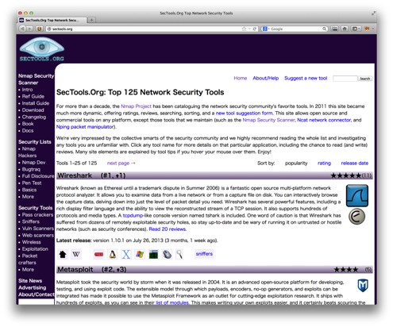
One of good information source of OSS security tools
Top 125 Network Security Tools
http://sectools.org/
Probably best free security list
https://www.techsupportalert.com/content/probably-best-free-security-list-world.htm

Slide 20
Share more OSS security tool knowledge/experiences
Beginners
I don’t know which one is good.
I don’t know how to use it.
I don’t know how to google it.
I don’t know how to learn it.
Seniors
I like this one best compare to all others.
I have my own way to use it.
Just google it to know! OR “Use the Source, Luke”
Don’t learn, do it.

Slide 21
Why don’t YOU to help?
Security is hands-on matter.
Beginners need Seniors.
Bring up new Jedi’s for future internet security.
Expect young generation do more than us.

Slide 22
Conclusion
Roles of CSIRT
OSS Security Tools
Issues on OSS

Slide 23
Another Topics for future
Best practices using OSS
OSS Security Tools repository and how to use them (Hands on)
User Vulnerability Educations
Secure Development and Secure Coding

Slide 24
Questions?
If you have any question, please speak slowly

Slide 25
Thank you very much
Freely contact us
Yoshiki yo!! Sugiura
E-mail:
yoshiki.sugiura@bornfromegg.net
yo.compas@gmail.com
Keisuke Kamata
E-mail:
yoshiki.sugiura@bornfromegg.net
yo.compas@gmail.com

Slide 26
Acknowledgement
Mr. Shin Adachi, NTT-CERT
Mr. Masahito Yamaga
Ms. Natsuko Inui, CDI-CIRT
Mr. Hitoshi Endo, NTT-CERT

