Slide 2
Don’t Panic! Case Studies of Incident Response from the Field
Kristy Westphal
Information Security Officer
Element Payment Services

Slide 3
Agenda
Practice practice practice.
Look at experiences from incident handling of various types of organizations (financial, health care and government)
Walk through the initial scenario.
Look at what was done.
After which we will discuss what could have been done differently to improve the response.
Each scenario will be information security/technically focused.

Slide 4
My poor bleeding heart
OK, we might have panicked a little here
Facts:
High impact, widespread vulnerability is published
IT/Security take a look; no OpenSSL in production
Assessed as no/low risk
Then all heck broke loose
Customers started asking questions
Unsure of path to come up with messaging
Needed to get answer quickly
After a little chaos, took collective breath, came up with response

Slide 5
So…lessons learned?
Don’t panic
Figure out what truly applies and what does not (e.g., has an incident actually occurred?)
Know ahead of time how a response should go out
Practice how this will work
Stay updated on any new developments
Other thoughts?

Slide 6
What is an incident?
In ITIL terminology, an ‘incident’ is defined as:
“An unplanned interruption to an IT service or reduction in the quality of an IT service. Failure of a configuration item that has not yet impacted service is also an incident, for example failure of one disk from a mirror set.
Incident Management is the process for dealing with all incidents; this can include failures, questions or queries reported by the users (usually via a telephone call to the Service Desk), by technical staff, or automatically detected and reported by event monitoring tools.”
And how do you define this based on IaaS, PaaS and SaaS?

Slide 7
How easy is that to put your finger on?
Everything is always an incident
Especially when my thing is broken
Which makes it even harder to figure out and address the REAL incidents!
So what do you do?

Slide 8
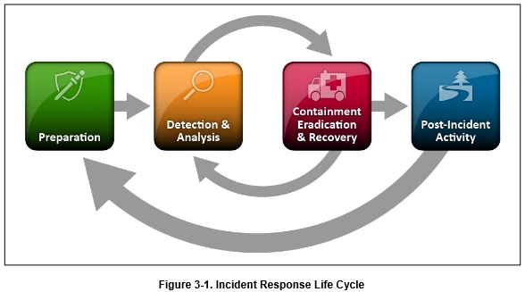
(groan) You need a process!
Not only how to do these things:
But also to answer questions like: Do you need to include bridge calls? (details, details)
Notes:
http://csrc.nist.gov/publications/nistpubs/800-61rev2/SP800-61rev2.pdf

Slide 9
You need to know what you are dealing with
What is the landscape of your environment?
Who is the owner?
Where is the problem?
What kind of information do you have access to?
Can you solve this on your own or do you need to engage the provider?
Analysis is critical and must be thorough
Why?

Slide 10
Define tasks
Arguably, this will change with each incident
But role ownership is key
To prevent duplicate work
To focus expertise where it’s needed
Common tasks such as:
Who knows what the normal behavior of a system is?
Who is responsible for maintaining logs (and which ones?)
Who owns clock synchronization?
Who can run the packet sniffer and what is the process to do so?
Who is responsible for cleaning up the problem?
What kind of information can be disclosed to who and when?
Who provides the post-mortem report?

Slide 11
How about Cloud providers?
My experience with: Symantec
No direct line in
But found points of escalation on the website
Actually got a response in the middle of the night
But it took several tries to finally fix the issue
(And this was just an outage)

Slide 12
Case 1
One month into the job
Suddenly files on the shared drives are inaccessible
Someone reported that they clicked on a link and then got this hideous popup window:
Your files have now been encrypted! Pay me or you’ll never get them back
Current staff inexperienced incident handling
Oh, and I was out of the office

Slide 13
What happened
Figured out what the ransomware was
Figured out how to fix it
Tried to head it off from spreading
Restore files
Ensure no customer data compromised
Employed all resources available to ensure that we did all the right things
But…it happened again a couple weeks later!

Slide 14
What would you do better?

Slide 15
Case 2
Virus outbreak on an IaaS platform
Landscape: Client outsourced all IT to us. Systems in transition between their data center and ours
Client notified us that several Trojan detects had been found. This happened a lot, so seemed to be nothing out of the ordinary.
Users began to notice that access to file shares was not available. Customer began to escalate to IT team.
Soon we learned we had a worm. The exploit happened due to a java exploit that the client was far behind on updates. The wagons were circled, a third party was brought in to determine extent of possible breach and the games began.

Slide 16
The remediation (Case 2)
Updating the clients
Cleaning file shares
Forensic analysis responsibility became an in-depth discussion
Daily calls
Contract review
Log review (what was really being stored?)
Contract thrown out the window
Very murky
Repercussions discussed much later
Took over a month to clean up and analyze
Exfiltration analysis a problem
Had to determine as we went

Slide 17
What would you do better?

Slide 18
Case 3
Large government agency
Never enough room in the offices
Rented a storage unit
Storage unit broken into
Three hard drives stolen
They were encrypted, but….

Slide 19
What would you do better?

Slide 20
Case 4
Lost a NIC in a server…that held backups for an environment
Old version of backup software
Working with staff who speak English as a second language
Different cultures deal with incidents differently

Slide 21
What would you do better?

Slide 22
Bonus Case 5
Customer unable to send mail
After a successful change
Reported by customer late
ONE resource who understands the mail environment
Not well mapped out
Traced it to a corrupted sendmail.cf file

Slide 23
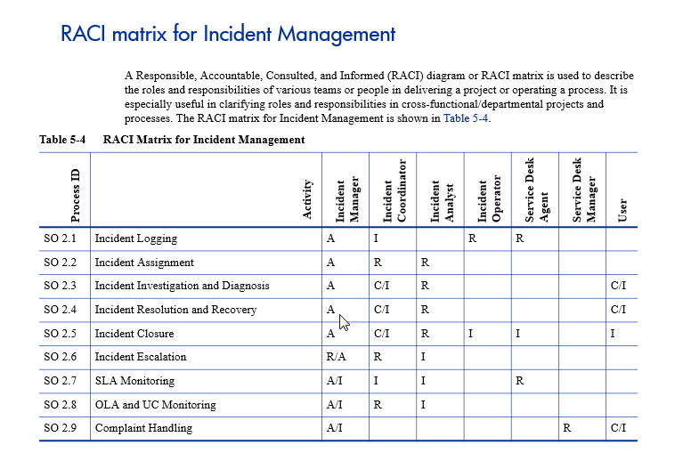
A RACI Matrix!
Notes:
Taken from HP Service Manager Best Practice: http://www.techport13.com/publications/newsletter/details/SM7_Best_Practices.pdf

Slide 24
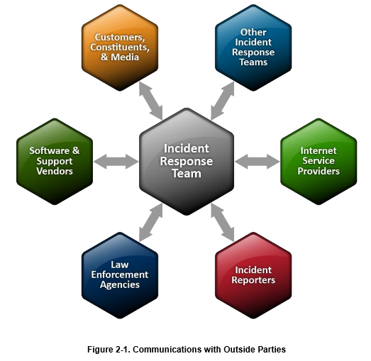
A Communications Plan
Third Party
Services Provider
Notes:
NIST 800-61

Slide 25
Processes and Templates
Go to NIST for processes
800-61 has quite a bit outlined
SANS still has great policy templates
http://www.sans.org/security-resources/policies/

Slide 26
Policies
Key thing to remember: just because you outsource support of IT, doesn’t mean you lose accountability!
Not that your provider doesn’t have any, but…
Log retention
Use cases for event correlation
What is the normal behavior profile for a system
Clock synchronization
Data disclosure to external parties

Slide 27
Summary
Plan ahead- don’t wait until you need it
Get involved in the contract process
Test it!
Don’t reinvent the wheel- this has been done before and a solution CAN be reached!

Slide 28
Thank you!
kwestphal@elementps.com

