Slide 1
Scaling Threat Intelligence Practices with Automation
How to build & scale a Threat Intelligence capability

Slide 2
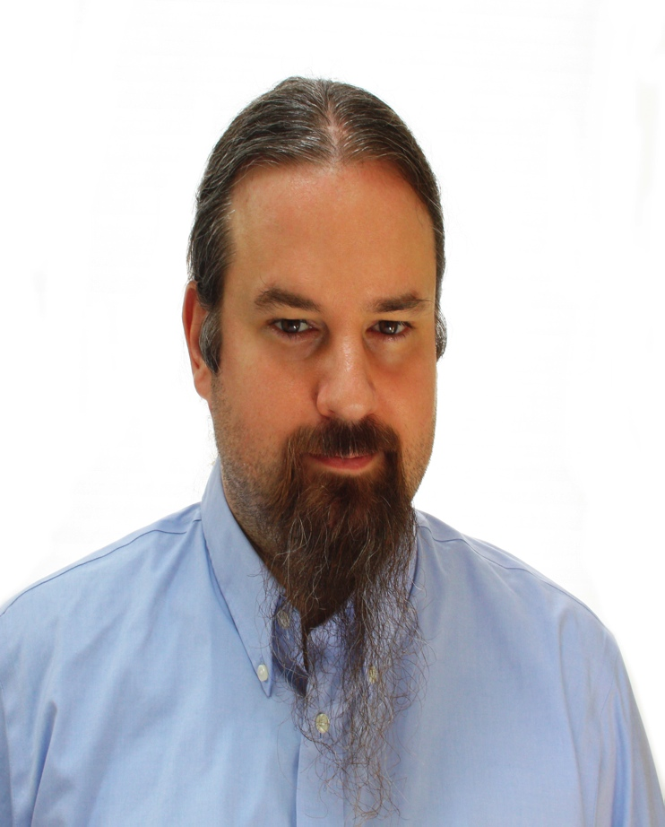
Doug Wilson
Manager at FireEye Labs
Mandiant since 2009
  2011 OpenIOC release
  2012 Intel Group
Infosec since 1999
  Background in
    Incident Response
    Multi-tiered Applications
    Web Hosting
@dallendoug on Twitter

Slide 3
Disclaimer
This presentation is drawn from my experience with employers, customers, and industry
No specific Products will be named
This presentation is not an endorsement by Mandiant or FireEye

Slide 4
Threat Intel
Buzzword?
Super Power?
or Necessary Evil?

Slide 5
Todays Agenda

Slide 6
Agenda
Business process for standing up Threat Intel
Components of an Intelligence Cycle
Lessons Learned
  How to make the Intel Cycle scale
  And tips for small organizations

Slide 7
first, a few questions

Slide 8
Is Threat Intel right for you?
Basic level of security maturity needed
  before an Intel practice has any use
Do you have:
  Insight into what is happening on your network
  The ability to take action to control what is happening on your network
If not, Threat Intel is NOT for you, yet. . .
Notes:
You must be this tall to ride

Slide 9
What is your focus?
Is your organization security or Intel focused?
Do you have Security or Intel SMEs on staff?
Do you have real resources to invest in Intel?
No to all these?
  Threat Intel is NOT for you.

Slide 10
Setting up a Threat Intel workflow
Getting started in Threat Intelligence

Slide 11
Intel meets Business Process
PLAN
  EXAMINE
    IR data in your org and how it flows
  WALK THROUGH
    A basic Intel lifecycle
    See how each step would work with your org
  PLAN AND RESOURCE
    Determine what resources will be committed
    And what steps will be followed

Slide 12
Intel meets Business Process
IMPLEMENT
  INCENTIVIZE
    Make your new process matter
  AUTOMATE
    Make your new process scale
  GET FEEDBACK
    Make your new process better

Slide 13
The Intelligence Lifecycle

Slide 14
Intelligence Lifecycle
Requirements
Collection
Analysis
Dissemination
Feedback

Slide 15
Intelligence Lifecycle
Requirements
Collection
Analysis
Dissemination
Feedback

Slide 16
Gathering Requirements
Why are you doing this?
  Don’t just buy Intel because everyone’s doing it
Look at your current creators and consumers
  Look at who you could empower with Threat Intel
If business units don’t understand “security,” translate for them.
  Show value and reasons to care
  This helps with incentivizing later
Look at what they can and can’t consume

Slide 17
Collection
Thought Process
  What can we collect
  What should we collect (and are allowed to?)
  Out of that, what is useful
  How do we get useful out of noise
    And do that in a timely manner
  How do we make useful standardized
    How do we make useful scale?

Slide 18
Collection
Sources
  IR
  Feeds
  Customers
  Partners
  And More

Slide 19
Collection: IR
What’s going on in your network may be your most important source of Intel
IR != conducive to time consuming reporting
Make the reporting part of process
  Standardize SOD
  Collect Indicators as part of normal workflow
  Assist with debriefings
  Privacy & Sharing Guidelines matter here

Slide 20
Collection: Feeds
All over the map in terms of quality
Many have LOTS of quantity
Need to ADD VALUE
  You need to be able to consume it
  Data for machines needs to be accessible via API
  Ideally organized in a standard fashion

Slide 21
Collection: Customers
Very much depends on what your organization does
Get Feedback from them if possible and pertinent
Source of Intel? Possibly
Source of Customer satisfaction? Definitely
  Lets you know if your Intel is useful
  Lets you know if changes you make matter

Slide 22
Collection: Partners
Even more “it depends” than customers
Concerns about “sharing” are complicated by concerns about business
You can get things through partnerships you can’t get any other way
You can also waste a lot of time on this

Slide 23
Collection: on and on
Government organizations
Non-profit organizations
Open Source Intel from bulletins and blogs
Innumerable sources
  Is there something you can use
  Is it worth the investment you make to consume it
  Is it API accessible and/or standardized in some way?

Slide 24
Analysis

Slide 25
Storage
You have SO MUCH DATA.
  Now where are you going to put it?
There is no “one answer” or magic product

Slide 26
Storage: requirements
Look for these things
  Your staff knows how to work with the technology
    Or you have the resources to staff to it
  Accommodates storage and processing load
    Both now, but also for X amount of time in the future
  Needs to enable what you consume and produce
  Needs to enable the analysis you intend to do
    Not all DB are equal, or shaped the same
    Not all are optimized the same

Slide 27
Storage: the hotness
Seeing a lot of graph databases used for analysis
Seeing a lot of “big data” solutions used for massive storage and queries across large amounts of data
  Traditional and NoSQL databases, Map Reduce, distributed file/storage solutions and more
Consult an SME if you don’t have one in house

Slide 28
Connecting the Dots
Clustering Data (Tactical)
  What matters to your organization
  What sort of data do you have
  What can you act on
Attribution example
Tactical benefits
  Improved/Targeted Detection of what’ clustered
  Basis for strategic defense decisions

Slide 29
Drawing the Graphs
Trending Data (Strategic)
After you gather enough data
  Can show shifts in TTPs
  Can show campaigns
  Most importantly, it shows you change over time – and if that relates to changes you made
    Metrics & Feedback, combined w/ other sources
    Are you getting better or worse at dealing w/ adversaries over time?

Slide 30
Reporting
Most mature form of analysis
Can achieve several goals
  Inform
  Empower
  Publicize
Again, how does your organization benefit?
  Do what gives you Return On Investment (ROI)
  Remember, ROI can be indirect

Slide 31
Dissemination of Intel

Slide 32
The Size and Shape of Indicators
In a perfect world, you create exactly what all consumers of your Intel need to consume
We’re very much not there yet
This is where standardization comes into play
The “lowering the barrier” idea
YOU have to create tools and utilities if you want adoption
Or incentivize their creation

Slide 33
Consumption of IOCs vs “Standards”
Remember, most orgs are NOT Intel or Security focused
Using Standards
  We have a “one percenter” problem in Threat Intel
  Most of our solutions are by the elite, for the elite
    they require vast resources and high end personnel
  We need to move past this
    the consumer end of the Intel process is the first place to start
  Most organizations’ ONLY contact with Intel is as consumers

Slide 34
Consumption of IOCs
Most people are REALLY HAPPY to receive Intel that they can use without any extra effort
The more the level of effort goes up, the more likely they are to walk away
Creating tools or translations that enable consumers to access your Intel is important
  However, it usually not cheap, fast, nor easy

Slide 35
Feedback -> Requirements

Slide 36
Feedback means metrics
Make sure you can MEASURE efficacy
Most companies have only anecdotal feedback
You have a lot of unanswered questions if you can’t measure whether what you are doing.
You can see
  what works & what doesn’t
  the effect of changes
  how much or little you are helping your customers

Slide 37
Feedback feeds Requirements
Even without requests for new features, feedback helps you make your Intel better.
If there is a problem seen in the metrics, an automatic requirement should be to fix that.
Having the insight of measurable metrics can help you gauge future requirements and feature requests

Slide 38
Lessons Learned: Scalability

Slide 39
Automate to Empower
Humans are the limiting reagent
Hardest to find/acquire/replace
In Threat Intel, they do a lot of busy work
Automate to protect and empower them

Slide 40
Simple Steps
Step through your process
Determine what steps MUST have a human making a decision
Automate all the rest, starting with the lowest hanging fruit.
The more automation you put in place, the more time your personnel have to do their real jobs

Slide 41
Requirements
Plan systems to be expandable
  If you succeed, your growth may be rapid!
Make investments in staff or resources
  You don’t want to have to figure out big data after you’re there already
Make sure incentives and buy-in from others can scale as well

Slide 42
Collection
Only take in feeds that you really need
  (Only take in ones you can automate)
Regularly evaluate what you are getting for your money or your effort
For groups of humans, make collection a part of other processes that have to be done anyways.

Slide 43
Analysis
Good tool selection can make or break your ability to scale
  Make sure what works for 10 or 100 can grow to handle 10,000 and on
You will probably hire the most staff in this area – plan for that.
  No amount of automation (yet) can replace a good analyst.

Slide 44
Dissemination
Standardization is your friend
  You can’t please everyone
  But you can come close with translation capabilities
Don’t fall into the “Document Trap”
IOCs are like Source Code – a LOT of the same tools for one work for the other
  Automate Packages, Builds, and Tests

Slide 45
Aside: The Document Trap
IOCs are documents, used to transfer data.
As such, they usually end up being used to store data as well.
Data works much better IN A DATABASE, not in documents
If you get too many documents, you have a document management problem
  When you really want a data management problem

Slide 46
Aside: Indicators
In a perfect world, Threat Data flows freely between those who need it
If you control the ecosystem, it should be API calls
Threat Intel “Standards” exist for when that is NOT the case
  Crossing borders and boundaries
  Exchange between organizations or multi-party communications

Slide 47
Aside: Standards
Standards ultimately will matter.
But do what works for your organization.
The field is immature
It will still change
Don’t ignore them, but solve your problems first
If you have the resources to do standards, GET INVOLVED in the conversations

Slide 48
Threat Intel Standards
OpenIOC – http://openioc.org
STIX/TAXII – http://stix.mitre.org
IODEF
  MILE working group: https://datatracker.ietf.org/wg/mile/
  IODEF standard (old) : http://www.ietf.org/rfc/rfc5070.txt
VERIS -- http://www.veriscommunity.net/

Slide 49
Feedback
Measure everything that you can that tells you if your Threat Intel is working or not
Make as much of this as automated and built into existing processes as possible
If your staff have to spend a lot of time sifting through mountains of data by hand, assume it won’t all get done

Slide 50
Lessons Learned: Small Shops

Slide 51
Most start small . . .
Identify internal resources that are already doing part of what you need
Figure out how to harness that
  or better yet, have them join the Intel effort
Intel isn’t just “hiring analysts”
  you’ll have more success with buy in from existing staff
The best one hire you can make might not be an analyst . . . It might be a developer

Slide 52
Be realistic
Consider your priorities
  Do NOT just get into Threat Intel because it’s trendy
Gauge your resources and you staffing
  It may be better to outsource, partner for, or pay for Threat Intel and associated Services
Do what you need for your org
  Not what everyone else is doing just “because”

Slide 53
Agenda
Business process behind Threat Intel
Components of an Intelligence Cycle
Lessons Learned
  How to make the Intel Cycle scale
  And tips for small organizations

Slide 54
Questions?
Doug Wilson
douglas.wilson@mandiant.com
douglas.wilson@fireeye.com
@dallendoug
OpenIOC – http://openioc.org
  or /openioc on Google Groups

Slide 55
Scaling Threat Intelligence Practices with Automation
How to build & scale a Threat Intelligence capability

