Slide 2
Attacks Using Malicious Hangul Word Processor Documents
Jaebyung Yoon @ KrCERT/CC

Slide 3
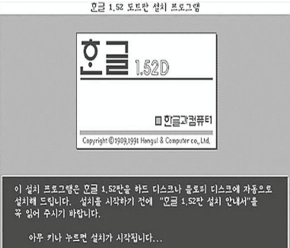
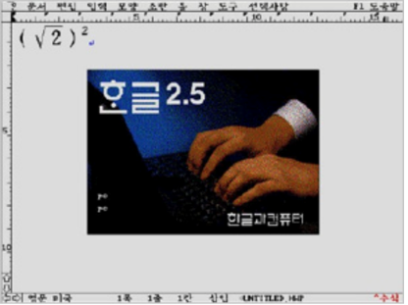
Introduction of HWP
Hangul(한/글) : Word Processor of Hancom Inc.
HWP is a filename extension and abbreviation of Hangul Word Processor
The latest version is Hangul 2014 for Windows, Hangul 2008 for Linux, and Hangul 2006 for Mac OS X
The first version is 0.9 in 1989

Slide 4
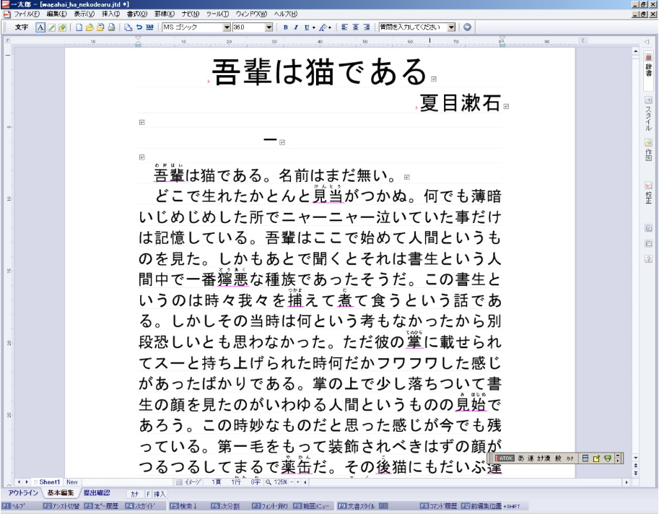
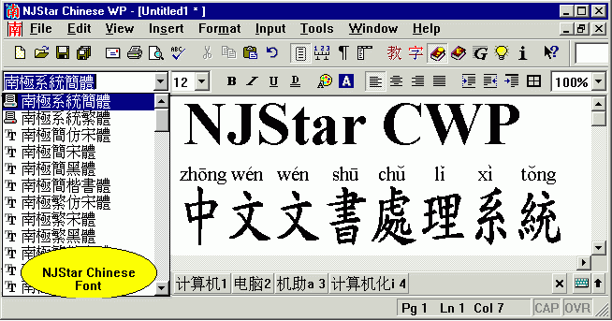
Other Asian Word Processors
2 byte language Word Processor
Ichitaro – Japanese Word Processor
NJStar – Chinese Word Processor

Slide 5
History of Hangul
First Generation (~1999, HWP 3.0)
Second Generation (2000~, HWP 5.0)

Slide 6
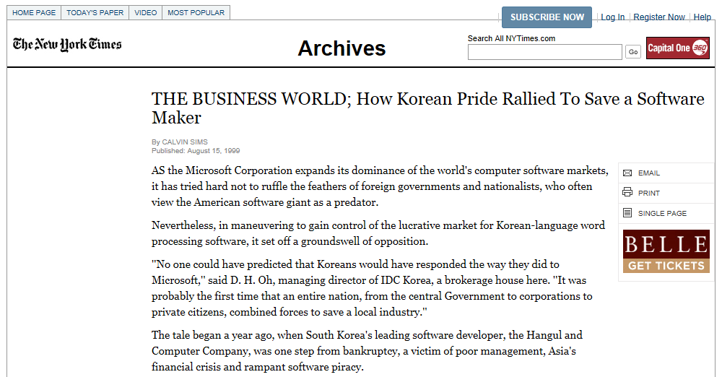
History of Hangul
Save a Local SW Maker (The New York Times, 1999)

Slide 7
Hancom sales composition
Hangul Sales Composition
Office S/W Market Share

Slide 8
Stature of Hangul in Korea
Hangul supports the special needs of Korean written language especially government’s needs.
De facto format especially in Korean government, military and public education.
Government officer receives a lot of e-mails attached HWP file EVERYDAY.
Attackers also knew this circumstance so they has researched the HWP document format as well as software vulnerabilities for a long time.

Slide 9
Malicious HWP Document
Can not tell malicious or not before open
The contents of malicious document is related with recipient’s business.
Malicious HWP Composed of
vulnerability part,
exploit part,
malware part
and normal document part.

Slide 10
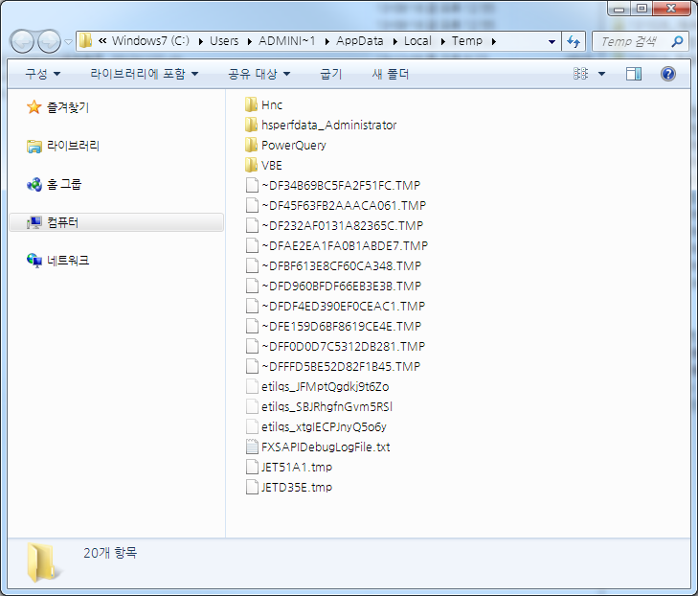
Composition of malicious document
① Vulnerability part
NORMAL.hwp
② Exploit Part
MALWARE.exe
③ Normal document
④ Malware part

Slide 11
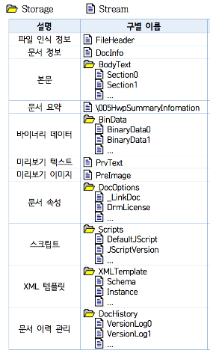
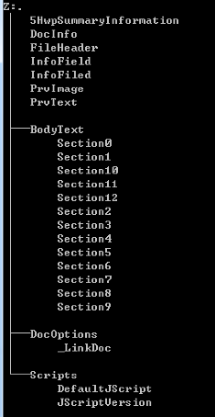
HWP Document Format
OLE (Object Linking and Embedding)

Slide 12
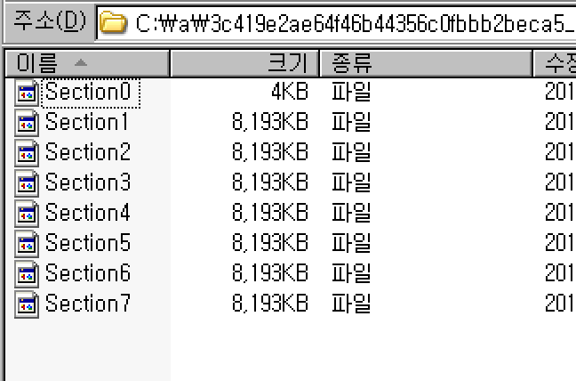
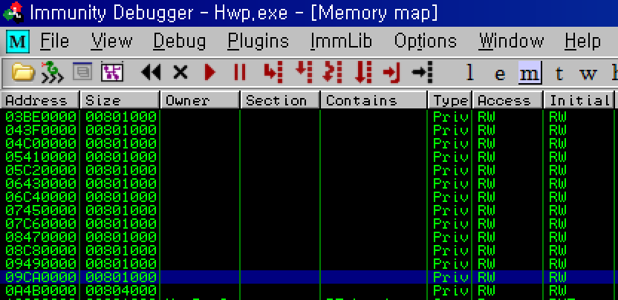
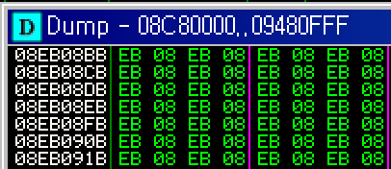
File structure and memory layout – Exploit
Streams of Bodytext storage are loaded
tremendous size in document
Heap Spray
EB 08 = jmp (here+0x08)

Slide 13
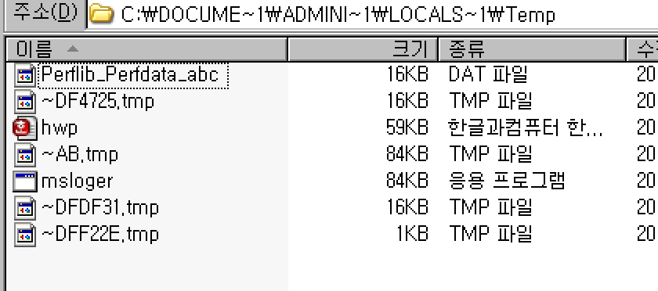
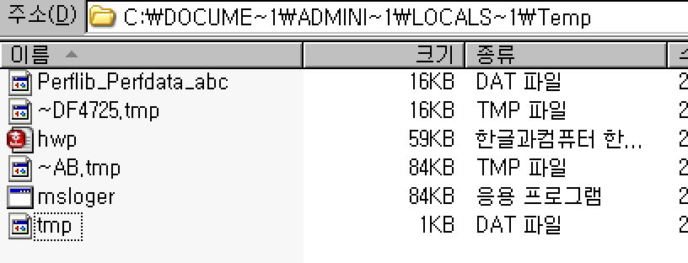
On document loading (tmp files)
Normal case (two tmp files)
Malicious case (normal document(hwp.hwp), ~AB.tmp, msloger.exe, tmp.dat)

Slide 14
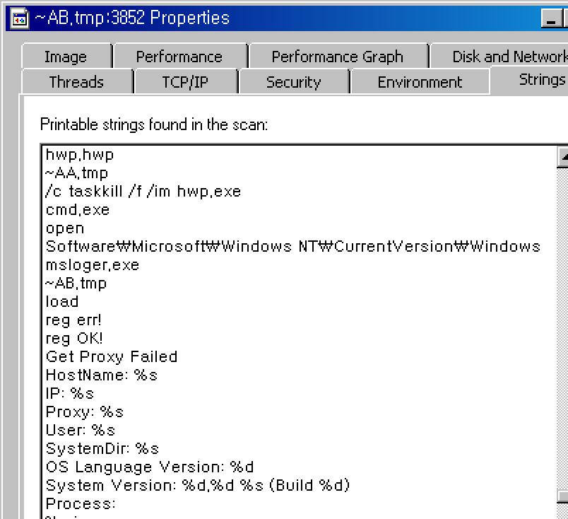
Malware Action 1
Hwp.exe process is not opened by user but ~AB.tmp.
~AB.tmp

Slide 15
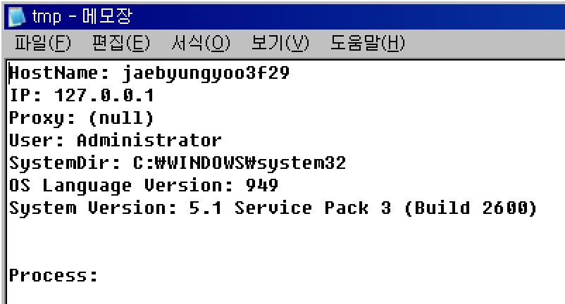
Malware Action 2
System information leakage from compromised PC

Slide 16
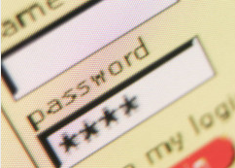
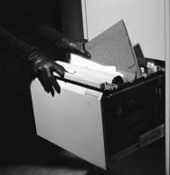
Use of Malware
Information leakage
Document leakage
Security bypass
Remote desktop
Key logger,
System information
HWP, DOCX
Vaccine, firewall
Team Viewer

Slide 17
Document Content and social issue
Personal Information Protection Act
Dokdo issue
CONTENTS
5th generations of Chinese leadership
Korean War & Peace
Key election promise
Diaoyu/Senkaku Islands dispute
World Energy Congress
Solution of North Korea Nuclear
’12. 6
’12. 7
’12. 9
’12. 10
’12. 11
’13. 8
60th anniversary of Armistice
Robert King visited South Korea (US special envoy for North Korean Human Rights Issues)
World Energy Congress Daegu 2013
Chinese navy exercise near Diaoyu/Senkakus
South Korean presidential election, 2012
ISSUE
Just before new china leader inauguration
Dokdo ceremony by Korean national football player
The Day of Information Security 2012

Slide 18
Keyword of Document
National Security
Future War
New product research
leadership
Armistice 60 years
LG
Korean War
contacts
Military
Tax audit
Korea Air force
Enterprise
SAMSUNG
Peace of
Korean peninsula
Wage
Contract
The public
territorial dispute
Movie news
Dokdo
Personal Information Protection Act
Takeshima
Defense Policy
Energy forum
How to be loved by wife
refugees
North Korea Strategies
Foreign policy
Policy recommendation
Next government
North Korea and China
Asia issue
Ministry
China visit
North
Korea
Park Geun-hye
Gov’t
Unification forum
East Asia
Kim Jong-un
Key pledge
foreign News
Nuclear
Policy
reunification
economic union
election pledge
Ministry of unification
Unified Progressive Party

Slide 19
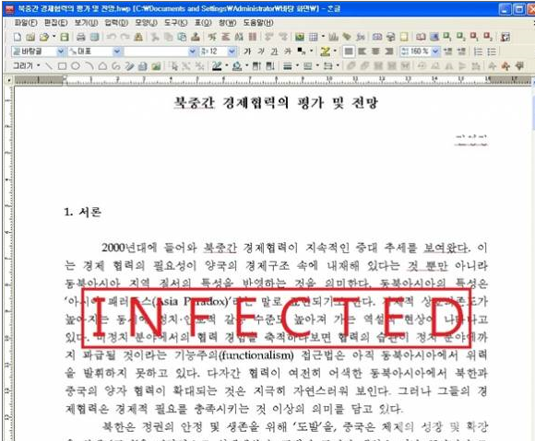
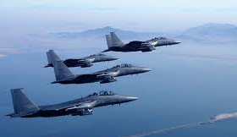
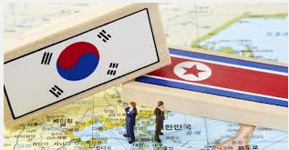
Scenario of malicious document attack
① Spear phishing mail
Government
② Open document
Attacker
Military
Compromised
.
Organization
④ Information gathering
③ Information leakage
E-mail account

Slide 20
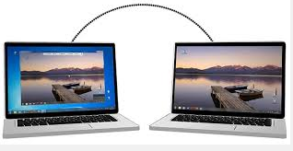
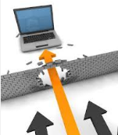
Attack feature
Use Email account like C&C
Use document as decoy
Use normal program as malware to avoid detection
Use Zero-day Vulnerability
Persistent Attack

Slide 21
Attack feature
Use email as command and control
Malware delivery & info. leakage
Final destination
- attacker’s account
Mail address & account info.
from
Sign in
example.com
example.com
aa@example.com
id : name
pw : pass
send
to
malware
aa@example.com
id : name
pw : pass
bb@example.com
bb@example.com
Hardcoded in malware

Slide 22
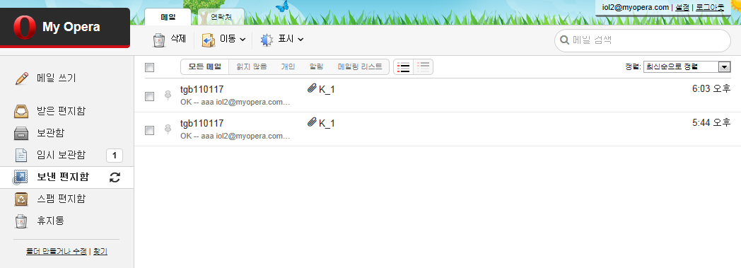
Attack feature
Information flow through email
Leaked Information from compromised PC
Sent

Slide 23
Attack feature
Use zero-day vulnerability
About 15% of malicious documents use zero-day vulnerability.
Finding zero-day and making exploit are not easy.
Must understand HWP document format
Own tools to exploit
→ They have researched the document format and software
Only Korea
Unlike doc & pdf, HWP is used in Korea only
It means opportunity cost is very high

Slide 24
Attack feature
A team not a person - guessing
Vulnerability Research Team
Document Format Research
Issue & Target Monitoring Team
Social issue monitoring
Malware Team
Manage C&C
Software Vulnerability Research
Document Contents search
Manage email account
Gathering target person email
Making malware

Slide 25
Response - KrCERT/CC Vulnerability Reward Program
Since Oct. 2012
Hancom office, Gom player, NateON Vulnerability (2013, 179 cases)
Especially HWP zero-day

Slide 26
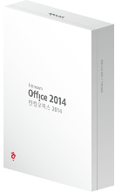
Response - Vendor (Hancom)
Secure Coding in software design step
Detect Abnormal section data and don’t load to memory
New version of Hancom office (2014)
Detect and protect of malicious document
Enhanced Secure coding

Slide 27
Response - Conclusion
Software User
MUST Update ALL software
MUST use Vaccine
Take care before opening attached file in email
Vendor
Introduce secure coding
Rapid respond for vulnerability
Effort to make users update
CERT or security company
Make pattern to detect malicious document
Share the vulnerability information

Slide 28
Thank you
jbyoon@krcert.or.kr

