Slide 1


U.S. DEPARTMENT OF ENERGY
Flexible Transform
Semantic Translation for Cyber Threat Indicators

Slide 2
Who We Are
Andrew Hoying
National Renewable Energy Laboratory
andrew.hoying@nrel.gov
Chris Strasburg
Ames National Laboratory
cstras@ameslab.gov
Dan Harkness
Argonne National Laboratory
dharkness@anl.gov
Scott Pinkerton
Argonne National Laboratory
pinkerton@anl.gov

Slide 3

Agenda
Motivation
Background
Flexible Transform (FT) Approach
Extended Example
Conclusions
Notes:
Andrew

Slide 4

Motivation
Why transformation? It is needed to:
Facilitate migration to a common language (STIX) …
without having to wait on entire customer base to adopt
the language natively
Adapt data to multiple tool chains
dynamically within a single site
Why must it be flexible?
Point–point translation is not scalable, O(n²)
A semantic representation minimizes data loss
Deals with inherent ambiguities in legacy data
  Shared Internet Protocol (IP) address – source or target (or resource or pivot point or …)?
Notes:
Split – Avoid least common denominator sharing
– STIX – STIX can use full profile; only those using legacy formats need to ‘dumb down’.
-- Is a tomato a fruit or a vegetable?

Slide 5
Motivating Example
Notes:
Chris
Planning to discuss:
Mapping from one syntax to another
Mapping between two schemas, same syntax (e.g. XML -> XML)
Point out scalability issue, semantics issue – what changes when the meaning of an element change? Nothing on this diagram, but code must change!

Slide 6
Translation Scalability
New Syntax
/ Schema
/ Semantics
O(N²)
CSV = comma-separated value; XML = extensible markup language.
Notes:
Andrew

Slide 7

Background
Sharing data is hard when everyone does not speak a common language
Methods exist for parsing data from systems you do not control
  Dynamic or static mapping
  of field names and types
  Post-ingestion data recognition
  Predefined parsers
We want a richer ontology
so that data are not lost
in translation.
Notes:
Andrew – Common Language, for example STIX – not everyone can adapt at the same rate

Slide 8
U.S. Department of Energy Cyber Fed Model (CFM) – GUWYG Background
[2004–2010] – Single Input Format Supported
[2010–2013] – Give Us What You’ve Got (GUWYG) v1
[2013–Present] – GUWYG v2
  Added XML and Key/Value formats for input
  CFM supports multiple input/output formats and functions as a bridge between Enhanced Shared Situational Awareness (ESSA) initiative and thousands of Energy Sector utilities
Notes:
Chris – Historical translation efforts – experience moving a community from a legacy sharing language to an updated one; communities are slow to migrate.

Slide 9
Ontology
Notes:
Chris

Slide 10
Ontology
Notes:
Chris

Slide 11
Flexible Transform Approach
Notes:
Chris

Slide 12
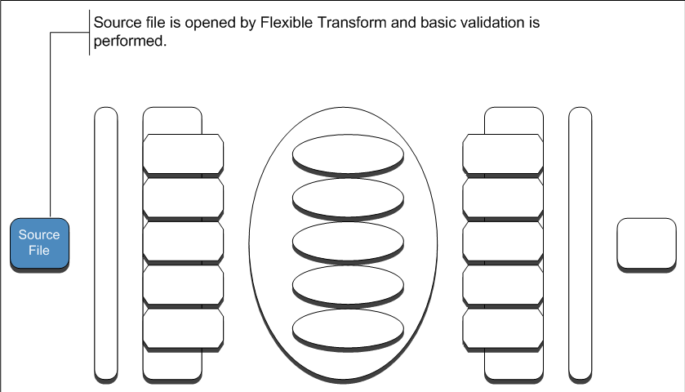

Approach/Design – Process Detail
Notes:
Andrew

Slide 13
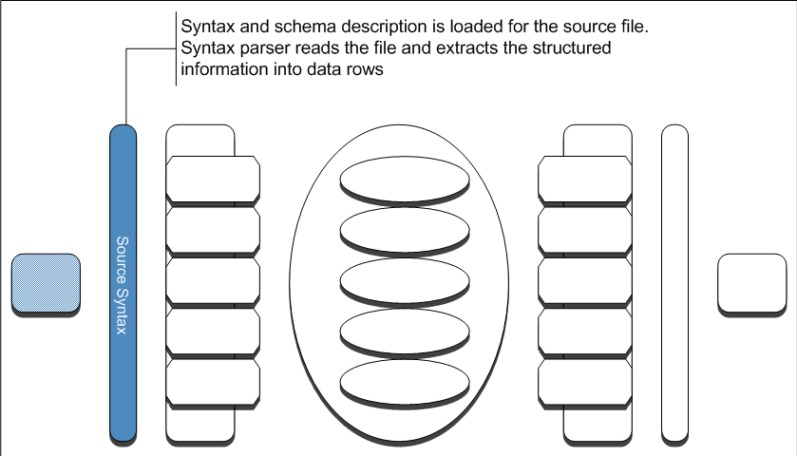
Approach/Design – Process Detail (cont.)
Notes:
Andrew

Slide 14
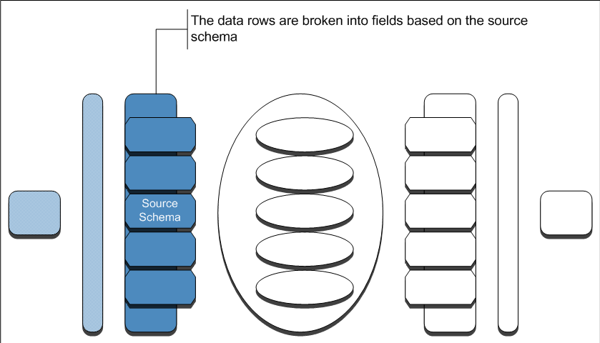
Approach/Design – Process Detail (cont.)
Notes:
Andrew

Slide 15
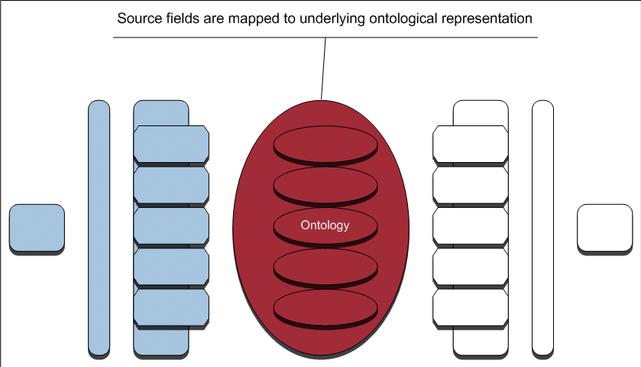
Approach/Design – Process Detail (cont.)
Notes:
Andrew

Slide 16
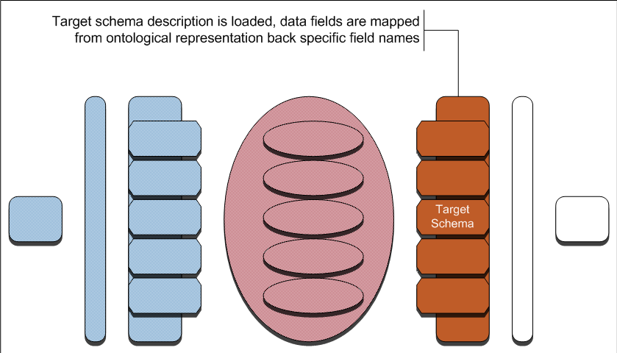

Approach/Design – Process Detail (cont.)
Notes:
Andrew

Slide 17
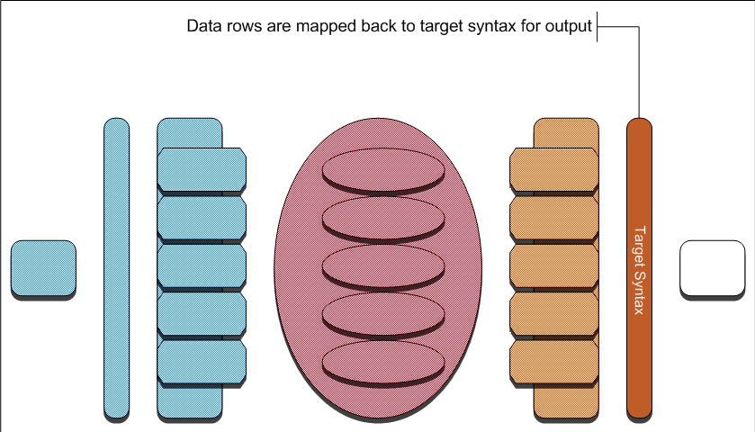
Approach/Design – Process Detail (cont.)
Notes:
Andrew

Slide 18
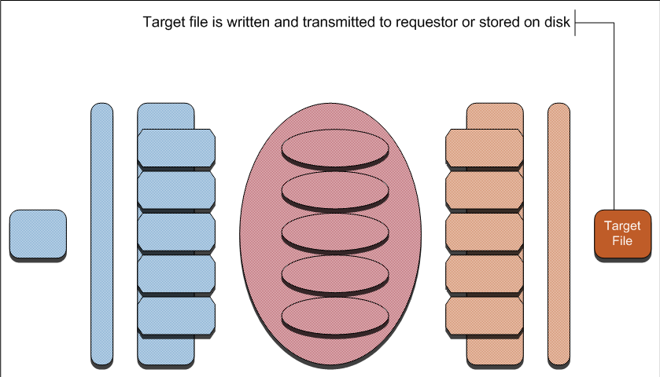
Approach/Design – Process Detail (cont.)
Notes:
Andrew

Slide 19
Flexible Transform Scalability
O(N)
Notes:
Chris

Slide 20
Approach/Design – Semantic Structure
Notes:
Chris

Slide 21
Extended Example – Perfect Semantic Match
Notes:
Andrew

Slide 22
Extended Example – Generalization Mismatch
Notes:
Chris

Slide 23
Extended Example – Specialization Mismatch
Notes:
Andrew

Slide 24
Extended Example – Missing Data 1
Notes:
Chris

Slide 25
Extended Example – Missing Data 2
Notes:
Andrew

Slide 26

Conclusions/Limitations
Using flexible transform, we act as an automated translator, enabling communities to share data regardless of the native tools/languages
FT carries a performance impact – additional processing
‘on-the-fly’
Current definition of new syntaxes, schemas is manual – we are working on an RDF language to automate this function
It requires fully structured data – we are examining the feasibility of parsing semi-
structured data
Reduces, but does not eliminate,
the problems of sharing
ambiguous data
Notes:
Chris – Until full adoption of a universal language, a-la STIX, translation will continue to be needed.

Slide 27
Preparing for Tomorrow’s Cyber Threat
Cyber threats are global – sharing is key:
  Are you ready to consume?
  Are you ready to produce?
Examine your data / workflow:
  Let us know what schemas/ languages are in use
  Provide/ask for schema specifications when needed
Add structure to your data!
Notes:
Andrew

Slide 28
Future Needs
A cross platform, or web-based, graphical user interface (GUI) for building indicators, other data types, and relationships using known semantic values
  Visualize large data sets
  List known semantics; provide user with a list of target formats
  Built-in definitions of field types help analysts choose the appropriate field for the indicator or relationship
Syntax parser and dynamic schema for semi-structured data
Notes:
Andrew – Example – Mandian IOC Editor
PDF Example
Extract probable fields from raw text, maintain logical groupings, provide analyst with simple to use tool to map the data to indicators.
Reduce chance of typos when report is translated to sharable indicators

Slide 29

Questions?
Questions Now?
  Ask away!
Questions Later?
  federated-admins@anl.gov
Notes:
All four

