Slide 1
Appliances And Incident Response
Gaus
<gaus.rajnovic@eu.panasonic.com>

Slide 2
Agenda
Current situation
Where are we heading
What that means for us?
Summary
Notes:
In this presentation

Slide 3
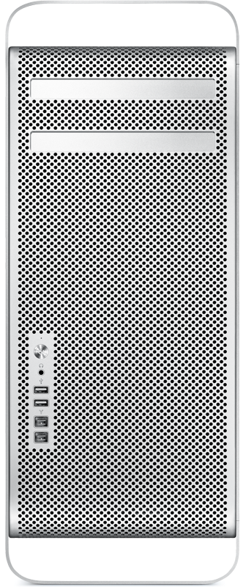
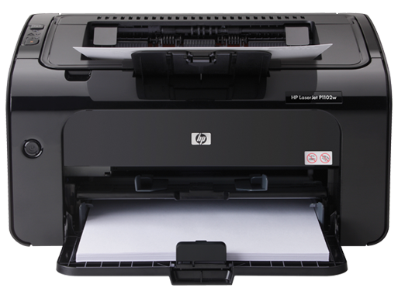
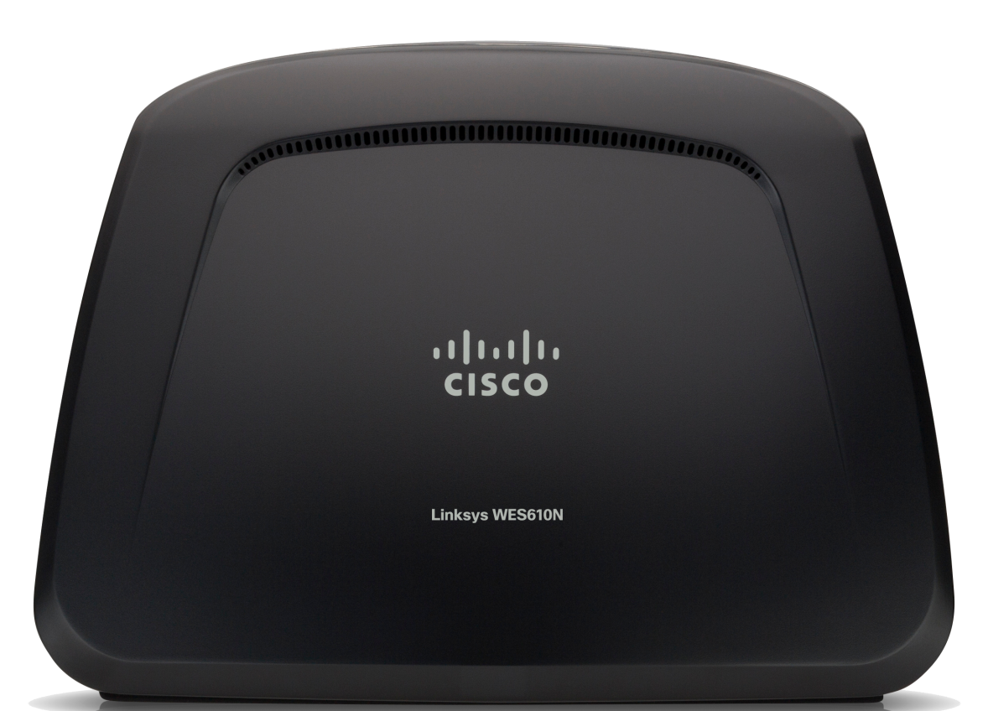

Slide 4
The Current State Of The Art
An offending IP is found in a log
The IP address is resolved to a block belonging to an ISP
The ISP is notified and asked to assist
The ISP will place the IP in question in a walled garden (or null-route) until the customers cleans up the machine
The IP address will be removed form the walled garden and be ready for the next cycle

Slide 5
What That Actually Means?
CERT is off-loading task to ISP
ISP is acting as a CERT for its customers
ISP needs additional resources (people, equipment) to deal with the incidents
Customers are temporarily off-line until the incident is resolved

CERT and ISP can automate their processes
Customer must do some reinstalling

Slide 6
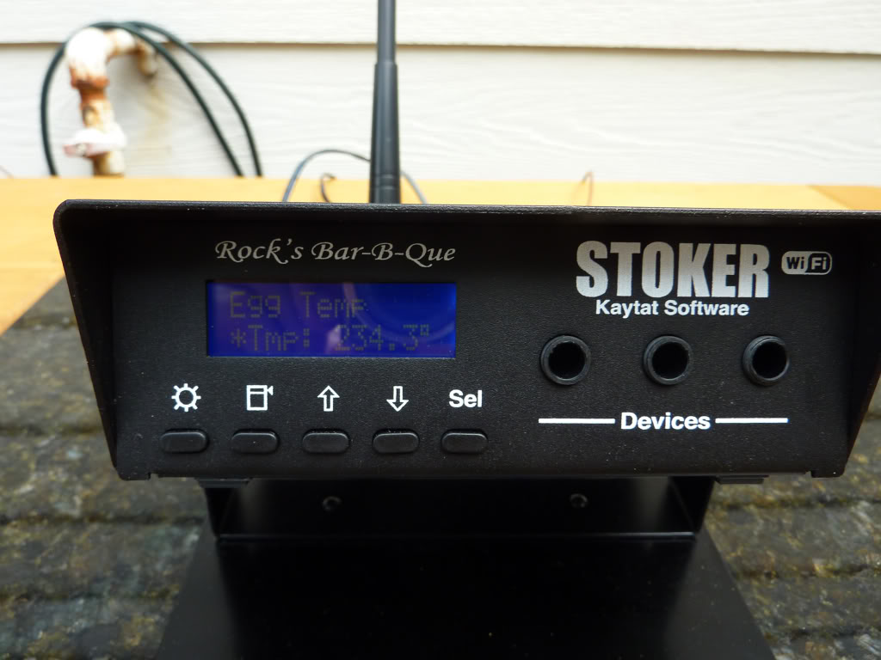
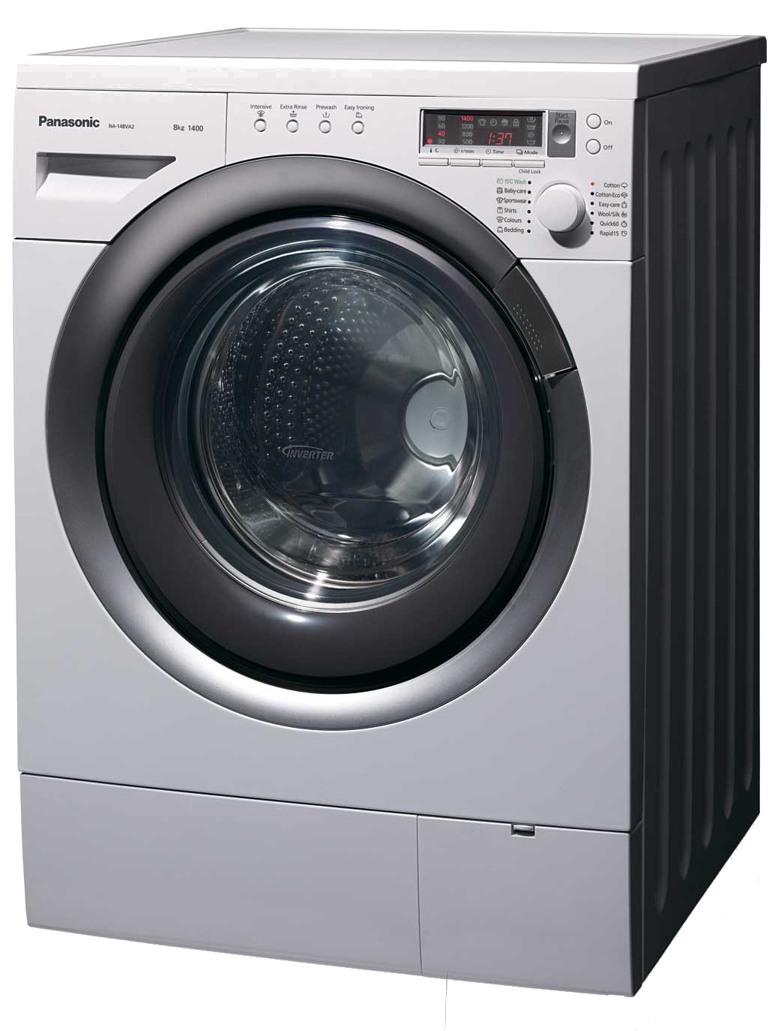
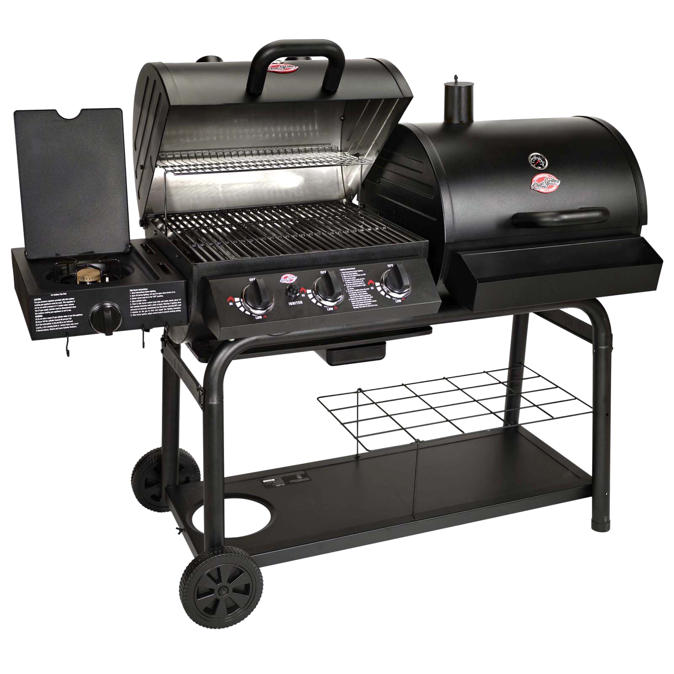
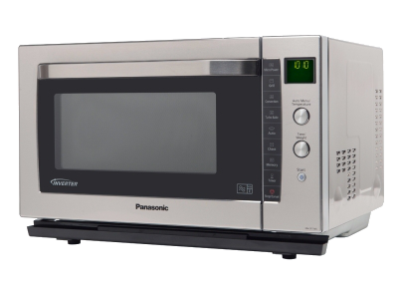
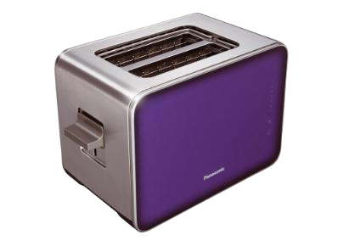
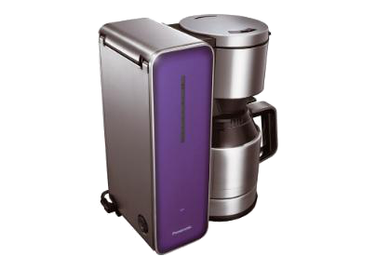

Slide 7
What Has Changed?
More of the same
Workload of CERTs and ISPs will increase
More automation is required to handle incidents
Customers will have more things to patch and maintain
Overall, essentially, nothing has really changed

Slide 8
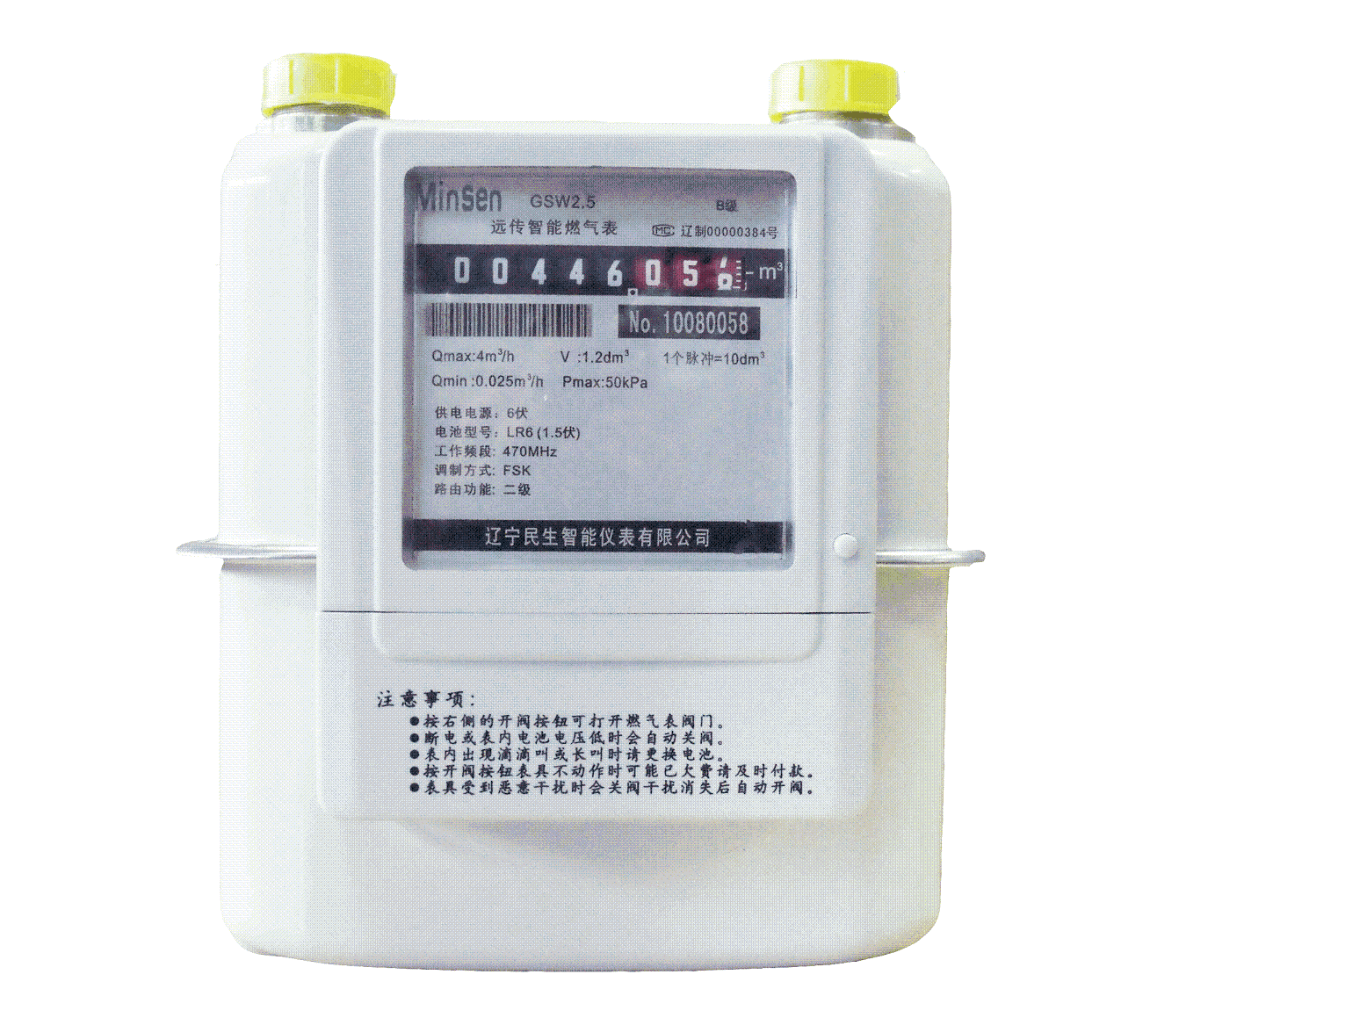
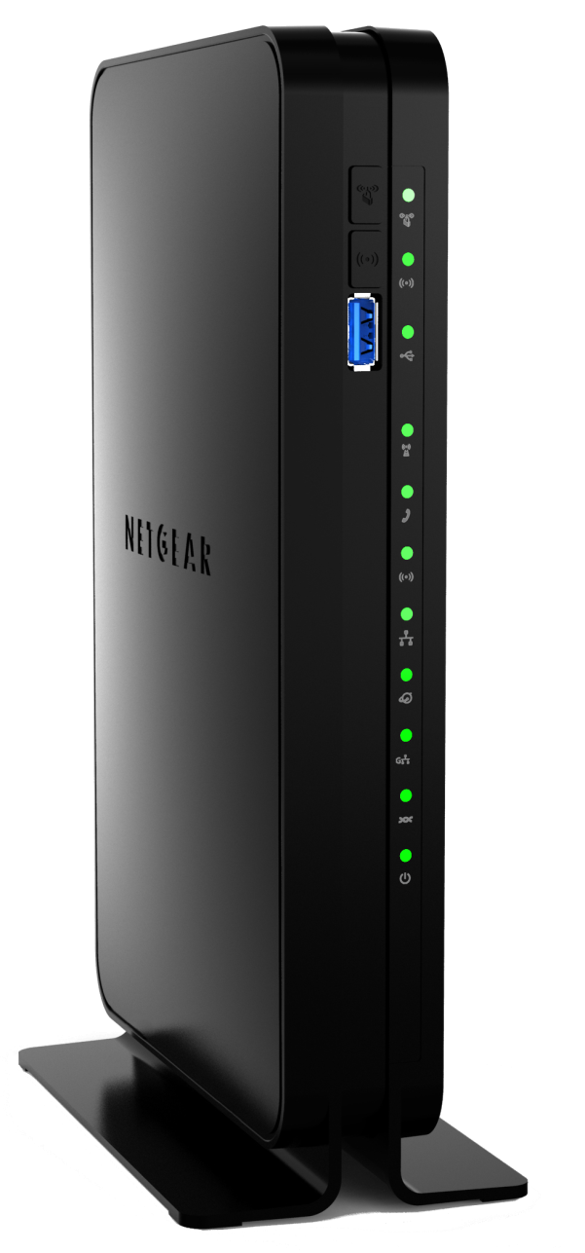
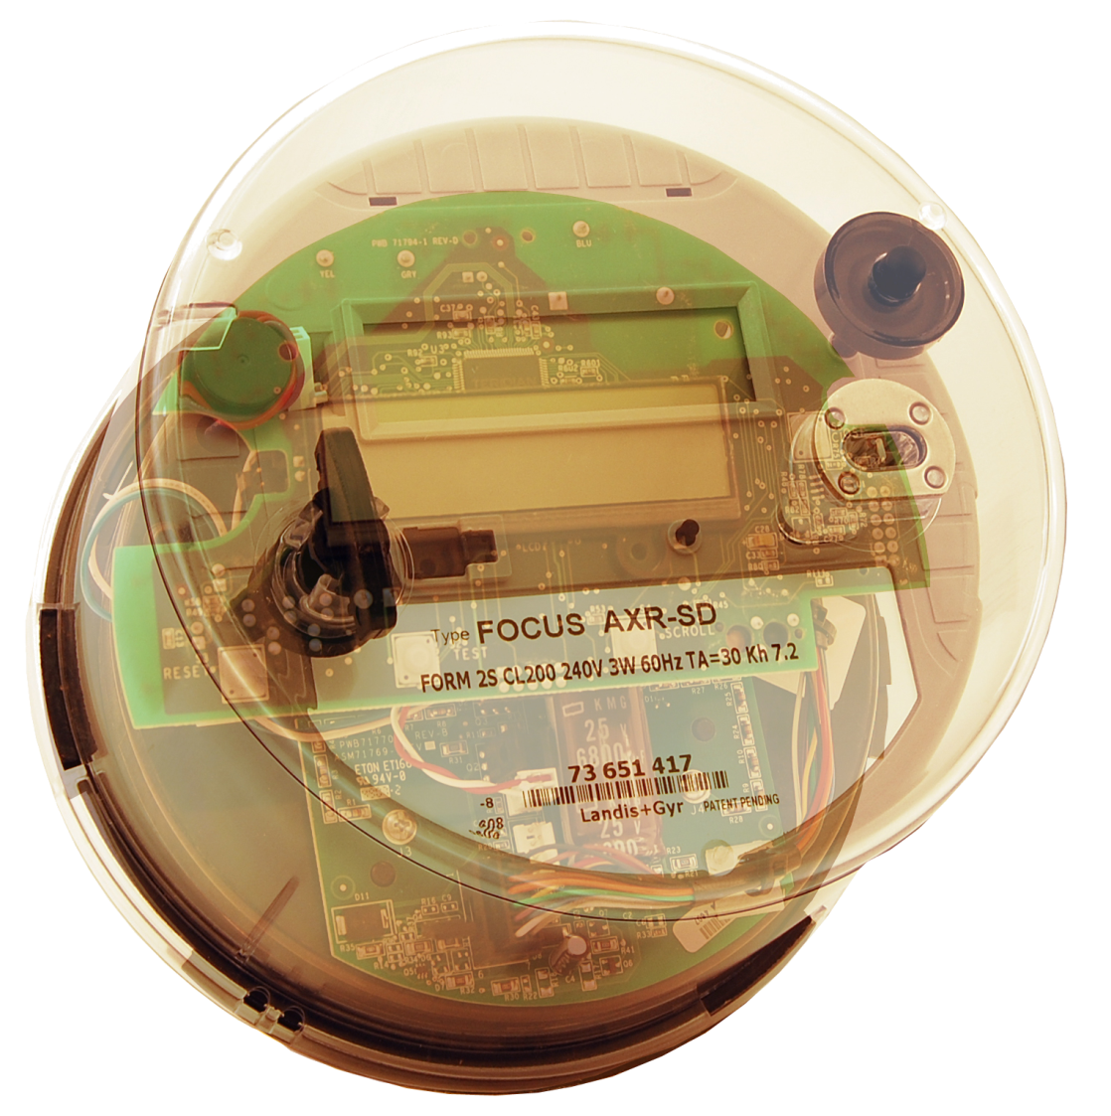
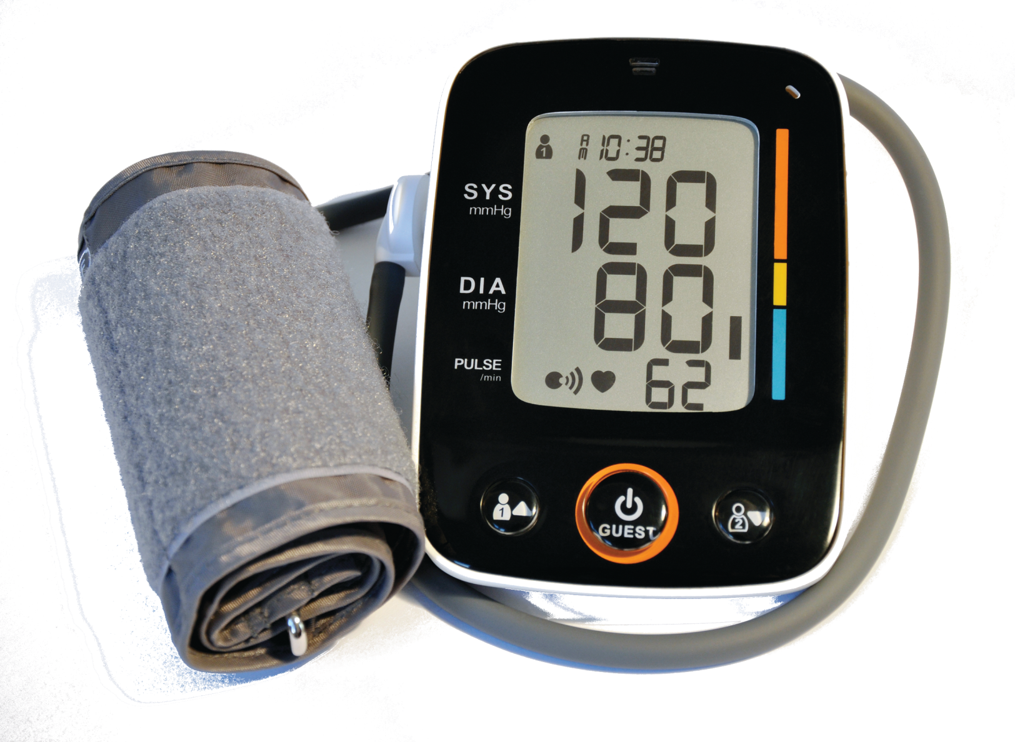
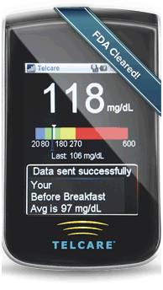

Slide 9
What Has Changed Now?
Even more devices/appliances
Devices are now part of CNI and used for life support
They must be constantly connected to the Internet
Patching a device is more involved – users cannot patch all devices
Notifying a device owner is more challenging – to whom my electric meter belongs to?
Multiple intersecting communication networks (cable/wireless, GSM, power cables) – how long it will take malware to start use all of them simultaneously?

Slide 10
The New Reality
Presence of devices that must always stay connected
Administrator of the device is hard to determine
The load on ISPs will increase dramatically – will they continue to serve as the CERT of last resort for free?
Multiple networks will co-exist within a household and malware will use them all
Notes:
My electric smart meter is installed by British Gas as I am in their ‘area’ where they are the main supplier. However I am buying electricity from Southern Electric. Who will administer my smart meter?
My home computer in infected and the main Internet connection is cut off by the ISP. Malware switch to using smart grid for communication as it has GSM backup network that terminates at mobile provider X who then backhauls it to my electricity provider (eventually). Now my computer is sending spam via my electricy provider.

Slide 11
How To Handle Incidents In The Brave New World?
How to change incident handling model for households?
What is the role of ISPs and CERTs?
Do we need more teams/organizations involved?
Can we rely on users to handle incident coordination?
What automation is needed? Where?
What security features products must have?
Notes:
ISPs have already started discussing provisioning of multiple household networks and routing problems within them (see NANOG??)

Slide 12
Potential Product Features
BUG FREE – sorry , no can do
Packet filtering
Better patching capabilities
Better self test and rollback capabilities
Improved logging
Secure boot
Code signing
Automated full SW erase and re-install every X hours
Throwaway virtual machine for one time use

Slide 13
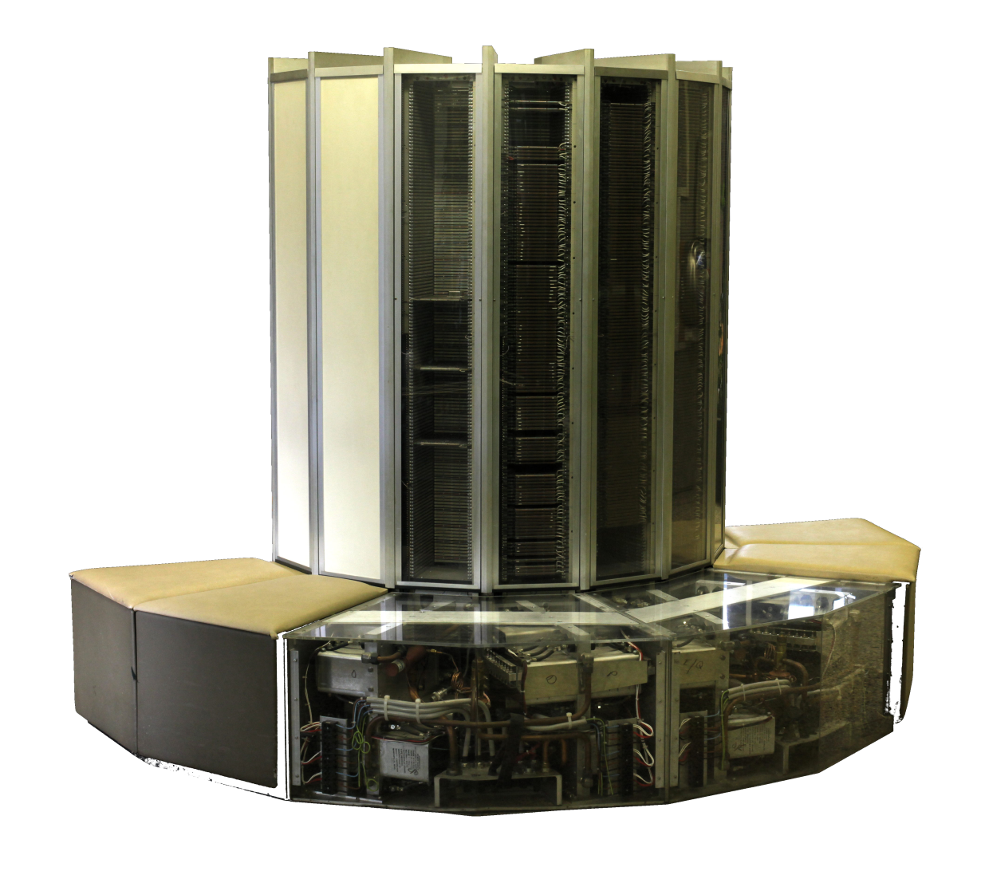
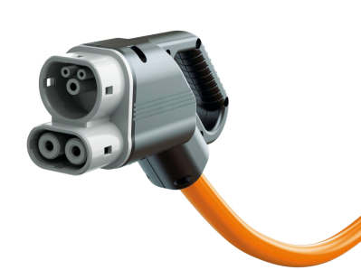
Notes:
We must strike a balance how much we can expect from a device. Some small devices will never be able to offer much CPU power and creating a monster like the one picture above would not serve any purpose.

Slide 14
Who Will Protect Denizens?
Incident response as part of ISP business model
Government CERT will send people to fix my home computer
How much privacy we will have to give up to receive this kind of service?

Slide 15
A New CERT Workflow
Each CERT capable of handling 10000+ cases per month
Almost fully automated incident handling
AI algorithms doing triage and response to low severity cases
Automated incident handover from CERT to CERT
Notes:
The essential issue here is that CERTs will have to be equipped to deal with large number of cases. Majority of them will be transient and one CERT will just hand it over to another CERT but even then, logs will have to be inspected, patterns observed and decision made. It is hard to see that teams will start employing hundreds of people so the only option is to automate things as much as possible.

Slide 16
What Do You Think?

Slide 17
THANK YOU FOR YOUR ATTENTION.
© 2013 Panasonic Europe / All rights reserved

