Slide 1
Quality over Quantity
Determining Your CTI Detection Efficacy
David J. Bianco
Principal Engineer, Cybersecurity
Target Corporation
@DavidJBianco

Slide 2
I’d like you to review and identify gaps in what we know about our high priority threat actors going into peak [retail season].
Yeah, I’d like that, too.
But how…?

Slide 3
Translation into action items
Identify our high priority threat actors
Figure out what we know about each (and how/where to find that info)
Develop CTI evaluation criteria
Evaluate and perform gap analysis

Slide 4
Data collection & Processing
IOCs
TTPs
Dump
Extract
Clean
Merge
Visualize

Slide 5
CTI evaluation criteria
Do we know the adversary’s repeated behaviors?
How volatile are our IOCs?
In which lifecycle phase(s) could the adversary operate with impunity?
Is our intel recent enough to be useful, but with enough history to provide context?
Where should we concentrate or improve our collection efforts?

Slide 6
Attack LIFECYCLE
Assigning the IOCs and TTPs to phases in MITRE’s ATT&CK™ lifecycle model allows us to see “where” in the lifecycle we know the most.
Source: attack.mitre.org

Slide 7
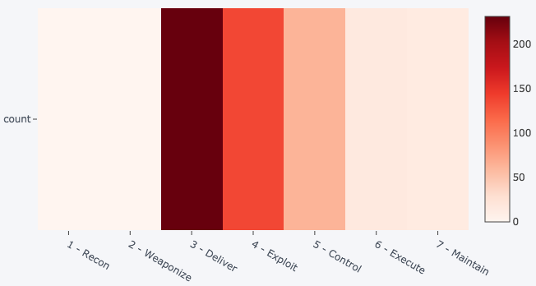
LIFECYCLE Visualization
Most of our CTI centers around the attacker’s process for gaining a foothold in the environment.
We know little about what happens before or after.

Slide 8
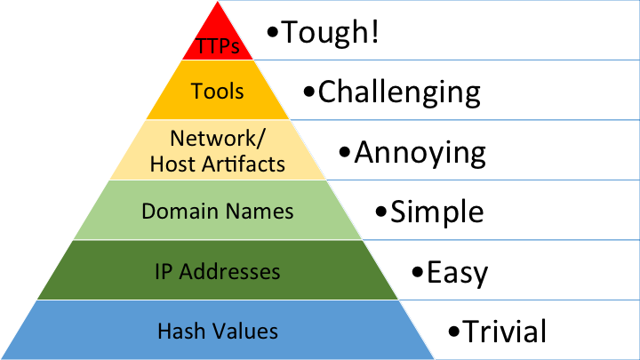
The Pyramid of Pain
Assigning IOCs to the appropriate Pyramid level helps describe their potential volatility and replaceability.
Put another way, we want to maximize our ability to increase the adversary’s cost of action against us.
Source: http://detect-respond.blogspot.com/2013/03/the-pyramid-of-pain.html

Slide 9
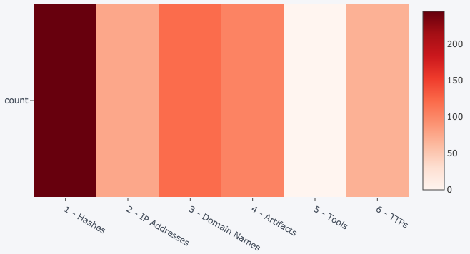
Pyramid Visualization
We’re doing pretty well covering most of the Pyramid.
Looks like we need more info about their toolset, though.

Slide 10
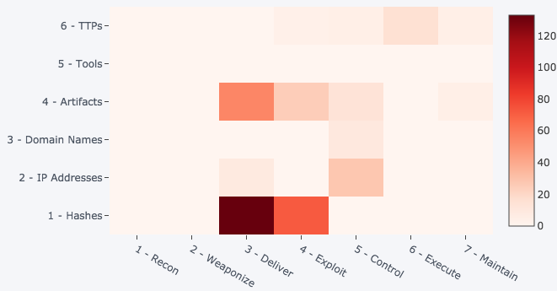
COMBINED Visualization
Good
Best
Plotting the lifecycle phase vs. Pyramid level can reveal not only current strengths, but also opportunities for improvement.
Good

Slide 11
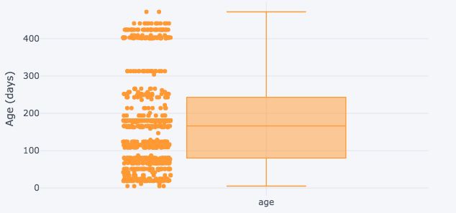
Overall IOC Age
Box plot of IOC age reveals your balance between currency and history.
”Banding” on the left reveals patterns of collection.
Oldest
Median
Newest

Slide 12
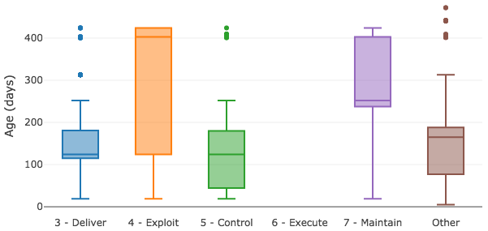
Age by Lifecycle Phase
Breaking down the ages by lifecycle phase gives more info about how current we are for each.

Slide 13
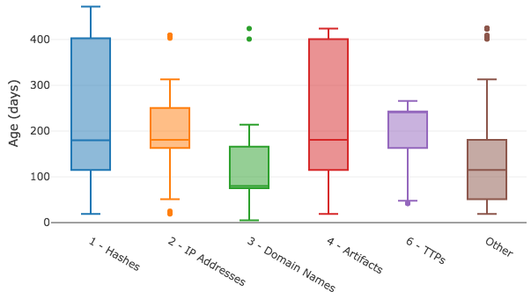
Age by Pyramid Level
Analyzing it by Pyramid level is also useful in comparing IOC ages to volatility.
The lower the level, the fresher your IOCs need to be.

Slide 14
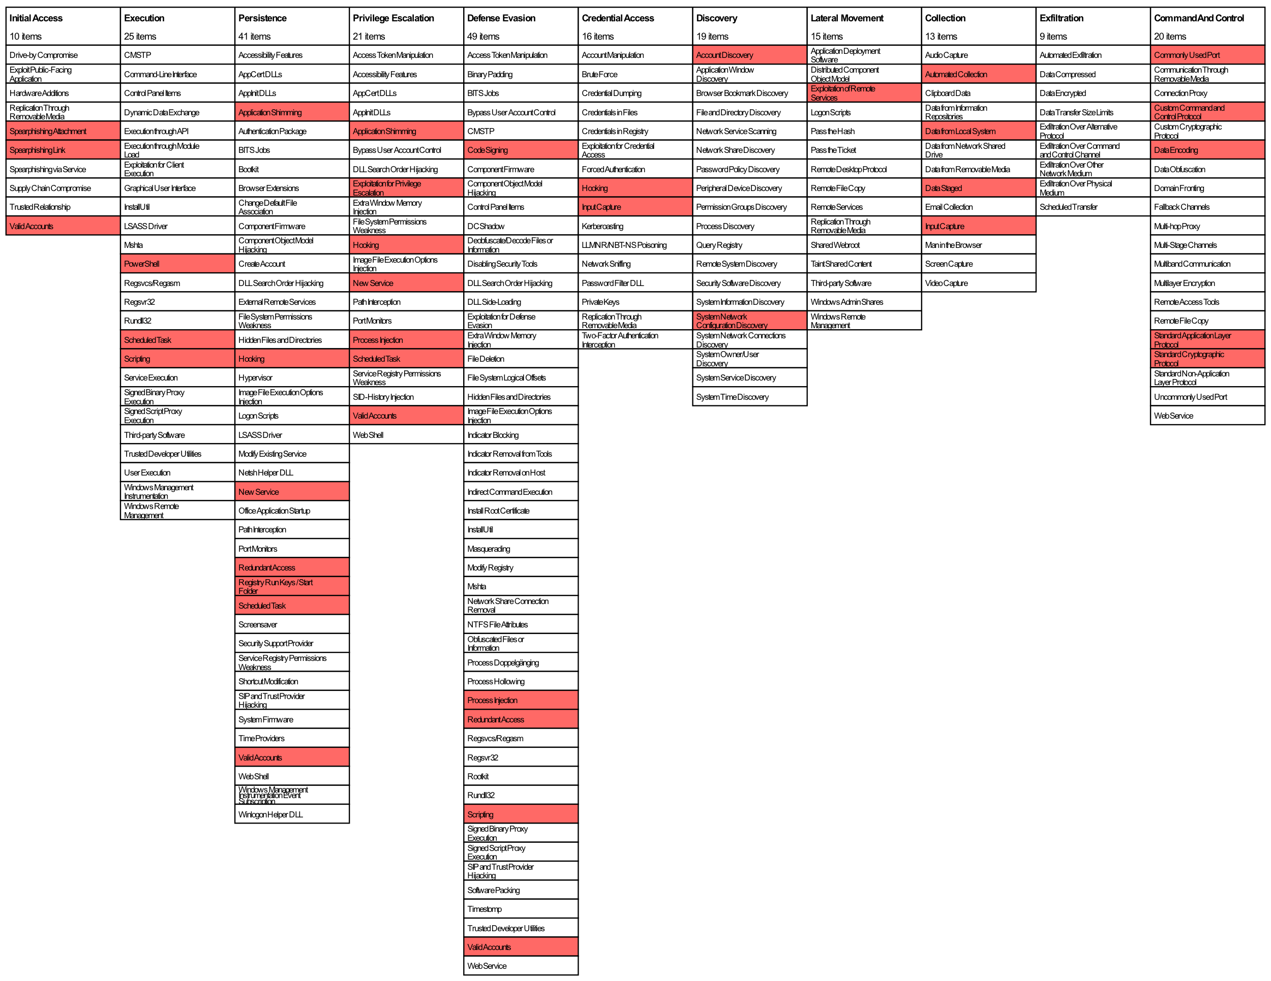
Ttps by tactic
Mapping the known TTPs to the ATT&CK Enterprise Matrix quickly shows strengths and weaknesses.
White doesn’t imply a gap. Maybe the actor doesn’t do that thing.
I’d like to find something better.

Slide 15
Key challenges
Challenge | What we did
CTI data in multiple repositories | Developed custom extraction for each and merging/deduplication logic Manual review of priority actor wiki pages
Data tracked by different repos is inconsistent, sometimes even when it looks the same (e.g., timestamps mean different things) | Analyzed using estimates and approximations when necessary Custom merging/deduplication logic
Converting a one-time analysis into a repeatable, automatable process | Captured code, documentation and graphs in a Jupyter Notebook Work is still ongoing…

Slide 16
Takeaways
Start by identifying your key threat actors
Where is all your data stored and what does it mean?
Extract, clean, merge & deduplicate (this is most of the work)
Map IOCs & TTPs to your favorite lifecycle model and to the Pyramid of Pain
Visualize to identify gaps
Automate this process and run it regularly to help keep yourself on track with actionable CTI

Slide 17
I have a question and/or wish to make a short speech…
David J. Bianco
@DavidJBianco

