Slide 1
Coordinated Security Response
A CACAO Introduction
(https://www.ietf.org/mailman/listinfo/Cacao)
Bret Jordan, Allan Thomson
March 19, 2019
Notes:
Today we are going to talk about Collaborative Automated Course of Action Operations (CACAO) for Cyber Security.

Slide 2
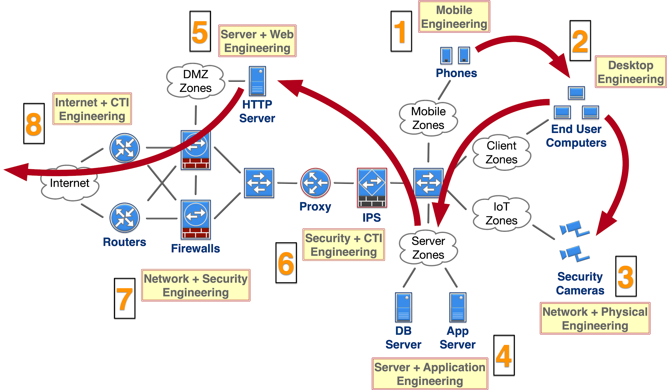
Why CACAO - Threat Detection and Mitigation Today
Notes:
Threats
Threat Actors and Intrusion Sets are advancing
Number of attacks are increasing
Attack surface is growing
More valuable electronic data and connected systems
Defense
Manual and reactive
Solutions are siloed
Organizations become system integrators with mixed results
Many different groups inside an organizations are part of the response
No easy way to share threat response expertise
Organizations need to respond in machine relevant time across multiple coordinated systems
ISACs and ISAOs could disseminate solutions with Threat Intelligence

Slide 3
What is CACAO?
Collaborative Automated Course of Action Operations for Cyber Security
  A standard that defines structured and machine parsable playbooks
    Creation of those playbooks
    Distribution of those playbooks across systems
    Monitoring of those playbooks and their results
  It includes documenting and describing the steps needed to prevent, mitigate, remediate, and monitor responses to a threat, an attack, or an incident
What it is not...
  This is not a standard for sharing arbitrary content or data
  This is not about documenting an incident, indicators of compromise, or threat actor behavior

Slide 4
Coordinated Security Response in 5 Steps
  Where a Coordinated Response is defined based on various inputs both automated and manually derived
Definition
  Where a Coordinated Response is reviewed for accuracy and correctness. It is optionally verified in an environment that can verify by executing the project in a way that provides an additional level of verification
Verification
  Where a Coordinated Response is distributed to the systems that will execute it. Distribution includes checking that the Coordinated Response has been deployed correctly and follows rules defined within the project for atomic transactions
Distribution
  Where a Coordinated Response is evaluated by one or more security infrastructure systems and execution events are communicated to the monitoring step
Execution
  Where a Coordinated Response execution is monitored and metrics are determined on the COA Project to enable further refinement or improvement to the definition
Monitoring
Notes:
Talk about the 5 steps that a coordinatred threat response capability requires and explain why we broke it into 5
This will lead into the next slide that talks about the system components...etc.

Slide 5
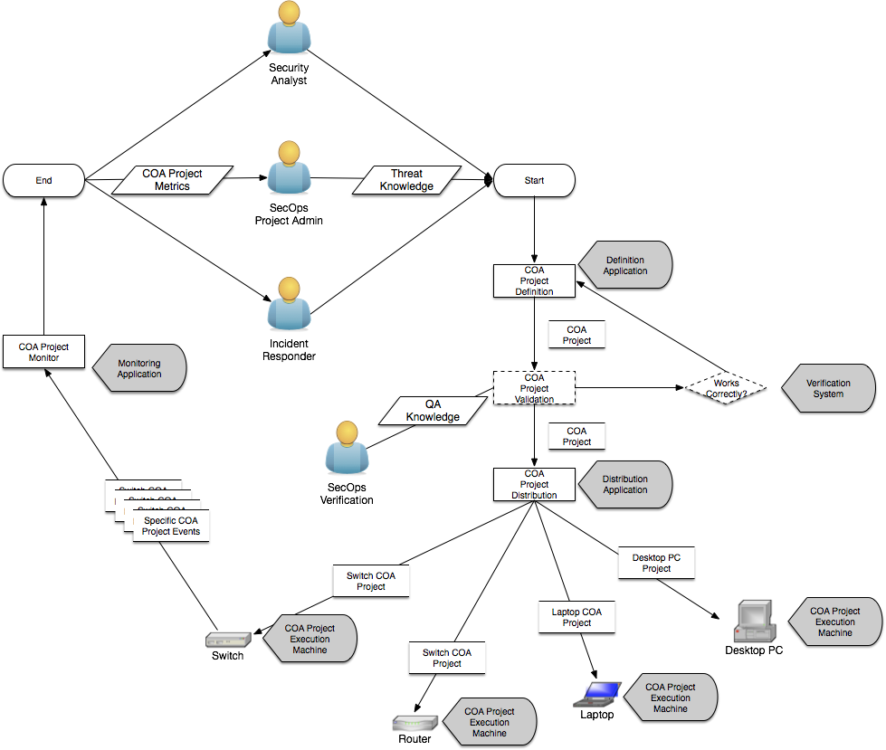
CACAO Overview - System
Architecture goals for coordinated threat response
System Level
Identify roles and requirements of system architectural components
Interface Level
Identify key requirements for interfaces across components
Protocol Level
Identify protocols that can/must transport CACAO content securely
Schema Level
A standard JSON structure for COAs / Playbooks
Notes:
Introduce the system architecture
Introduce the key roles and functional components of CACAO and segue into next slide

Slide 6
CACAO Overview - Roles
Security Analyst
  Senior role where the person performs analysis of all available threat intelligence; malware research; active threats that may be relevant to their environment to determine a set of recommended steps to both detect and respond to threats
  Aware of the capabilities of the organization to respond where they have knowledge of the security infrastructure deployed on both network; servers and endpoints as well as the services running on those systems
SecOps Project Admin
  Senior role that oversees and manages the security operations of the network
  May work closely with the Security Analyst to determine response playbooks to proactively manage risk in the enterprise environment.
  May either define COA Projects themselves or review/refine COA Projects defined by the Security Analyst
Incident Responder
  Focused on responding to an active threat to the enterprise where they have limited time to respond and most of their actions are focused on mitigation and remediation
  Any outcomes and results of the incident may be fed back into the other 2 teams involved to enable enhancement future responses that reduce the risk of threat incidents
Notes:
Talk to the roles and why this matters to the CACAO projects

Slide 7
CACAO Overview - Interfaces
Architecture goals for coordinated threat response
System Level
Identify roles and requirements of system architectural components
Interface Level
Identify key requirements for interfaces across components
Protocol Level
Identify protocols that can/must transport CACAO content securely
Schema Level
A standard JSON structure for COAs / Playbooks
Notes:
Talk to what interfaces do and their roles
Talk about different interfaces do in a distribution system (orchestrator) vs execution machine

Slide 8
CACAO Overview - Protocols
Architecture goals for coordinated threat response
System Level
Identify roles and requirements of system architectural components
Interface Level
Identify key requirements for interfaces across components
Protocol Level
Identify protocols that can/must transport CACAO content securely
Schema Level
A standard JSON structure for COAs / Playbooks
Notes:
Talk to the protocols involved and why its not 1 protocol and not necessarily just HTTP

Slide 9
CACAO Overview - Schema(s)
Architecture goals for coordinated threat response
System Level
Identify roles and requirements of system architectural components
Interface Level
Identify key requirements for interfaces across components
Protocol Level
Identify protocols that can/must transport CACAO content securely
Schema Level
A standard JSON structure for COAs / Playbooks
Notes:
Talk to what needs to be in the schema; why each schema may be broken down by product, technology, process and function

Slide 10
CACAO Overview - Verification
Ability for an actor who has created or updated a COA Project Definition to validate that the project will execute correctly once deployed in an operational environment
Verification includes
  All COA Project Sequence Elements are connected so that the complete sequence will complete when executed
  All COA Project Conditional Elements have connections to defined COA Project Steps
  Each COA Project Step is well-formed and parses correctly according to the COA Project JSON schema
Notes:
Talk to the need for verification and what it entails
More advanced verification may take place but those advanced verification processes are considered out of scope for this specification

Slide 11
CACAO Overview - Operational Goals
Operational goals for coordinated threat response
Allow for manual (e.g. human-performed), process, and automatic actions
Integration with other security systems
  E.g. Cyber Threat Intelligence; Identity; Risk Management
  This will allow pivoting, sharing, collaboration, and enrichment
Provide preventative, mitigative, and remediation solutions that are measurable and scalable
Notes:
Talk to the operational challenges that cacao needs to embrace and solve

Slide 12
CACAO Operational Requirements
Workflow
Multiple Actions
  Perform multiple steps across many different pieces of infrastructure
Sequencing of Actions
  Actions often have to be done in a very specific order
Temporal Logic
  Perform actions at certain times or after a certain amount of time has passed after the previous action
Conditional Logic
  Perform actions based on outcomes or state
Product Support
Versioning
  Support playbook and system component versioning
System Targeting
  Support specific machines, operating systems & software
Security
  Support best practices in SDLC and deployment including full data protection, integrity and authentication
Transport
  Support both directed delivery and publish/subscribe solutions

Slide 13
Examples

Slide 14
Individual Enterprise Response - Fuzzy PandaX
Quarantine system to a sandbox VLAN
Delete run at start reg keys and triggers
Reboot into SafeMode
Kill process 3 then 1 then 2
Delete temp files
Delete compromised files from the system
Delete other Reg keys
Reboot system in to safe mode
Verify processes do not restart
Patch AV system
Run updated AV scan
Patch OS
Run additional on-demand special AV scanners
Reboot system to normal mode
Move system out of sandbox VLAN in to a restricted watch VLAN

Slide 15
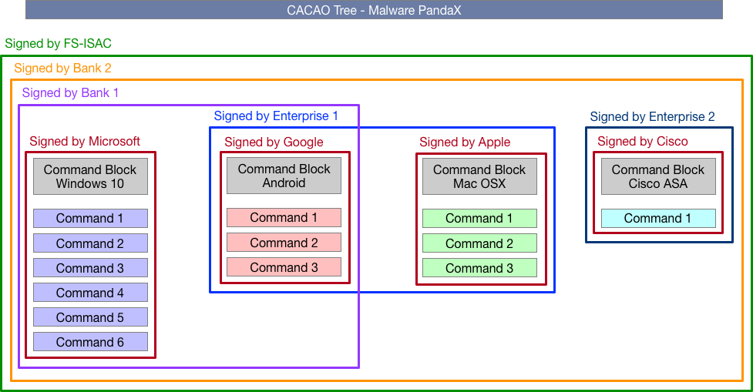
Collaboration Example - Industry Wide Response
An organization create a series of commands that mitigate malware "PandaX"
An ISAC, banks, & enterprises sign parts of the solution for mitigating PandaX

Slide 16
Getting Involved
Prague IETF
  https://www.ietf.org/how/meetings/104/
Subscribe to List
  https://www.ietf.org/mailman/listinfo/Cacao
Email List
  cacao@ietf.org
Draft Document
  https://datatracker.ietf.org/doc/draft-jordan-cacao-introduction/

