Slide 1

Logistical Budget
Quantifying Threat Actors

Slide 2
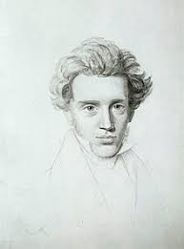
“Life can only be understood backwards; but it must be lived forwards.”
-Søren Kierkegaard

Slide 3
What if IoCs are a historical record of hacker effort?
Binaries take time to produce (and reproduce).
Domains have to be bought, maintained, shut down..
Certificates have to be bought, keys generated…
IP addresses for exfiltration need to have listening sockets…
Money, Time, Team size, and yes….TALENT, are encoded in their operational capacity.
Infrastructure needs to be recycled, to avoid our signatures/IoCs/Observables.

Slide 4
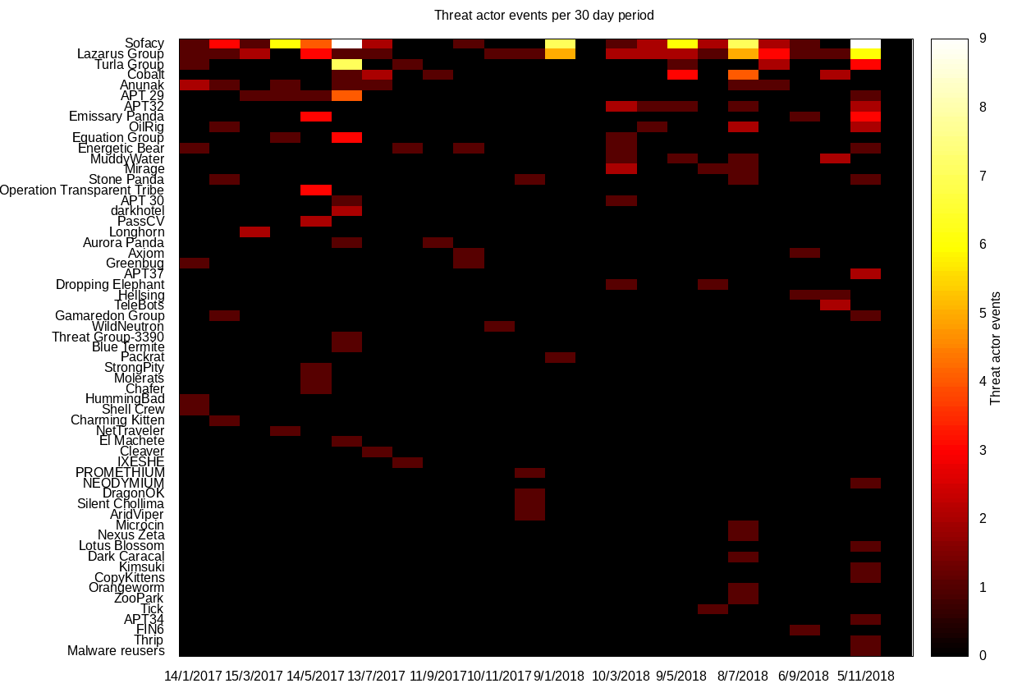
The simplest of metrics would be event count.
We can do much, much, better than this if we take this seriously as a research idea.
And we MUST!

Slide 5
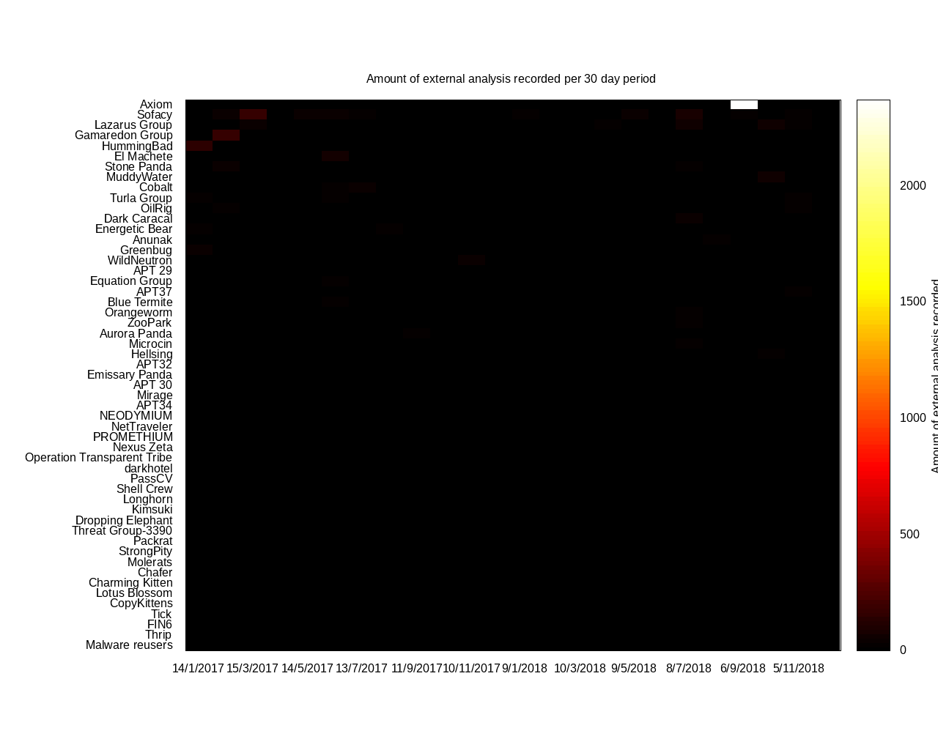
Where those the most prolific threats? Or the most tracked?

Slide 6
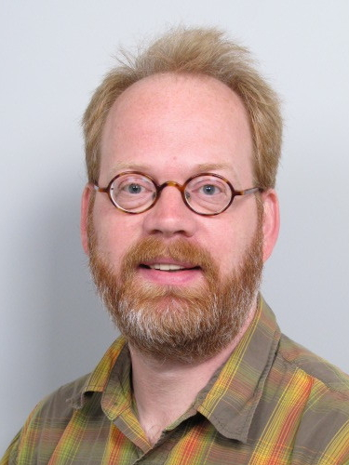
@ErwinKooi
“Your estimation of an APT’s capacity and skill is inversely proportional to how well you know them and their TTPs.”

Slide 7
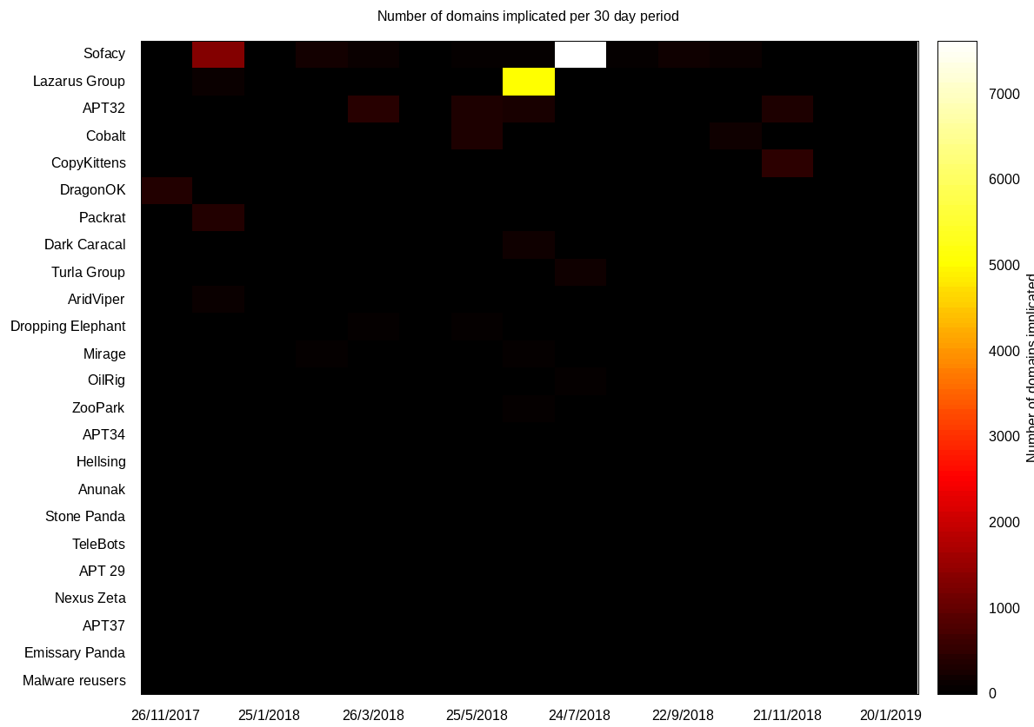
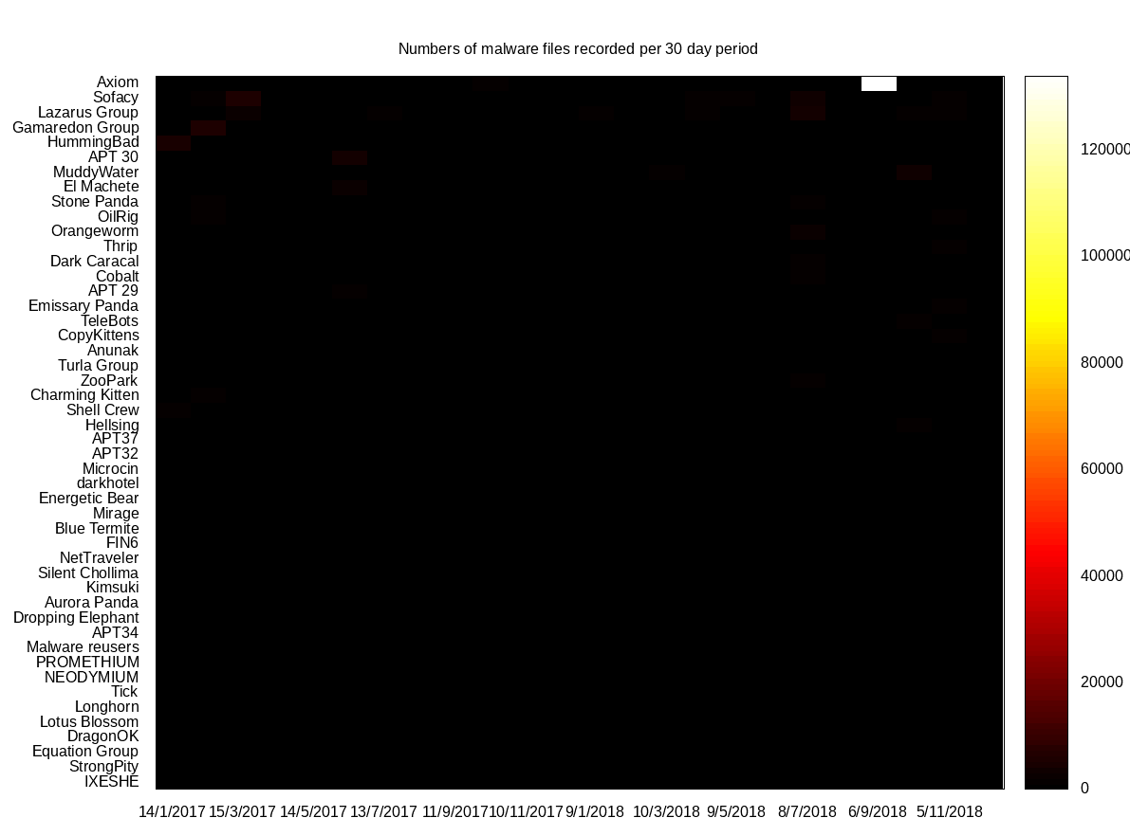
“All your heatmaps are belong to us.” -Richard Struse

Slide 8
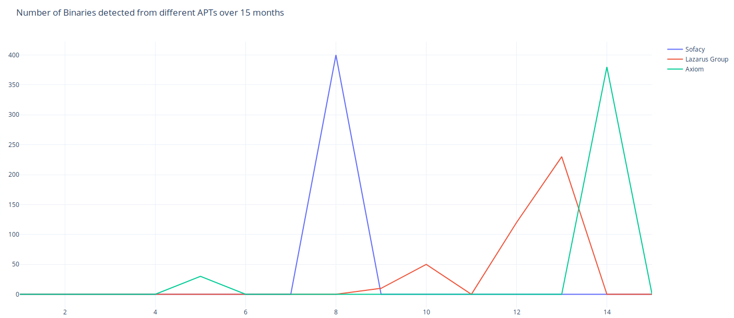
But what if we abandon heatmaps and get quantitative? MMMMMmmmm Binaries.

Slide 9
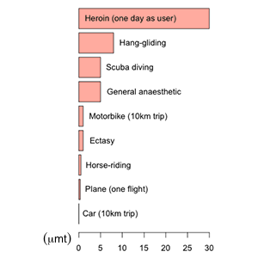
“All risks are comparable, or at least they should be.” - Gordon Woo
Why can’t we do this yet for:
Parsing a packet
Email
Viewing a file
Browsing a website
Firmware upgrade

Slide 10
Let’s estimate some crucial constants.
Money
Manpower
Time
IP Address
Domain
1KB Binary
500Mb Binary
SHA1
TLSH

Slide 11
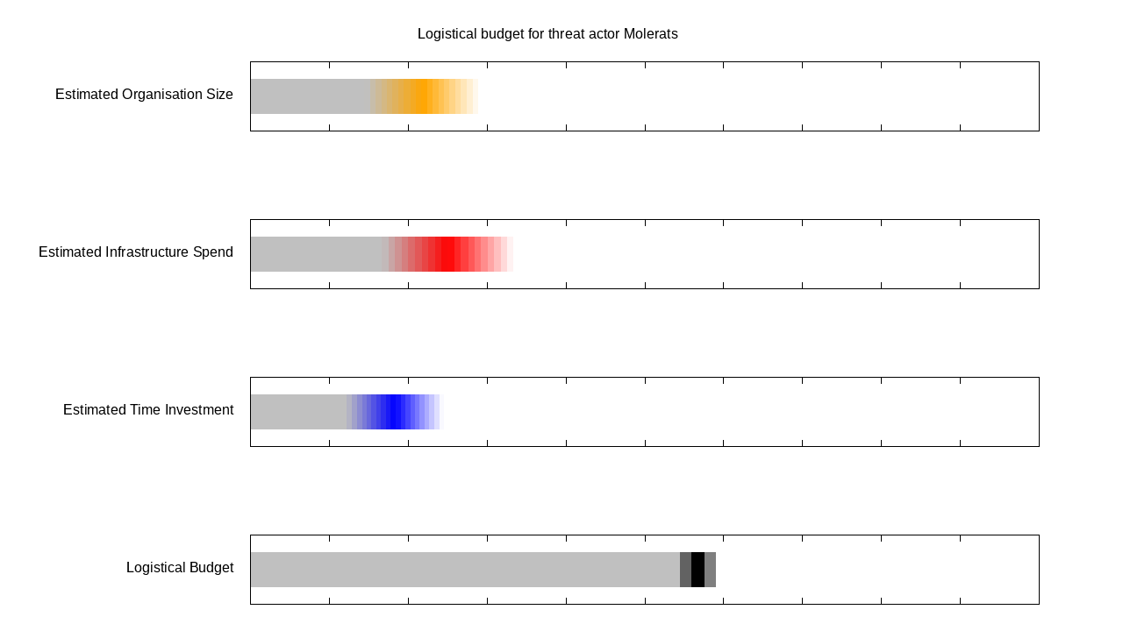

Slide 12
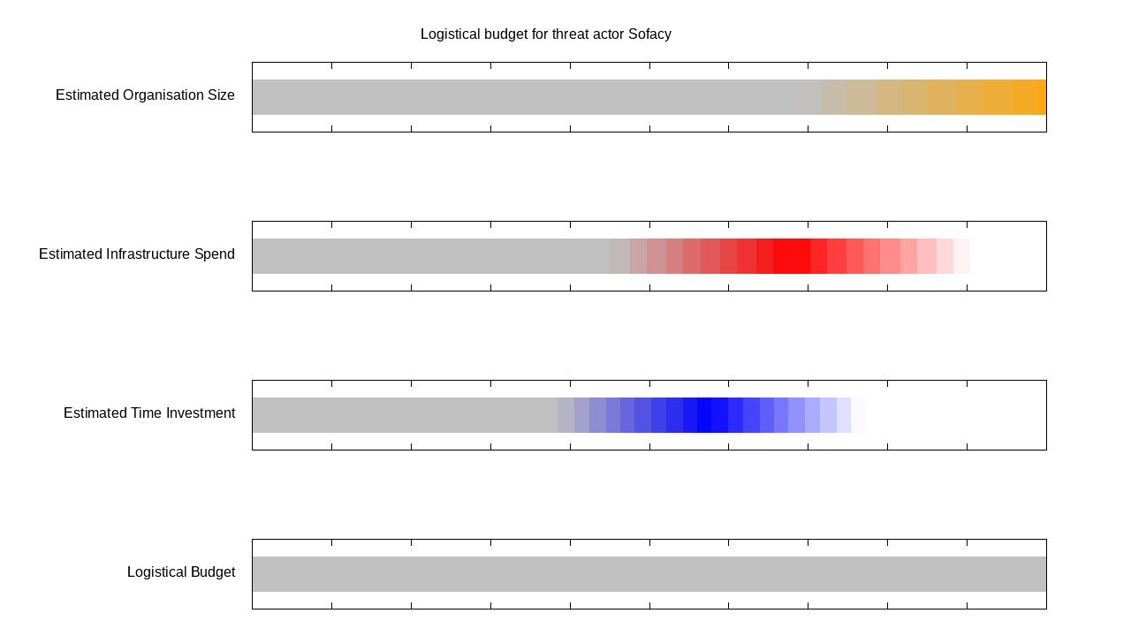

Slide 13
Now we’ve made APTs comparable, can we start to understand their capacity, so what about Ransomware?

Slide 14
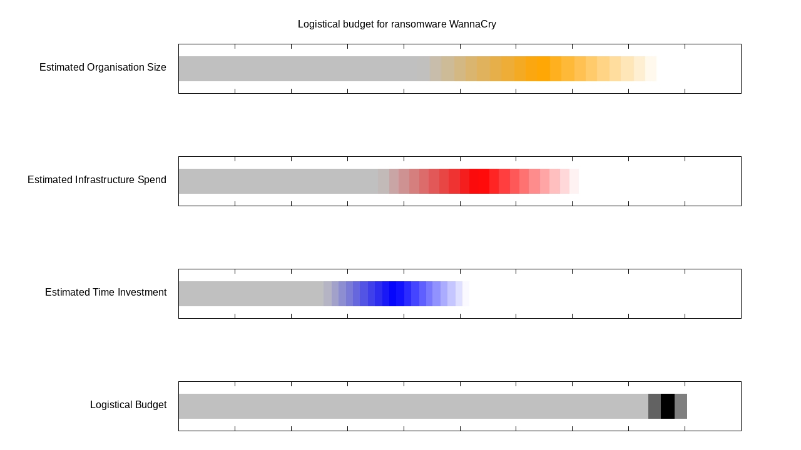
928 -> $105,955

Slide 15
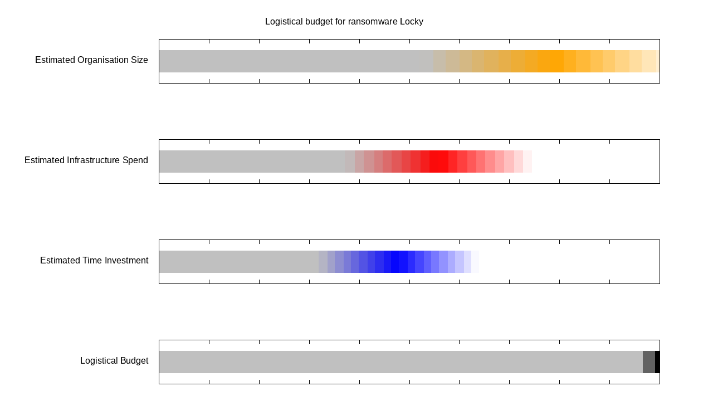
1074 -> $7.84 Million

Slide 16
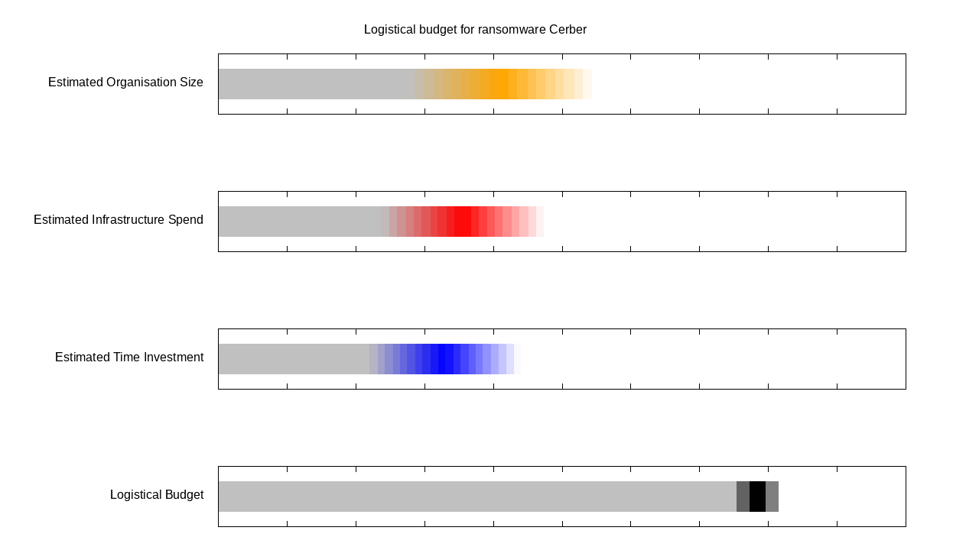
837 -> $7.50 Million

Slide 17
Ransomware has a “natural” scoring system, but what about APTs?

Slide 18
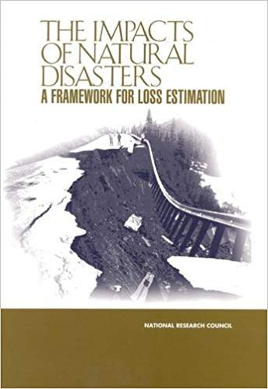
Insurance has skills we’ve ignored.
There is a science to loss estimation, which might significantly help our community.

Slide 19
First we estimate APT “capacity for harm”, then we solve for “loss estimation” of minimal and maximal harms.

Slide 20


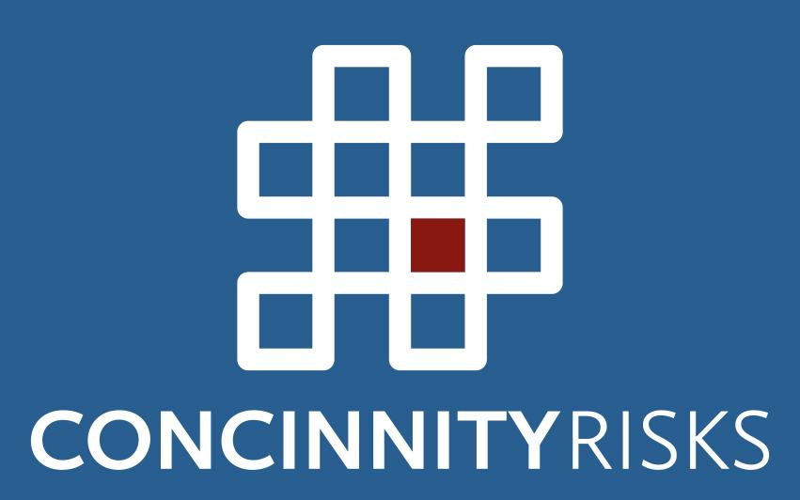
“We had the tools, we had the talent.”
- Winston Zeddmore

