Slide 1
File-Centric Analysis through the Use of Recursive Scanning Frameworks

Slide 2
About
$ id

Slide 3
Defender at Heart
Credit: Marvel Comics

Slide 4
Background

Slide 5
Defense Faces Numerous Challenges
Actors with varying Tactics, Techniques and Procedures (TTPs) to achieve objectives
Securing a vast terrain using an assortment of methods, technologies and tools
Managing the above while working in an asynchronous setting with evolving dynamics

Slide 6
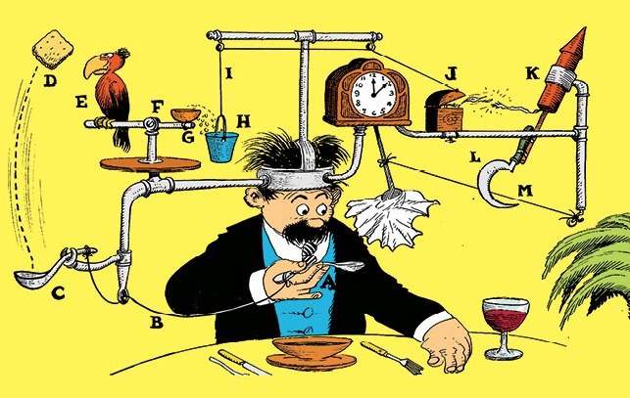
Traditional Defense
Typically includes:
Variety of disjointed appliances, approaches and tools
Limited visibility into common protocols
Host/Network IDS
Firewalls
AV
etc.
Credit Rube Goldberg Inc,

Slide 7
Incomplete Picture
Network (NIDS, Firewall, etc.)
Partial visibility into payloads via streams
Focus more on transmission protocol
Easily bypassed via a variety of measures
Host (HIDS, AV, etc.)
Limited visibility into network data
Focus more on the endpoint events
Few artifacts prior to exploitation phase

Slide 8
Files
E-mails
Web traffic
<ENTER MONITORED PROTOCOL HERE>
All share opportunities for extending our visibility and defense.

Slide 9
Files as Objects
Data structures
Metadata
Objects contained in objects
Various formats

Slide 10
Integration Issues
Numerous tools to extract, parse, etc. with varying outputs
Analysis isolated from origination of finding
Difficulty with incorporating into existing capabilities

Slide 11
File-Centric Analysis

Slide 12
Concept
Abstract needs for file analysis from collection
Client/server model for structuring workflows
Normalize the data to provide consistent logging and outputs
Simplify the process for identification leading to action and outcomes
Scale to the needs of the environment with additional workers

Slide 13
Scanning of Objects
Pass root objects for file analysis
Static
Dynamic
Identify child/sub objects by file format/type
Lather, rinse, repeat
Retain findings throughout the process to properly classify original root object

Slide 14
Modular Dispatch
Identify files via properties found in the object
Support for varying file formats through the use of modules
Load appropriate module as new objects are found

Slide 15
Typical Modules
Metadata
Collect/identify properties found in objects
Explode/Extract
Expand objects contained inside found object
Scan
Apply/implement/run additional detection capabilities against found object
Log
Export findings and observables to support analysis and other use cases

Slide 16
Conditional Dispatch
Highly customizable to fit current needs
Flexible for common to specific needs and workflows
Swap manual, mundane tasks into consistent, repeatable modules
Empower analysts
Improve efficiencies to existing operations
Discover new approaches with uncovering commonalities found in their datasets
Democratize analysis seamlessly across members and teams
Other potential use cases (depends on needs and imagination)

Slide 17
Dispositioner
“Brains” supporting the overall recursive scan operation
Determines which modules to dispatch
Tracks observables throughout the recursion
Unifies methodology for determining actions and outcomes based on findings

Slide 18
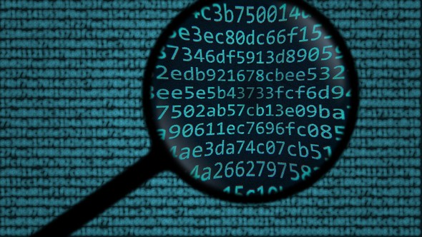
Dispositioning
Passive
Alert
Retrospective analysis
Manual submission
Inline
Block
Intercept via monitored protocol
Full integration with existing capabilities

Slide 19
Example: E-Mail
Recursively scan root object (e-mail message) to identify and scan child objects
Credit: Lockheed Martin Corporation

Slide 20
Example: Zip File
Recursively scan root object (zip file) to identify and scan child objects
Credit: Emerson Electric Company

Slide 21
Example: Log Output
Glimpse of log output after recursively scanning objects
Truncated to show first passed object for demonstration
Complete output would take numerous slides ☺

Slide 22
{
"Scan Time": "2016-02-10 20:14:41.229920",
"Filename": "test.zip",
"Source": "Analyst",
"Object": {
"META_BASIC_INFO": {
"MD5": "f77489b604a106a0e0cd715d84a975a4",
"SHA1": "872f221d3a893afb3895f3eae82b7877ba38b655",
"SHA256": "1e97ee119b350f12ffb366aebab625a46c24d44f22416f289412e5de5053794d",
"SHA512": "cd10a807da10ed796f1b9a8fa10e378efec9b12e16acbb0a983c3e2579f622dc6e96f65e69e19e056934ab1999777492638bb75dd04ed2b35a1e9944418af3a3",
"ssdeep": "6144:Cl5QCGRIcQ5lunKBVOEfvWRmG7t1u9VhcLjs0ZAIdB084E5fnKESn4zbhxJfmeH1:CvQ1uf5l4KBIEfvW3wT6jjafLWK1nibV",
"Size": "351521 bytes"
},
"SCAN_YARA": {
"misc_compressed_exe": "No Meta Provided",
"ft_zip": {
"company": "Emerson",
"lastmod": "20141217",
"desc": "File type signature for basic ZIP files.",
"author": "Jason Batchelor"
},
"compressed_exe_in_zip": {
"company": "Emerson",
"lastmod": "20150813",
"desc": "Detect on evidence of a compressed executable within a ZIP",
"author": "Jason Batchelor"
}
},
"EXTRACT_ZIP": {
"Object_0": {
"Name": "mypdf.pdf",
"Last modified": "2015-06-29 13:52:08",
<truncated>
Credit: Emerson Electric Company

Slide 23
Projects

Slide 24
Current Projects
Laika BOSS (Apache 2.0) - https://github.com/lmco/laikaboss
File Scanning Framework/FSF (Apache 2.0) - https://github.com/EmersonElectricCo/fsf
MultiScanner (Mozilla Public License 2.0) - https://github.com/mitre/multiscanner
StoQ (Apache 2.0) - https://github.com/PUNCH-Cyber/stoq
Assemblyline (MIT License) - https://bitbucket.org/cse-assemblyline/
Strelka (Apache 2.0) - https://github.com/target/strelka

Slide 25
Similar Core Capabilities
Projects share the following common approaches:
Client/Server model
Use of modules to break out functions
Offer a means to dispatch processing of objects
Provide the ability to alert or disposition on findings
Extensible to meet a variety of needs and requirements
Provide rich metadata and observables found from File-centric analysis

Slide 26
Current State of Projects

Slide 27
Laika BOSS
Support for a general list of filetypes as well as logging to Fluentd and Tactical modules
Milter (e-mail filter) component
Allows for tight integration with mail transfer agents (MTAs) including blocking e-mails
Suricata integration prototype
Uses Redis client to send to Redis Database

Slide 28
File Scanning Framework/FSF
Support for a variety of filetypes including Mach-O metadata
Detailed documentation and explanation on use cases
Existing integrations with open source Network Security Monitoring (NSM) platform:
Rock NSM - https://rocknsm.io/

Slide 29
MultiScanner
Support for a number of general use cases
Metadata collection of several filetypes
AV scans, detonation, Machine Learning, Yara
Compare hashes against National Software Reference Library (NSRL)
Prototype for distributing tasks using Celery workers
Comprehensive documentation including Application Programming Interfaces
Web
Python
RESTful

Slide 30
STOQ
Support for a considerable amount of filetypes
Including decompression, extraction, metadata collection
Additional modules for specific needs and use cases
Monitoring directories for new files
Connectors for a variety of logging needs such as ElasticSearch, Kafka, MongoDB, STDOUT
Plugins for other open source tools for built-in integration
In-depth documentation including explanations to further extend existing capabilities

Slide 31
Assemblyline
Support for a diverse set of filetypes and use cases
AV scans, detonation, static analysis, configuration decode/extraction
Integration with a variety of services and open source tools
Additional capabilities for processing of files
Compressed and RC4 Transport (CaRT) for encrypted transmission of files and objects
Sync service to ensure availability for processing of files and objects
Ample documentation covering components, deployments and troubleshooting

Slide 32
Strelka
Support for wide-range of filetypes and use cases via “scan” modules
Metadata/observable collection, detonation, decompression, extraction
Inclusion of various libraries for static analysis of objects
Direct and remote file requests including configurable authentication and encryption options
Integration with common logging needs such as ElasticSearch and Splunk
Extensive documentation including configuration, management and use cases
Slack channel for additional support and participation

Slide 33
Opportunities

Slide 34
Apply/Test in your Environment
Many of the projects provide ways to test drive:
Docker
Vagrant
Virtual machine images

Slide 35
Extend Capabilities
Support for additional filetypes and objects
Integration to other platforms, software and tools
Tie into common workflows
NSM
Dynamic/static analysis
Digital Forensics/Incident Response (DFIR)
Threat Intelligence

Slide 36
Participate!
Pull requests are welcome
Code
Documentation
Ideas
Issues

Slide 37
Questions?

Slide 38
References (ICYMI)
Laika BOSS (Apache 2.0) - https://github.com/lmco/laikaboss
File Scanning Framework/FSF (Apache 2.0) - https://github.com/EmersonElectricCo/fsf
MultiScanner (Mozilla Public License 2.0) - https://github.com/mitre/multiscanner
StoQ (Apache 2.0) - https://github.com/PUNCH-Cyber/stoq
Assemblyline (MIT License) - https://bitbucket.org/cse-assemblyline/
Strelka (Apache 2.0) - https://github.com/target/strelka

