Slide 1
A Lightweight Markup Language for Graph-Structured Threat Sharing
Disclosure to 2019 FIRST CTI Symposium London
Copyright(c)2019 NTT Corp. All Rights Reserved.
Mayo YAMASAKI
NTT-CERT, NTT Secure Platform Labs

Slide 2
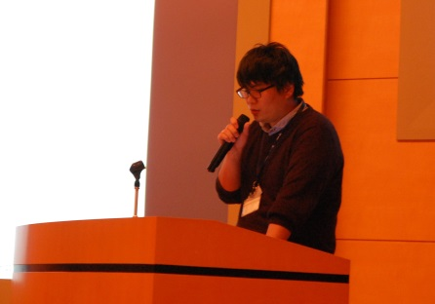

$whoami
Mayo YAMASAKI @ Tokyo, Japan
  Researcher at NTT R&D
  Member of NTT-CERT's OSINT Team
R&D Topics
  Search System
  Knowledge Extraction from Text with NLP/ML
  Knowledge Representation for Threat Sharing
www.ntt-cert.org

Slide 3
Agenda
Background
Overview of Proposed Lightweight Markup Language
Demo
Capability & Limitation
Current Implementation
Future Work

Slide 4
Agenda
Background
Overview of Proposed Lightweight Markup Language
Demo
Capability & Limitation
Current Implementation
Future Work

Slide 5
Security Reporting in NTT-CERT
Publishing about 20 security (threat) reports every day
Creating these reports associated with STIX data
Using web-based internal collab system for security reporting
STIX Data
Security
Report
IoCs
TTPｓ
CVEs
Attributions

Slide 6
Problem in Operation
Difficulty of creating structured STIX data in our operations
  Time constraints and/or inadequate analyst training
Shortage of structured data in operations^{[1][2]}
  Unstructured expression used by 60% practitioners
  Lack of context such as TTPs in structured data
How to create structured data more easily ?
[1] "The Value of Threat Intelligence: The Second Annual Study of North American & United Kingdom Companies", Anomali, 2017.
[2] "Exploring the opportunities and limitations of current Threat Intelligence Platforms", ENISA, 2018.

Slide 7
Our Approach
Text-based representation, not GUI
New language for STIX 2 compatible graph data
High Graph Expressiveness
STIX
Proposal
System Language
RDF&DOT
Human Language
Markdown
Low Graph Expressiveness

Slide 8
RDF; Resource Description Framework
Graph as set of tuples such as (subject, predicate, object)
  Multiple format including JSON, XML, N-Triples, Turtle, etc.
RDF N-Triples
<http://example.com/ipv4/192.168.0.0> <http://example.com/indicates> <http://example.com/malware/EvilRat> .
<http://example.com/ipv4/192.168.0.0> <http://example.com/indicates> <http://example.com/malware/EvilTrojan> .
Graph Representation
EvilRat(malware)
EvilTrojan(malware)
indicates
indicates
192.168.0.0(ioc-ipv4)

Slide 9
DOT Language
A DSL for a graph visualization tool such as Graphviz
DOT Representation
Graph Representation
digraph G {
a [label = “malware:EvilRat”];
b [label = “malware:EvilTrojan”];
c [label = “ioc-ipv4:192.168.0.0”];
c -> a [label=“indicates”];
c -> b [label=“indicates”];
}
EvilRat(malware)
EvilTrojan(malware)
indicates
indicates
192.168.0.0(ioc-ipv4)

Slide 10
Agenda
Background
Proposed Lightweight Markup Language
Demo
Capability & Limitation
Current Implementation
Future Work

Slide 11



Overview
Consists of pre-shared graph schema & graph data
  Schema: domain specific definition of edges between node types
      Rarely updated like RDB-schema
  Data(Report): plane-text with nodes as "[NAME]{TYPE}"
      Edges automatically extracted according to the schema
Sharing a report
Team A
Team B
Schema
Report
STIX
Schema
Report
STIX

Slide 12
Example 1: IP with malware
Schema: A table of directed relationships from rows to cols
Destination types
 | malware | ioc-ipv4
malware | - | -
ioc-ipv4 | indicates | -
Source types
Edge types
Report
STIX compatible Graph
[EvilRat]{malware} sends system information to [192.168.0.0]{ioc-ipv4}.
The IP address also had been used for C2 server of [EvilTrojan]{malware}.
EvilRat(malware)
EvilTrojan(malware)
indicates
indicates
192.168.0.0(ioc-ipv4)

Slide 13
Constraints
Any pair of node types must have 1 or 0 edge type.
  To deterministically extract edges
All pair of nodes in a paragraph has edges if edge between these node types is defined in schema.
  To extract multiple graph data in a document

Slide 14
How to Make STIX Data?
Extracting graphs from each paragraphs in a report
Merging nodes by comparing node names/types
Rule-based conversion to STIX data
Report
Sub Graphs
Graph
STIX

Slide 15
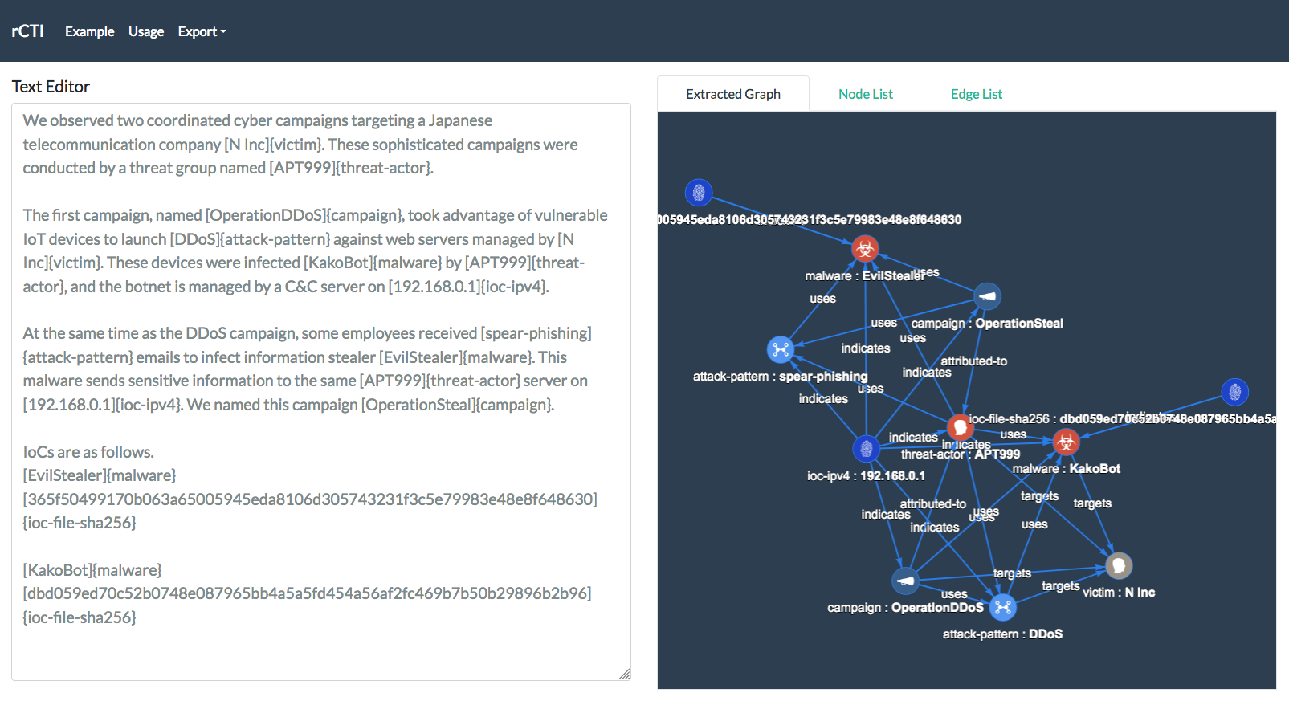
Example2: A Sample Scenario
Par. 1
Par. 2
Par. 3
Par. 4
Par. 5

Slide 16
Schema & Rules for STIX 2
Schema definition including 52 node types & 200 edge labels
  SRO relationship_type between two SDO types
  Additional node types for usability and a language's constraint
Examples of conversion rules
ioc-ipv4 | label=“indicator”, pattern="[ipv4-addr:vlaue=${NODE_NAME}]", labels=[“unknown”]
file-sha256 | label=“observed-data”, objects={ "0":{"type":"file","hashes": { "SHA-256": "${NODE_NAME}"}} }, first_observed=${CURRENT_TIMESTAMP}, last_observed=${CURRENT_TIMESTAMP}, number_observed=1

Slide 17
Agenda
Background
Overview of Proposed Lightweight Markup Language
Demo
Capability & Limitation
Current Implementation
Future Work

Slide 18
Agenda
Background
Overview of Proposed Lightweight Markup Language
Demo
Capability & Limitation
Current Implementation
Future Work

Slide 19
Evaluation of Proposed Language
Comparing editing cost for evaluating usability
  How easy is creating structured data ?
  Comparing raw STIX, RDF, DOT, and the proposed language
Measuring STIX data coverage for understanding tradeoff
  How much is coverages ratio of STIX data on the proposed lang ?
  Comparing between existing STIX data and the proposed lang

Slide 20
Comparing Editing Cost: Method
Comparing editing costs on existing text-based threat reports
  Levenshtein Distance^{*1} of markup-ed reports to original ones
    Costs of STIX, RDF and DOT equal number of characters
      expressions separated from text-based reports
Original Report
Proposed Lang
EvilRat malware sends stolen data to 192.168.0.0.
Editing Cost: 16
[EvilRat]{malware} sends stolen data to [192.168.0.0]{ioc-ipv4}.
^{*1} It is the minimum number of single-character editing operations (insertion or deletion) required to convert one sequence into the other.

Slide 21
Comparing Editing Cost: Dataset
Collecting 15 threat reports on the WEB and extracting these text
Creating structured data by using representations
  STIX(JSON, YAML)
  RDF(N-Triples, Turtle)
  DOT
Stats of Dataset | Count
Avg. text length (number of characters) | 13,548
Avg. number of SDOs (≒ number of nodes) | 13.9
Avg. number of SROs (≒ number of edges) | 14.5

Slide 22
Comparing Editing Cost: Result
 | Avg. Cost | Percentage of Avg. Cost to STIX(JSON)
STIX(JSON) | 17509 | 100
STIX(YAML) | 14001 | 80
RDF(N-Triples) | 3239 | 19
RDF(Turtle) | 2594 | 15
DOT | 1793 | 10
Proposed Lang | 327 | 2

Slide 23
STIX Data Coverage: Method & Dataset
Method: Comparing data coverage on existing STIX data
  Coverage: Percentage of all STIX objects and object's attributions extracted from proposed lang's report to existing STIX data's ones
Dataset: 3 threat reports on the STIX official site^{*1}
  APT1, Poison Ivy, IMDDOS
*1 https://oasis-open.github.io/cti-documentation/stix/examples

Slide 24
STIX Data Coverage: Result
Report | SDO Coverage | SRO Coverage | Attribution Coverage
APT1 | 46/48 | 30/30 | 94/422
Poison Ivy | 45/66 | 53/90 | 107/351
IMDDOS | 4/9 | 2/5 | 8/35
Uncovered data
  SDO: marking-definition, complex indicator containing AND/OR
  SRO: associated with uncovered SDOs
  Attribution: created, modified, description, objec_marking_refs, labels, and kill_chain_name

Slide 25
Agenda
Background
Overview of Proposed Lightweight Markup Language
Demo
Capability & Limitation
Current Implementation
Future Work

Slide 26
Tools: Currently Internal Project :(
Raph: A parser of lightweight markup language for graph description
  Golang implementation and API
  Domain independent graph description
rCTI: Raph Language for Cyber Threat Intelligence
  Golang's CLI tool, REST API server, and WEB editor app
  CTI domain graph description
  Exporting STIX 2 data

Slide 27
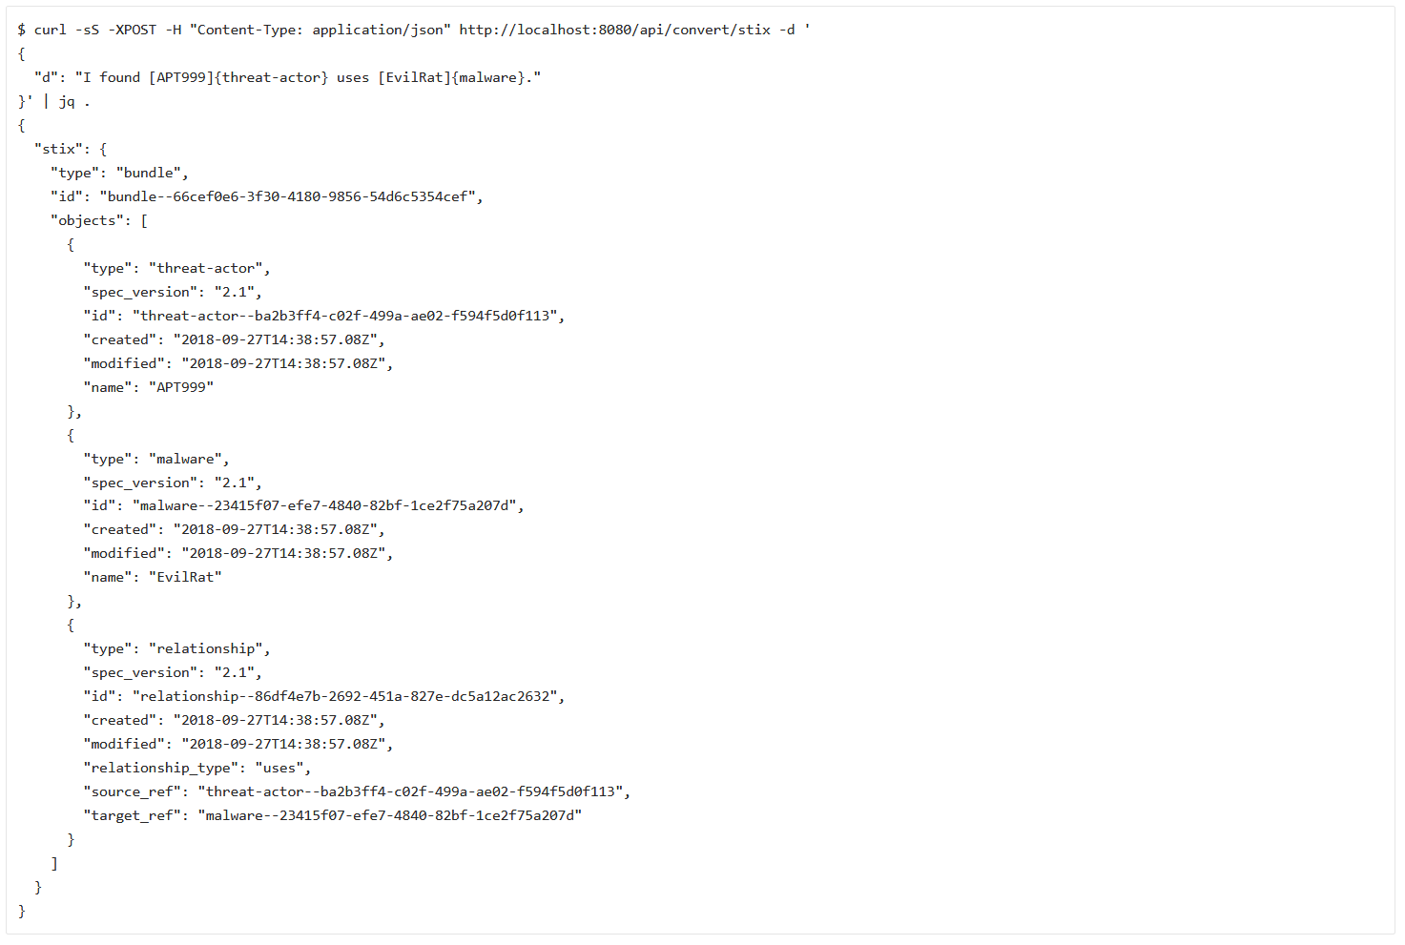
rCTI REST API sample
Input Text
Output STIX

Slide 28


Integration in Our Team
New & Experimental Flow
Our Team's Workflow
  Collecting open source info
  Analyzing selected events
  Writing reports
  Editing STIX data on WEB UI
  Publishing reports
Collab System
for Security Reporting
with proposed lang
Browser
App
DBs
REST API
TIPs
rCTI Server

Slide 29
Agenda
Background
Overview of Proposed Lightweight Markup Language
Demo
Capability & Limitation
Current Implementation
Future Work

Slide 30
Future Work
Language
  Representing attributions
Schema
  Fixing and Expanding schema for CTI
Implementation
  Resolving equivalence identification of nodes including TIP's ones
Next Step
  Using markup-ed reports for ML-based knowledge extraction

Slide 31
Summary
Proposed a lightweight markup language for graph-structured CTI

