Slide 1
Workshop: Tracking Adversary Infrastructure
Mike Schwartz, Target
Tim Helming, DomainTools
FIRST CTI Symposium
18 March 2019

Slide 2
Agenda
Part I: Theory and Case Studies
Housekeeping, and Meet Your Presenters
Team Formation and Icebreakers
Description of the Problem Space
Basic Adversary Investigation Concepts
Case Studies
Getting Started + Best Practices
LUNCH
Part II: Hands-On
Investigation Walkthroughs
Activity: CTF
  Overview
  Go!
  Team Presentations and Feedback
Wrap-Up
Q&A

Slide 3
Meet Your Presenters
Mike Schwartz, Target
Director – Threat Intel Detection Engineering
20 years experience in IT
  Help Desk
  Systems Engineering/Support
  Intelligence Analyst
  Android Malware RE
  Threat Intel
  Detection Engineer
Tim Helming, DomainTools
Director, Product Management
The “features and roadmap guy”
Nearly 20 years in infosec
  Technical Support grunt
  Technical Support leader
  Product management grunt
  Product management leader
Just for fun: ham radio, motorcycles, classical percussion

Slide 4

Team Formation
Icebreakers
Notes:
Icebreakers:
We will have them do two activities. First, they will turn to the person to their right (wrap around the rows if odd #s in a row), introduce themselves, and ask each other the following questions:
How did you get into infosec?
What was the best “dumb” question you ever asked, that turned out to lead to really interesting learnings?
We will give them about 3-4 minutes to do these questions.
Then we will create the groups. Aiming for group size of about 5, and depending on how many ppl we have in the room, we will have them count off by [room count]/[ideal group size]. These are the groups.
The groups will arrange themselves into workspaces, then as a group they will do this icebreaker (each person goes):
-Introduce themselves
-Share the most interesting idea in infosec that they've read, said, or thought in the last year
We will give about 10 minutes for this icebreaker.

Slide 5
Profile Adversaries And Map Campaigns With This One Weird Trick

Slide 6
The “Oh Snap” Moment
OK-stopped the leak (for now).
But…
How long have they been inside?
Where have they been sending my data—have I stopped the whole leak?
Why didn’t my TI feed(s) flag that domain or IP?
….Thus our journey begins…
exfiltrationdomain.com
data hemorrhage
Something throws an alert!

Slide 7
DNS OSINT for Hunting and Analysis
Normally we might assume that hunting for signs of compromise is about looking at internal systems/indicators (infected machines, corrupted/deleted file systems, etc). However:
Attackers almost always leave clues behind
These can occur at any stage of the operation (some more than others)
Some of the clues involve observable Internet traffic
…and some of that traffic could hold the key to discovering, stopping, or even preventing a breach or other event

Slide 8
Network-Based Adversary Profiling: Data Sources
DNS lookups (many sources of passive/massive DNS. Live lookups are fine but don’t scale, plus you have to know what to look up a priori)
Dig (command line)
Whois lookups (many web sources, or port 43 from command line)
MX records (several web sources, command line also supports this)
Archive.org’s Wayback Machine
Search engines - there are a few of these too :)
Malware analysis (that’s more Mike’s area)

Slide 9
OSINT=Free?
Short answer
Piecemeal: Yes
At scale: No (typically)
Longer answer
With some work, there are things you can do to automate collection/querying of OSINT in large(ish) volumes, but…
Consider the domains-by-IP problem
Creating cross-indexed databases of OSINT is not trivial

Slide 10
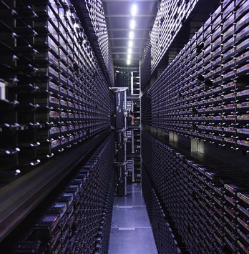
A Note on Directionality
What is observable to you varies with the direction of the traffic.
Threat actors “rent” IP addresses but own domains. This can be valuable for forensics.
*IFF you’re logging the right things.
Inbound: IP addresses/ports
Outbound: IPs/ports and domain names*

Slide 11



OSINT, Threat Feeds, Directionality
Bad Actor
You
visit domains, get pwnd
OSINT is useful here (actors own domains).
1.2.3.4
succumb to hacks, get pwnd
Need observation-based intel for this part (actors rent IP addresses)

Slide 12
Asking the Right Questions
Domains
What is its purpose?
Is it legit?
Is it recent?
Who registered it?
Where is it hosted?
Does it have web content?
Has anyone flagged it as bad?
What is it connected to?
IPs
Who owns the IP or range?
Where is it based?
Is it hosting domains, and if so, what are they?
What port(s) are open?
Has anyone flagged it as bad?
What else is on the same ASN?
Is it part of a coordinated campaign?
Hint: we’re going to revisit these questions later!

Slide 13
Workflow: Adversary Infrastructure Mapping
An indicator is seen.
IOC Sources:
Phish domain
Firewall/IPS alert
SIEM correlation
Form Hypothes(es).
This indicator could be
Part of a campaign
Targeting my industry
Targeting my org
Gather Data
Enrich indicators
Cross-indexed Whois/DNS Other domain profile info
Test Hypothesis
Evaluate data
Connected infrastructure?
Thematic consistency?
High risk scores?
Other red flags?
Test Hypothesis part 2
Look for more evidence
Search alerts for domains/IPs
Search archived logs
Search SIEM/feeds
Act!
Block domains/IPs in network/host defenses
Monitor observed actors
Block future infrastructure

Slide 14
Break Time!

Slide 15
The Real World: Case Studies

Slide 16
Digital Skimmers e.g. MageCart
Credit Card Skimmers for websites
Became more mainstream in 2016 by exploiting the Magento e-commerce platform
Have been all the rage the past 6 months
  Ticketmaster UK https://www.riskiq.com/blog/labs/magecart-ticketmaster-breach/
  Newegg https://techcrunch.com/2018/09/19/newegg-credit-card-data-breach/
  British Airways https://www.riskiq.com/blog/labs/magecart-british-airways-breach/
  Various other retailers https://www.riskiq.com/blog/labs/magecart-shopper-approved/

Slide 17
Digital Skimmers cont.
Follow the researchers
  In this space…
    Kevin Beaumont ^{@gossithedog}
    Yonathan Klijnsma ^{@ydklijnsma}
    Willem de Groot ^{https://gwillem.gitlab.io}
Infrastructure is needed for exfil (credit card data)
In some cases, infra is needed to load 3rd party JS
  Unless you know the complete URI, you can find the infra ^{publicwww.com}
This infra is trackable and you likely have users shopping

Slide 18
Tools
Censys.io
Domaintools Iris
URLScan
Passivetotal
Virustotal
Google
Publicwww

Slide 19
The Right Tool for the Job: Domains
Question | Tools
What is its purpose? | (Your judgment after using other tools!)
Is it legit? | (Your judgment after using other tools!)
Is it recent? | Whois lookup tools; URLScan.io
Who registered it? | Whois lookup tools, google
Where is it hosted? | URLScan.io, DomainTools,
Does it have web content? | Wayback Machine, DomainTools, URLScan.io,
What server(s) or service(s) are running? | URLScan, shodan, DomainTools, censys.io,
Has anyone flagged it as bad? | VirusTotal, AlienVault OTX, Google Safe Browsing,
What is it connected to? | Reverse lookup tools (Whois, NS, IP, trackers, certs), pDNS databases

Slide 20
The Right Tool for the Job: IPs
Question | Tools
Who owns the IP or range? | Whois tools, URLScan.io,
What other ranges are owned by the same entity? | Reverse IP Whois tools (note: different from Reverse IP!)
Where is it based? | IP2Location, Maxmind, URLScan,
Is it hosting domains? Which ones? | pDNS, DomainTools,
What else is on the same ASN? | Whois lookup tools
What port(s) are open? | Wayback Machine, DomainTools, URLScan.io,
Has anyone flagged it as bad? | VirusTotal, AlienVault OTX, Google Safe Browsing,
Is it part of a coordinated campaign? | Your judgment, AlienVault OTX, VirusTotal,

Slide 21
[PLACEHOLDER FOR VIDEO]

Slide 22
FIN7
Prolific cybercrime actor that has targeted retail, banking, hospitality, and restaurant groups
Initial intrusion is with a maldoc usually followed-up with some sort of social engineering (e.g. phone call)
Payment card data is the target
Often reused infrastructure even after being published
Used trackable methods to setup infrastructure

Slide 23
Tools
DomainTools Iris
VirusTotal
  pDNS and URL scan can uncover maldocs

Slide 24
[FIN7 VIDEO]

Slide 25
Commodity Malz
Commodity malware infrastructure is usually stood-up well before it’s used in a campaign
  You can get lead-time detection
Cyber criminal are lazy
  Infrastructure is reused
  Certs
    Self-signed
    Expired
    Wild card

Slide 26
[VIDEO] LokiBot today… Pony Yesterday?

Slide 27
Break Time!

Slide 28
Getting Started;
Best Practices;
Budget Management

Slide 29
You need to buy threat intel… not really!
Your organization should be the first place you start for threat intel
You should have e-mail logging to include quarantined files
  Start a phishing tracking program (1 FTE)
  From here you can begin a full infra tracking program (1 FTE)
No threat intel feed will be as good as what you generate
Only buy to fill gaps your intel program identifies
Best ROI would be to start with vulnerability intel (.5 FTE)

Slide 30

Fuel For The Engine
What is your logging/archiving policy?
Is your internal infrastructure ready? Storage, LAN bandwidth, etc
You’ll need to shove a lot of packets around!
…but it’s worth it.
Notes:
If you think of your automated threat management playbooks as the engine of your operation, then the data that feeds the process is the fuel for the engine. You can have the most incredible, powerful, finely-tuned engine in the world—but it won’t get you anywhere without any fuel, right?
We’re going to talk about the formula for the fuel in a few minutes, but let’s look a bit at the systems that deliver it to your engine.
Do you know what your logging policy is? Did you build it based on experience, consultation with mentors or peers in the industry, or is it more ad-hoc? (It’s okay if it’s ad-hoc. That’s just reality for a lot of us. But if that’s the case, it gives you one of the points you’ll want to think about as you set up your SOAR environment). What is your archiving policy? Do you have a regulation like SOX or HIPAA or PCI that mandates how long you keep records? If you do, then you know what your retention policy needs to be (or hopefully you do!). If you aren’t under those regulations, then you get to do what works best for your company in terms of how you want to manage risk.
Here’s one idea to chew on, though: we know that the average dwell time for a breach is still several months. If the worst happened and you discovered you’d been breached, wouldn’t it be good to know that you had logs that most likely go back to when the attacker first got their foothold in the network, assuming you were somewhere around the average in terms of dwell time? For some organizations that is an absolutely mammoth amount of data to consider, but the good news these days is that mammoth amounts of storage are available.
If you’re doing comprehensive logging, you’re also going to be shoving a lot of packets around on your network (and/or to the cloud). LANs of 40 gigabit are not uncommon, so within your environment, it shouldn’t be too hard to move the log data around. If you are using a cloud service, then the pipeline to that service is something you need to plan for.
As expensive as some of these things may be….they are probably still cheaper than getting breached.

Slide 31
You will need data
Your organization’s data
  DNS logs
  Proxy logs
  E-mail logs (envelope info)
  Netflow
External data
  pDNS
  Domain/Infra History

Slide 32
Leverage Open Source / Free Intel
Open source logging technologies
  Graylog
  Elastic / Logstash / Kibana (ELK)
  Fluentd
  ElastAlert
  SecurityOnion
Free Intel Sources
  Threatcrowd.org
  Virustotal.com
  Censys.io
  Shodan.io
  Passivetotal.org
TWITTER!
@pmelson
@timstrazz
@danielbohannon
@gossithedog

Slide 33
Threat Intelligence
Your Network
Notes:
OK—so let’s assume we have infrastructure that is up and running and is able to handle and process the data you need to power your efforts. Now let’s talk about threat intelligence. This is where we get into the forumulation of that jet fuel.
There are vast quantities of threat intelligence out there. Millions of IOCs of all kinds—domain names, IP addresses, files, et cetera et cetera. And a lot of that threat intel is really good—it’s well-researched, vetted, comprehensive. So there’s this vast set that we’ll call “threat intelligence.”
The thing you have to keep in mind about that, is that there is another collection of IP addresses, domain names, etc, that I guarantee that each and every one of you cares about. A lot. It’s the infrastructure that touches your network.
And it doesn’t matter how big your company is, because I guarantee that the set of data in the world of threat intelligence is much larger than the set of infrastructure data that you care about most. And for most companies (and you have to hope that this is the case for you, btw), the overlap between these sets tends to be incredibly small. Probably smaller than it’s depicted here.
Something to point out about this image: it would be easy to interpret it such that the little football shape where the circles overlap is where the Bad Stuff is.
Unfortunately, the bad stuff probably occupies more of the circle than that little football. [CLICK] The delta between the little football and the bigger one represents the malicious infrastructure that someone on your network had some contact with, but that doesn’t appear on whichever threat intel feeds you’re using. We had one CISO tell us that the overlap between sketchy traffic on their network, and what they saw in the feeds, was about 3%. And this was a very sophisticated shop, and they were consuming high-quality feeds. That 3% number doesn’t mean that the feeds aren’t good. It means that they aren’t psychic. They only can know about the malicious infrastructure (or files or whatever) that have been reported by someone. There’s a LOT out there that is bad but has never been reported.

Slide 34
What Data?
What Data?
Your Network—the ultimate source of relevant data:
Email logs, including quarantined files
DNS logs
Proxy logs
Netflow
These all contain a wealth of forensic information!
Your Network
Notes:
So….what *should* be your starting point? Well, when you’re contemplating what data you want to use as the fuel for your threat intelligence engine, the best place to start is inside your environment. Start inside and work your way out, not the other way around.
So the places where you need to focus are on sources like these here.
There’s something that email, DNS, and proxy logs have in common (and this can be true in netflow but it’s pretty much always true in the others): they contain domain names. There’s a reason (actually, a lot of reasons) that matters. So much of what we look at in terms of logs and alerts just gives us IP addresses and ports. But if you have a host that’s talking to an IP, but you don’t have logging from your DNS resolver or your web proxy, and if that IP address hosts a whole bunch of domains, how do you know which one your host was talking to? If you don’t know that, you’re already in a tougher spot when it comes to evaluating the severity of that connection.
Here’s food for thought: when you’re evaluating a new piece of defensive technology like a firewall or an email filter, in addition to asking questions about what kinds of threats it can stop, consider asking the vendor “what can its logs tell me?” Remember, you’re going to be counting on that log data to help power your forensic activities, whether they are manual or part of a SOAR setup.

Slide 35
Anecdotes
My Cyber Intel / Detection Engineering team uses multiple ELK stacks – the free version.
Configure ElastAlert for easy alerting
  Alerting configured to HipChat channel for malware sample hunting
ThreatCrowd
  Useful for searching OSINT on infra
Shodan
  Not just for fun
  Profile infrastructure to create a fingerprint
  Identify common ports and services
  Maybe you’ll find a unique banner to pivot on

Slide 36
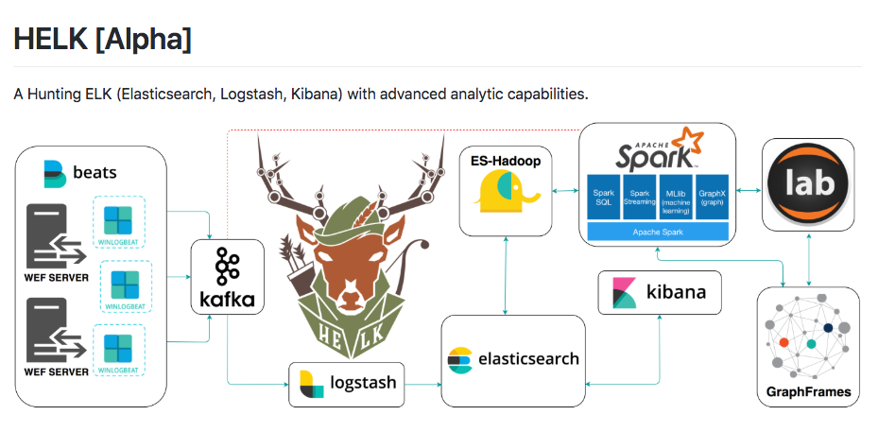
Lets go nuts!
https://github.com/Cyb3rWard0g/HELK

Slide 37
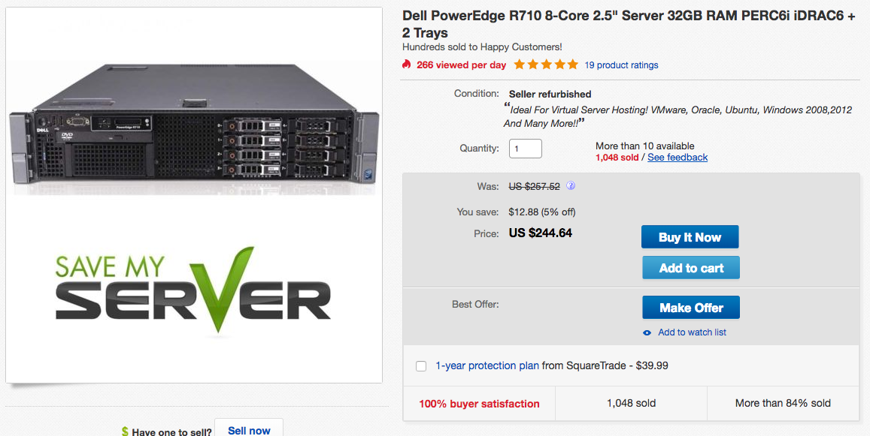
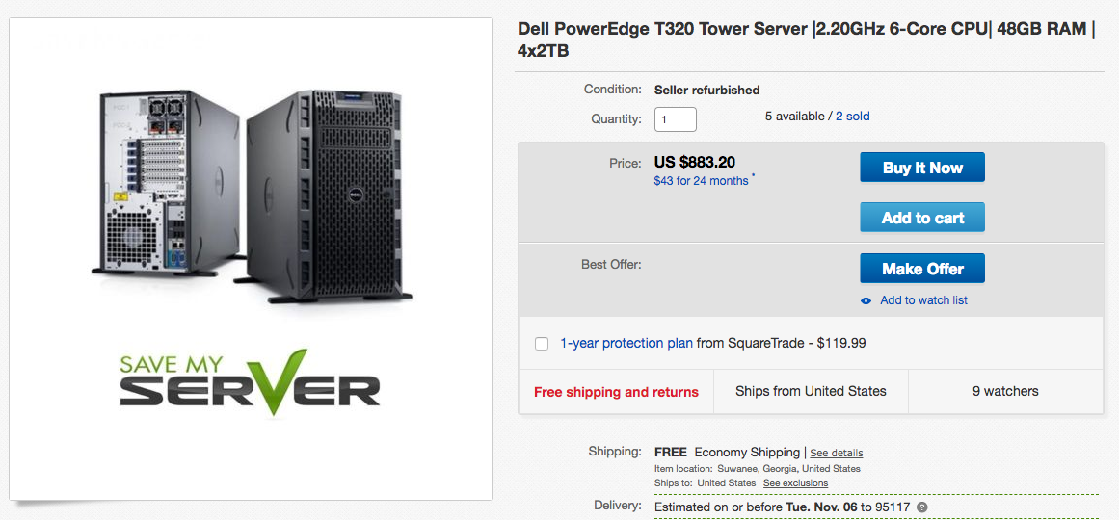
Hardware is expensive… but it can be cheap
Buy refurbished
  3-5 year old servers are cheap and usually also come with a warranty

Slide 38
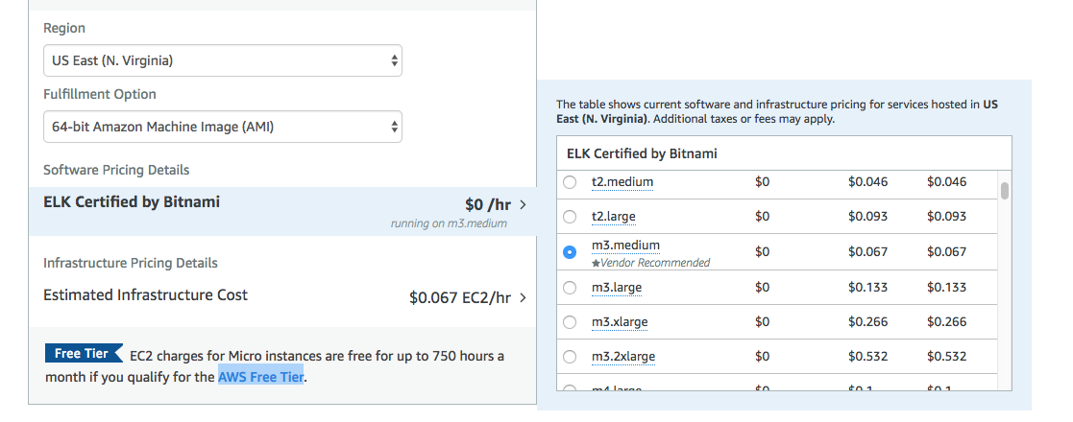
The cloud is also reasonable
There are some free tiers of service that may work well
No upfront costs

Slide 39
Recap
You don’t need to buy a TI feed
Best ROI would be to start with vulnerability intel (.5 FTE)
  Build your program from here
If you’re not logging the basics, your TI team will having nothing to work with… neither will IR.
Most of what you will initially need is free
Refurb hardware is much cheaper than new and still very effective
Cloud solutions have no sunk costs

Slide 40
LUNCH BREAK!

Slide 41
Hands-On!

Slide 42
Agenda: Hands-On Training
Group Walk-Through: Profiling a Campaign
  Log in: https://research.domaintools.com/iris
  Credentials were emailed to you
Team Formation
Ice-breakers
Team Exercises
  Characterizing Domains
  Connecting Domains
  Mapping Attack Infrastructure

Slide 43
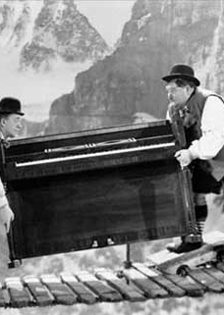
Group Walk-through
Tab 1: URLScan.io
Tab 2: VirusTotal
Tab 3: DomainTools Iris

Slide 44
Scenario: Venezuelan DNS Manipulation
In February 2019, a malicious site was set up to spoof a humanitarian aid site.
Our task: profile the infrastructure, and ideally the actors, involved in this campaign.
  Identify related infrastructure
  Identify or create “John Doe” profile of actors
  Characterize the campaign
  Predict future moves?
Starting point: 159.65.65[.]194

Slide 45
CTF
The Challenge:
You have #? minutes to work through the exercises. These exercises are based on real world cases.
Your Mission:
Make your best assessment on what to hunt on.
Identify the malware, if possible, and assess the severity.
Identify additional infrastructure for IR hunting and tasking.
Identify attributes for long term monitoring and intelligence gathering.
The Rules:
There aren’t any
This is an intelligence exercise
Sometimes there are no good answers
Call out assumptions

Slide 46
Team Presentations

Slide 47
Break Time!

Slide 48
Results and Feedback

Slide 49
Wrapping Up

Slide 50
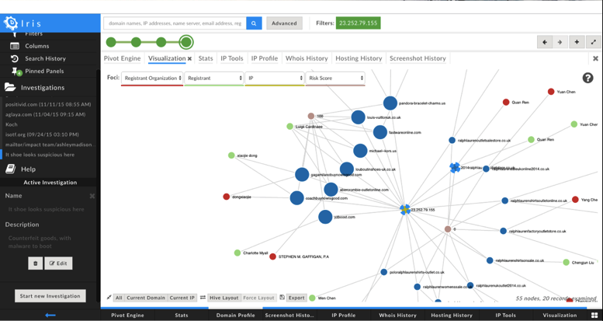
The “oh snap” moment revisited
OK-stopped the leak (for now).
But…
How long have they been inside?
Where have they been sending my data—have I stopped the whole leak?
Why didn’t my TI feed(s) flag that domain?
pwnyoudomain.com
lulzdomain.com
etc…
exfiltrationdomain.com
pwnyoudomain.com
lulzdomain.com
wewinulosedomain.com
data hemorrhage
data trickle
Now you have:
-Other domains to block
-An indication of dwell time
-IOCs/actors to watch for
-Possibly other insights:
-TTP examples etc
Under the radar
Something throws an alert!
← dwell time upper bound
time

Slide 51

Takeaways
Adversary analysis and campaign mapping will help you find threats your TI feeds may miss
It is an approachable “on-ramp” to more comprehensive hunting
Newer folks can quickly get proficient, experienced ones can go fast
Your organization is the best place to source “intel”
It’s more worthwhile to start with basic logging
You should not be paying anyone for intel yet

Slide 52
Thank You! thelming@domaintools.com
@timhelming michael.j.schwartz@target.com
@kungfu_javeous

