Slide 1
A Place for Analysis of competing hypotheses (ACH) in Cyber Threat intelligence (CTI) Applications and Evolution

Slide 2
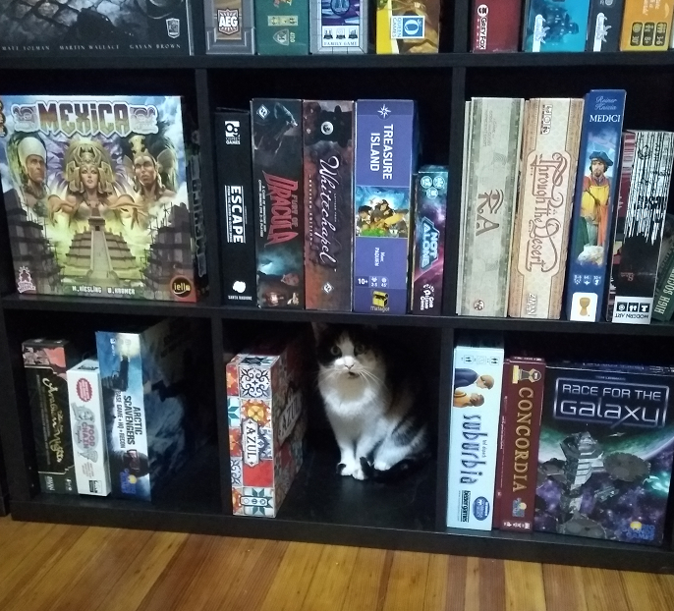
Caitlin HueY
Senior Threat Intelligence Analyst
EclecticIQ

Slide 3
Agenda
What is ACH
Traditional uses of ACH
ACH in CTI
Use Case
Structuring ACH
Evolution of ACH
Conclusion

Slide 4
ACH: Analysis of Competing Hypotheses
Analyst tradecraft
Evaluate consistencies and inconsistencies
See an alternative view(s)
Produce a more confident hypothesis – one hypothesis will score stronger that the rest (H1, H2, H3) based on available evidence

Slide 5
ACH Applied
Traditional ACH: Analysts operating over several “INTs” have relied on a way to effectively test data coming from multiple sources and producers in order to measure evidence against them.
Place in CTI: Producers and consumers of cyber threat intelligence have largely relied on ACH to evaluate data and analyze it on the basis of identifying attribution, patterns, and more.

Slide 6
Traditional Uses of ACH
Evaluate a range of hypotheses against a set of evidence
Weigh evidence against each hypothesis
Calculate score of how individual pieces of evidence proves or disproves a hypothesis
Enhanced use of the “Analyst Comment”
Confidence in something increases after conducting ACH

Slide 7
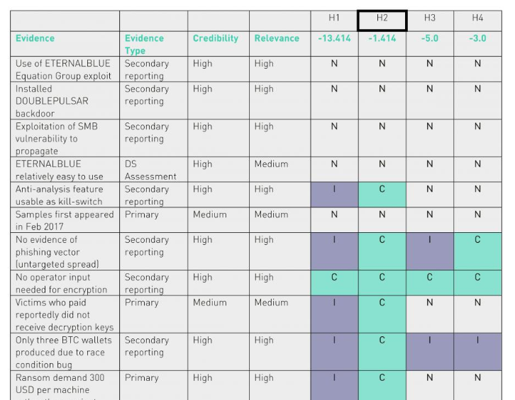
Place for ACH in CTI
ACH conducted in CTI is different from traditional applications
Types of evidence
Qualify evidence
Facilitate intelligence sharing in a structured way
https://www.digitalshadows.com/blog-and-research/digital-shadows-most-popular-blogs-of-2017-analysis-of-competing-hypotheses-for-the-win/

Slide 8
https://www.sans.org/cyber-security-summit/archives/file/summit-archive-1492185958.pdf

Slide 9
USE Case

Slide 10
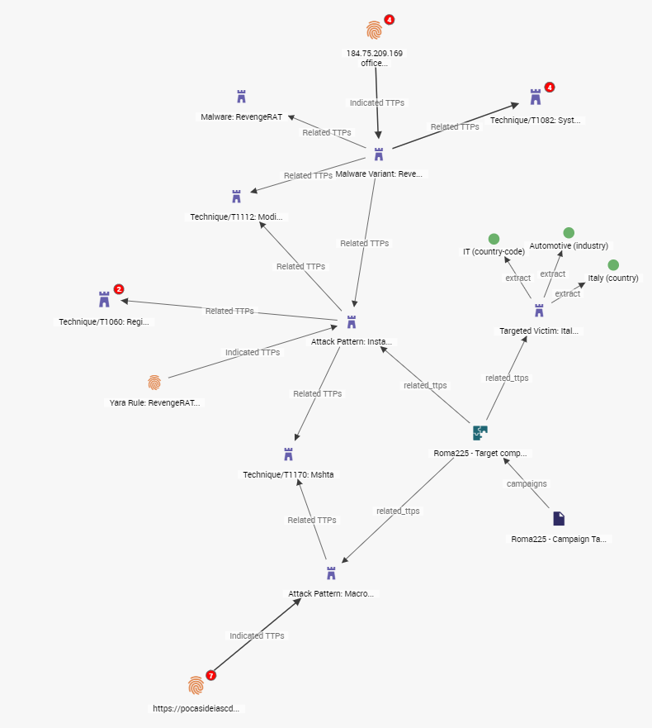
Gorgon Group Report: Roma225 Campaign
https://blog.yoroi.company/research/the-enigmatic-roma225-campaign/
https://unit42.paloaltonetworks.com/unit42-gorgon-group-slithering-nation-state-cybercrime/

Slide 11
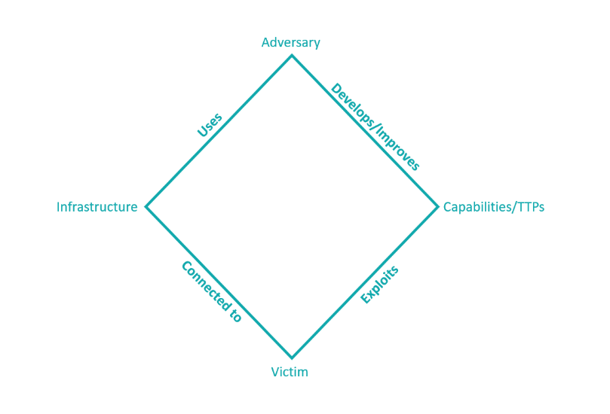
Using Models to Expand What We Know
??
Gorgon Group
Phishing emails impersonating a senior partner in a major Brazilian law firm
Leveraged Duck DNS
PowerPoint add-in document (.ppa extension) armed with auto-open VBA macro code
Blogspot hosted web page downloaded by mshta.exe
MSHTA.exe
RevengeRAT payload
Italian Automotive Sector

Slide 12
Looking at the Evidence
H1: Gorgon Group is behind Roma225
H2: Gorgon Group is not behind Roma225
 | H1 | H2
RevengeRAT Is Not Exclusively Used by Gorgon Group | + | +
Dynamic DNS Service Does Not Align with Gorgon Group Infrastructure | - | +
Gorgon Group Did Not Use Blogger Service in Previous Campaigns | - - | +
MSHTA.exe Not Used by Gorgon Group Before | - | +
Sophistication: Novice to Practitioner | - | +
Gorgon Group Unlikely to Repeat OPSEC mistake | - | -
- - Very Inconsistent
- Inconsistent
+ Consistent
++ Very Consistent
Notes:
For ACH to work, you must have hypotheses are mutually exclusive: for one to be true, the other one is false.

Slide 13
What This Starts to Look Like
Confirmed reality vs a speculative one
H1, H2, H3
Changing how we share Hypotheses with the community
Making ACH actionable
Notes:
My initial mapping of this campaign is turning less into a confirmed reality – and more into a speculative one. In that I mean, I am trying to bring context to the unknowns and represent these in the same way I am able to represent my initial mapping of this campaign…next slide…

Slide 14
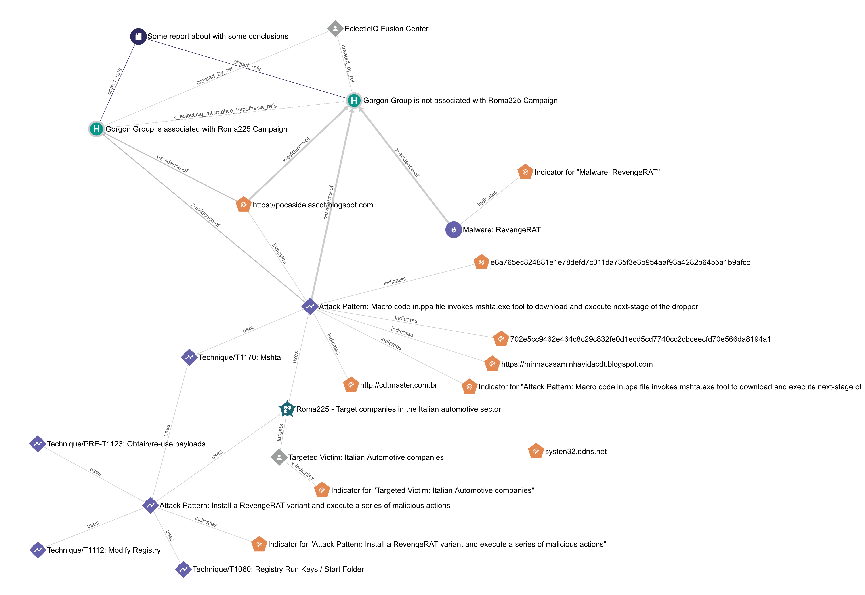
How can we involve this core tradecraft into something to structure

Slide 15
What Structure Helps to Achieve
See Hypotheses from different sources over time
See what the world looks like if Producer A’s hypotheses were true
Use structured ACH as a way to expand an organization’s threat hunting around the diamond model
To identify all the hypotheses related to a Threat Actor
See same/similar evidence used to support different Hypotheses over time

Slide 16
What Structure Helps to Achieve (2)
How to maintain changes in hypotheses over time
Example: WannaCry
Where we can import classic intel → automate
Competing hypotheses
How to champion one hypothesis and reduce the noise of less-supported hypotheses
Metrics as a way to evaluate sources

Slide 17
Is ACH Evolving?
ACH as a process is cumbersome/lengthy
There is no way to currently receive results from conducting ACH apart from a free text report
Track various hypotheses over time
Get value from someone else’s ACH process into my own intelligence

Slide 18
Questions & Conclusion
caitlin@eclecticiq.com
https://gist.github.com/CaitlinHuey/6a0fbb0f6e7faf063c748b23f9c7dc62

