Slide 1
An Inside View to Domain Typosquatting
Jüri Shamov-Liiver
Co-founder, researcher, developer, … at Spectx

Slide 2
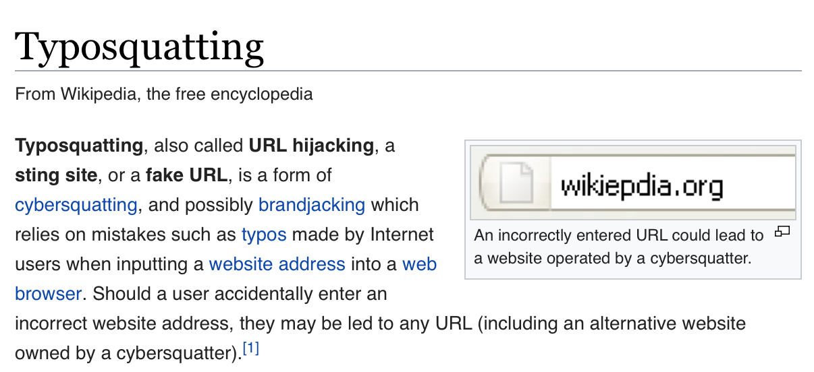

Slide 3
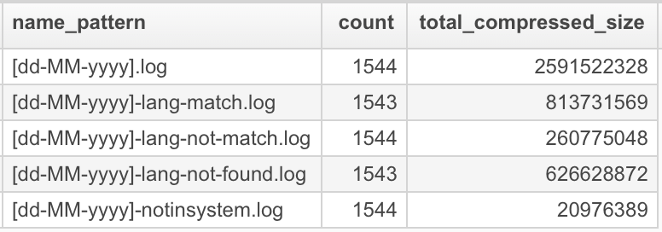
Source Data
7718 files
Total plaintext size ~37 Gb
Dating from Aug 2013 until March 2018
Organized as:
Daily batches
Language matching

Slide 4
Source Data
The files contain tab separated fields: domain, client ip-address, query, referrer, user agent, language.
But NO timestamp!
Also no status code, response size, …
Some fields contain abnormal data (lang, client). A lot.
On such occasions the content of the field appears to be truncated at 4096 bytes
Limitations imposed by a parser script?
Tabulated structure, minimum needed fields, created as a result of parsing and stored in publicly accessible place ...

Slide 5
Source Data
Intermediate product of operational analytics:
Main dataset: Daily export from their redirector application log
The subsets of main data:
events grouped by redirection decisions

Slide 6
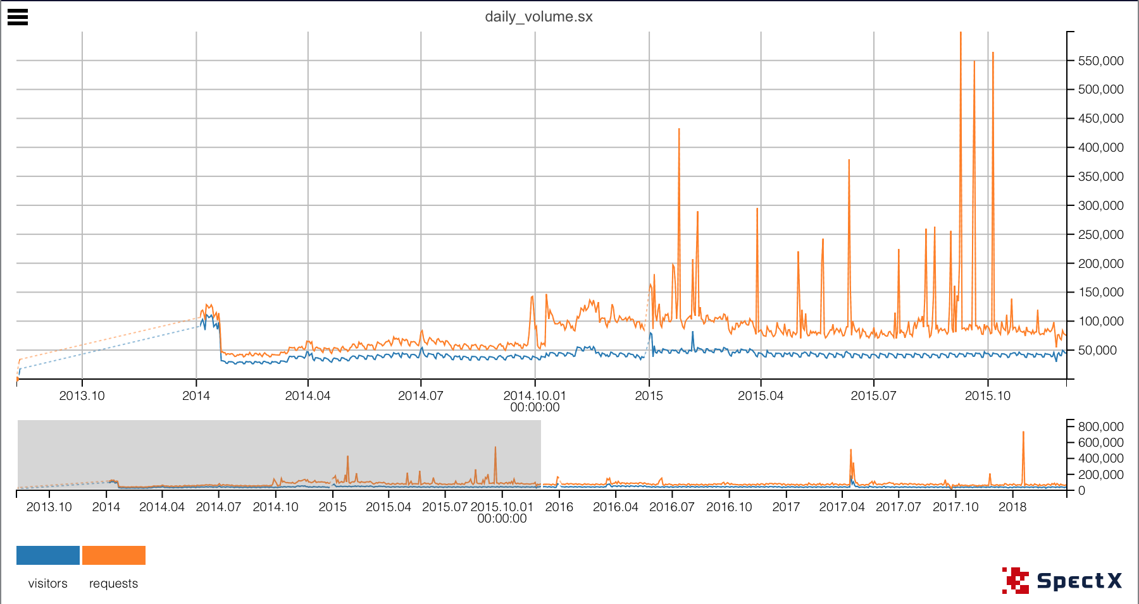
Daily volume
Requests:
Average 81 742 req/day (~1 req/sec)
Max: 740 834 req/day (~8 req/sec)
Visitors:
Average: 42 511 per day
Max: 184 270 per day
Jan 2018: 980 964
Feb 2018: 872 504
Mar 2018: 952 764

Slide 7
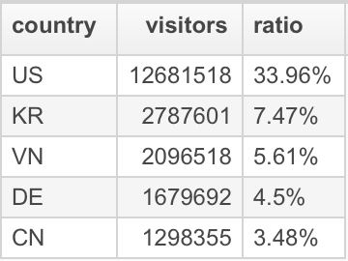
From where?
From 245 countries
In total 37 339 836 unique ip-addresses:
99,86% are IPv4
0,14% are IPv6
1,24% are private addresses

Slide 8
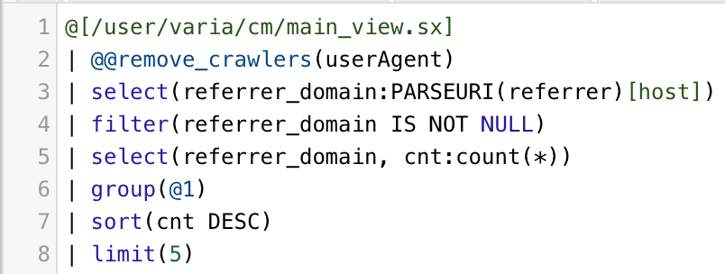
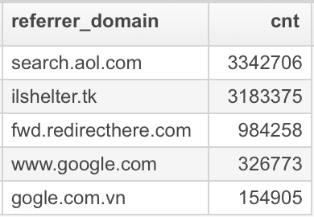
End Users
How much of the requests are made by humans?
Remove non-standard user-agent records
Remove known crawler records
~89% requests are made from browsers
How much is caused by end-user typing errors?
~86% is direct traffic (no referrer)
~14% clicks on search engine results, malicious ads, etc …

Slide 9
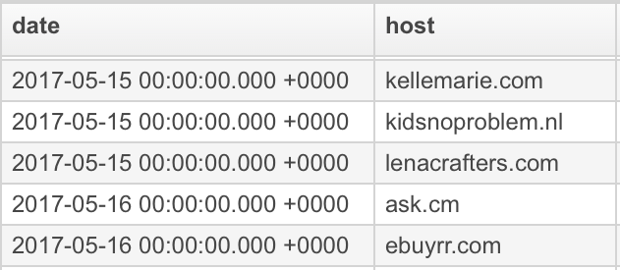
Server Side
Are end-users the only ones with fat fingers?
CNN: 20158 redirects to akamaihd.ne, from 107 news articles and online games, from 14’th Mar 2014 until 23’rd Jan 2018
Finnish national media yle.fi: 359 redirects to akamaihd.ne, from 43 news videos during 15 June until 16 August of 2017
BBC: 52 redirects to 13 typosquatted sites, from 20 news topics from 14’th May from 14’th May 2014 until 28’th Feb 2018
Victims of malicious ads or roque proxying?
www.marinetraffic.com: 7779 redirects to 1906 typosquatted sites (in daily rotating manner), all in the AS17621 network in the city of Shanghai.

Slide 10
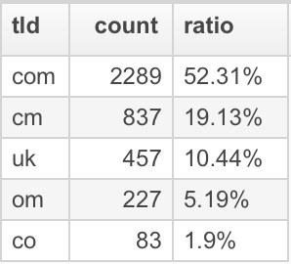
Domains
4376 domains in total
52,3% in .com
.cm + .om = ~25%
Most countries tld’s are represented

Slide 11
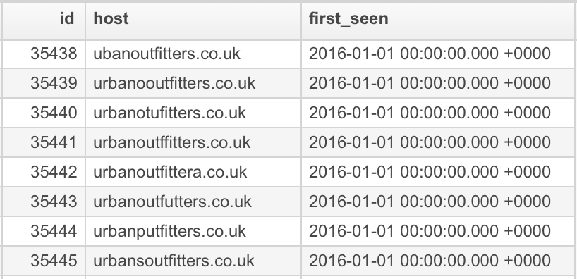
Campaigns
Each typosquatted domain is assigned to numeric ID code
Registered incrementally over time:
Increasing when ordered by ‘first-seen’ date of appearance
‘Out-of-order’ ID’s likely indicate that an earlier registered domain did not ‘work’ for a while
Similarly, there are gaps in the ID sequence, which likely represent campaigns that never worked.

Slide 12
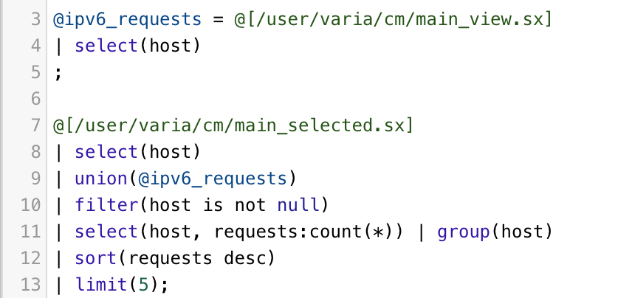
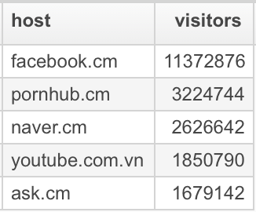
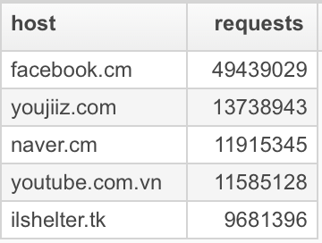
Top campaigns
Metrics:
# of visitors
# of requests

Slide 13
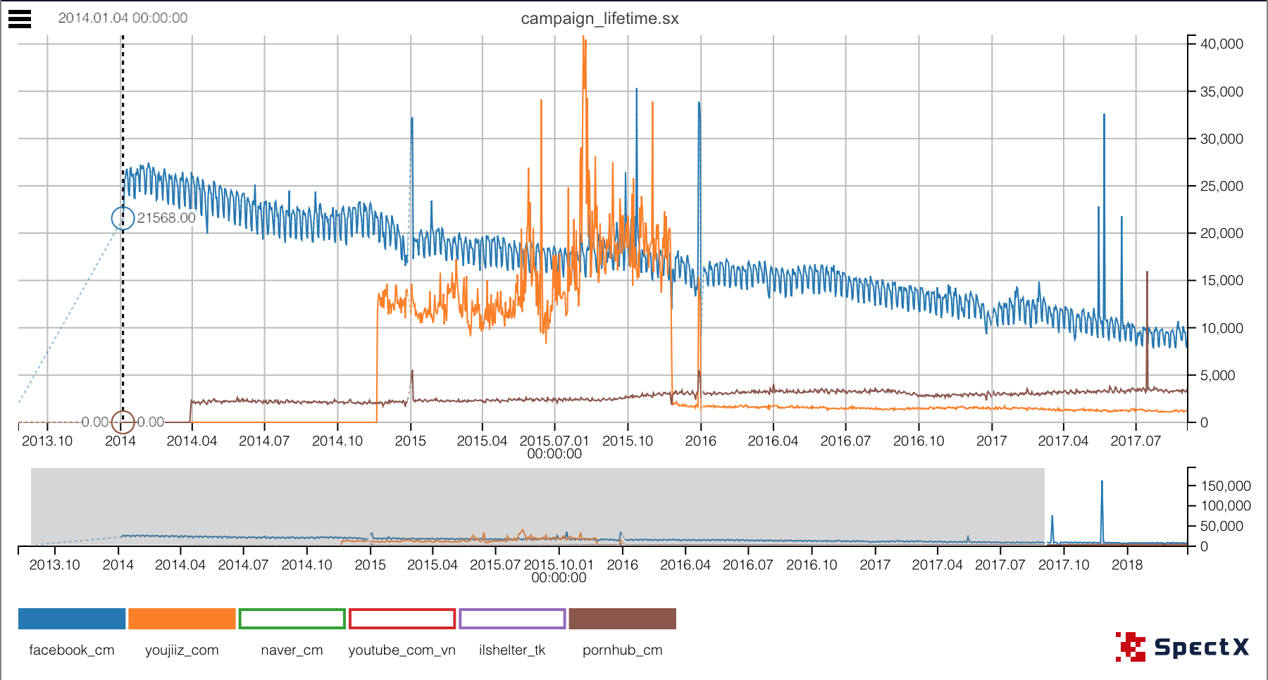
Campaigns lifetime
Characterized by
#visitors
#requests

Slide 14
How Hard Did They Work?
The incremental nature of the campaign ID lets us infer the rate at which new domains were added:

Slide 15
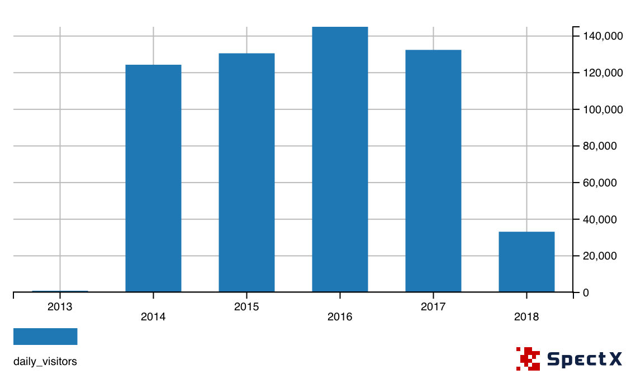
How about Spain?
In total:
665346 visitors from 621 ASN’s
3224 sites visited

Slide 16
How about Spain?
In total:
665346 visitors from 621 ASN’s
3224 sites visited

Slide 17
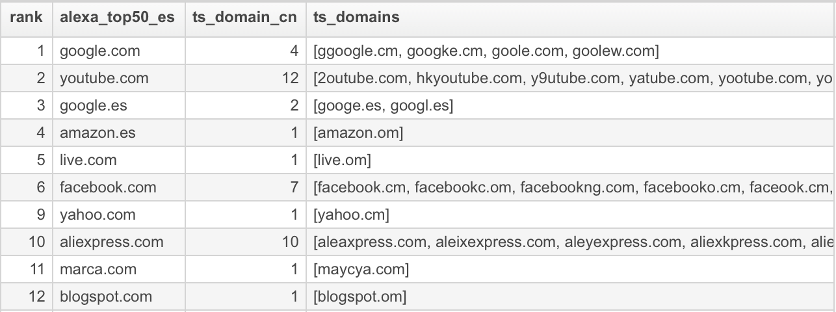
Popular sites in Spain
20 out of Alexa top 50 sites of Spain are typosquatted:

Slide 18
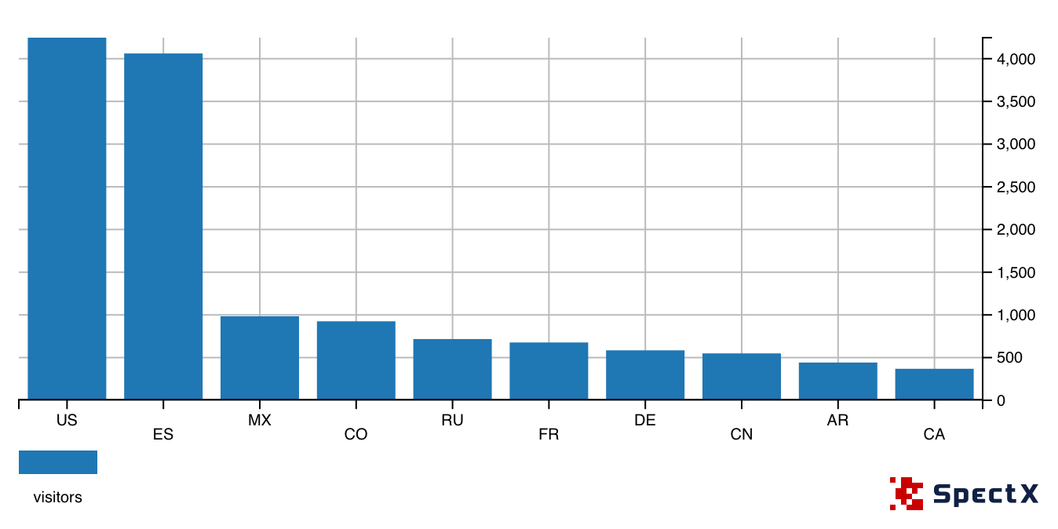
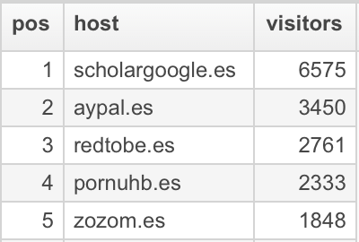
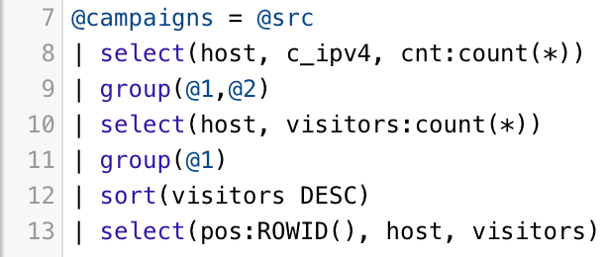
Typosquatting in .es TLD
Only 18 domains
Mostly visited from abroad - ~22% of visitors are from Spain
23,59%
22,56%
5,47%
5,14%
3,98%

Slide 19
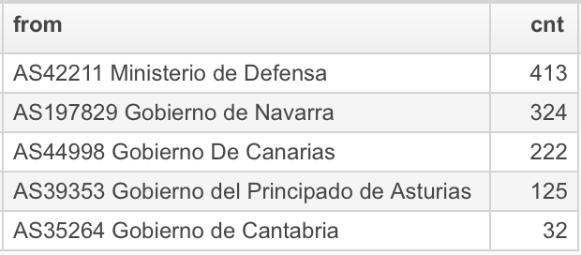
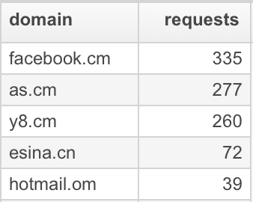
Government of Spain

Slide 20
The darker side of Typosquatting
Lync/Skype for Business - Autodiscover Web Service requests

Slide 21
Lync/SfB Sign-In flow
1. Server Discovery
2. Connectivity Check
3. Authentication
4. Optional Redirection
5. Retrieve Settings and Policies
Web autodiscovery:
1. lyncdiscoverinternal.<domain>
2. lyncdiscover.<domain>
DNS SRV records:
3. _sipinternaltls._tcp.<domain>
4. _sip._tls.<domain>
DNS A records:
5. sip.<domain> 6. sipinternal.<domain> 7. sipexternal.<domain>

Slide 22
Lync/SfB Sign-In flow
User provides the sip uri Mouli@contoso.com on the skype for business desktop client and clicks on sign in.
Client first performs “Server Discovery step” and tries Lyncdiscover Records, if it’s not available, then it will failback to SRV Records and then host A Records.
Client would now attempt and check if it can establish Network connectivity and TLS Connectivity.
Post successful connectivity checks, client would now send the first anonymous sign in Request “REGISTER” to the server, to learn what all authentication methods are available.
Server would present the available Authentication methods and respective target/service name and other info.
Client now selects one of the Authentication methods depending on whether signing in internally or externally, first time sign in or subsequent sign in.
Server validates end-user identity using agreed Authentication method

Slide 23
Phishing for Credentials
The attacker prepares its environment of typosquatted domain:
Register DNS Autodiscovery records
Setup Lync server
Enable only NTLM authentication method
Upon receiving request from fat-fingered customer, capture NTLM hash.
Use it for Pass The Hash attack
Profit

Slide 24
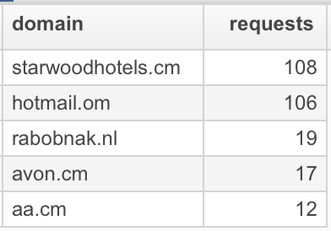
Is it worth trying?
32 237 requests
472 users
Vice president, sr. manager, associate general counsel, system engineer, IT manager, sr. software engineer, account manager,...
103 domains:
Banks, hotels, airlines, online portals, communication, retail, ...

Slide 25
Traditional analytics
Twitter: @spectx
www.spectx.com
Notes:
Questions?

