Slide 1
Identifying Internet Bad Neighborhoods at Scale
John Bambenek
ThreatSTOP

Slide 2
Sharing Restrictions
This talk is TLP:WHITE, no confidential or private information is contained. Share away.

Slide 3
About me
VP of Security Research and Intelligence at ThreatSTOP
PhD student in Informatics focusing on cybersecurity machine learning.

Slide 4
The Pwnage Cycle
Attack
Breach
  Potential long gap between breach and detection
Detection
Analysis
Distribution
  Maybe, but threat sharing is another problem
Protection

Slide 5
Pwnage Cycle TL;DR
We not only have to wait for attackers to strike to develop defenses, we have to wait for our detection.
On a time scale, we’re setup to always lose.

Slide 6
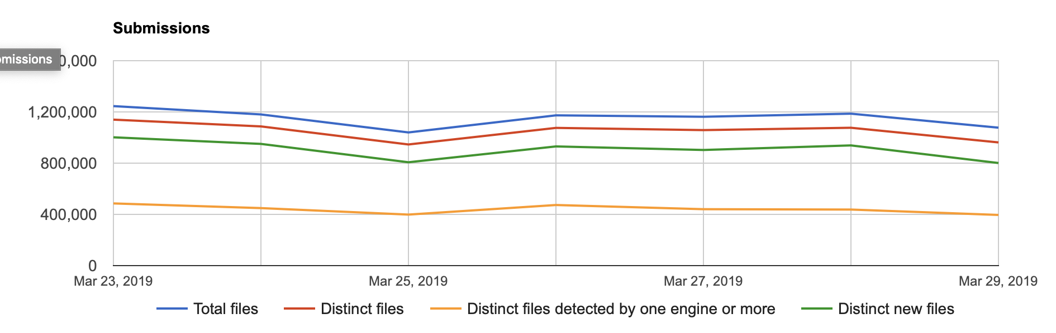
It’s not our only scaling problem
Notes:
On this slide the interesting data points is the orange line (new and distinct malware samples) and the line not seen between orange and green (new files, some of which are malicious but completely undetected).

Slide 7
Scale of attacks
There are too many samples of malware (much less attacks generally) that could ever be analyzed.
Firewalls can’t hold “all” the malicious IP addresses we have.
IPv6 (when fully adopted) will break many of the systems we use due to scale.
  Imagine IP rep just on an /64 in IPv6.
  What will Shodan do? ☺
Notes:
I was going to talk about challenges of policy size. My Raspberry Pi can hold a DNSFW policy of about 2 M. A Pi-Hole can hold more because it’s just a forwarding resolver. My shared webhosting server will crash if I’m too aggressive with fail2ban firewall rules (only 2 GB ram, yeah yeah, I should upgrade).
A full IP Rep database is sub terabyte in IPv4. In IPv6 in /64 only is beyond the storage, memory, and processing power of most supercomputers.

Slide 8
Creating Broad-based Blocklists
Criminals, in some cases, congregate around specific providers.
Calculate abuse % of those providers:
  TLD
  ASN
  Authoritative Nameserver
  Registrar*
Block at the broadest possible level, be precise when necessary.
Notes:
This goes to our blocking bad neighborhoods talking point.
In this case, it’s simply # of bad entries / # of total entries of the provider, there is no weighting based on type of abuse (scanning vs spam vs C2).

Slide 9
ICANN DAAR
ICANN set up a means to measure abuse by TLD and Registrar.
Registries and Registrars hate it and no substantial results are released.
Took # of abuse domains in list of feeds and divided by total number of domains in TLD or by Registrar.
Notes:
So I helped consult on DAAR, it was an ICANN project to measure abuse prevalence by TLDs and Registrars, ICANN is producing reports that say very little because the registrars don’t want that data public. But basically it takes a very similar approach but based on a different dataset. It was very controversial at ICANN as you can imagine.

Slide 10
Why Track Provider Abuse%
“Promotes, encourages or engages in any spam or other unsolicited bulk email, or computer or network hacking or cracking;” – GoDaddy ToS
Anti-spam companies data is built into “everything”, clear economic consequences, so the usual “we don’t police content” doesn’t fly.
If we could put the same pressure for cybercrime generally, some providers may be more helpful.
Notes:
Many providers say “we don’t police content”. They do copyright because the law says they have to. But they do spam because the anti-spam guys will start blocking netblocks and it becomes obvious and painful. Until we can do the same for malware/abuse, providers as a class won’t honor abuse complaints. If this can get to the anti-spam level of pressure, those providers will change.

Slide 11
Abuse by TLD
Take raw list of hostnames, reduce to domains and dedup.
Count and calculate total abuse % based on total number of domains.
Note- some TLDs have started “wildcard-ing” non-registered domains.
Some ccTLDs operate as “free” domains (i.e. .tk).
Notes:
One criticism of this approach is that ”third-level domain providers” get listed. There are phishy blogspot.com sites, well, blogspot only gets listed once because everything is reduced to domain level. Compromised sites can get listed, but in both cases the prevalence of subdomain providers and compromised sites may be similar across TLDs. If it’s wildly divergent, that is something worthy of query. That said, from a defender perspective, does it matter if, say, .pw is 40% compromised or 40% malicious? It’s still attacking them and they should defend themselves. Just like in spam.

Slide 12
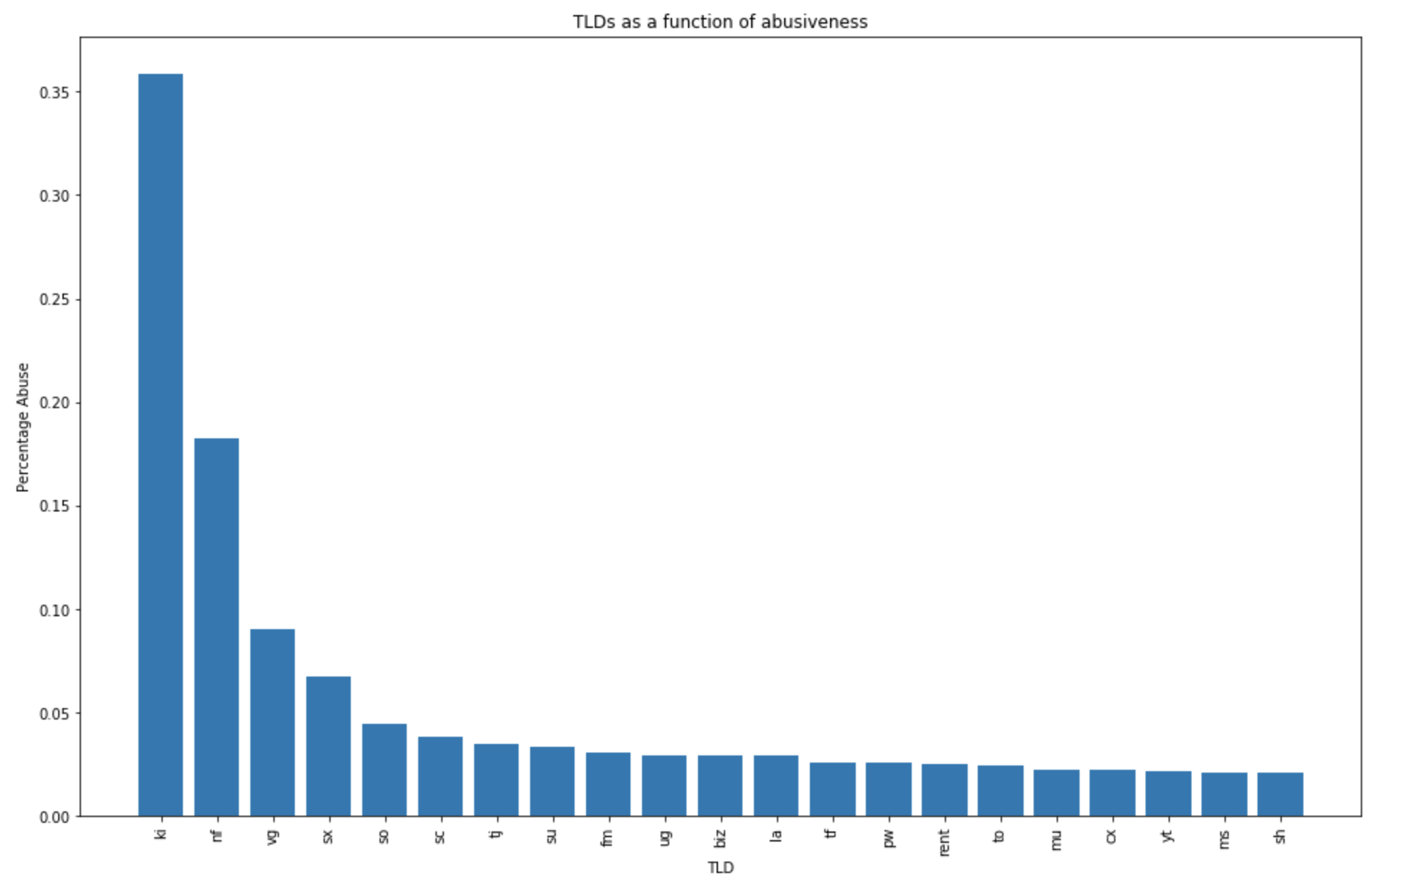
TLD Abuse Rates
Notes:
This was from 3/29/19 data. Kiribati was the worst. But this is different than the anti-spam lists because they just rely on e-mail and our feeds/targets ingest data from C2 tracking, etc. We also don’t block say pill scam / romance scam domains.

Slide 13
TLD Findings
Very different from what Anti-Spam companies publish
Data, in this case, is from abuse and malware feeds, not just spam.
  Surbl and SpamHaus have very different results.
Spam feeds include “scammy” or “loud” domains for e-mail.
  Important to note data sources and selection bias matter greatly.
Very quick dropoff in abuse rates.
Notes:
Self-explanatory points

Slide 14
Ranking ASNs by Abuse
Predecessor: https://bgpranking.circl.lu does modify IoCs by threat type. (Now running again!)
Basic approach is to total all IPs in an AS and the abusive IPs in an AS can do math.
Notes:
BGPRanking DOES rank by scoring the source. In this case, I don’t do that. It was part of a masters thesis to create it, but takes same general approach… take the # of bad Ips, apply a score and do math.
Our data sources are broader because we have non-public and free, and we use EDROP, which we get to in a few slides.

Slide 15
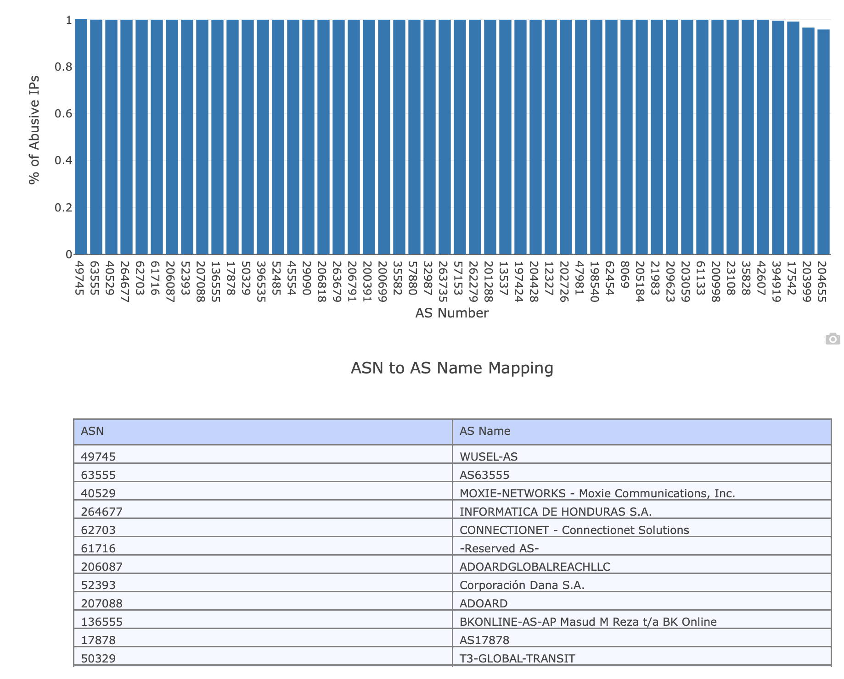
ASN Abuse Rates
Notes:
I dropped the 100% abusive ASNs, this is everyone from 50%-99%. I included this for the contract… there is clear clustering in domains, in ASes, if you’re bad, you’re practically all bad.

Slide 16
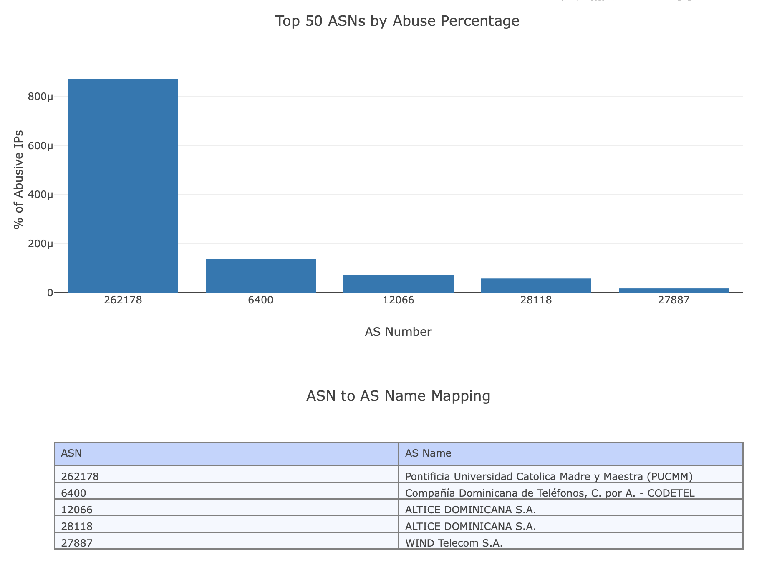
Dominican Republic Abuse Rate

Slide 17
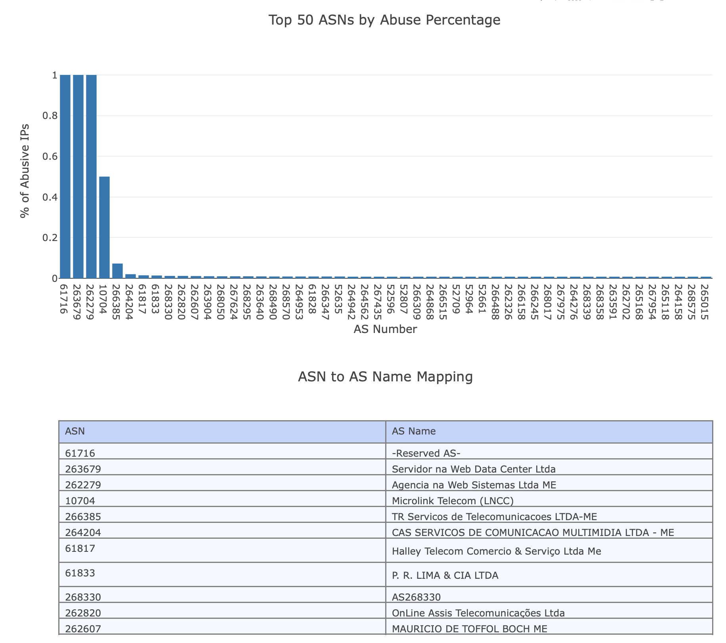
Brazil Abuse Rate

Slide 18
ASN Findings
There were quite a few 100% abusive ASNs (not shown in graph) due to blocking entire netblocks
Graph shows anything less than 100% abusive.
  Even bulletproof hosters have “legit” customers.
Use this to mathematically determine “abuse-friendly” providers.
Then can use to block. Lots of “highly” abusive ASNs.
Notes:
Self-explanatory

Slide 19
An interesting side benefit…
Analyzing the data this way led to lots of rabbit holes…
It also provided insight into quality issues of third-party feed providers and how they are creating and (not) curating data.
Notes:
Examples in following slides, but this is about TLD states and ASN stats.

Slide 20
MyEtherWallet
MyEtherWallet.com is an ethernet web-wallet provider.
Scammers created tons of MyEtherWallet.* domains.
EtherScamDB basically dumped a list of all TLDs and put everything not .com in their list.
One such domain is MyEtherWallet.va which was never registered.
  And it’s not trivial to get a Vatican City domain name.
Notes:
This one stood out because .va doesn’t have many sites so it’s abuse % was high due to the presence of this. Short answer, abuse feeds can and do include things that may not even be registered. Sometimes its laziness (like above), sometimes domains get taken down, and there are TLDs that wildcard the entire TLD so everything points to their parking page.

Slide 21
SpamHaus (and anti-spam lists in general)
They block (rightly) entire netblocks. Some of those blocks are quite expansive.
When calculating ASN abuse %, AS0 was worst offender.
Some of those netblocks are unallocated subblocks or allocated to other ASes (also cymru and iptoasn aren’t completely identical in their mappings).
But spam DOES originate from unallocated space from time to time…
128.85.0.0/16 | ARIN | SBL210373 | 15-Jan 2014
1.19.0.0/16 | APNIC | SBL434604 | 25-Feb 2019
101.134.0.0/15 | APNIC | SBL434605 | 25-Feb 2019
101.42.0.0/16 | cnisp.org.cn | SBL434606 | 25-Feb 2019
Notes:
This touches on one problem that took me awhile to figure out. I used Team Cymru to do ad hoc conversion of IP to ASN. But I used iptoasn to calculate total Ips. Those sources have some differences in where they put various netblocks so data on the edges was weird (some AS had well above 100% abuse). Important to use the same source for this information to eliminate this problem.

Slide 22
Name-Server
This is more complicated, no one distributes nameserver information or blocklists.
Creating master list of all domains with auth nameservers is non-trivial (you can do it with WhoisXMLApi data).
Need to start with a whitelist first.
Notes:
This touches on the draft paper you saw. In RPZ you can block using nameserver information, but no one produces feeds and few people do it, in part, because there is no whitelist for it.
You could get auth nameserver via DNS lookups of 340M domains (no way), ICANN offers a service to get the zone files for the gTLDs but they don’t cover ccTLDs (only some of them give up their zones). So you have to have the data from the WHOIS database.

Slide 23
Creating Nameserver Reputation
Using WhoisXMLApi database, it’s possible to count auth nameservers by domains served.
CZDS is a possibility, but doesn’t include most ccTLDs.
In domains, “popular” is used as a whitelist (i.e. alexa, umbrella, majestic). Same concept here.
Data published eventually here: https://github.com/threatstop/authns-whitelist
Notes:
A rant about Centralized Zone Download Service (CZDS), its from ICANN, you have to ask for permission from every TLD individually, those requests have to be approved by hand so response time varies wildly and... Access expires in 90 days.
That github link is a first pass, automating something soon. But here the idea was basically to do a count of occurances of auth nameservers by domains under the guise if you’re gonna nuke 1M domains, you should do so in a thoughtful way. I then do an nslookup on the nameservers and create the same # of domains by auth nameserver IP.

Slide 24
Auth Nameserver Whitelist
10429085,ns02.freenom.com
10429085,ns01.freenom.com
10429068,ns04.freenom.com
10429068,ns03.freenom.com
3889206,f1g1ns1.dnspod.net
3888099,f1g1ns2.dnspod.net
3876521,dns1.registrar-servers.com
3872669,dns2.registrar-servers.com
3143858,nsg2.namebrightdns.com
3143841,nsg1.namebrightdns.com
2548276,www.eurid.eu
2313783,ns2.123-reg.co.uk
2313105,ns.123-reg.co.uk
2204168,dns10.hichina.com
Notes:
It surprised me how centralized DNS is which is the point of this slide. The internet was supposed to be decentralized and radically democratic, the reality now is that a few entities control overwhelming portions of key components of how the internet works. Nuke GoDaddy, almost a third of the internet goes dark.

Slide 25
Auth Nameserver IP Whitelist
769325,162.88.61.49
769146,162.88.60.49
771461,162.88.60.47
771404,162.88.61.47
713596,162.251.82.250
698036,162.251.82.249
698036,162.251.82.248
700472,162.251.82.246
713596,162.251.82.123
713596,162.251.82.122
698036,162.251.82.121
700472,162.251.82.119
Notes:
Its similar with IPs, but they rotate through clusters of nameservers in a netblock. But if you DDoS’d the router in front, that would make for a broad outage quickly.

Slide 26
Findings
The Internet is much more centralized than we give it credit for.
Blocking the wrong nameserver or IP could disable millions of sites quickly.

Slide 27
Registrar
Some registrars are more amenable to criminality than others.
Whois database will also have registrar information.
Turning this into a blocklist would reintroduce the scale problem (you still have to list all domains individually).
  Some may have managed DNS though.
Not done at this phase.
Notes:
Unlike domain, IP, or NS, you can’t use RPZ to block registrar, you have to block all the domains (unless they used managed DNS for all or most of their domains, anyway). This was where things got difficult with DAAR. You could use WHOIS for this, but you’d hit a rate limit. With the database you could do the math though. That said, there are series LLCs that are registrars individually, various DBAs, etc.

Slide 28
Results
Reports will be published and updated at Threatstop.com once they are “production-ready”.
Other efforts are underway to create open “provider” reputational data. More info “soon”.

Slide 29
Interesting Data Point I Can’t Example… Yet

Slide 30
Next Steps
Adding TLD, ASN, Registrar, Nameserver reputational data to machine learning classifier on domains.
Prototype ML classifier uses 10 domain DNS attributes to reliably classify a domain malicious (~95% accuracy).
The single biggest (by far) criteria to determine a domain is malicious, the absence of an MX record.

Slide 31
Online Resources
The online jupyter notebook binder is available at: https://mybinder.org/v2/gh/bambenek/abuserates/master
Need to finish auto-updating the data, should be done soon.
Github repo : https://github.com/bambenek/abuserates

Slide 32
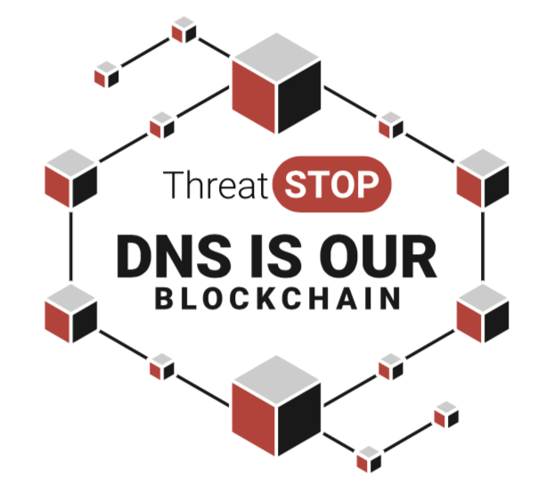
Questions?
John Bambenek / @bambenek
jbambenek@threatstop.com

