Slide 1
FIRST
How can MANRS actions prevent incidents

Slide 2
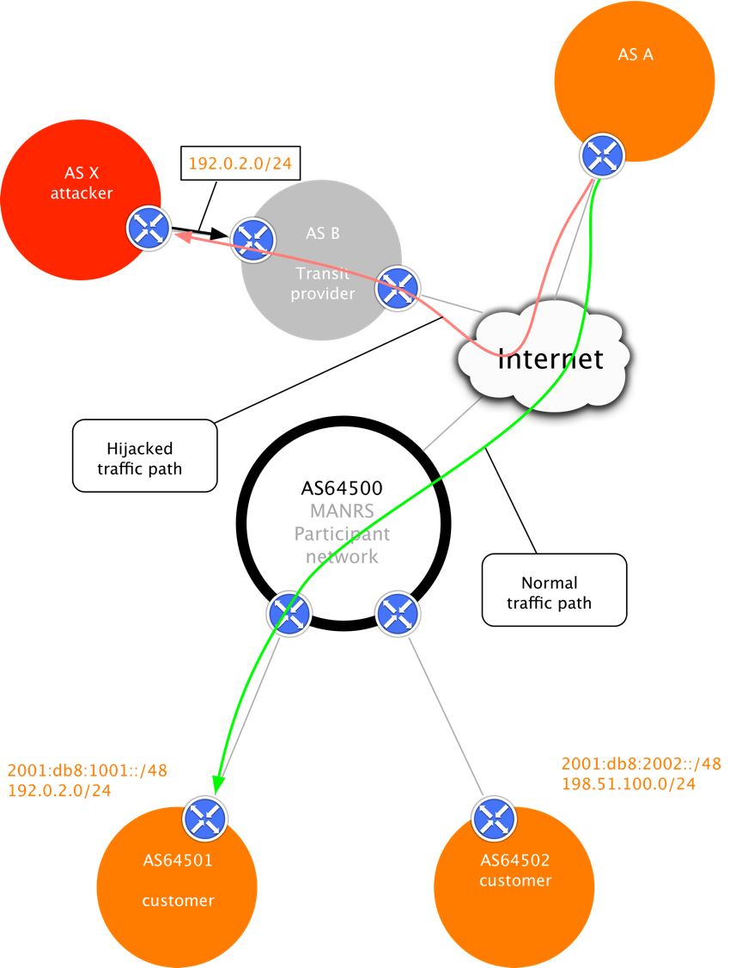
Why MANRS
How routing works
PACKETS
DESTINATIONS / ANNOUNCEMENTS
REACHABILITY
FORWARDING

Slide 3
What problems are we trying to mitigate: Routing incidents
Event | Explanation | Repercussions | Example
Prefix/Route Hijacking | A network operator or attacker impersonates another network operator, pretending that a server or network is their client. | Packets are forwarded to the wrong place, and can cause Denial of Service (DoS) attacks or traffic interception. | The 2008 YouTube hijack
Route Leak | A network operator with multiple upstream providers (often due to accidental misconfiguration) announces to one upstream provider that is has a route to a destination through the other upstream provider. | Can be used for traffic inspection and reconnaissance. | September 2014. VolumeDrive began announcing to Atrato nearly all the BGP routes it learned from Cogent causing disruptions to traffic in places as far-flung from the USA as Pakistan and Bulgaria.
IP Address Spoofing | Someone creates IP packets with a false source IP address to hide the identity of the sender or to impersonate another computing system. | The root cause of reflection DDoS attacks | March 1, 2018. Memcached 1.3Tb/s reflection-amplificationattack reported by Akamai

Slide 4
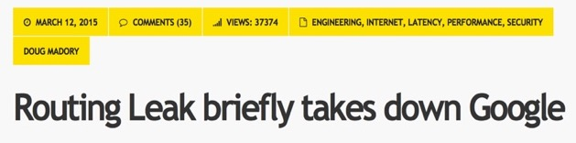
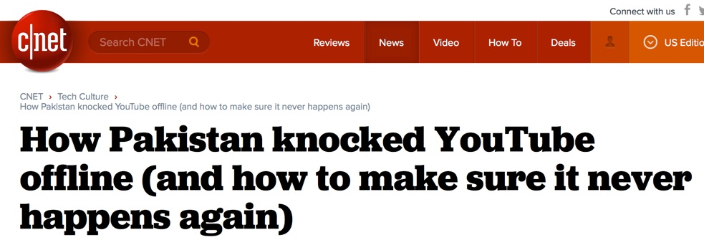




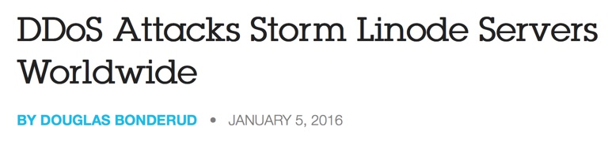


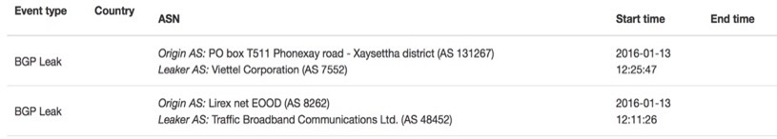


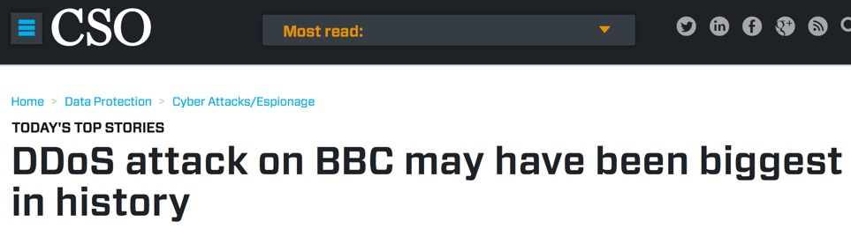
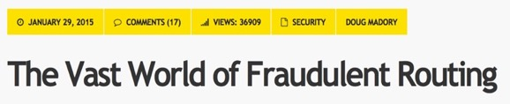
How users are affected

Slide 5
How can MANRS actions prevent incidents:
MANRS defines four simple but concrete actions that network operators must implement to improve Internet security and reliability.
  The first two operational improvements eliminate the root causes of common routing issues and attacks, while the second two procedural steps improve mitigation and decrease the likelihood of future incidents.
MANRS builds a visible community of security minded network operators and IXPs

Slide 6
How can MANRS actions prevent incidents: MANRS Actions
Filtering
Prevent propagation of incorrect routing information
  Ensure the correctness of your own announcements and announcements from your customers to adjacent networks with prefix and AS-path granularity
Anti-spoofing
Prevent traffic with spoofed source IP addresses
  Enable source address validation for at least single-homed stub customer networks, their own end-users, and infrastructure
Coordination
Facilitate global operational communication and coordination between network operators
  Maintain globally accessible up-to-date contact information in common routing databases
Global Validation
Facilitate validation of routing information on a global scale
  Publish your data, so others can validate

Slide 7
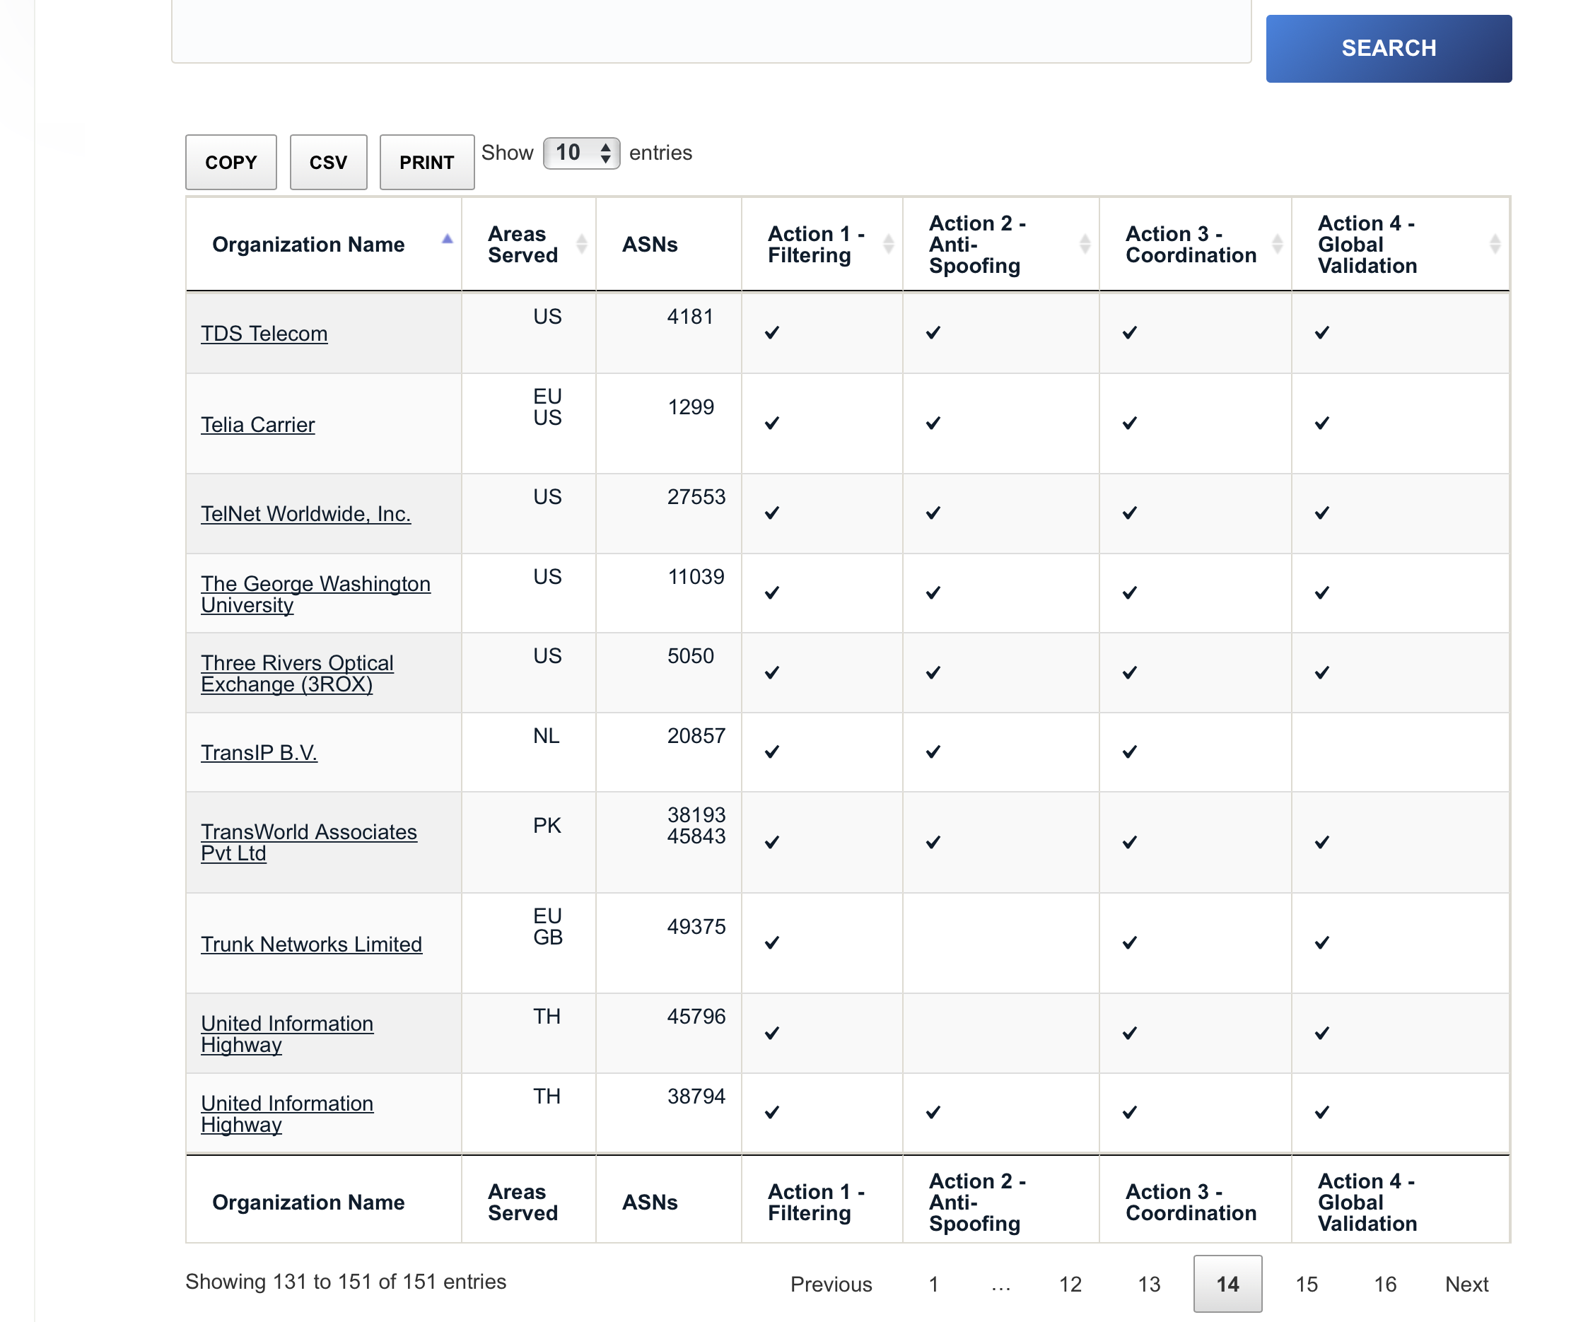
WWW.MANRS.ORG

Slide 8
Where are those actions configured and how users are protected?
Actions 1 BGP configuration
  core network team
  network planning & engineering
  Prevents route leaks & Hijacking
Action 2 RPF & packet filtering
  user port configuration
  service delivery team, process and BCOP implementation
  DDoS impact
Action 3 (core team socialization)
Action 4 core team
  IRR
  LACNIC on RPKI

Slide 9
How to use MANRS information in a CSIRT
Where is the information available ?
  BGP Stream https://bgpstream.com
  Caida Report http://www.caida.org/data/overview/
  RIPE Stat
  CAIDA Spoofer Project https://www.caida.org/projects/spoofer/
  Peeringdb https://peeringdb.com
  Whois.[RIR].net
  lacnic rpki, IRRs
    Radb, RIPE, Level3, etc.
    https://rpki.lacnic.net
MANRS observatory https://observatory.manrs.org/

Slide 10
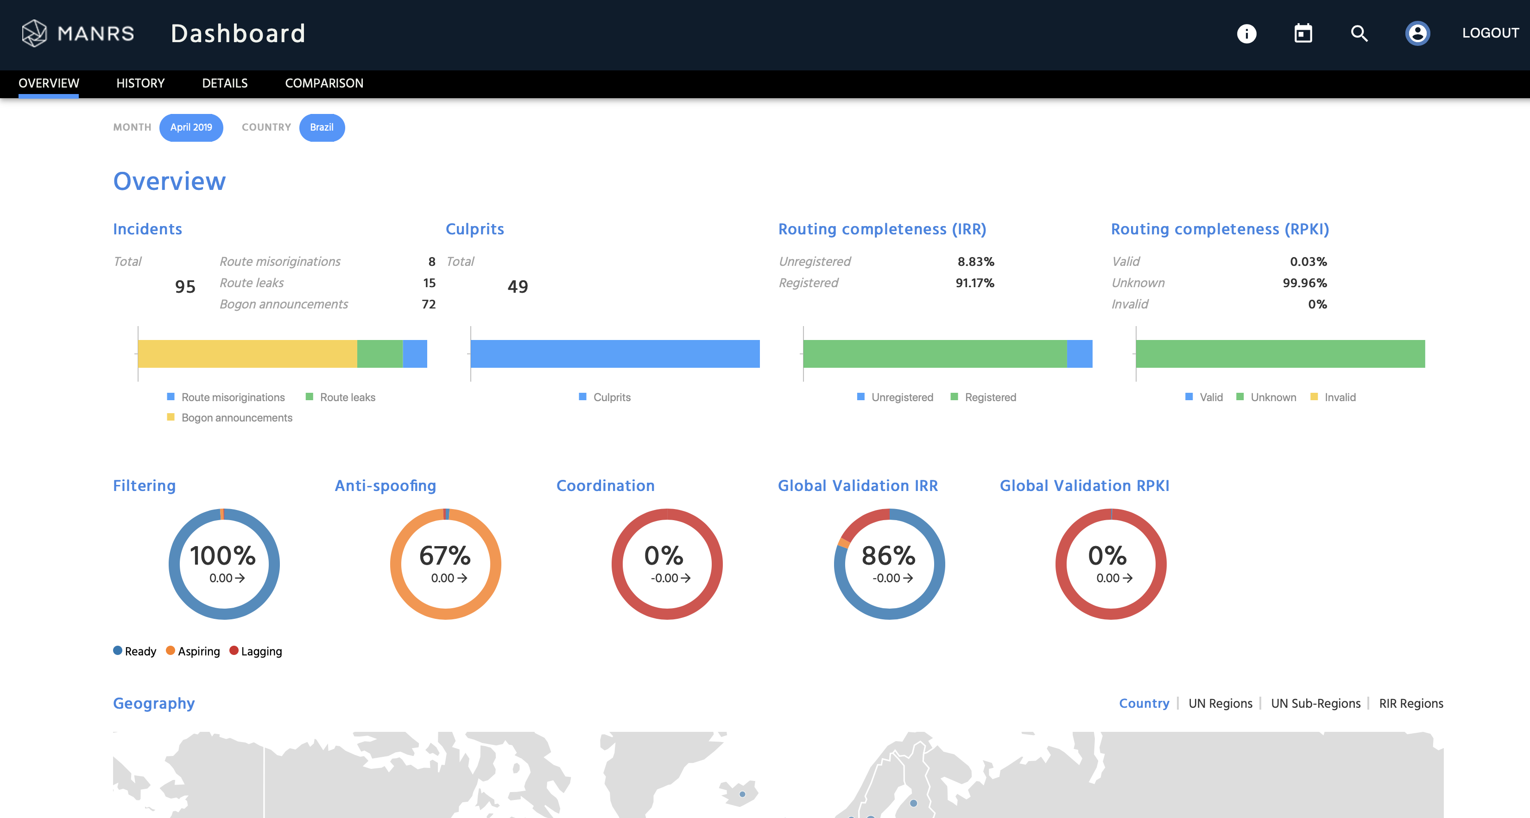
MANRS observatory

Slide 11
MANRS Observatory

Slide 12
How to contribute to MANRS from your CSIRT
Identify networks not following BCOPS
  Usually involved in security incidents
  Reported in CAIDA spoofer or rpki violations
  Networks not present in peering db, whois or IRR
Help them
  Promote NOGs, IXPs, NRENS, operational communities
  Refer them to MANRS.org
  Engage them in LACNOG
Generating awareness regarding routing incidents ( reports, presentations, surveys, etc)
There are tools available

Slide 13
MANRS Training Modules
Module 1: Introduction to MANRS What is MANRS, and why should you join? MANRS is a global initiative to implement crucial fixes needed to eliminate the most common routing threats. In this module you will learn about vulnerabilities of the Internet routing system and how four simple steps, called MANRS Actions, can help dramatically improve Internet security and reliability. | Module 2: IRRs, RPKI, and PeeringDB This module helps you understand the databases and repositories MANRS participants should use to document routing policy and maintain contact information. You’ll learn what database objects to use to document routing information related to your network and how to register information in the RPKI system. Finally, you will learn how to use the Peering DB and other databases to publish your contact information. | Module 3: Global Validation: Facilitating validation of routing information on a global scale In this module, you will learn how to prevent incorrect routing announcements from your customers and your own network. The module explains how filters can be built, including the tools used to build them. It also shows how to signal to other networks which announcements from the network are correct.
Module 4: Filtering: Preventing propagation of incorrect routing information This module will help you apply anti-spoofing measures within your network. After this module you will be able to identify points/devices in the network topology where anti-spoofing measures should be applied, identify adequate techniques to be used (for example, uRPF, or ACL filtering), configure your devices to prevent IP spoofing, and verify that the protection works. | Module 5: Anti-Spoofing: Preventing traffic with spoofed source IP addresses This module is to understand how to create and maintain contact information in publicly accessible places. It explains why it is important to publish and maintain contact information, how to publish contact information to Regional Internet Registries (RIRs), Internet Routing Registries (IRRs), and PeeringDB, and what contact information you should publish to a company website. | Module 6: Coordination: Global communication between network operators This module helps you understand how to enable others to validate route announcements originating from your network by documenting a Network Routing Policy. You’ll learn what a Network Routing Policy is, how to document your organization’s Network Routing Policy and make it publicly available in order to signal to other networks which announcements from your network are correct.

Slide 14
MANRS IXPP
MANRS IXP Partnership Programme
Action 1 – Filtering
  BGP, RPKI, etc
Action 2. Promotion
  Events, membership, fees, etc
Action 3 - Protect Peering Fabric
  L2 BCOP
Action 4 – Coordination
  Updated and shared contact information
Action 5. Operation support tools
  Looking Glass, etc

Slide 15
MANRS is a community effort
CSIRTs can contribute significantly
Message to Network Operators:
”Your security is in someone else’s hands. The actions of others directly impact you and your network security (and vice versa)”
QUESTIONS?
lucimara@cert.br oflaherty@isoc.org

