Slide 1

Malware Analysis Automation Platform
CSIRT-MU, Masaryk University
TLP:WHITE

Slide 2
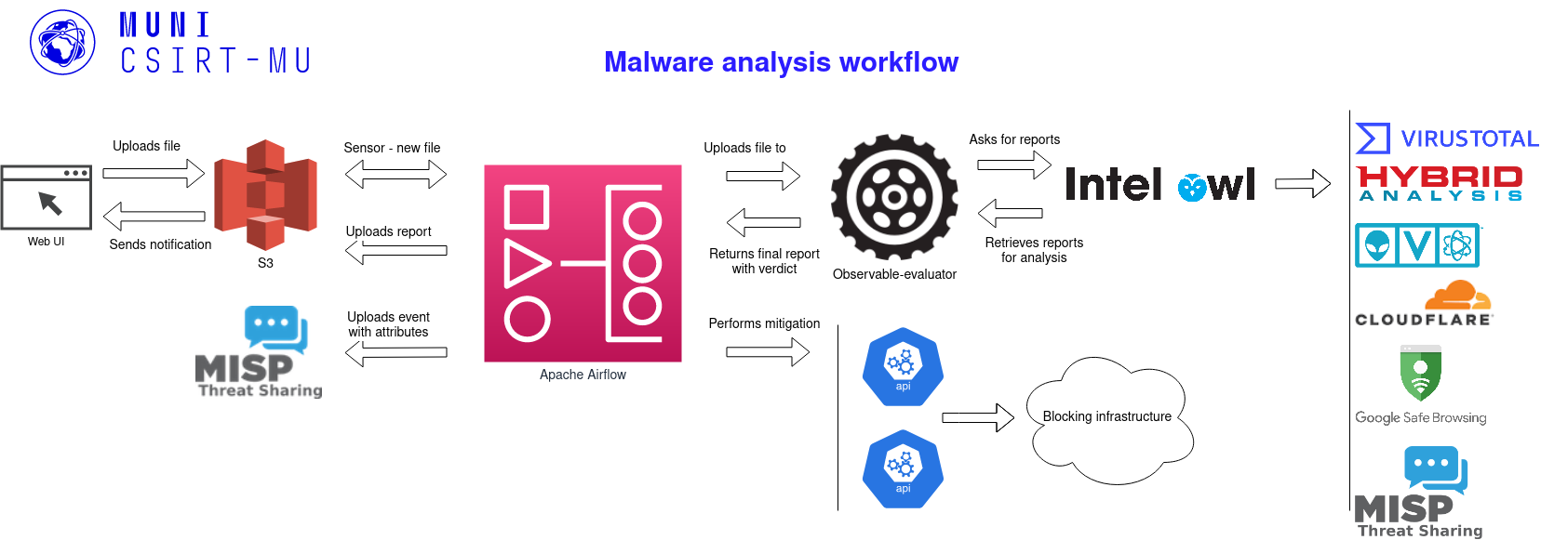
Platform Architecture

Slide 3
Deployment
Provide API keys to supported tools through config file
  Public API without key may have limited services
Run Docker containers
  Using Docker – docker-compose up
  or Using Vagrant – vagrant up

Slide 4
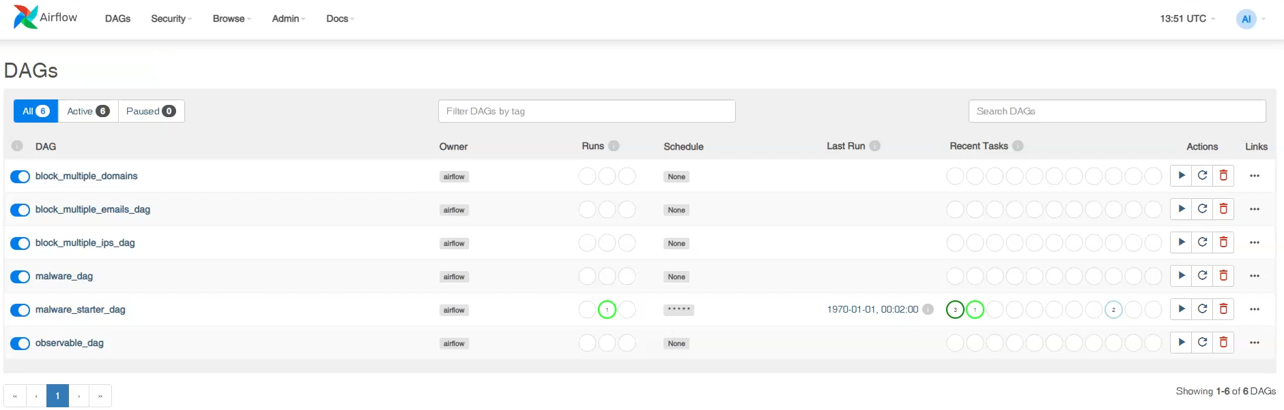
Initial Airflow State

Slide 5

Malware Gateway

Slide 6
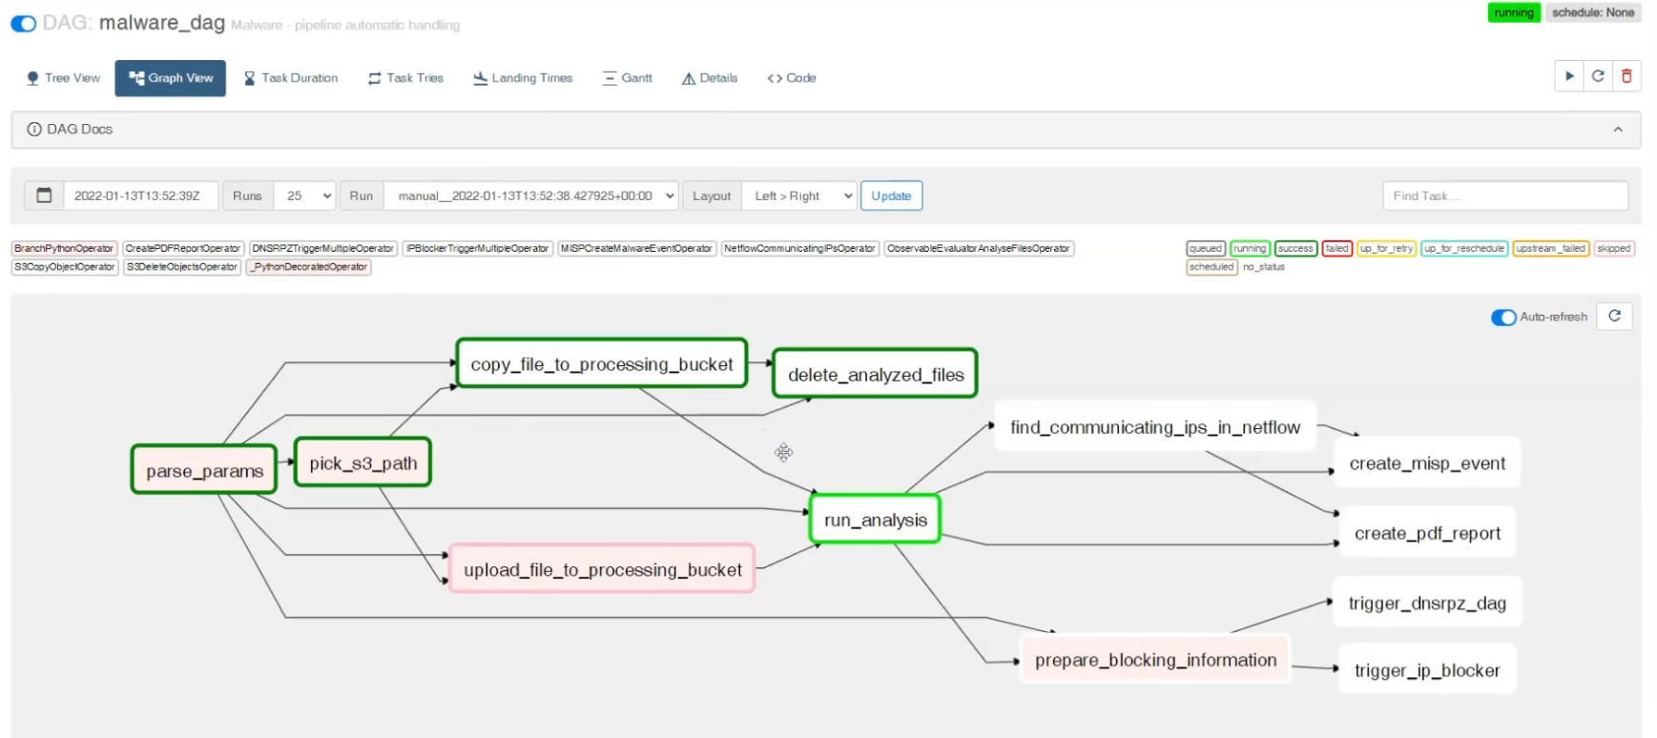
Running Malware Analysis DAG

Slide 7
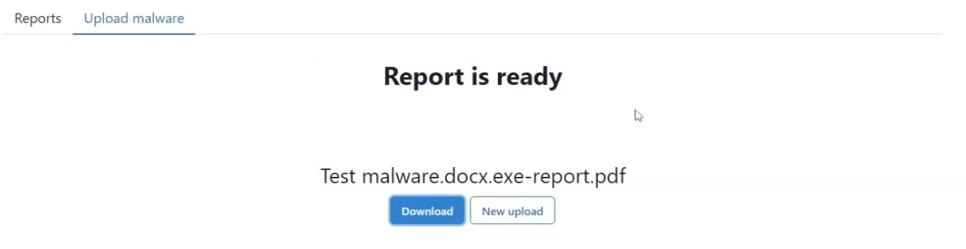
Report Download

Slide 8
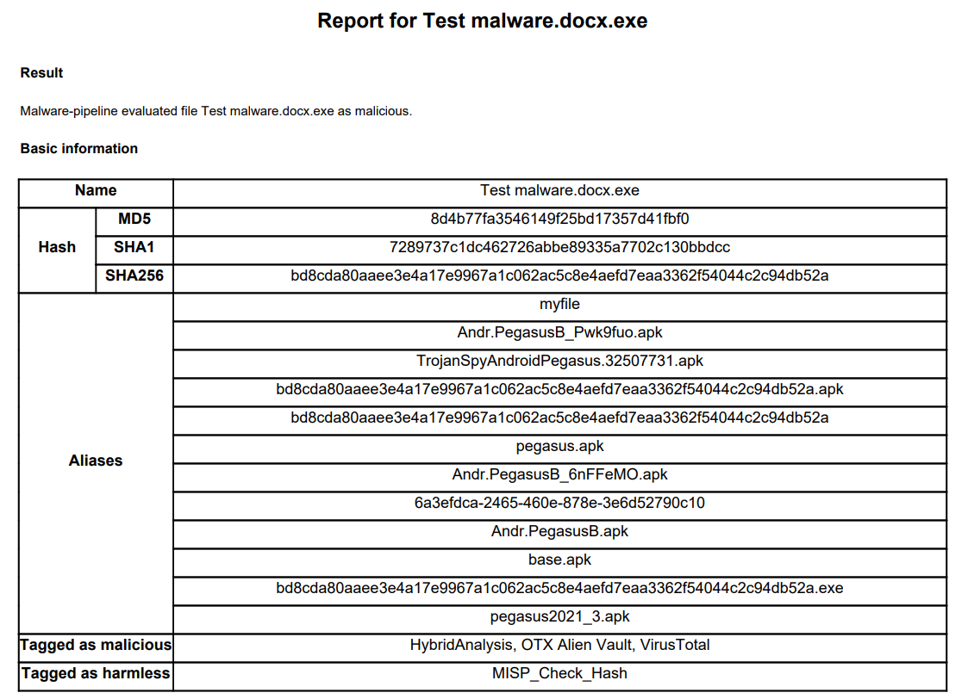
Report for the File

Slide 9
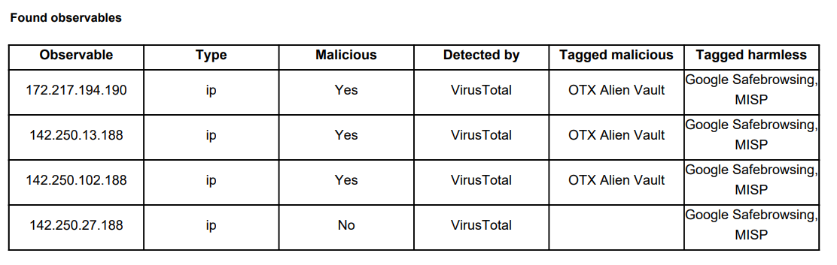
Observables in the Report

Slide 10
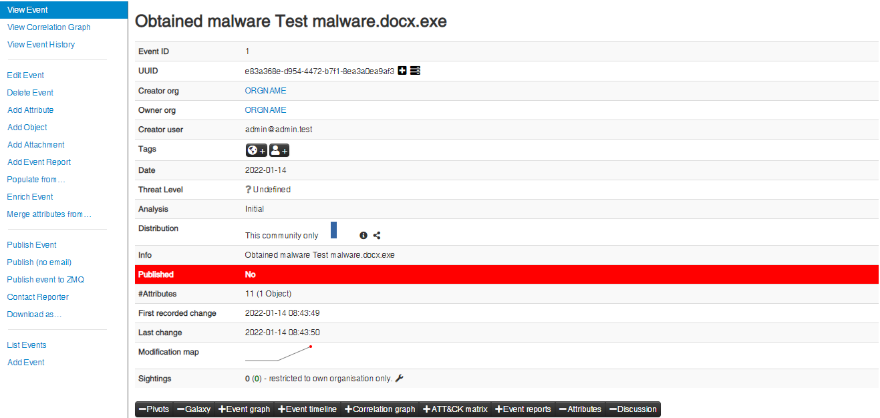
MISP Event

Slide 11
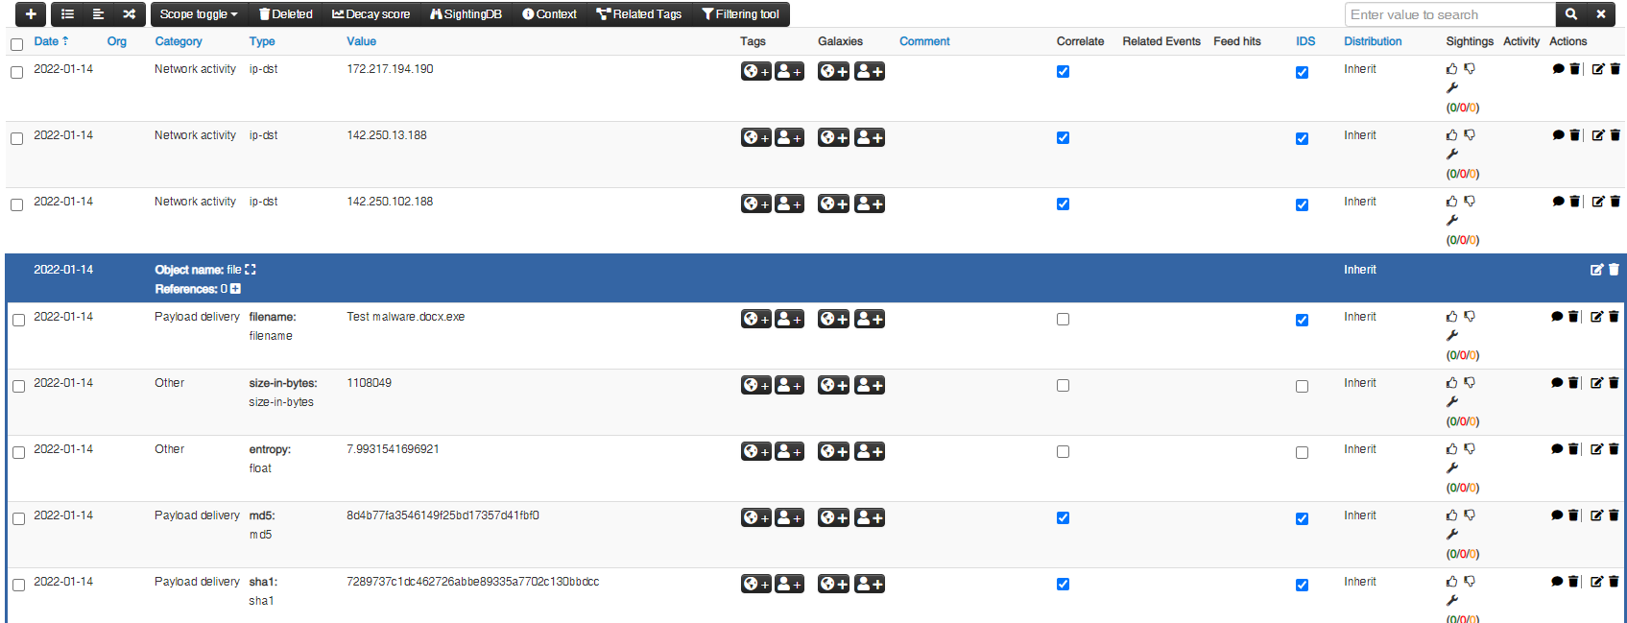
MISP Event Cont.

Slide 12
Malware Analysis Automation Summary
Platform independent
One-command deployment
Speeds-up the initial evaluation of a suspicious file
Will be released as open-source in April

