Slide 1
OWASP Top 10 Mobile Risks
Appsec USA
Minneapolis, MN
September 23, 2011
Jack Mannino, nVisium Security
Mike Zusman, Carve Systems
Zach Lanier, Intrepidus Group
OWASP Mobile Security Project

Slide 2
Agenda
  Introductions
  Mobile Security Project
  Mobile Threat Model
  Top 10 Risks
  Wrap Up/Q&A

Slide 3



Introductions
Mike Zusman
Carve Systems
Principal Consultant
http://www.carvesystems.com
Jack Mannino
nVisium Security
CEO
https://www.nvisiumsecurity.com
Zach Lanier
Intrepidus Group
Principal Consultant
https://intrepidusgroup.com

Slide 4
Mobile Security Project
Began Q3 2010
Why Unique and different security risks
Goal To build security into mobile dev. life cycle
Interested? Contribute
Threat Model
Risks
Controls
Training
Dev. Guide
Secure Libraries
Tools
Methodologies
Cheat Sheets

Slide 5
Mobile Threat Model

Slide 6
Mobile Threat Model
Platforms vary with mileage
Very different from traditional web app model due to wildly varying use cases and usage patterns
Must consider more than the ‘apps’
  Remote web services
  Platform integration (iCloud, C2DM)
  Device (in)security considerations

Slide 7
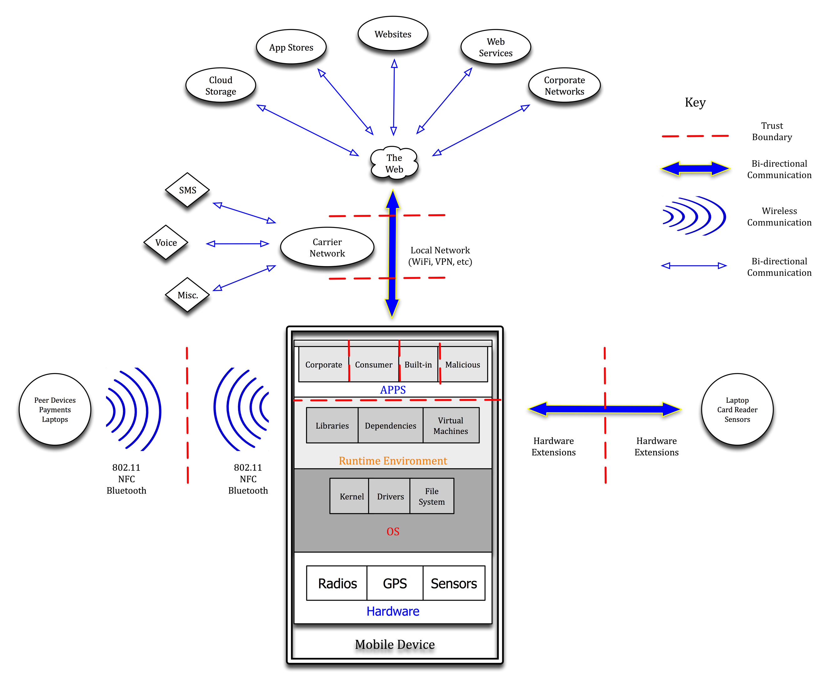
Mobile Threat Model

Slide 8
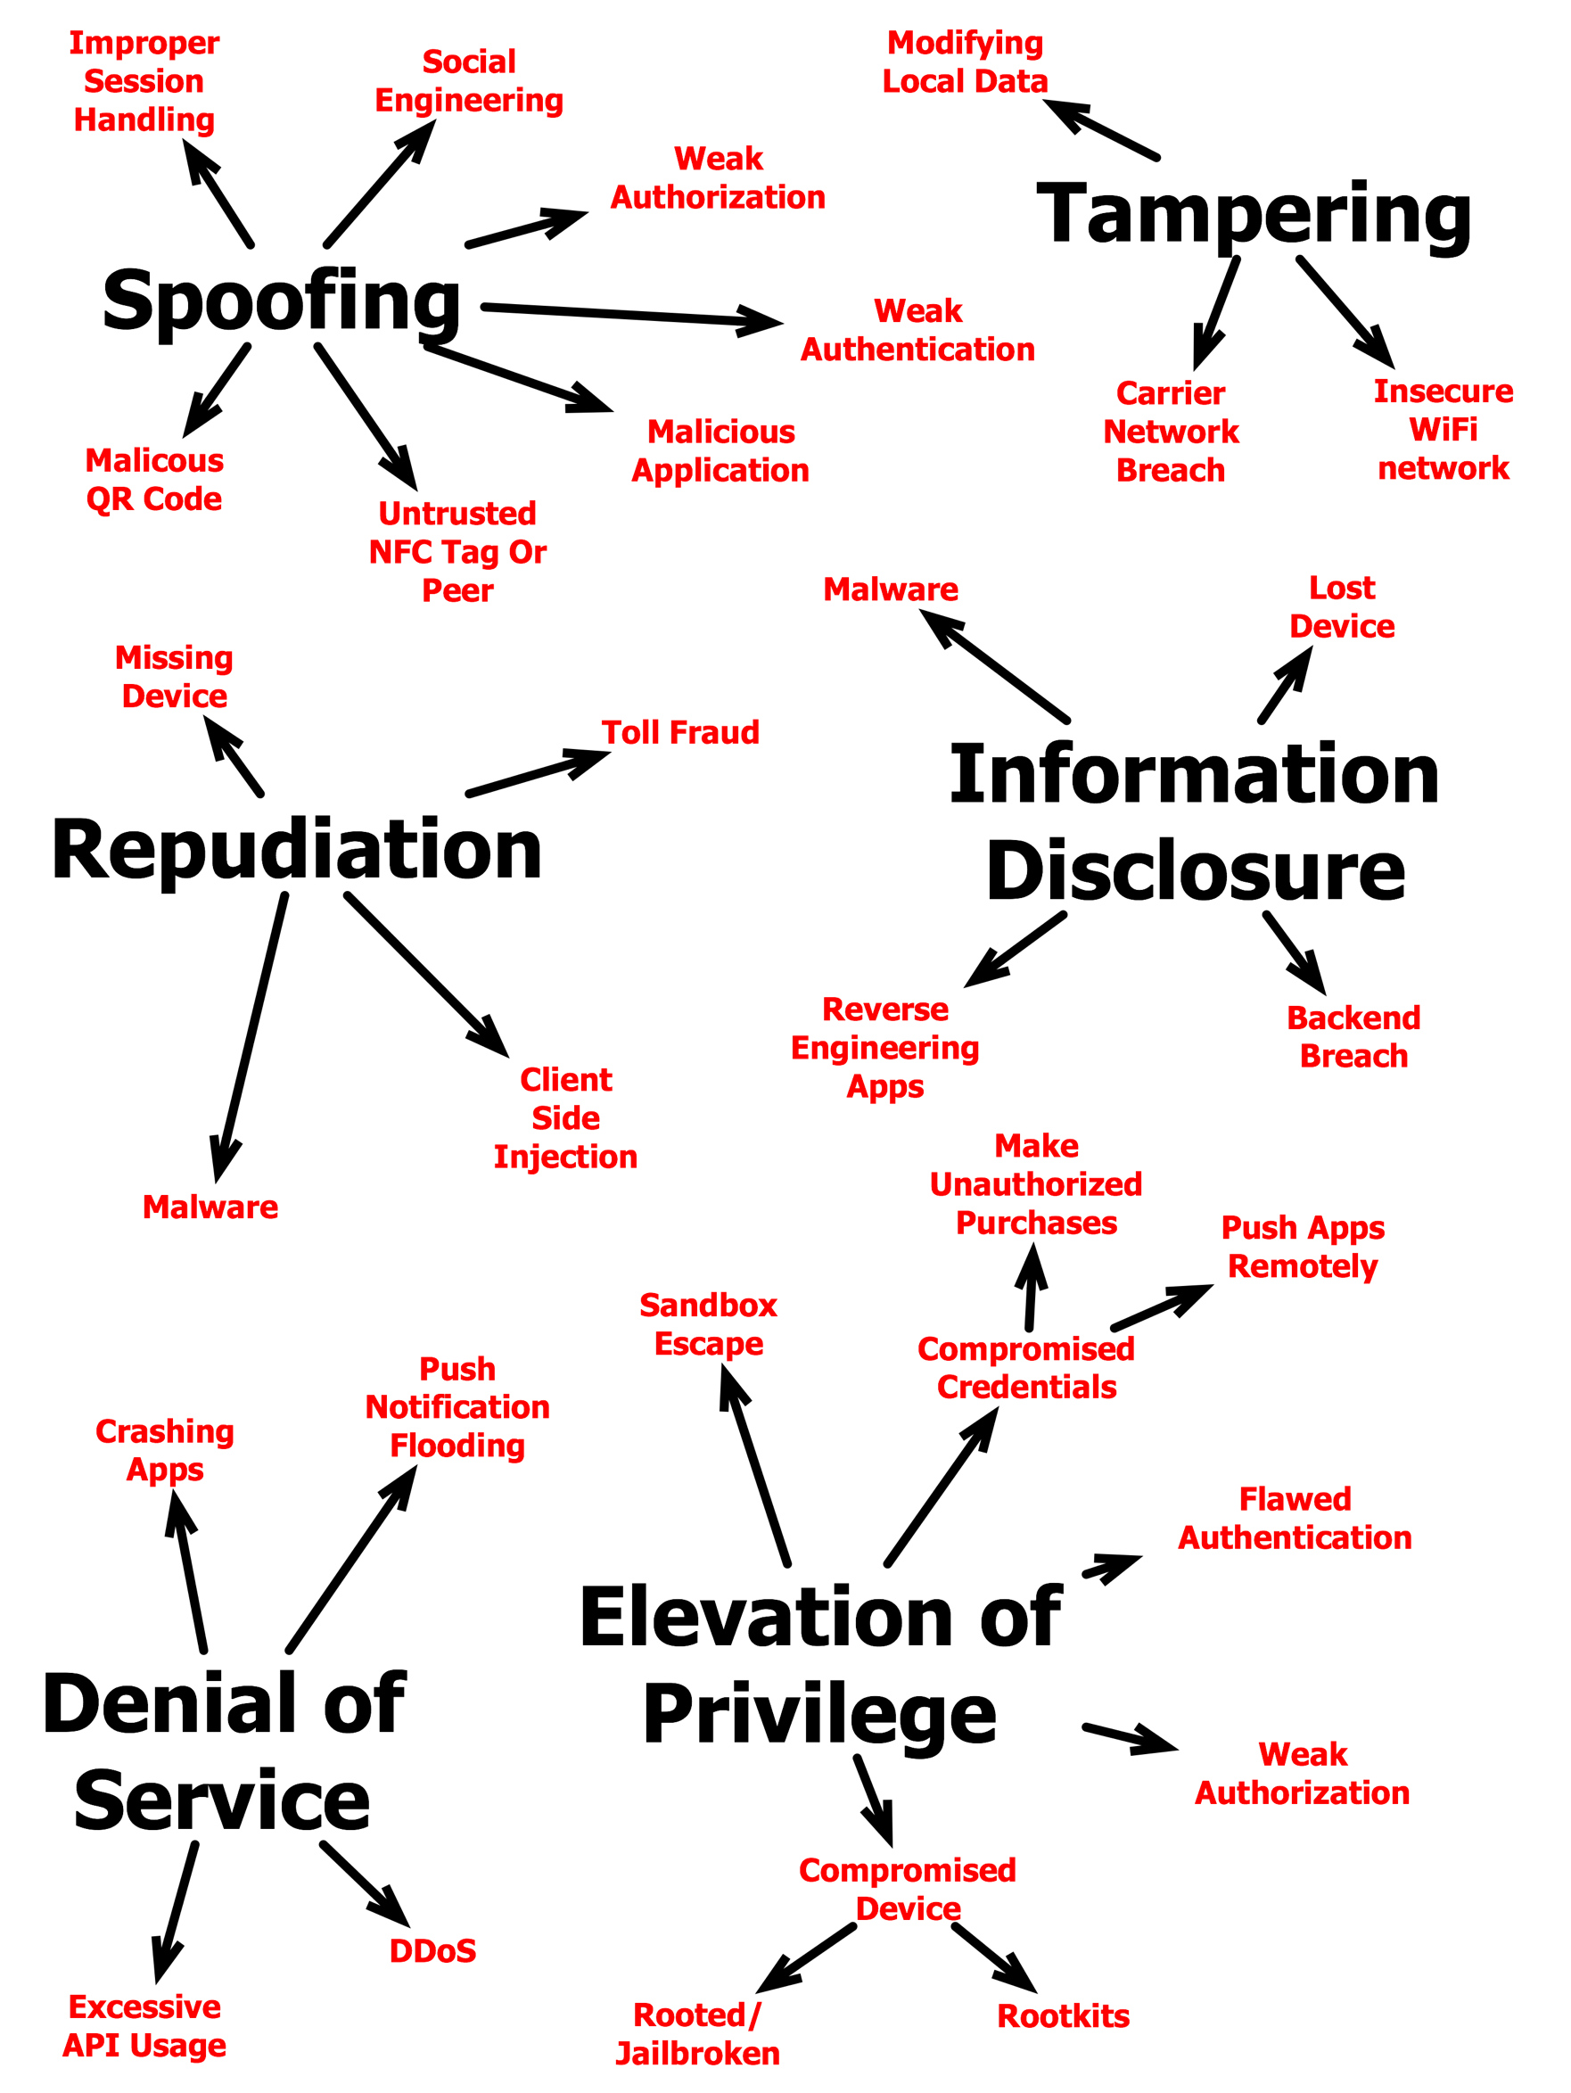
Mobile Threat Model

Slide 9
Top 10 Risks

Slide 10
Top 10 Risks
Intended to be platform-agnostic
Focused on areas of risk rather than individual vulnerabilities
Weighted utilizing the OWASP Risk Rating Methodology
  https://www.owasp.org/index.php/OWASP_Risk_Rating_Methodology
Thanks to everyone who participated

Slide 11
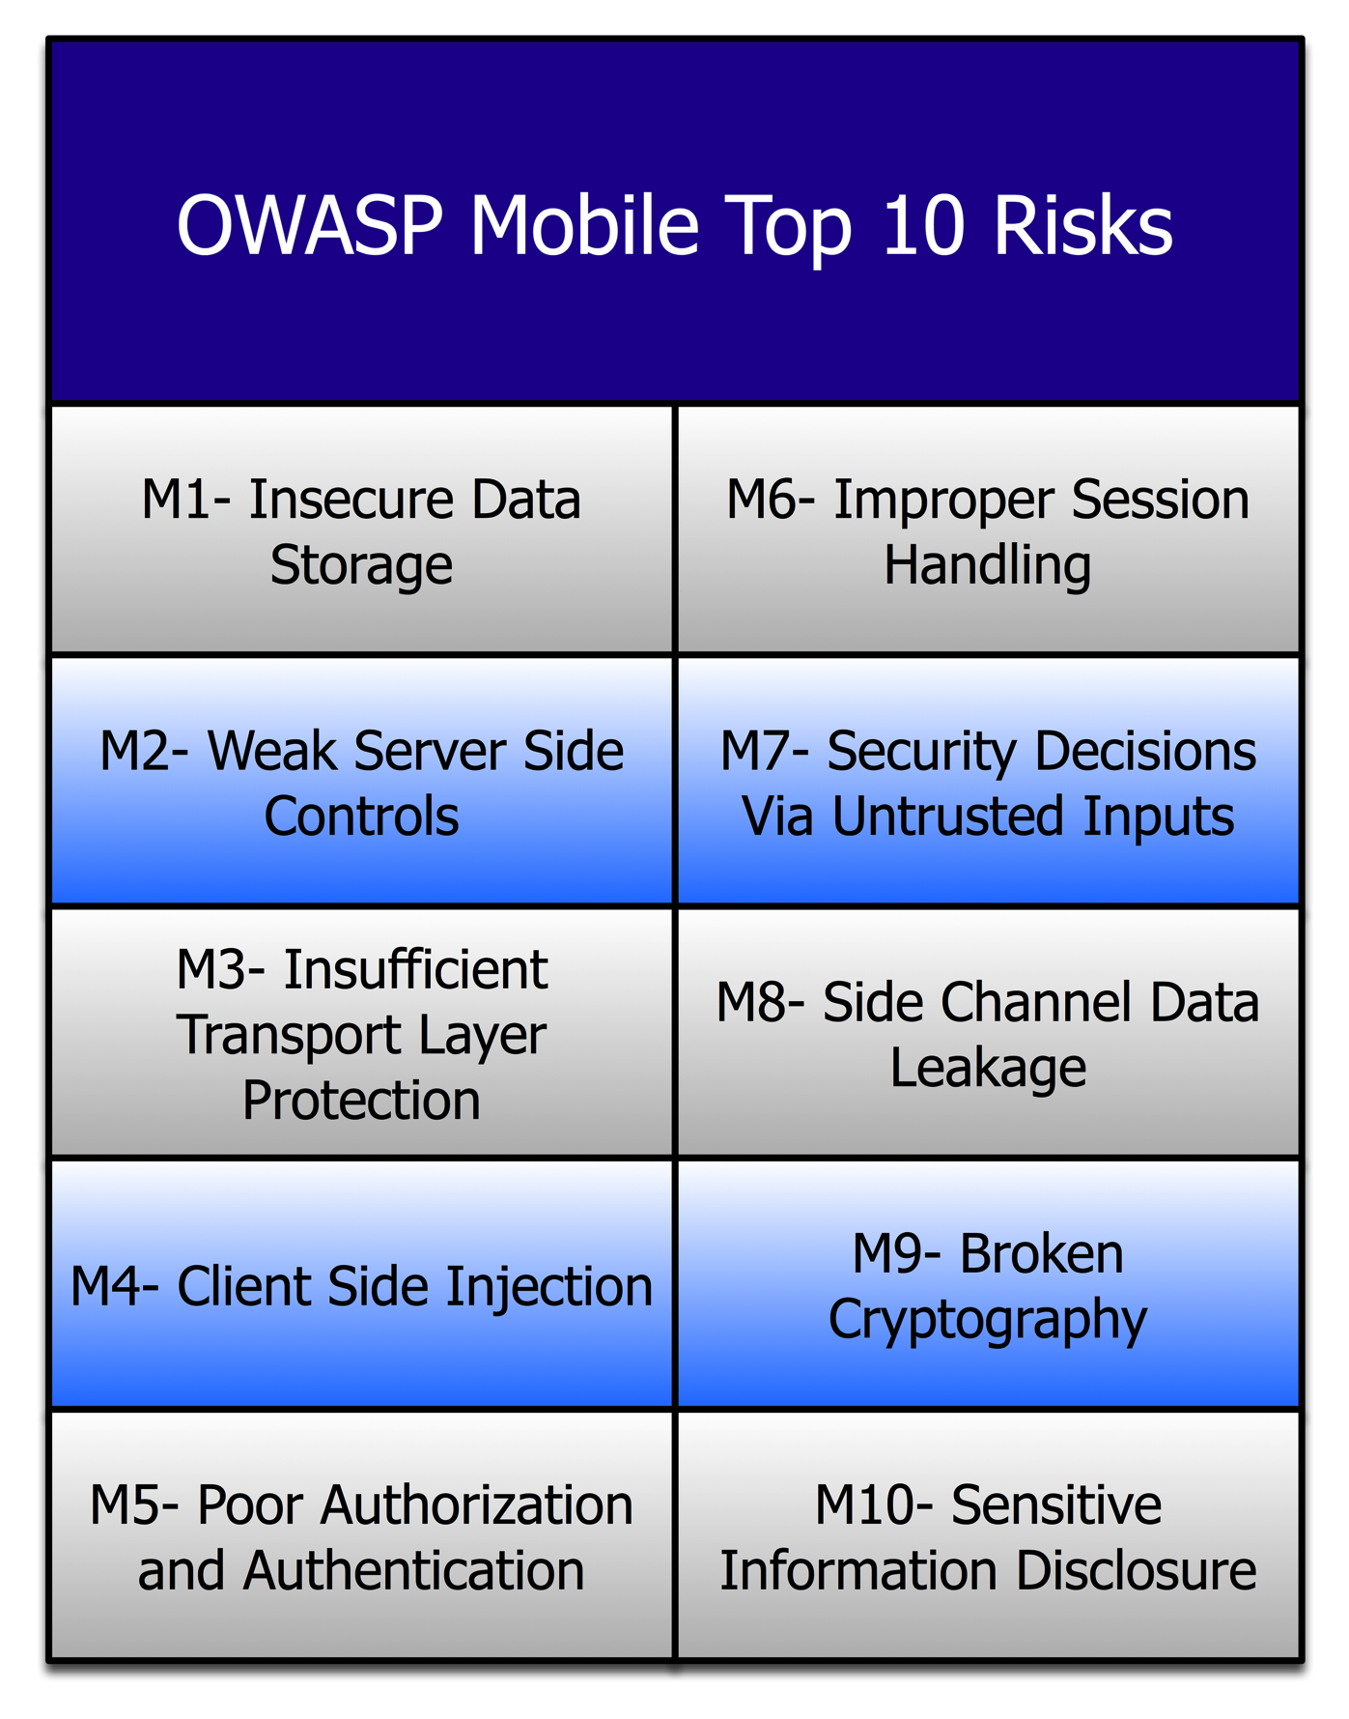
Top 10 Risks

Slide 12

M1- Insecure Data Storage
Sensitive data left unprotected
Applies to locally stored data + cloud synced
Generally a result of:
  Not encrypting data
  Caching data not intended for long-term storage
  Weak or global permissions
  Not leveraging platform best-practices
Impact
Confidentiality of data lost
Credentials disclosed
Privacy violations
Non-compliance

Slide 13
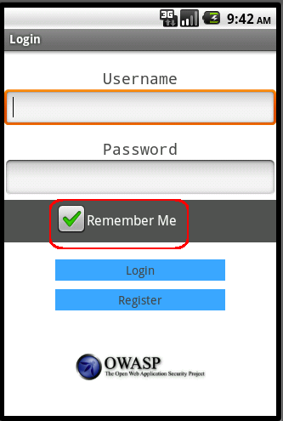
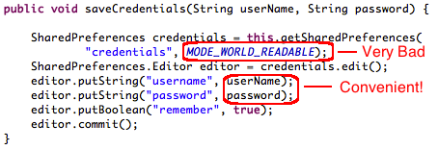

M1- Insecure Data Storage

Slide 14
M1- Insecure Data Storage
Prevention Tips
Store ONLY what is absolutely required
Never use public storage areas (ie- SD card)
Leverage secure containers and platform provided file encryption APIs
Do not grant files world readable or world writeable permissions
Control# | Description
1.1-1.14 | Identify and protect sensitive data on the mobile device
2.1, 2.2, 2.5 | Handle password credentials securely on the device

Slide 15
M2- Weak Server Side Controls
Applies to the backend services
Not mobile specific per se, but essential to get right
We still can’t trust the client
Luckily, we understand these issues well
Existing controls may need to be re-evaluated (ie- out of band comms)
Impact
Confidentially of data lost
Integrity of data not trusted

Slide 16
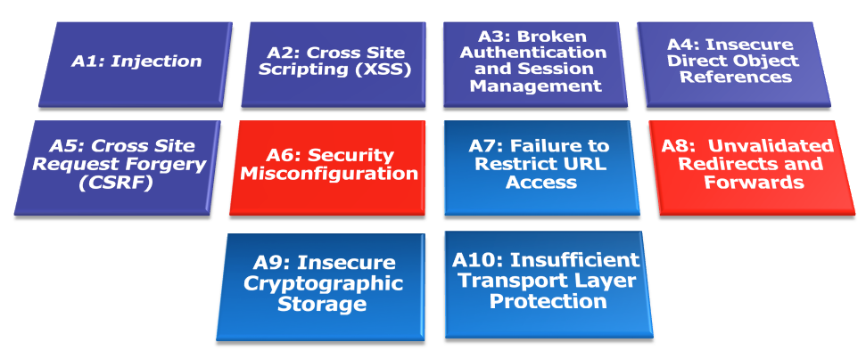
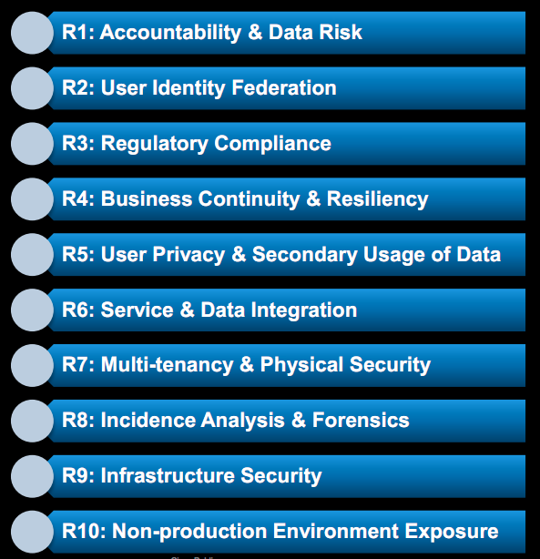
M2- Weak Server Side Controls
OWASP Top 10
https://www.owasp.org/index.php/Category:OWASP_Top_Ten_Project
OWASP Cloud Top 10
https://www.owasp.org/images/4/47/Cloud-Top10-Security-Risks.pdf

Slide 17
M2- Weak Server Side Controls
Prevention Tips
Understand the additional risks mobile apps introduce into existing architectures
Leverage the wealth of knowledge that is already out there
OWASP Web Top 10, Cloud Top 10, Web Services Top 10
Cheat sheets, development guides, ESAPI
Control# | Description
5.1-5.8 | Keep the backend APIs (services) and the platform (server) secure

Slide 18
M3- Insufficient Transport Layer Protection
Complete lack of encryption for transmitted data
  Yes, this unfortunately happens often
Weakly encrypted data in transit
Strong encryption, but ignoring security warnings
  Ignoring certificate validation errors
  Falling back to plain text after failures
Impact
Man-in-the-middle attacks
Tampering w/ data in transit
Confidentiality of data lost

Slide 19
M3- Insufficient Transport Layer Protection
Real World Example: Google ClientLogin Authentication Protocol
Authorization header sent over HTTP
When users connected via wifi, apps automatically sent the token in an attempt to automatically synchronize data from server
Sniff this value, impersonate the user
  http://www.uni-ulm.de/in/mi/mitarbeiter/koenings/catching-authtokens.html

Slide 20
M3- Insufficient Transport Layer Protection
Prevention Tips
Ensure that all sensitive data leaving the device is encrypted
This includes data over carrier networks, WiFi, and even NFC
When security exceptions are thrown, it’s generally for a reason…DO NOT ignore them!
Control# | Description
3.1.3.6 | Ensure sensitive data is protected in transit

Slide 21
M4- Client Side Injection
Apps using browser libraries
  Pure web apps
  Hybrid web/native apps
Some familiar faces
  XSS and HTML Injection
  SQL Injection
New and exciting twists
  Abusing phone dialer + SMS
  Abusing in-app payments
Impact
Device compromise
Toll fraud
Privilege escalation

Slide 22
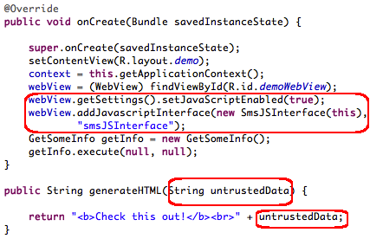
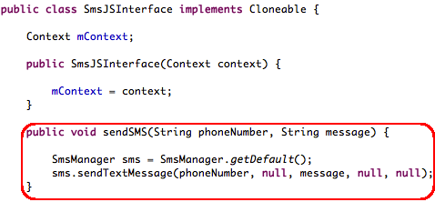
M4- Client Side Injection
Garden Variety XSS….
With access to:

Slide 23
M4- Client Side Injection
Prevention Tips
Sanitize or escape untrusted data before rendering or executing it
Use prepared statements for database calls…concatenation is still bad, and always will be bad
Minimize the sensitive native capabilities tied to hybrid web functionality
Control# | Description
6.3 | Pay particular attention to validating all data received from and sent to non-trusted third party apps before processing
10.1-10.5 | Carefully check any runtime interpretation of code for errors

Slide 24
M5- Poor Authorization and Authentication
Part mobile, part architecture
Some apps rely solely on immutable, potentially compromised values (IMEI, IMSI, UUID)
Hardware identifiers persist across data wipes and factory resets
Adding contextual information is useful, but not foolproof
Impact
Privilege escalation
Unauthorized access

Slide 25
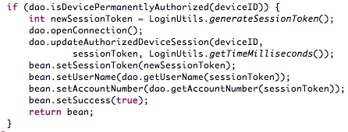
M5- Poor Authorization and Authentication

Slide 26
M5- Poor Authorization and Authentication
Prevention Tips
Contextual info can enhance things, but only as part of a multi-factor implementation
Out-of-band doesn’t work when it’s all the same device
Never use device ID or subscriber ID as sole authenticator
Control# | Description
4.1-4.6 | Implement user authentication/authorization and session management correctly
8.4 | Authenticate all API calls to paid resources

Slide 27
M6- Improper Session Handling
Mobile app sessions are generally MUCH longer
Why? Convenience and usability
Apps maintain sessions via
  HTTP cookies
  OAuth tokens
  SSO authentication services
Bad idea= using a device identifier as a session token
Impact
Privilege escalation
Unauthorized access
Circumvent licensing and payments

Slide 28
M6- Improper Session Handling
Prevention Tips
Don’t be afraid to make users re-authenticate every so often
Ensure that tokens can be revoked quickly in the event of a lost/stolen device
Utilize high entropy, tested token generation resources
Control# | Description
1.13 | Use non-persistent identifiers
4.1-4.6 | Implement user authentication/authorization and session management correctly

Slide 29
M7- Security Decisions Via Untrusted Inputs
Can be leveraged to bypass permissions and security models
Similar but different depending on platform
  iOS- Abusing URL Schemes
  Android- Abusing Intents
Several attack vectors
  Malicious apps
  Client side injection
Impact
Consuming paid resources
Data exfiltration
Privilege escalation

Slide 30
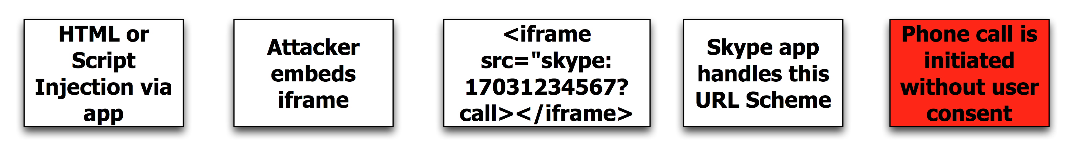
M7- Security Decisions Via Untrusted Inputs
Skype iOS URL Scheme Handling Issue
http://software-security.sans.org/blog/2010/11/08/insecure-handling-url-schemes-apples-ios/

Slide 31
M7- Security Decisions Via Untrusted Inputs
Prevention Tips
Check caller’s permissions at input boundaries
Prompt the user for additional authorization before allowing
Where permission checks cannot be performed, ensure additional steps required to launch sensitive actions
Control# | Description
10.2 | Run interpreters at minimal privilege levels

Slide 32
M8- Side Channel Data Leakage
Mix of not disabling platform features and programmatic flaws
Sensitive data ends up in unintended places
  Web caches
  Keystroke logging
  Screenshots (ie- iOS backgrounding)
  Logs (system, crash)
  Temp directories
Understand what 3rd party libraries in your apps are doing with user data (ie- ad networks, analytics)
Impact
Data retained indefinitely
Privacy violations

Slide 33
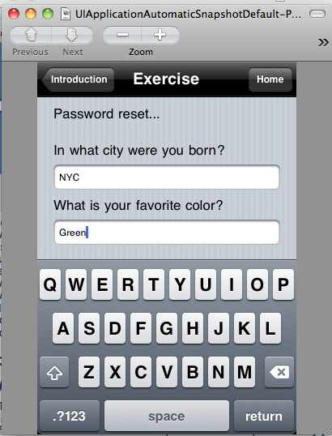
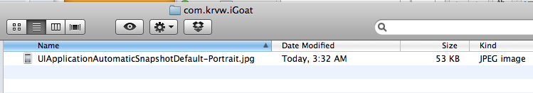
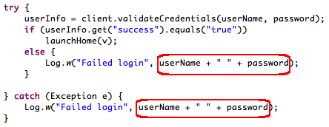
M8- Side Channel Data Leakage
Screenshots
Logging

Slide 34
M8- Side Channel Data Leakage
Prevention Tips
Never log credentials, PII, or other sensitive data to system logs
Remove sensitive data before screenshots are taken, disable keystroke logging per field, and utilize anti-caching directives for web content
Debug your apps before releasing them to observe files created, written to, or modified in any way
Carefully review any third party libraries you introduce and the data they consume
Test your applications across as many platform versions as possible
Control# | Description
7.3 | Check whether you are collecting PII, it may not always be obvious
7.4 | Audit communication mechanisms to check for unintended leaks (e.g. image metadata)

Slide 35
M9- Broken Cryptography
Two primary categories
  Broken implementations using strong crypto libraries
  Custom, easily defeated crypto implementations
Encoding != encryption
Obfuscation != encryption
Serialization != encryption
Impact
Confidentiality of data lost
Privilege escalation
Circumvent business logic

Slide 36
M9- Broken Cryptography
ldc literal_876:"QlVtT0JoVmY2N2E=”
invokestatic byte[] decode( java.lang.String ) // Base 64
invokespecial_lib java.lang.String.<init> // pc=2
astore 8
private final byte[] com.picuploader.BizProcess.SendRequest.routine_12998
(com.picuploader.BizProcess.SendRequest, byte[], byte[] );
{
enter
new_lib net.rim.device.api.crypto.TripleDESKey

Slide 37
M9- Broken Cryptography
Prevention Tips
Storing the key with the encrypted data negates everything
Leverage battle-tested crypto libraries vice writing your own
Take advantage of what your platform already provides!
Control# | Description
1.3 | Utilize file encryption API’s
2.3 | Leverage secure containers

Slide 38
M10- Sensitive Information Disclosure
We differentiate by stored (M1) vs. embedded/hardcoded (M10)
Apps can be reverse engineered with relative ease
Code obfuscation raises the bar, but doesn’t eliminate the risk
Commonly found “treasures”:
  API keys
  Passwords
  Sensitive business logic
Impact
Credentials disclosed
Intellectual property exposed

Slide 39

M10- Sensitive Information Disclosure

Slide 40
M10- Sensitive Information Disclosure
Prevention Tips
Private API keys are called that for a reason…keep them off of the client
Keep proprietary and sensitive business logic on the server
Almost never a legitimate reason to hardcode a password (if there is, you have other problems)
Control# | Description
2.10 | Do not store any passwords or secrets in the application binary

Slide 41
Wrap Up

Slide 42
Going Forward
60 day review period open to the public
RC1 then becomes ‘Final v1.0’
12 month revision cycle
  Rapidly evolving platforms
  Stale data = not as useful
If you have suggestions or ideas, we want them!

Slide 43
Conclusion
This is a good start, but we have a long way to go
We’ve identified the issues…now we have to fix them
Platforms must mature, frameworks must mature, apps must mature
The OWASP Mobile body of knowledge must grow

Slide 44
Q&A
Thanks for listening!
Jack Mannino jack@nvisiumsecurity.com http://twitter.com/jack_mannino
Zach Lanier zach.lanier@intrepidusgroup.com http://twitter.com/quine
Mike Zusman mike.zusman@carvesystems.com http://twitter.com/schmoilito

