Slide 1
Ethics Special Interest Group
Shawn Richardson (NVIDIA)
Jeroen van der Ham (NCSC-NL)

Slide 2
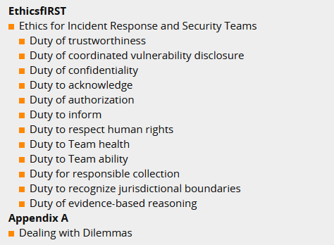
Duties
https://ethicsfirst.org/

Slide 3
Time to Come Clean

Slide 4
Progress
Public launch completed www.ethicsfirst.org
Translated from English into the 5 United Nations’ languages
First draft of case studies completed
Presented at AusCert
Notes:
arabic, french, spanish, russin, chinese

Slide 5
Next Steps
Look for organizations/companies to endorse the Code
Complete case duties for each duty
Create training content
Aid new organizations that want to establish a code of ethics
Come join us!
Email shawn@first.org or jeroen.vanderham@ncsc.nl

