Slide 1
FIRST Metrics SIG Update
May 27, 2021

Slide 2
Introduction
The Metrics SIG is for FIRST members who are seeking approaches for benchmarking and/or improving their CSIRT processes and metrics to provide effective incident management quantification.
The Metrics SIG is not an accrediting or certifying body
The Metrics SIG will not evaluate other CSIRTs
Metrics SIG Co-chairs:
  Mike Murray (Secureworks)
  Robin Ruefle (CERT/CC - Carnegie Mellon University)

Slide 3
Overview of the Metrics SIG
Focus: The Metrics SIG has two main areas of activity
providing a forum for the exchange and sharing of ideas, initiatives, projects, knowledge, and resources related to measuring CSIRT and security operations effectiveness
developing and defining metrics and metric categories that may be of use to organizations looking to determine measurement strategies for incident management and security operation activities and resources

Slide 4
Past Accomplishments 2019-2020
Delivery of a series of Webinars on Metric Topics
  https://www.first.org/global/sigs/metrics/events
Development of “Time to” Metrics by a subgroup of the
Metrics SIG.
Development of a repository for metric articles or resources.
Information exchange with a private group looking to establish a metrics methodology.
Coordination of a joint Cyber Insurance / Metrics SIG meeting to discuss Ransomware and Insurance Triggers and the benefits of bringing the communities closer together on definition and navigation of these topics.

Slide 5
Planned Activities for Coming Years
Hold a Full Metrics SIG members virtual call to discuss current work and future ideas
Populate the metrics repository
Schedule a new set of webinars on metric topics
Complete a written standard on “Time To” metrics.
Define a categorization framework and catalogue for metrics related to incident management and security operations.

Slide 6
Updates on Subgroup Work
Co-Chairs:
  Logan Wilkins – Cisco, CSIRT Engineering, Manager
  Francesco Chiarini – PepsiCo, CSIRT Director
  Désirée Sacher-Boldewin - Finanz Informatik, SOC Architect
Presenter: Logan Wilkins

Slide 7
About Us – Timing Metrics Deep Dive Subgroup
Security Incident Timing Standard
We need to be measuring efficacy of:
Benchmarking of Timing Metrics
We want to be able to say what is „best-in-class” based on:
- Incident scenarios
- Industry
- Organization type
…
Simplified Ticketing Tracking Tools
We need to align to a framework for incident tracking:
- Incident Response
- Threat Detection
- IT partners
- Vendors
- MSSP
…
- FIRST CSIRT Framework v2.0
- NIST CSF v1.1
- SOC-CMM v2.0
- CSIRT services
…
TLP: Amber
Notes:
Met during 2019 FIRST Annual Conference
Scope of the Deep Dive team
Timing Metrics
Incident Tracking Frameworks
1st bullet is the main, others secondary
Pause criteria – discuss
During this session, you will receive an overview of the proposal for new FIRST guidelines related to security incident timeline and timing metrics. Measuring efficacy of an incident response team, as well as the extended IT team’s performance, is perceived as a key factor for many CSIRT leaders. At the same time, there seem to be no shared consensus within the community on what security incident timing framework to use. This lack, ultimately hinders CSIRT teams to align to a well-reputed community guideline as well as benchmarking within trusted peer groups. This work tries to mitigate this gap and sets a roadmap for future improvements.
Why are timing metrics are important
Efficacy: ability of something to produce the results that are wanted
Efficiency: how well we manage resources to achieve results
Source: Intelligence-Driven Computer Network Defense Informed by Analysis of Adversary Campaigns and Intrusion Kill Chains, Lockheed Martin Corporation
A unified approach to security incident timing metrics
Achieve community consensus on timing and frameworks for incident tracking
Allow benchmarking among FIRST members & trusted peer groups
For timing and other key incident tracking indicators or metrics
Simplify ticketing timing tracking by engaging tools’ vendors
Easier and shared deployment of „out of the box”
Do Metrics matter? Why? Make the case:
- measure efficiency of prevention, detection
- identify focus areas (where is the adversary faster than the defender? where in the kill chain does this matter most?)
- select the timing metrics that are the most important in your eyes and provoke reaction from the audience

Slide 8
Security Incident Timing Standard
TLP: Amber
Recon, Weaponize, Deliver
Exploit, Control, Execute, Maintain
Time of First Activity
Time of Detection
Time of Resolution / Closure
Time of Notification
Time of First Response
Time of Containment Submission / Completion
Time of Remediation Submission / Completion
Definitions
Scenarios
Metrics
Phishing - Credentials Harvesting
Ransomware - Payload
Email Account Compromise
Time of Detection
Time of First Response
Time of Containment
Time of Remediation
Notes:
11 timeline points
3 scenarios
4 metrics

Slide 9
Must-Have
Timeline Records
TLP: Amber
Time of First Activity
Time of Detection
Time of Resolution / Closure
Time of Notification
Time of First Response
Time of Containment Submission / Completion
Time of Remediation Submission / Completion
Incident Timeline | Applicability Level | Description
Time of First Activity | Recommended for significant incidents | This is the earliest event in a confirmed or potential chain of events, that caused the incident.
Time of Detection | All incidents | The time that a control (e.g. telemetry, technology) or another detection mechanism (e.g. a human) recognizes that something has occurred.
Time of Containment | All incidents that require Containment | Time of Containment is the point in time at which the incident can no longer spread nor do damage.
Time of Remediation | All incidents that require Remediation | Time of Remediation is the point in time at which an affected target asset is returned to its pre-incident state or removed from the environment permanently.
Time of Closure | All incidents | This is the point in time at which the required follow up, analysis, reporting, post-mortem etc. has been completed and there is no longer any work being done on the incident.

Slide 10
What’s Next
TLP: Amber
Focus on developing a broader set of metrics, mapping to existing content / frameworks
Evaluated several options
  NIST CSF 1.1
  SOC CMM 2
Decided to use FIRST CSIRT Service Framework
  Review framework element
  Define objectives
  Establish metrics, data required, targets, etc.

Slide 11
CSIRT Framework Map Examples
TLP: Amber
Service Area | Service | Function | Outcome | Measure
(5) Event Management | (5.1) Monitoring & Detection | (5.1.1) Log and sensor management | Reliable stream of relevant information security events | Outages Time to recover
 |  | (5.1.2) Detection use case management | A portfolio of effective detection use cases | Efficacy Count / coverage Analysis time TP count
 | (5.2) Event Analysis | (5.2.2) Qualification | Qualified potential information security incidents are available for handling | TP / FP Ratio
(6) Incident Management | (6.4) Mitigation & Recovery | (6.4.2) Ad hoc measures & containment | Control of systems and networks involved is regained. Access is denied for attackers. | Time to Contain Time to Restore # of assets affected
… | … | … | …

Slide 12
Special Thanks
TLP: Amber
Timing Metrics Deep Dive - Contributors
Désirée Sacher-Boldewin - Finanz Informatik, SOC Architect
Mark Zajicek, CERT/CC, Carnegie Mellon University
FIRST Metrics SIG Team Members
Paul Loosemore, CIBC.ca
Carson Zimmerman, Microsoft
Mike Murray, Secureworks
Robin M Ruefle, CERT/CC, Carnegie Mellon University

Slide 13
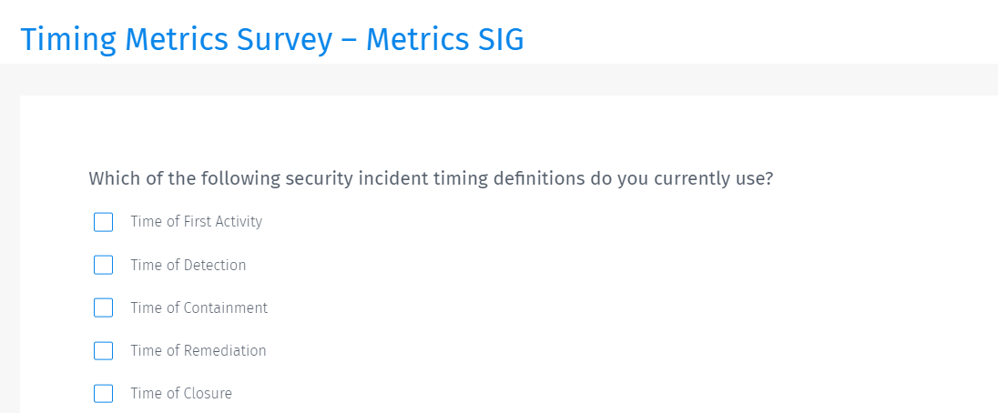
We Need You to Baseline
The Timing Metrics
https://www.questionpro.com/t/Cmt1dZguEm2?

Slide 14

Questions

Slide 15
Contact Information
Mike Murray
Senior Manager, Incident Response Consulting
Secureworks | A Dell Technologies Company
mmurray@secureworks.com
Robin Ruefle
Team Lead, CSIRT Development and Training
Security Operations | Monitoring and Response |CERT Division
Software Engineering Institute | Carnegie Mellon University
rmr@cert.org
Logan Wilkins
Manager, CSIRT Engineering
Cisco
loganw@cisco.com

